Slide 1
EEL 646 POWER ELECTRONICS II Zero-Voltage Trasition (ZVT): Buck and Buck-Boost
Lecture 8

Slide 2
Agenda
Steady-State Analysis of Zero-Voltage Transition (ZVT) of buck and buck-boost
Application of Zero-Voltage Transition (ZVT): Bidirectional Buck-Boost Converter

Slide 3
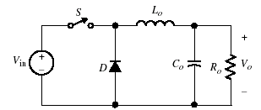
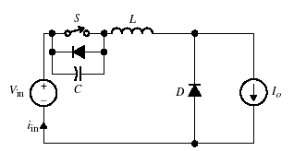
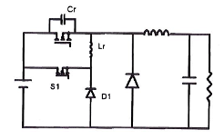
The Buck ZVT Converter
Conventional PWM buck Converter
Quasi-Resonant PWM buck Converter
ZVT PWM buck Converter

Slide 4
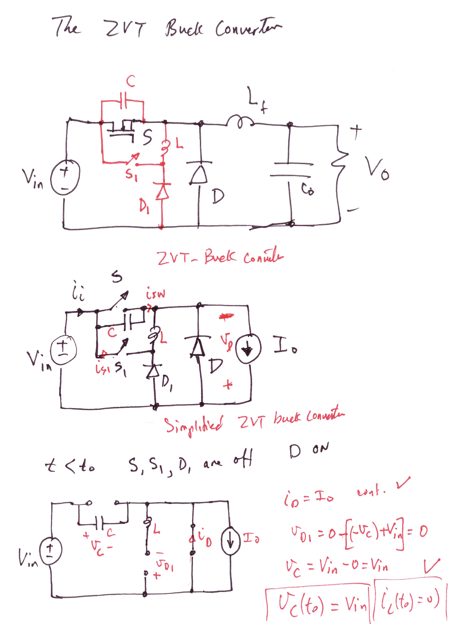

Slide 5
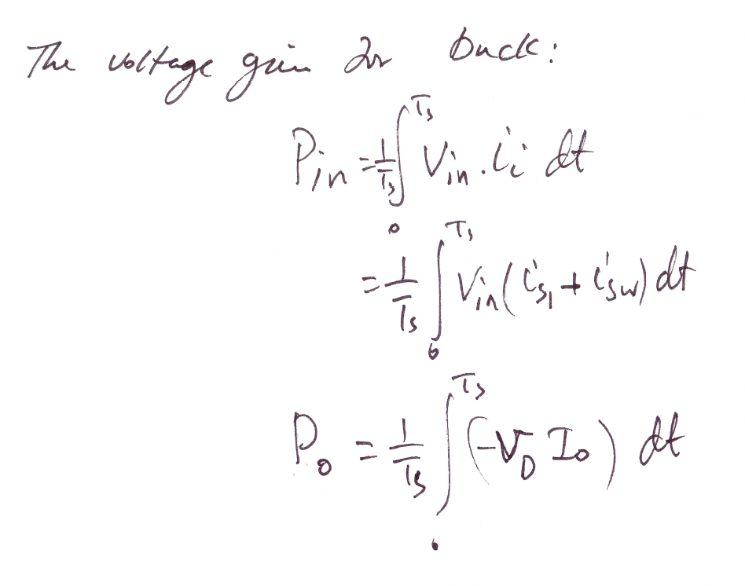

Slide 6
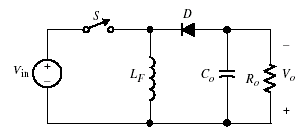
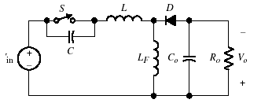
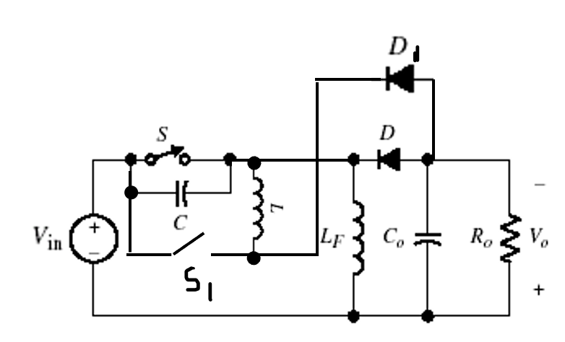
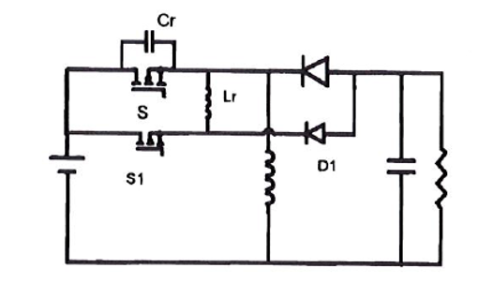
The Buck-Boost ZVT Converter
Conventional PWM buck-boost Converter
Quasi-Resonant PWM buck-boost Converter
$$D$$
ZVT PWM buck-boost Converter

Slide 7
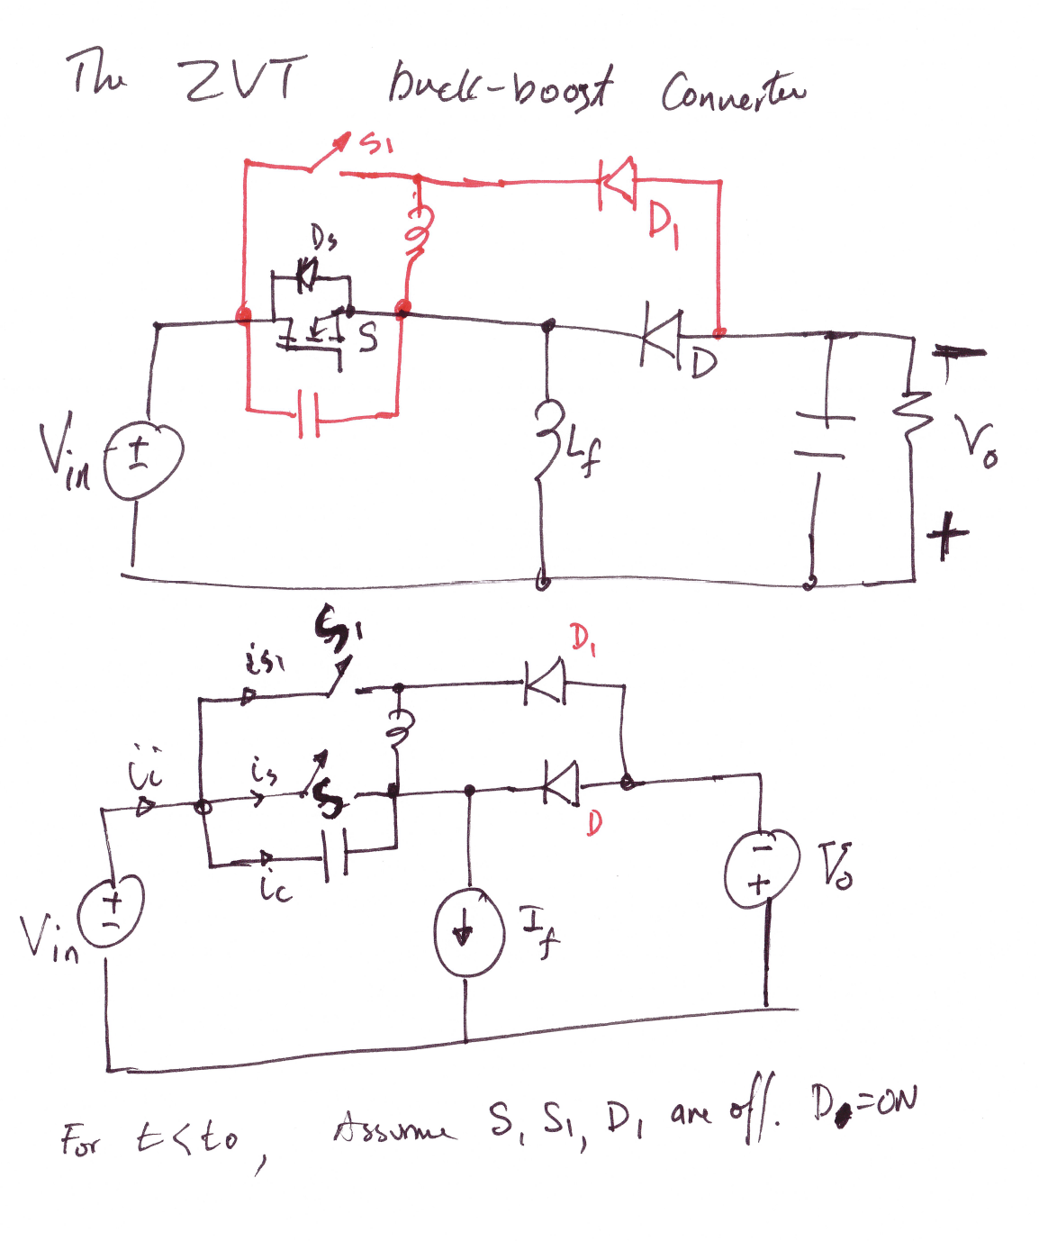

Slide 8
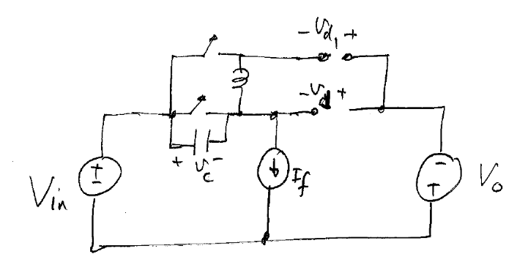
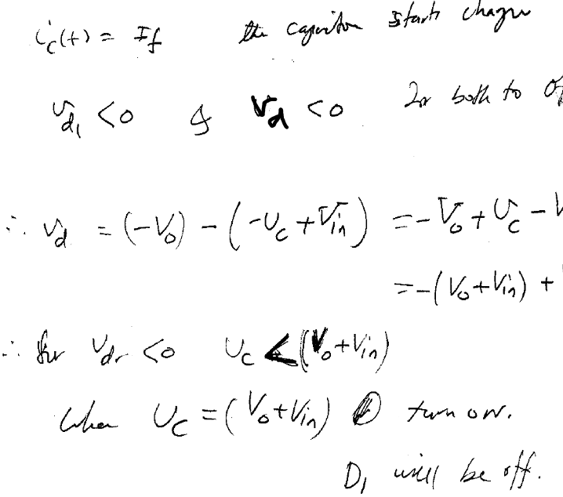
The Buck-Boost ZVT Converter
For t<0, assume all devices are off

Slide 9
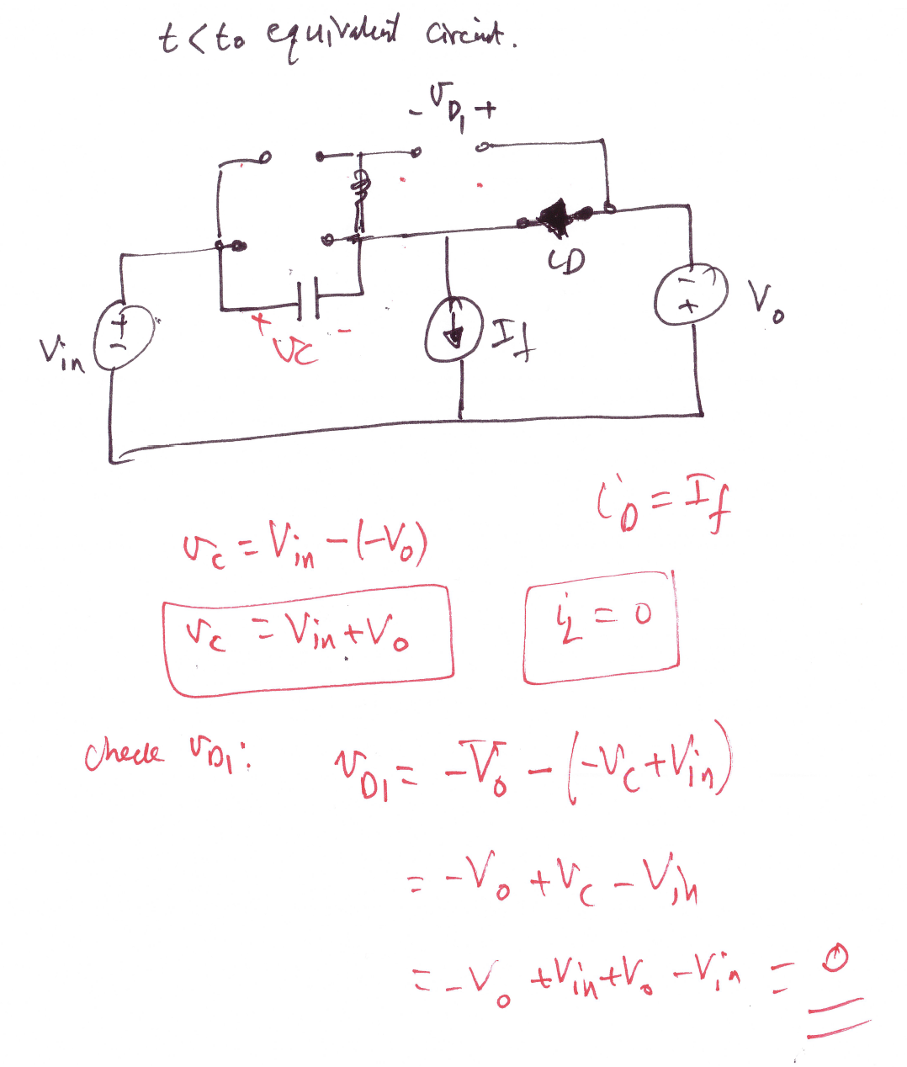

Slide 10
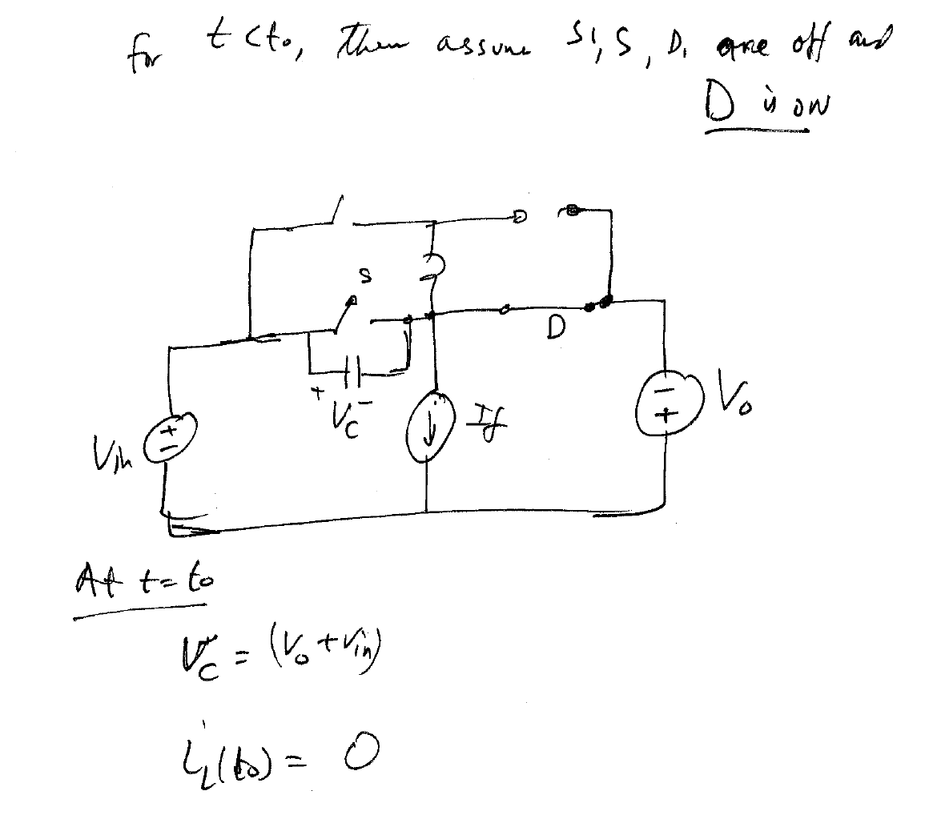

Slide 11
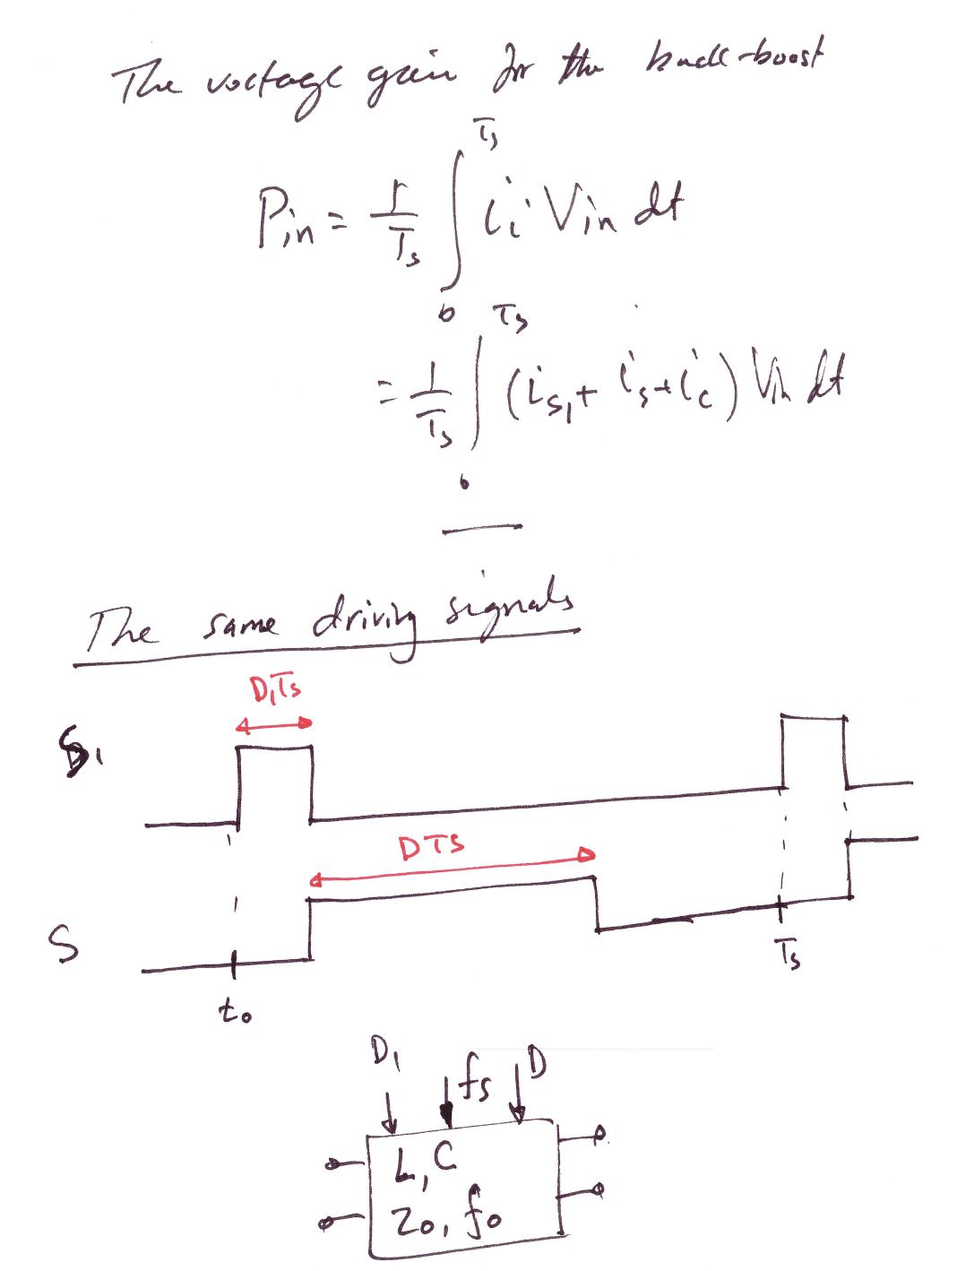

Slide 12
Applications of ZVT

Slide 13
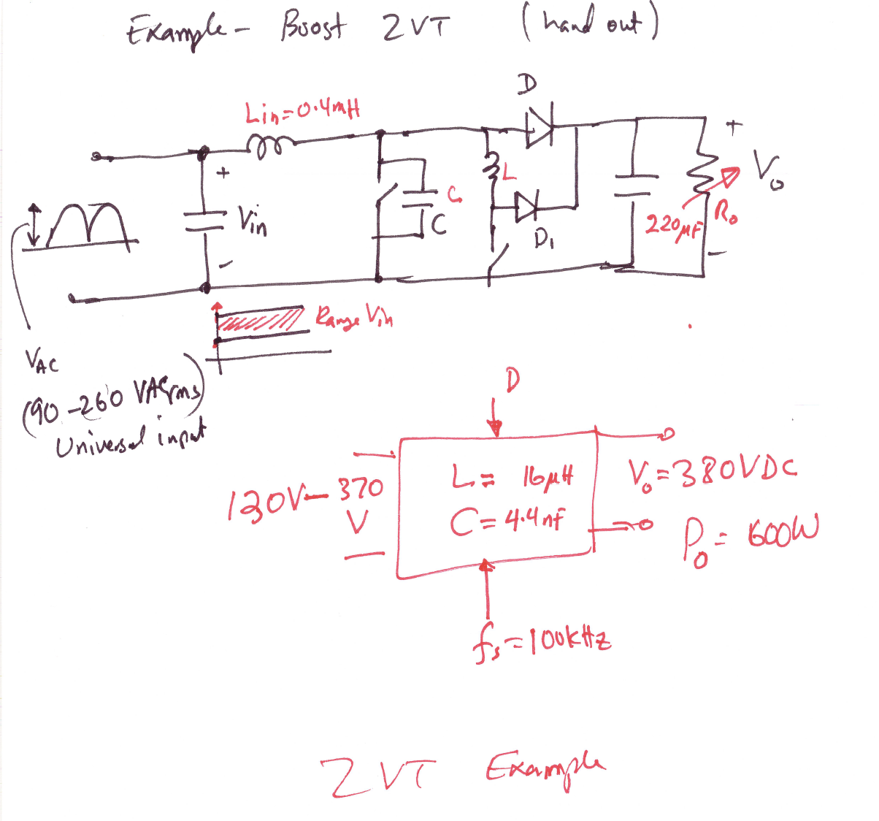

Slide 14
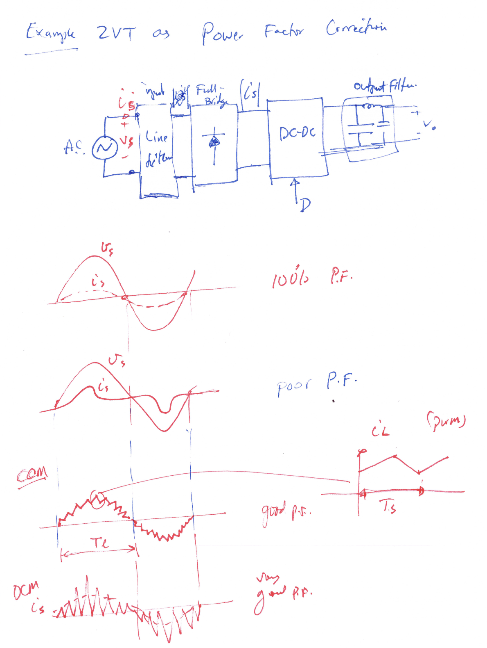

Slide 15
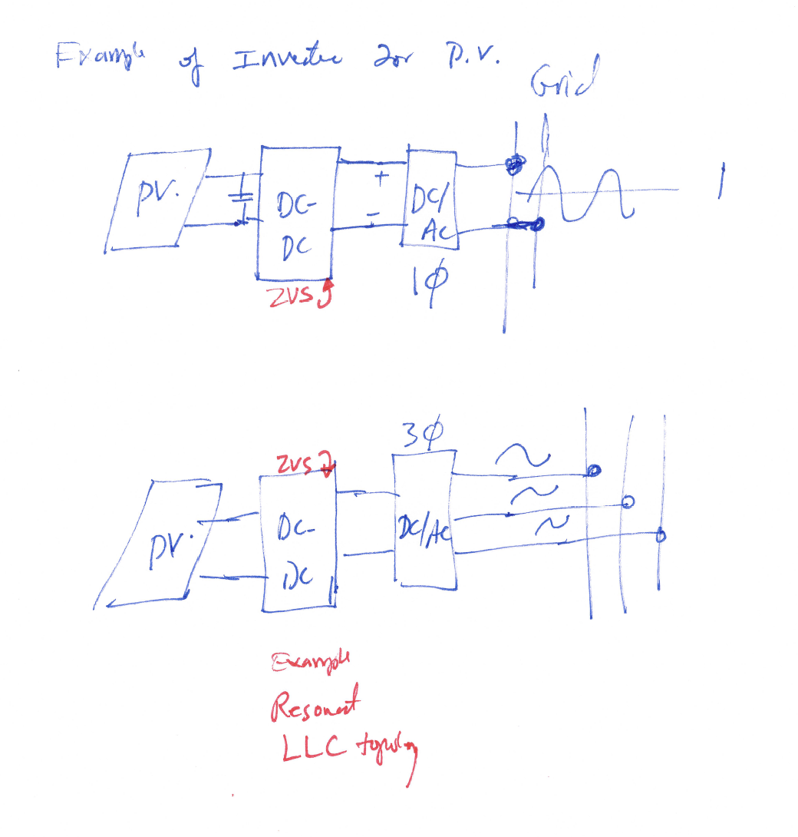

Slide 16
Application of ZVT
Bidirectional Buck-Boost Converter

Slide 17
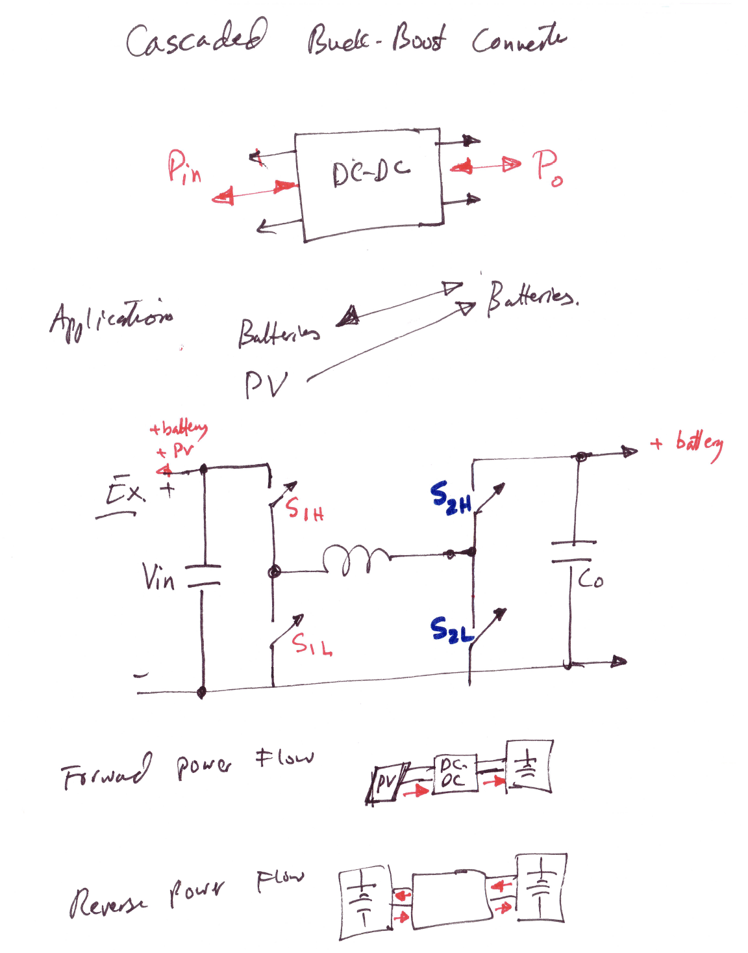

Slide 18
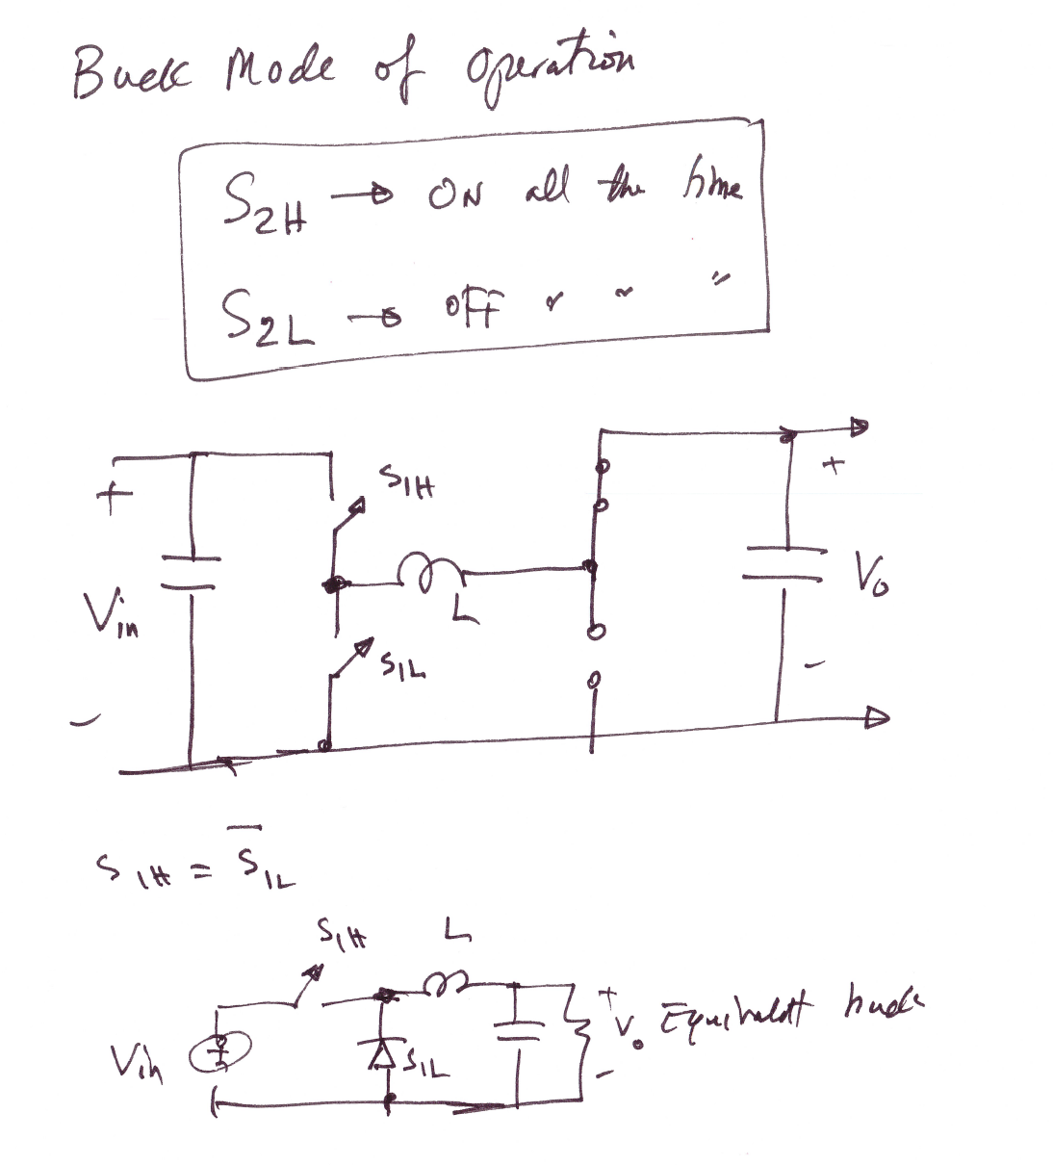

Slide 19
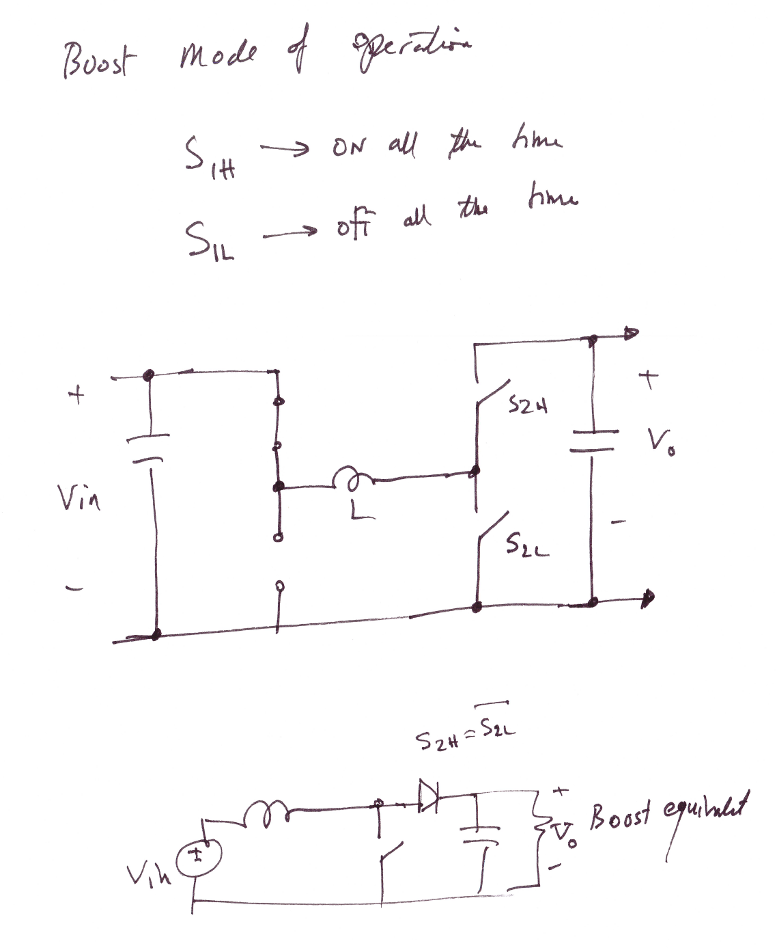

Slide 20
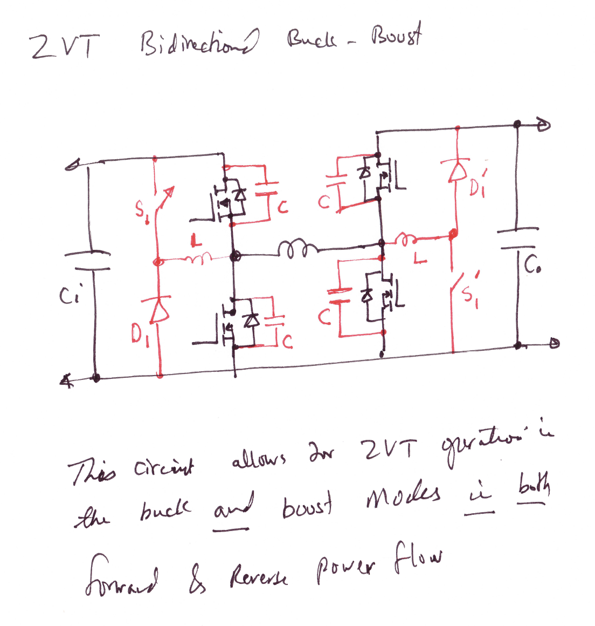

Slide 21
