Slide 1
EEL 646 POWER ELECTRONICS II Zero-Voltage Swithcing: The Buck, Boost and Buck-Boost Converters
Lecture 6

Slide 2
Agenda
Steady-State Analysis of Zero-Voltage Switching Topologies –
The Buck, Boost and Buck-Boost Converters

Slide 3
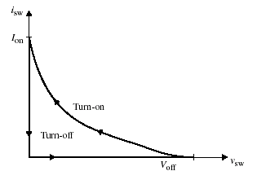
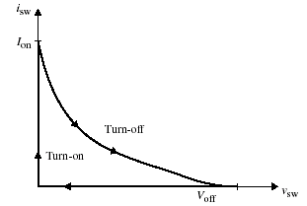
Soft Switching Locus
(a)
(b)
turn-on at Zero Voltage (ZVS)
turn-off at Zero current (ZCS)

Slide 4
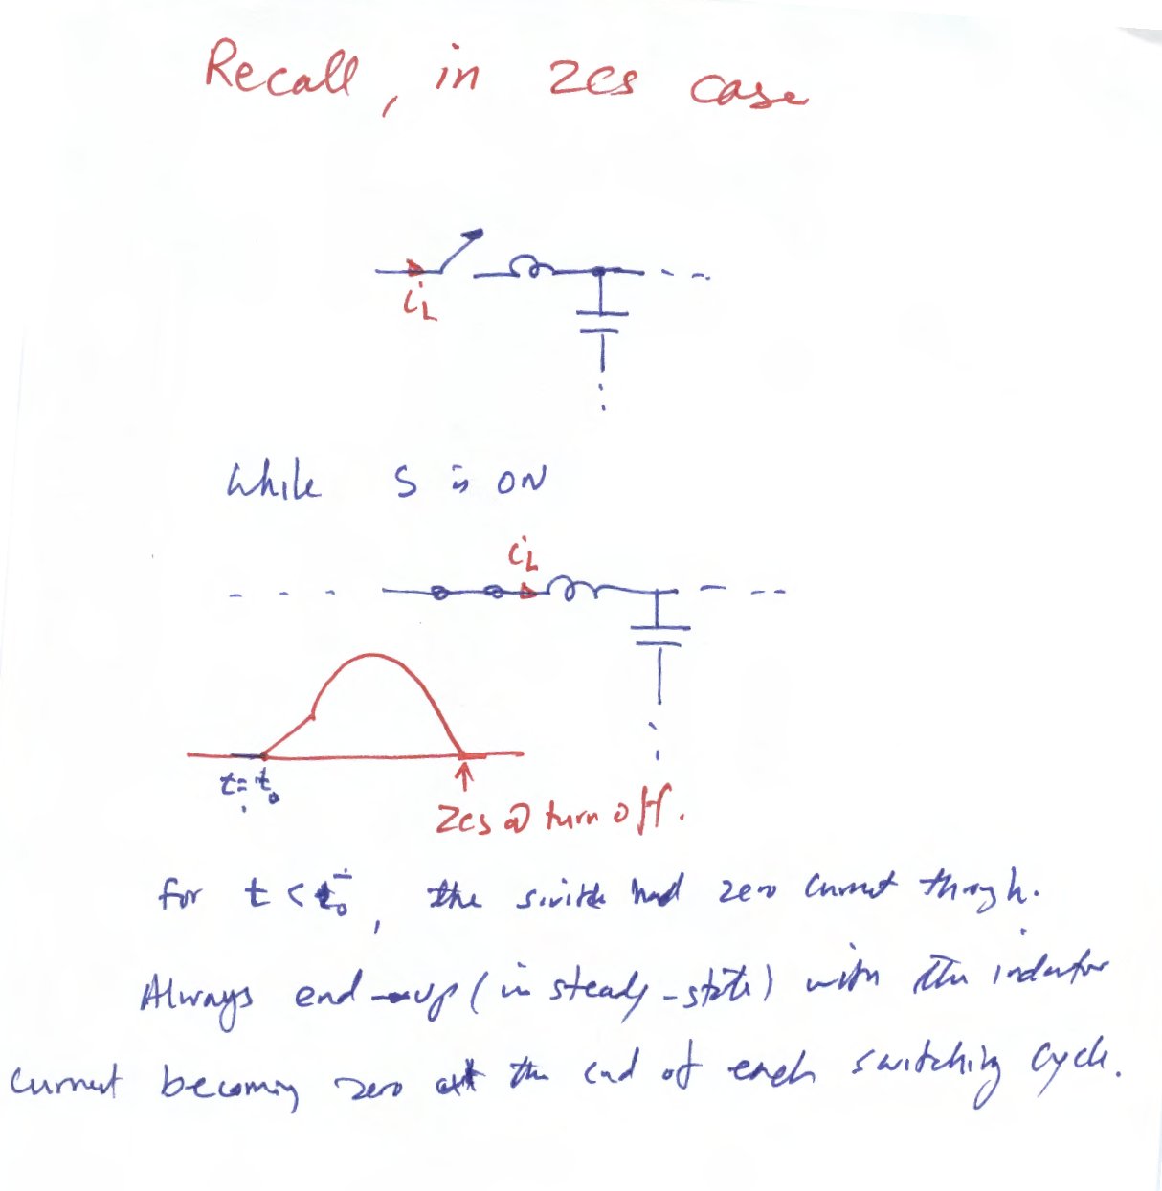

Slide 5
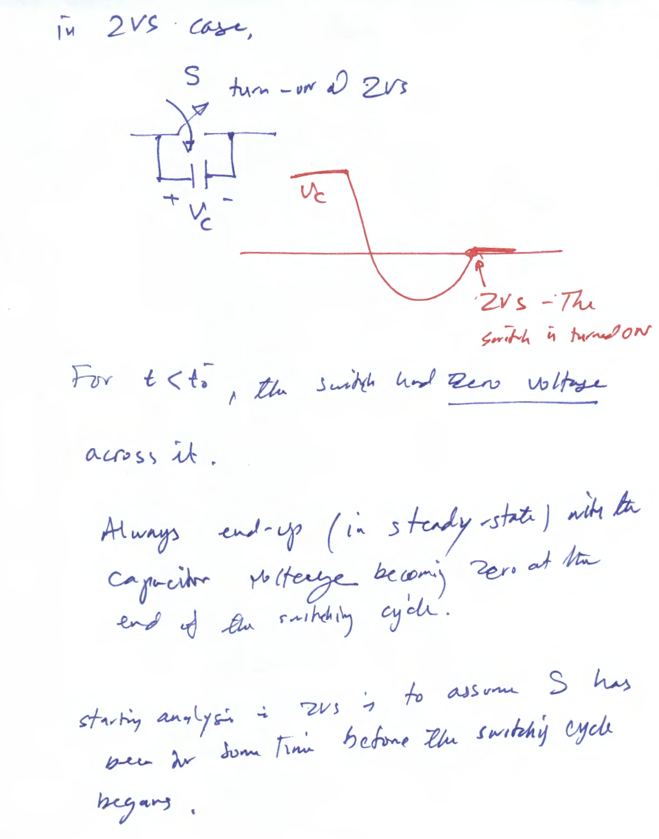

Slide 6
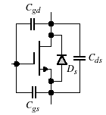
ZERO-Voltage Switching Topologies
Switch Implementation
Figure 6.23(a) shows a MOSFET switch implementation by including an internal body diode and parasitic capacitance.
We will assume and are too small to be included.
(a)
Fig 6.23 (a) MOSFET implementation.

Slide 7
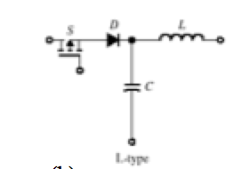
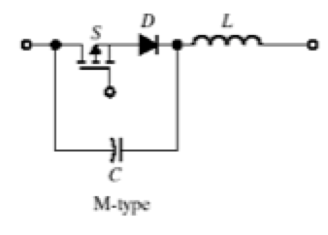
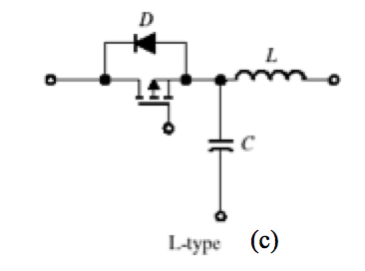
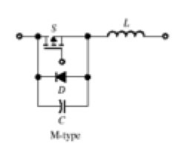
ZVS Resonant Switch Arrangements
Figure 6.24(a) shows the two possible switch implementations using L- and M-type resonant switches.
The half-wave L-type and M-type MOSFET implementations are shown in Fig 6.24(b), whereas Fig 6.24(c) shows the full-wave implementations for L- and M-type switches.
(a)
(b)
(c)
Fig 6.24 (a) Resonant switch arrangement types for ZVS operation. (b) Half-wave MOSFET implementation. (c) Full-wave MOSFET implementation.

Slide 8
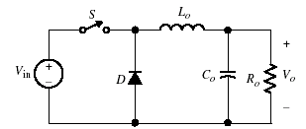
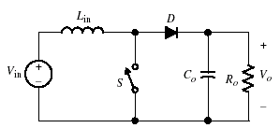
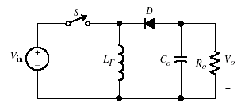
Steady-State Analysis of ZVS Topologies
To simplify the steady-state analysis
The filtering components L_{o}, L_{in}, L_{F} and C_{o} are large when compared to the resonant components L and C
The output filter L_{o} - C_{o} - R is treated as a constant current source I_{o}
The output filter C_{o} - R is treated as a constant voltage source V_{o}
Switching devices and diodes are ideal
(a)
(b)
(c)
Fig 6.7 Conventional converters: (a) buck, (b) boost, and (c) buck-boost

Slide 9
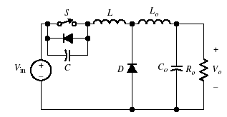
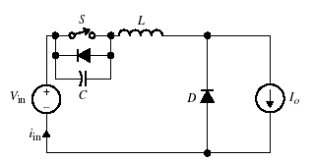
Steady State Analyses of ZVS Quasi-Resonant Converters
The Buck Converter
Replacing the switch in Fig. 6.7(a) by the M-type switch of Fig. 6.24(a), we obtain a new ZVS buck converter as shown in Fig. 6.25(a). The simplified equivalent circuit is given in Fig. 6.25(b).
(a)
(b)
Fig 6.25 (a) Quasi-resonant buck converter with M-type switch. (b) Simplified equivalent circuit.

Slide 10
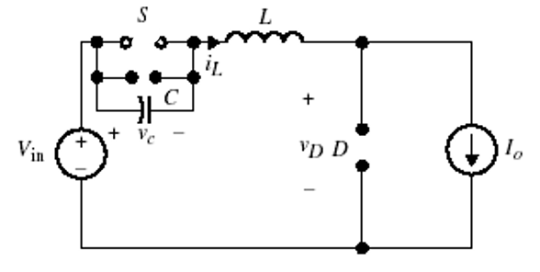
Steady-State Analysis
For t<0, assume the switch was ON:
assume the diode is OFF
$$i_{L}=I_{o}$$
$$v_{C}=0$$
$$v_{L}=v_{C}=0$$
$$v_{D}=V_{in}>0$$
D is OFF
( t < 0)
$$v_{L}$$
assume the diode is ON
$$i_{D}=I_{o}−i_{L}$$
$$i_{D}$$
$$v_{L}=V_{in}=L\frac{di_{L}}{dt}$$
$$i_{L}=\frac{V_{in}}{L}t$$
( t < 0)
$i_{L}$starts increases until
$$i_{D}=0$$
$$i_{L}=I_{o}$$

Slide 11
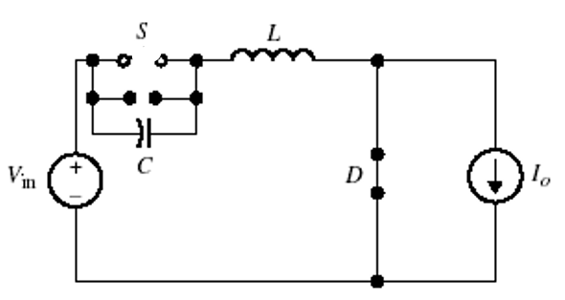
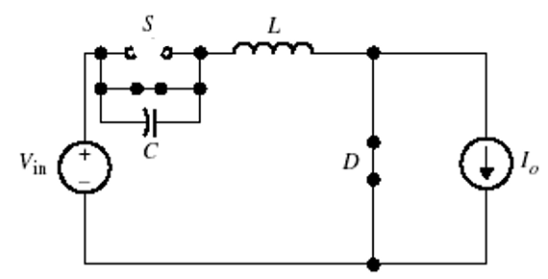
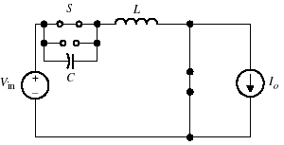
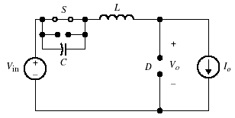
Steady-State Analysis
Under steady-state conditions, there are four modes of operation with the following equivalent circuits:
Mode I
Mode II
(t₂ ≤ t < t₂`)
t₂` ≤ t < t₃
Mode VI
Mode III

Slide 12
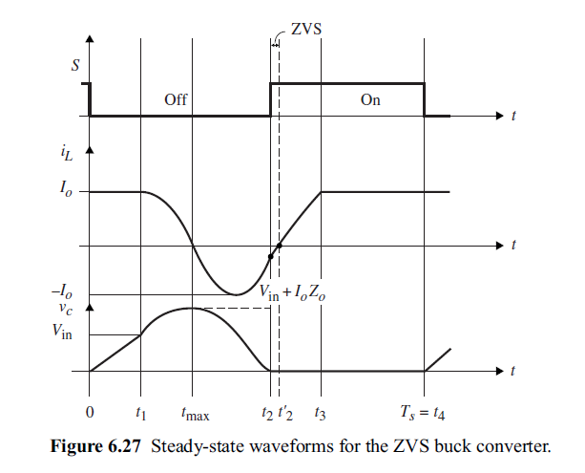
Steady-State Wavefroms

Slide 13
Steady State Analysis
Mode I [0 ≤ t < t₁]
Assume initially for t < 0 the S is conducting, and the diode is OFF. At t=0, we start Mode I when the switch is turned OFF.
The initial capacitor voltage, is zero, and the inductor current is
Applying KCL to Fig. 6.26(a),
since ,the capacitor starts to charge,
The voltage across the output diode,
As long as v_{c}<V_{in}, the diode remains OFF.

Slide 14
Steady State Analysis (cont’d)
The capacitor voltage reaches the input voltage, , at ,causing the diode to turn ON. Hence, at ,we have
and can be expressed as
At , the circuit enters Mode II.

Slide 15
Mode II [t₁≤ t < t₂]:
Mode II starts at t₁ with diode turns ON, circuit enters the resonant stage. At ,the capacitor voltage tends to go negative, hence, forcing the diode across S to turn ON. The initial condition,
The expressions of the current and the voltage
The period between and is given by,
and the inductor current at is,
=

Slide 16
Steady State Analysis (cont’d)
Mode III [t₂ ≤ t < t₃]:
At t₂, the capacitor voltage becomes zero, and the inductor current starts to charge linearly, and it reaches the output current at t = t₃. The body diode of the switch turns ON at t = t₂
The initial value of the capacitor voltage in Mode III is zero
The inductor voltage,
The inductor current can be expressed as,
At , the inductor current reaches the output current ,forcing the diode to turn OFF.
Time interval from - is

Slide 17
Steady State Analysis (cont’d)
Mode IV [t₃≤ t < t₄]:
In this mode, the inductor current is trapped and held constant at =I_{o}, with = 0, i.e.,
Mode IV will continue as long as the switch remains on. By turning off the switch at ${t=t}_{4}=T_{s}$, the switching cycle repeats. The dead time $t_{4}=t_{3}$, is given by,
$$t_{4}−t_{3}=T_{s}−Δt_{1}−Δt_{2}−Δt_{3}$$

Slide 19
ZVS Buck Converter - Voltage Gain
The input energy is given by,
is the current which is equal to .Hence, we have
(6.71)
The inductor current equals the output current in Mode I and IV, and for t₁ ≤ t < t₂ and t₂ ≤ t < t₃,
(6.72)
Substituting for the time intervals t₁, (t₂-t₁), (t₃-t₂) and (T_{s}-t₃) using the normalized parameters M, Q, and
(6.73)

Slide 20
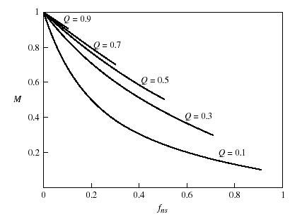
ZVS Buck Converter - Voltage Gain (cont’d)
The output energy is expressed by,
Equating the input and output energy
A plot of the control characteristic curve of M vs. is shown in Fig. 6.28.
Fig 6.28 Control characteristic curve of M vs. ƒ_{ns} for ZVS buck converter.

Slide 21
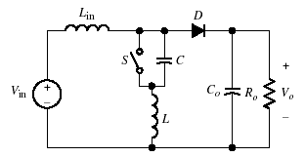
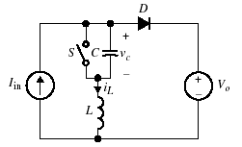
ZVS Boost Converter
The quasi-resonant boost converter by using the M-type switch as shown in Fig. 6.29(a) with its simplified circuit shown in Fig. 6.29(b).
(a)
(b)
Fig 6.29 (a) Quasi-resonant boost converter with M-type switch. (b) Equivalent circuit.

Slide 22
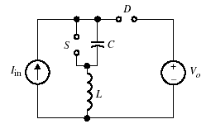
Steady-State Analysis
For t<0, assume the switch was ON:
assume the diode is OFF
$$i_{L}=I_{in}$$
$$v_{C}=0$$
$$v_{L}=0$$
$$v_{D}=V_{in}>0$$
D is OFF
( t < 0)

Slide 23
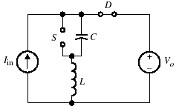
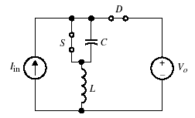
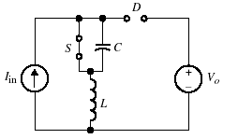
ZVS Boost Converter – Equivalent Circuit Modes
The four circuit modes of operation are shown;
Mode I
Mode II
Mode III
Mode VI

Slide 24
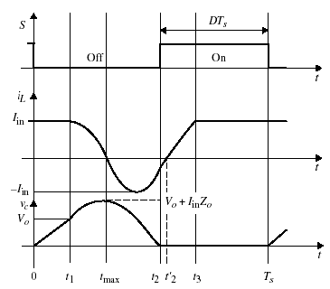
ZVS Boost Converter – Steady-State Waveform

Slide 25
Steady-State Analysis
Mode I [ 0 ≤ t < t₁]:
Assume for t < 0, the switch is closed while D is open. At t=0, the switch is turned OFF, allowing the capacitor to charge by the constant current I_{in,}
(6.76)
With the initial capacitor voltage equals zero
(6.77)
The capacitor voltage reaches the output voltage at ,
(6.78)
At ,the diode starts conducting since , and the converter enters Mode II.

Slide 26
Steady-State Analysis (cont’d)
Mode II [t₁≤ t < t₂]:
At t = t₁, the resonant stage begins since D is ON and S is OFF,
The initial conditions are and .
The expression for is given by
(6.79)
Inductor current,
(6.80)
Evaluating Eq. (6.79) at t = t₂ with v_{c}(t₂)=0, the time interval between to can be found to be,
(6.81)

Slide 27
Steady-State Analysis (cont’d)
Mode III [t₂ ≤ t < t₃]:
Mode III starts at t₂ when v_{c} reaches zero, and the switch diode (anti-parallel diode) turns ON, clamping the voltage across C to zero
At , S turns ON at ZVS. The switch picks up the current, and the inductor current linearly increases to I_{in}.
The initial conditions at are,
(6.82a)
(6.82b)
Because the capacitor voltage is zero, the inductor voltage is equal to the output voltage.
(6.83)
The inductor current becomes,
(6.84)
To achieve ZVS, the switch can be turned ON anytime after t₂ and before t’₂.
At , reaches I_{in} , resulting in the time interval given in Eq. (6.85)
(6.85)

Slide 28
Steady-State Analysis (cont’d)
Substituting the initial condition into the equation,
(6.86)
At ,the output diode turns OFF and the entire current flows in the transistor and the inductor.
Mode IV [t₃ ≤ t < t₄]:
At time t₃, the inductor current reaches I_{in} , and the output diode turns OFF, but the switch remains closed. The cycle of the mode will repeat again at t = T_{s} .
Fig 6.31 Steady-state waveforms for ZVS boost converter.

Slide 29
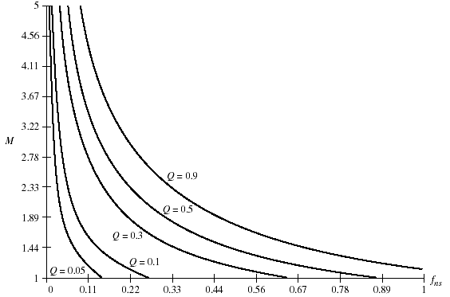
Voltage Gain:
The voltage gain in terms of the normalized parameter:
(6.87)
A plot of the control characteristic curve of M vs. is shown in Fig. 6.32.
Fig 6.32 Control characteristic curve of M vs. ƒ_{ns} for ZVT boost converter.

Slide 30
ZVS Boost Converter
Example 6.5
Design a ZVS-QRC boost converter for the following design parameters: V_{in}=30V, P₀=30W at V₀=38V, f_{ns}=0.4, and T_{s}=4 μs. Assume the output voltage ripple is limited to 2% at D = 0.4.
Solution:
The voltage gain:
The switching frequency:
The resonant frequency:
The load resistor:
With f_{ns} = 0.4, and M=1.3, Q=0.2
The second equation in terms of L and C is obtained from,
Substituting in the above relation for Q, we obtain
Solving the above two equations for C and L, we obtain,

Slide 31
$$Q≈0.2$$
Fig 6.32 Control characteristic curve of M vs. ƒ_{ns} for ZVT boost converter.

Slide 32
To calculate L_{o} and C_{o}, using the voltage ripple of the conventional boost to be 2%, we use the following relation,
where,
The critical inductor value is given by,
To achieve a limited ripple current, it is recommended that L_{o} be set to be about a 100 times the critical inductor value. So we select L_{o}=1.4 mH.

Slide 33
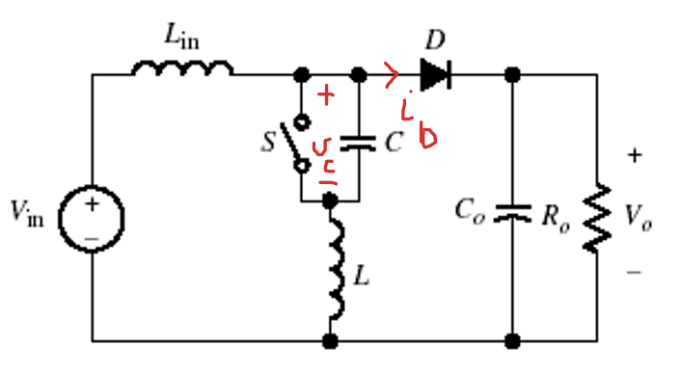
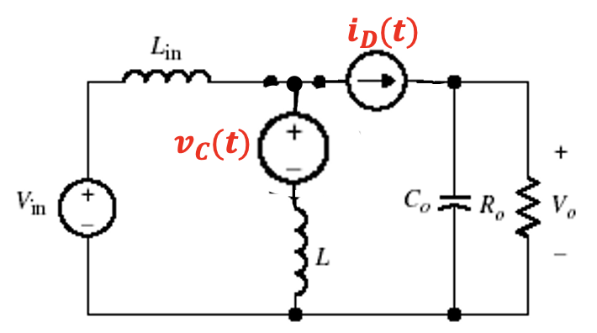
First harmonic approximation
Another way to calculate L_{o} and C_{o}, is to use the first harmonic approximation of the voltage across the capacitor C and the current through the diode D.
$$v_{C}\left( t\right)=\left\{\begin{aligned}&\frac{I_{o}}{C}t \\ &\left.V_{in}+I_{o}Z_{o}sin{ω_{o}\left(t−t_{1}\right.}\right) \\ &0\end{aligned}\right.\begin{aligned}& \\ & \begin{aligned}&t_{1}<t≤t_{2} \\ &t_{2}<t≤t_{3} \\ &t_{3}<t≤T_{s}\end{aligned} \\ & \end{aligned}$$
$$i_{D}\left(t\right)=I_{in}−i_{L}(t)$$
$$i_{L}\left( t\right)=\left\{\begin{aligned}&I_{o} \\ &\left.I_{o}cos{ω_{o}\left(t−t_{1}\right.}\right) \\ &I_{o}\end{aligned}\right.\begin{aligned}& \\ & \begin{aligned}&t_{1}<t≤t_{2} \\ &t_{2}<t≤t_{3} \\ &t_{3}<t≤T_{s}\end{aligned} \\ & \end{aligned}$$

Slide 34
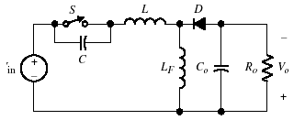
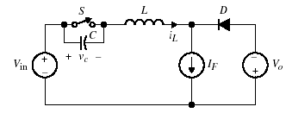
The Buck-Boost Converter
(a)
(b)
Fig 6.34 (a) ZVS buck-boost converter with M-type switch. (b) Simplified equivalent circuit.

Slide 35
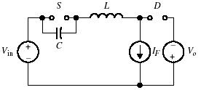
Steady-State Analysis
For t<0, assume the switch was ON:
assume the diode is OFF
$$i_{L}=I_{F}$$
$$v_{D}$$
$$v_{C}=0$$
$$v_{L}=0$$
$$v_{D}=V_{in}+V_{O}>0$$
D is OFF
( t < 0)

Slide 36
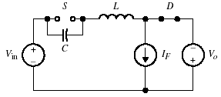
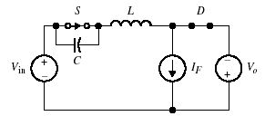
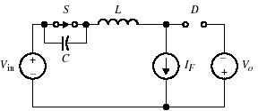
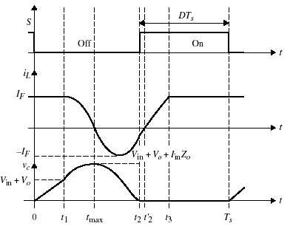
Equivalent Modes
Mode I
Mode II
Mode III
Mode VI

Slide 37
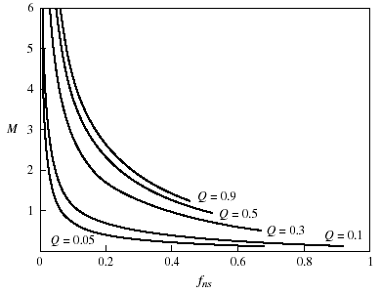
Voltage Gain
The voltage gain in terms of M, Q, and is given,
Figure 6.36 shows the control characteristic curve for M vs. fns.
Fig 6.36 Control characteristic curve of M vs. ƒ_{ns} for ZVS buck-boost converter.

