Slide 1
EEL 646 POWER ELECTRONICS II Zero-Current Swithcing: The Boost and Buck-Boost Converters
Lecture 4

Slide 2
Agenda
Steady-State Analysis of Zero-Current Switching Topologies – The Boost and Buck-Boost Converters

Slide 3
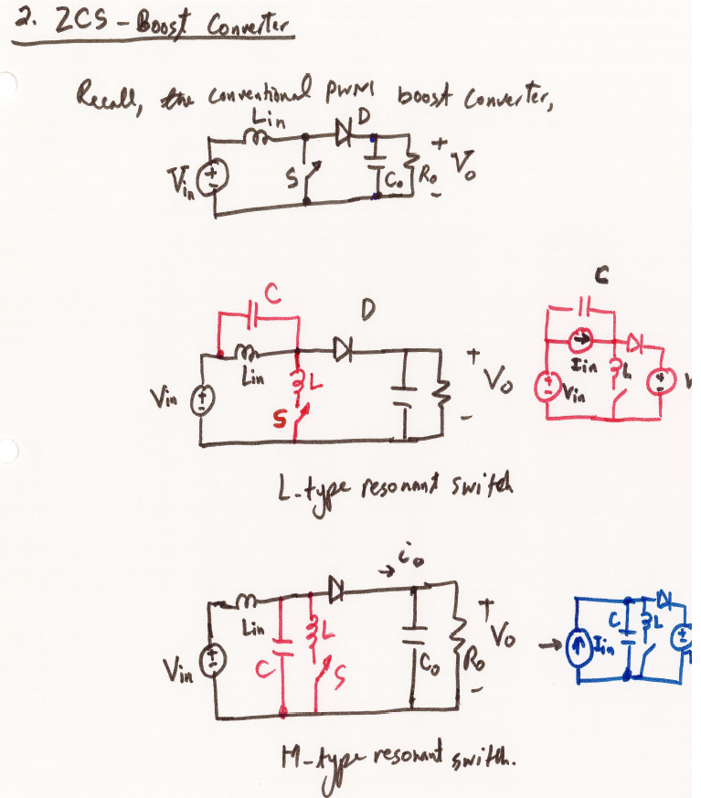

Slide 4
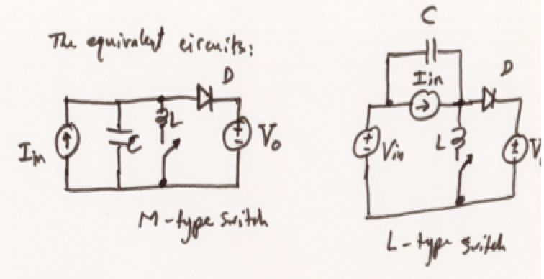
ZCS Boost Converter with M-Type Resonant Switch

Slide 5
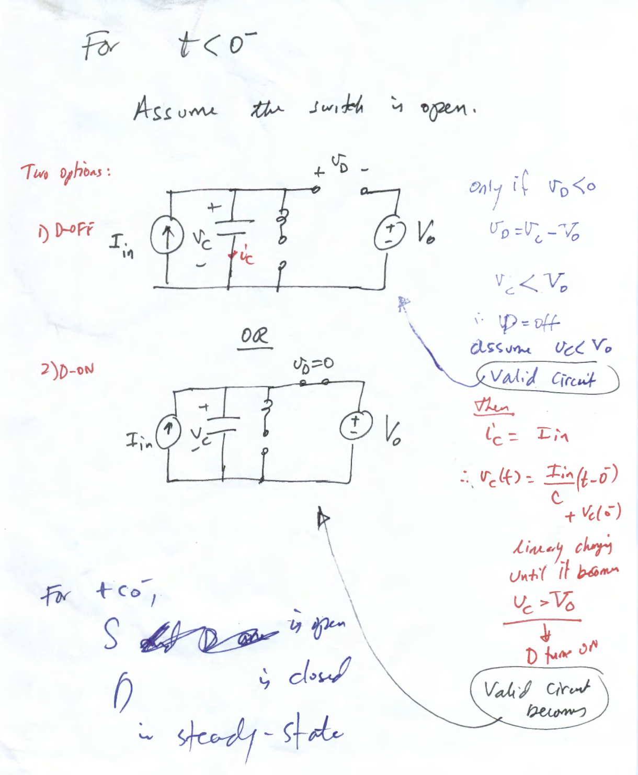

Slide 6
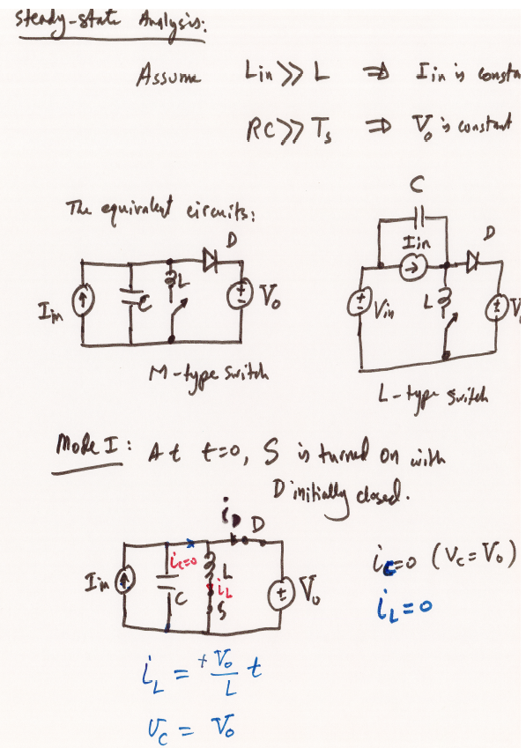

Slide 7
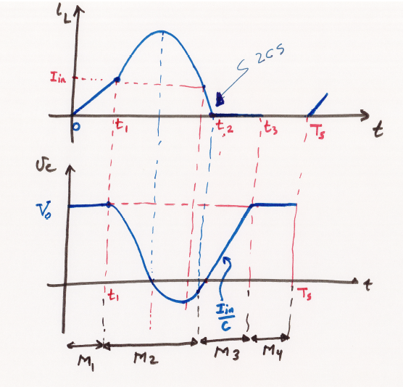
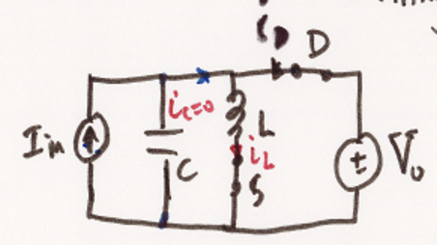
Mode I

Slide 8
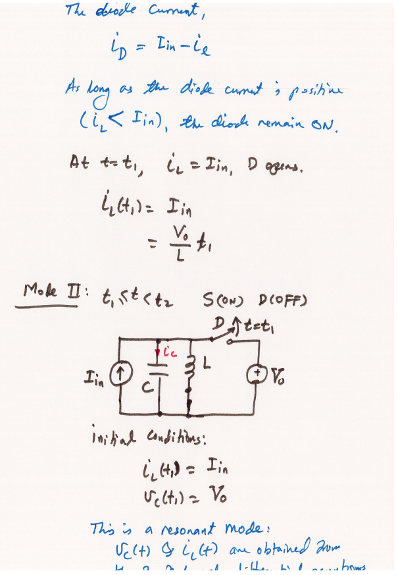

Slide 9
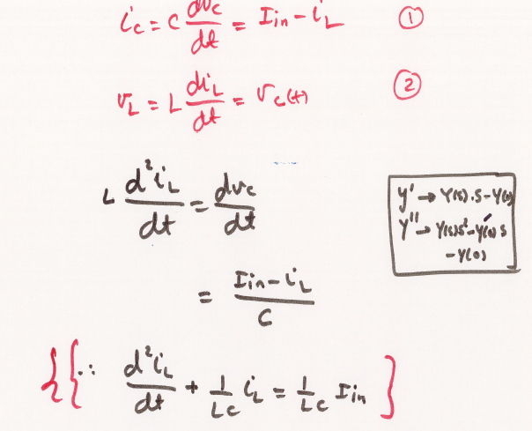

Slide 10
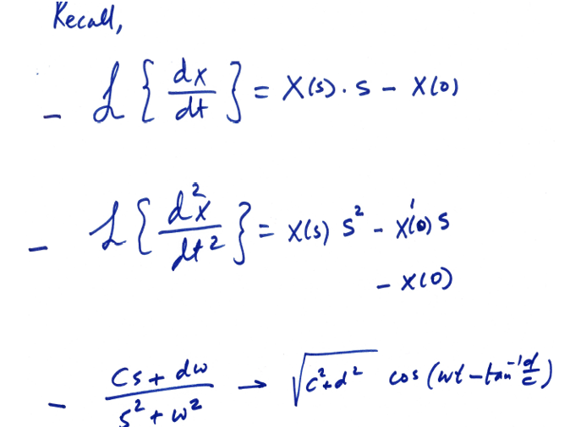

Slide 11
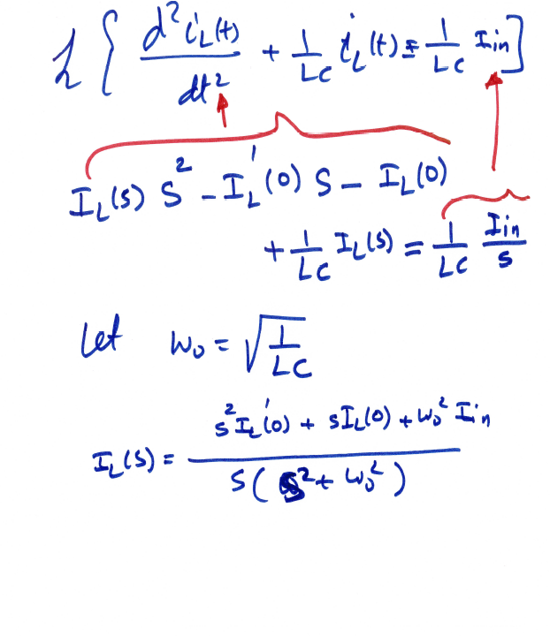

Slide 12
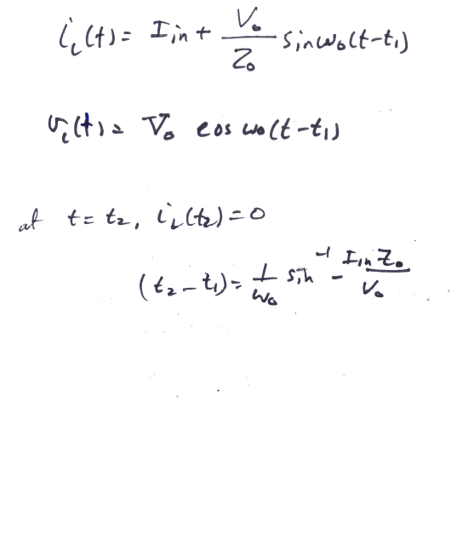

Slide 13
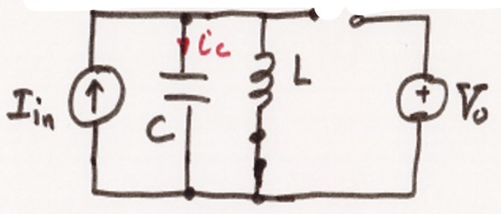
Mode I
Mode II

Slide 14
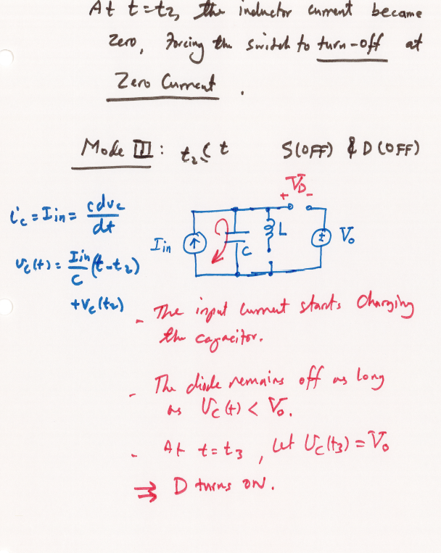

Slide 15
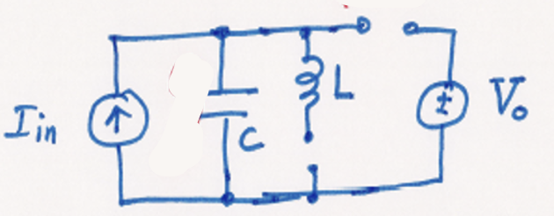
Mode I
Mode II
Mode III

Slide 16
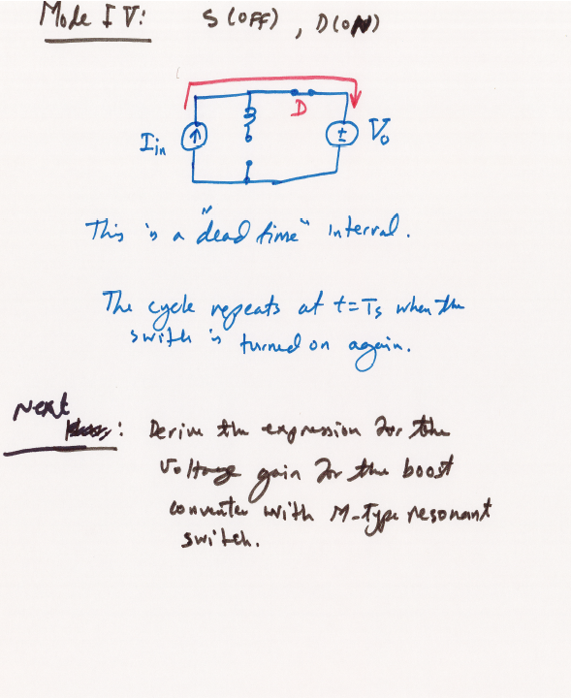

Slide 17
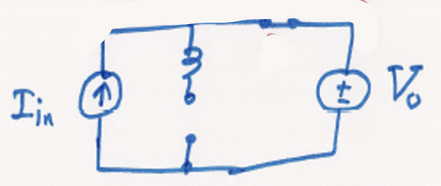
Mode I
Mode II
Mode III
Mode IV

Slide 18
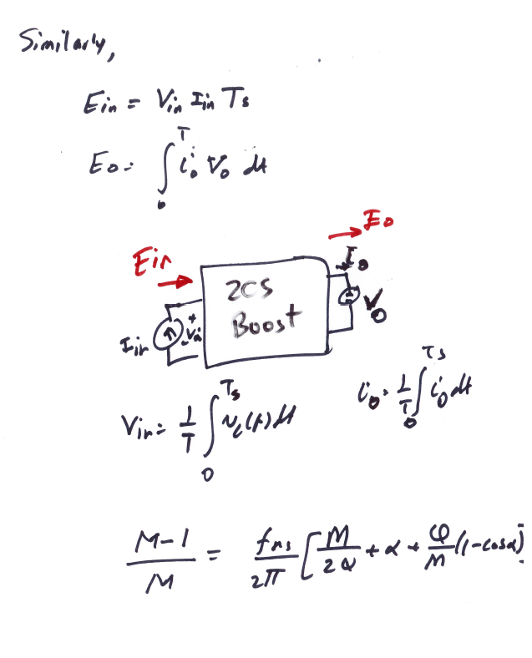

Slide 20
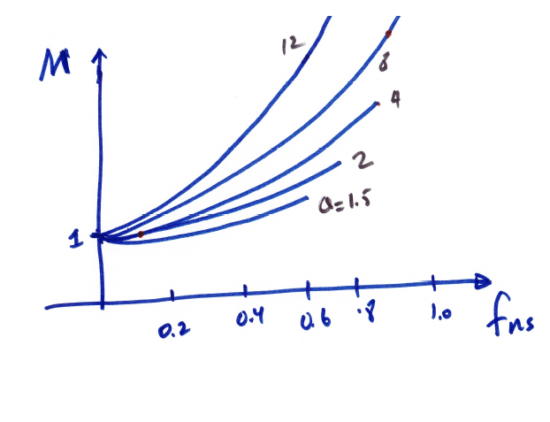

Slide 21
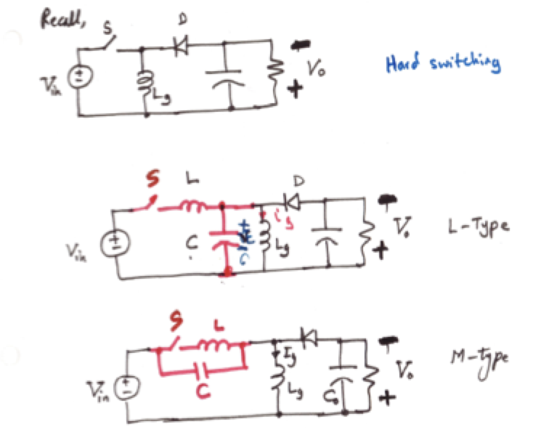
Buck-Boost ZCS Quasi-Resonant Converter

Slide 22
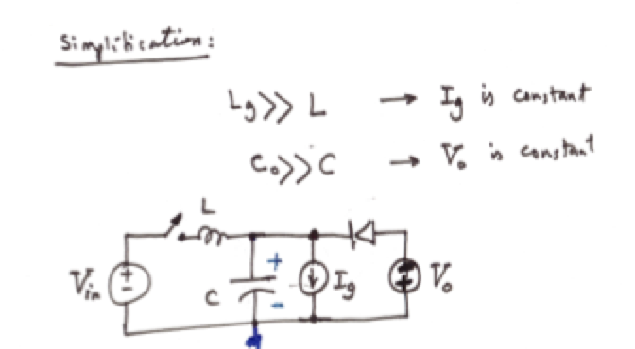

Slide 23
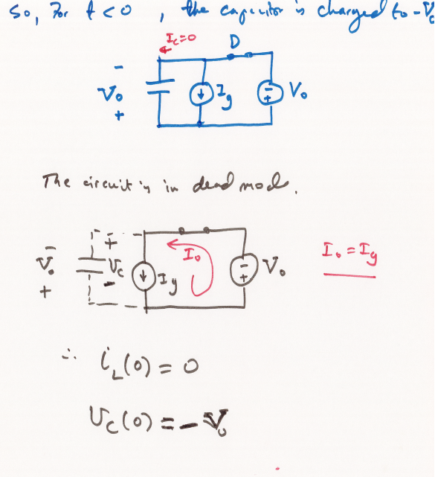

Slide 24
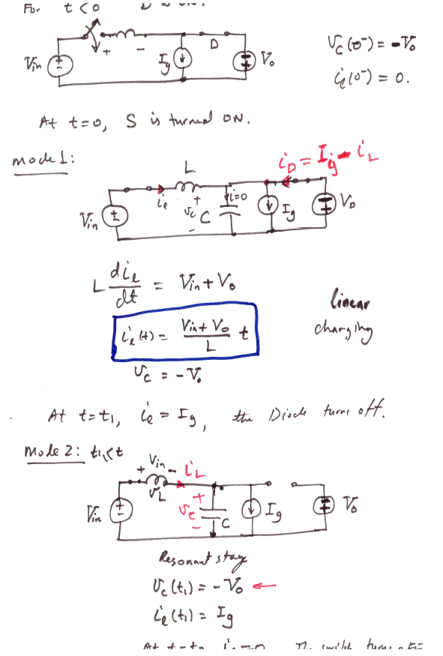

Slide 25
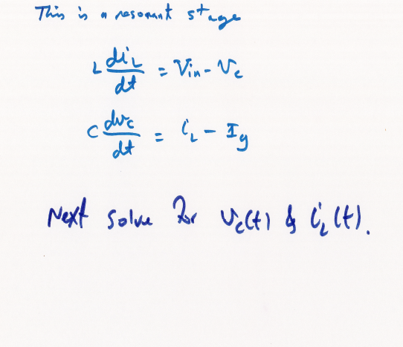

Slide 26
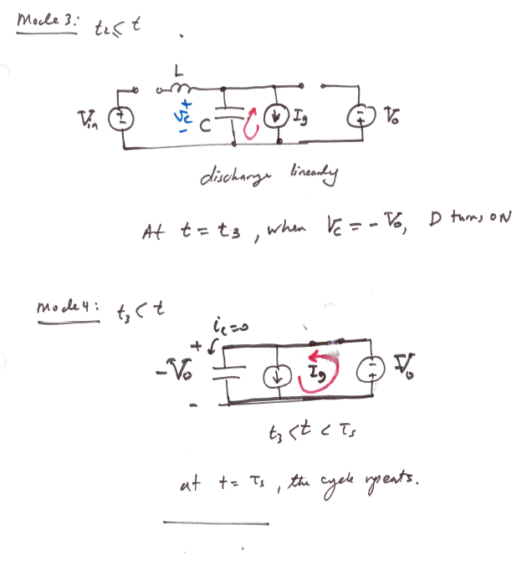

Slide 27
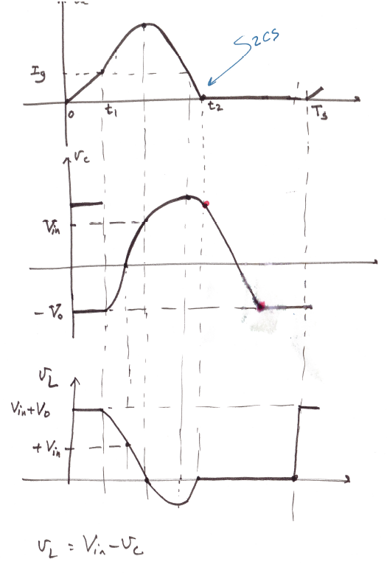

Slide 28
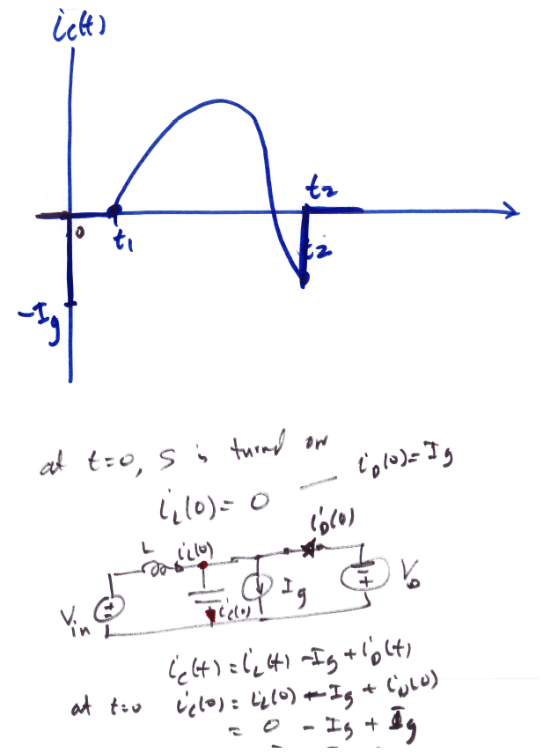

Slide 29
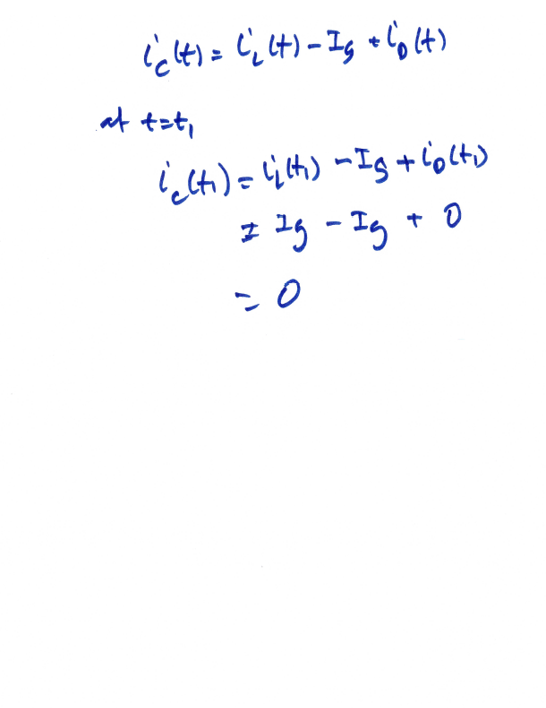

Slide 30
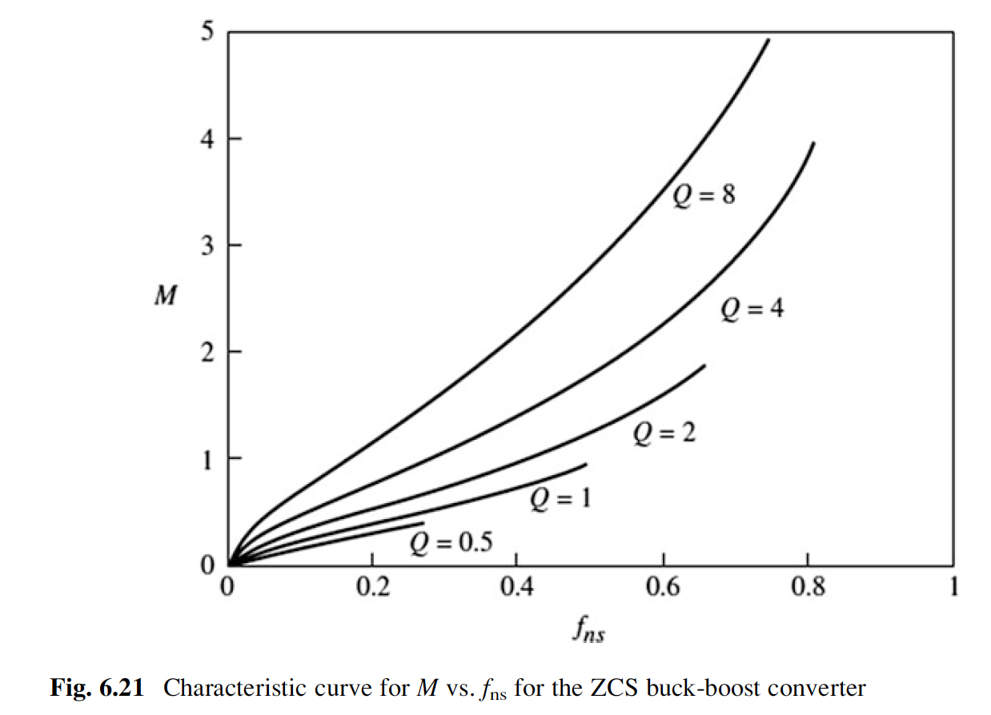
Voltage Gain equation:

Slide 31
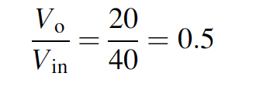
Solution:
The output voltage and load resistance are given by:
The voltage gain is given by:

Slide 32
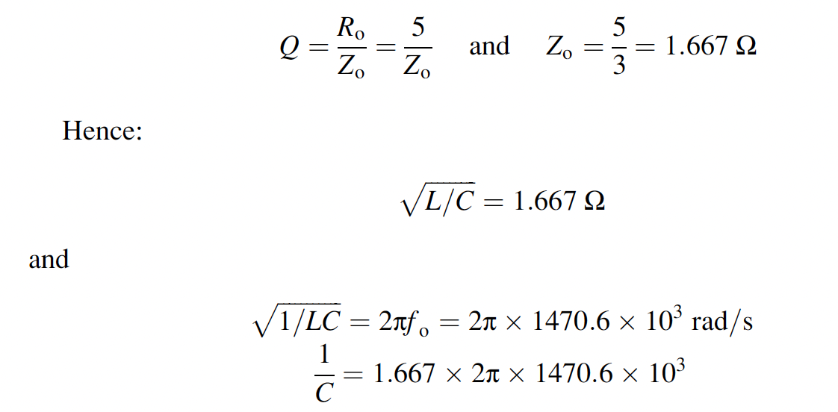
From Q and Zo, we have:

Slide 33
Load Regulations
What if the load current $I_{o}$changed from 4A to 12 A, what is the new switching frequency?
The new load current of 12 A means $R_{o}=1.67 Ω$ $which corrospnds to$new Q=1.0
From the curve, the new $f_{ns}≈0.3$
Hence with $f_{o}=1470.6 kHz$, the new $f_{S} becomes,$
$$f_{S}=f_{o} f_{ns}=1470.6x0.3≈441 kHz$$
What if the load current $I_{o}$changed from 4A to 1.5 A, what is the new switching frequency?
The new load current of 1.5 A means $R_{o}=13.33 Ω$ $which corrospnds to$new Q=8.0
From the curve, the new $f_{ns}≈0.05$
Hence with $f_{o}=1470.6 kHz$, the new $f_{S} becomes,$
$$f_{S}=f_{o} f_{ns}=1470.6x0.05≈74 kHz$$
Hence, the rang of the switching frequency is between 73.5kHz to 441.2 kHz

Slide 34
Load Regulations
(nominal load)
$$f_{ns}=0.17, Q=3,$$
$$M=0.5$$
(light load)
$$f_{ns}=0.05$$
$$Q=8,$$
$$M=0.5$$
(heavy load)
$$f_{ns}=0.3, Q=1,$$
$$M=0.5$$

Slide 35
Line Regulations
What if the line voltage $V_{in}$changed from 40V to 60 V, what is the new switching frequency?
The new input of 60 V, the new gain becomes M=0.33.
From the curve with Q=3 and M=0.33, the new $f_{ns}≈0.07$
Hence with $f_{o}=1470.6 kHz$, the new $f_{S} becomes,$
$$f_{S}=f_{o} f_{ns}=1470.6x0.07≈103 kHz$$
What if the line voltage $V_{in}$changed from 40V to 30 V, what is the new switching frequency?
The new input of 30 V, the new gain becomes M=0.7
From the curve with Q=3 and M=0.7, the new $f_{ns}≈0.26$
Hence with $f_{o}=1470.6 kHz$, the new $f_{S} becomes,$
$$f_{S}=f_{o} f_{ns}=1470.6x0.26≈382 kHz$$
Hence, the rang of the switching frequency is between 102.9 kHz to 382.4 kHz

Slide 36
Line Regulations
$$f_{ns}=0.26, Q=3,$$
$$M=0.7$$
(low input)
$$f_{ns}=0.17, Q=3,$$
$$M=0.5$$
(nominal input)
$$f_{ns}=0.07$$
$$Q=3,$$
$$M=0.33$$
(high input)

Slide 37
Line & Load Regulations – worst case
What if the line voltage $V_{in}$becomes 30V and load current becomes 12 A, what is the range of the switching frequency needed to keep $V_{o}=20 V$?
The new input voltage of 30 V, the new gain becomes M=0.7.
The new load current of 12 A means $R_{o}=1.67 Ω$ $which corrospnds to$new Q=1.0
Hence with M=0.7 and Q=1, we have $f_{ns}=0.41$ which corresponds the new $f_{S}$ given by
$$f_{S}=f_{o} f_{ns}=1470.6x0.41≈603 kHz$$
Load/line regulation
Load Regulations
(nominal input)
(low input. High load)
Line Regulations
(heavy load)
$$74$$
$$103$$
$$382$$
$$441$$
$$603$$
$f_{S}(kHz$)

Slide 38
Line & Load Regulations – worst case
(nominal input)
$$f_{ns}=0.17, Q=3,$$
$$M=0.5$$
(low input. High load)
$$f_{ns}=0.41, Q=1,$$
$$M=0.7$$

Slide 39
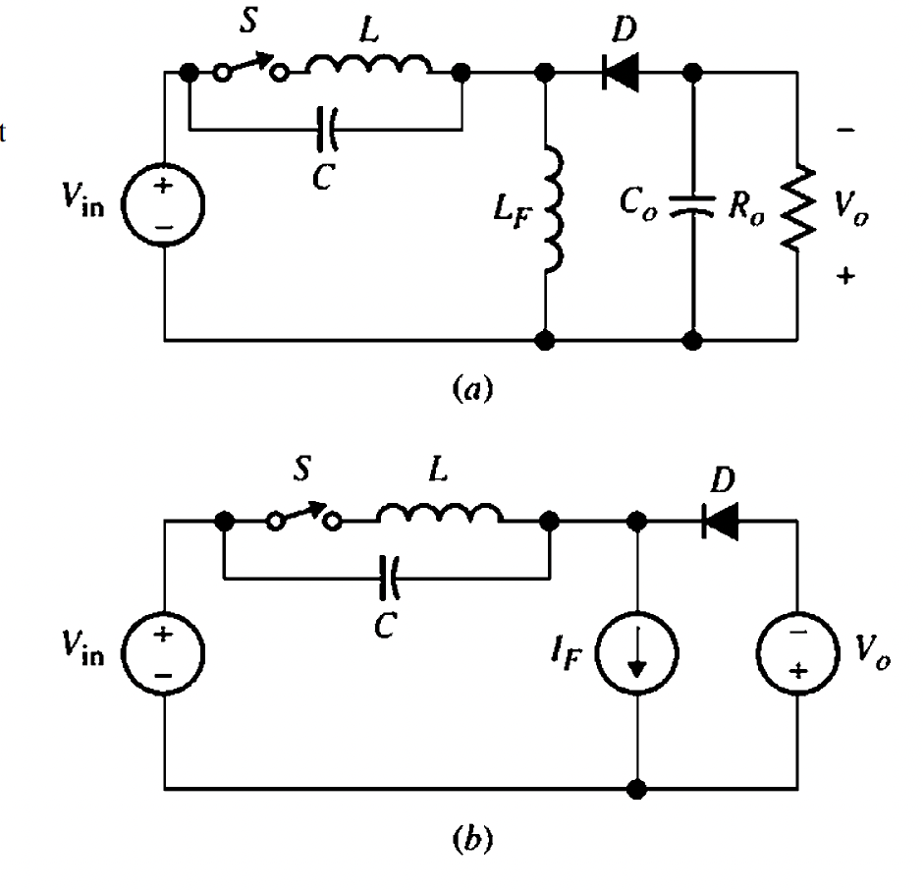
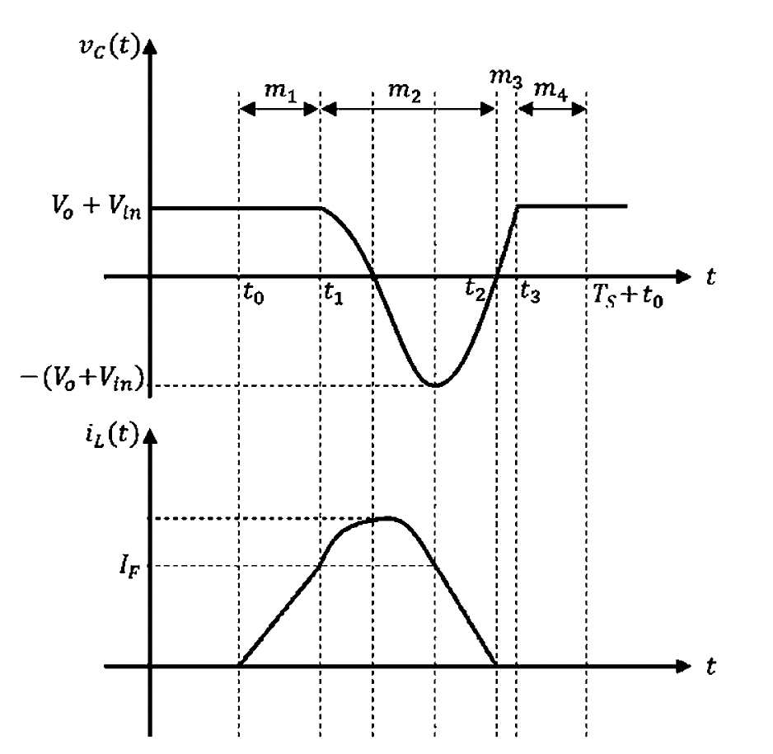
ZCS buck-boost converter with an M-type switch
Steady-state waveform for the M-type
ZCS buck-boost converter

