Slide 1
EEL 646 POWER ELECTRONICS II Zero-Current Swithcing: The Buck Converter
Lecture 3

Slide 2
Agenda
Steady-State Analysis of Zero Current Switching
ZCS Analysis of The Buck Converter

Slide 3
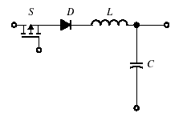
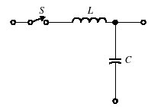
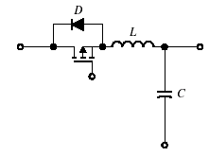
Zero-Current Switching (ZCS) Topologies - The Resonant Switch Concept -
Depending on the inductor-capacitor arrangements (LC tank forms the resonant tank), there are two possible types of resonant switch arrangements:
The L-type
The M-type
And each can be implemented as a half-wave or a full-wave, i.e. unidirectional or bi-directional
L-type switch-Half-wave
L-type switch-full-wave

Slide 4
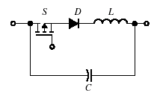
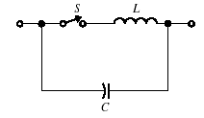
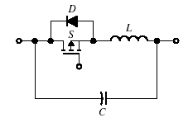
Zero-Voltage Switching (ZVS) Topologies - The Resonant Switch Concept -
Depending on the inductor-capacitor arrangements (LC tank forms the resonant tank), there are two possible types of resonant switch arrangements:
The L-type
The M-type
And each can be implemented as a half-wave or a full-wave, i.e. unidirectional or bi-directional
M-type switch-Half-wave
M-type switch-full-wave

Slide 5
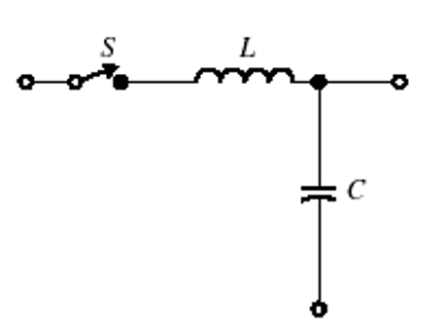
The Resonant Switch in ZCS Topologies
When the Resonant switch is formed by adding the LC resonant tank, as follows:
Ideal Standard Switch
Ideal Resonant Switch

Slide 6
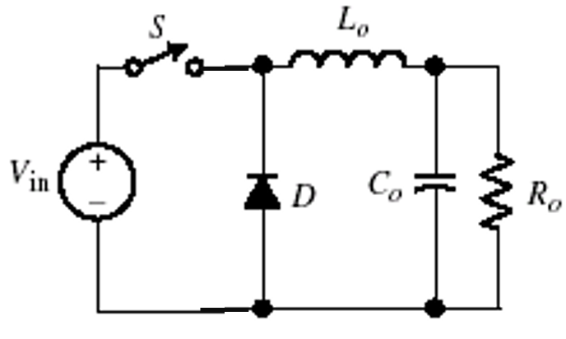
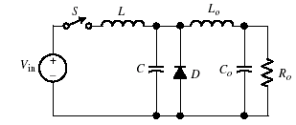
The Buck Resonant Converter
Replacing the standard switch by the resonant-type switch:
$$+$$
$$I_{o}$$
$$+$$
$$V_{o}$$
$$V_{o}$$
$$−$$
$$−$$
Conventional buck converter
Quasi-resonant PWM buck converter
Steady-State Analysis:
Assume $R_{o}C_{o}≫T$
$V_{o} becomes constant$ voltage
The circuit became 1st order
Steady-State Analysis:
Assume $R_{o}C_{o}≫T$ & $\frac{L_{o}}{R_{o}}≫$
$V_{o} becomes constant$
Assume $\frac{L_{o}}{R_{o}}≫T$
$I_{o} becomes constant$ current
The circuit became 2nd order

Slide 7
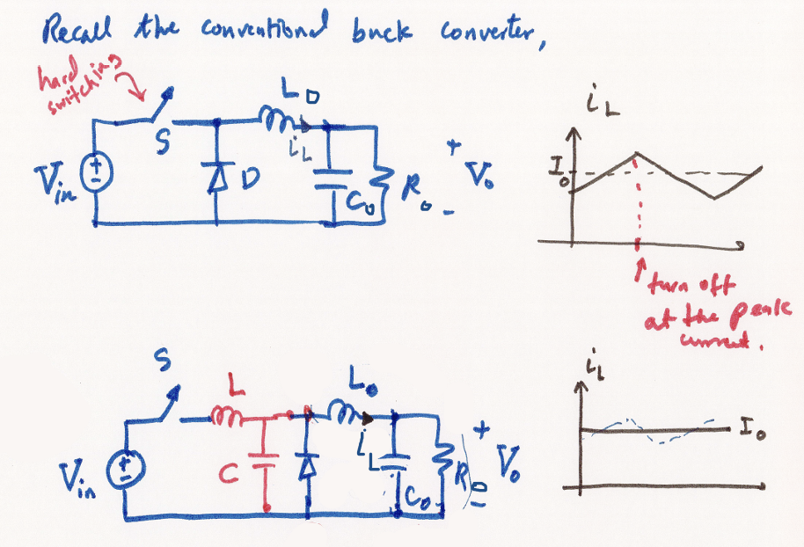

Slide 8
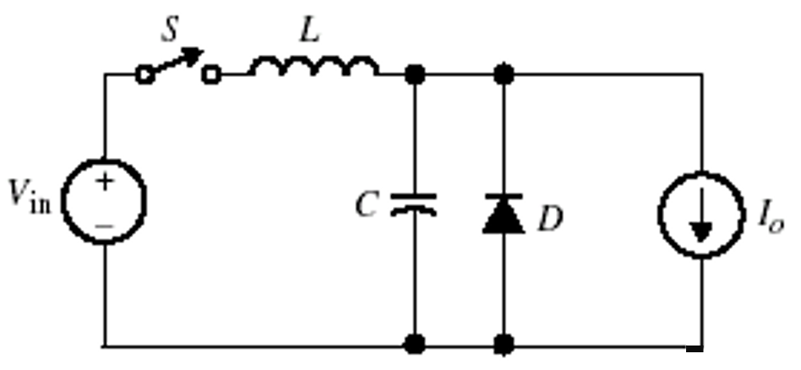
Steady-State Analysis of the Buck ZCS Quasi Resonant Converter
Simplified equivalent circuit for the Buck ZCS with L-type resonant switch

Slide 9
Steady-State Analysis of the Buck ZCS Quasi Resonant Converter
Use the L-type Resonant Switch to analyze the quasi-ZCS buck converter
Derive the steady-state waveforms for the inductor current $i_{L}(t)$and capacitor voltage $v_{C}(t)$
Find the mathematical expressions for $i_{L}(t)$and $v_{C}\left(t\right)$
Derive the Voltage Gain
$$M=\frac{V_{o}}{V_{in}}$$

Slide 10
Stead-state Analysis
Let us assume at $t=0$, the switch has been turned OFF with the initial conditions as follows:
$$i_{L}\left(0\right)=0 and v_{C}\left(0\right)=0$$
Then, the diode can be either ON or OFF. Let us try both cases.
$$i_{L}(t)$$
$$+$$
$$v_{C}(t)$$
$$C$$
$$−$$

Slide 11
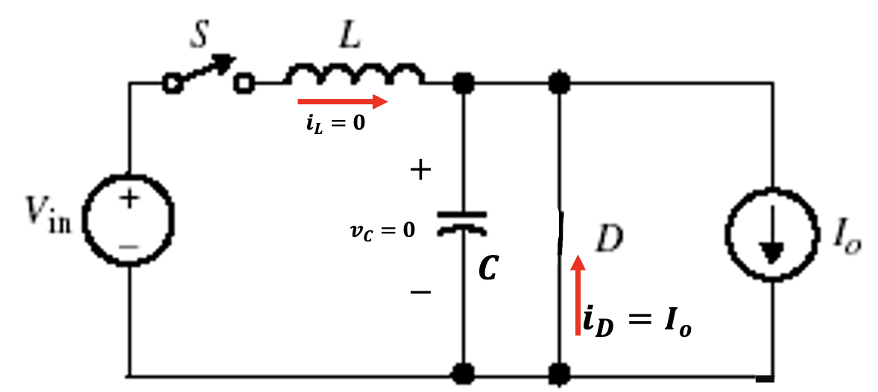
Stead-state Analysis
Assume the diode is ON:
Hence, the diode current takes all the load current and the circuit remains in this position for all times – Valid Assumption

Slide 12
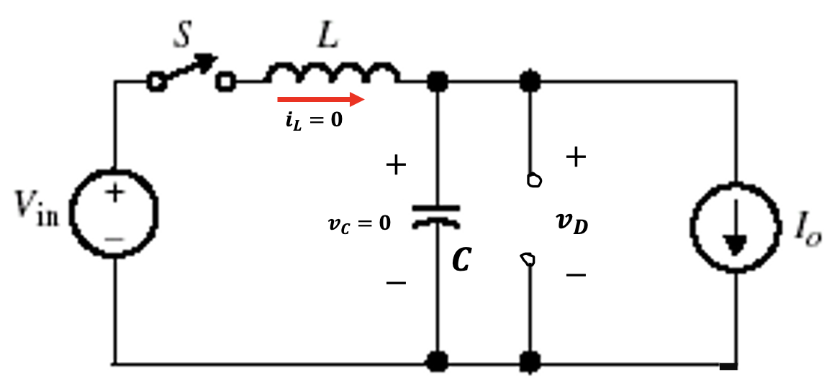
Stead-state Analysis
Assume the diode is OFF:
In this equivalent circuit the capacitor voltage cannot be zero! It will start charging (going negative) by the load current:
$$v_{C}(t) =\frac{{−I}_{o}}{C}t$$
Hence, the diode voltage $v_{D}(t)$ becomes equal to a negative $v_{C}(t)$, forcing the diode to turn ON!

Slide 13
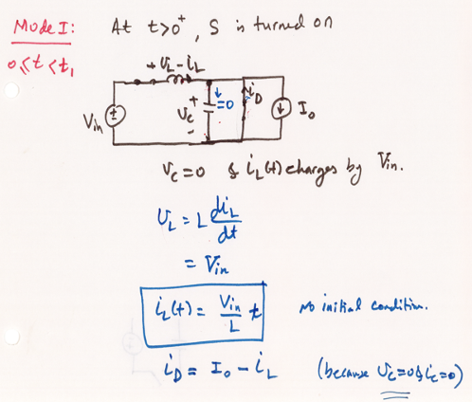
Stead-state Analysis
So, Mode I begins with S open and D is on.

Slide 14
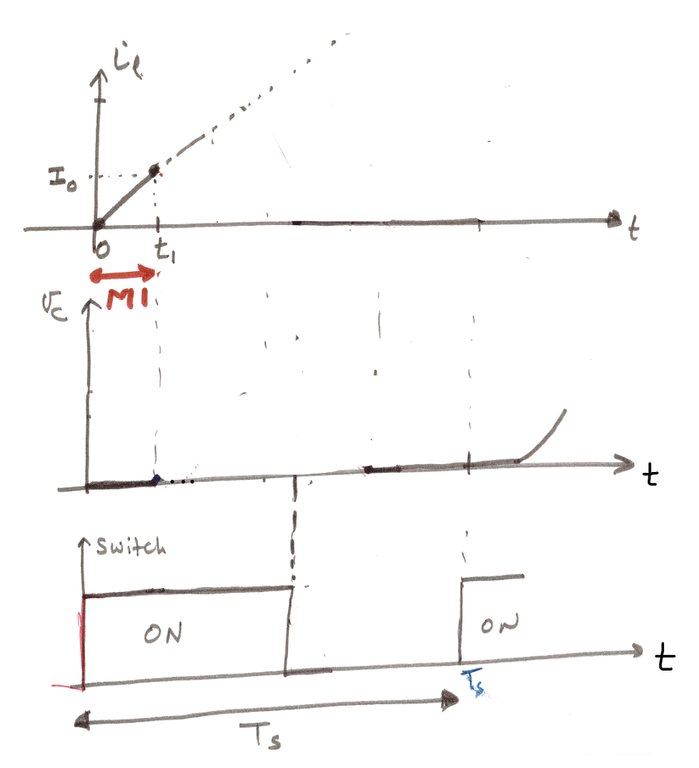
Stead-state Wave from for Mode I
Notice that at $t=t_{1}$, the diode current $i_{D}=0 , since the inductor current reached I_{o}$
$$i_{L}\left(t_{1}\right)=I_{o}$$
The diode must turn off and the circuit enters Mode II

Slide 15
Hence, the inductor current at $t=t_{1}$,
$$i_{L}\left(t_{1}\right)=\frac{V_{in}}{L}t_{1}=I_{o}$$
Solving for $t_{1}$,
$$t_{1} =\frac{I_{o}}{V_{in}}L$$
Hence, we enter Mode II at $t=t_{1}$ with the initial conditions to Mode II:
$$i_{L}\left(t_{1}\right)=I_{o}$$
$$v_{C}\left(t_{1}\right)=0$$

Slide 16
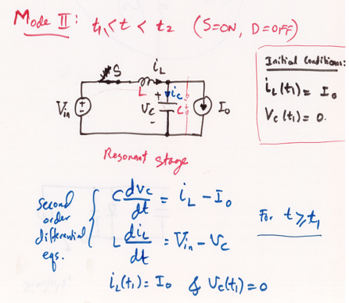

Slide 17
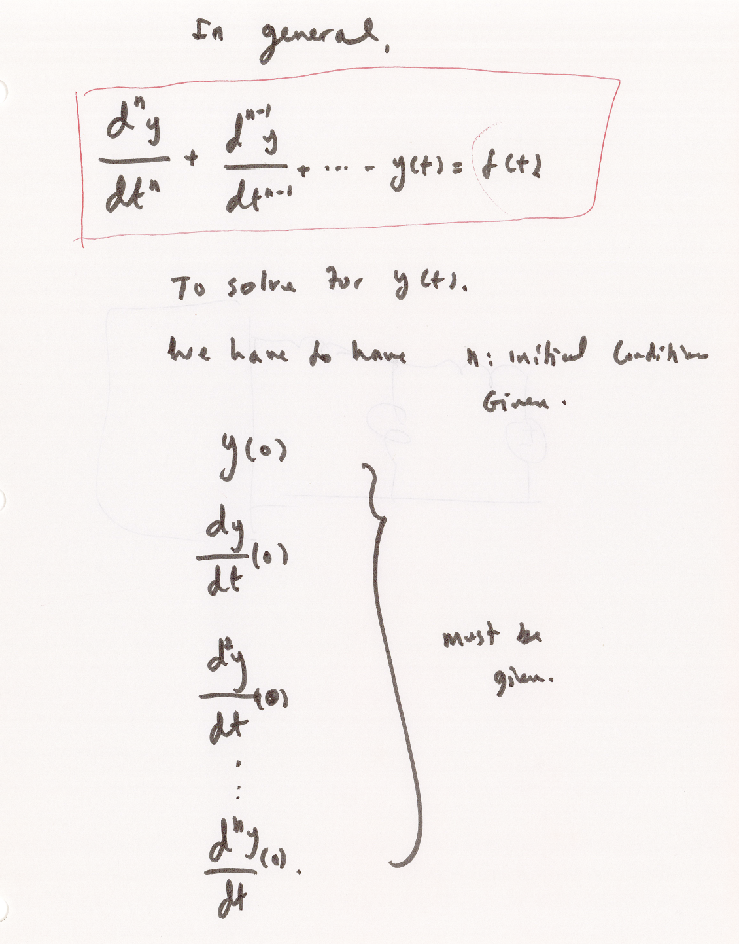
Then we solve for the second order differential equations:
In the second order differential equations with LC, we need to know the inductor current and capacitor voltage at t=0:

Slide 18
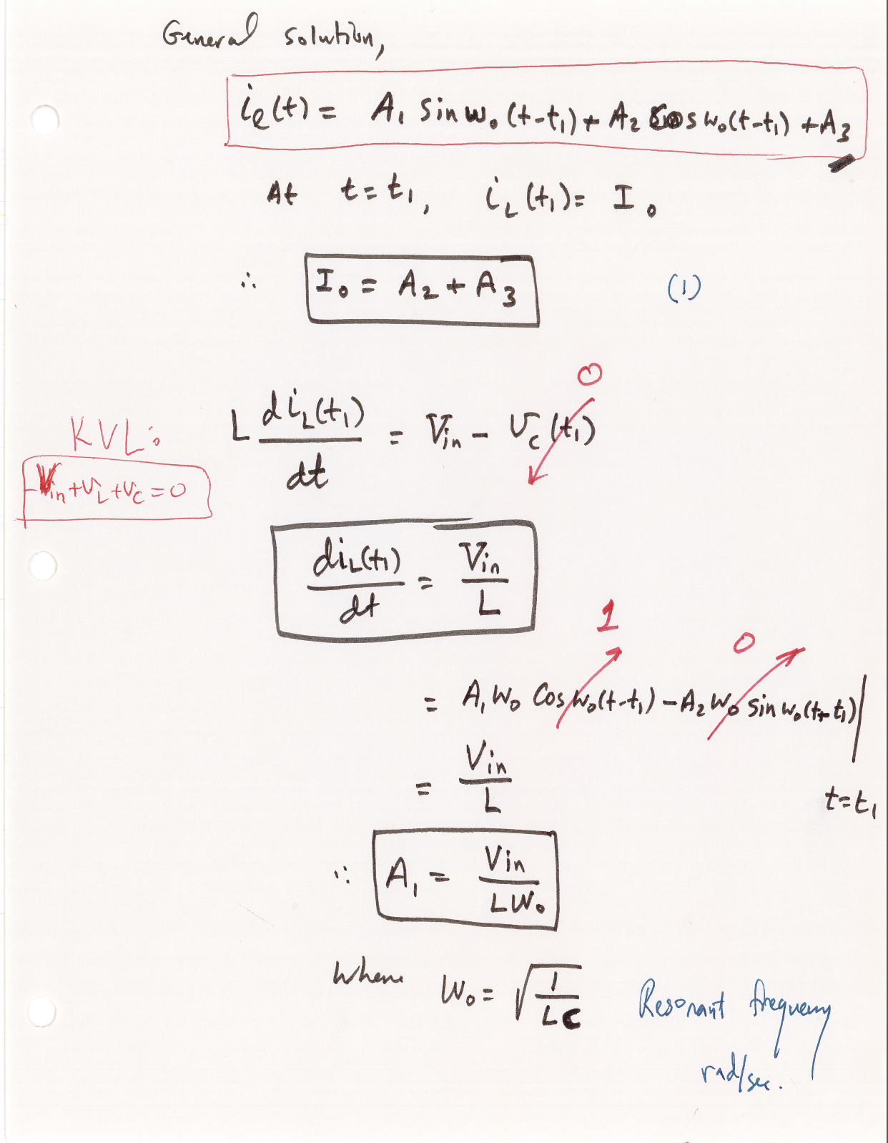

Slide 19
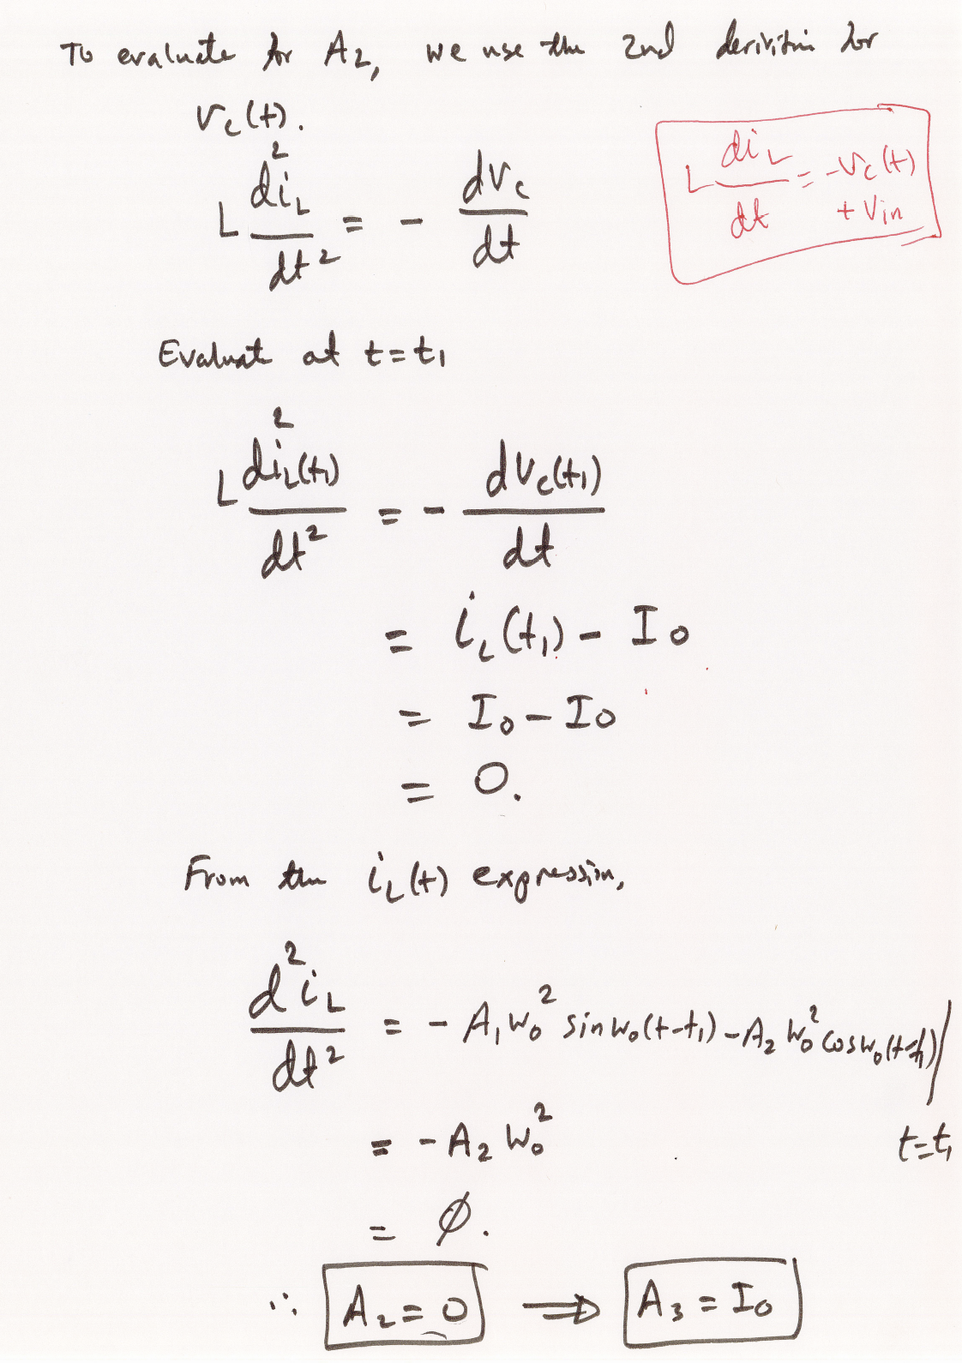

Slide 20
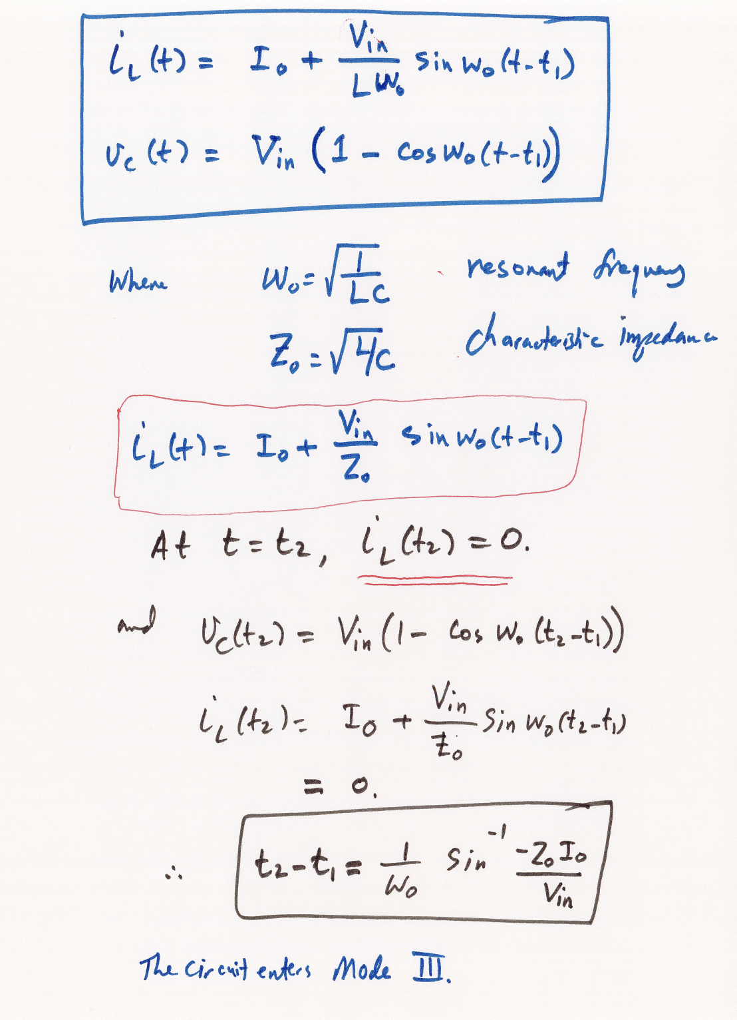
Notice the minus sign (-) in the equation!

Slide 21
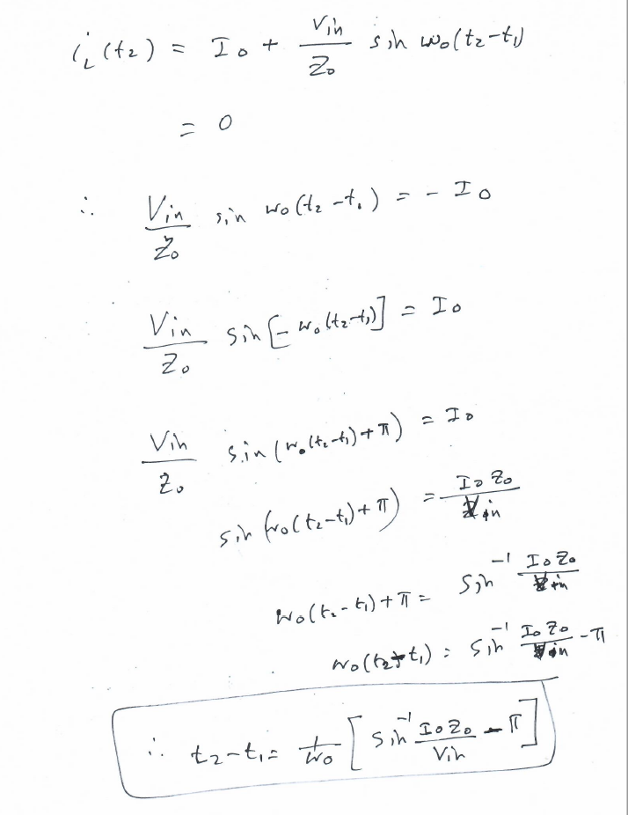
The following shows how to handle the minus sign (-) in the equation!
Solving for ${t_{2}−t}_{1}$,

Slide 22
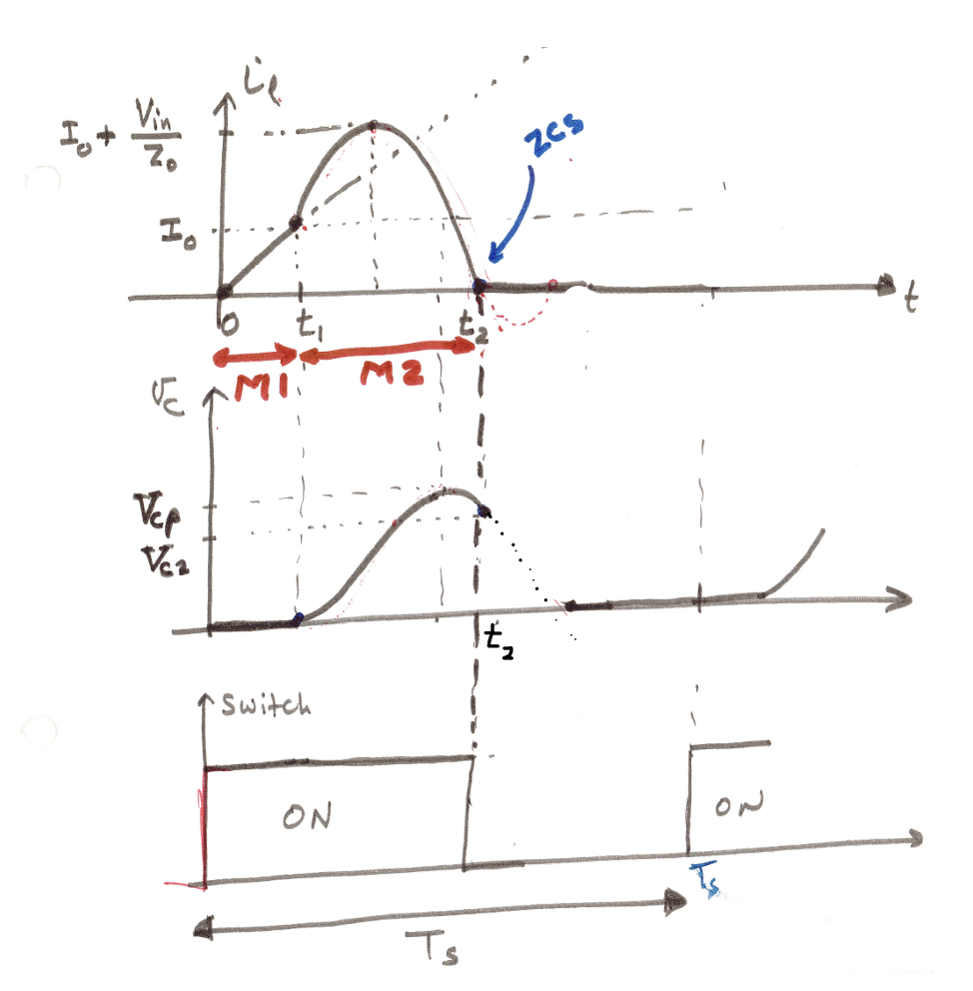
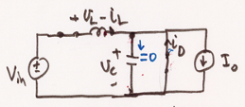
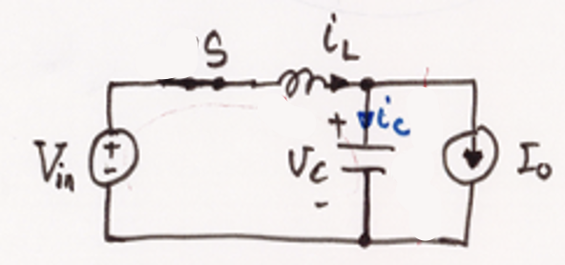

Slide 23
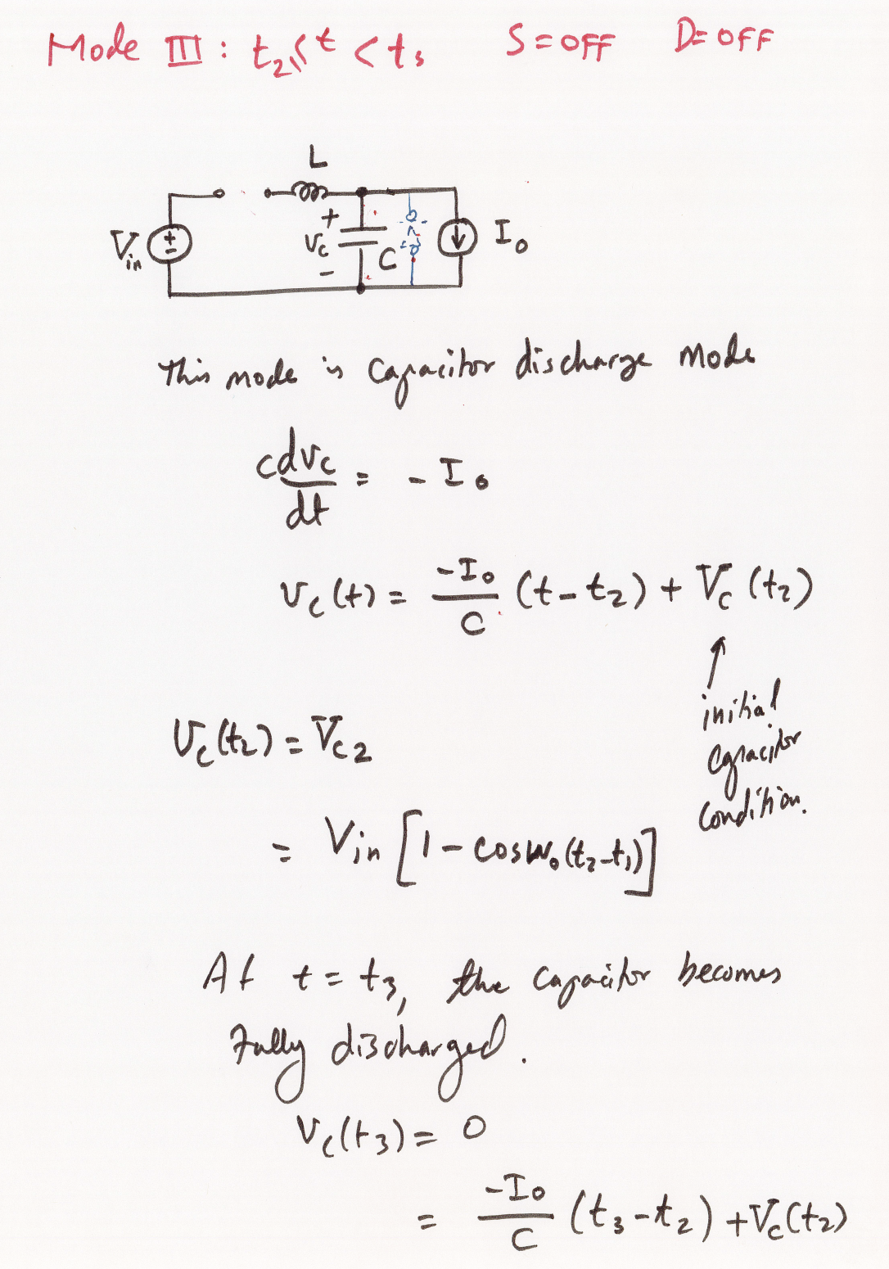

Slide 24
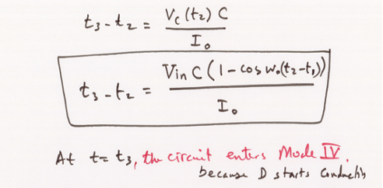

Slide 25
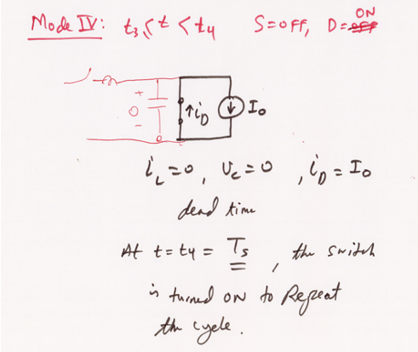

Slide 26
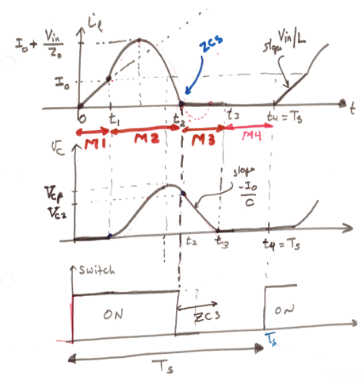

Slide 27
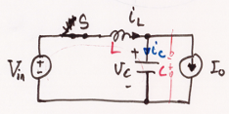

Slide 30
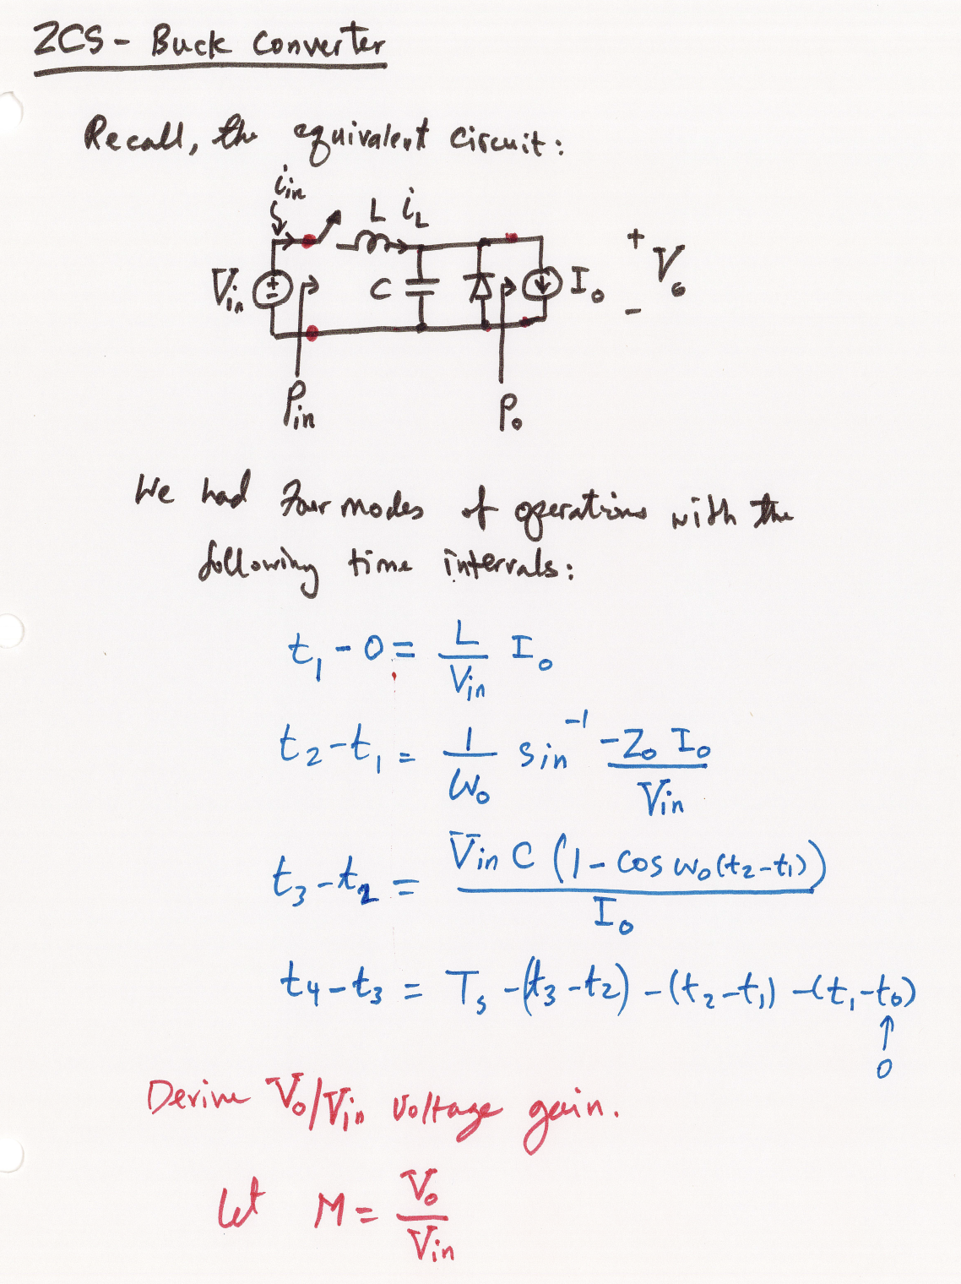

Slide 31
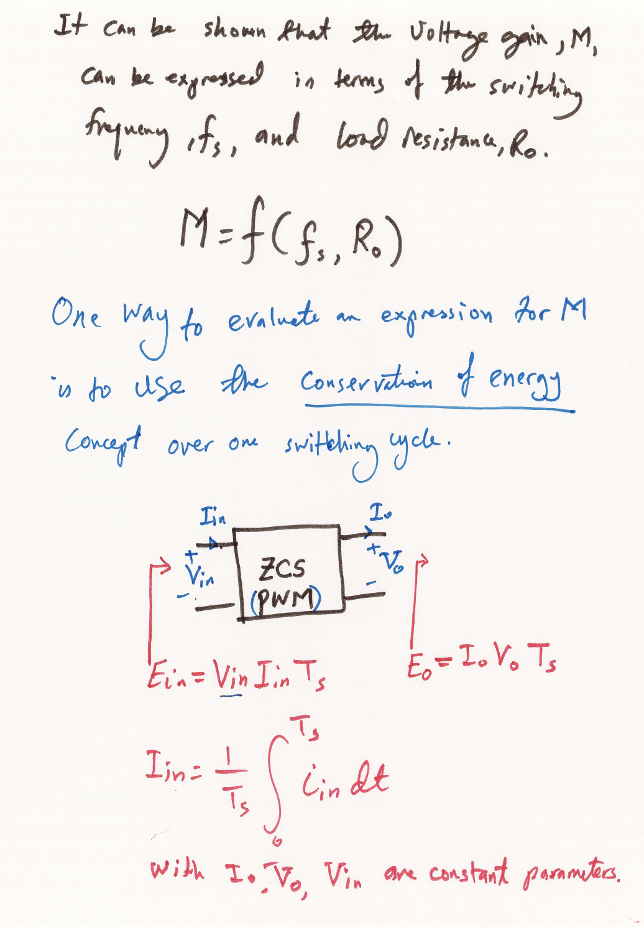

Slide 32
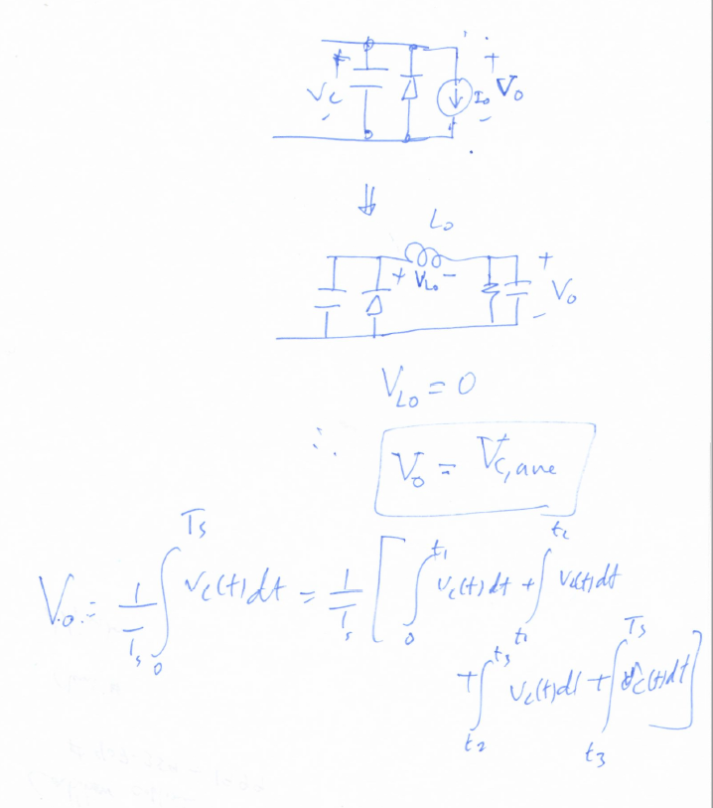
Another way to find the average output voltage Vo is to to take the average voltage of v_{C}(t).

Slide 33
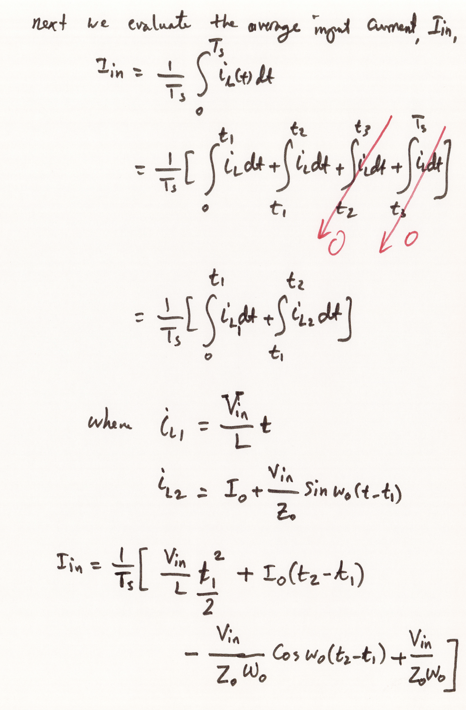

Slide 34
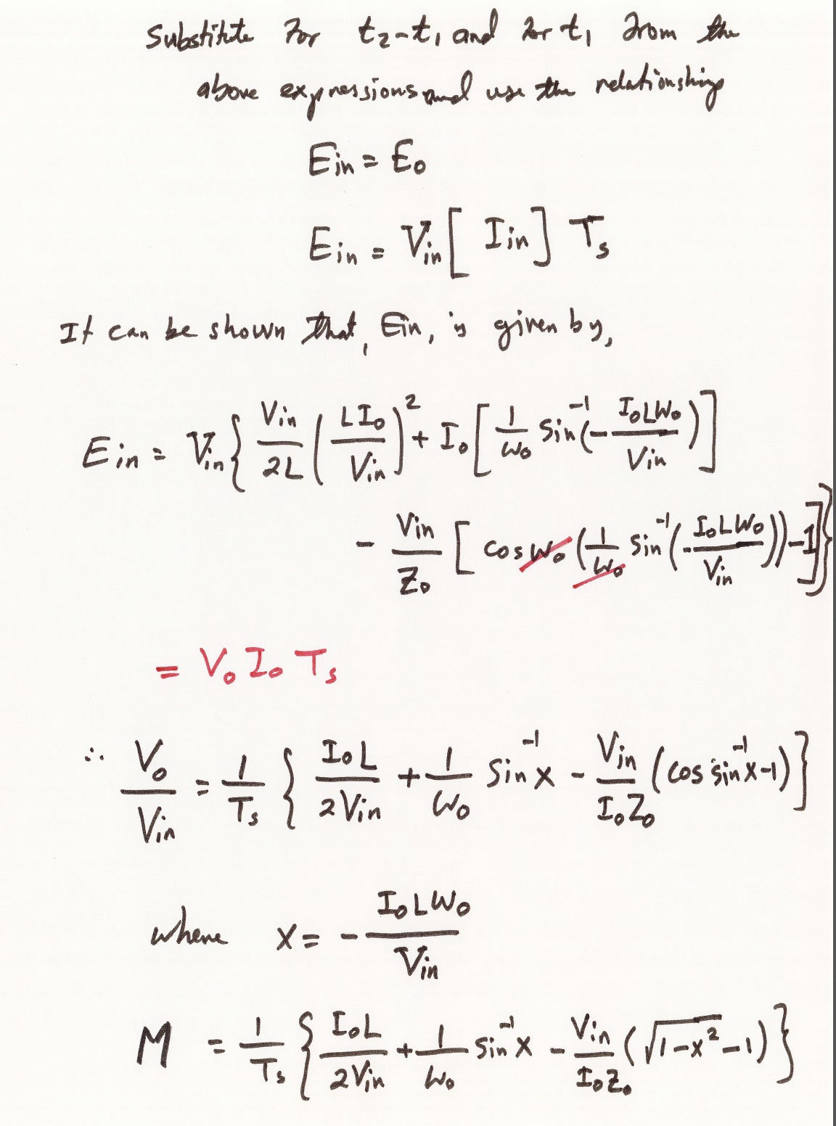

Slide 35
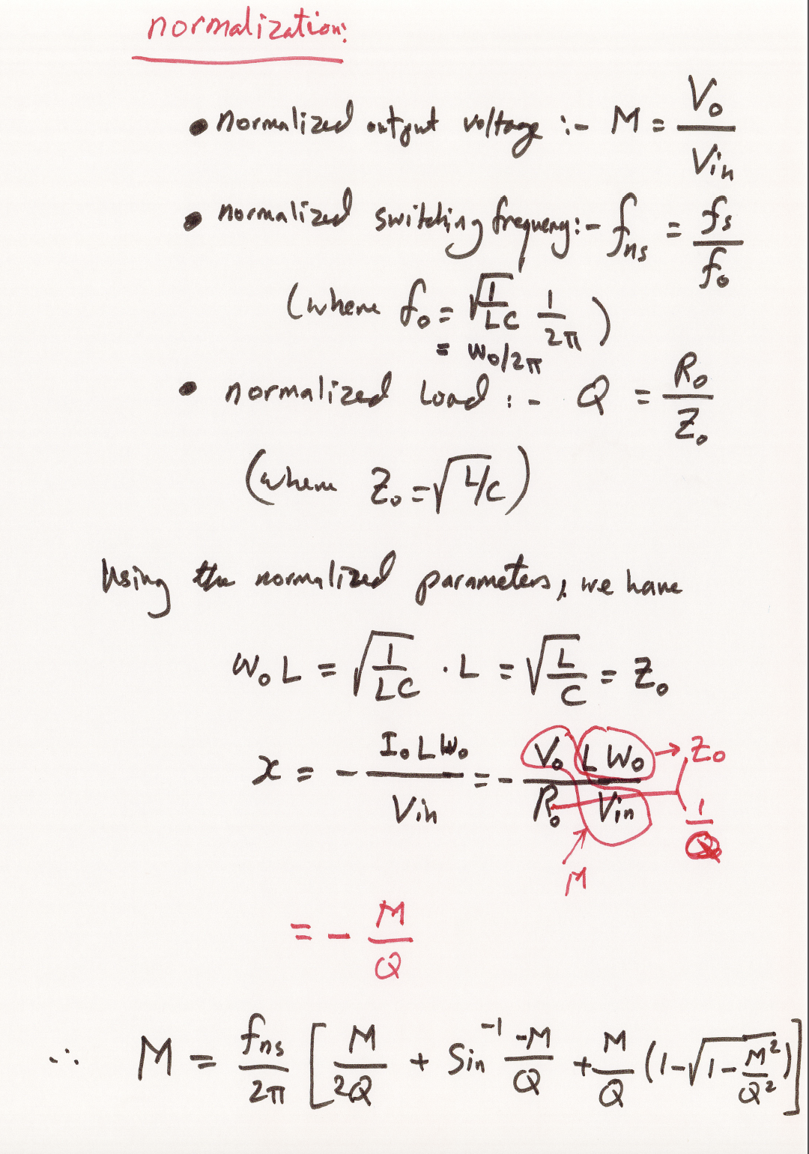

Slide 36
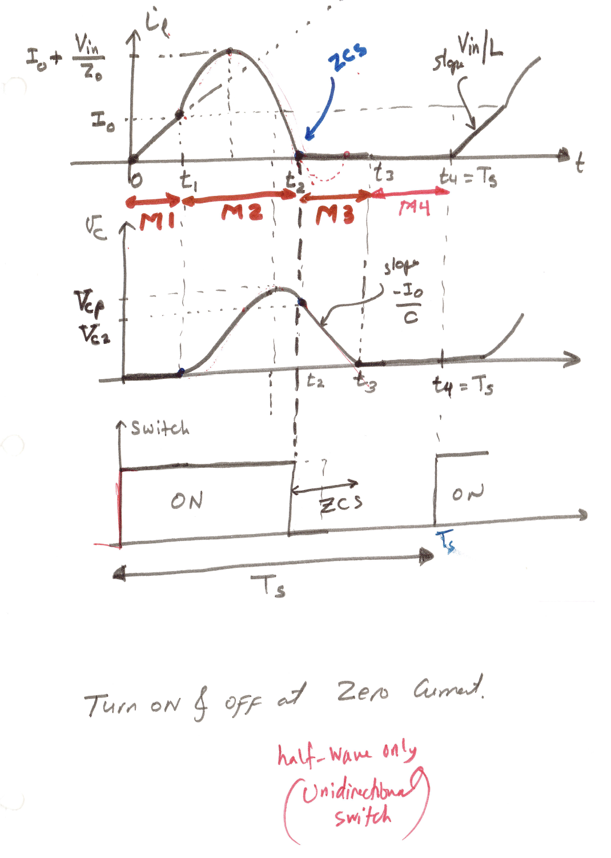

Slide 37
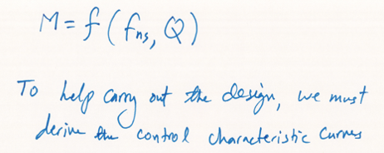
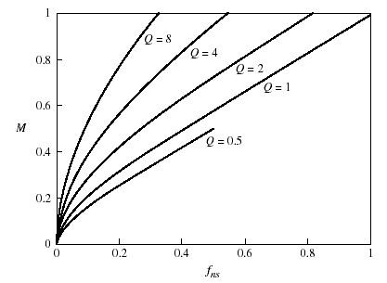
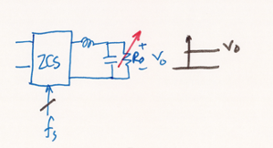

Slide 38
Summary of the ZCS Quasi-Resonant Buck Converter with L-Type Resonant Switch

Slide 39
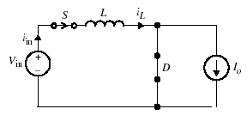
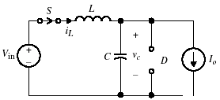
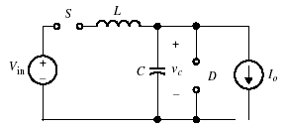
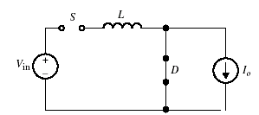
Buck Converter: Equivalent Modes
(a)
(b)
(c)
(d)
Fig 6.9 (a) Equivalent circuit for Mode I. (b) Equivalent circuit for mode II. (c) Equivalent circuit for mode III. (d) Equivalent circuit for mode IV.

Slide 40
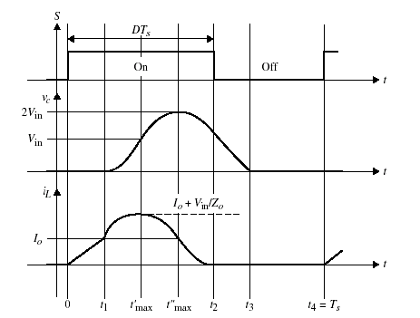
Typical Steady-State Waveforms
Voltage Gain
The expression for the voltage gain,
Figure 6.10 shows the steady state waveforms for and for the buck converter with L-type switch.
Fig 6.10 Steady-state current and voltage waveforms of buck L-type

Slide 41
Normalization
To simplify and generalize the gain equation, the following normalized parameters are defined:
normalized output voltage
(6.29a)
normalized load
(6.29b)
average output current
(6.29c)
normalized switching frequency
(6.29d)
By substituting Eq. (6.29) into Eq. (6.28), the final voltage gain is simplified into
(6.30)
where,
(6.31)

Slide 42
Buck-Control Characteristic Curve
A plot of the control characteristic curve of M vs. f_{ns} under various normalized loads is given in Fig. 6.11
Fig 6.11 Control characteristic curve of M vs. ƒ_{ns} for the ZCS buck converter.

Slide 43
ZCS Buck Converter
Example 6.1
Consider the following specifications for a ZCS buck converter of Fig. 6.8(a). Assume the parameters are: V_{in} = 25V, V_{o} = 12V, I_{o} = 1A, f_{s} = 250kHz
Design for the resonant tank parameters L and C and calculate the peak inductor current, and peak capacitor voltage. Determine the time interval for each mode.

Slide 44
ZCS Buck Converter
Solution:
The voltage gain is
Select
Determine Q from either the control characteristic curve of Fig. 6.11 or from the gain equation of Eq. (6.30). This results in Q approximately equal to 1.
Since
the characteristic impedance is given by
The second equation in terms of L and C is obtained from f_{o}. From the normalized switching frequency, f_{o} may be given by,

Slide 45
Example 6.1 (cont’d)
In terms of the angular frequency, ω_{o},
Solving Eqs. (6.32) and (6.33) for L and C, we obtain,

Slide 46
Example 6.1 (cont’d)
The peak inductor current, is given by,
The peak capacitor voltage is:
The time intervals are calculated from the following expressions:
For t’_{max} we have

Slide 47
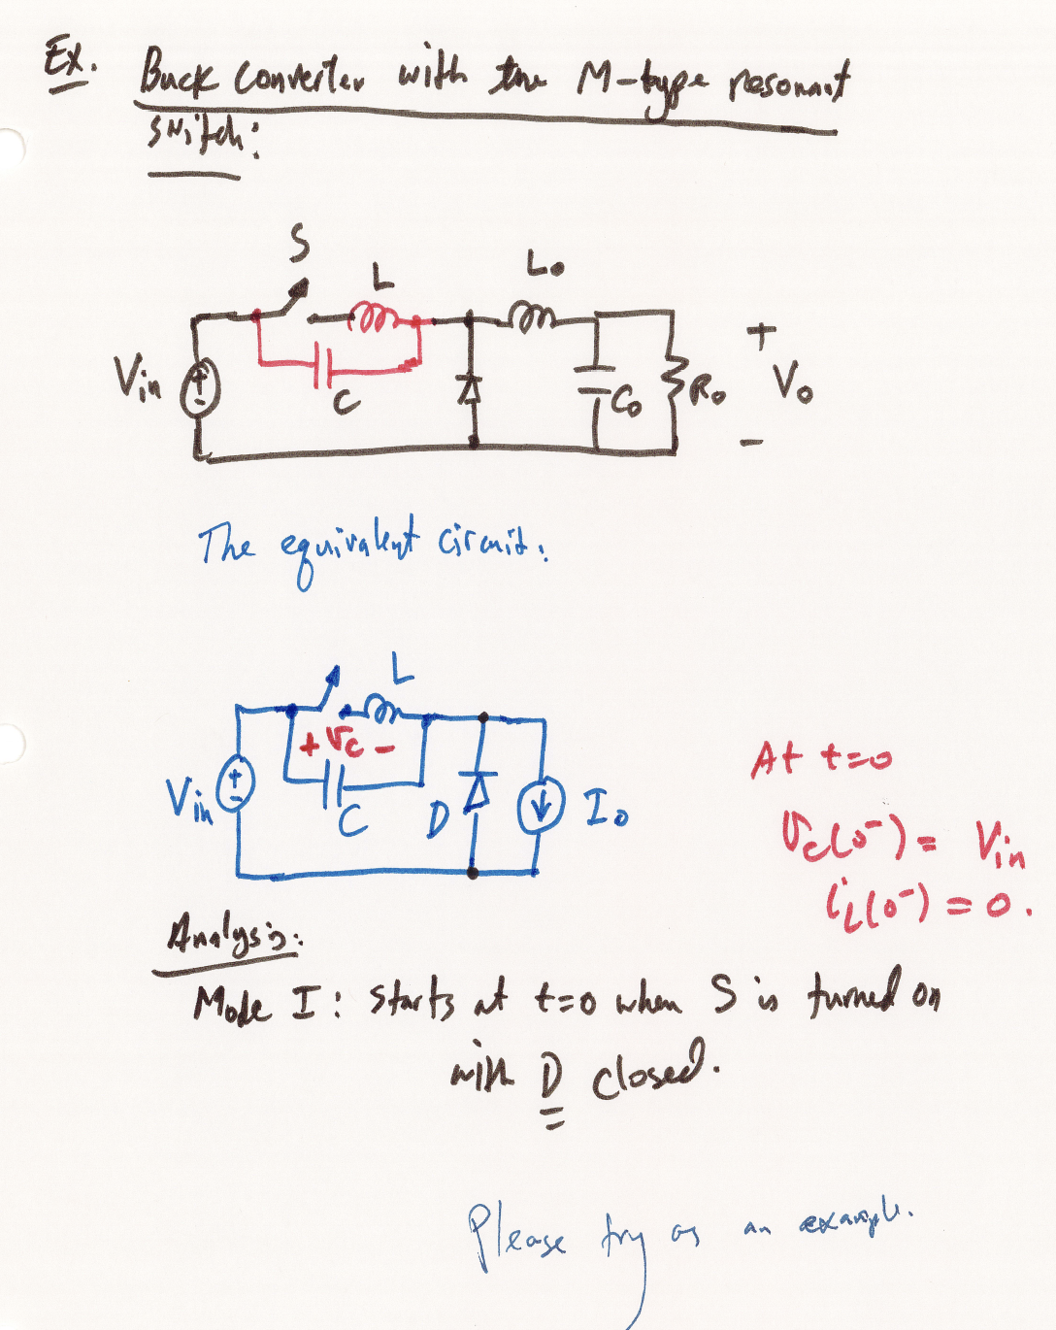
Example Buck ZCS with M-Type Switch

Slide 48
