Slide 1
EEL 646 POWER ELECTRONICS II Closed-Loop Control
Lecture 22

Slide 2
Reminder
Final Exam – During the Final Exam Week:
Take home exam
Thursday April 29 – Sunday May 2rd midnight
Projects final reports due on Midnight Thursday April 29.
Project Presentations:
Monday (April 19): 7 presentations (7-10 minutes each)
Wed (April 21): 7 presentations (7-10 minutes each)

Slide 3
Project Presenters:
Monday (April 19):
Sahin, Mohammad, Reza, Mathew Lucente, Andrew Siwarski, Justin Phelps
Wed (April 21):
Russ, Robert, Sumana, Safayat, Joshua Cates, Ganesh Marasini, Carlos Granda, Mohammadali, Ben Heintze, Luke Minks

Slide 4
Agenda
Final Exam Topics:
Ch 6 (ZVS, ZCS) , SRC, PRC, LLC, small Signal modeling

Slide 5
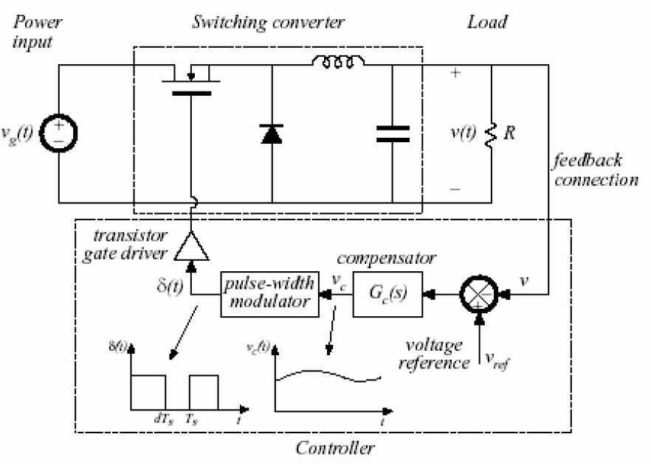
Closed-Loop DC-DC Converter
H(s)
Based on the textbook by Robert Erickson

Slide 6
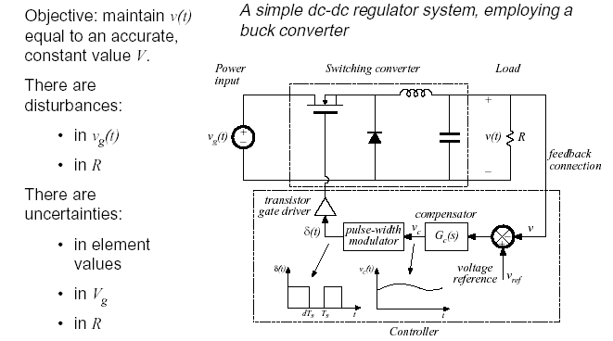

Slide 7
Objective of ac converter modeling
Predict how low-frequency variations in duty cycle induce low- frequency variations in the converter voltages and currents.
^{Ignore the switching ripple}
Ignore complicated switching harmonics and sidebands
The approach is to Remove switching harmonics by averaging all waveforms over one switching period

Slide 8
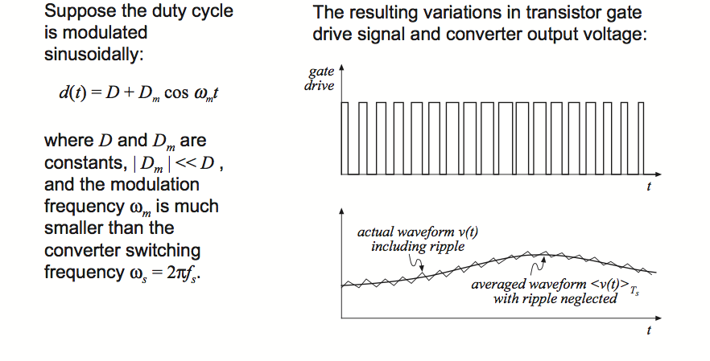
Example of neglecting Switching Ripples
Based on the textbook by Robert Erickson

Slide 9
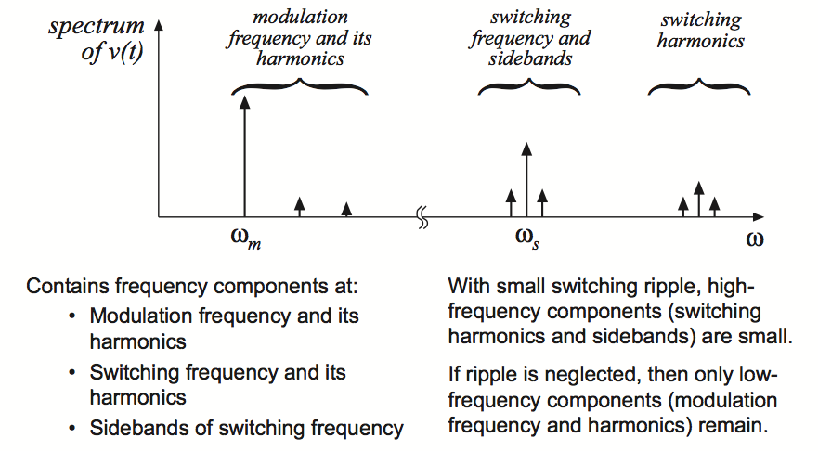
Output voltage spectrum with sinusoidal modulation of duty cycle
Based on the textbook by Robert Erickson

Slide 10
Averaging to remove switching ripple

Slide 11
Example Outlining Basics of Averaging and Linearization (Manual Circuit Averaging and Linearization)
i_{L}
v_{in}
i_{L}
i_{D}
+
v_{out}
_
L
C
R
i_{D}
Fig. (1.) Buck-Boost Converter
From the i_{D} plot we can see the average current is given by:
Fig. (2.) Inductor and Diode Current in DCM
A resulting averaged circuit can be drawn as:
*Note- In the general case, both D and Vin vary with time and we
can see the nonlinear dependence on the circuit parameters.

Slide 12
Example Outlining Basics of Averaging and Linearization (Manual Circuit Averaging and Linearization)
To linearize, we first solve for the DC operating point as:
Next, we introduce AC perturbations and neglect second and higher order terms:
Separating the AC and DC quantities in the equation, we have:
For DC terms:
For AC terms:
Substituting the DC expression for Id into the AC expression and solving for we obtain:

Slide 13
Example Outlining Basics of Averaging and Linearization (Manual Circuit Averaging and Linearization)
Substituting in the DC operation point (expression for Vo) into the expression for we obtain:
The resulting linearized, averaged circuit is:
*Note- The linearization process introduces an additional resistance, also note LTI elements map to themselves in the model but nonlinear elements are replaced by controlled sources and dampening resistances.

Slide 14
Example Outlining Basics of Averaging and Linearization (Manual Circuit Averaging and Linearization)
Another key point here is that the same result can be obtained by the following expression:
where
Key Issue
*Note- Therefore Both approaches are an expression of Taylor Series expansion up to the linear terms.

Slide 15
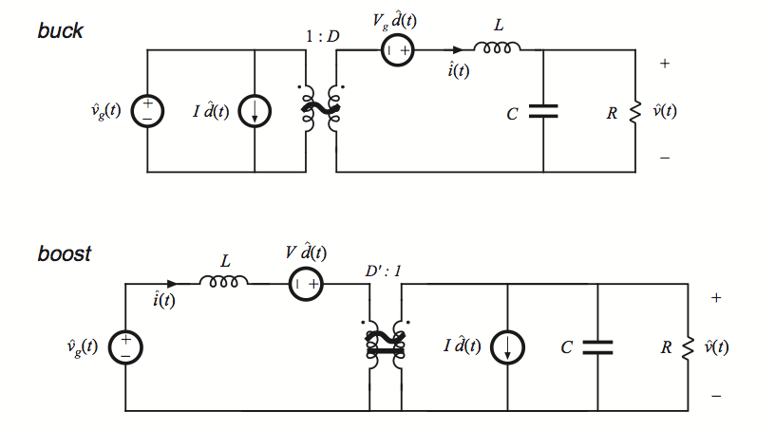
Complete equivalent Circuit models

Slide 16
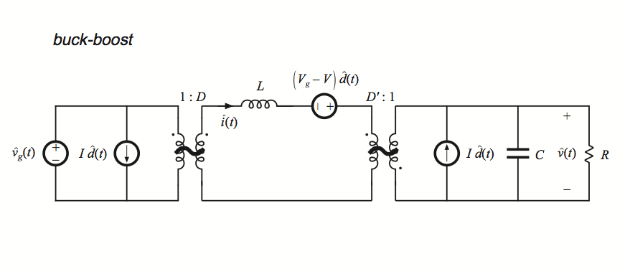
Complete equivalent Circuit models

Slide 17
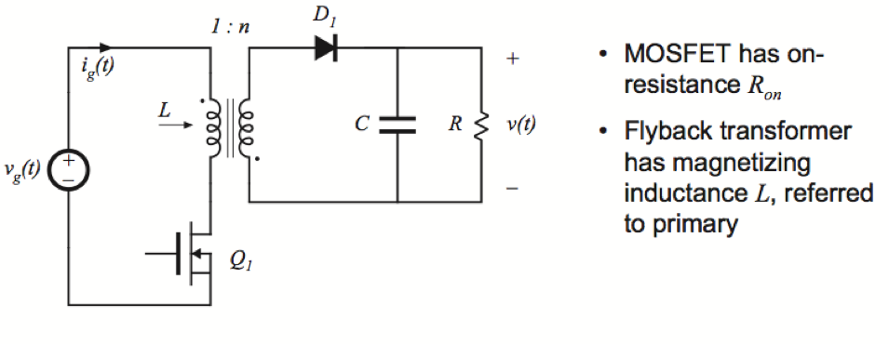
Example of Flyback Converter

Slide 18
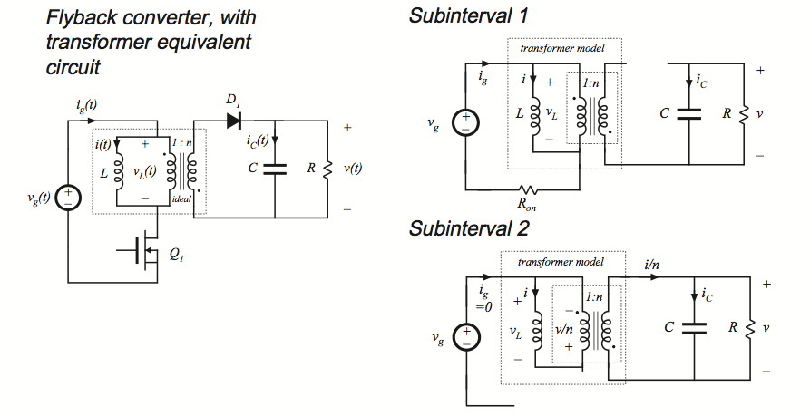
Example of Flyback Converter

Slide 21
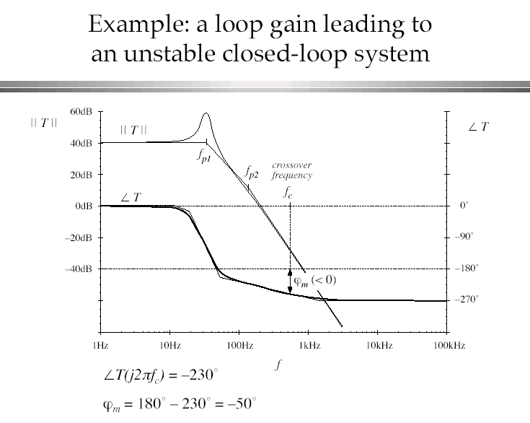

Slide 24
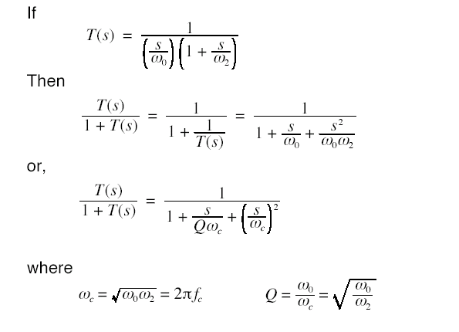

Slide 25
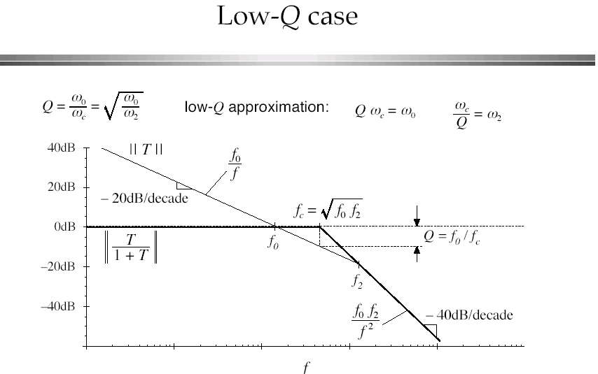

Slide 26
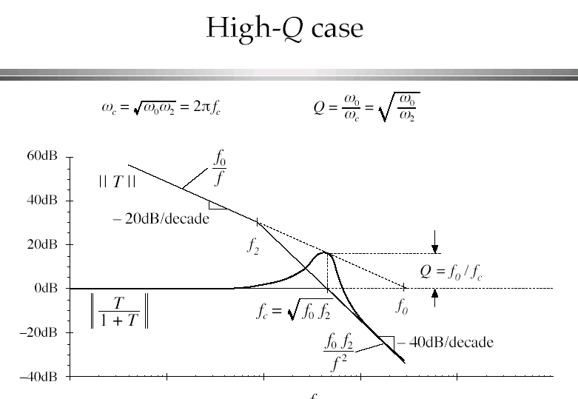

Slide 27
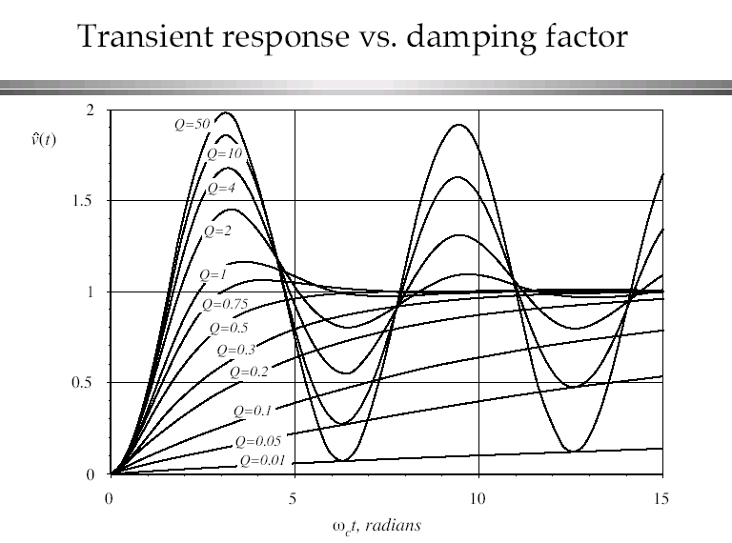

Slide 28
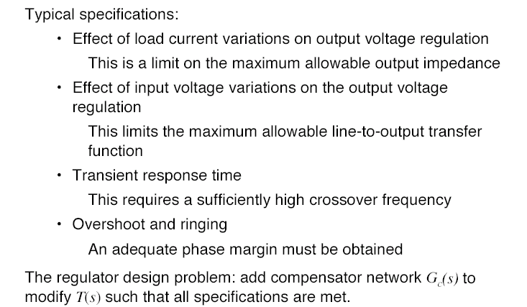

Slide 29
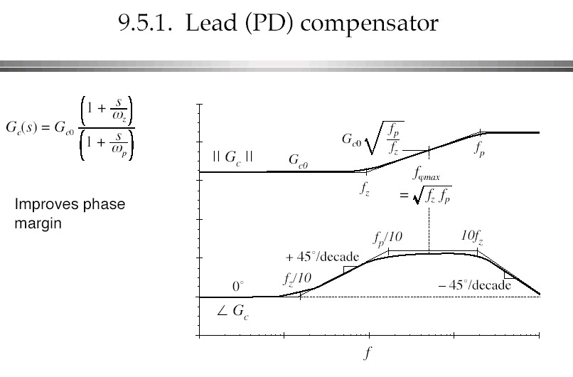

Slide 30
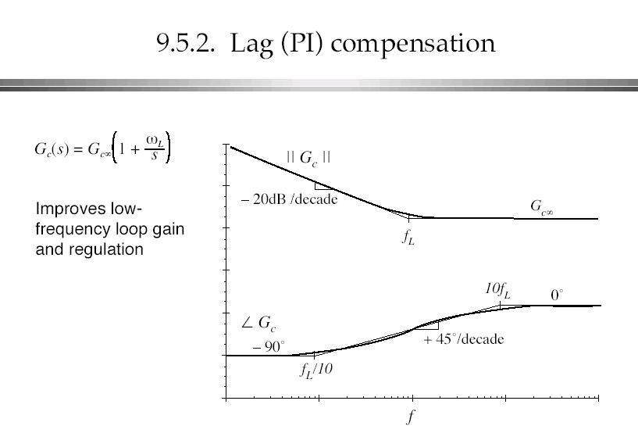

Slide 31
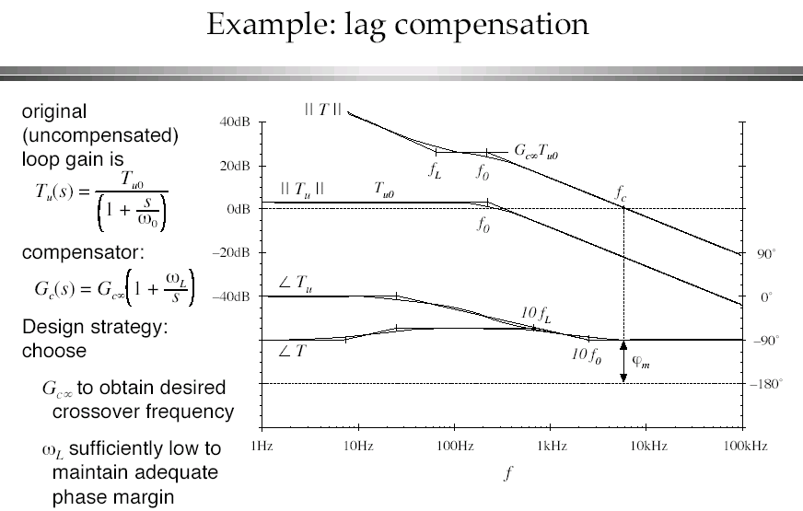

Slide 32
