Slide 1

Closing the Loop
Lecture 21
EEL 646 POWER ELECTRONICS II

Slide 2
Agenda
Introduce the loop transmission – Loop Gain
Derivation of loop Gain Transfer Functions

Slide 3
Closing the Loop for DC-DC Converters
Introduce the loop transmission – Loop Gain
Derivation of loop Gain Transfer Functions
EEL 646 POWER ELECTRONICS II
Agenda

Slide 4
Closing the Loop
Typically, regulating the output voltage to the desired value can use one or two units of sensing (Voltage or/and Current)
Current-mode control
Voltage-mode control

Slide 5
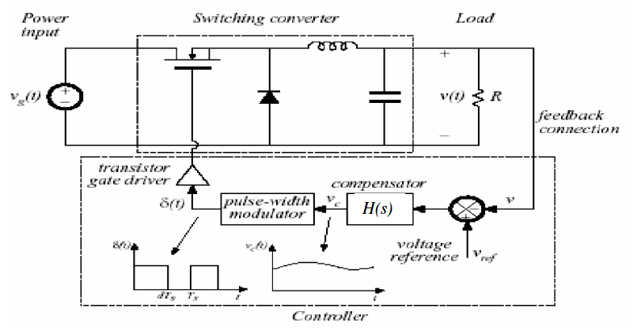
Typical Closed Loop in voltage control DC-Dc Converters

Slide 6
Voltage-mode control

Slide 7
Voltage-mode control
Recall,
The loop contain several gain transfer function:
G_{S}: sampling resistive network
G_{C}: compensator
G_{PWM}: PWM gain
G_{dv}: control to output transfer function
T(s) : Loop Gain

Slide 8
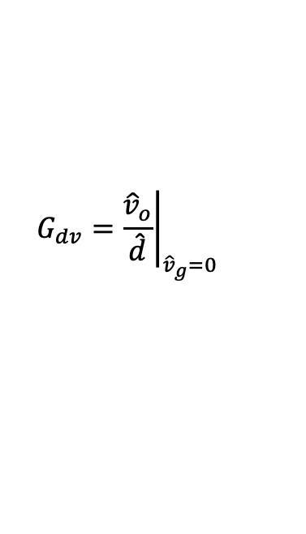
Transfer Functions
Control-to-output transfer function-G_{dv}(s)-
$$G_{dv}={\left.\frac{{\hat{v}}_{o}}{\hat{d}}\right|}_{{\hat{v}}_{g}=0}$$

Slide 9
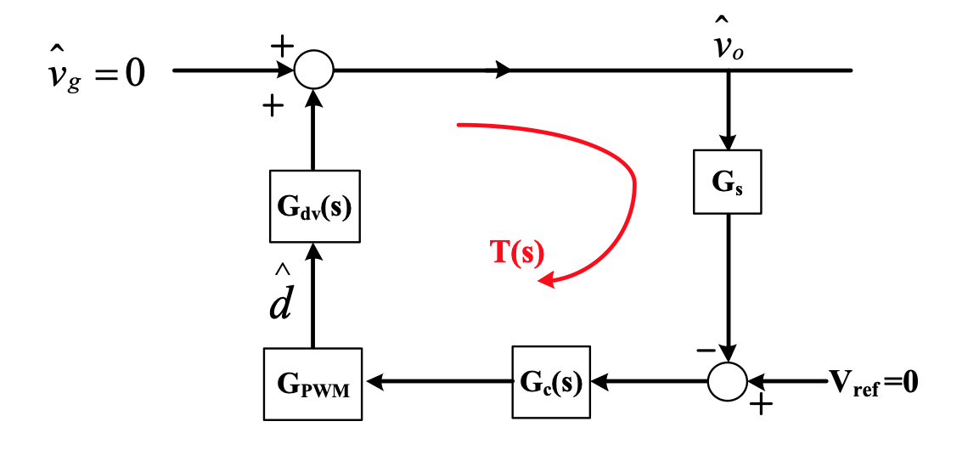
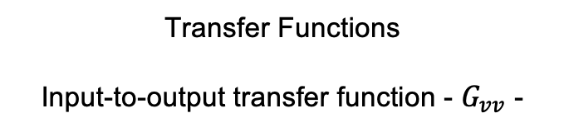
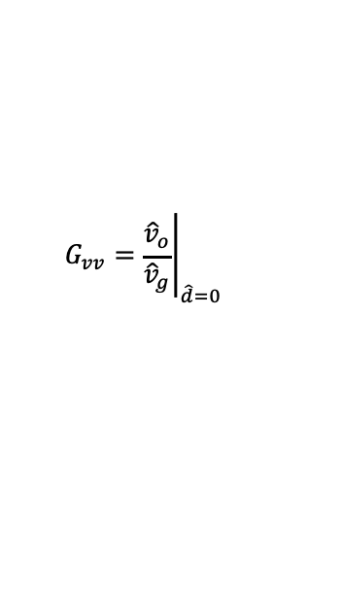


Transfer Functions
Input-to-output transfer function - $G_{vv}$ -
$$=0$$
$$G_{vv}={\left.\frac{{\hat{v}}_{o}}{{\hat{v}}_{g}}\right|}_{\hat{d}=0}$$

Slide 10









The transmission transfer function, T(s):
$T\left(s\right)=G_{s}.G_{c}.G_{PWM}$ $.G_{dv}$
When,
$${\hat{v}}_{o}=G_{vv}{\hat{v}}_{g}+G_{dv}\hat{d}$$
Note:
$$\hat{d}={\hat{v}}_{o}.G_{dv}$$
$${\hat{v}}_{g}=0$$
$$\hat{d}=−{\hat{v}}_{o}.G_{s}.G_{c}.G_{PWM}$$
$$\hat{d}=−{\hat{v}}_{o}G_{s}.G_{c}.G_{PWM}.G_{dv}\frac{1}{G_{dv}}$$
$$T\left(s\right)$$
$$\frac{{\hat{v}}_{o}}{\hat{d}}=\frac{G_{dv}}{T\left(s\right) }$$
Disturbances are reduced by T(s)+1≈ T(s)
Similarly,
$$\frac{{\hat{v}}_{o}}{{\hat{v}}_{g}}=\frac{G_{vv}}{1+T\left(s\right) }$$

Slide 11
Derivation of the Two Transfer Functions:
Input-to-output Transfer Function G_{vv}(s)
Control-to-output Transfer Function G_{dv}(s)

Slide 12
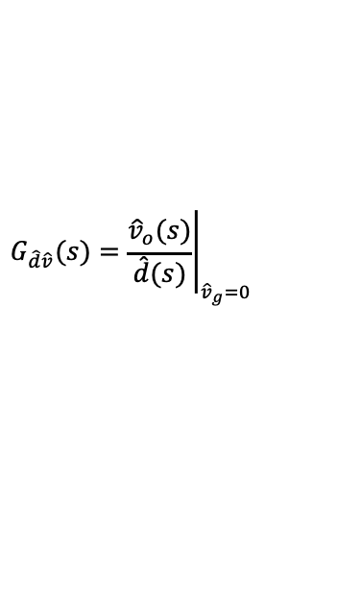
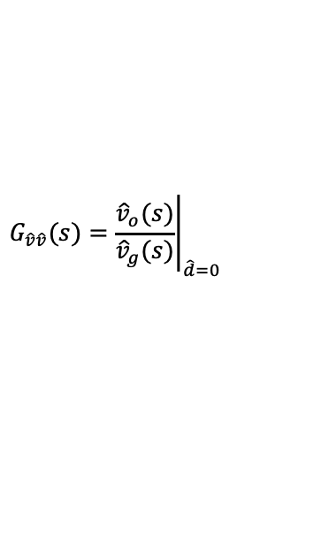
Derivation of the Transfer Functions for DC-DC PWM Converter:
Averaging Small Signal method
$$G_{\hat{v}\hat{v}}(s)={\left.\frac{{\hat{v}}_{o}(s)}{{\hat{v}}_{g}(s)}\right|}_{\hat{d}=0}$$
Input voltage to output voltage transfer function
$$G_{\hat{d}\hat{v}}(s)={\left.\frac{{\hat{v}}_{o}(s)}{\hat{d}(s)}\right|}_{{\hat{v}}_{g}=0}$$
Control to output voltage transfer function

Slide 13
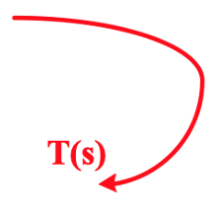
Large signal (ac + dc)

Slide 14
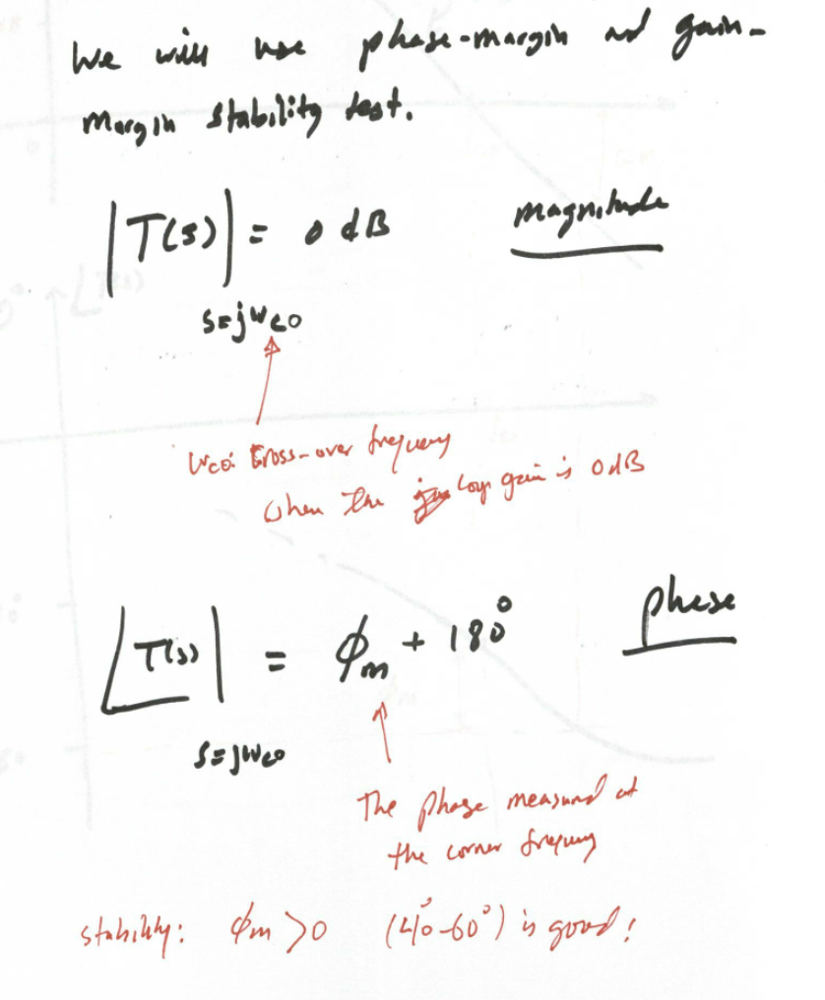
Stability of Typical closed loop system

Slide 15
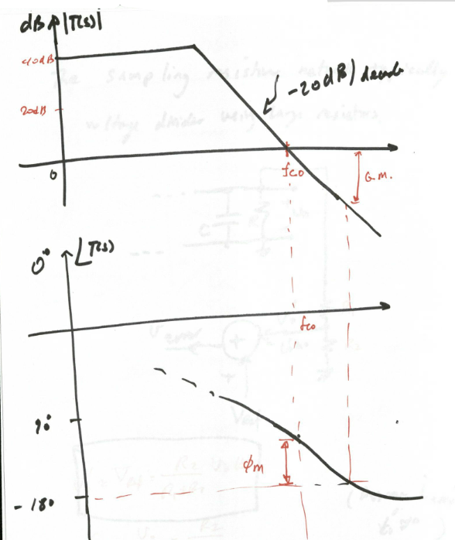
Body Plots – magnitude and phase of T(s)

Slide 16
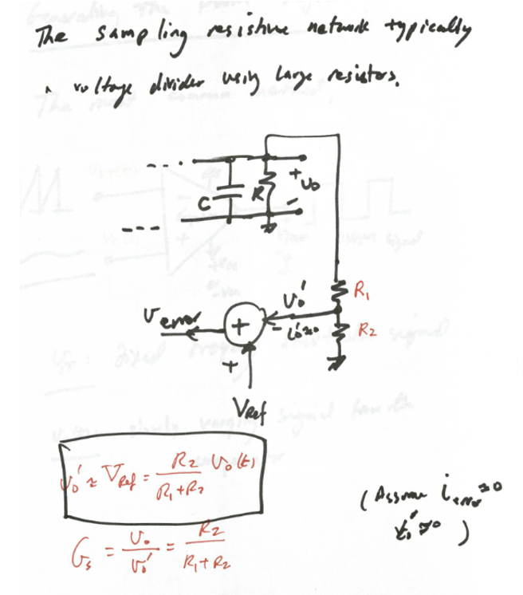
Sampling voltage gain - G_{s}

Slide 17
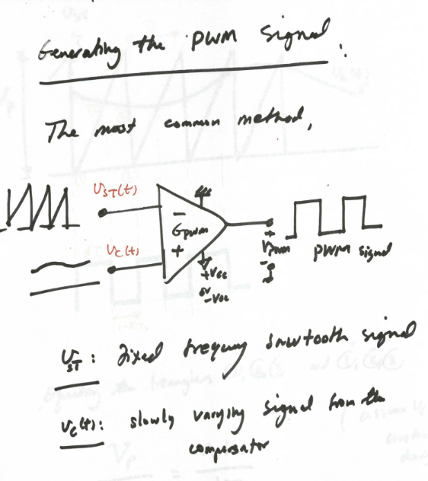
PWM gain - G_{PWM}

Slide 18
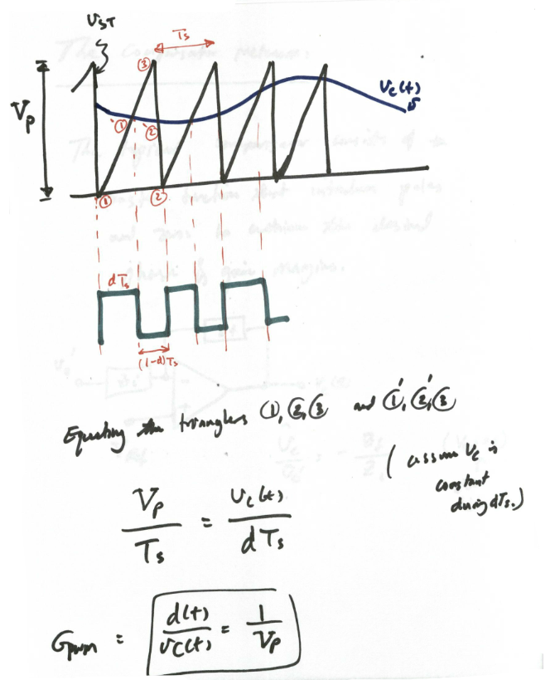

Slide 19
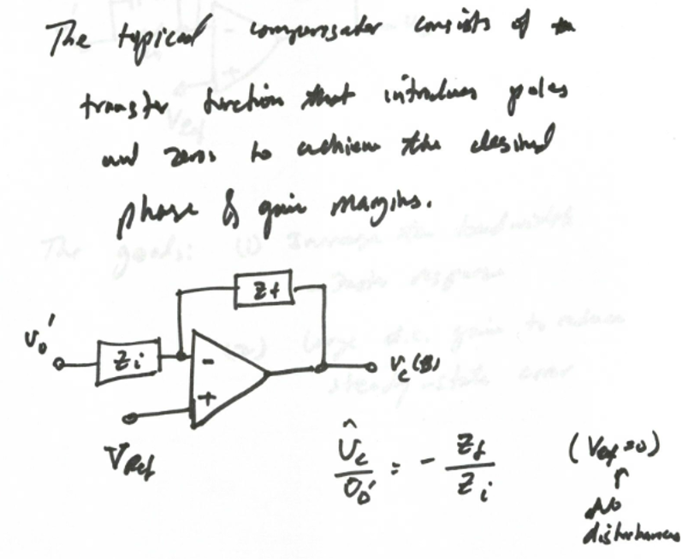
Compensator voltage gain – G_{C}(s)

Slide 20
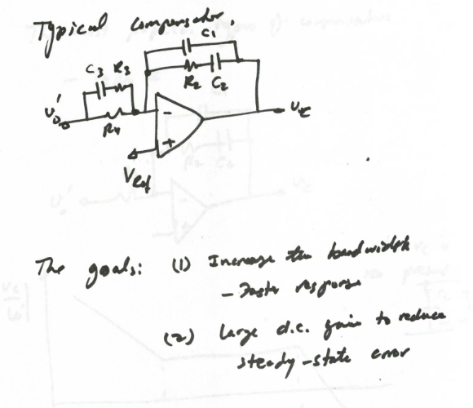

Slide 21
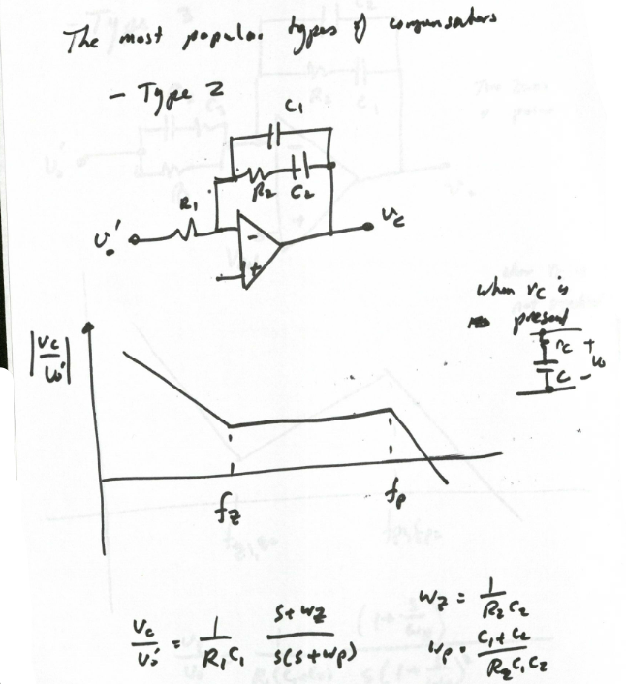

Slide 22
