Slide 1
EEL 646 POWER ELECTRONICS II Issa Batarseh
Lecture 2

Slide 2
Agenda
The Soft-Switching Concepts
Resonant vs. None Resonant
Classification of Soft-Switching
Zero Current Switching Topologies

Slide 3
Chapter 6 Soft-Switching dc-dc Converters Outlines
Classification of soft-switching resonant converters
Advantages and disadvantages of ZCS and ZVS
Zero-current switching topologies
The resonant switch
Steady-state analyses of Quasi-resonant converters
Zero-voltage switching topologies
Resonant switch arrangements
Steady-state analyses of Quasi-resonant converters
Generalized analysis
The generalized switching cell
Basic Operation of the ZCS and ZVS QRC cells
Zero-Voltage and Zero-Current transition converters
The Boost ZVT PWM Converter

Slide 4
Types of dc-dc Converters
The linear power supplies
Advantages: Simplicity in design, no electrical noise in its output, fast dynamic response time, and low cost.
Disadvantages: it can only be used as a step down regulator, Each regulator is limited to only one output, and Low efficiency when compared to other switching regulators
High frequency pulse width modulation (PWM) switching regulator
Advantages: Higher efficiency, Power transistors operate at their most efficient points, Multi-output applications are possible, Size and the cost are much lower.
Limitations: Greater circuit complexity compared to the linear power supplies, High Electromagnetic Interference (EMI).

Slide 5
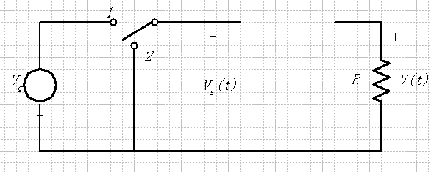
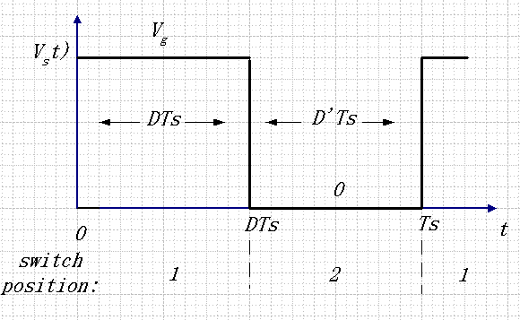
Pulse Width Modulation (PWM) Switching Duty Ratio Controlled Switch
Duty Cycle D:
0 < D < 1
Complement D’ :
0 < D’ < 1

Slide 6
DC Component

Slide 7
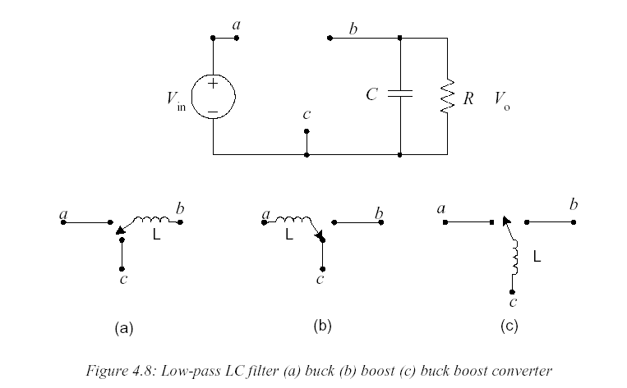
Derivation of Classic Converter Topologies (2nd Order)

Slide 8
Classic Converter Topologies

Slide 9
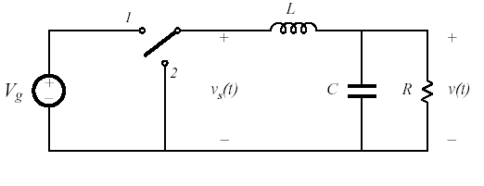
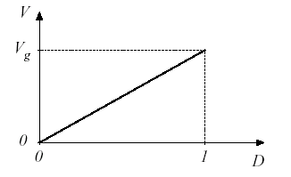
Step Down Converter-Buck
Low Pass extracts DC
Position 2 allows for current “freewheeling”
Vo can be controlled by adjusting D (Switching Period/Frequency Fixed), Vo/Vin = D
Ideally, is no switch/filter loss, η=100%
We assume an ideal switch here

Slide 10
Types of dc-dc Converters
Non-Resonant Converters are the Pulse Width Modulation (PWM) known as Conventional Converters
Resonant converters are used to convert dc-to-dc through a resonant network.
Advantages:
natural commutation of power switches
low switching power dissipation
reduced component stresses, which in turn results in an increased power efficiency and an increased switching frequency
higher operating frequencies result in reduced size and weight of equipment and results in faster responses; hence, a possible reduction in EMI problems

Slide 11
Resonant vs. Conventional PWM
In PWM converters, the switching of semiconductor devices normally occurs at high current levels.
When switching at high frequencies these converters are associated with high power dissipation in their switching devices. (Known as Hard Switching)
The PWM converters suffer from EMI caused by high frequency harmonic components associated with their quasi-square switching current and/or voltage waveforms.

Slide 12
Resonant vs. Conventional PWM
In the resonant techniques, the switching losses in the semiconductor devices are avoided due to the fact that current through or voltage across the switching device at the switching point is equal to or near zero. (Known as Soft Switching)
Compared to the PWM converters, the resonant converters show a promise of achieving the design of small size and weight converters.
Decrease of the harmonic content in the soft-switching converter voltage and current waveforms.

Slide 13
Classification of Resonant Converters
Conventional Full Resonant Converters
Series Resonant Converters (SRC)
Parallel Resonant Converters (PRC)
Soft-Switching PWM Converters
Zero-current switching (ZCS)
Zero-voltage switching (ZVS)

Slide 14
Classification of soft-Switching Resonant Converters
Quasi-resonant converters (single-ended)
Zero-current switching (ZCS)
Zero-voltage switching (ZVS)
Quasi-squarewave (QSW) converters
Zero-current switching (ZCS)
Zero-voltage switching (ZVS)
Zero Transition Topologies
Zero-voltage transition (ZVT)
Zero- current transition (ZCT)

Slide 15
Advantages and Disadvantages of ZCS and ZVS
Power switch is turned ON and OFF at Zero-Voltage and Zero-Current
In ZCS topologies, the rectifying diode has ZVS
In ZVS topologies, the rectifying diode has ZCS
In isolated topologies, both the ZVS and the ZCS utilize transformer leakage inductances and diode junction capacitors and the output parasitic capacitor of the power switch.
Some ZVS and ZCS techniques requires variable-frequency control to regulate the output, which is a disadvantage.
In ZCS, the power switch turns-OFF at zero current but at turn-ON, the converter still suffers from turn-ON loss caused by the output capacitor of the power switch.

Slide 16
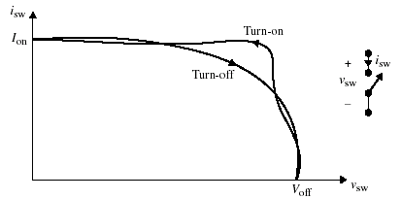
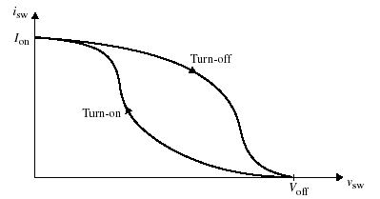
Switching Locus
Typical switching loci for a hard-switching converter without and with a snubber circuit as shown in Fig. 6.2.
Fig 6.2 Switching loci. (a) Without snubber circuit. (b) With snubber circuit.
(a)
(b)
Snubber is a circuit that is used used to suppress ("snub") voltage transients and smoothes switching waveforms

Slide 17
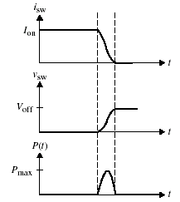
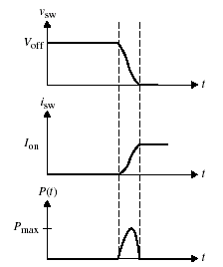
Switching Losses
(a)
(b)
Typical switching current, voltage, and power loss waveforms at (a) turn-off and (b) turn-on.

Slide 18
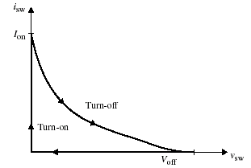
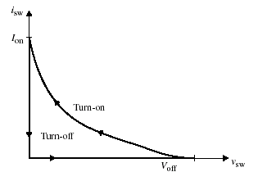
Soft Switching Locus
(a)
(b)
(a) ZVS at turn-on. (b) ZCS at turn-off.

Slide 19
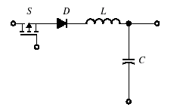
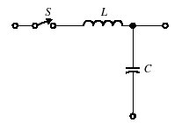
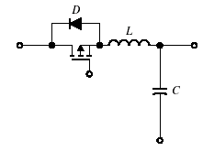
Zero-Current Switching (ZCS) Topologies - The Resonant Switch Concept -
Depending on the inductor-capacitor arrangements (LC tank forms the resonant tank), there are two possible types of resonant switch arrangements:
The L-type
The M-type
And each can be implemented as a half-wave or a full-wave, i.e. unidirectional or bi-directional
L-type switch-Half-wave
L-type switch-full-wave

Slide 20
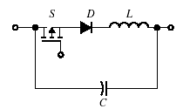
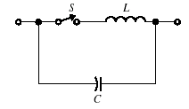
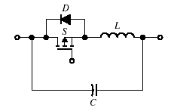
Zero-Voltage Switching (ZVS) Topologies - The Resonant Switch Concept -
Depending on the inductor-capacitor arrangements (LC tank forms the resonant tank), there are two possible types of resonant switch arrangements:
The L-type
The M-type
And each can be implemented as a half-wave or a full-wave, i.e. unidirectional or bi-directional
M-type switch-Half-wave
M-type switch-full-wave

Slide 21
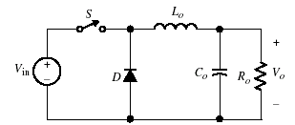
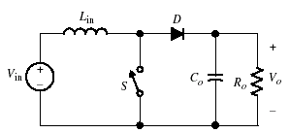
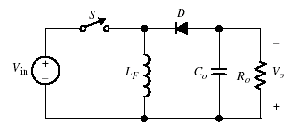
Steady-State Analysis of Quasi-Resonant Converters
To simplify the steady-state analysis
The filtering components L_{o}, L_{in}, L_{F} and C_{o} are large when compared to the resonant components L and C
The output filter L_{o} - C_{o} - R is treated as a constant current source I_{o}
The output filter C_{o} - R is treated as a constant voltage source V_{o}
Switching devices and diodes are ideal
(a)
(b)
(c)
Conventional converters: (a) buck, (b) boost, and (c) buck-boost

Slide 22
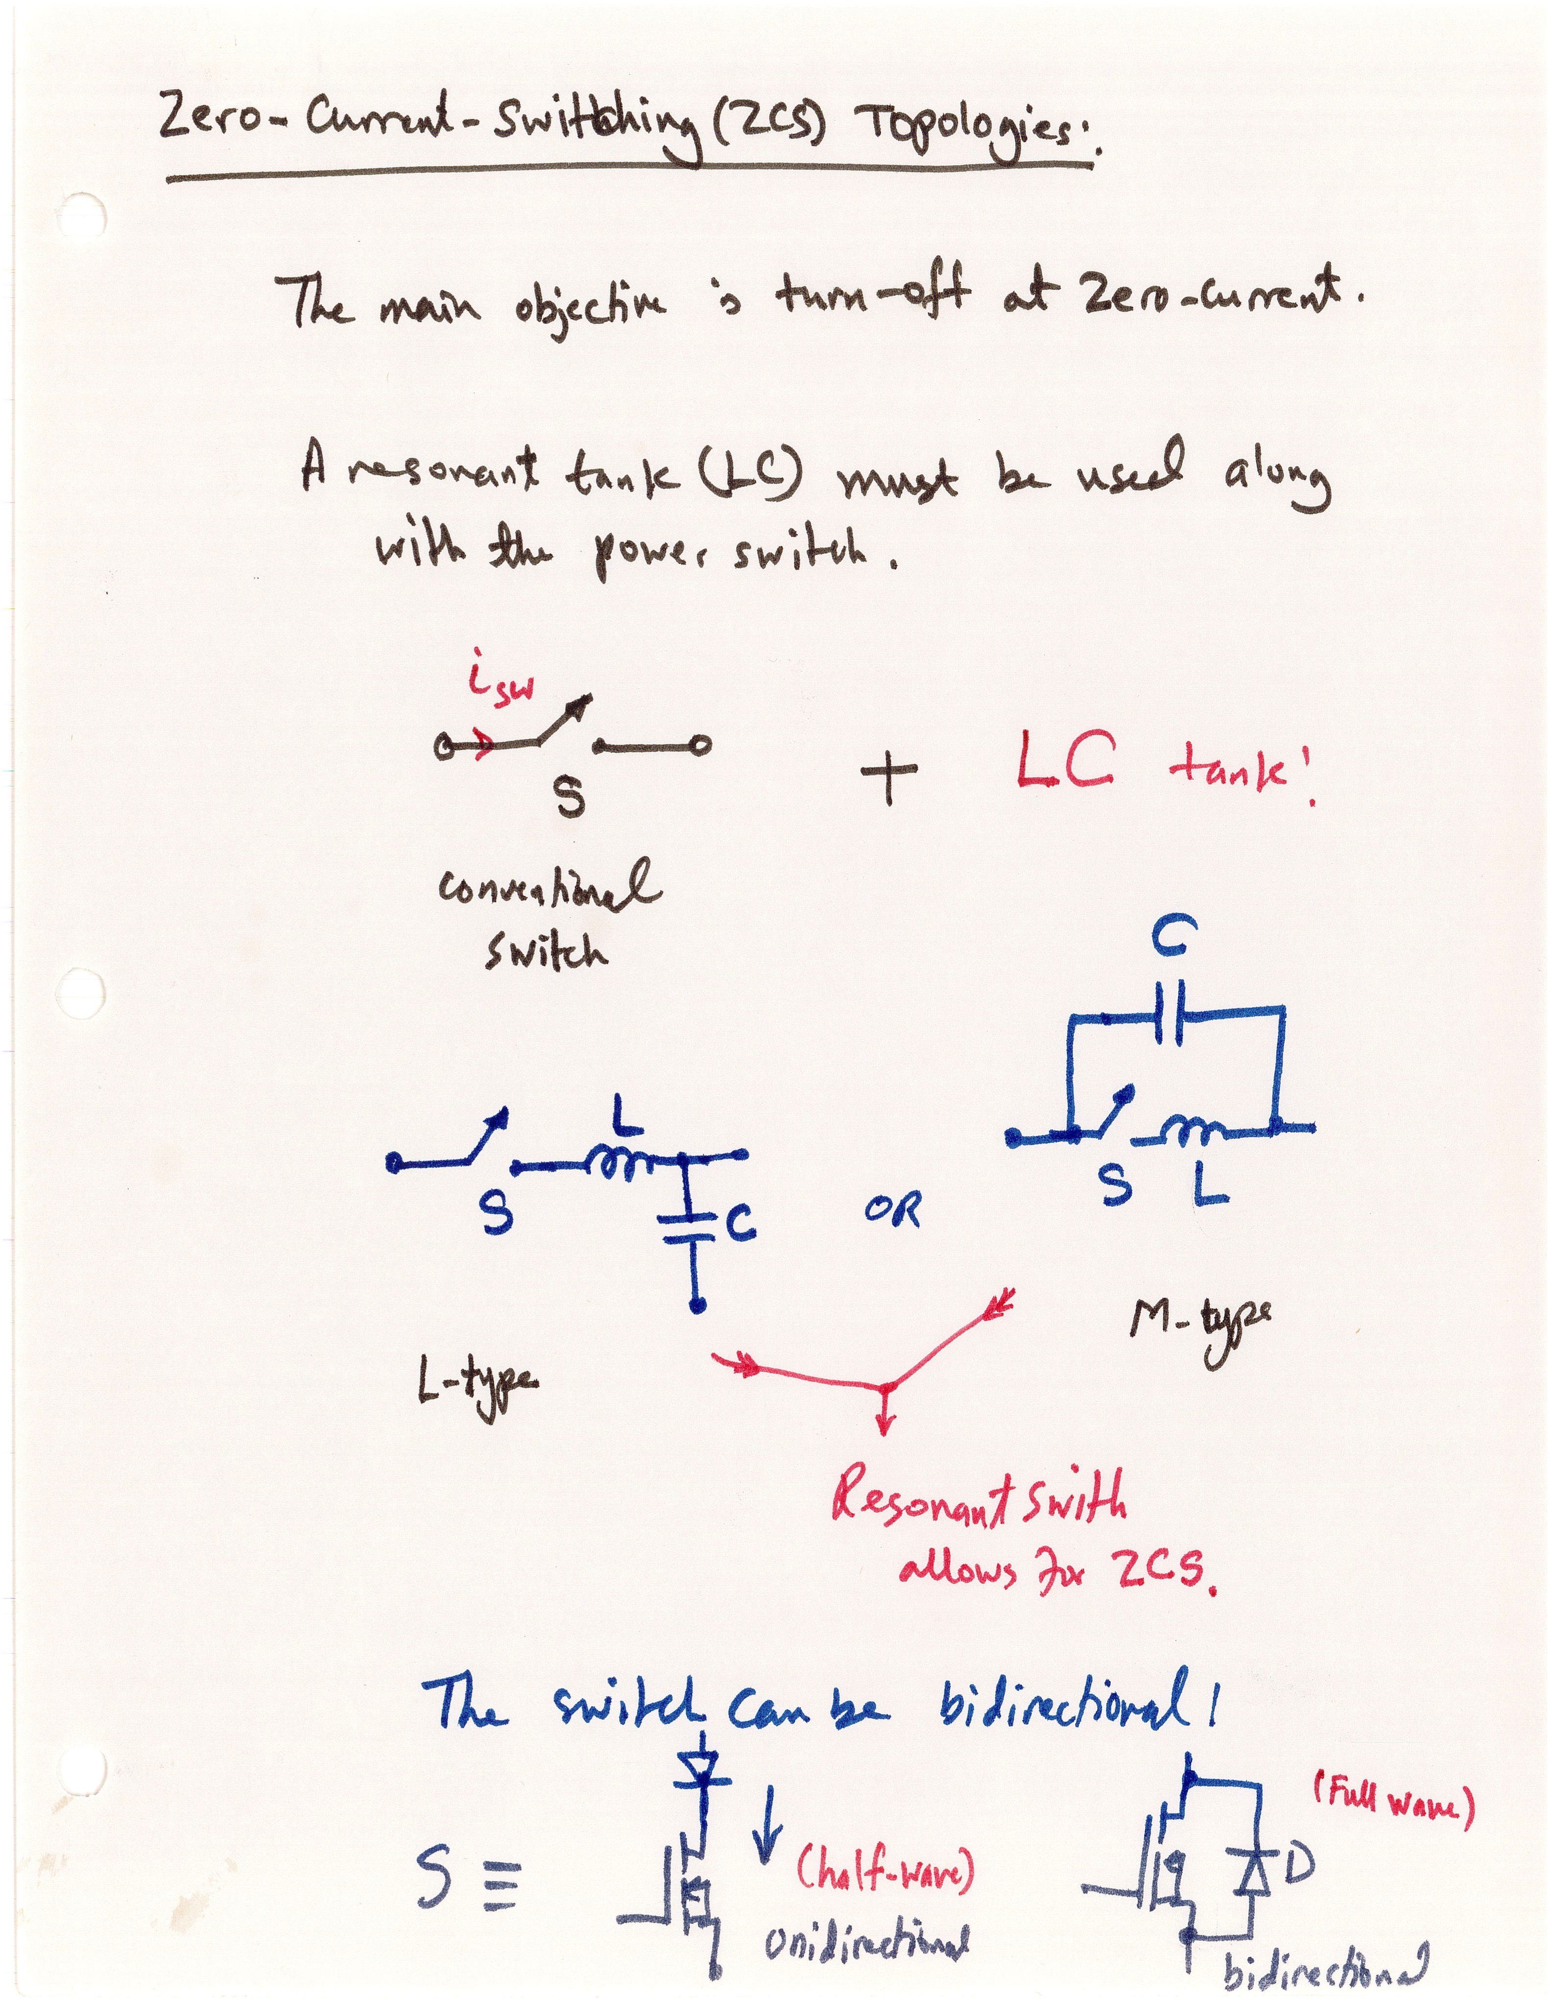

Slide 23
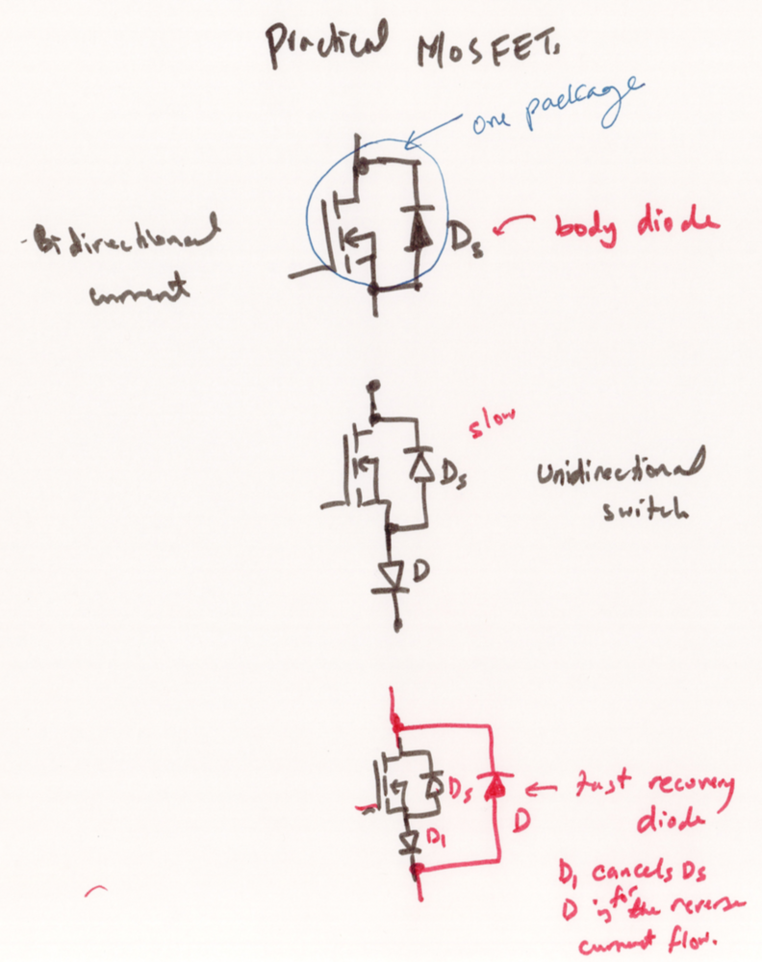

Slide 24
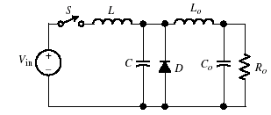
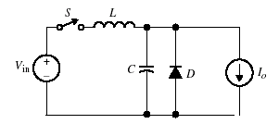
The Buck Resonant Converter - Assumptions
Replacing the switch by the resonant-type switch, to obtain a quasi-resonant PWM buck converter
Large output Inductor, Lo – Ideal output current source
Ideal switches and diodes
It can be shown that there are four modes of operation under the steady-state condition
Fig 6.8 (a) Conventional buck converter with L-type resonant switch. (b) Simplified equivalent circuit.
(a)
(b)

