Slide 1
EEL 646 POWER ELECTRONICS II Examples - Averaged Circuit and Small Signal Transfer Functions.
Lecture 19

Slide 2
Agenda
Boost Converter
Second order converter

Slide 3
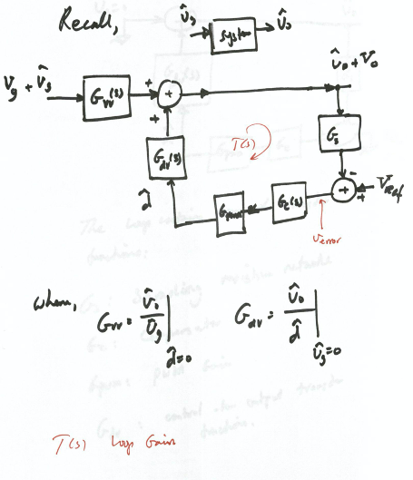
Recall
Voltage-Mode Control
dc-dc Converter

Slide 4
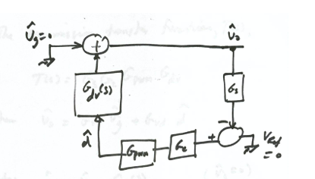
Transfer Functions
Control-to-output transfer function

Slide 5
Transfer Functions
Input-to-output transfer function

Slide 16
Highly non-linear

Slide 17
Assume 1st order
approximation
Linear

Slide 25
EXAMPLE

Slide 30
Check the Voltage Gain through the volt-second balance concept

