Slide 1

Averaged Circuit and Small Signal Transfer Functions
Lecture 18
EEL 646 POWER ELECTRONICS II

Slide 2
Closing the Loop for DC-DC Converters
EEL 646 POWER ELECTRONICS II
Small Signal Approximation
Closed-loop transfer functions
Introducing The Averaged Circuit Model
Agenda

Slide 3
Closing the Loop
Typically, regulating the output voltage to the desired value can use one or two units of sensing (Voltage or/and Current)
Current-mode control
Voltage-mode control

Slide 4
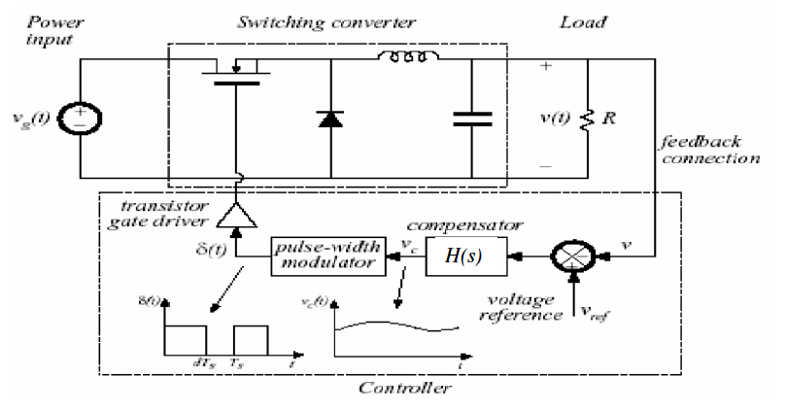
Typical Closed Loop in DC-Dc Converters

Slide 5




Voltage-mode control
$$v_{g}(t)$$
$$v_{o}(t)$$
$$v_{o}(t)$$

Slide 6





Voltage-mode control
Recall,
$$v_{g}(t)$$
$$v_{o}(t)$$
The loop contain several gain transfer function:
G_{S}: sampling resistive network
G_{C}: compensator
G_{PWM}: PWM gain
G_{dv}: control to output transfer function
$$v_{g}(t)$$
$$v_{o}(t)$$
$$d(t)$$
T(s) : Loop Gain

Slide 7





Voltage-mode control
The system response to DC+AC variation,
$$v_{g}(t)={\hat{v}}_{g}(t)+V_{g}$$
$$v_{o}(t)={\hat{v}}_{o}(t)+V_{o}$$
$$d\left(t\right)=\hat{d}(t)+D$$
Large Signal System (both DC and AC signals included

Slide 8





Full Block Diagram with total AC+DC signals
$$v_{g}(t)={\hat{v}}_{g}(t)+V_{g}$$
$$v_{o}(t)={\hat{v}}_{o}(t)+V_{o}$$
$$d\left(t\right)=\hat{d}(t)+D$$

Slide 9
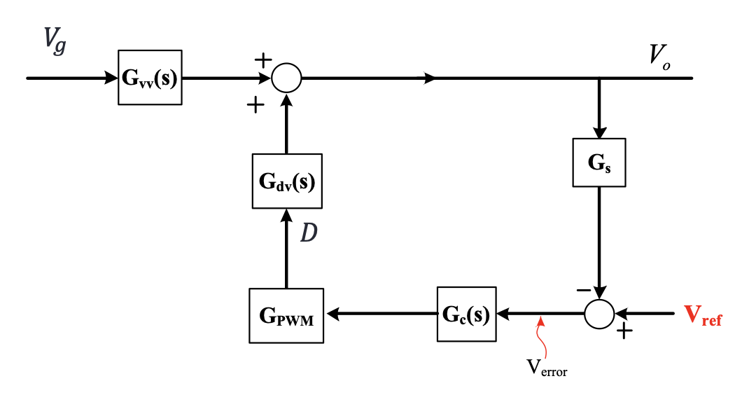




DC-Block Diagram
$$D$$

Slide 10






AC-Block Diagram
$${\hat{v}}_{g}(t)$$
$${\hat{v}}_{o}(t)$$
$$\hat{d}(t)$$
$$D$$

Slide 11



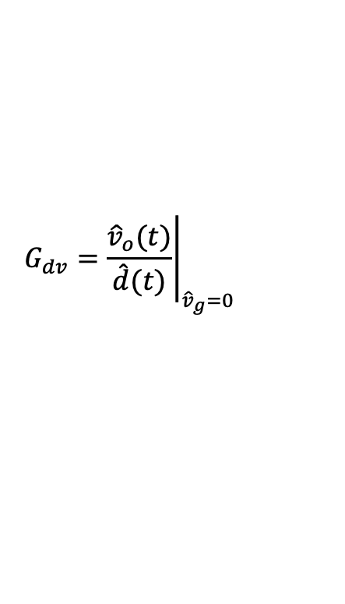


Transfer Functions
Control-to-output transfer function-G_{dv}(s)-
To obtain $G_{dv}$, we set ${\hat{v}}_{g}(t)=0$ in the block diagram as follows,
$$G_{dv}={\left.\frac{{\hat{v}}_{o}(t)}{\hat{d}(t)}\right|}_{{\hat{v}}_{g}=0}$$
$${\hat{v}}_{o}(t)$$
$${\hat{v}}_{g}\left(t\right)=0$$

Slide 12





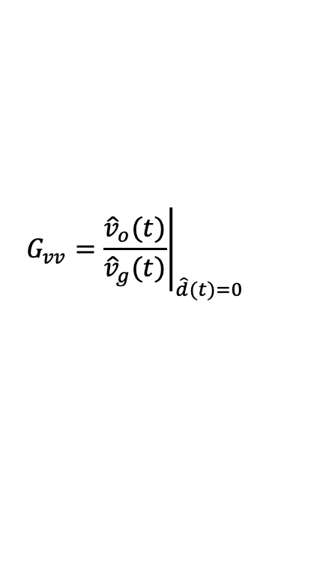
Transfer Functions
Control-to-output transfer function-G_{dv}(s)-
To obtain $G_{vv}$, we set $\hat{d}(t)=0$in the block diagram as follows,
$$G_{vv}={\left.\frac{{\hat{v}}_{o}(t)}{{\hat{v}}_{g}(t)}\right|}_{\hat{d}(t)=0}$$
$${\hat{v}}_{g}\left(t\right)$$
$${\hat{v}}_{o}(t)$$
$$\hat{d}(t)=0$$

Slide 13
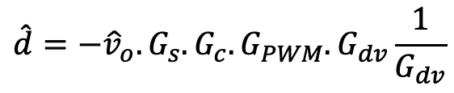


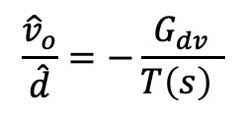
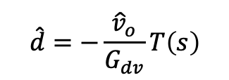


The transmission transfer function, T(s)
From the AC block diagram, $T\left(s\right)$ and ${\hat{v}}_{o}$ is given by,
$T\left(s\right)=G_{s}.G_{c}.G_{PWM}$ $.G_{dv}$
$${\hat{v}}_{o}=G_{vv}{\hat{v}}_{g}+G_{dv}\hat{d}$$
Also, notice from the block diagram,
$$\hat{d}=−{\hat{v}}_{o}.G_{s}.G_{c}.G_{PWM}$$
$$\hat{d}=−{\hat{v}}_{o}.G_{s}.G_{c}.G_{PWM}.G_{dv}\frac{1}{G_{dv}}$$
$$T\left(s\right)$$
$$\hat{d}=−\frac{{\hat{v}}_{o}}{G_{dv}}T\left(s\right)$$
Hence, the control-to-output can also be presented in terms of In terms of $T\left(s\right)$ as follows,
$$\frac{{\hat{v}}_{o}}{\hat{d}}=−\frac{G_{dv}}{T\left(s\right) }$$

Slide 14
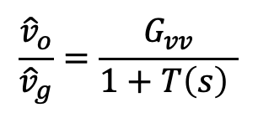
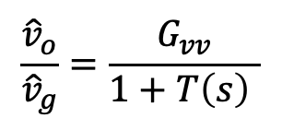
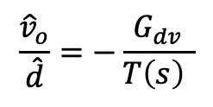
The transmission transfer function, T(s)
Similarly, we can express the output-to-input transfuser function as follows,.
$$\frac{{\hat{v}}_{o}}{{\hat{v}}_{g}}=\frac{G_{vv}}{1+T\left(s\right) }$$
Therefor, the disturbances (variation) at the input $v_{g}(t)$ and control $d(t)$ signals is reduced by the amount of $T\left(s\right)+1$
$$\frac{{\hat{v}}_{o}}{\hat{d}}=−\frac{G_{dv}}{T\left(s\right) }$$
Disturbances are reduced by T(s)+1≈ T(s)
$$\frac{{\hat{v}}_{o}}{{\hat{v}}_{g}}=\frac{G_{vv}}{1+T\left(s\right) }$$

Slide 15
Derivation of the Two Transfer Functions:
Input-to-output Transfer Function G_{vv}(s)
Control-to-output Transfer Function G_{dv}(s)

Slide 16
Derivation of the Transfer Functions for DC-DC PWM Converter:
1.
Original switching network
All v & i variables are instantaneous and time invariant

Slide 17
2.
Derive the averaged circuit model
Non-linear with small ripple value compound to average value (model of circuit component)

Slide 18


Derive the small-signal and large signal model (perturbation)
3.
Each average value has ac+dc combination – non-linear large signal model
$$\overline{i}=\hat{i}+I$$
$$\overline{v}=\hat{v}+V$$
non-linear large signal model
ac
dc

Slide 19








$$\overline{d}(t)$$
$$\overline{d}(t)=\hat{d}(t)+D$$
Varying duty-cycle at frequency smaller than fs
Fixed duty-cycle
$$\overline{v_{g}}(t)$$
$$\overline{v_{g}}(t)={\hat{v}}_{g}(t)+V_{G}$$
Small signal input voltage varying at frequency smaller than fs
Fixed input voltage
$$\overline{v_{o}}(t)$$
$$\overline{v_{o}}(t)={\hat{v}}_{o}(t)+V_{o}$$
Varying output voltage at frequency smaller than fs
Fixed output voltage
$$\overline{i_{o}}(t)$$
$$\overline{i_{o}}(t)={\hat{i}}_{o}(t)+I_{o}$$
Varying load current at frequency smaller than fs
Fixed load current

Slide 20



4.
Linearize the large signal model by assuming high order ac signals are zero
6.
Draw the equivalent circuit model for dc circuit. determine the dc operating value
$\hat{i}$. $\hat{v}$=0
$\hat{v}$. $\hat{v}$=0
$\hat{i}$. $\hat{i}$=0
Linearize the large signal model contain dc and ac variables
7.
Draw the equivalent circuit model for ac circuit. All signals are ac with controlling parameters ..dc operating point
5.

Slide 21
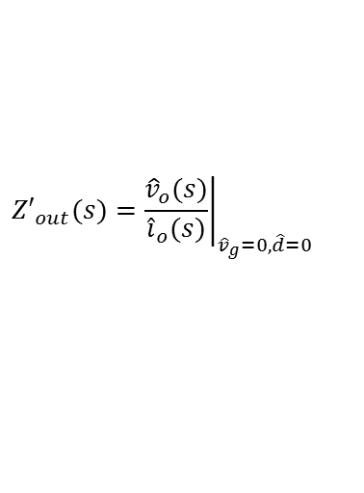

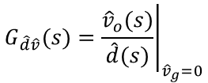

8.
9.
Derive for possible transfer function
$$G_{\hat{v}\hat{v}}(s)={\left.\frac{{\hat{v}}_{o}(s)}{{\hat{v}}_{g}(s)}\right|}_{\hat{d}=0}$$
Input voltage to output voltage transfer function
$$Z_{in}(s)={\left.\frac{{\hat{v}}_{g}(s)}{{\hat{i}}_{g}(s)}\right|}_{\hat{d}=0}$$
Input impedance
$$G_{\hat{d}\hat{v}}(s)={\left.\frac{{\hat{v}}_{o}(s)}{\hat{d}(s)}\right|}_{{\hat{v}}_{g}=0}$$
Control to output voltage transfer function
$${Z′}_{out}(s)={\left.\frac{{\hat{v}}_{o}(s)}{{\hat{i}}_{o}(s)}\right|}_{{\hat{v}}_{g}=0, \hat{d}=0}$$
Output impedance

Slide 22
Averaging methods
1) From the waveform
2) PWM averaged switch
3) State-space
4) Direct method- i-v of D&S

Slide 23
Large signal (ac + dc)

Slide 24
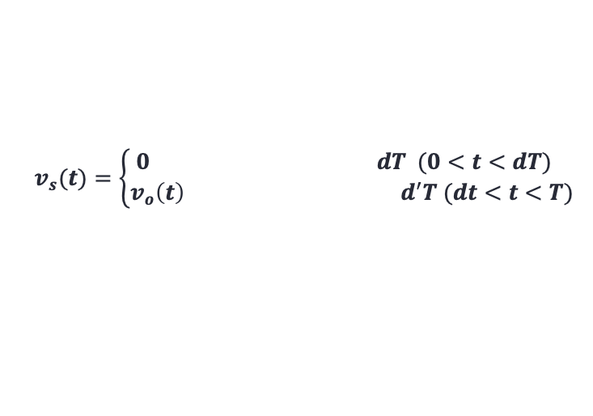
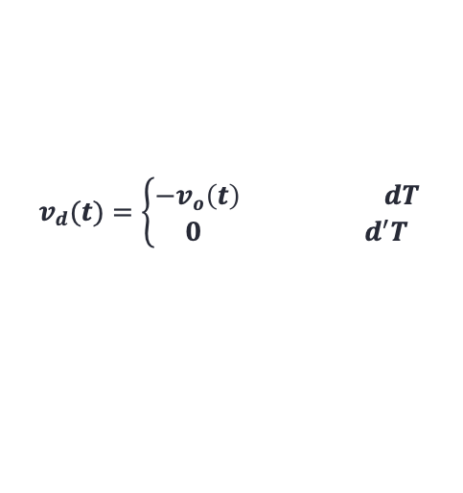
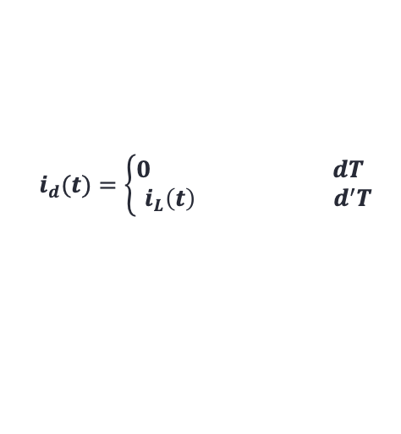
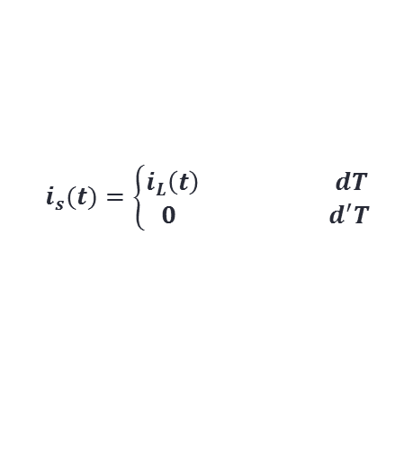

Example: Find the average circuit model for the boost converter
Time-domain circuit of the boost converter
With the Switch turned on and off for dT and (1-d)T periods, respectively,
$$v_{d}(t)=\left\{\begin{aligned}{−v}_{o}\left(t\right) dT \\ 0 d^{′}T\end{aligned}\right.$$
$$v_{s}(t)=\left\{\begin{aligned}0 dT (0<t<dT) \\ v_{o}\left(t\right) d^{′}T (dt<t<T)\end{aligned}\right.$$
$$i_{s}(t)=\left\{\begin{aligned}i_{L}\left(t\right) dT \\ 0 d^{′}T\end{aligned}\right.$$
$$i_{d}(t)=\left\{\begin{aligned}0 dT \\ i_{L}\left(t\right) d^{′}T\end{aligned}\right.$$
$$where d^{′}=\left(1−d\right)$$

Slide 25








Let us average i_{d}, v_{d}, i_{s}, v_{s}
$${\overline{v}}_{s}=d′{\overline{v}}_{o}$$
$${\overline{v}}_{d}=−d{\overline{v}}_{o}$$
$${\overline{i}}_{s}=d{\overline{i}}_{L}$$
$${\overline{i}}_{d}=d′{\overline{i}}_{L}$$
Re-arrange the equations,
$${\overline{v}}_{s}=\frac{−d′}{d}{\overline{v}}_{d}$$
$${\overline{v}}_{d}=\frac{−d}{d′}{\overline{v}}_{s}$$
or
$${\overline{i}}_{s}=\frac{d}{d′}{\overline{i}}_{d}$$
$${\overline{i}}_{d}=\frac{d′}{d}{\overline{i}}_{s}$$
or
Representing the switch and diode i-v equations as controlled sources as a function of d,
S
D

Slide 26


The equivalent average circuit for the boost converter is given by
Non-linear average circuit model (large signal averaged model)
Let us use any of combination to represent the switch and diode, here we use diode voltage and switch current as follows,
$${\overline{v}}_{d}=\frac{−d}{d′}{\overline{v}}_{s}$$
$${\overline{i}}_{s}=\frac{d}{d′}{\overline{i}}_{d}$$

Slide 27
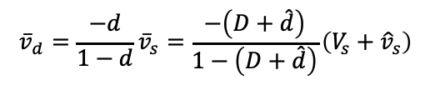

Next step, we apply perturbation of each circuit variable
Representing the controlled variables for the diode voltage,
$${\overline{v}}_{d}=\frac{−d}{1−d}{\overline{v}}_{s}=\frac{−\left(D+\hat{d}\right)}{1−\left(D+\hat{d}\right)}\left(V_{s}+{\hat{v}}_{s}\right)$$
$${\overline{v}}_{d}=−\frac{D+\hat{d}}{\left(1−D\right)−\hat{d}}{\hat{v}}_{s}−\frac{D+\hat{d}}{\left(1−D\right)−\hat{d}}V_{s}$$

Slide 28





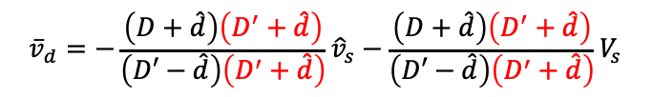
This equation for the average diode voltage is non-linear in terms of $\hat{d}$as illustrated by
$${\overline{v}}_{d}=−\frac{D+\hat{d}}{\left(1−D\right)−\hat{d}}{\hat{v}}_{s}−\frac{D+\hat{d}}{\left(1−D\right)−\hat{d}}V_{s}$$
$${\overline{v}}_{d}=−\frac{D+\hat{d}}{D′−\hat{d}}{\hat{v}}_{s}−\frac{D+\hat{d}}{D′−\hat{d}}V_{s}$$
Where, $D^{′}=1−D$
To eliminate from the denominator, we multiply both denominator and numerator by $\left(D^{′}+\hat{d}\right)$ as follows,
$${\overline{v}}_{d}=−\frac{\left(D+\hat{d}\right)\left(D^{′}+\hat{d}\right)}{\left(D′−\hat{d}\right)\left(D^{′}+\hat{d}\right)}{\hat{v}}_{s}−\frac{\left(D+\hat{d}\right)\left(D^{′}+\hat{d}\right)}{\left(D′−\hat{d}\right)\left(D^{′}+\hat{d}\right)}V_{s}$$
$${\overline{v}}_{d}=\frac{−DD^{′}−D\hat{d}−\hat{d}D^{′}−\hat{d}\hat{d}}{{D′}^{2}−\hat{d}D^{′}+D^{′}\hat{d}−\hat{d}\hat{d}}{\hat{v}}_{s}−\frac{DD^{′}+D\hat{d}+\hat{d}D^{′}+\hat{d}\hat{d}}{{D′}^{2}−\hat{d}D^{′}+D^{′}\hat{d}−\hat{d}\hat{d}}V_{s}$$
$${\overline{v}}_{d}=\frac{−DD^{′}−D\hat{d}−\hat{d}D^{′}−\hat{d}\hat{d}}{{D′}^{2}−\hat{d}\hat{d}}{\hat{v}}_{s}−\frac{DD^{′}+D\hat{d}+\hat{d}D^{′}+\hat{d}\hat{d}}{{D′}^{2}−\hat{d}\hat{d}}V_{s}$$

Slide 29
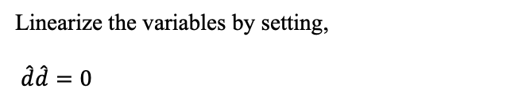





Linearize the variables by setting,
$\hat{d}\hat{d}=0$
${\hat{v}}_{s}\hat{d}$=0
$${\overline{v}}_{d}=\frac{−DD^{′}−}{{D′}^{2}}{\hat{v}}_{s}−\frac{DD^{′}+D\hat{d}+\hat{d}D^{′}}{{D′}^{2}}V_{s}$$
$${\overline{v}}_{d}=\frac{−DD^{′}−}{{D′}^{2}}{\hat{v}}_{s}−\frac{DD^{′}+D\hat{d}+\hat{d}−\hat{d}D}{{D′}^{2}}V_{s}$$
$${\overline{v}}_{d}=\frac{−DD^{′}−}{{D′}^{2}}{\hat{v}}_{s}−\frac{DD^{′}+\hat{d}}{{D′}^{2}}V_{s}$$
$${\overline{v}}_{d}=\frac{−D−}{D^{′}}{\hat{v}}_{s}−\frac{DD^{′}+\hat{d}}{{D^{′}}^{2}}V_{s}=\frac{−D−}{D^{′}}{\hat{v}}_{s}−\frac{D}{D^{′}}V_{s}−\frac{V_{s}}{{D^{′}}^{2}}\hat{d}$$

Slide 30







H$ence, {\overline{v}}_{d}$ is given by
$${\overline{v}}_{d}=\frac{−V_{s}}{{D′}^{2}}\hat{d}−\frac{D}{D^{′}}\left(V_{s}+{\hat{v}}_{s}\right)=\frac{−V_{s}}{{D′}^{2}}\hat{d}−\frac{D}{D^{′}}{\hat{v}}_{s}−\frac{D}{D^{′}}V_{s}$$
(1)
Since the average variable consists of dc+ac terms,
$${\overline{v}}_{d}={\hat{v}}_{d}+V_{D}$$
(2)
Hence, matching Eqs. (1) and (2), we conclude that,
$$V_{D}=−\frac{D}{D^{′}}V_{s}$$
$$d.c.$$
Averaged and Linearized diode equations
$${\hat{v}}_{d}=\frac{−V_{s}}{{D′}^{2}}\hat{d}−\frac{D}{D^{′}}{\hat{v}}_{s}$$
$$a.c.$$

Slide 31





The same,
$${\overline{i}}_{s}={\hat{i}}_{s}+I_{s}=\frac{I_{D}}{{D′}^{2}}\hat{d}+\frac{D}{D^{′}}\left(I_{D}+{\hat{i}}_{d}\right)$$
$$I_{s}=\frac{D}{D^{′}}I_{D}$$
$$d.c.$$
Averaged and Linearized switch equations
$${\hat{i}}_{s}=\frac{I_{D}}{{D′}^{2}}\hat{d}+\frac{D}{D^{′}}{\hat{i}}_{d}$$
$$a.c.$$
Next, we replace these equations for the switch current and diode voltage in equivalent circuit representation.

Slide 32
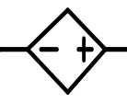




Linearized & Averaged Circuit Model for boost Converter (ac+dc)
$$\frac{D}{D^{′}}V_{s}$$
$$+$$
$$−$$
$${\overline{v}}_{d}$$

Slide 33










The d.c. model
To derive the dc model, we set all the ac signals to zero, i.e.
$${\hat{v}}_{g}=0$$
$${\hat{v}}_{o}=0$$
short
$${\hat{i}}_{L}=0$$
$$\hat{d}=0$$
open
$$I_{D}=I_{o}=\frac{V_{o}}{R}$$
$$V_{D}=\frac{D}{D′}V_{s}=\frac{D}{1−D}V_{g}$$
d.c. operating point
$$I_{s}=\frac{D}{D′}I_{D}=\frac{D}{D′}I_{o}=\frac{D}{1−D}\frac{V_{o}}{R}$$
$$V_{s}=V_{g}$$
$$KVL:−V_{g}−\frac{D}{D^{′}}V_{s}+V_{o}=0$$
$$\frac{V_{o}}{V_{g}}=\frac{1}{1−D}$$

Slide 34


The a.c. model
To derive the ac model, we set all the dc signals to zero, i.e.
$$V_{s}=0$$
$$V_{D}=0$$
To resultant equivalent ac “small-signal” circuit model is shown by,

Slide 35

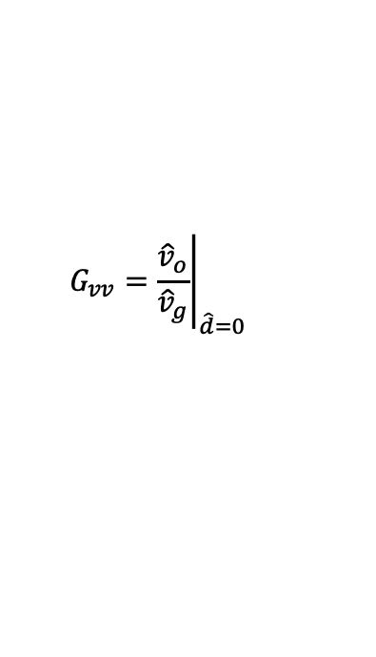

The a.c. model
Next., we find the two transfer function:
The equivalent ac “small-signal” with $\hat{d}=0$,
1) The input-to-output transfer function
$$G_{vv}={\left.\frac{{\hat{v}}_{o}}{{\hat{v}}_{g}}\right|}_{\hat{d}=0}$$
Next, we use circuit analysis to solve for $G_{vv}(s)$

Slide 36


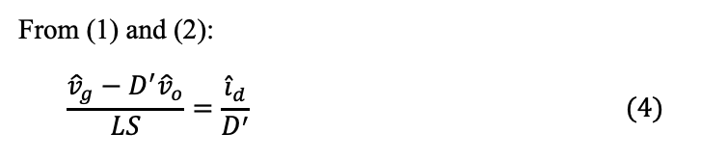




It can be easily derive the ration between ${\hat{v}}_{o}$ and ${\hat{v}}_{g}$
$$KVL: −{\hat{v}}_{s}−\frac{D}{D^{′}}{\hat{v}}_{s}+{\hat{v}}_{o}=0$$
$$→ {\hat{v}}_{s}=D^{′}{\hat{v}}_{o} \left(1\right)$$
$$KCL: \frac{{\hat{v}}_{g}−{\hat{v}}_{s}}{LS}={\hat{i}}_{d}+\frac{D}{D^{′}}{\hat{i}}_{d}=\frac{{\hat{i}}_{d}}{D^{′}} (2)$$
$$KCL:$$
$${\hat{i}}_{d}={\hat{v}}_{o}\left(\frac{1}{R}+CS\right) \left(3\right)$$
Solve $\frac{{\hat{v}}_{o}}{{\hat{v}}_{g}}$ by removing ${\hat{v}}_{s}$
From (1) and (2):
$$\frac{{\hat{v}}_{g}−D^{′}{\hat{v}}_{o}}{LS}=\frac{{\hat{i}}_{d}}{D^{′}} (4)$$

Slide 37
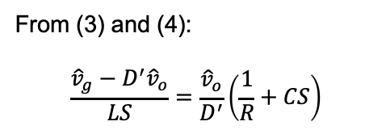
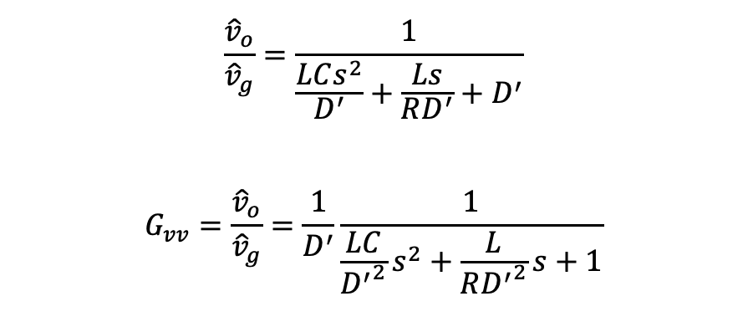
From (3) and (4):
$$\frac{{\hat{v}}_{g}−D^{′}{\hat{v}}_{o}}{LS}=\frac{{\hat{v}}_{o}}{D^{′}}\left(\frac{1}{R}+CS\right)$$
Thus,
$$\frac{{\hat{v}}_{o}}{{\hat{v}}_{g}}=\frac{1}{\frac{LCs^{2}}{D^{′}}+\frac{Ls}{RD^{′}}+D^{′}}$$
$$G_{vv}=\frac{{\hat{v}}_{o}}{{\hat{v}}_{g}}=\frac{1}{D^{′}}\frac{1}{\frac{LC}{{D^{′}}^{2}}s^{2}+\frac{L}{R{D^{′}}^{2}}s+1}$$

Slide 38
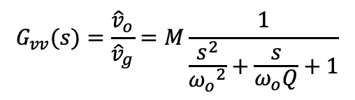







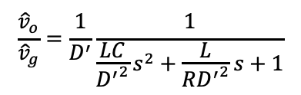
In standard form,
$$\frac{{\hat{v}}_{o}}{{\hat{v}}_{g}}=\frac{1}{D^{′}}\frac{1}{\frac{LC}{{D^{′}}^{2}}s^{2}+\frac{L}{R{D^{′}}^{2}}s+1}$$
$$G_{vv}(s)=\frac{{\hat{v}}_{o}}{{\hat{v}}_{g}}=M\frac{1}{\frac{s^{2}}{{ω_{o}}^{2}}+\frac{s}{ω_{o}Q}+1}$$
_{Where,}
$$M=\frac{1}{1−D}$$
$${ω_{o}}^{2}=\frac{{(1−D)}^{2}}{LC}$$
$$ω_{o}=\frac{(1−D)}{\sqrt{LC}}$$
$$ω_{o}Q=\frac{R{(1−D)}^{2}}{L}$$
$$Z_{o}=\sqrt{L/C}$$
$$Q=\frac{R{(1−D)}^{2}}{ω_{o}L}=\frac{\sqrt{LC}}{RL}\left(1−D\right)=\frac{\sqrt{L/C}}{R}=\frac{Z_{o}}{R}$$
$$Q=\frac{Z_{o}}{R}$$

Slide 39
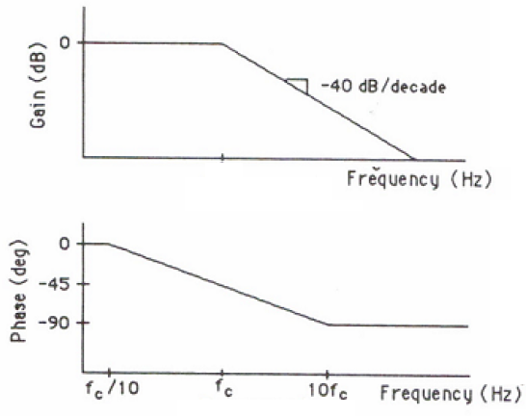



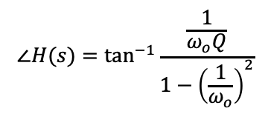
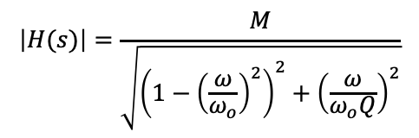


Recall for a given transfer function,
$$\left|H(s)\right|$$
$$H\left(s\right)=\frac{{\hat{v}}_{o}}{{\hat{v}}_{g}}$$
$$M_{dB}$$
The magnitude and phase are given by,
$$\left|H(s)\right|=\frac{M}{\sqrt{{\left(1−{\left(\frac{ω}{ω_{o}}\right)}^{2}\right)}^{2}+{\left(\frac{ω}{ω_{o}Q}\right)}^{2}}}$$
f_{s} f_{o} f_{s}
$$∠H(s)$$
$$∠H(s)=\tan^{−1}{\frac{\frac{1}{ω_{o}Q}}{1−{\left(\frac{1}{ω_{o}}\right)}^{2}}}$$
$$M_{dB}=20 logM$$

Slide 40

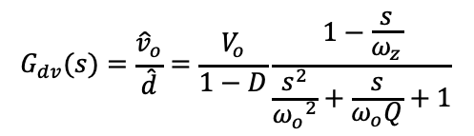
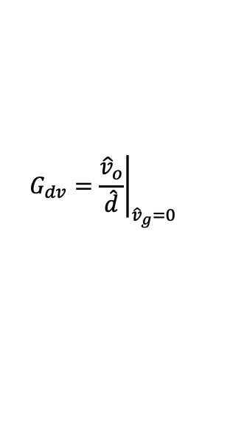



The a.c. model
2) The control to output transfer function:
The equivalent ac “small-signal” with ${\hat{v}}_{g}=0$,
$$G_{dv}={\left.\frac{{\hat{v}}_{o}}{\hat{d}}\right|}_{{\hat{v}}_{g}=0}$$
Similar circuit analysis,
$$G_{dv}(s)=\frac{{\hat{v}}_{o}}{\hat{d}}=\frac{V_{o}}{1−D}\frac{1−\frac{s}{ω_{z}}}{\frac{s^{2}}{{ω_{o}}^{2}}+\frac{s}{ω_{o}Q}+1}$$
_{Where,}
$$ω_{o}=\frac{(1−D)}{\sqrt{LC}}$$
$$ω_{z}=\frac{{(1−D)}^{2}R}{L}$$
$$Q=\frac{{(1−D)}^{2}R}{ω_{o}}$$

Slide 41
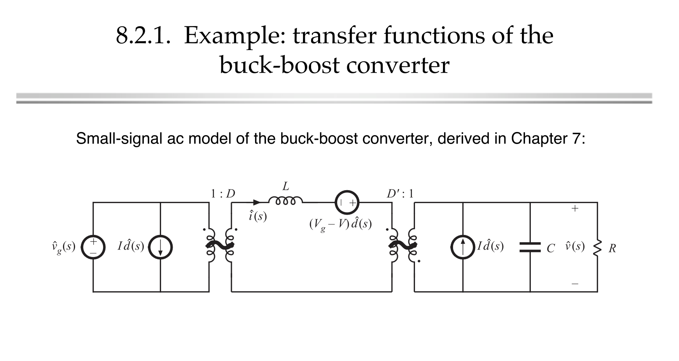



Slide 42
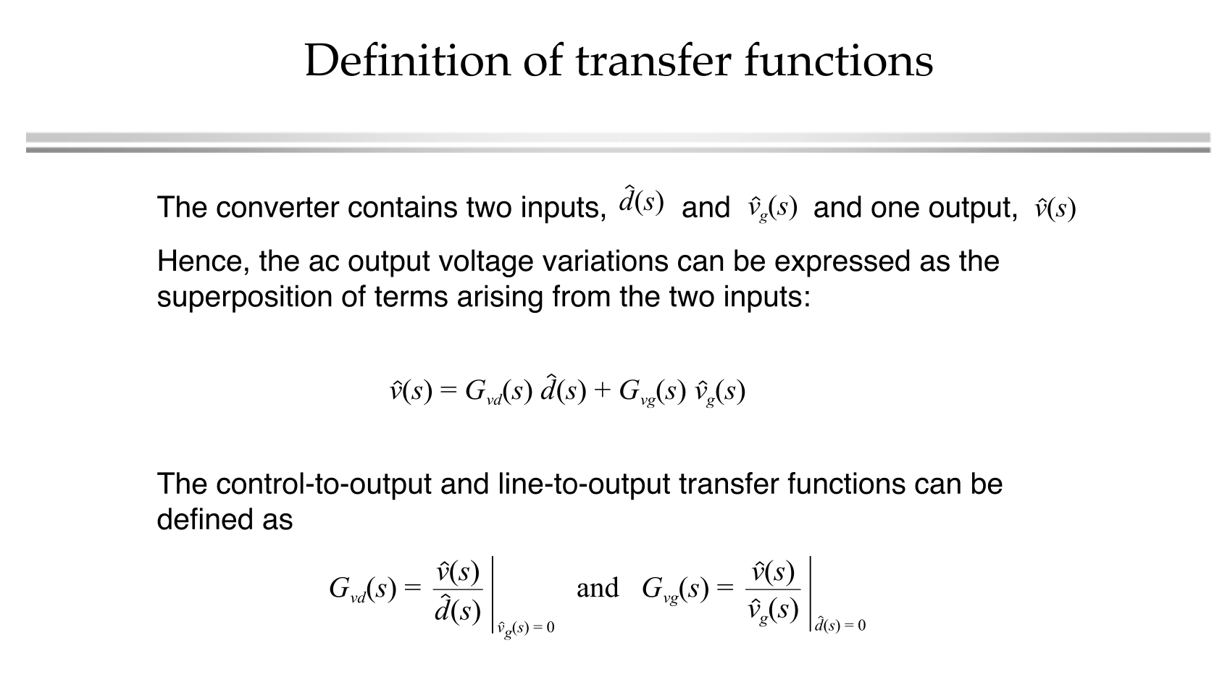

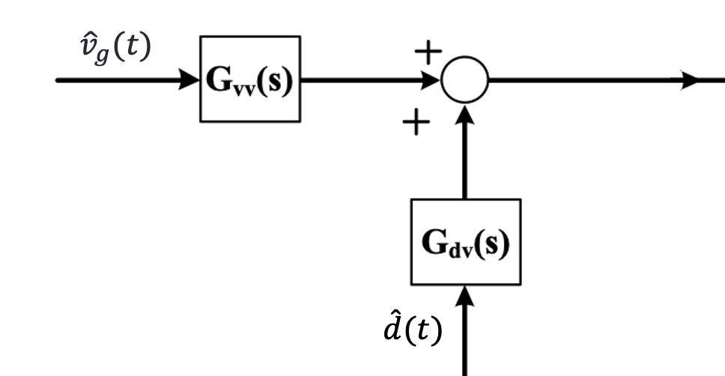

Slide 43
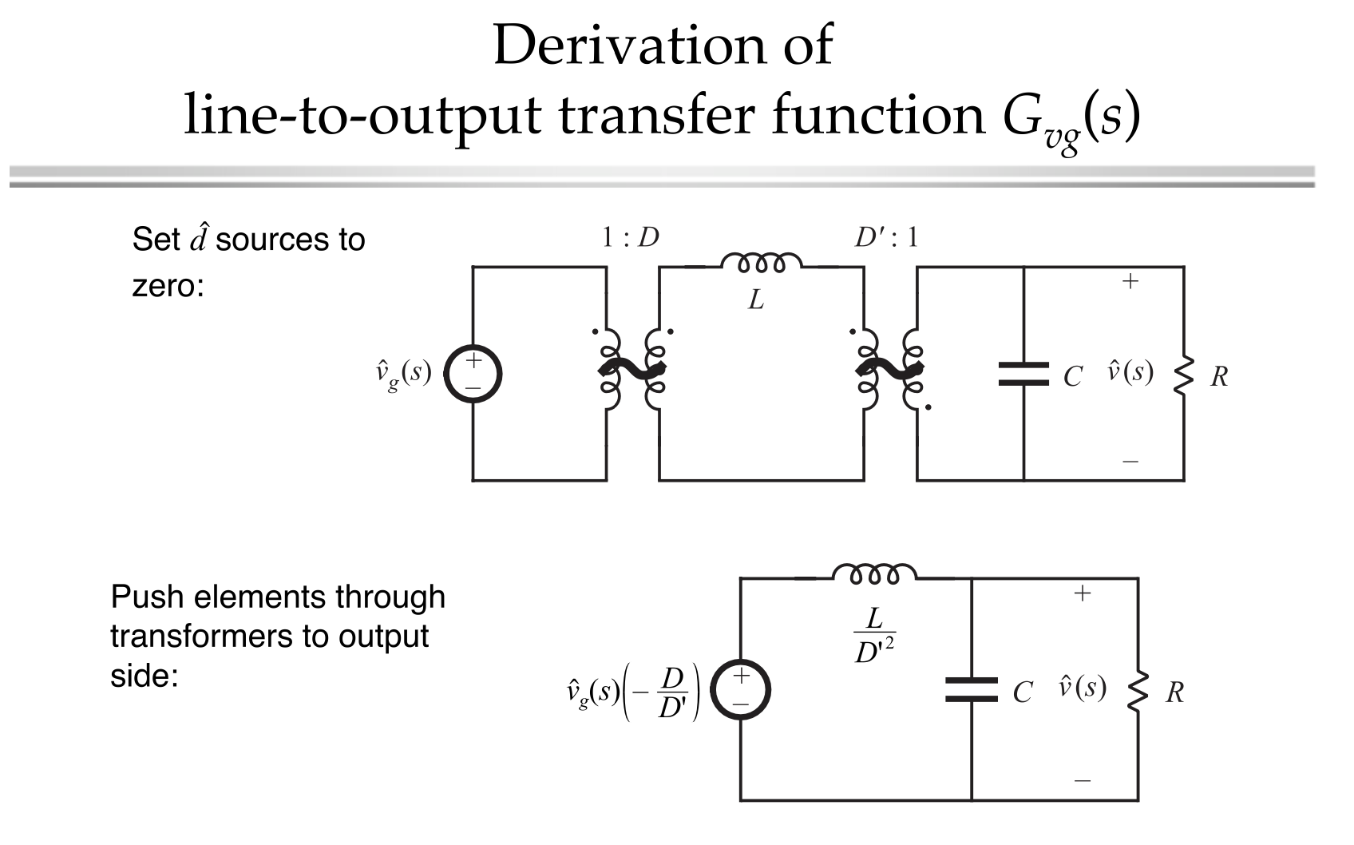

Slide 44
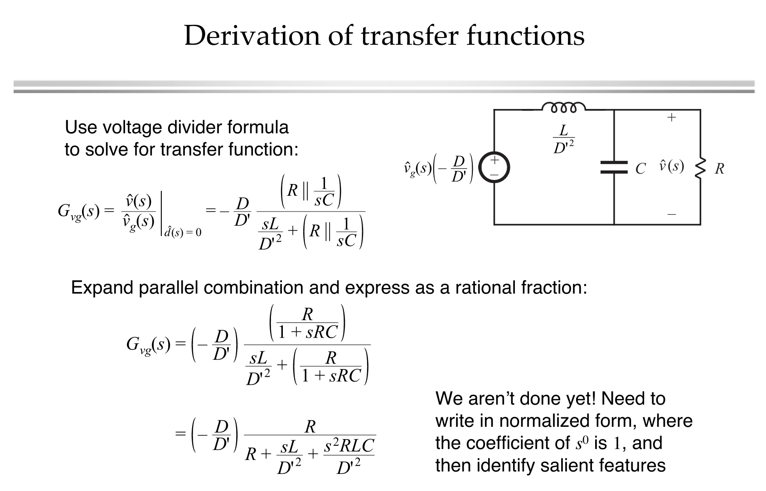

Slide 45
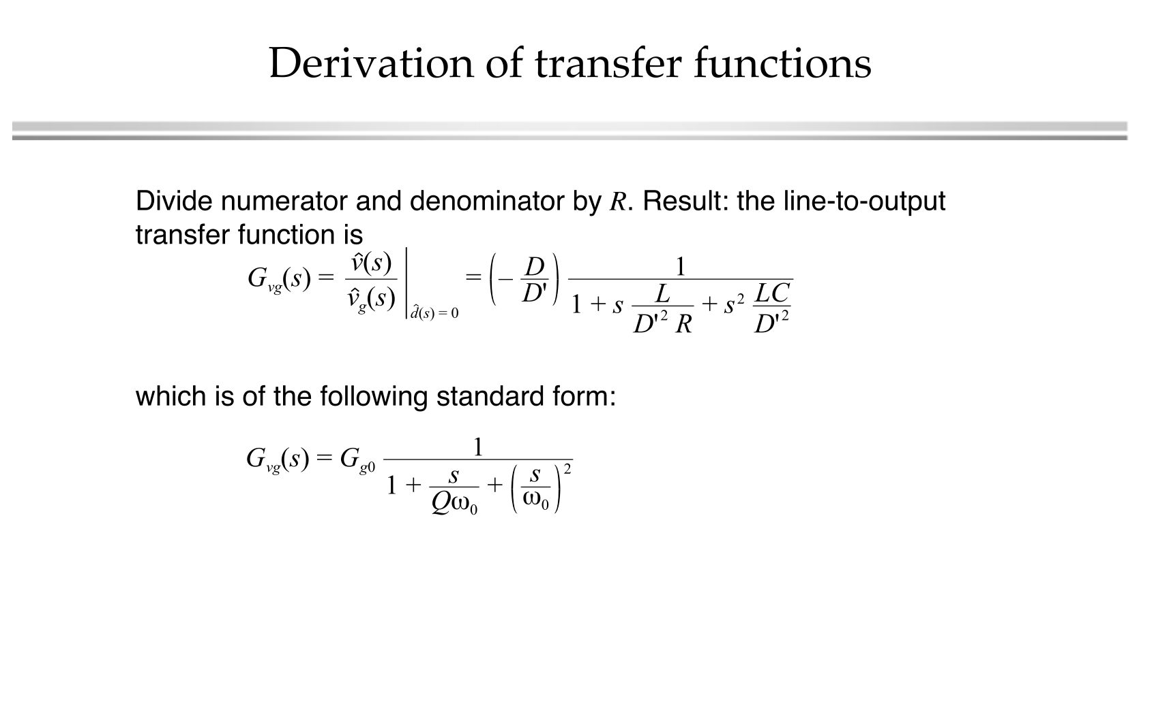

Slide 46
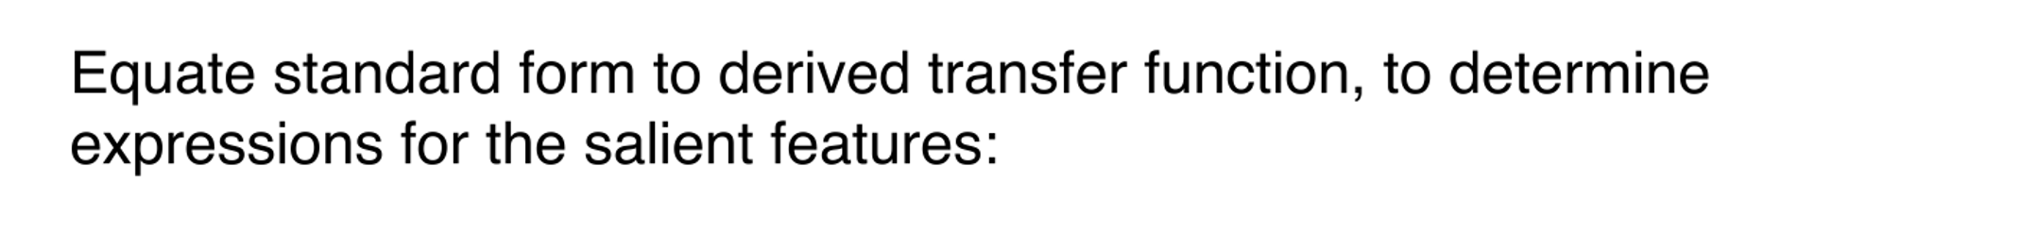
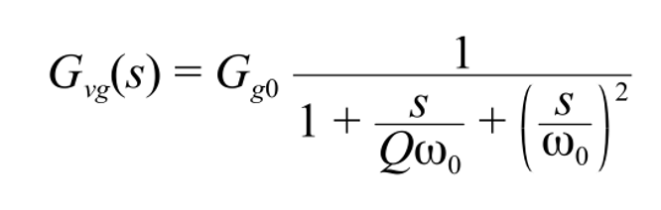
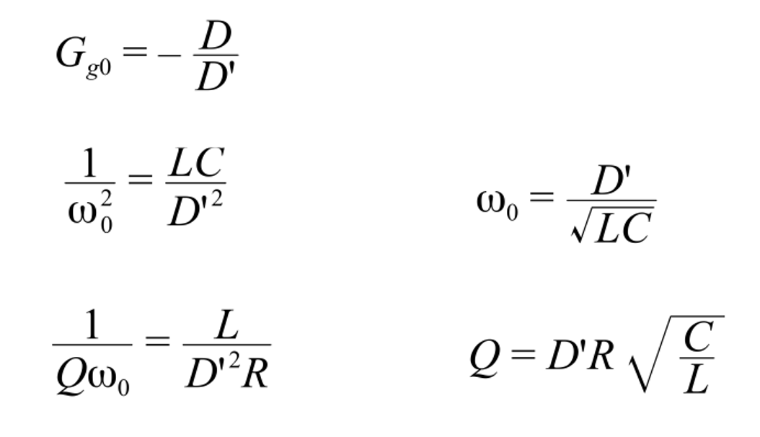
Where, the following standard quantities are defined:

Slide 47
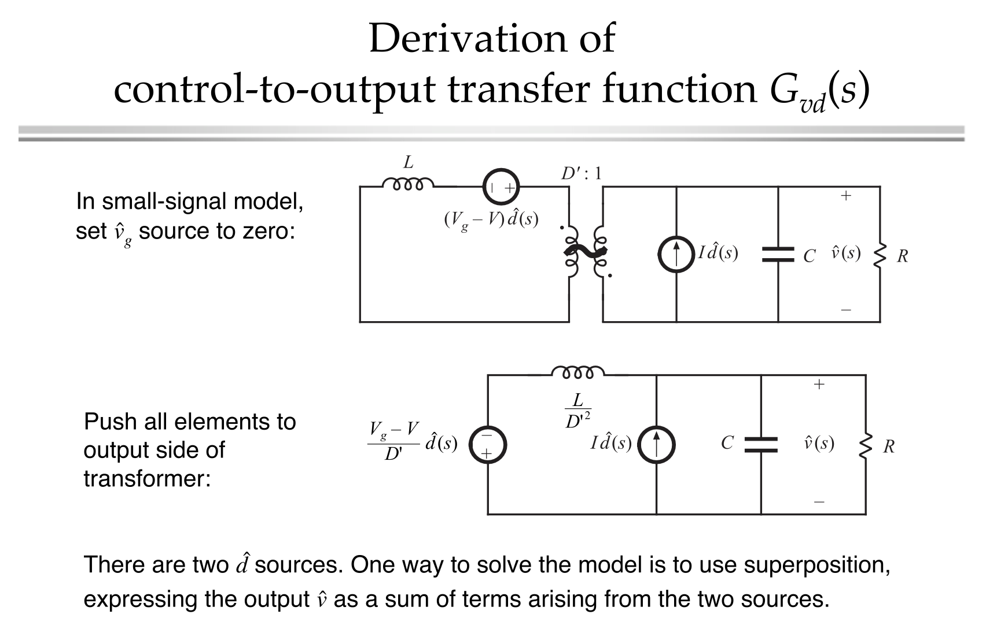

Slide 48
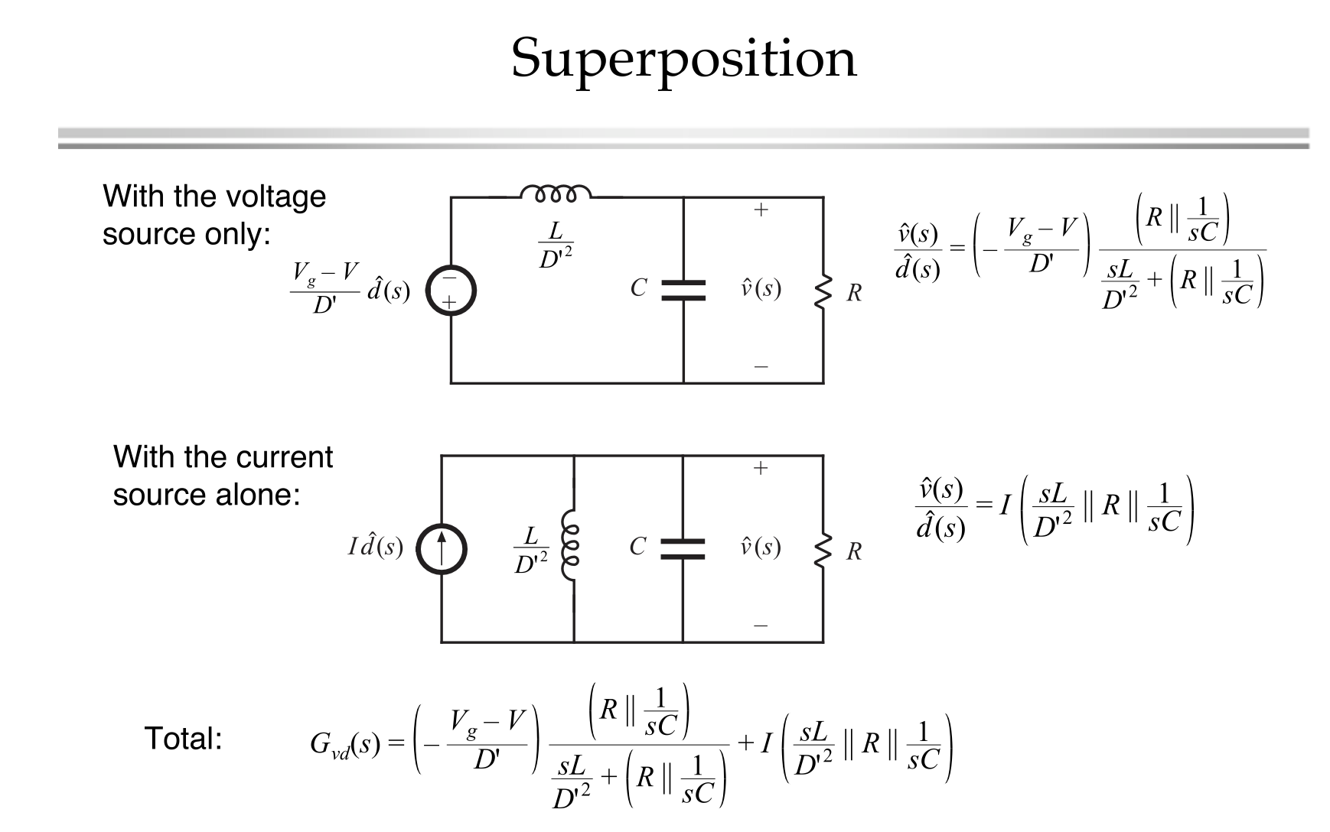

Slide 49
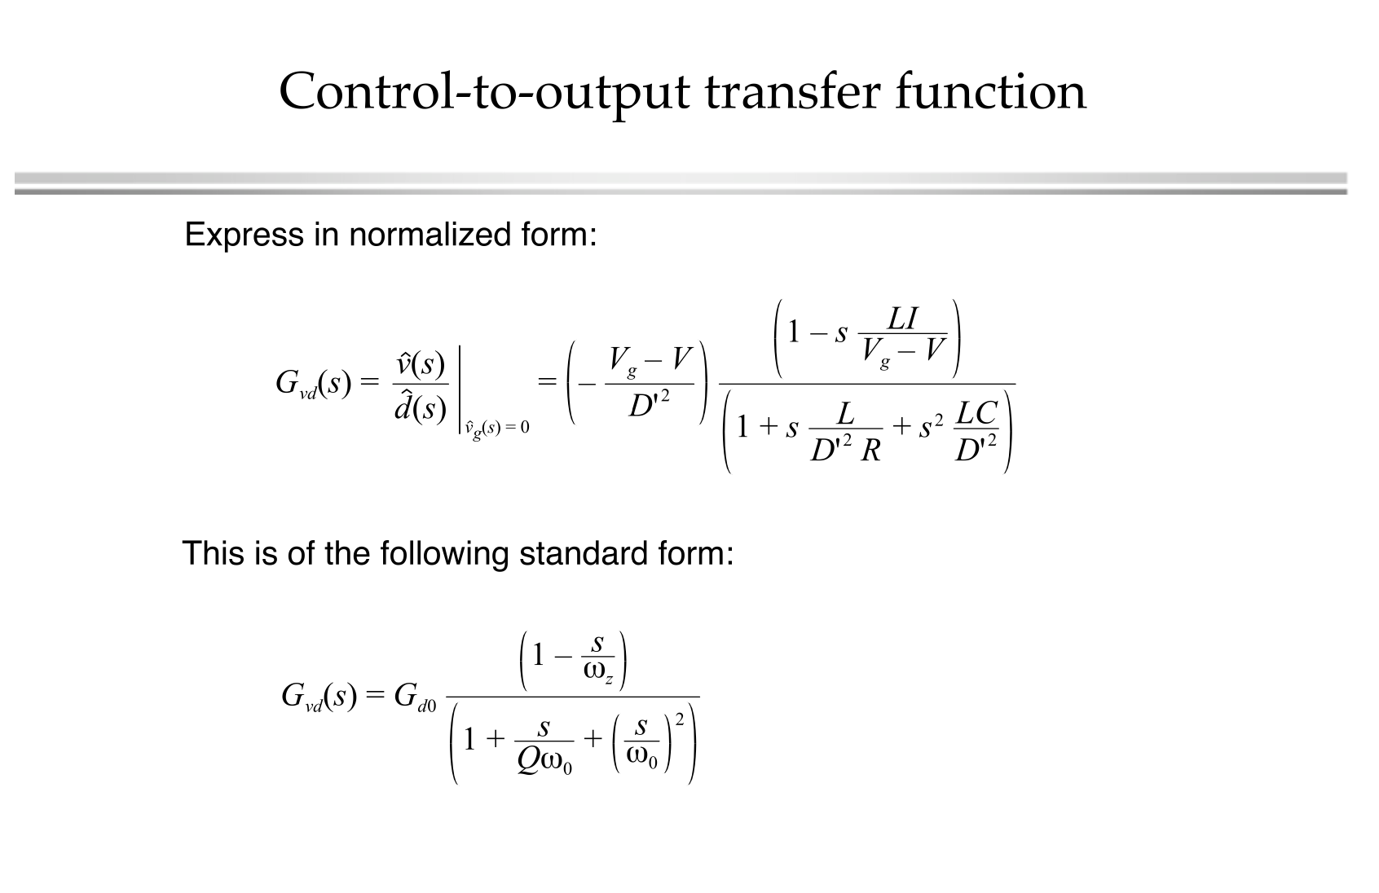

Slide 50

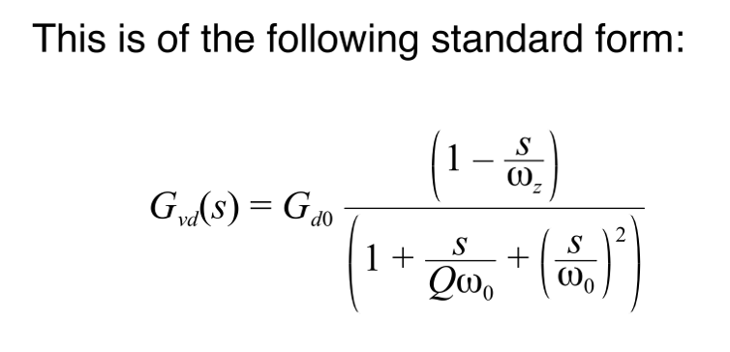
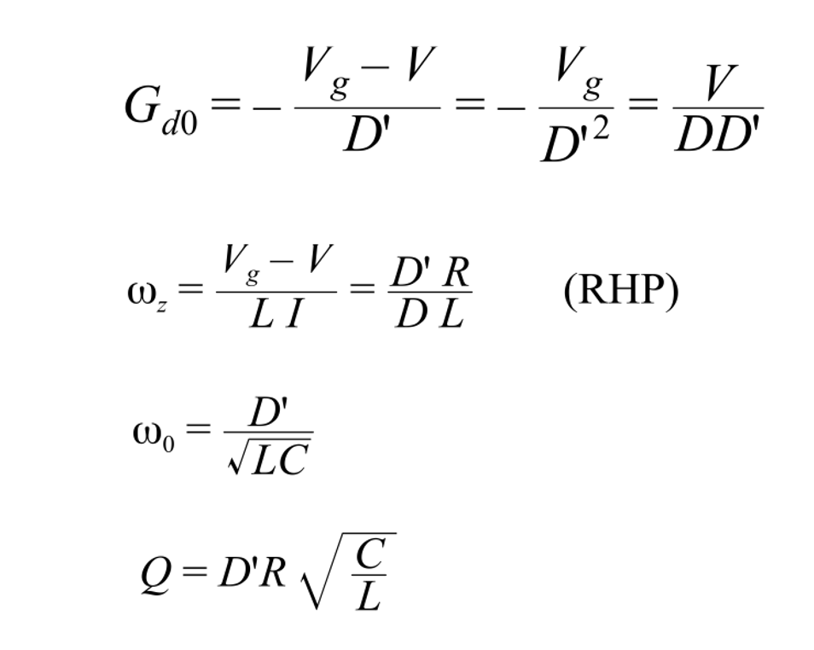
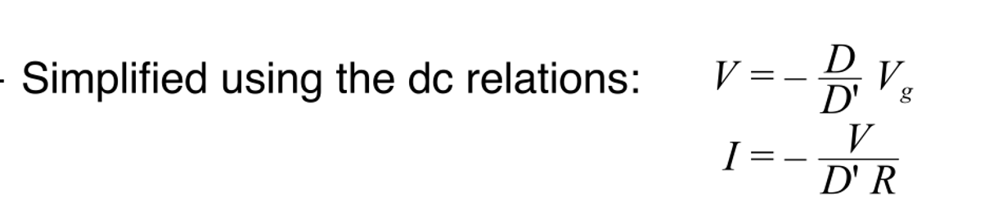

Slide 51
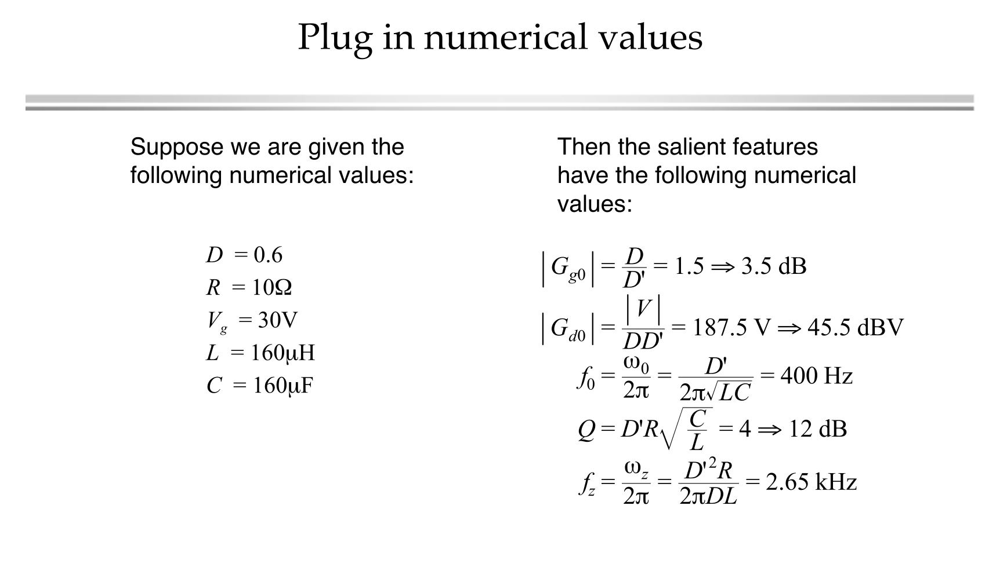

Slide 52
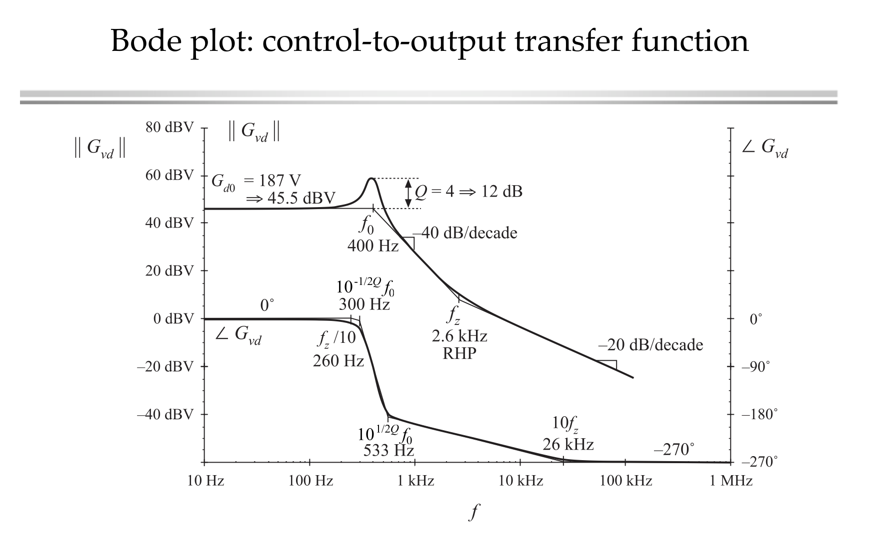

Slide 53
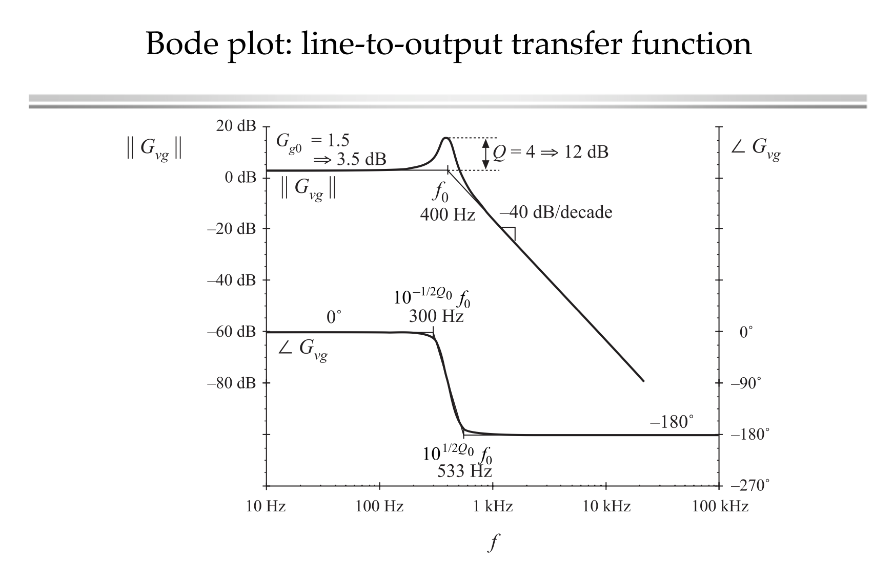

Slide 54
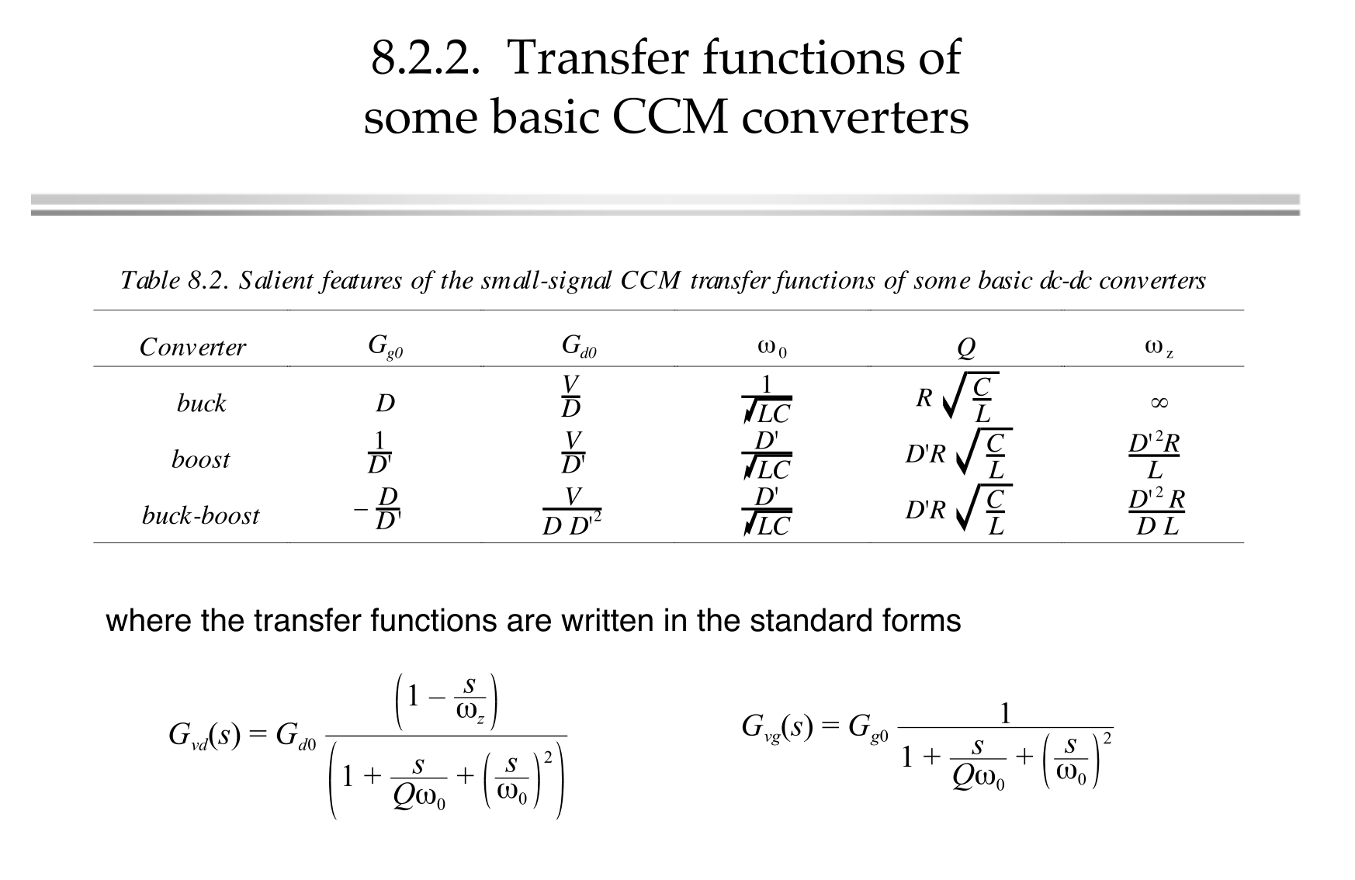

Slide 55


Slide 56


Slide 57


