Slide 1
EEL 646 POWER ELECTRONICS II
Lecture 17
LLC Resonant Converter

Slide 2
Agenda
Carry out approximated LLC Resonant Converter

Slide 3
LLC Resonant Converter
PRC

Slide 4
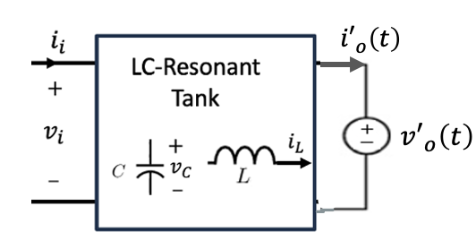
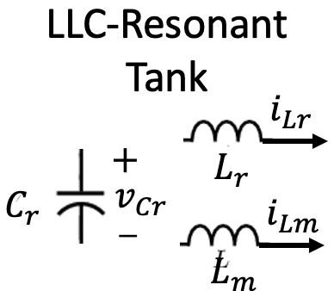
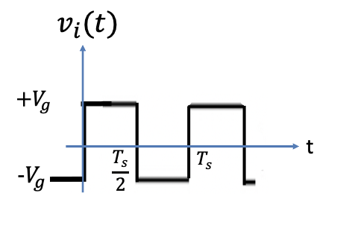
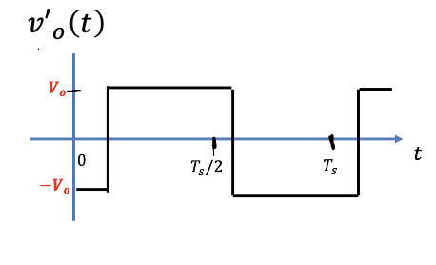
The LLC Resonant Converter
Using the assumptions above, the simplified equivalent configuration is shown in the figure below,
The currents $i_{i}\left(t\right)$and ${i′}_{o}\left(t\right)$can be any resonant waveforms

Slide 5
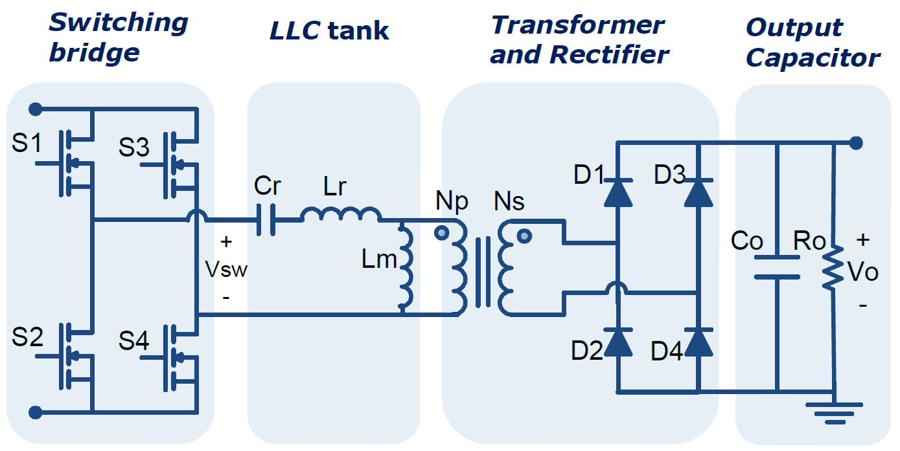
Introduction
Switching Bridge: Generate pulsating voltage
Either a half-bridge (with 0.5 gain) or full-bridge ( with unity gain)
Transformer and rectifier:
Transformer provides galvanic isolation
Rectifier transforms the pulsating voltage to DC
Resonant tank: Modulates the gain through changing the switching frequency

Slide 6
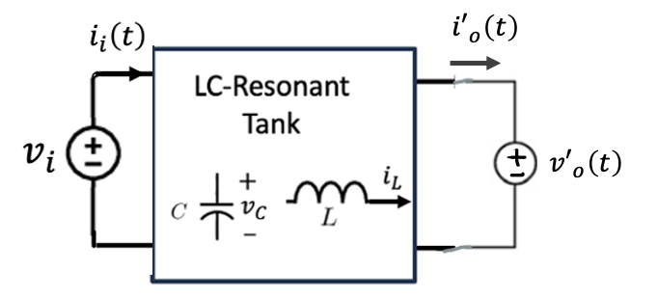
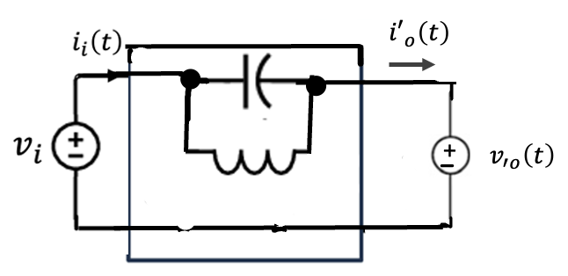
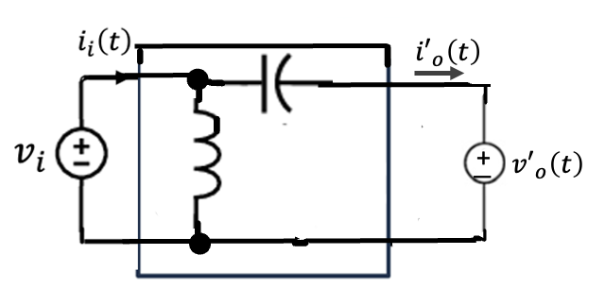
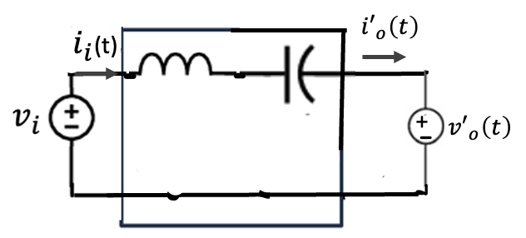
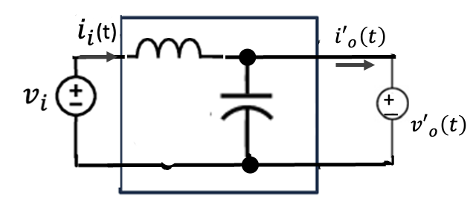
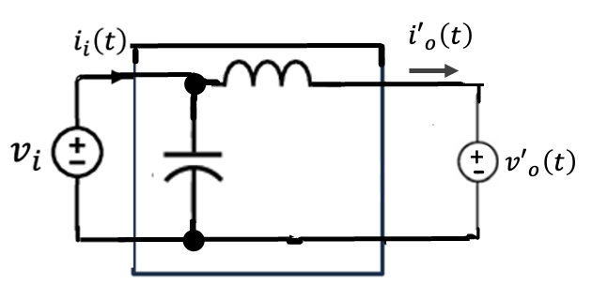
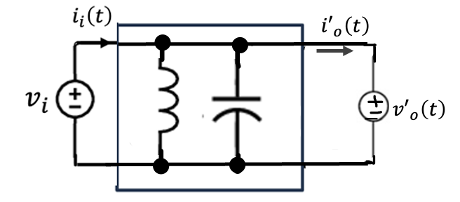
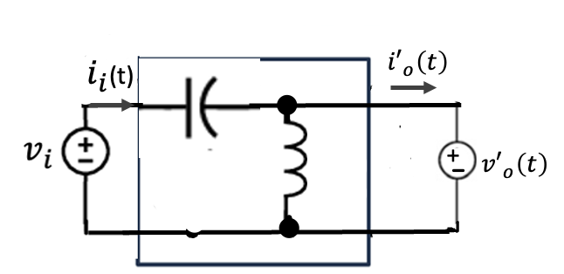
Capacitive RC output Filter
Possible 2nd Resonant Tank Topologies

Slide 7
Capacitive RC output Filter
Possible 2nd Resonant Tank Topologies

Slide 8
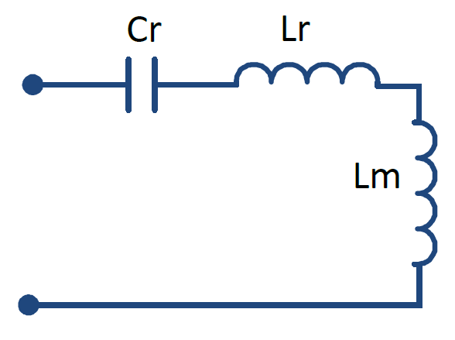
LLC Tank
Features:
Soft switching for wide range
high gain
Low power density
High efficiency
Modes of Operation:
At resonance: Gain = 1
Below resonance: Gain > 1
Above resonance: Gain < 1
$$i_{Lr}$$
$$−$$
$$v_{Cr}$$
$$+$$

Slide 9
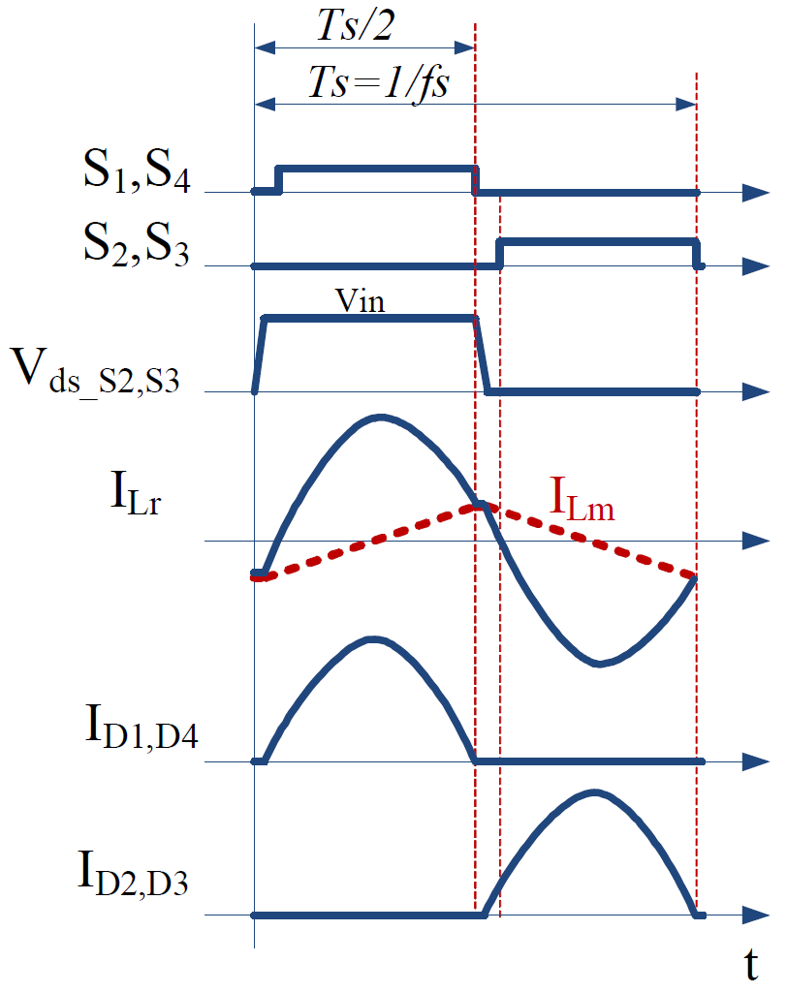
At Resonance
The switching freq. operates at resonant freq.
$$f_{s}=f_{r}=\frac{1}{2π\sqrt{L_{r}C_{r}}}$$
$L_{m}$ is clamped to the load through the whole cycle
$I_{L_{r}}$is a pure sine wave
Complete power delivery to the rectifier
$$i_{Lr}$$

Slide 10
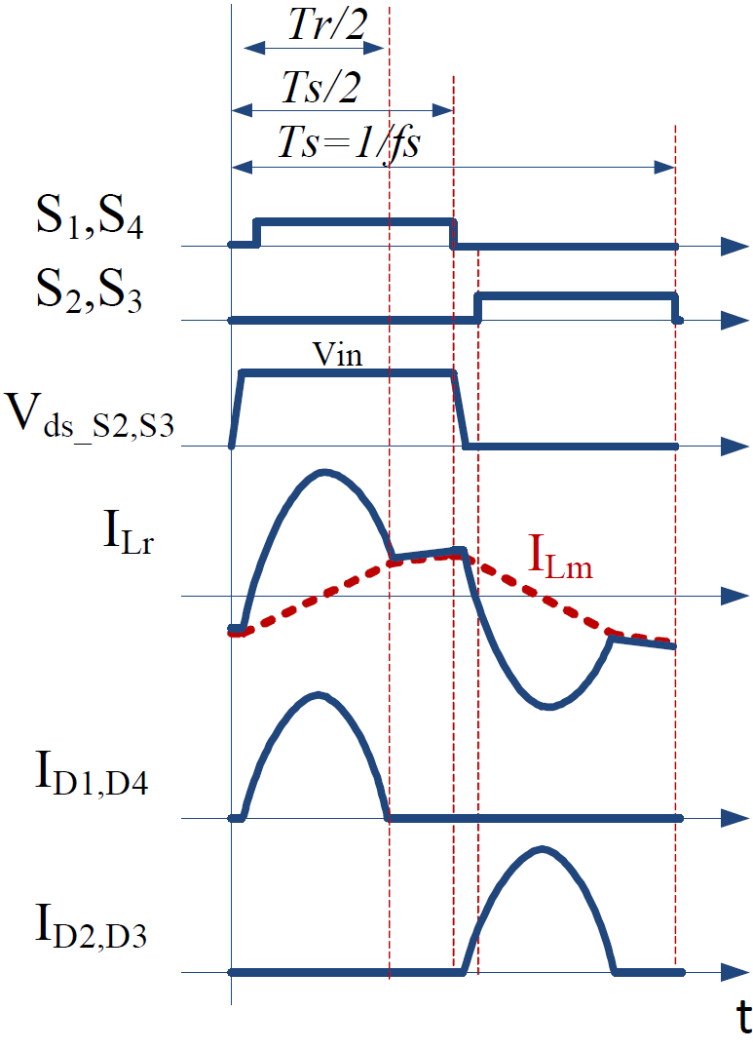
Below Resonance
$$f_{s}<f_{r}$$
Power delivery period ends at $T_{r}/2$
As $I_{L_{r}}=I_{L_{m}}$, $L_{m}$ resonates with the tank forming a freewheeling period
The converter operates in this mode when a boost operation is required
$$i_{Lr}$$

Slide 11
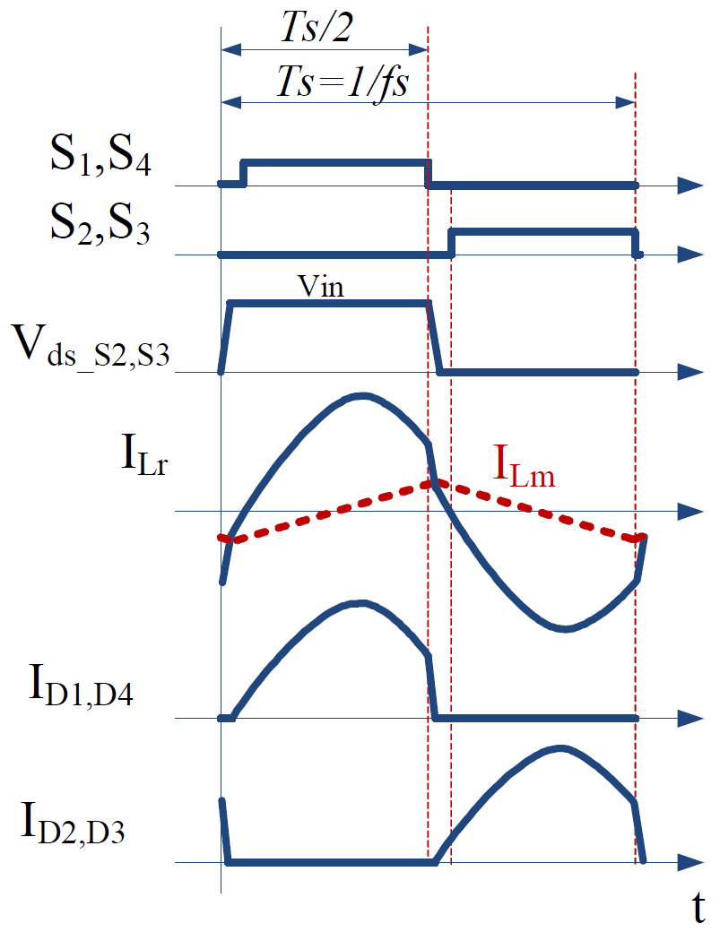
Above Resonance
$$f_{s}>f_{r}$$
$I_{L_{r}}$ is interrupted by the end of the half cycle before completion
ZCS is lost in the rectifying diodes
The converter operates in this mode when a buck operation is required
$$i_{Lr}$$

Slide 12
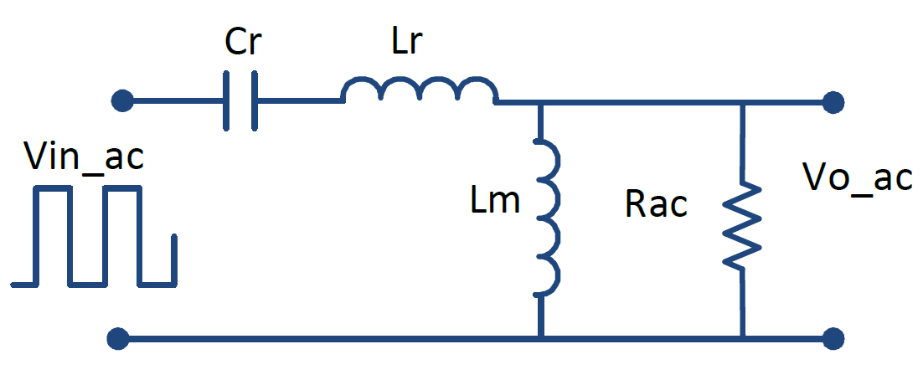
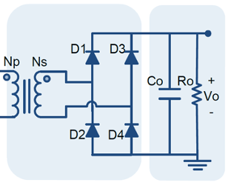
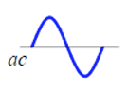
Approximation Analysis
Fundamental Harmonic Approach

Slide 13
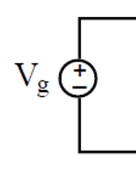
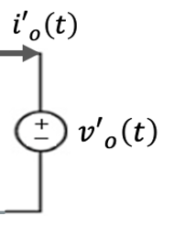
Steady-State Voltage Gain
L_{r}, L_{m ,} C_{r} $Z_{O},ω_{O}$, $f_{O}$
$$+$$
$$v_{i}(t)$$
$$V_{o}$$
$$−$$
L_{r}, L_{m ,} C_{r} $(Z_{O},ω_{O}$,$f_{O})$
$$R_{o} =\frac{V_{o}}{I_{o}}$$
$$v_{i}(t)$$

Slide 14
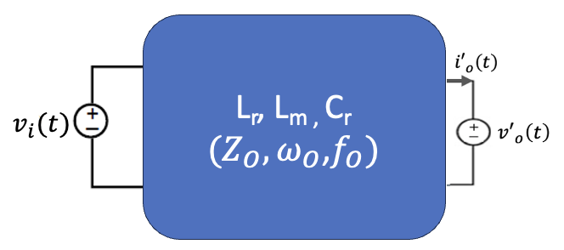
Steady-State Voltage Gain

Slide 15
Steady-State Voltage Gain
$$V_{o} =\frac{1}{T_{s}}\int_{0}^{T_{s}}{\left|v_{C}\left(t\right)\right|dt}$$
L_{r}, L_{m ,} C_{r} $Z_{O},ω_{O}$, $f_{O}$
$$+$$
Define normalized values:
$$V_{o}$$
$$−$$
$$M=\frac{V_{o}}{V_{g}}$$
$$Q=\frac{Z_{o}}{R_{o}}$$
$$Z_{o} =\sqrt{L_{r}/C_{r}}$$
$$R_{o} =\frac{V_{o}}{I_{o}}$$
$$f_{ns} =\frac{f_{s}}{f_{o}}$$
$$k=\frac{L_{r}+L_{m}}{L_{r}}=1+\frac{L_{m}}{L_{r}}$$
$$ω_{o} =1/\sqrt{L_{r}C_{r}}$$

Slide 16
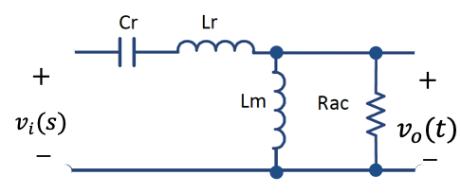
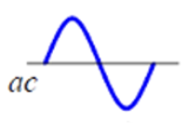
Steady-State Voltage Gain
Commonly used to overcome the non-linear circuit complexity
Considering only first harmonics results in pure input and output sinusoidal voltage and current.
The DC Gain M can be defined as
Derive the s-domain transfer function of
$$\frac{V_{o}(s)}{V_{i}(s)}$$

Slide 19
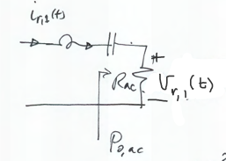

Slide 26
$R_{ac}:$Equivalent AC Load Impedance Derivation

Slide 27
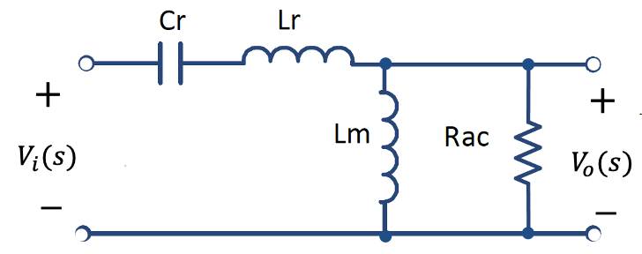
Fundamental Harmonic Approximation (FHA)
$$R_{ac}=\frac{8}{π^{2}}{(\frac{N_{P}}{N_{S}})}^{2}R_{o}$$
$$Q=\frac{Z_{o}}{R_{ac}}=\frac{\sqrt{L_{r}/C_{r}}}{R_{ac}}$$
$$\frac{V_{o}(s)}{V_{i}(s)}=\frac{\frac{sL_{m}R_{ac}}{sL_{m}+R_{ac}}}{\frac{1}{sC_{r}}+sL_{r}+\frac{sL_{m}R_{ac}}{sL_{m}+R_{ac}}}$$
$$M=\frac{V_{o}}{V_{g}}=\frac{f_{ns}^{2}(k−1)}{\sqrt{{\left(kf_{ns}^{2}−1\right)}^{2}+f_{ns}^{2}{\left(f_{ns}^{2}−1\right)}^{2}{\left(k−1\right)}^{2}Q^{2}}}$$

Slide 28
Fundamental Harmonic Approximation (FHA)
$$M=\frac{f_{ns}^{2}(k−1)}{\sqrt{{\left(kf_{ns}^{2}−1\right)}^{2}+f_{ns}^{2}{\left(f_{ns}^{2}−1\right)}^{2}{\left(k−1\right)}^{2}Q^{2}}}$$
$$M=\frac{1}{\sqrt{1+{\left(\frac{1}{f_{ns}}−f_{ns}^{2}\right)}^{2}Q^{2}}}$$
notice if $L_{m}→∞$, then the LLC becomes the conventional SRC

Slide 29
${M vs. f}_{ns}$Characteristics
$$M=\frac{V_{o}}{V_{g}}$$
$$\frac{L_{m}}{L_{r}}=5$$
$$k=6$$
$$Q=0.2$$
$$Q=0.3$$
$$Q=0.5$$
$$Q=0.7$$
$$Q=1$$
$$Q=5$$
$$f_{ns}$$

Slide 30
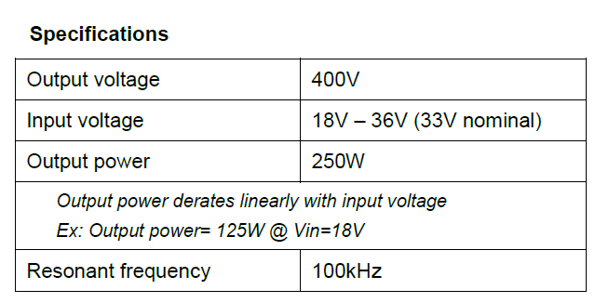
Design Example: Design the LLC DC-DC Converter

Slide 31
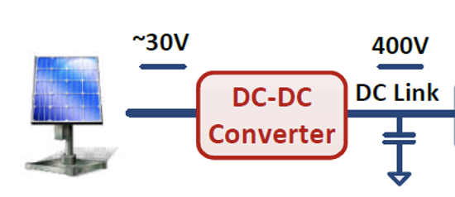
Select the LLC Resonant Converter for the DC-DC conversion stage

Slide 32
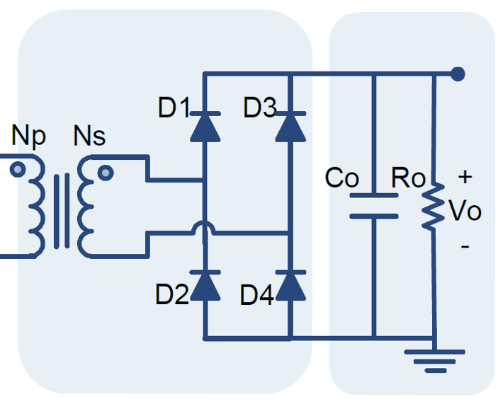
Select the LLC Resonant Converter for the DC-DC conversion stage
Define the transformer ration:
$$n=\frac{N_{p}}{N_{s}}$$
$$+$$
$${V′}_{o}$$
$$−$$
$${V′}_{o}=\frac{N_{p}}{N_{s}}V_{o}=n V_{o}$$

Slide 33
Design Steps
2. Calculating the Transformer turns ratio
Assume the gain at the nominal input voltage is unity.
The maximum and minimum gains:
$$M_{nom}=\frac{n V_{out}}{V_{in, nom}}$$
$$n=\frac{N_{p}}{N_{s}}$$
$$M_{max}=\frac{V_{in, nom}}{V_{in, min}}M_{nom}=\frac{33}{18}1=1.83$$
Transformer ratio:
$$M_{min}=\frac{V_{in, nom}}{V_{in, max}}M_{nom}=\frac{33}{36}1=0.92$$
$$n=M_{nom}\frac{V_{in, nom}}{V_{out}}=1\frac{33}{400}=0.0825$$
$$\frac{N_{s}}{N_{p}}=\frac{1}{0.0825}=12.12$$

Slide 34
Design Steps
Calculating Transformer turns ratio and the min. and max. gains
Assume the gain at the nominal input voltage is unity.
The maximum and minimum gains:
$$M_{nom}=\frac{n V_{out}}{V_{in, nom}}$$
$$n=\frac{N_{p}}{N_{s}}$$
$$M_{max}=\frac{V_{in, nom}}{V_{in, min}}M_{nom}=\frac{33}{18}1=1.83$$
Transformer ratio:
$$M_{min}=\frac{V_{in, nom}}{V_{in, max}}M_{nom}=\frac{33}{36}1=0.92$$
$$n=M_{nom}\frac{V_{in, nom}}{V_{out}}=1\frac{33}{400}=0.0825$$
$$\frac{N_{s}}{N_{p}}=\frac{1}{0.0825}=12.12$$

Slide 35
Design Steps
1. Select the nominal gain at nominal input voltage
Select the nominal input voltage gain at unity (operating at resonance):
2. Calculating the Transformer turns ratio
$$M_{nom}=\frac{{V′}_{o}}{V_{in, nom}}=\frac{n V_{o}}{V_{in, nom}}=1$$
$$n=0.0825$$
Solving for $n$,
$$\frac{N_{s}}{N_{p}}=\frac{1}{n}=12.12$$
$$n=\frac{V_{in,min}}{V_{o}}=\frac{33}{400}=0.0825$$

Slide 36
Design Steps
3. Calculating the minimum and maximum gains
The maximum and minimum gains:
$$M_{max}=\frac{n V_{o}}{V_{in,min}}=\frac{0.0825x400}{18}=1.83$$
$$M_{max}=1.83$$
The maximum and minimum gains:
$$M_{min}=0.92$$
$$M_{min}=\frac{n V_{o}}{V_{in,max}}=\frac{0.0825x400}{36}=0.92$$

Slide 37
Design Steps
4. Select the ratio of the magnetizing and resonant inductors
Let us select the ratio of the magnetizing and resonant inductors to 5 times,
$$\frac{L_{m}}{L_{r}}=5$$
$$k=1+\frac{L_{m}}{L_{r}}=6$$
5. Obtain the M vs. f_{ns} plots

Slide 38
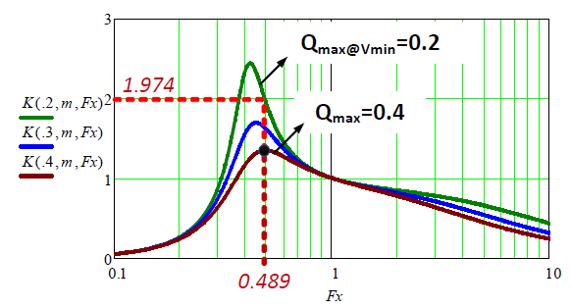
Design Steps
3. Selecting $Q_{max}$ that guarantee inductive operation for the max. gain required.
$$Q_{max}=0.4$$
$$Q=0.2$$
$$Q=0.3$$
$$Q=0.4$$
$$f_{ns}$$

Slide 39
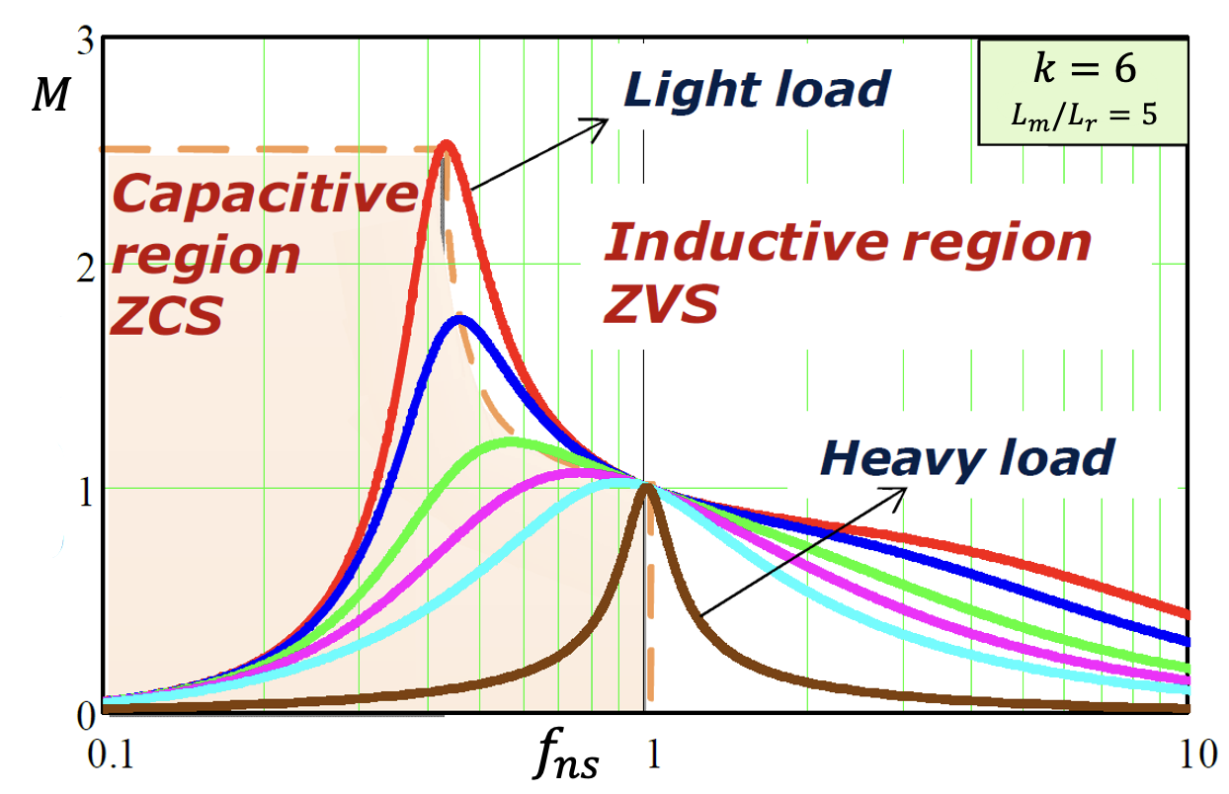
${M vs. f}_{ns}$Characteristics
$$M_{max}=1.83$$
$$M_{max}=0.92$$

Slide 40
${M vs. f}_{ns}$Characteristics
$$\frac{L_{m}}{L_{r}}=5$$
$$k=6$$
$$Q=0.2$$
$$Q=0.3$$
$$M_{max}=1.83$$
$$Q=0.5$$
$$Q=0.7$$
$$M_{max}=0.92$$
$$Q=1$$
$$Q=5$$
$$f_{ns}$$

Slide 41
${M vs. f}_{ns}$Characteristics
$$M_{max}=1.83$$
$$M_{max}=0.92$$
$$k=6$$
$$M$$
$$L_{m}/L_{r}=5$$
$$Q=0.2$$
$$Q=0.3$$
$$Q=0.5$$
$$Q=0.7$$
$$Q=1$$
$$Q=5$$
$$f_{ns}$$

Slide 42
${M vs. f}_{ns}$Characteristics
$$M_{max}=1.83$$
$$M_{max}=0.92$$
$$M$$
$$k=6$$
$$L_{m}/L_{r}=5$$
$$Q=0.2$$
$$Q=0.3$$
$$Q=0.5$$
$$Q=0.7$$
$$Q=1$$
$$Q=5$$
$$f_{ns}$$

Slide 43
Design Steps (continue)
Finding the min. switching frequency ($f_{s_min}$) from the first derivative of the gain equation
Verifying the voltage gain by determining the max. gain ($K_{max}$) at min. input voltage ($V_{min}$)

Slide 44
Design Steps (Gain Verification)

Slide 45
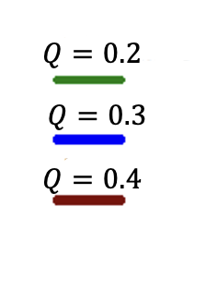
Design Steps (Gain Verification)
$$f_{ns}$$

Slide 46
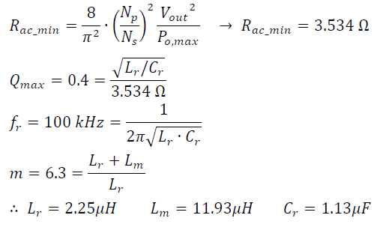
Design Steps (continue)
Finally, calculating the resonant components values

Slide 47
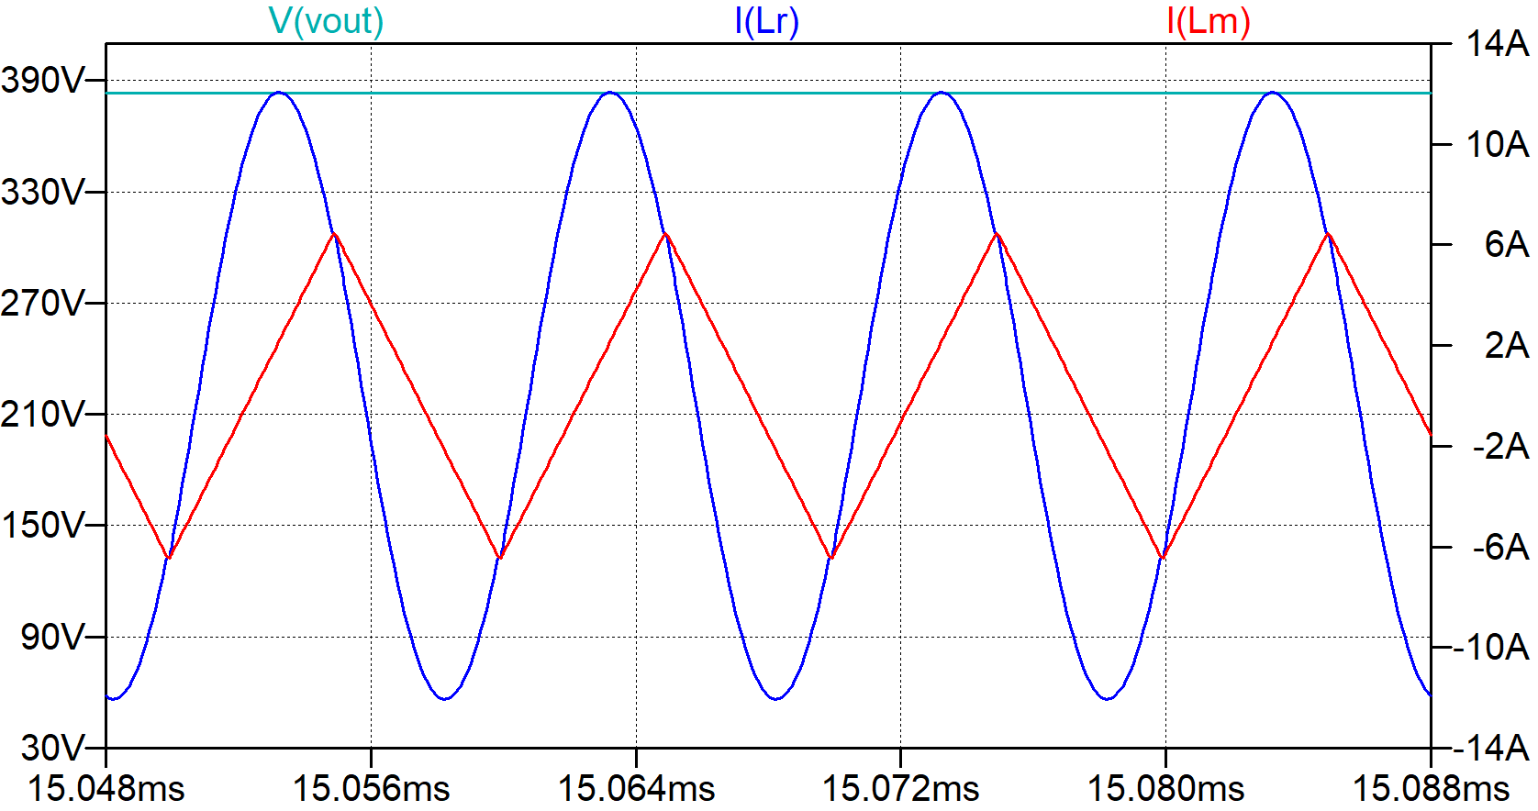
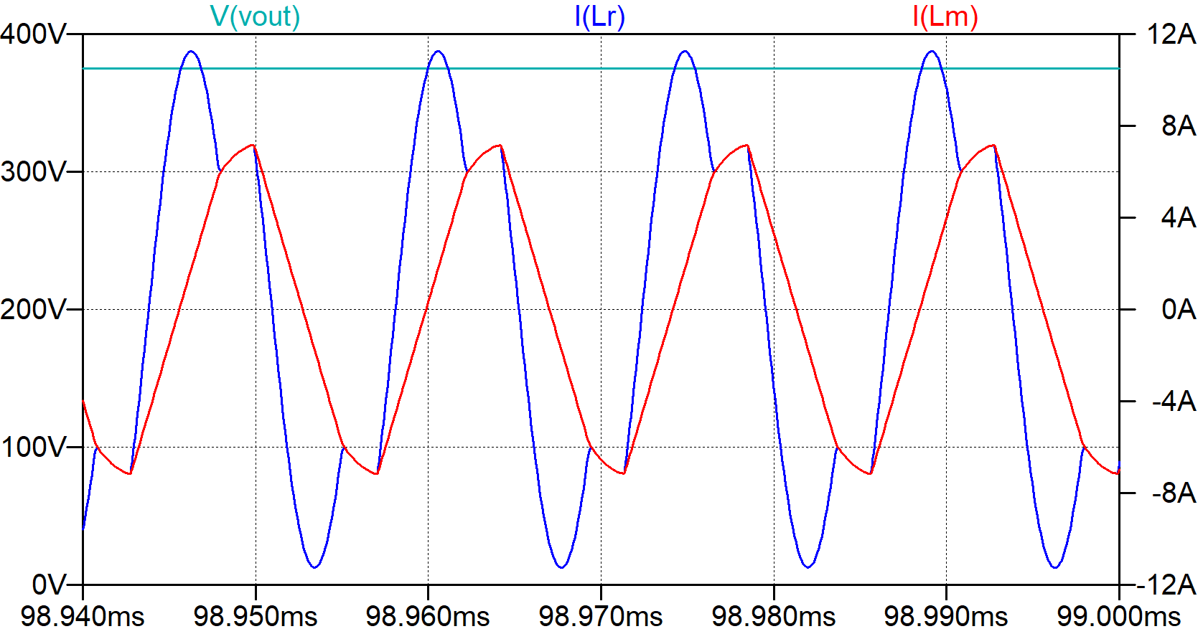
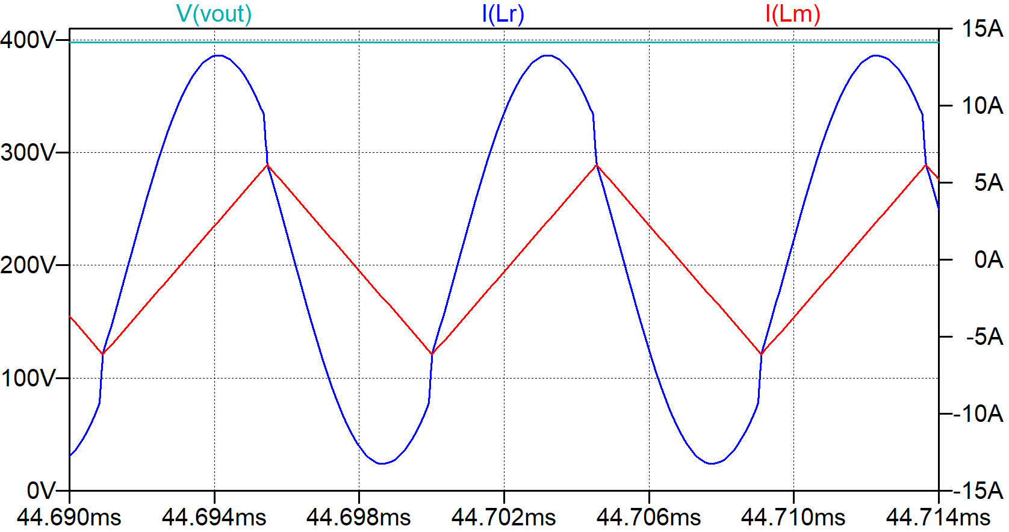
Simulation Results
$V_{in}=33V P_{o}=220W$
$V_{in}=25V P_{o}=160W$
$V_{in}=36V P_{o}=250W$

