Slide 1
EEL 646 POWER ELECTRONICS II
Lecture 17
LLC Resonant Converter

Slide 2
Agenda
Carry out approximated LLC Resonant Converter

Slide 3
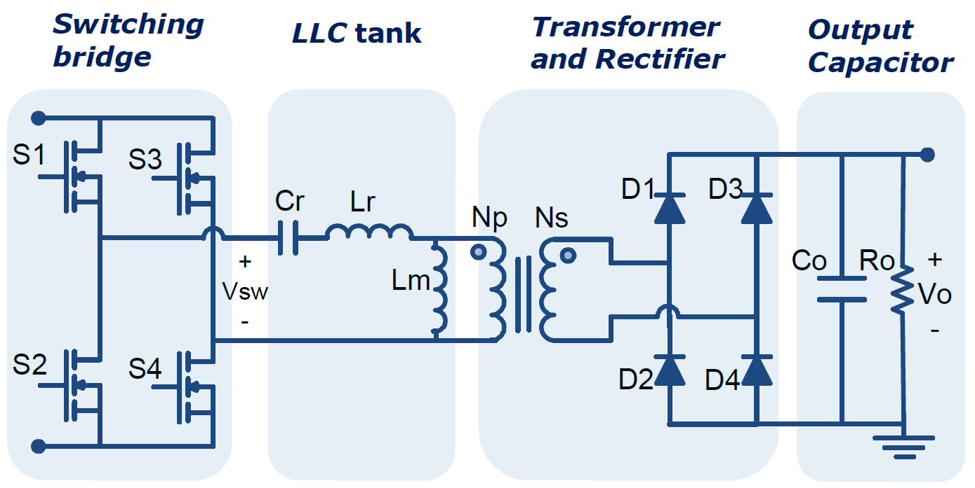
Introduction
Switching Bridge: Generate pulsating voltage
Either a half-bridge (with 0.5 gain) or full-bridge ( with unity gain)
Transformer and rectifier:
Transformer provides galvanic isolation
Rectifier transforms the pulsating voltage to DC
Resonant tank: Modulates the gain through changing the switching frequency

Slide 4
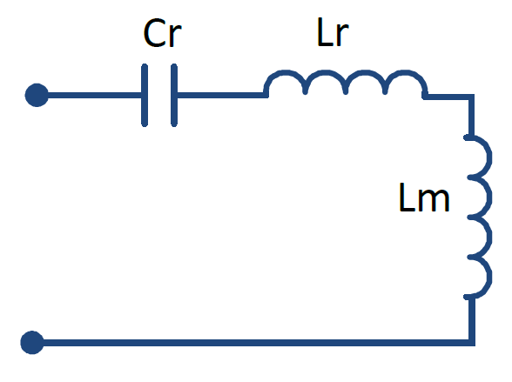
LLC Tank
Features:
Soft switching for wide range
high gain
Low power density
High efficiency
Modes of Operation:
At resonance: Gain = 1
Below resonance: Gain > 1
Above resonance: Gain < 1

Slide 5
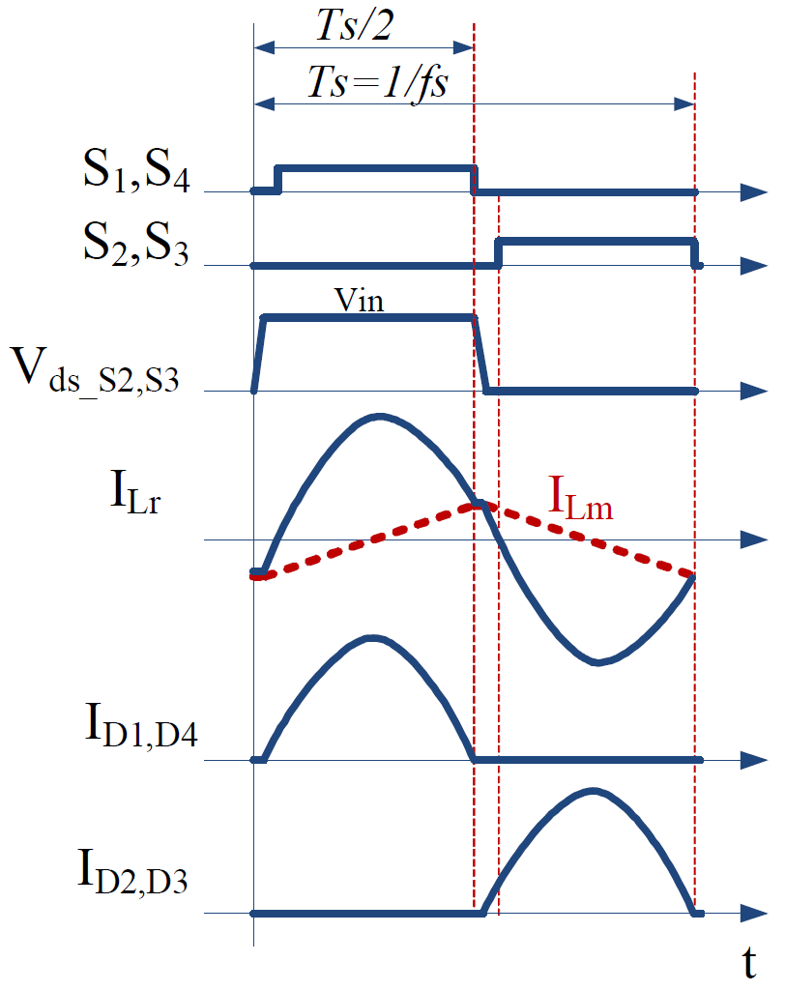
At Resonance
The switching freq. operates at resonant freq.
$$f_{s}=f_{r}=\frac{1}{2π\sqrt{L_{r}C_{r}}}$$
$L_{m}$ is clamped to the load through the whole cycle
$I_{L_{r}}$is a pure sine wave
Complete power delivery to the rectifier

Slide 6
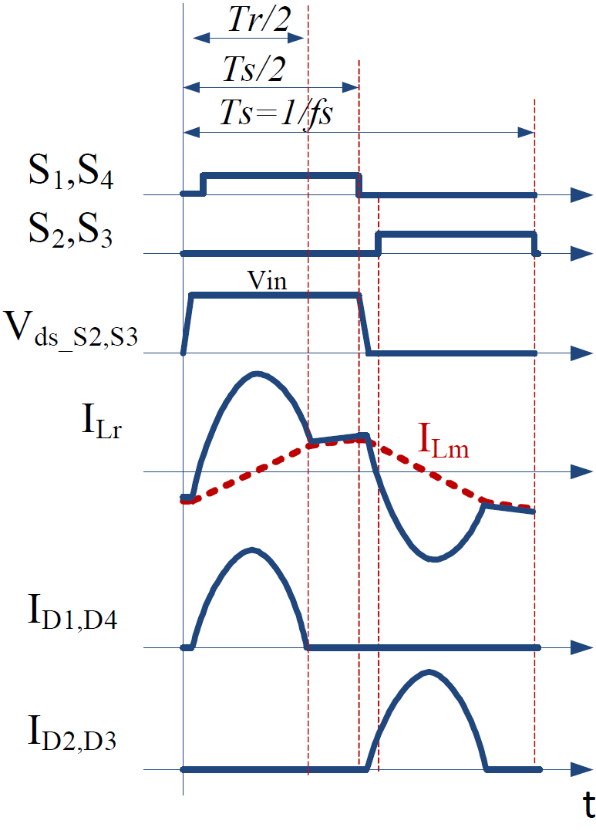
Below Resonance
$$f_{s}<f_{r}$$
Power delivery period ends at $T_{r}/2$
As $I_{L_{r}}=I_{L_{m}}$, $L_{m}$ resonates with the tank forming a freewheeling period
The converter operates in this mode when a boost operation is required

Slide 7
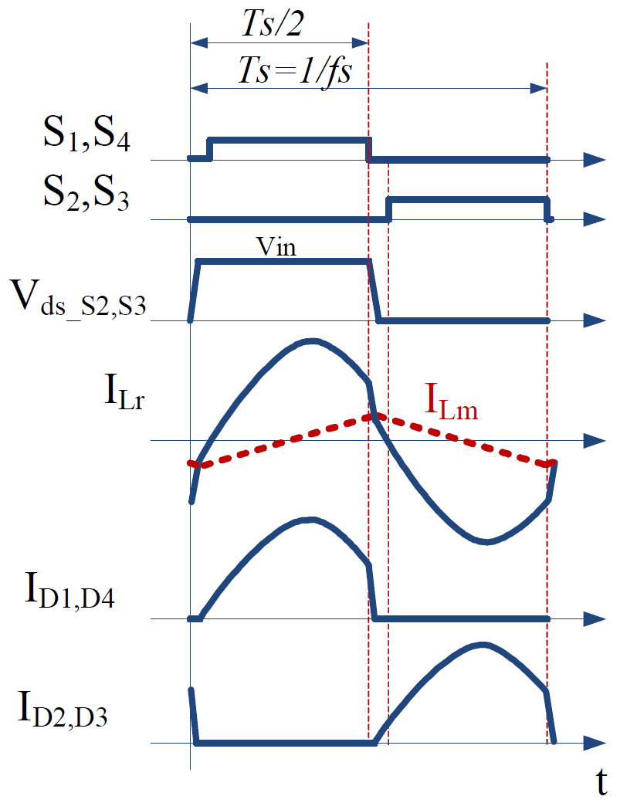
Above Resonance
$$f_{s}>f_{r}$$
$I_{L_{r}}$ is interrupted by the end of the half cycle before completion
ZCS is lost in the rectifying diodes
The converter operates in this mode when a buck operation is required

Slide 8
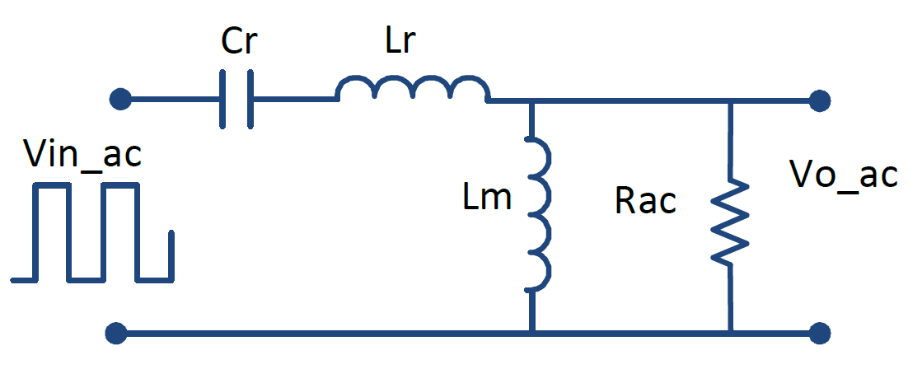
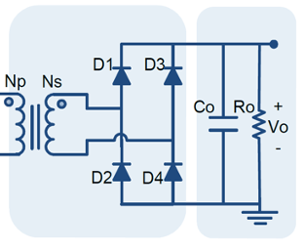
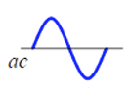
Approximation Analysis
Fundamental Harmonic Approach

Slide 9
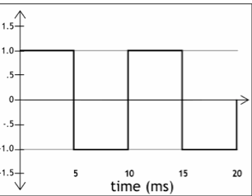
$$v_{i}(t)$$
$$V_{m}$$
$$t$$
$${0.5T}_{s}$$
$$T_{s}$$
$${−V}_{m}$$

Slide 10
Fundamental Harmonic Approximation (FHA)
Commonly used to overcome the non-linear circuit complexity
Considering only first harmonics results in pure input and output sinusoidal voltage and current.
The DC Gain K can be defined as
$$A=πr^{2}$$
$$H=\frac{Z_{out}}{Z_{in}}=\frac{\frac{sL_{m}∗R_{ac}}{sL_{m}+R_{ac}}}{{(sC_{r})}^{−1}+sL_{r}+\frac{sL_{m}∗R_{ac}}{sL_{m}+R_{ac}}}$$
$$K\left(Q,m,F_{x}\right)=\left|H\right|=\frac{F_{x}^{2}(m−1)}{\sqrt{\left(mF_{x}^{2}−1\right)+F_{x}^{2}{\left(F_{x}^{2}−1\right)}^{2}\left(m−1\right)Q^{2}}}$$
$$F_{x}=\frac{f_{s}}{f_{r}}$$
$$R_{ac}=\frac{8}{π^{2}}{(\frac{N_{P}}{N_{S}})}^{2}R_{o}$$
$$m=\frac{L_{r}+L_{m}}{L_{r}}=1+\frac{L_{m}}{L_{r}}$$
$$Q=\frac{Z_{r}}{R_{ac}}=\frac{\sqrt{L_{r}/C_{r}}}{R_{ac}}$$

Slide 11
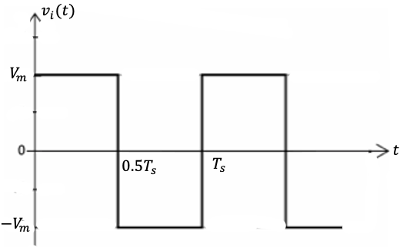
Consider the output circuit for an LLC converter whose square input voltage is shown in (a)
$$v_{i}(t) =\frac{Z_{r}}{R_{ac}}$$
$$+$$
$$v_{i}(t)$$
$$C$$
$$v_{o}(t)$$
$$−$$

Slide 12
Consider the output circuit for an LLC converter whose square input voltage is shown in (a)
$$v_{i}(t) =\frac{Z_{r}}{R_{ac}}$$

Slide 13
Gain Characteristics
$$\frac{L_{m}}{L_{r}}=5$$

Slide 14
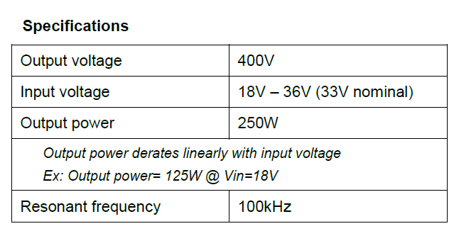
Design Example: Design the LLC DC-DC Converter

Slide 15
Design Steps
Calculating Transformer turns ratio and the min. and max. gains
Assume the gain at the nominal input voltage is unity.
The maximum and minimum gains:
$$M_{nom}=\frac{n V_{out}}{V_{in, nom}}$$
$$n=\frac{N_{p}}{N_{s}}$$
$$M_{max}=\frac{V_{in, nom}}{V_{in, min}}M_{nom}=\frac{33}{18}1=1.83$$
Transformer ratio:
$$M_{min}=\frac{V_{in, nom}}{V_{in, max}}M_{nom}=\frac{33}{36}1=0.92$$
$$n=M_{nom}\frac{V_{in, nom}}{V_{out}}=1\frac{33}{400}=0.0825$$
$$\frac{N_{s}}{N_{p}}=\frac{1}{0.0825}=12.12$$

Slide 16
Design Steps
2. Let us assume the ratio of the magnetizing and resonant inductor are 5, i.e.
$$\frac{L_{m}}{L_{r}}=5$$
$$m=1+\frac{L_{m}}{L_{r}}=6$$

Slide 17
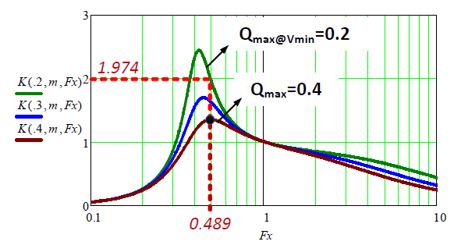
Design Steps
3. Selecting $Q_{max}$ that guarantee inductive operation for the max. gain required.
$$Q_{max}=0.4$$

Slide 18
Gain Characteristics
$$\frac{L_{m}}{L_{r}}=5$$

Slide 19
Design Steps (continue)
Finding the min. switching frequency ($f_{s_min}$) from the first derivative of the gain equation
Verifying the voltage gain by determining the max. gain ($K_{max}$) at min. input voltage ($V_{min}$)

Slide 20
Design Steps (Gain Verification)

Slide 21
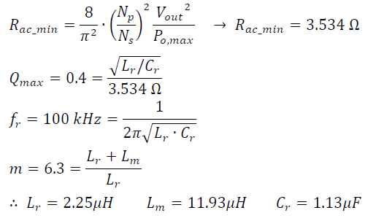
Design Steps (continue)
Finally, calculating the resonant components values

Slide 22
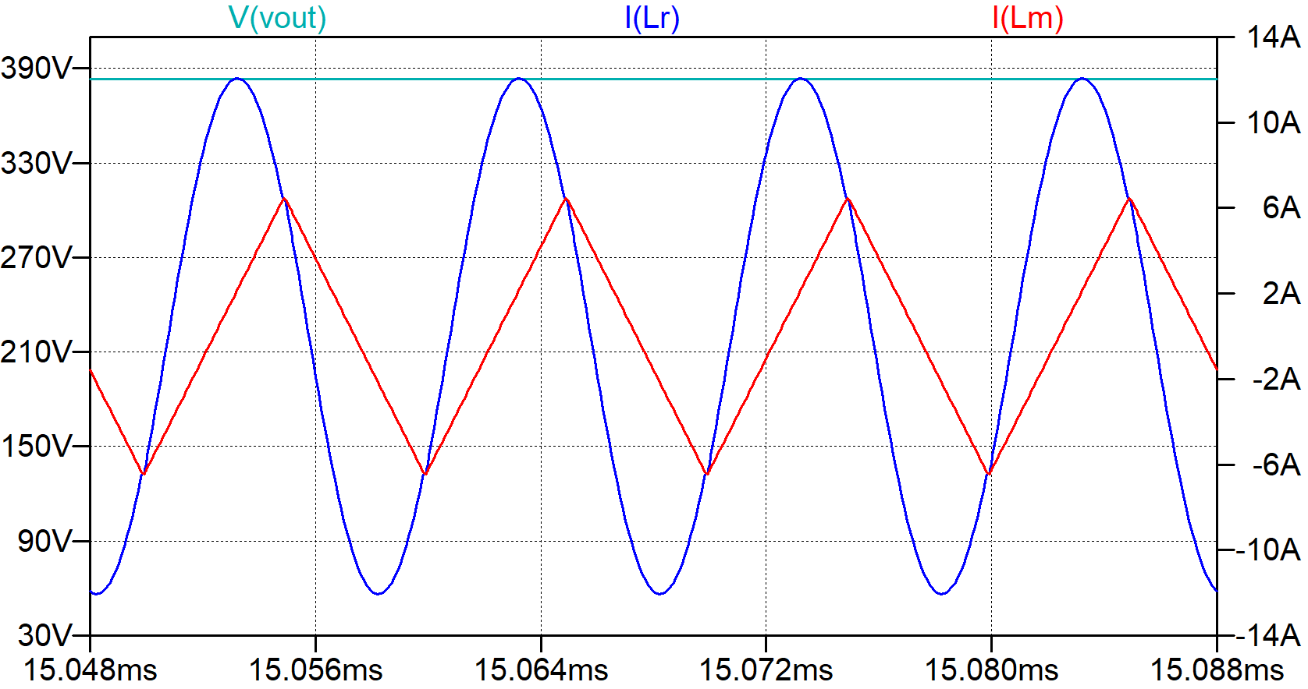
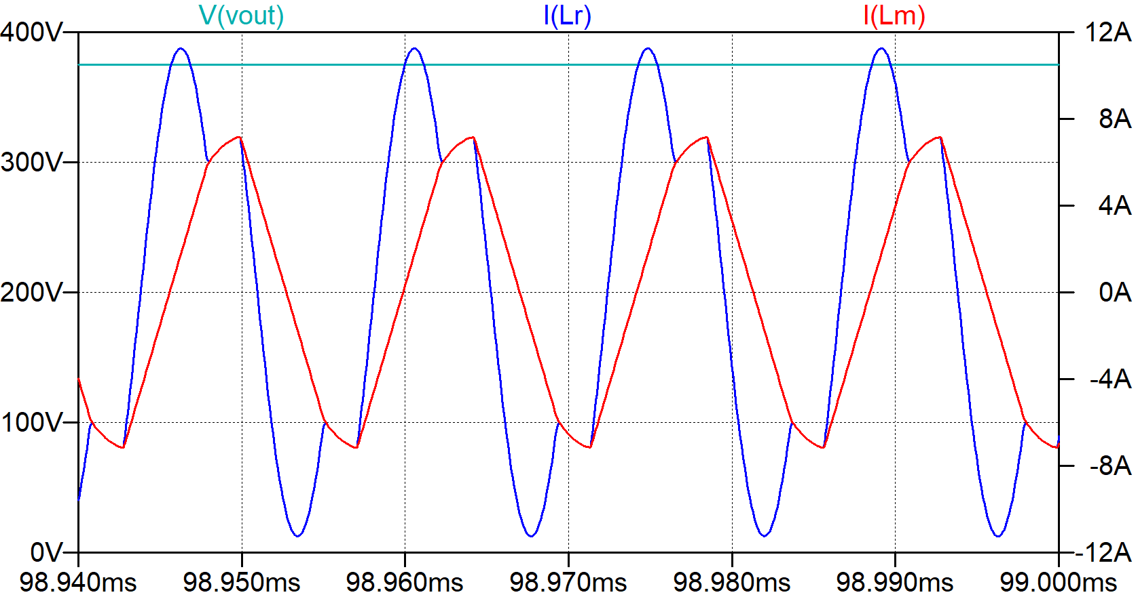
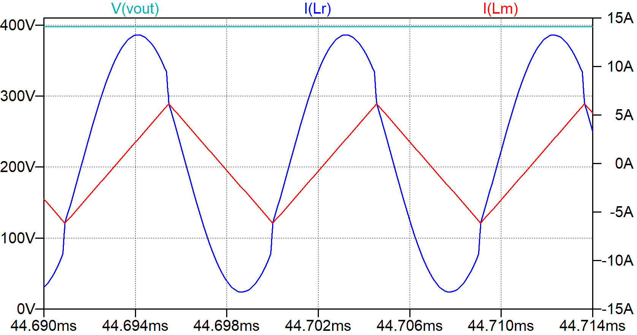
Simulation Results
$V_{in}=33V P_{o}=220W$
$V_{in}=25V P_{o}=160W$
$V_{in}=36V P_{o}=250W$

