Slide 1
EEL 646 POWER ELECTRONICS II Steady-State Analysis of the SRC -Approximation Method -
Lecture 13

Slide 2
Agenda
Steady-State Analysis of the Series Resonant Converter (SRC)
- Using the Sinusoidal Approximation Method

Slide 3
Series Resonant Converter
Series Resonant
Converter (SRC)
SRC

Slide 4
The Resonant Configurations
In the LC-Resonant Converters (2nd order converter), the resonant stage for the inductor current and capacitor voltage covers the entire full resonant cycle.
$v_{C}\left(t\right)$and $i_{L}\left(t\right)$are the resonant inductor current and capacitor voltage.
$i_{i}\left(t\right)$and $v_{i}\left(t\right)$are the AC output current and voltage produced by. The bridge-circuit (full- or half bridge)
${i′}_{o}\left(t\right)$and ${v′}_{o}\left(t\right)$are the AC input current and voltage into the full-wave rectifier
$$i_{o}\left(t\right)=|{i^{′}}_{o}\left(t\right)|$$
$$v_{o}\left(t\right)=|{v^{′}}_{o}\left(t\right)|$$
$i_{o}\left(t\right)$and $v_{o}\left(t\right)$ are the rectified output AC current and voltage into the full-wave rectifier
$Since$resonance occurs over the full cycle, then their average values must be zero to be stable, i.e.
$$v_{C,ave}\left(t\right)=0$$
$$i_{L,ave}\left(t\right)=0$$

Slide 5
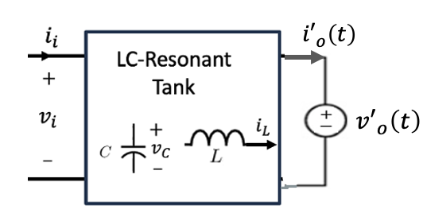
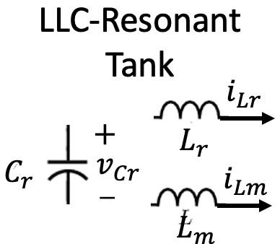
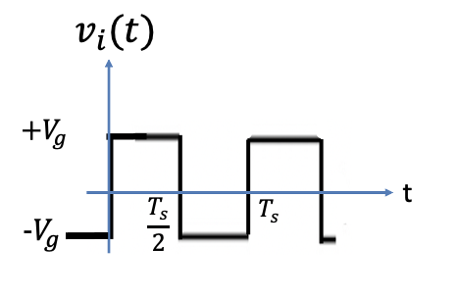
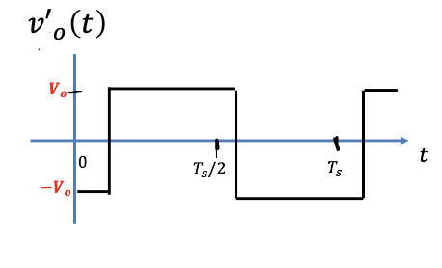
The LLC Resonant Converter
Using the assumptions above, the simplified equivalent configuration is shown in the figure below,
The currents $i_{i}\left(t\right)$and ${i′}_{o}\left(t\right)$can be any resonant waveforms

Slide 6
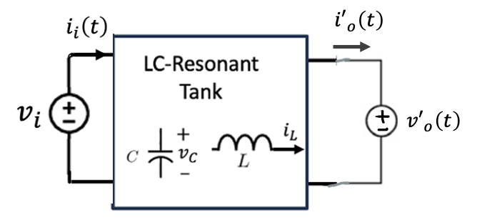
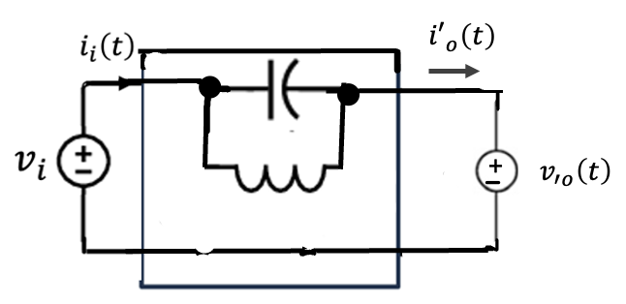
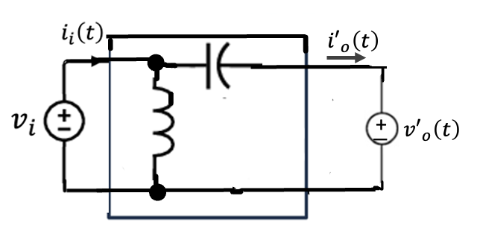
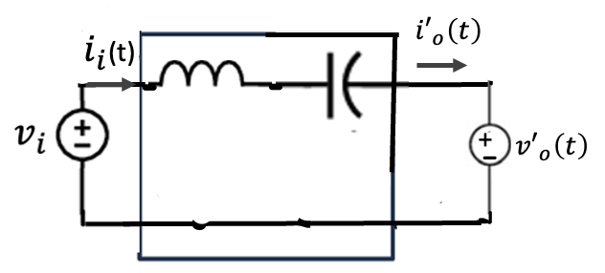
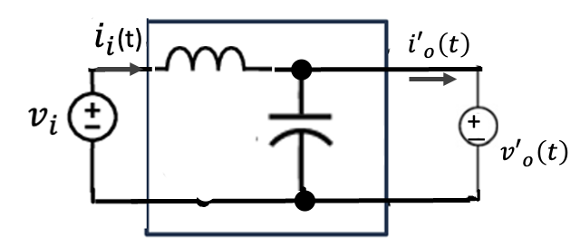
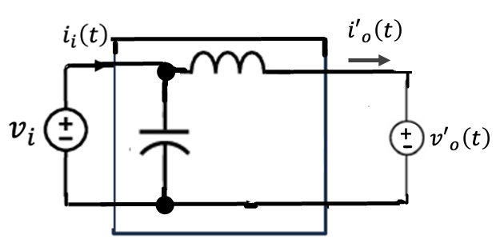
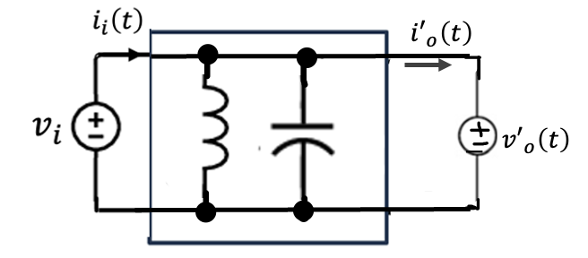
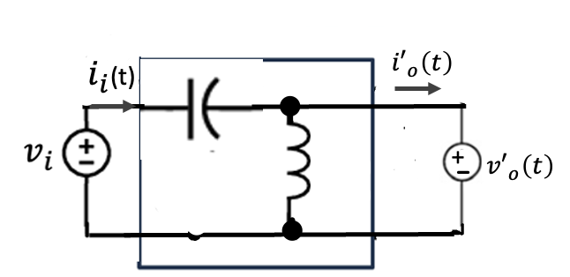
Capacitive RC output Filter
Possible 2nd Resonant Tank Topologies

Slide 7
Capacitive RC output Filter
Possible 2nd Resonant Tank Topologies

Slide 8
Capacitive RC output Filter
Possible 2nd Resonant Tank Topologies

Slide 9
Capacitive RC output Filter
Possible 2nd Resonant Tank Topologies

Slide 11
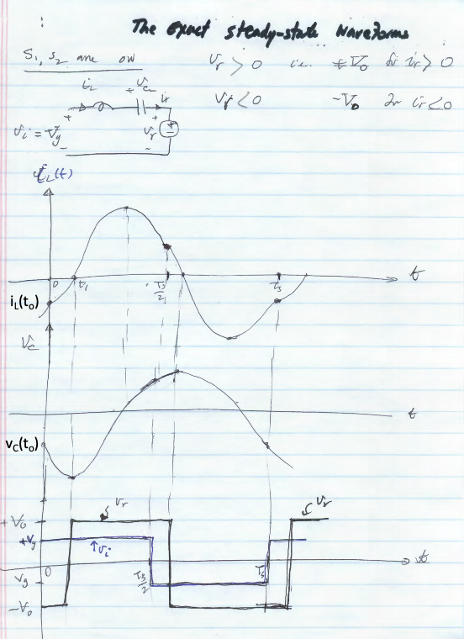
i_{L}(t_{o})
v_{C}(t_{o})
The initial inductor current i_{L}(t_{o})
The initial capacitor voltage v_{C}(t_{o})

Slide 15
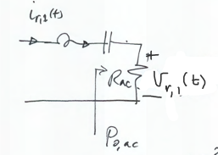

Slide 25
