Slide 1
Lecture 11
EEL 646 POWER ELECTRONICS II Steady-State Analysis of the SRC & PRC

Slide 2
Agenda
Agenda
Steady-State Analysis of the the Parallel Resonant Converter (PRC)
Steady-State Analysis of the Series Resonant Converter (SRC)

Slide 3
Parallel Resonant Converter
PRC

Slide 4
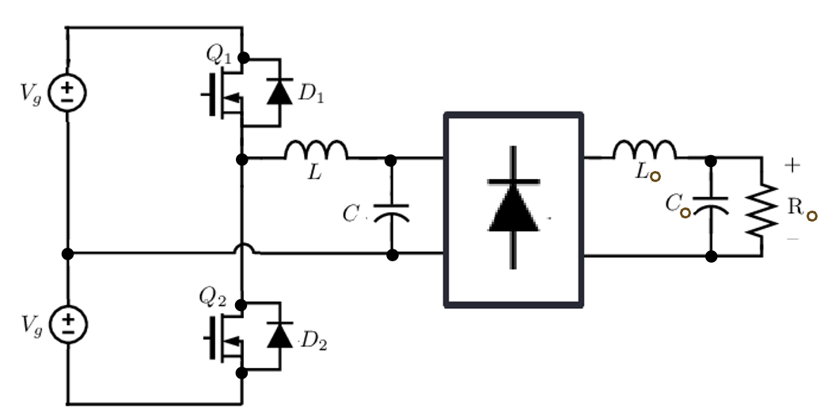
Parallel Resonant Converter

Slide 5
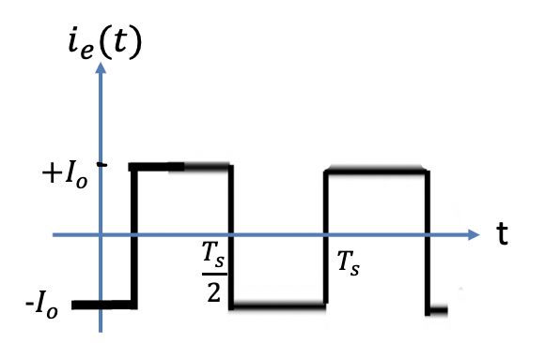
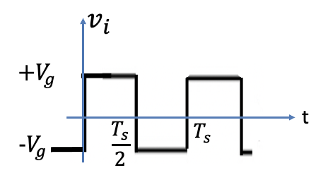
Simplified Parallel Resonant Converter

Slide 6
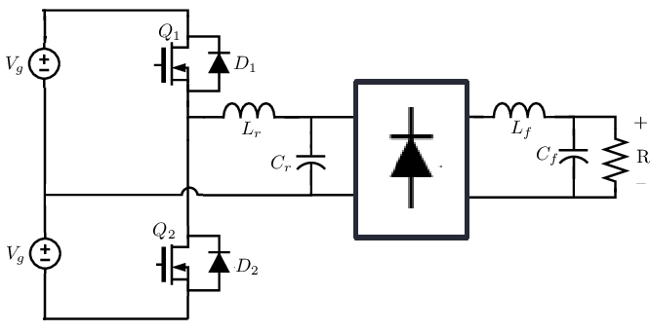
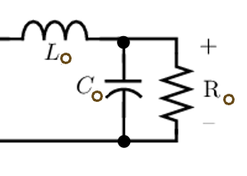
Steady-State Analysis
i_{i}
i_{e}
+
_
+
_
v_{i}
v_{C}
Resonant Tank
Rectifier

Slide 7
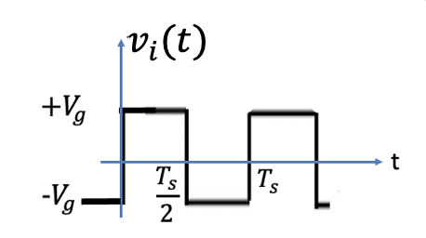
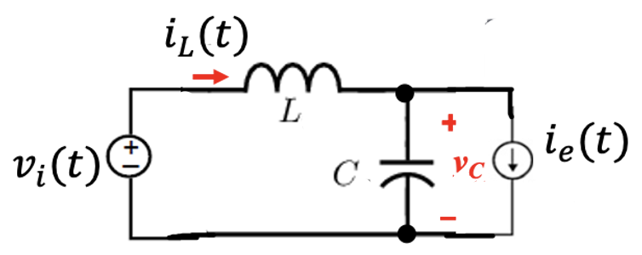
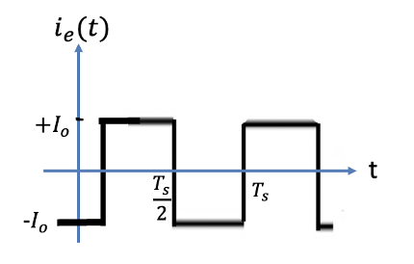
Steady-State Equivalent Circuits

Slide 8
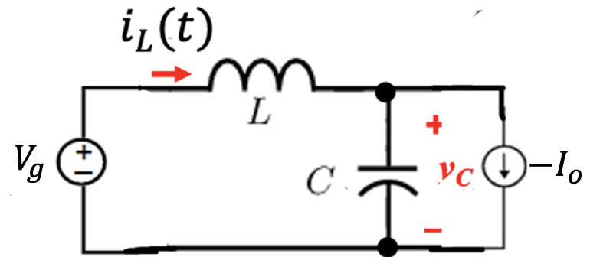
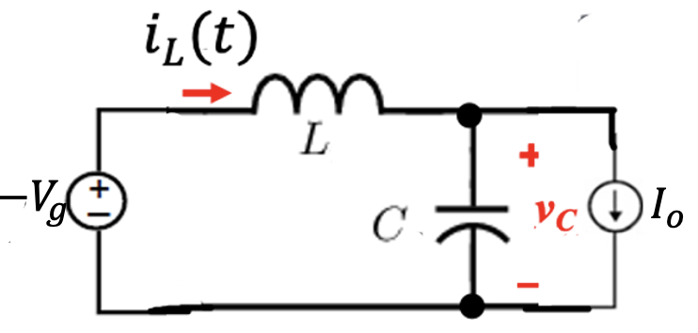
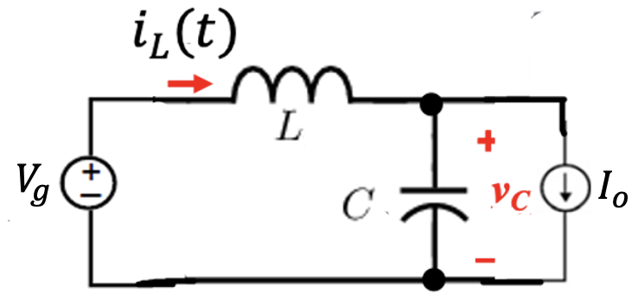
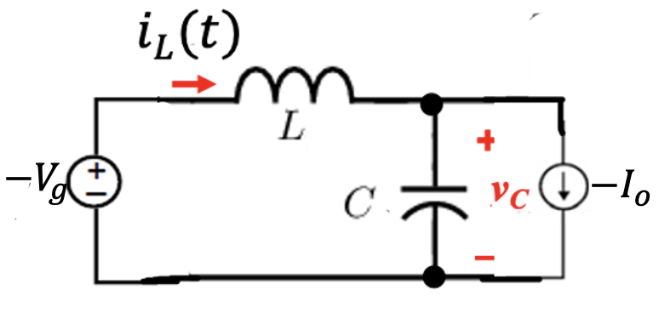
Steady-State Equivalent Circuits

Slide 9
Steady-State Modes of Operation
Assume we start at ${t=t}_{o}$ by turning $Q_{1}$ ON
The Initial Inductor current $i_{L}(t_{o})$
The initial capacitor voltage $i_{C}(t_{o})$
Assume that we have we:
$$i_{L}\left(t_{o}\right)>0$$
The current $i_{L}\left(t\right)$is flowing in $Q_{1}$
$$v_{C}\left(t_{o}\right)<0$$
The current $i_{e}\left(t\right)=−I_{o}$

Slide 10
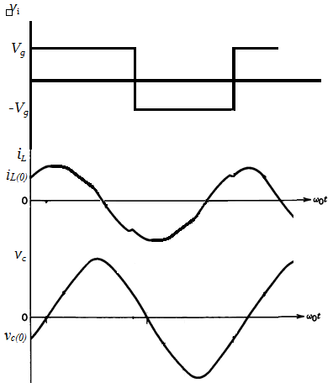
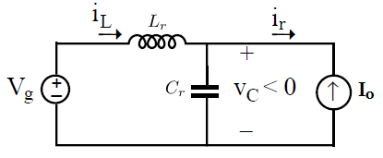
Mode 1 (t₀ ≤ t < t₁)
Q1: ON
V_{c} < 0
Vg >0
Initial Conditions:
i_{L}(t₀) = i_{L}(0)
v_{c}(t₀) = v_{c}(0)
I_{o}
-I_{o}
Interval Equations:
$$\frac{diL}{dt}=\frac{1}{L}\left(Vi(t)−VC(t)\right)=\frac{1}{L}\left(Vg−VC(t)\right)$$
t_{x}
t_{x'}
$$\frac{dvC}{dt}=\frac{1}{C}\left(iL(t)−ir(t)\right)=\frac{1}{C}\left(iL\left(t\right)+Io\right)$$
Q1
t₀ t₁ t₂ t₃ t₄
$$\frac{Ts}{2}$$
T_{s}

Slide 11
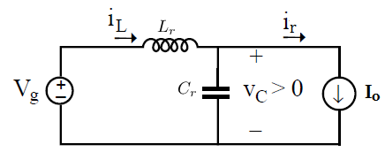
Mode 2 (t₁ ≤ t < t₂)
Q1: ON → D_{Q1}: ON
V_{c} > 0
Vg >0
I_{o}
-I_{o}
Interval Equations:
$$\frac{diL}{dt}=\frac{1}{L}\left(Vi(t)−VC(t)\right)=\frac{1}{L}\left(Vg−VC(t)\right)$$
t_{x}
t_{x'}
$$\frac{dvC}{dt}=\frac{1}{C}\left(iL(t)−ir(t)\right)=\frac{1}{C}\left(iL\left(t\right)−Io\right)$$
Q1
Q1
D_{Q1}
t₀ t₁ t₂ t₃ t₄
$$\frac{Ts}{2}$$
T_{s}
Mode II (Flyback diode)

Slide 12
I_{o}
-I_{o}
Interval Equations:
$$\frac{diL}{dt}=\frac{1}{L}\left(Vi(t)−VC(t)\right)=\frac{1}{L}\left(Vg−VC(t)\right)$$
t_{x}
t_{x'}
$$\frac{dvC}{dt}=\frac{1}{C}\left(iL(t)−ir(t)\right)=\frac{1}{C}\left(iL\left(t\right)−Io\right)$$
Q1
Q1
D_{Q1}
t₀ t₁ t₂ t₃ t₄
$$\frac{Ts}{2}$$
T_{s}
Mode II (Flyback diode)

Slide 14
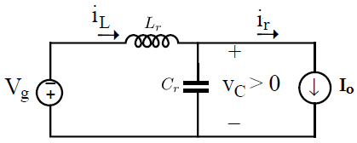
Mode 3 (t₂ ≤ t < t₃)
Q2: ON
V_{c} > 0
Vg <0
I_{o}
-I_{o}
Interval Equations:
$$\frac{diL}{dt}=\frac{1}{L}\left(Vi(t)−VC(t)\right)=\frac{1}{L}\left(−Vg−VC(t)\right)$$
$$\frac{dvC}{dt}=\frac{1}{C}\left(iL(t)−ir(t)\right)=\frac{1}{C}\left(iL\left(t\right)−Io\right)$$
t_{x}
t_{x'}
Q1
Q1
D_{Q1}
Q2
t₀ t₁ t₂ t₃ t₄
$$\frac{Ts}{2}$$
T_{s}

Slide 15
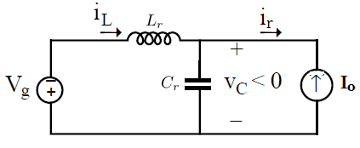
Mode 4 (t₃ ≤ t < t₄)
Q2: ON → D_{Q2}: ON
V_{c} < 0
Vg <0
I_{o}
-I_{o}
Interval Equations:
$$\frac{diL}{dt}=\frac{1}{L}\left(Vi(t)−VC(t)\right)=\frac{1}{L}\left(−Vg−VC(t)\right)$$
$$\frac{dvC}{dt}=\frac{1}{C}\left(iL(t)−ir(t)\right)=\frac{1}{C}\left(iL\left(t\right)+Io\right)$$
t_{x}
t_{x'}
D_{Q2}
Q1
Q1
D_{Q1}
Q2
Q2
t₀ t₁ t₂ t₃ t₄
$$\frac{Ts}{2}$$
T_{s}

Slide 16
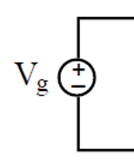
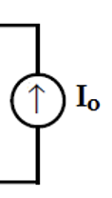
Steady-State Voltage Gain
$$V_{o} =\frac{1}{T_{s}}\int_{0}^{T_{s}}{\left|v_{C}\left(t\right)\right|dt}$$
L, C $Z_{O},ω_{O}$, $f_{O}$
$$+$$
$$V_{o}$$
Define normalized values:
$$−$$
$$M=\frac{V_{o}}{V_{g}}$$
$$Z_{o} =\sqrt{L/C}$$
$$R_{o} =\frac{V_{o}}{I_{o}}$$
$$f_{ns} =\frac{f_{s}}{f_{o}}$$
$$Q_{p} =\frac{R_{o}}{Z_{g}}$$
$$ω_{o} =1/\sqrt{LC}$$

Slide 17
$$V_{o}=\frac{1}{γ}[V_{g}\left(γ−2β_{1}\right)+2Z_{o}i_{L}\left(t_{1}\right)]$$
$$M=\frac{V_{o}}{V_{g}}$$
$$M=\frac{1}{γ}[\left(γ−2β_{1}\right)+2i_{nL1}]$$
$$γ=π\frac{f_{o}}{f_{s}}=\frac{π}{f_{ns}}$$
$$i_{nL1}=\frac{Z_{o}i_{L}\left(t_{1}\right)}{V_{g}}]$$
$i_{L}\left(t_{1}\right)$ is the value of the inductor current at $t=t_{1}$

Slide 18
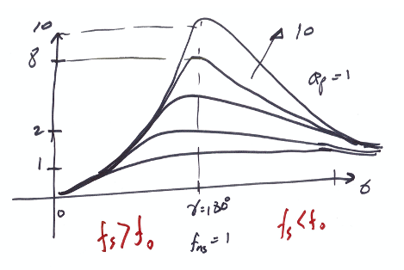

Slide 19
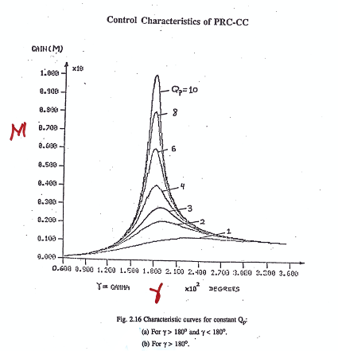
$$M$$
$$γ$$

Slide 20
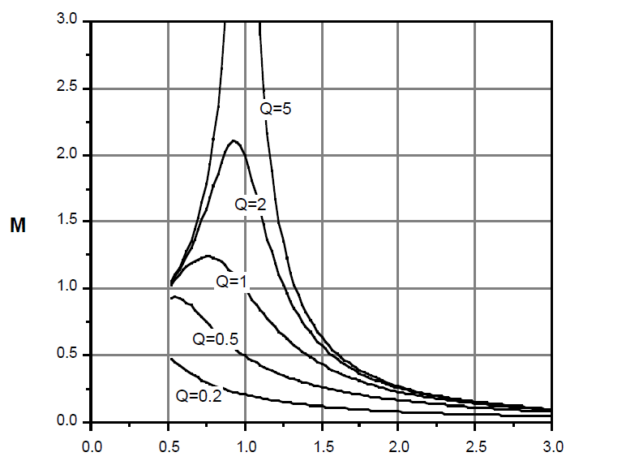
$$ω0=\frac{1}{\sqrt{LC}}$$
$$Z0=\sqrt{\frac{L}{C}}$$
$$Q=\frac{R0}{Z0}$$
$$γ=ω0\frac{TS}{2}$$
Q
$$β=ω0\left(t1−t0\right)$$
$$Vo=\frac{1}{{TS}/2}\int_{t0}^{{TS}/2}{\left|Vc(t)\right|dt}=\frac{1}{γ}\left[Vg\left(γ−2β\right)+2Z0iL(t)\right]$$
$$M=\frac{Vo}{Vg}$$
$fs$< $fo$
$$γ$$
$fs$> $fo$
$$fn=\frac{fs}{fo}$$

Slide 21
