Slide 1
Lecture 10
EEL 646 POWER ELECTRONICS II Introduction to Second Order Full Resonant Converters

Slide 2
Agenda
What is the topology for full resonance converters
Single RC tanks topologies
The introduction to the Parallel Resonant Converter (PRC)
The introduction to the Series Resonant Converter (SRC)

Slide 3
The Resonant Configurations
In the LC-Resonant Converters (2nd order converter), the resonant stage for the inductor current and capacitor voltage covers the entire full resonant cycle.
$v_{C}\left(t\right)$and $i_{L}\left(t\right)$are the resonant inductor current and capacitor voltage.
$i_{i}\left(t\right)$and $v_{i}\left(t\right)$are the AC output current and voltage produced by. The bridge-circuit (full- or half bridge)
${i′}_{o}\left(t\right)$and ${v′}_{o}\left(t\right)$are the AC input current and voltage into the full-wave rectifier
$$i_{o}\left(t\right)=|{i^{′}}_{o}\left(t\right)|$$
$$v_{o}\left(t\right)=|{v^{′}}_{o}\left(t\right)|$$
$i_{o}\left(t\right)$and $v_{o}\left(t\right)$ are the rectified output AC current and voltage into the full-wave rectifier
$Since$resonance occurs over the full cycle, then their average values must be zero to be stable, i.e.
$$v_{C,ave}\left(t\right)=0$$
$$i_{L,ave}\left(t\right)=0$$

Slide 4
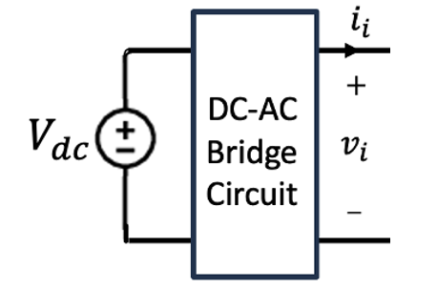
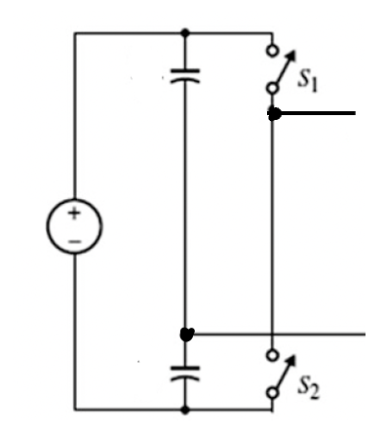
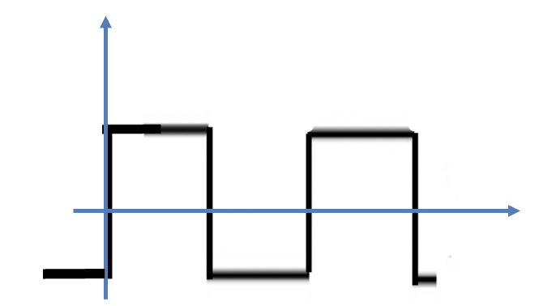
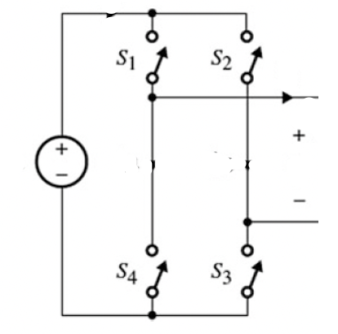
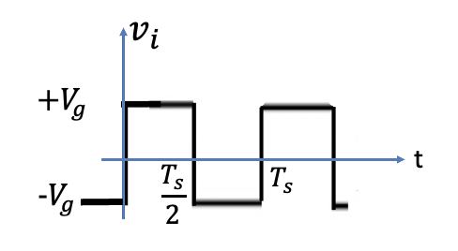
Block Diagram of Resonant Converter
Half-bridge Configuration:
$$V_{g}$$
$$+$$
$$−$$
$$i_{i}$$
$$+$$
$$v_{i}(t)$$
$${V_{dc}=2V}_{g}$$
$$v_{i}$$
$$−$$
$$+V_{g}$$
$$V_{g}$$
$$+$$
$$−$$
$$\frac{T_{s}}{2}$$
$$T_{s}$$
t
$$-V_{g}$$
Full-bridge Configuration:
$$i_{i}$$
$$V_{dc}{=V}_{g}$$
$$v_{i}$$

Slide 5
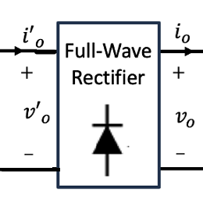
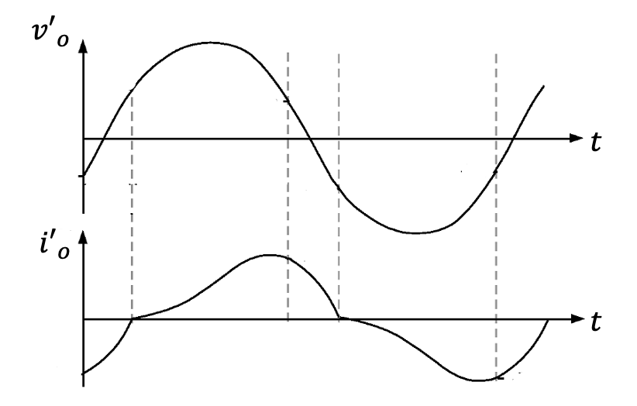
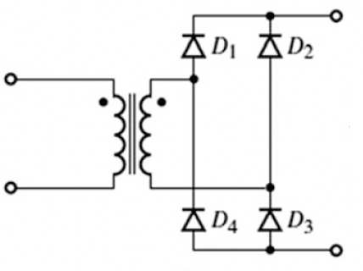
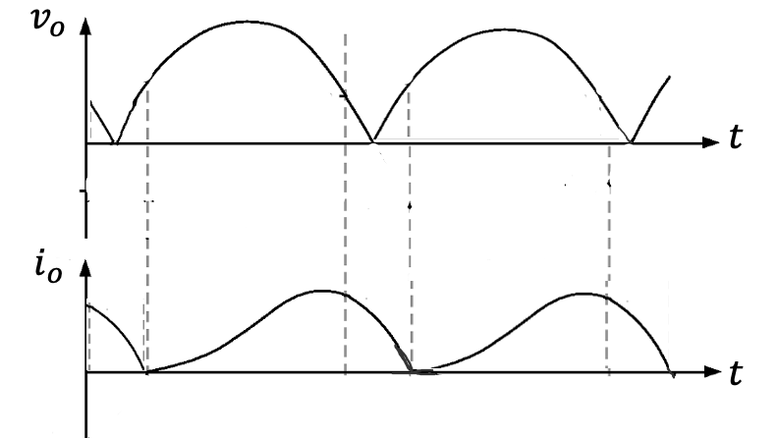
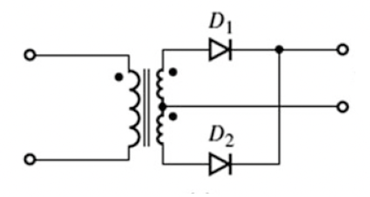
Block Diagram of Output Rectifier
Full-wave Configuration:
$$i_{o}$$
$${i′}_{o}$$
$$+$$
$$+$$
$${v′}_{o}$$
$$v_{o}$$
$$−$$
$$−$$
Center-tap half-wave Configuration:
$${i′}_{o}$$
$$i_{o}$$
$$+$$
$$+$$
$$v_{o}$$
$${v′}_{o}$$
$$−$$
$$−$$

Slide 6
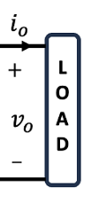
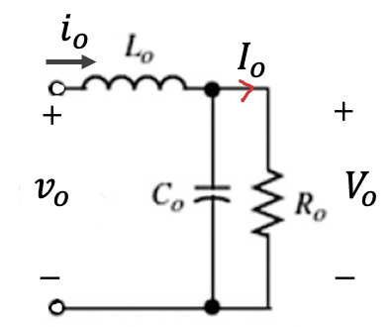
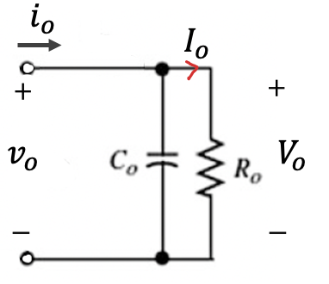
Block Diagram of Output Load
RLC-Filter Configuration:
The average output current:
$$I_{o}=\frac{1}{T_{s}}\int_{0}^{T_{s}}{i_{o}\left(t\right) dt}$$
The average output voltage:
RC-Filter Configuration:
$$V_{o}=\frac{1}{T_{s}}\int_{0}^{T_{s}}{v_{o}\left(t\right) dt}$$
$$R_{o}=\frac{V_{o}}{I_{o}}$$

Slide 7
Simplified - RLC-Filter Configuration:
Assume:
$$\frac{L_{o}}{R_{o}}≫T_{s}$$
$$I_{o}≈i_{o}\left(t\right)$$
$$I_{o}$$
The average output current:
The average output voltage:
$$V_{o}=\frac{1}{T_{s}}\int_{0}^{T_{s}}{v_{o}\left(t\right) dt}$$
$$R_{o}=\frac{V_{o}}{I_{o}}$$

Slide 8
Simplified - RLC-Filter Configuration:
Assume:
$$R_{o}C_{o}≫T_{s}$$
$$V_{o}≈v_{o}\left(t\right)$$
$$V_{o}$$
The average output current:
The average output voltage:
$$I_{o}=\frac{1}{T_{s}}\int_{0}^{T_{s}}{i_{o}\left(t\right) dt}$$
$$R_{o}=\frac{V_{o}}{I_{o}}$$

Slide 9
Block Diagram of Output Rectifier
Full-wave Configuration:
$$i_{o}$$
$${i′}_{o}$$
$$+$$
$$+$$
$${v′}_{o}$$
$$v_{o}$$
$$−$$
$$−$$
Center-tap half-wave Configuration:
$${i′}_{o}$$
$$i_{o}$$
$$+$$
$$+$$
$$v_{o}$$
$${v′}_{o}$$
$$−$$
$$−$$

Slide 10
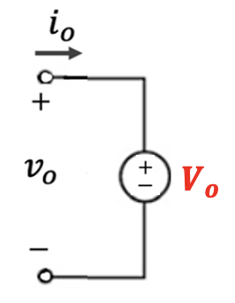
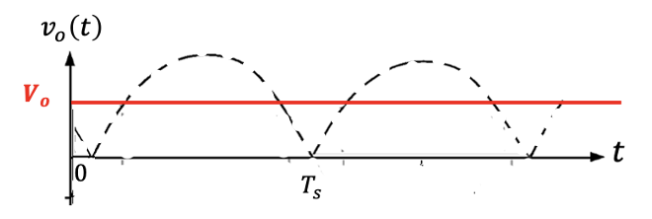
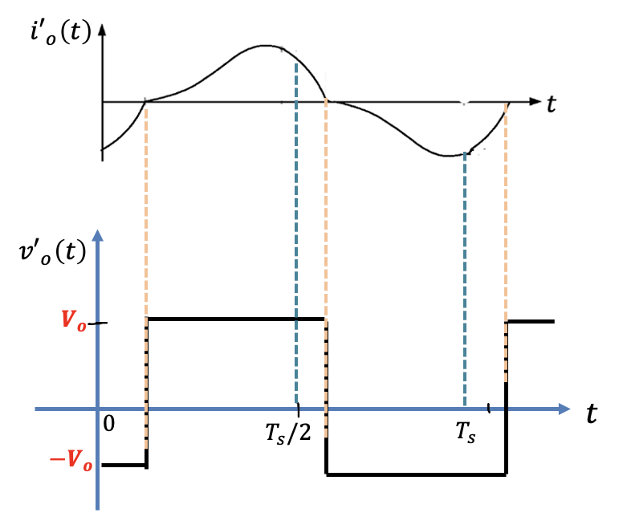
With the assumption of constant load voltage:

Slide 11
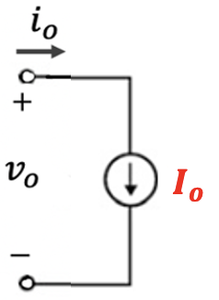
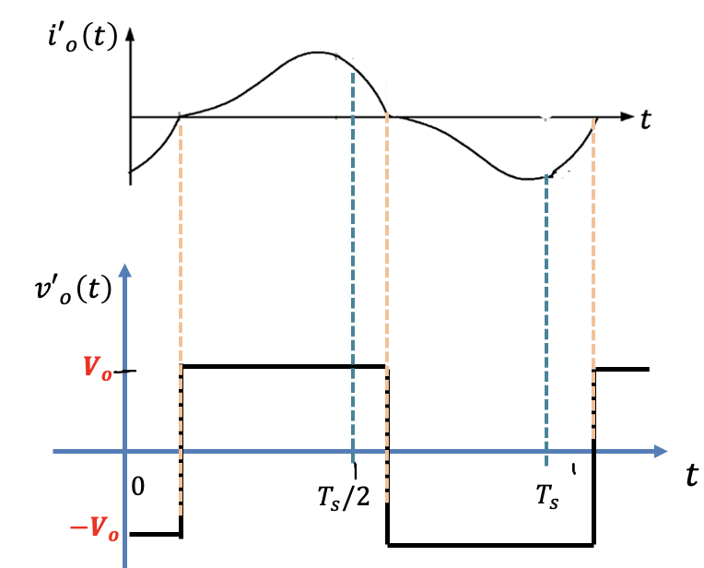
With the assumption of constant load current:

Slide 12
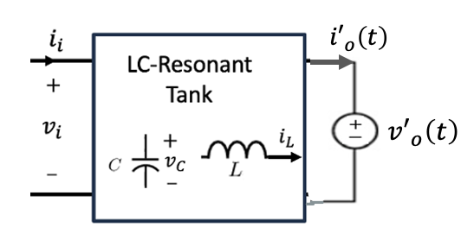
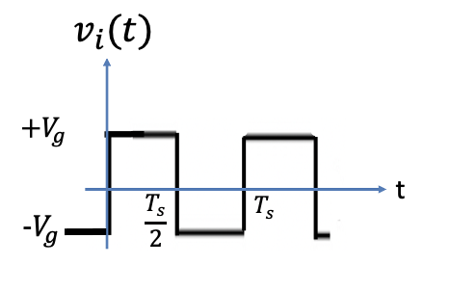
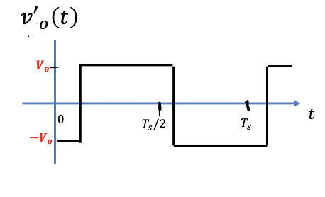
2nd Resonant Tank Configuration
Using the assumptions above, the simplified equivalent configuration is shown in the figure below,
I) Capacitive RC output Filter
The currents $i_{i}\left(t\right)$and ${i′}_{o}\left(t\right)$can be any resonant waveforms

Slide 13
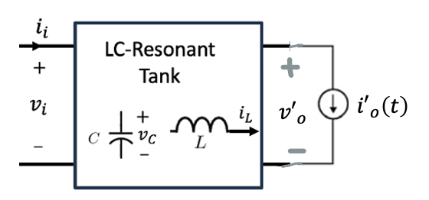
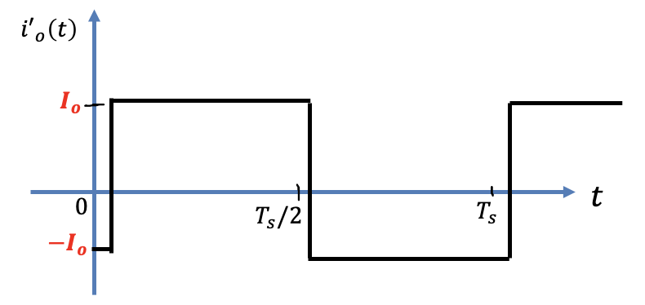
2nd Resonant Tank Configuration
II) Inductive RLC output Filter
$${i′}_{o}\left(t\right)$$
The currents $i_{i}\left(t\right)$and voltage ${v′}_{o}\left(t\right)$can be any resonant waveforms

Slide 14
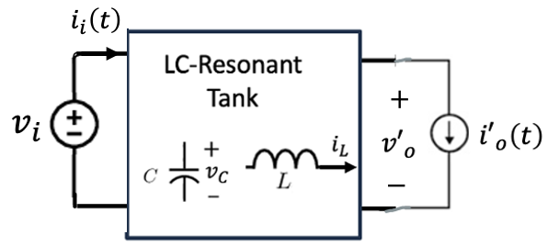
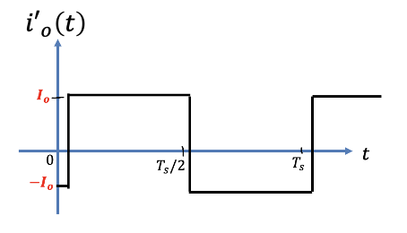
Possible 2nd Resonant Tank Topologies
II) Inductive RLC output Filter
The currents $i_{i}\left(t\right)$and voltage ${v′}_{o}\left(t\right)$can be any resonant waveforms

Slide 15
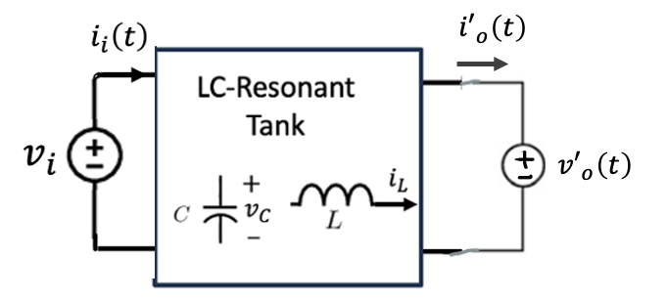
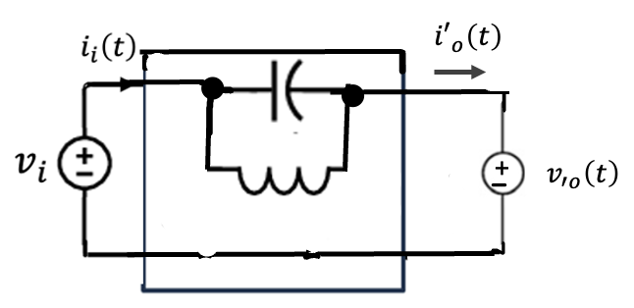
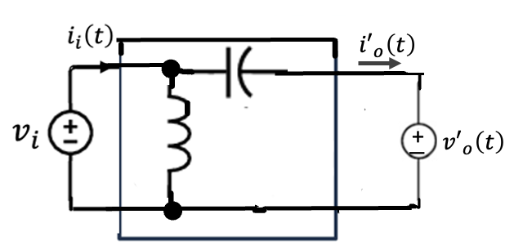
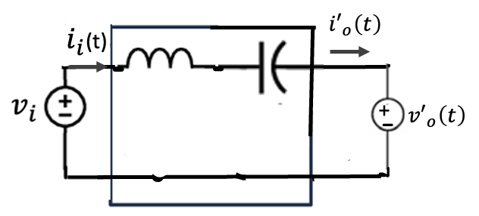
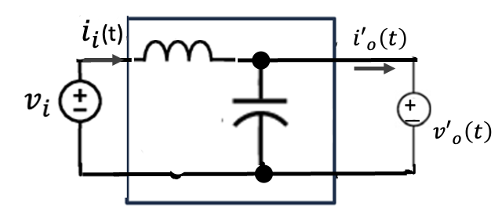
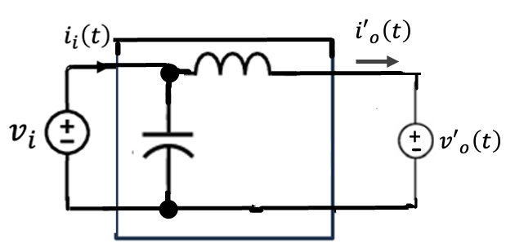
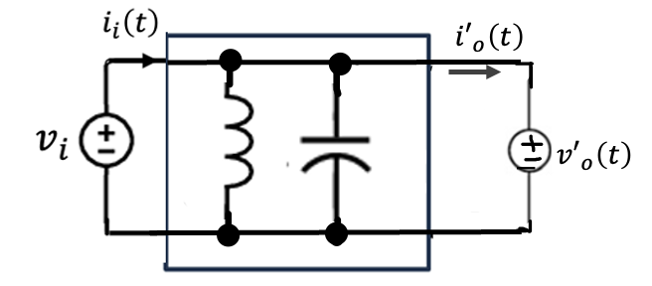
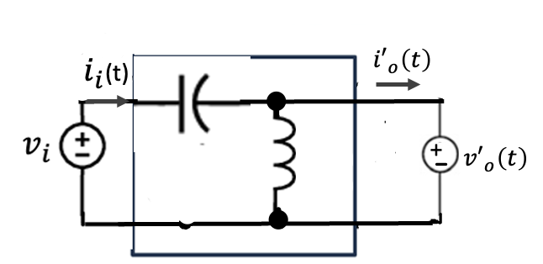
Possible 2nd Resonant Tank Topologies
I) Capacitive RC output Filter

Slide 16
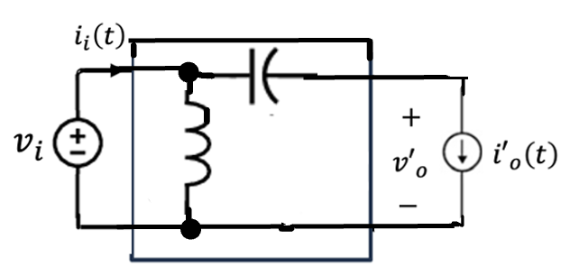
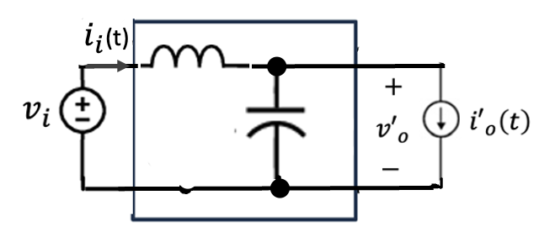
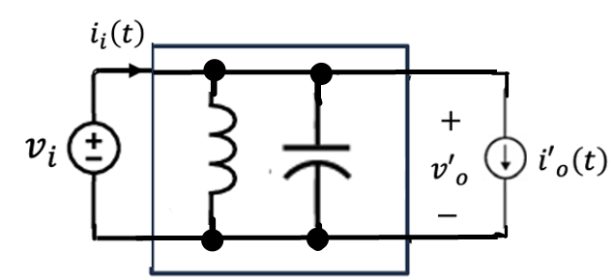
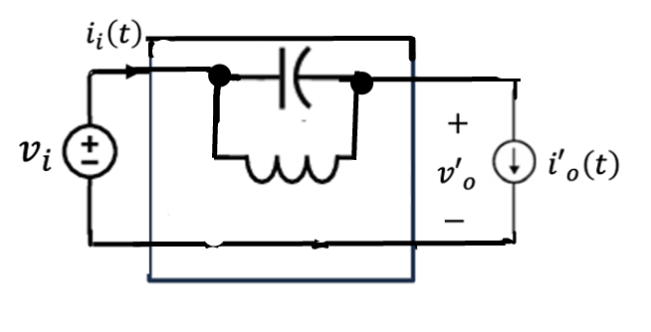
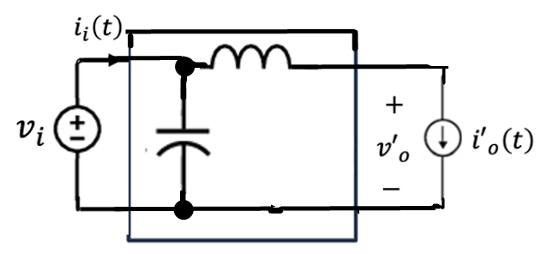
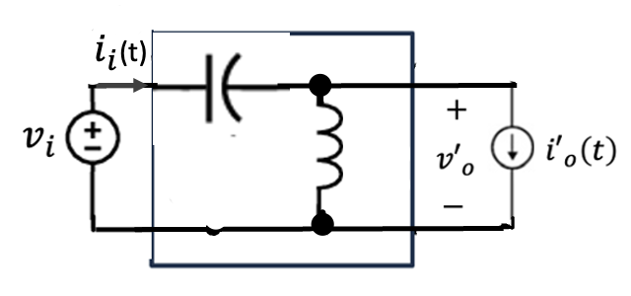
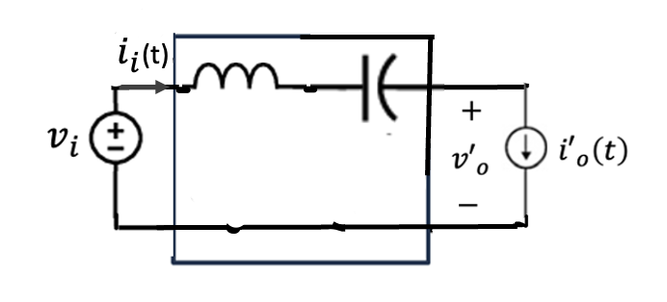
Possible 2nd Resonant Tank Topologies
II) Inductive RLC output Filter

