Slide 1

EEL 5245 POWER ELECTRONICS I
Lecture #9:
Ch 3: Diode Switching Circuits with R-C and RLC Loads and AC Source

Slide 2
Objectives
Introduce Concepts of Steady State/Transient in RC and LRC circuits
Emphasize mode-by-mode analysis
Simulating Ideal Elements
Half Wave Capacitor Rectifiers
Define capacitor Current Ripple
Example

Slide 3
Full Wave Rectifier with Capacitive Load

Slide 4
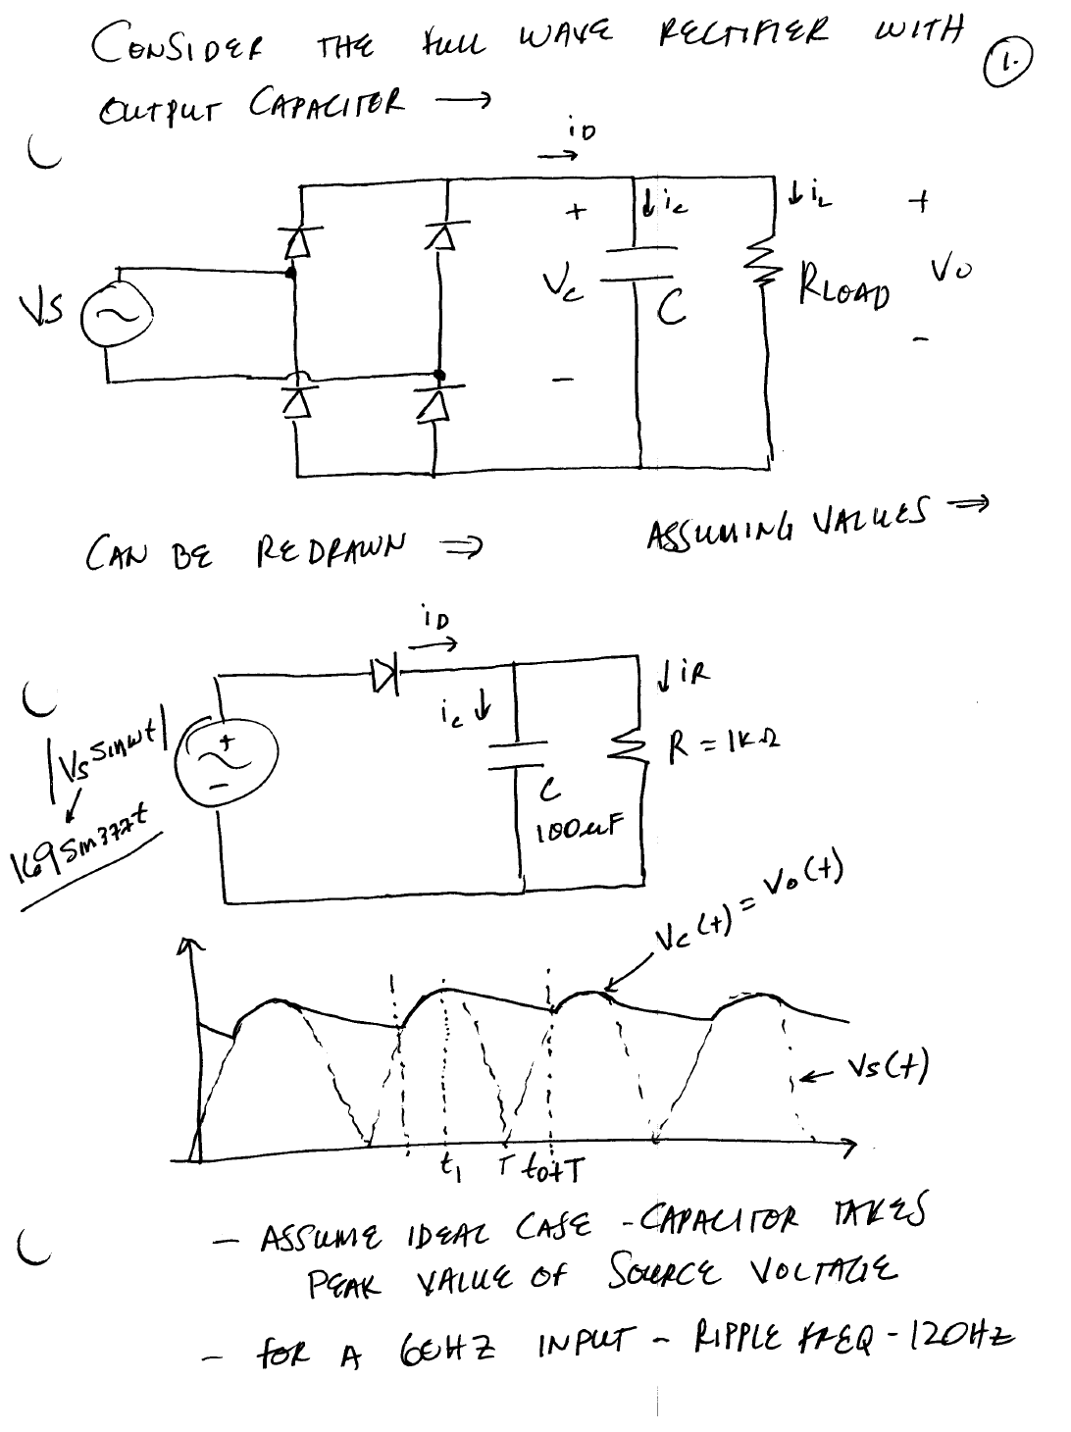



Slide 5
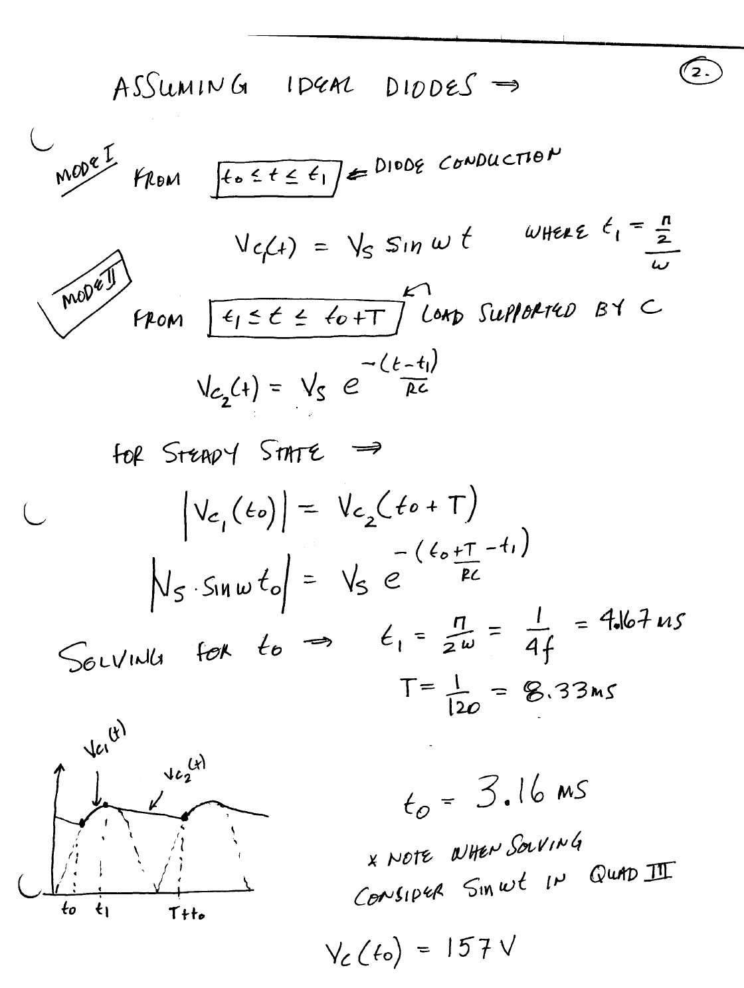



Slide 6
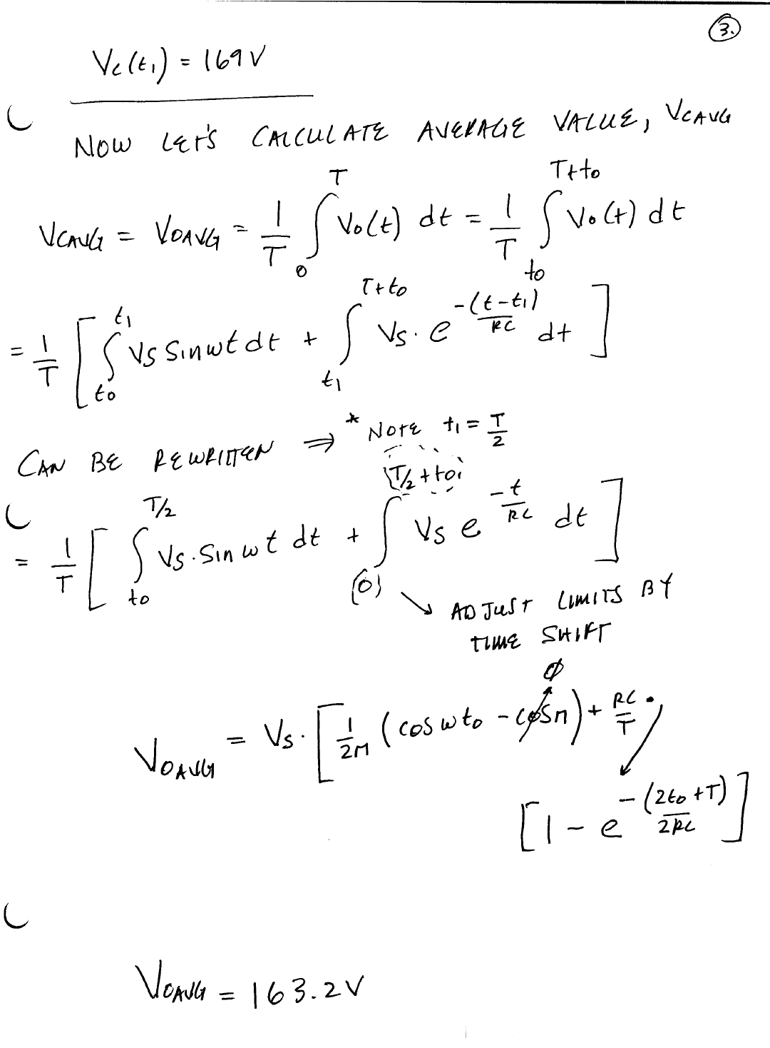


Slide 7
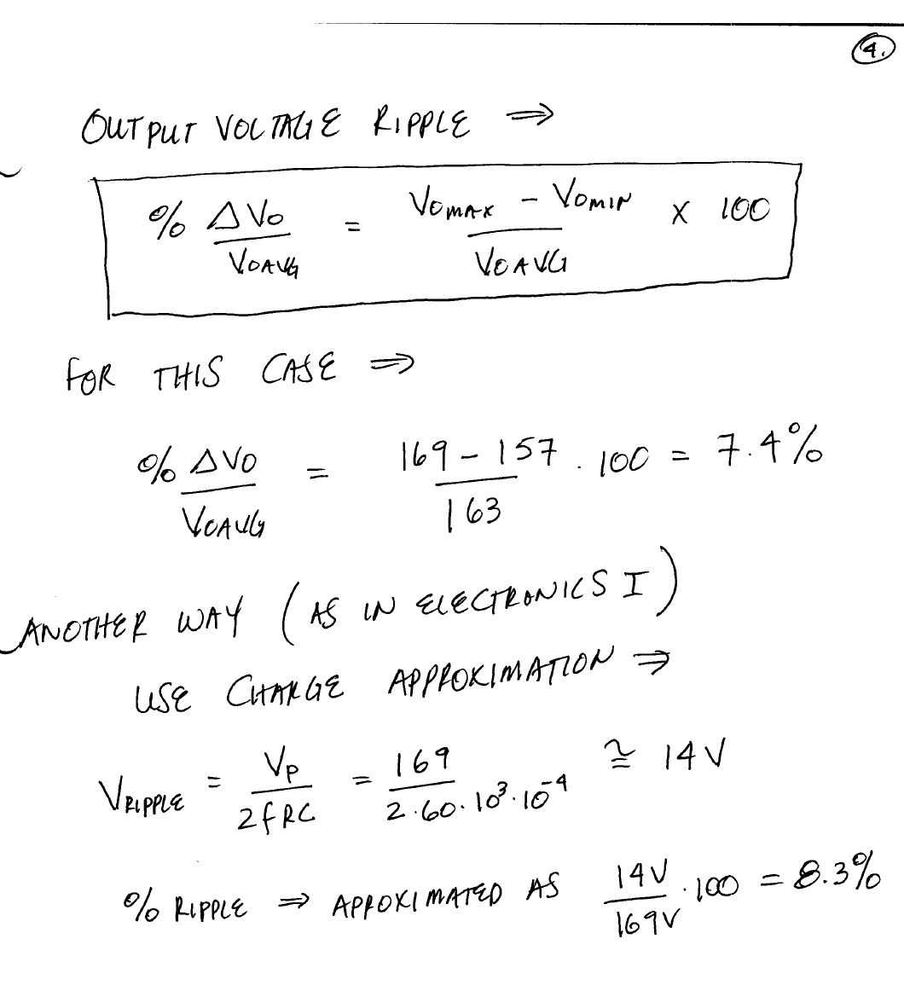


Slide 8
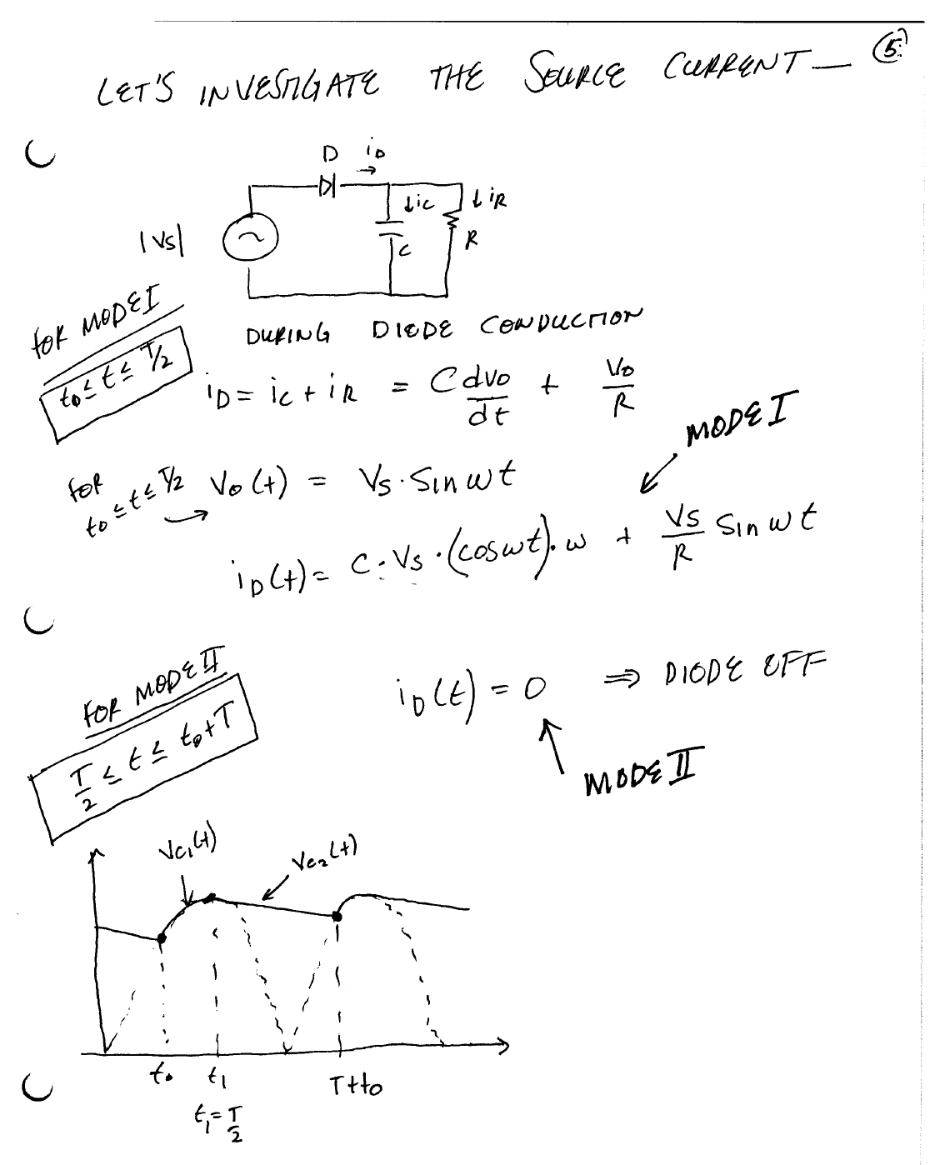




Slide 9
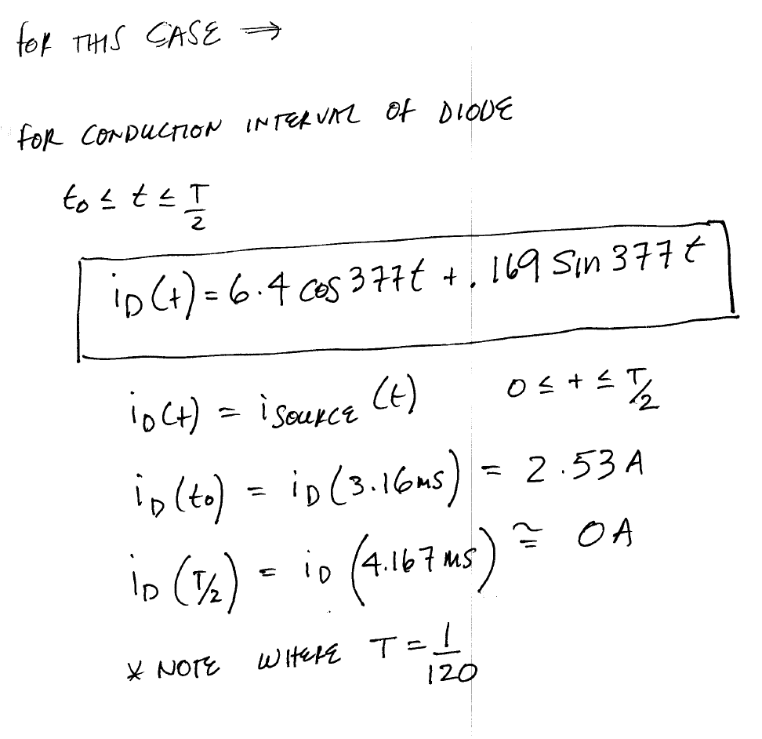

Slide 10
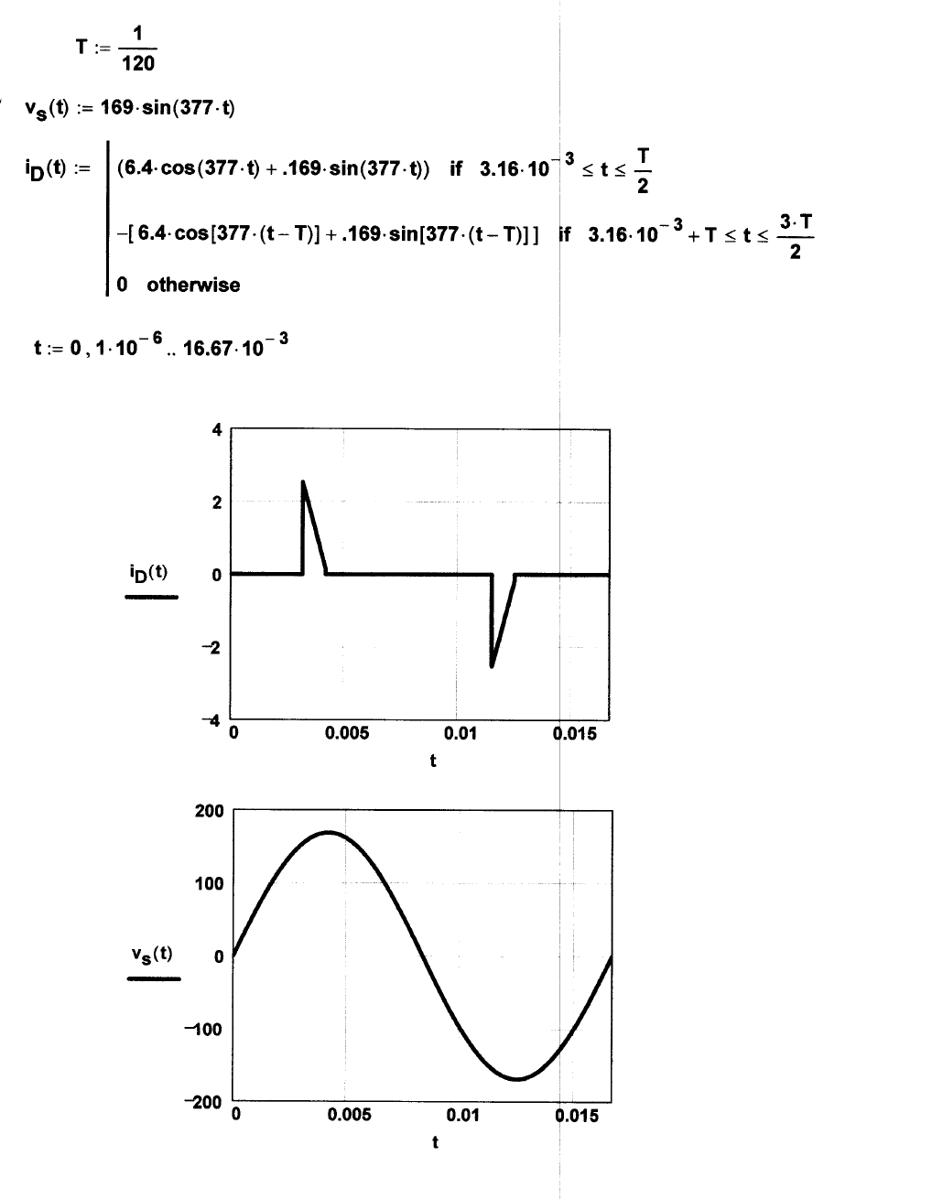

Slide 11
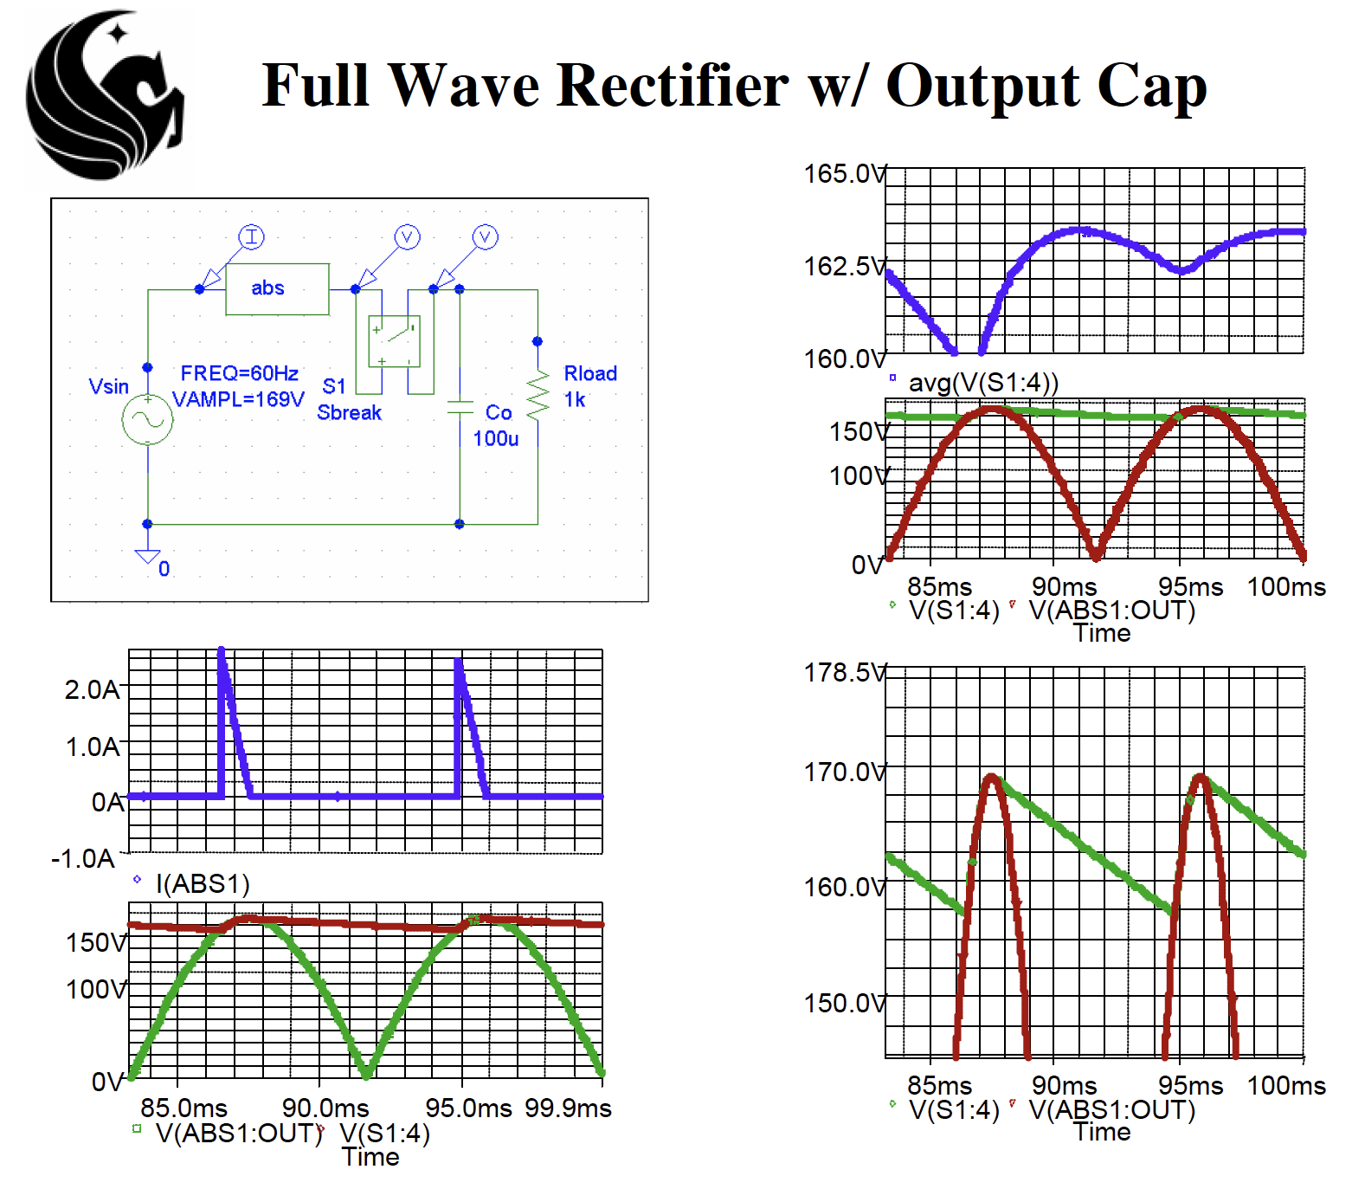

Slide 12
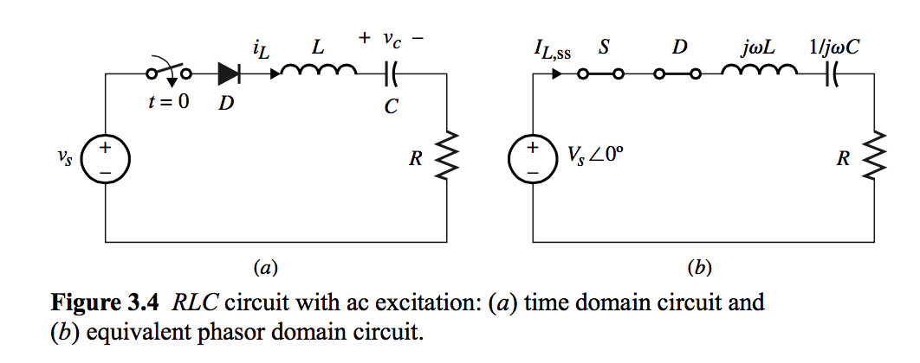
Switching Diod Circuits with an ac Source

Slide 13
Switching Diode Circuits with an ac Source

Slide 14
Switching Diode Circuits with an ac Source

Slide 15
Switching Diode Circuits with an ac Source

Slide 16
Switching Diode Circuits with an ac Source

Slide 17
SCR Switching Circuit with RLC Load

Slide 18
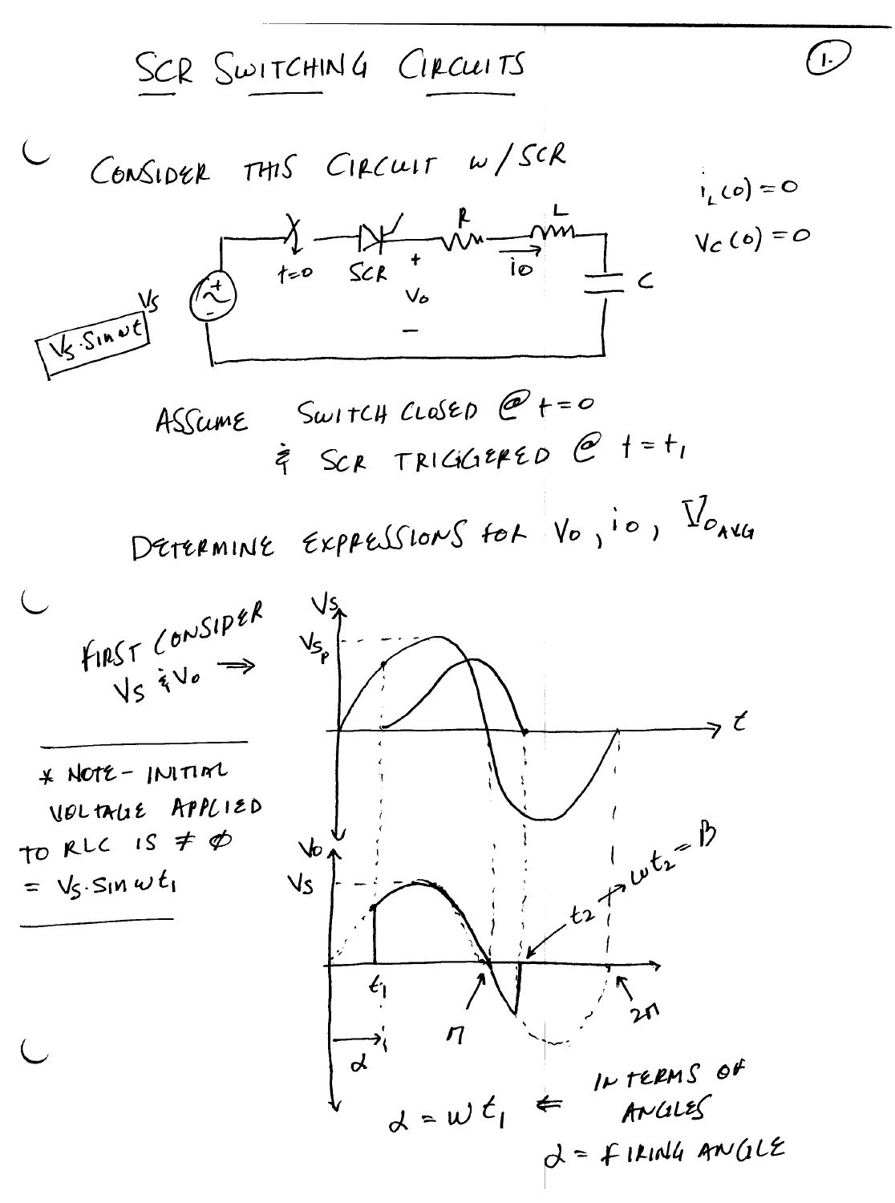



Slide 19
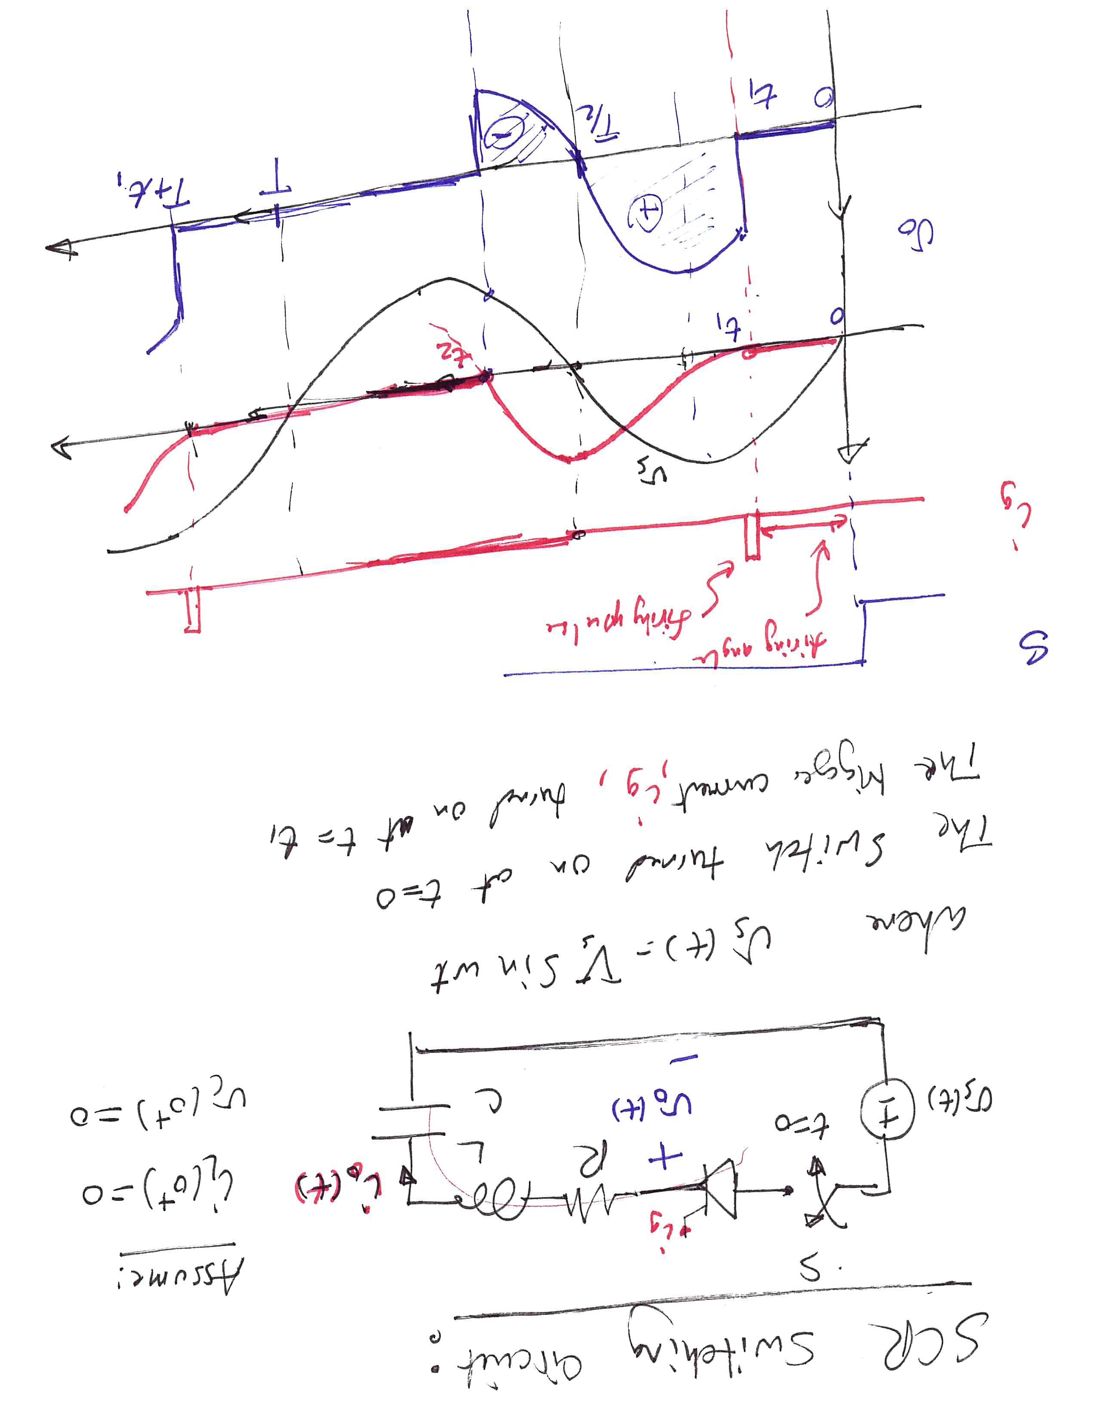

Slide 20
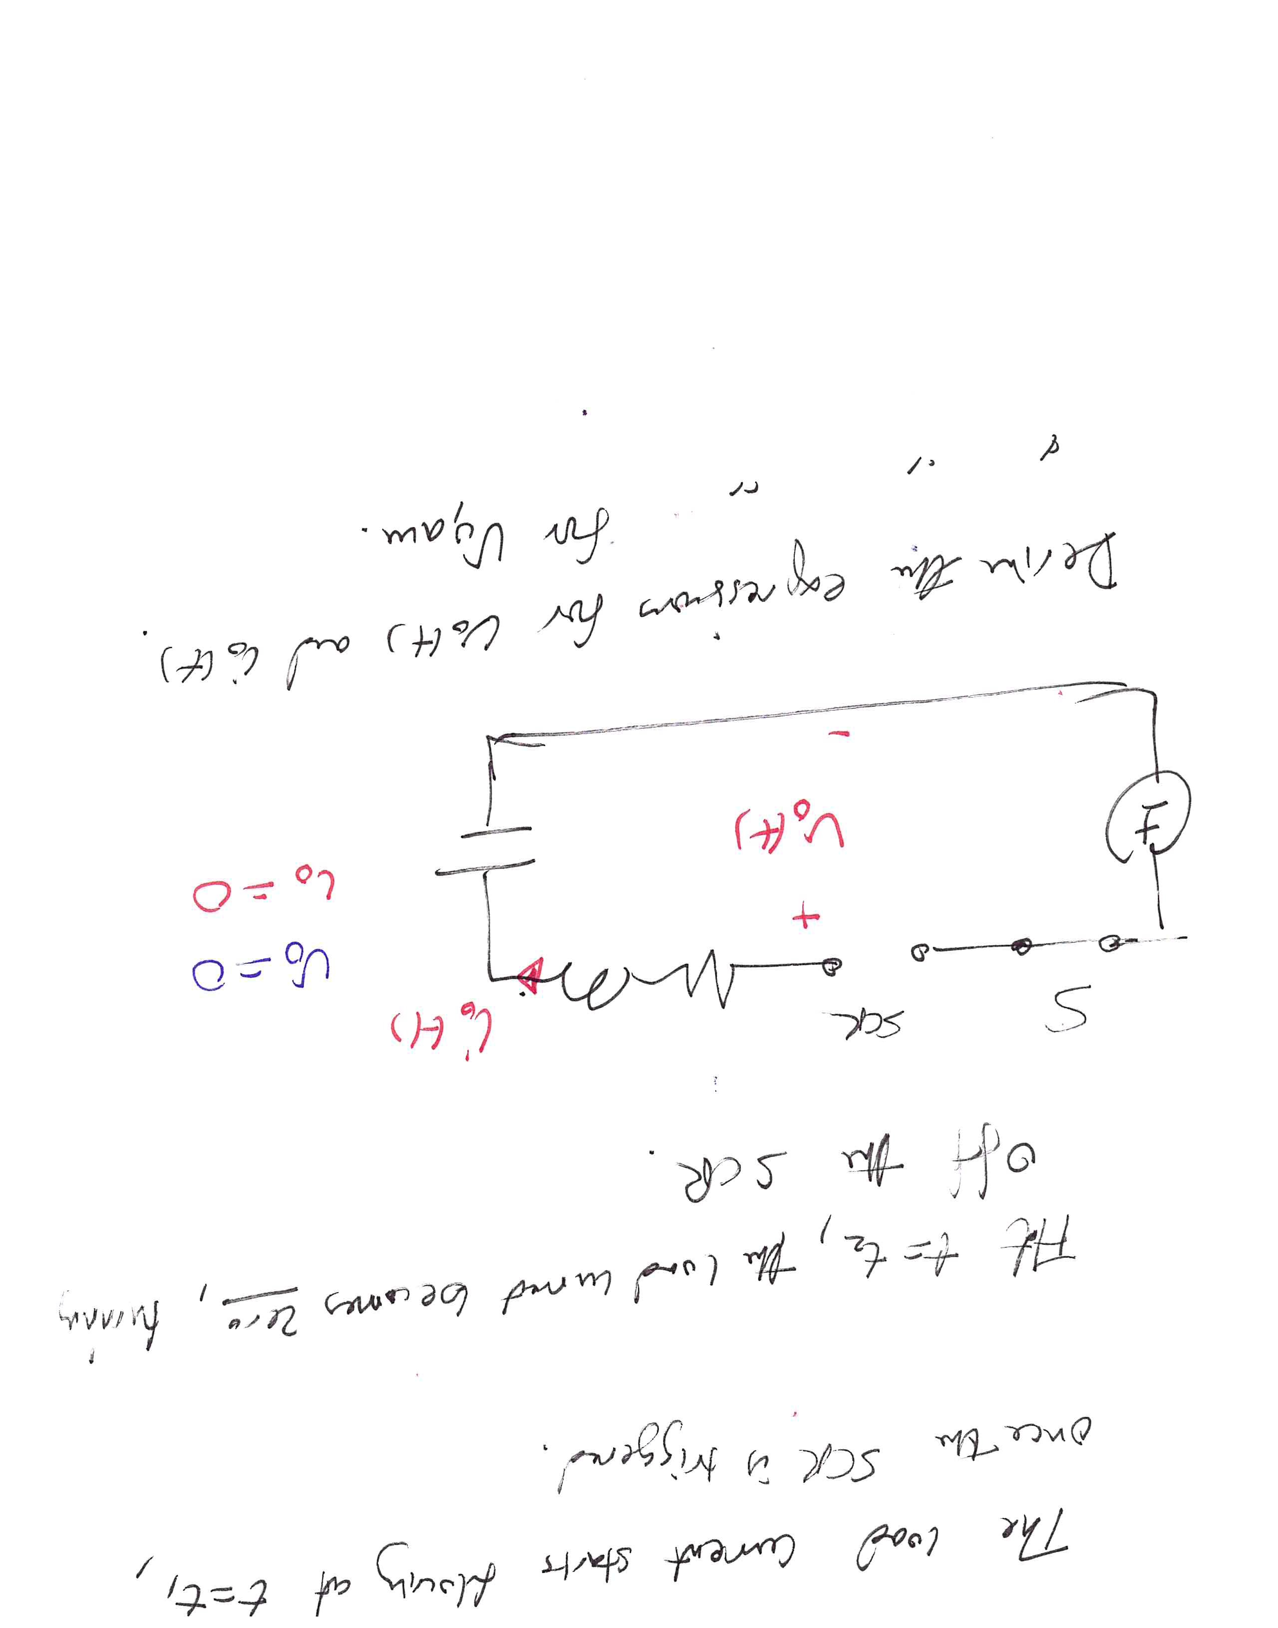

Slide 21
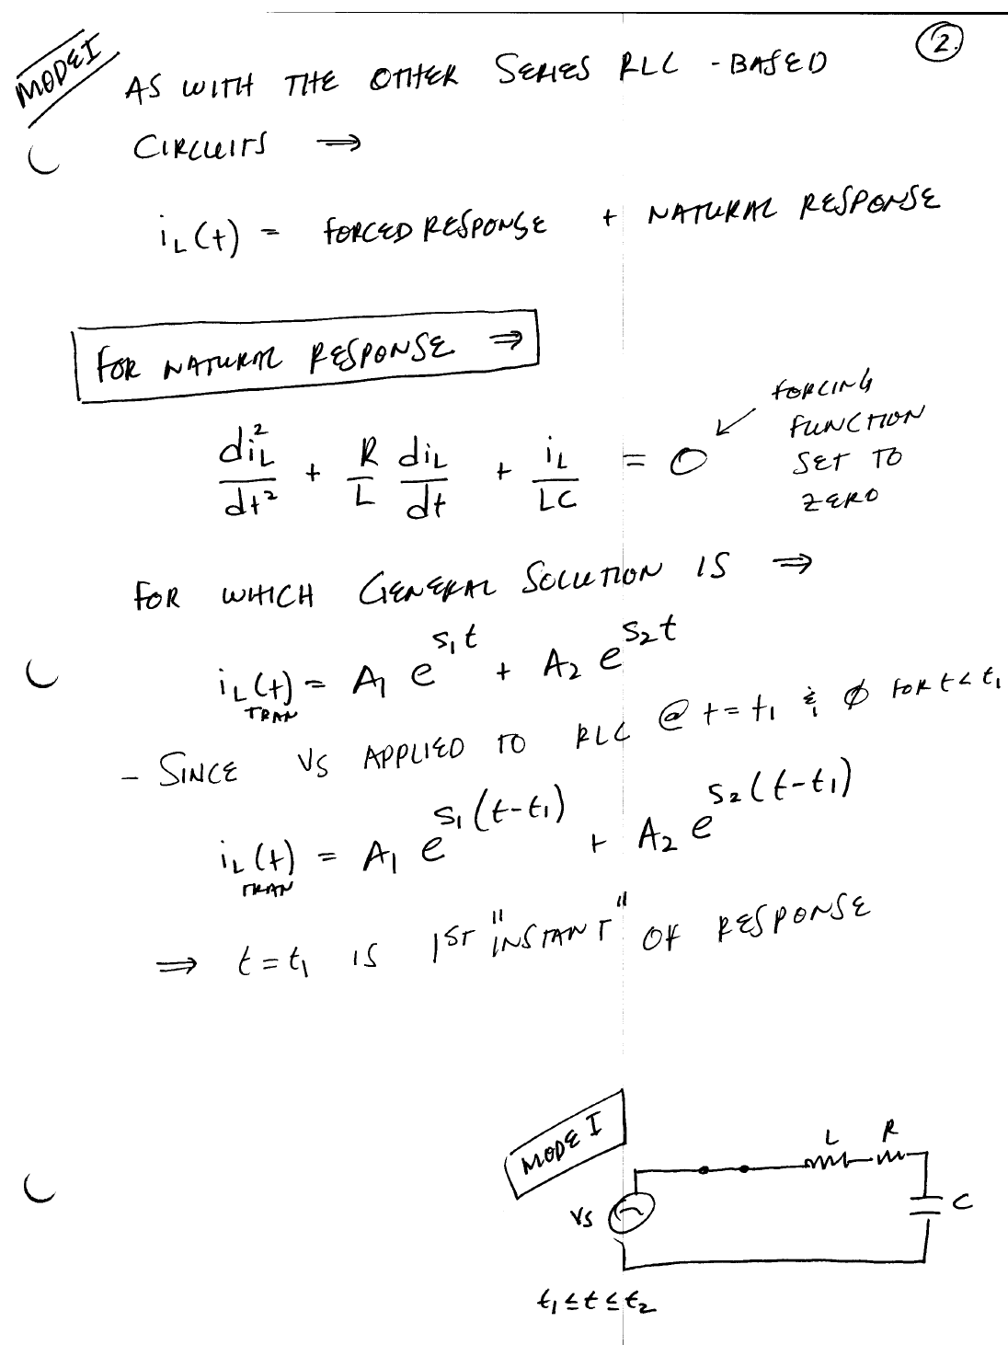


Slide 22
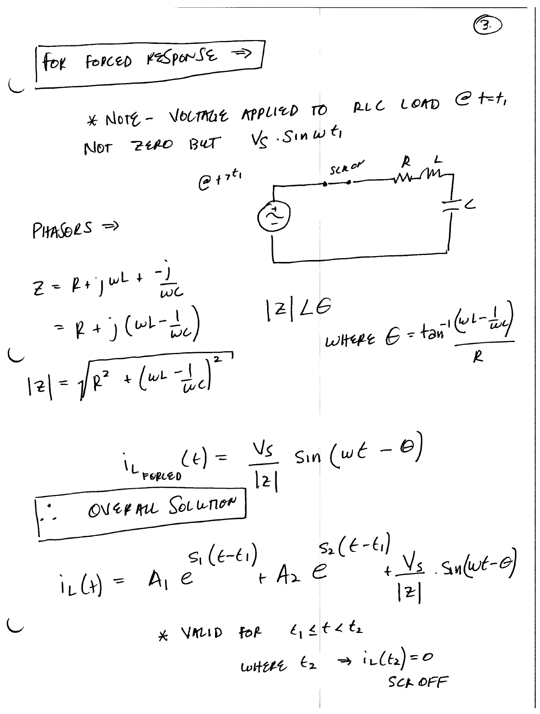


Slide 23
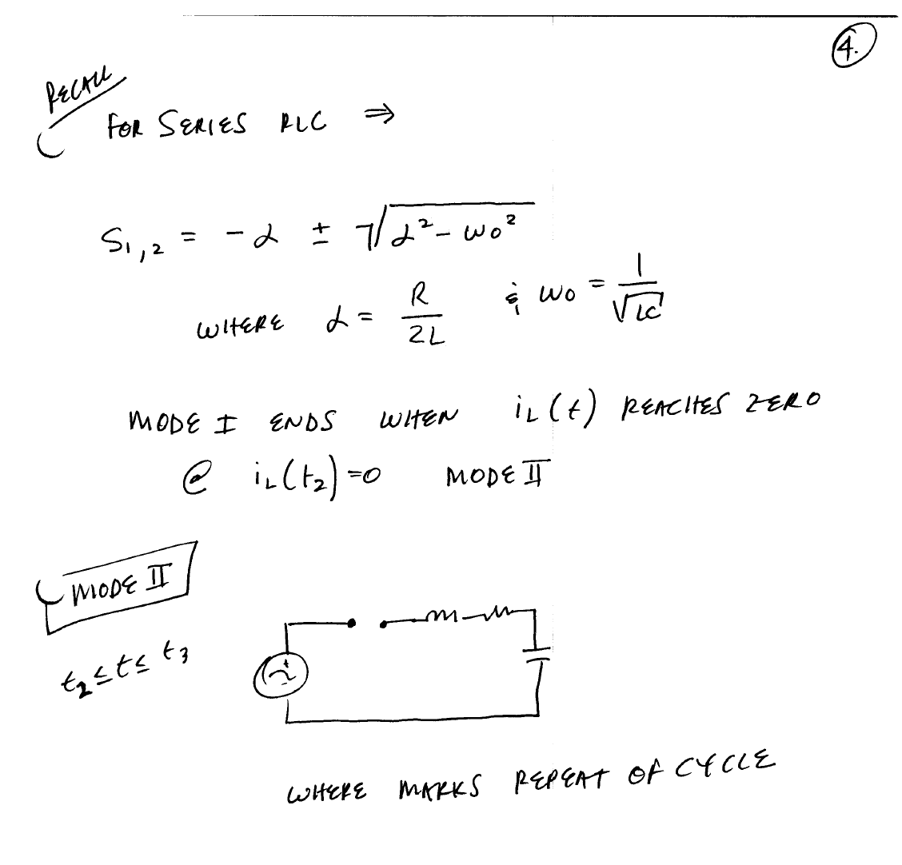



Slide 24
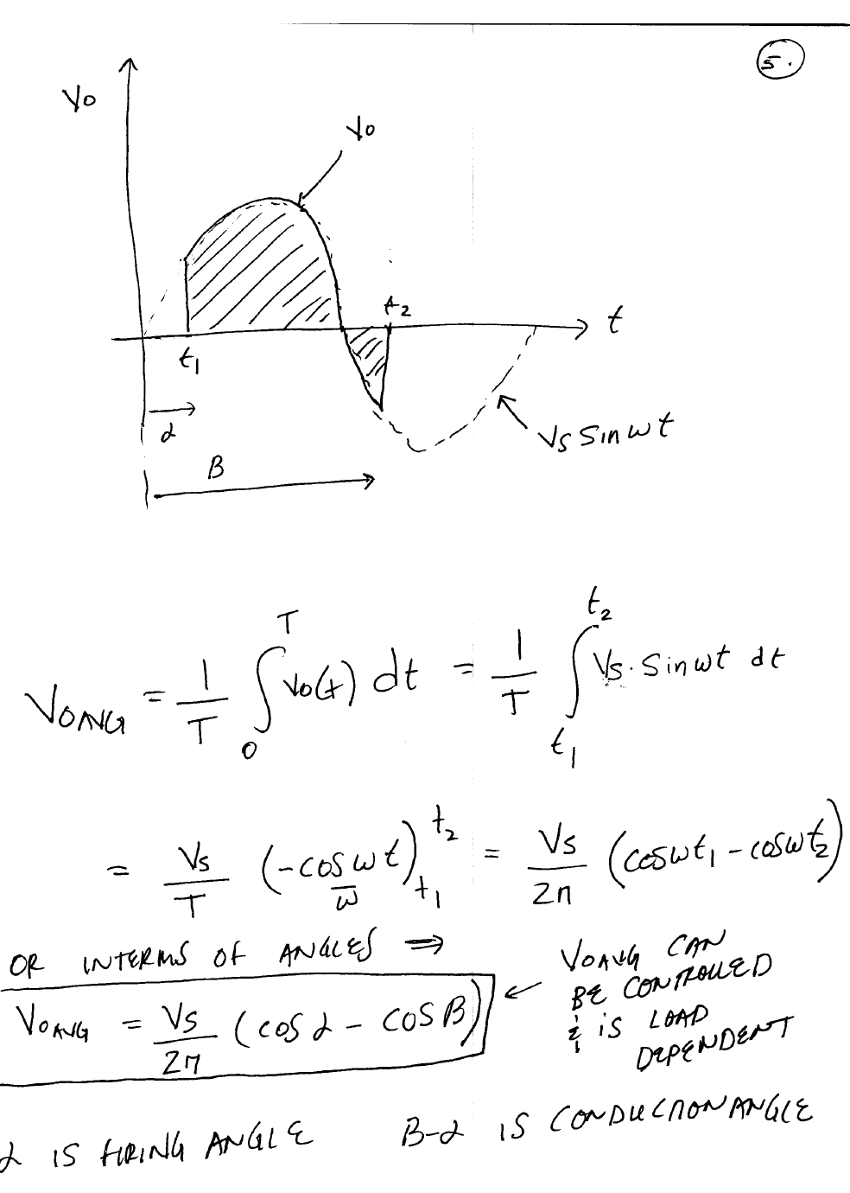


Slide 25
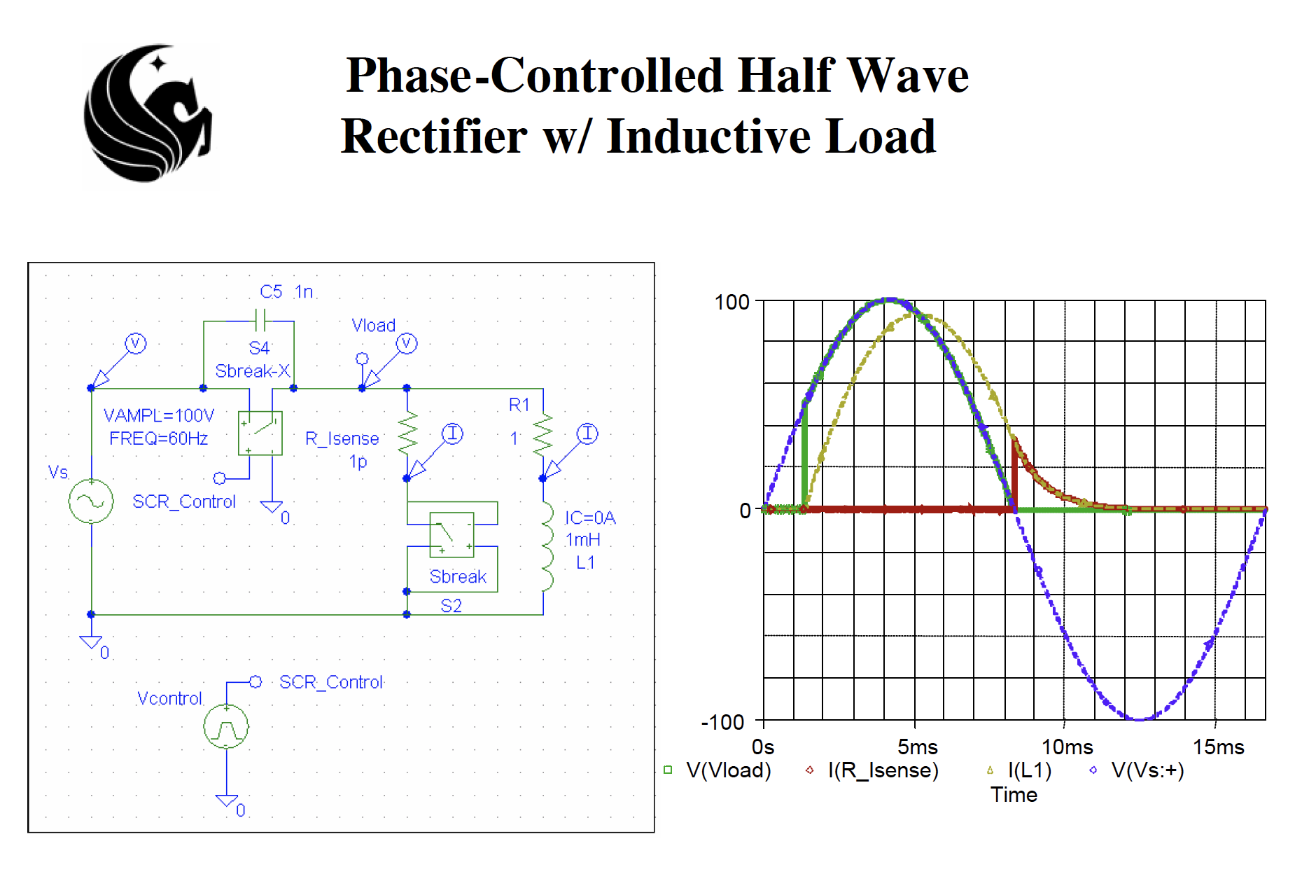

Slide 26
