Slide 1
EEL 5245 POWER ELECTRONICS I Lecture #8: Ch 3: Diode Switching Circuits: L-R Load and AC Source

Slide 2
Homework Assignment #2
Exercises:
3.1, 3.2, 3.4, 3.5, 3.6
Problems:
P3.1, P3.4, P3.6, P3.8, P3.9

Slide 3
Objectives
Introduce Concepts of Steady State/Transient
Emphasize mode-by-mode analysis
Simulating Ideal Elements
Introduce Load Regulation, Current Commutation
Present Current Freewheeling
Half Wave Inductive Rectifiers w/ and w/out Freewheeling Diode
Define Inductor Current Ripple
Example of Diode Switching circuit with DC Source in the load side.

Slide 4
Switching Diode Circuits with an ac Source
The analysis of diode switching circuits ac sources are carried out in two steps:
I) The natural response (also known as transient response) by setting the ac source to zero
II) The steady state response (also known as forced response ) by converting the circuit to phaser domain.
The final solution is the sum of both the natural and forced responses.

Slide 5
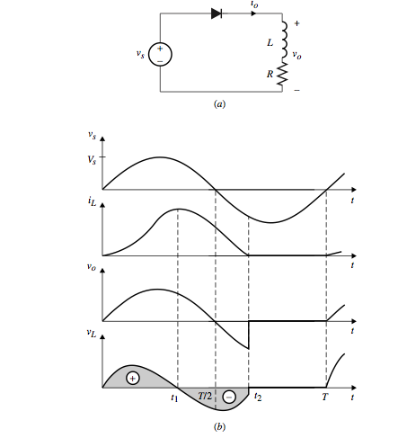
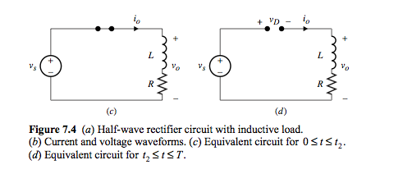
Half Wave Rectifier w/ Inductive Load

Slide 6
Half Wave Rectifier w/ Inductive Load Average Vo
The governing Differential Eq is given by:
The governing solution for i_{o}(t) q is given by:
The average output voltage is given by:
t₂ is the time when i_{o}(t)=0

Slide 7
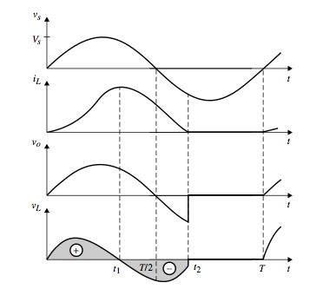
Half Wave Rectifier w/ Inductive Load
i_{o}(t)=i_{L}(t)

Slide 8
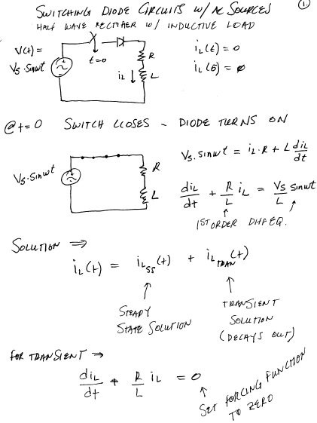
Switching Diode Circuits w/AC Sources Half Wave Rectifier with Inductive Load – Detailed Analysis

Slide 9
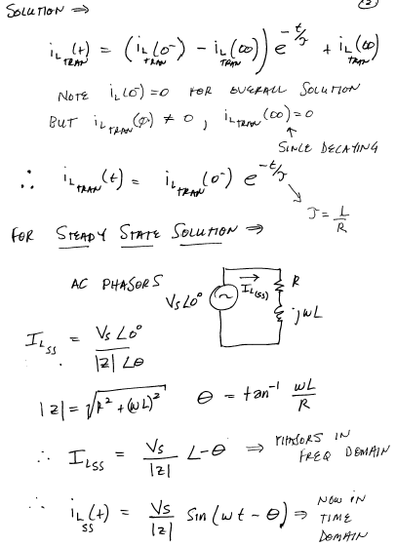

Slide 10
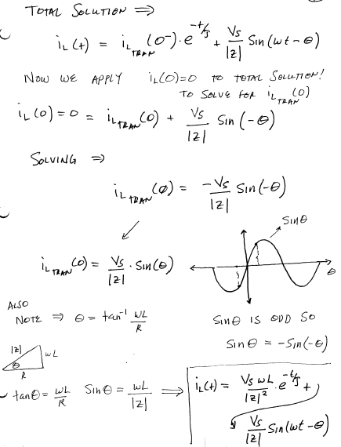

Slide 11
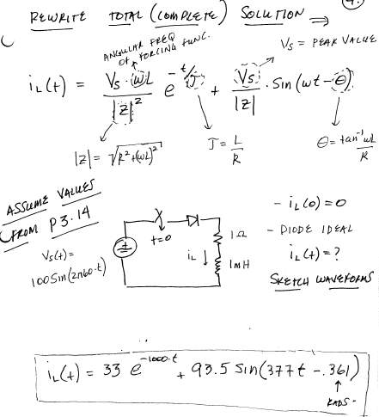

Slide 12
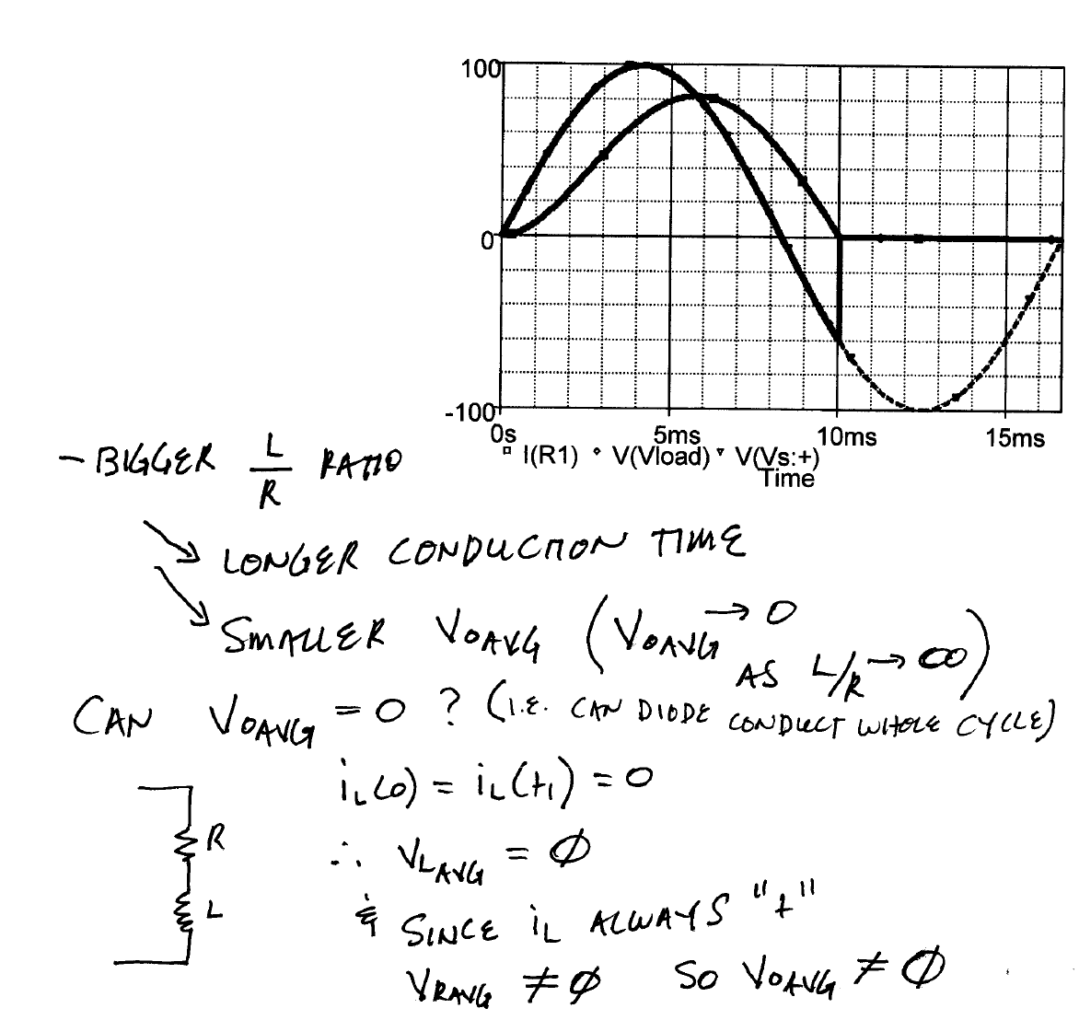
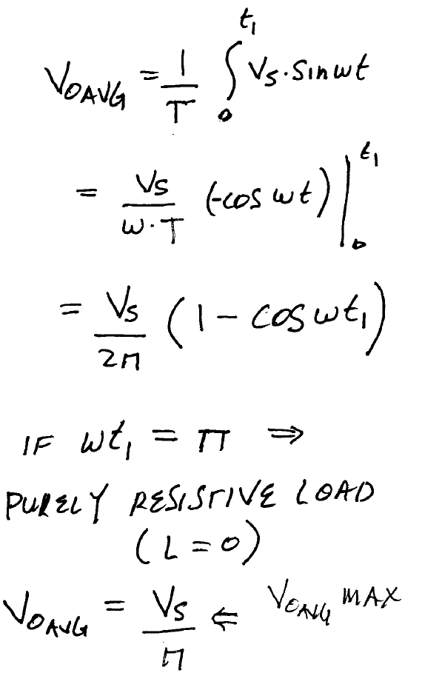
Half Wave Rectifier w/Inductive Load

Slide 13
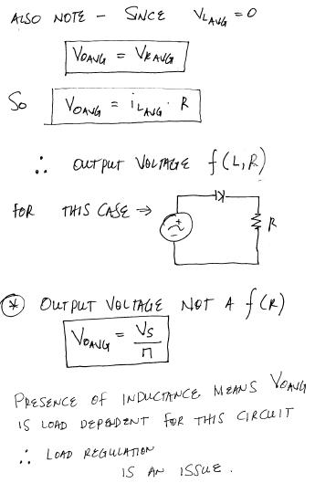

Slide 14
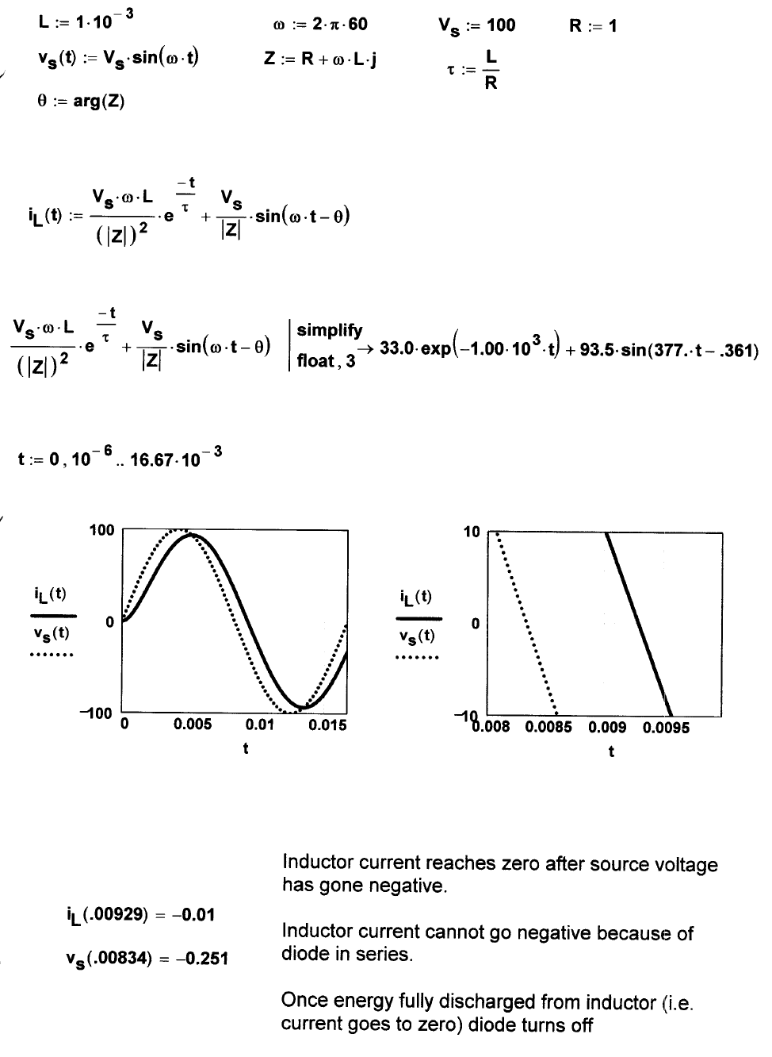

Slide 15
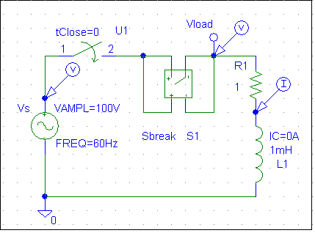
Half Wave Rectifier w/ Inductive Load
100
0
-100
0s
5ms
10ms
15ms
V(Vs:+)
V(Vload)
I(L1)
Time
20
-0
-20
-40
7.20ms
V(Vs:+)
8.00ms
V(Vload)
9.00ms
10.00ms
10.88ms
I(L1)
0
Time

Slide 16
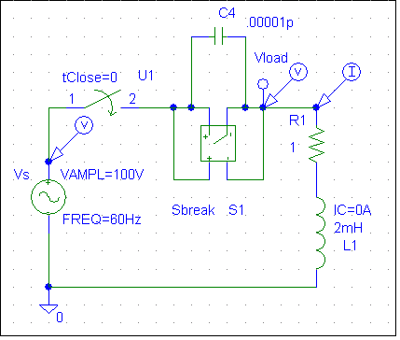
Half Wave Rectifier w/ Inductive Load
100
0
-100
0s
5ms
10ms
15ms
I(R1)
V(Vload)
V(Vs:+)
Time
26
0
-50
-82
8.00ms
10.00ms
12.00ms
13.55ms
I(R1)
V(Vload)
V(Vs:+)
0
Time

Slide 17
Half Wave Rectifier w/ Inductive Load
100
Vo_{avg}
0
-100
0s
5ms
10ms
15ms
I(R1)
V(Vload)
V(Vs:+)
Time

Slide 18
Half Wave Rectifier w/ Inductive Load and Freewheeling Diode

Slide 19
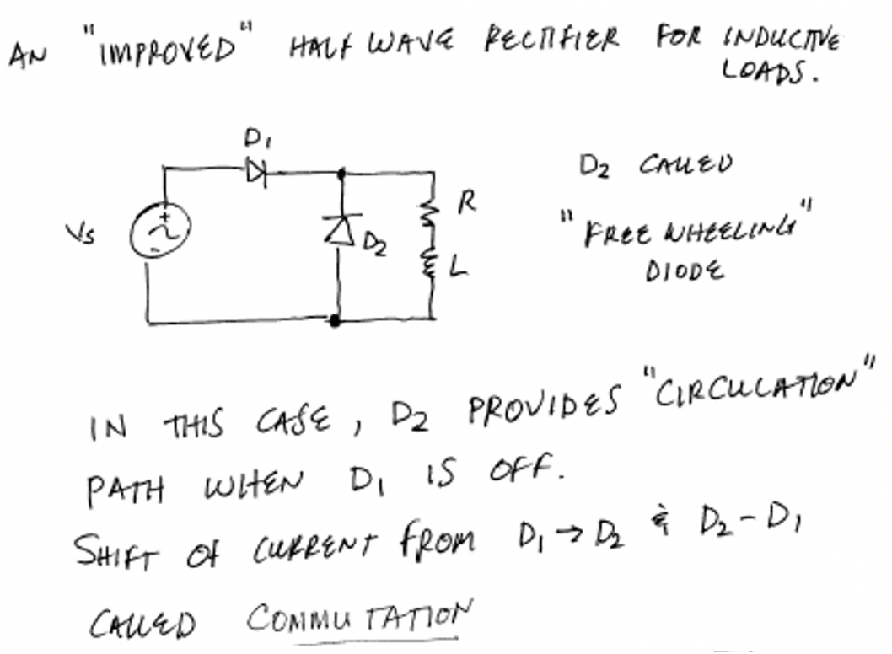

Slide 20
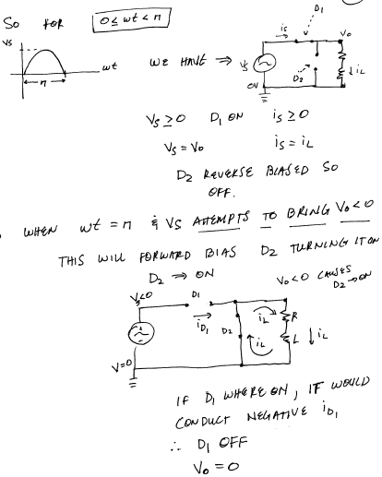

Slide 21
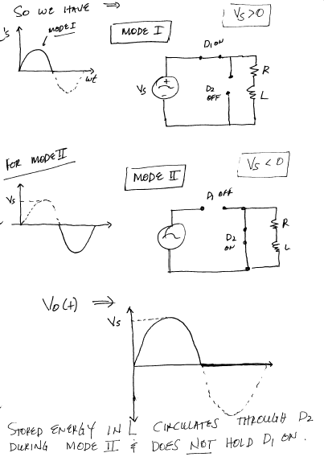

Slide 22
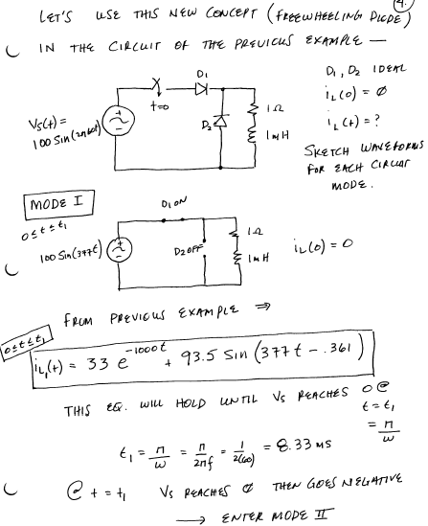

Slide 23
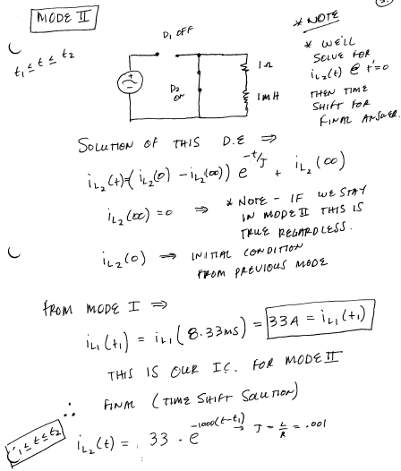

Slide 24
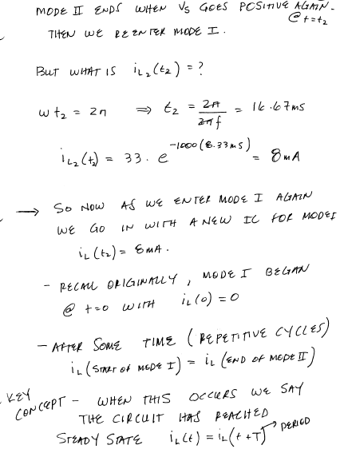

Slide 25
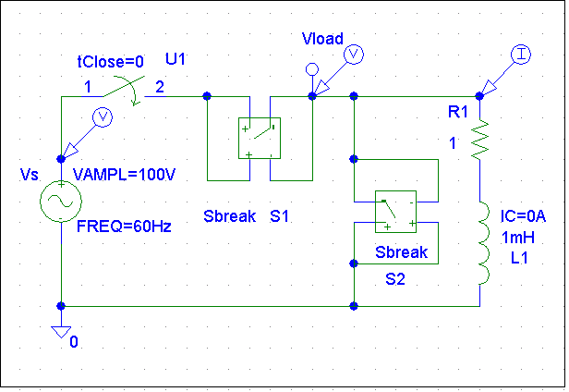
Half Wave Rectifier w/ Inductive Load and Freewheeling Diode
100
0
-100
0s
5ms
10ms
15ms
I(R1)
V(Vload)
V(Vs:+)
Time

Slide 27
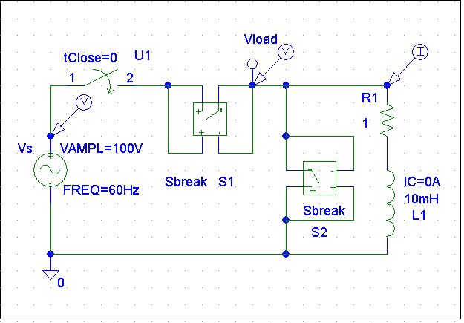
Half Wave Rectifier w/ Inductive Load and Freewheeling Diode
100
0
-100
0s
5ms
10ms
15ms
I(R1)
V(Vload)
V(Vs:+)
Time

Slide 28
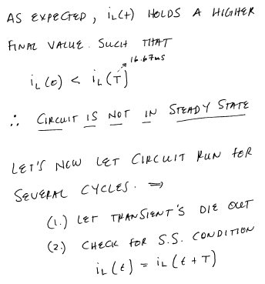

Slide 29
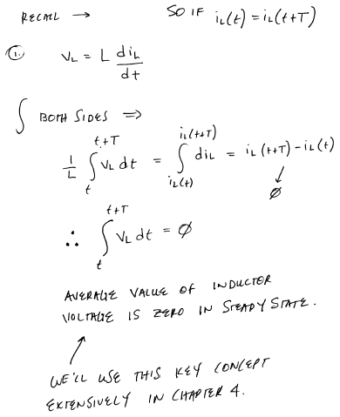

Slide 30
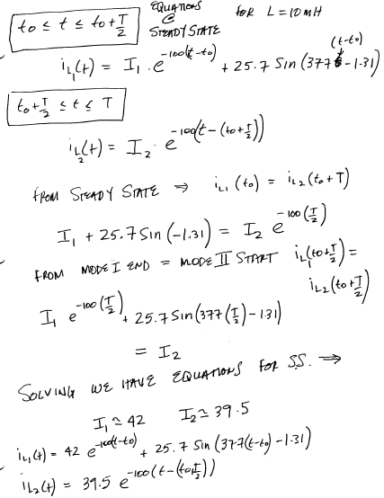

Slide 31
Half Wave Rectifier w/ Inductive Load and Freewheeling Diode
100
0
-100
0s
5ms
10ms
15ms
I(R1)
V(Vload)
V(Vs:+)
Time

Slide 32
Half Wave Rectifier w/ Inductive Load and Freewheeling Diode
Steady-State reached after 9 cycles:
100
0
-100
0s
50ms
100ms
150ms
I(R1)
V(Vload)
V(Vs:+)
Time
100
0
-100
130ms
140ms
150ms
160ms
I(R1)
V(Vload)
V(Vs:+)
Time

Slide 33
Half Wave Rectifier w/ Inductive Load and Freewheeling Diode
100
100
0
0
-100
-100
130ms
140ms
150ms
160ms
170ms
133ms
140ms
150ms
160ms
167ms
I(L1)
V(Vs:+)
I(L1)
V(Vs:+)
-I(Vs)
Time
Time

Slide 34
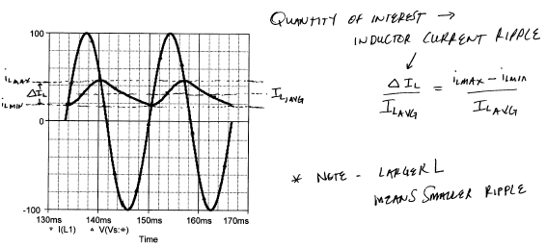
Half Wave Rectifier w/Inductive Load and Freewheeling Diode

Slide 35
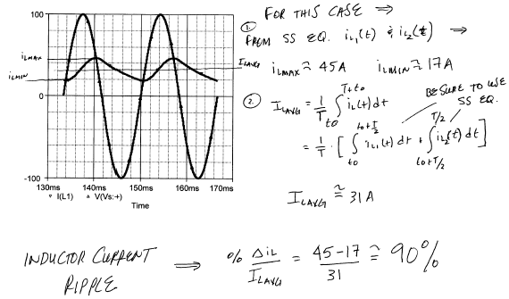
Half Wave Rectifier w/Inductive Load and Freewheeling Diode

Slide 36
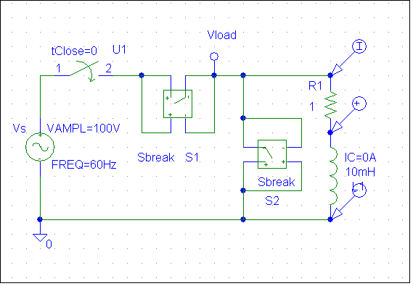
Half Wave Rectifier w/ Inductive Load and Freewheeling Diode
What is the average inductor voltage in steady-sate?
100
0
-100
I(R1)
V(R1:2,L1:2)
50V
0V
-50V
133.3ms
140.0ms
150.0ms
160.0ms
avg(V(R1:2,L1:2))
Time

Slide 37
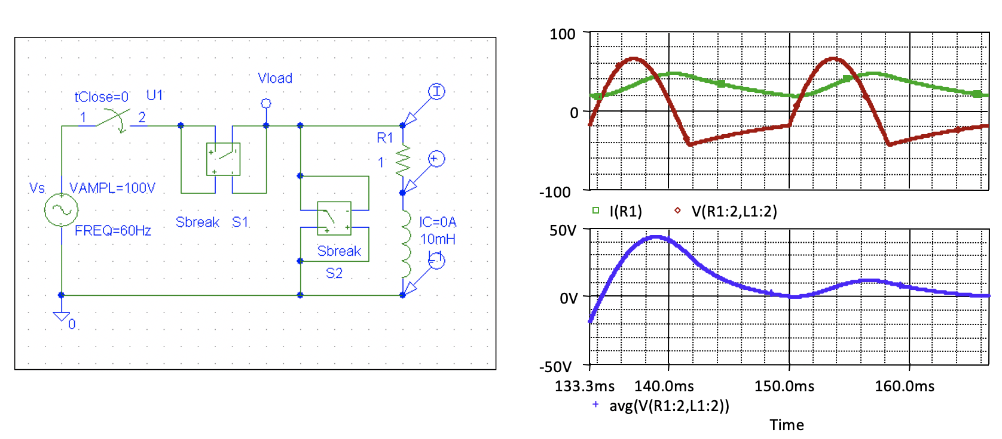
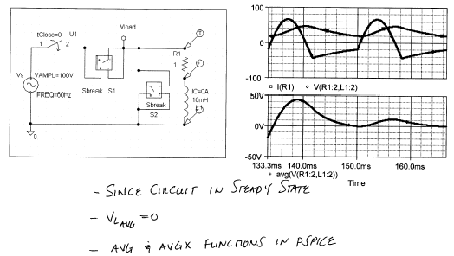
Half Wave Rectifier w/Inductive Load and Free wheeling Diode

Slide 38
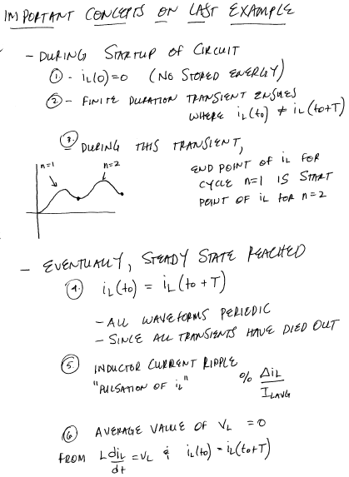
Important Concepts on Last Example

Slide 39
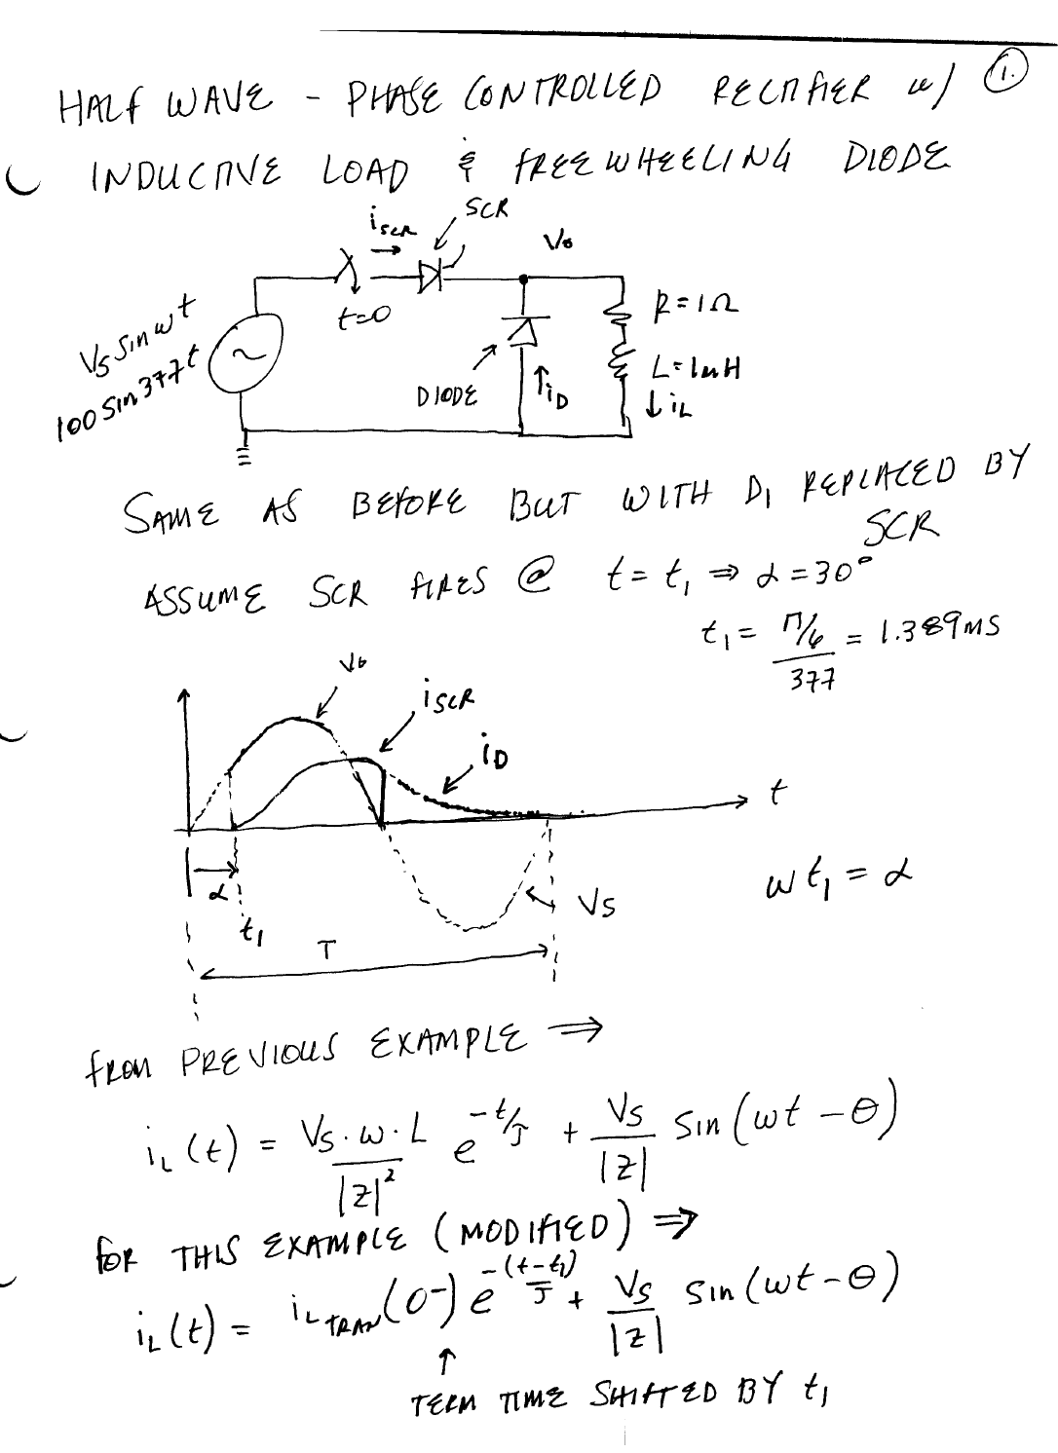

Slide 40
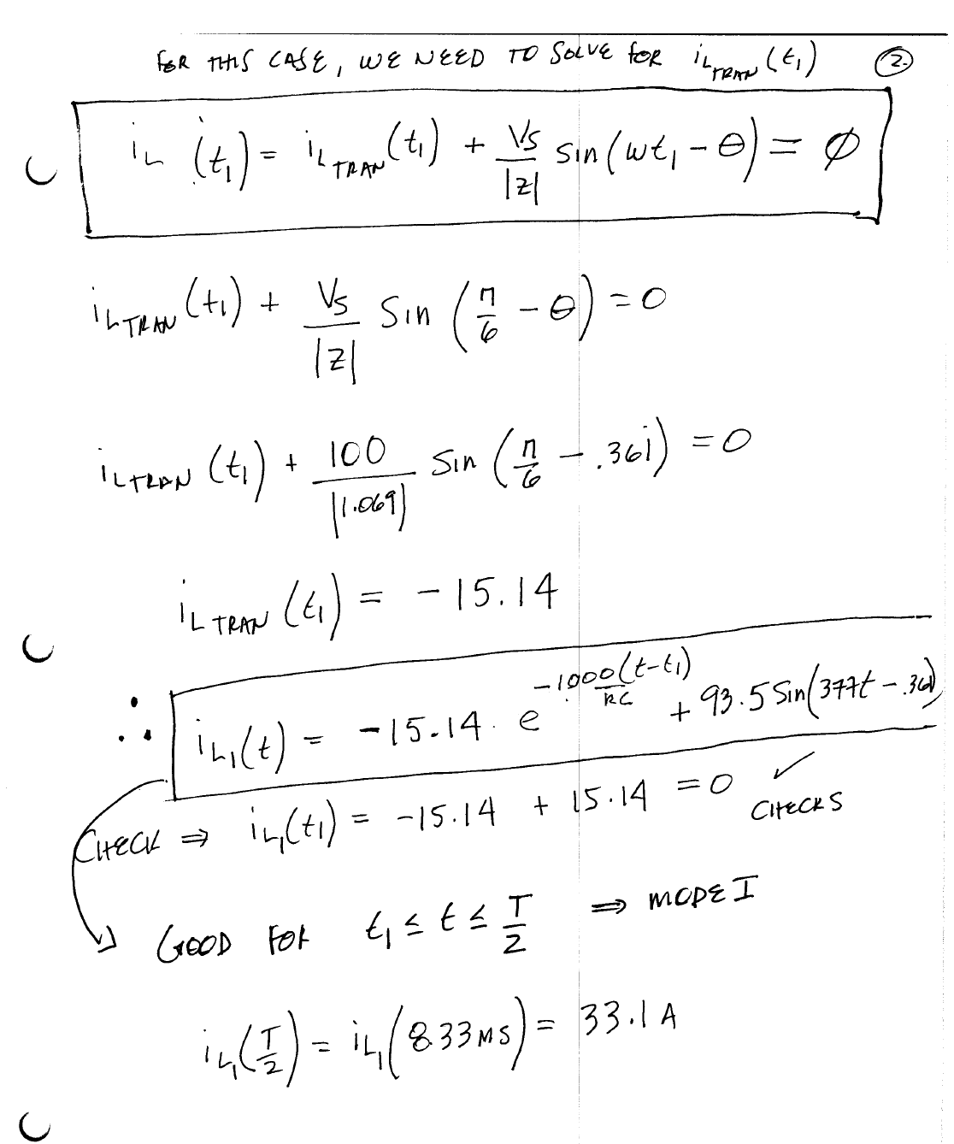

Slide 41
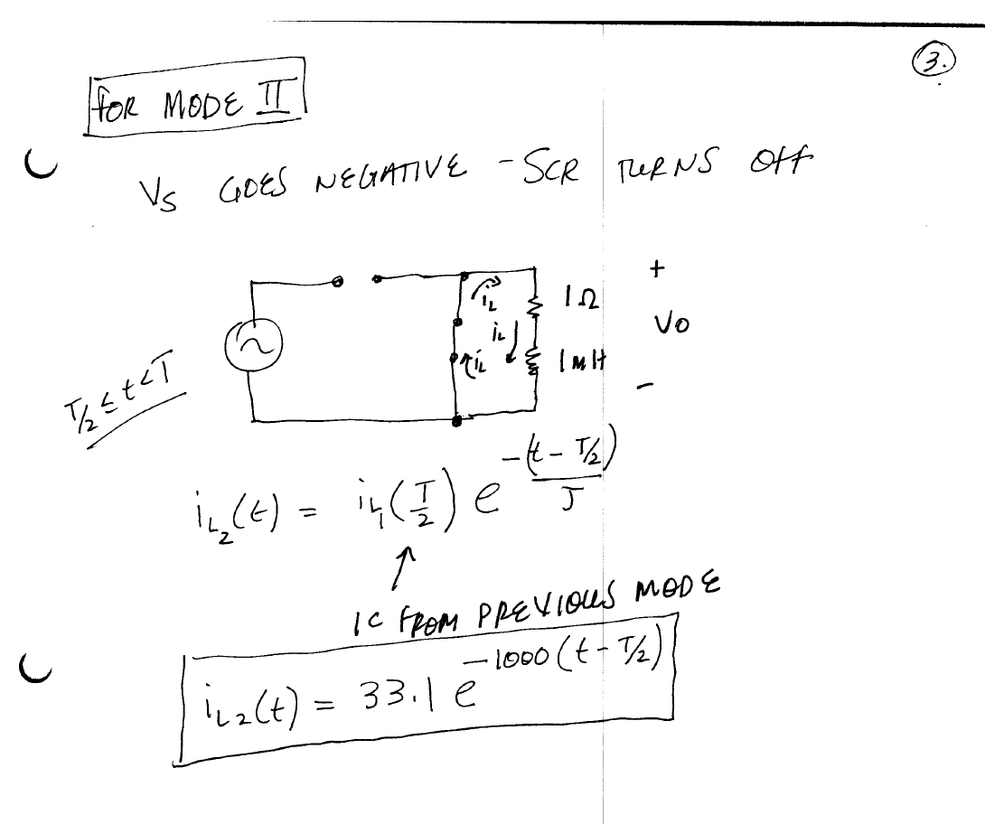

Slide 42
Switching Diode Circuits with an ac Source

Slide 43
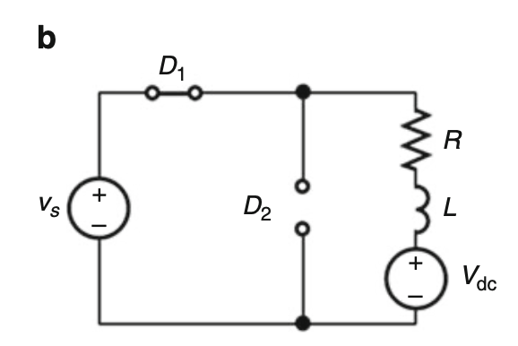
Switching Diode Circuits with an ac Source

Slide 44
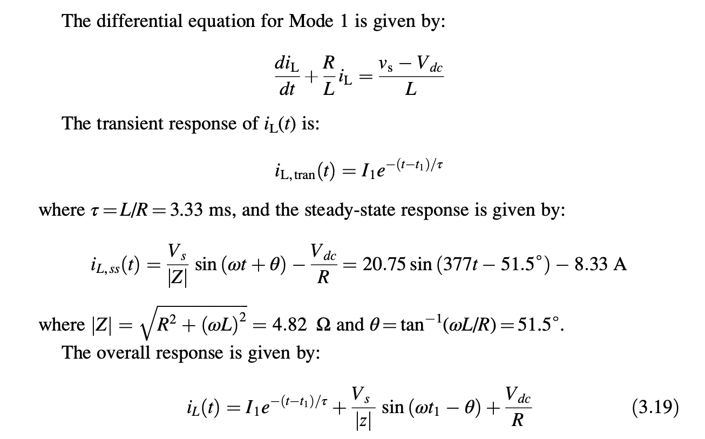
Switching Diode Circuits with an ac Source

Slide 45
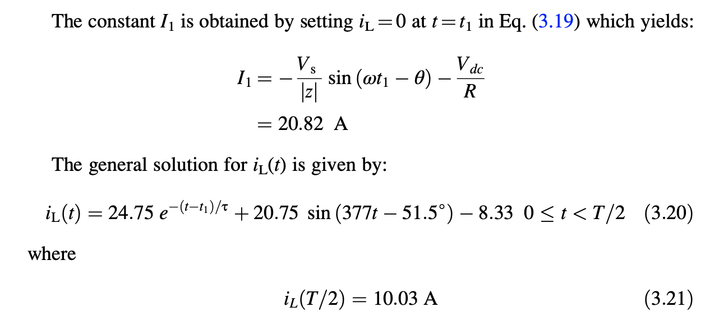
Switching Diode Circuits with an ac Source

Slide 46
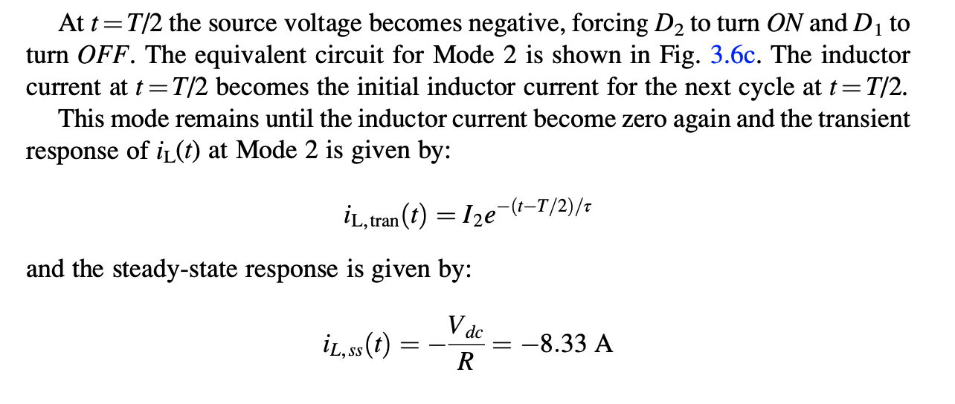
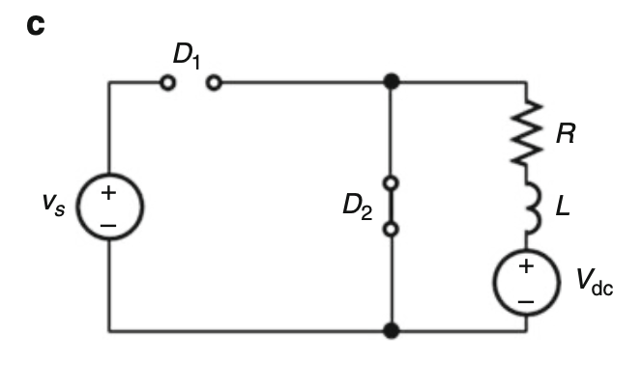
Switching Diode Circuits with an ac Source

Slide 47
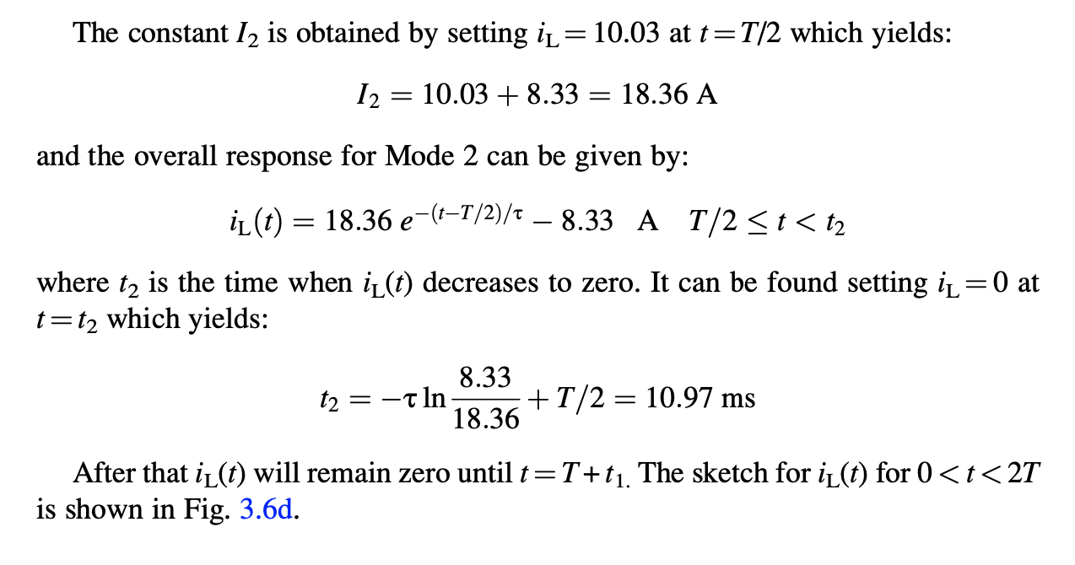
Switching Diode Circuits with an ac Source

Slide 48
Switching Diode Circuits with an ac Source

