Slide 1

EEL 5245 POWER ELECTRONICS I
Lecture #7
Ch 3 - Diode Switching Circuits with DC
Sources

Slide 2
Objectives
Incorporate Diodes in DC circuits to “control” flow of energy and state variables
Underscore Energy Exchange between L and C
Simulating Ideal Elements
Demonstrate Mode Concept
Series RLC under DC Excitation and Diode

Slide 3
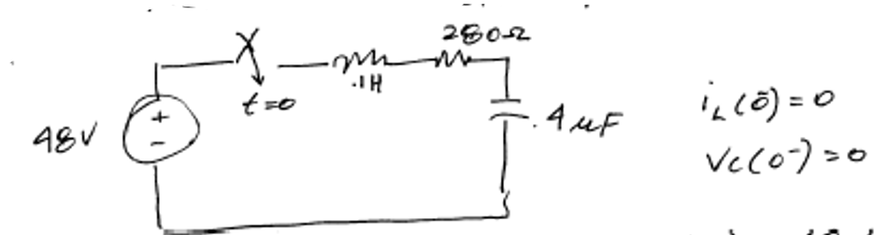
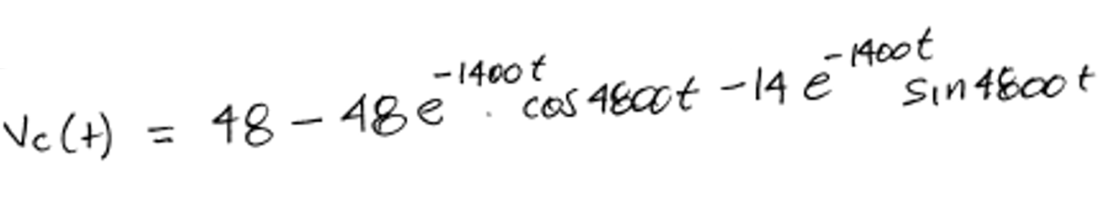
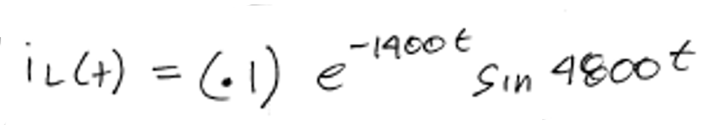
Numerical Example
Recall from previous example,

Slide 4
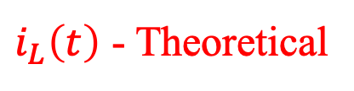
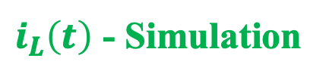
Series RLC Example-Verification

Slide 5
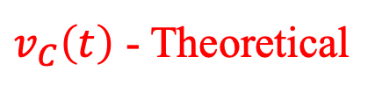
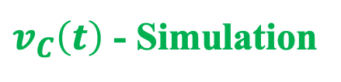
Series RLC Example-Verification

Slide 6

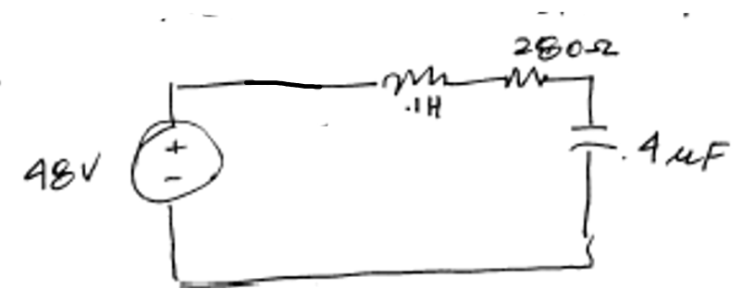



Numerical Example – Series RLC with Diode
Derive the capacitor voltage and inductor current expressions.
Solution:
Assume the diode is on:

Slide 7
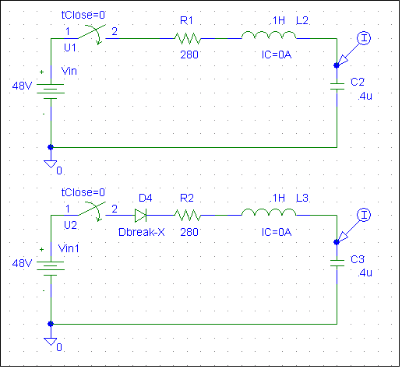
Series RLC Example – with/without a diode
80mA
40mA
Red Waveforms
0A
-40mA
0s
1.0ms
2.0ms
3.0ms
I(C2)
I(C3)
Time
80V
Green Waveforms
40V
0V
0s
1.0ms
2.0ms
3.0ms
V(C3:1)
V(C2:1)
Time

Slide 8
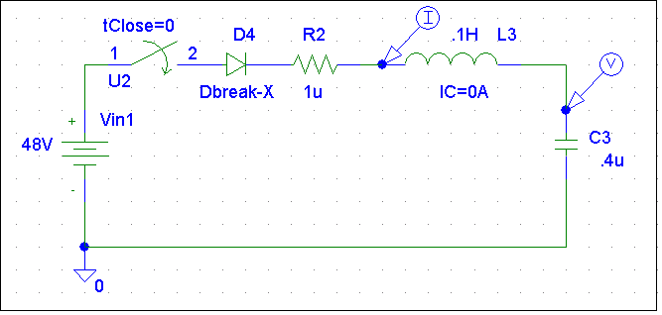
Series RLC Example-with diode
100mA
(323.864u,94.339m)
50mA
0A
I(L3)
100V
(806.818u,94.487)
50V
0V
0s
0.5ms
1.0ms
1.5ms
V(C3:1)
Time

Slide 9
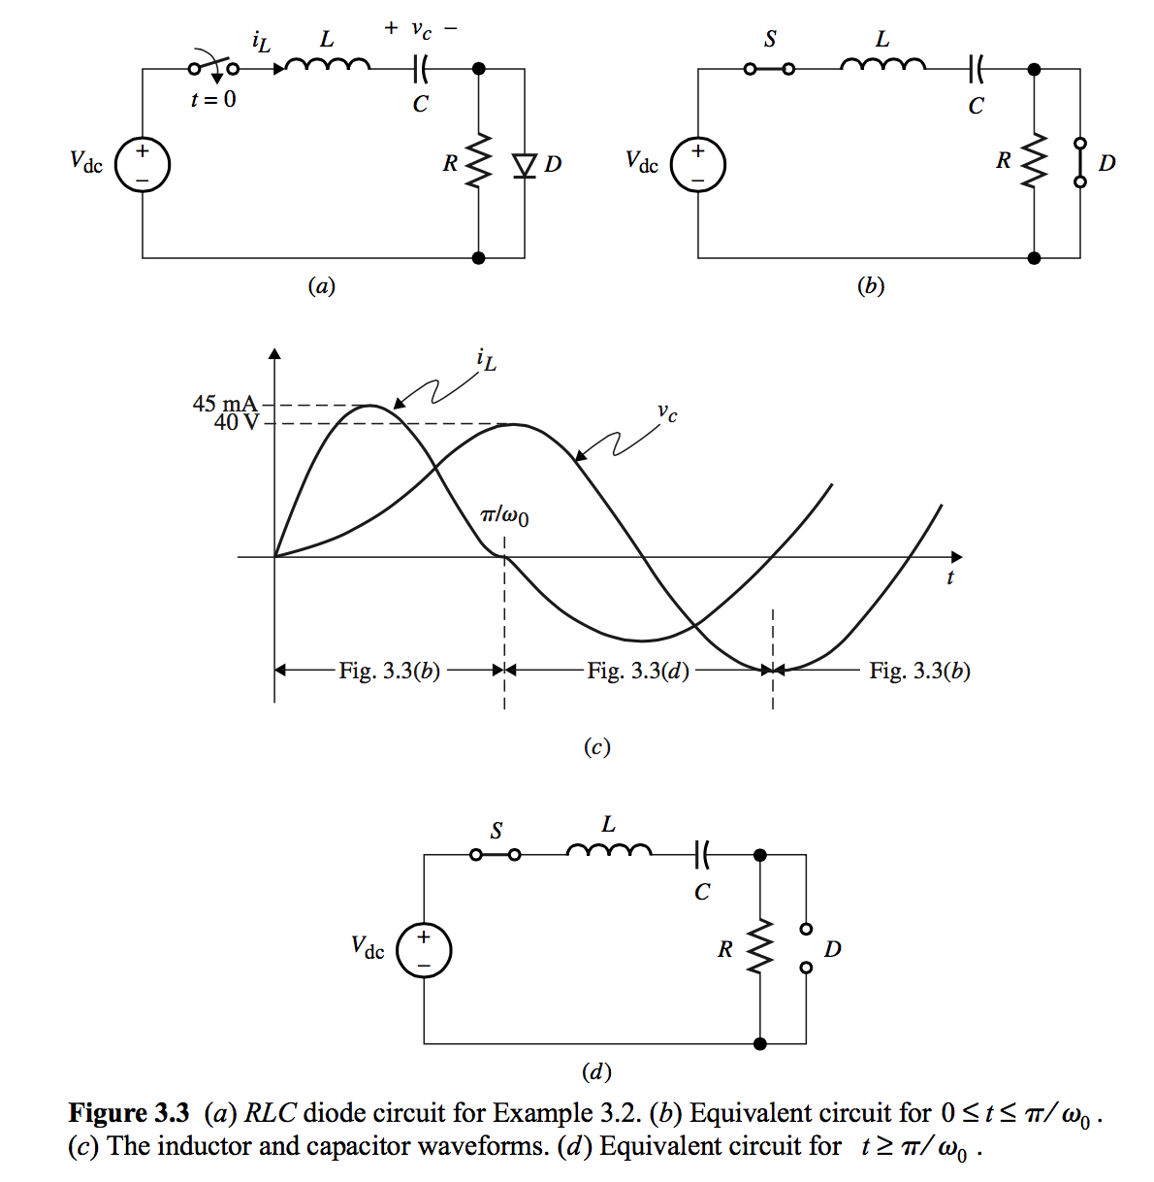
Example 3.2

Slide 10
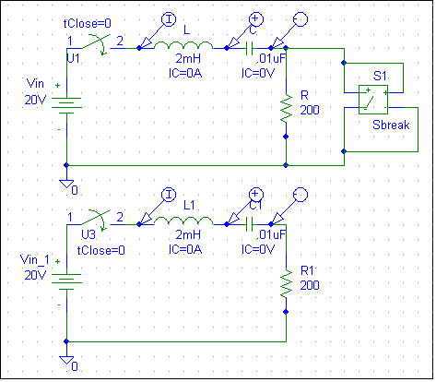
PSPICE Simulation-Example 3.2
50mA
0A
-50mA
I(L1)
I(L)
40V
20V
0V
0s
50us
100us
V(C1:1,C1:2)
V(C:1,C:2)
Time

Slide 11
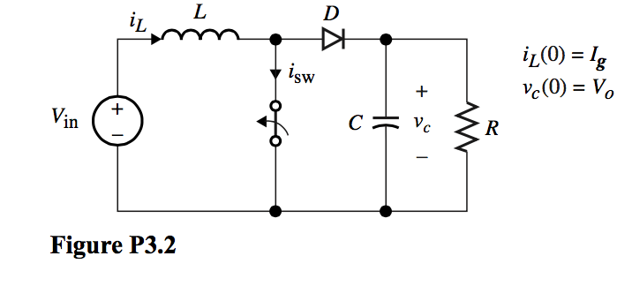
Example

Slide 12
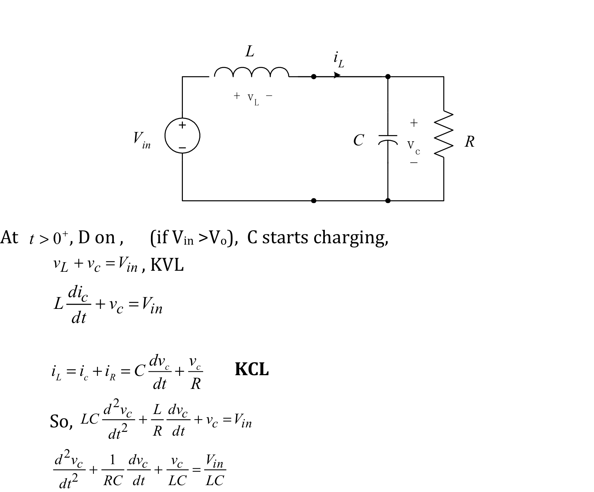
Solution

Slide 13
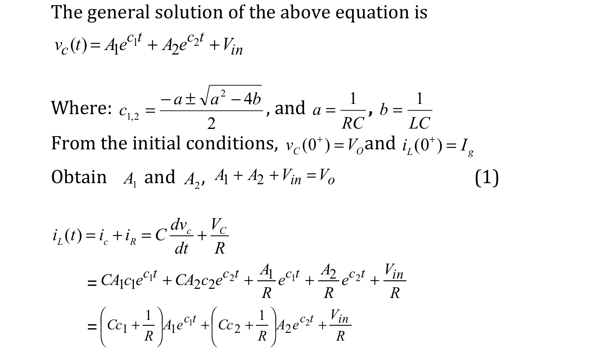
Solution (con’d)

Slide 14
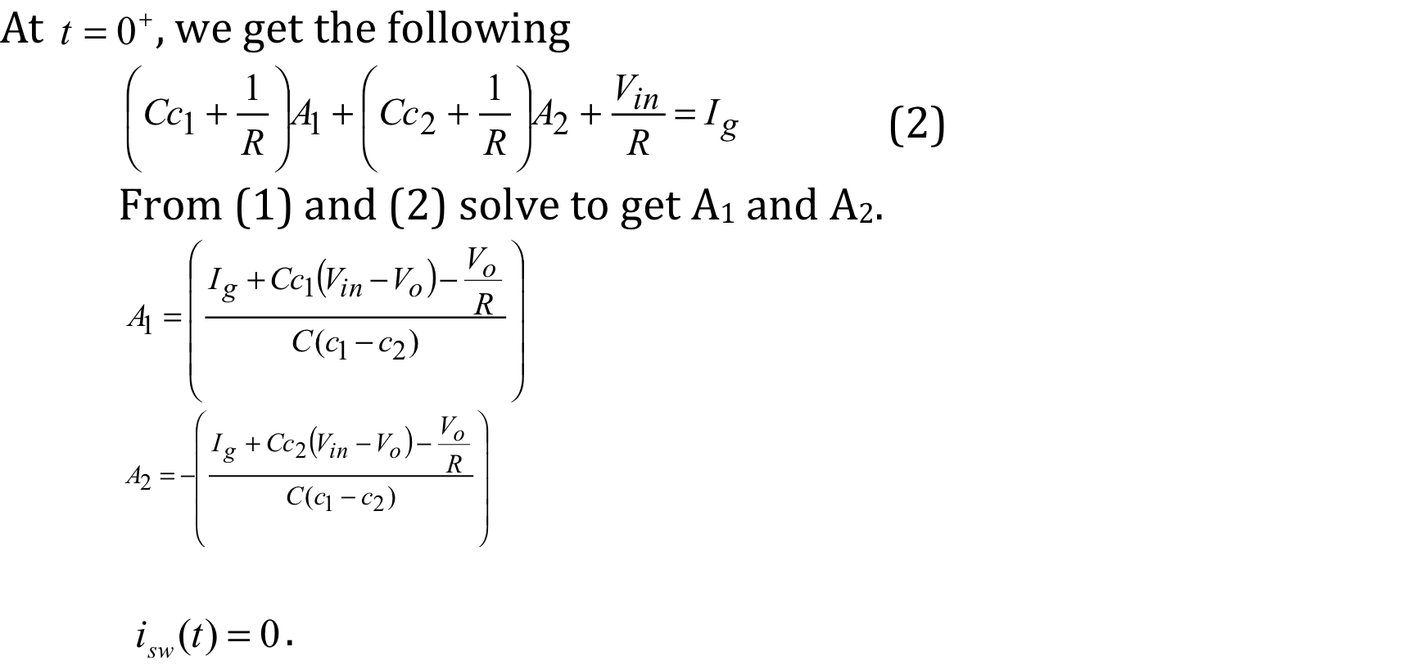
Solution (cont’d)

Slide 15
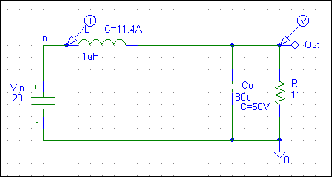
PSPICE Simulation without the diode
200
0
-200
0s
V(Out)
25us
50us
75us
90us
0
I(L1)
Time
55.3
151
40.0
0
20.0
0
-200
-276
0s
10us
20us
30us
0s
V(Out)
1.00us
0
2.00us
3.00us
V(Out)
0
I(L1)
I(L1)
Time
Time

Slide 16



PSPICE Simulation without the diode
200
0
-200
0s
V(Out)
25us
50us
75us
90us
0
I(L1)
Time
55.3
151
40.0
0
20.0
0
-200
-276
0s
10us
20us
30us
0s
V(Out)
1.00us
0
2.00us
3.00us
V(Out)
0
I(L1)
I(L1)
Time
Time

Slide 17
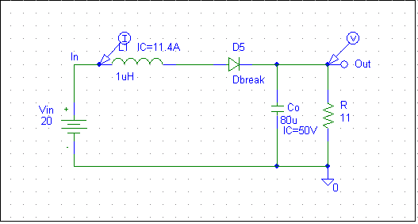
PSPICE Simulation with the diode
50.0250V
50.0125V
50.0000V
V(Out)
10A
5A
0A
0s
I(L1)
400ns
800ns
Time
50.0V
37.5V
25.0V
V(Out)
10A
5A
0A
0s
I(L1)
250us
500us
750us
Time

Slide 18
MathCAD Verification without the diode

Slide 19
MathCAD Verification without the diode
Inductor Current Equation:

Slide 20
Problem 3.6 – Switching Diode 2nd order Circuit
  Assume the switch in Fig. P3.6 is opened at t=0. Derive the expressions and sketch the waveforms for vc1, vc2, i_{L} and i_{D}. Assume vc1(0)=vc2(0)=0, and i_{L}(0)=0.

Slide 21
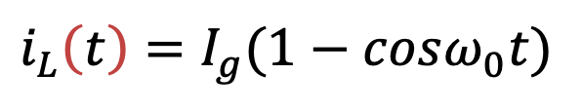
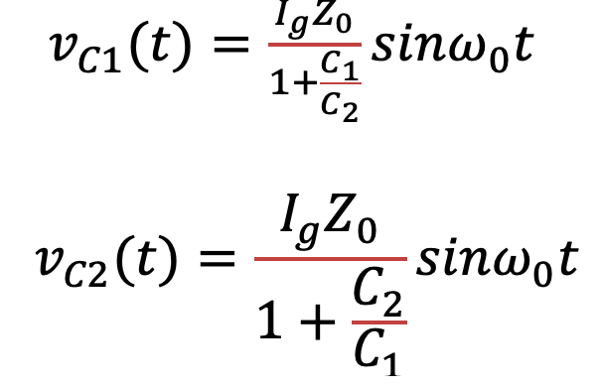
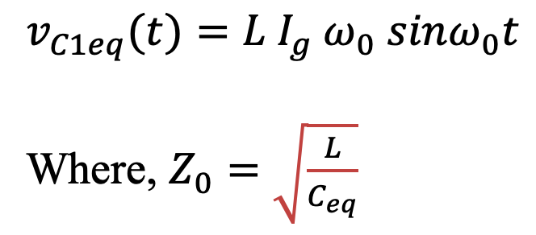
Problem 3.6 – Switching Diode 2nd order Circuit
Solution:
At t = 0⁺, D is off and the equivalent circuit is shown below,

Slide 22
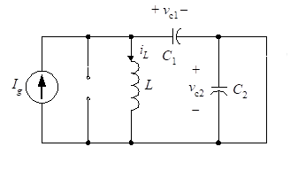
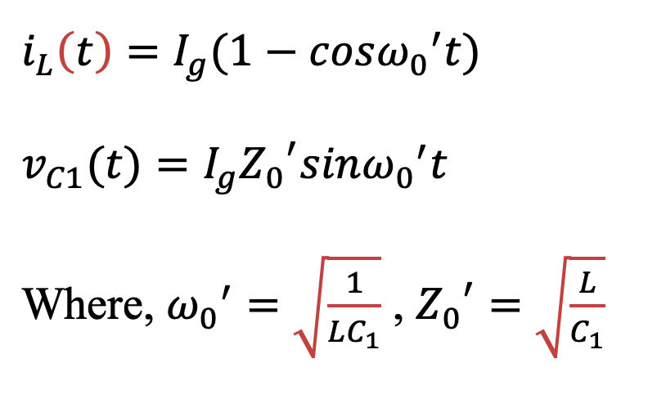
Problem 3.6 – Switching Diode 2nd order Circuit
Solution:
The diode remains off as long as v_{C2}t>0, at ω₀t=π, v_{C2}t becomes zero, the diode turns on, resulting in the following equivalent circuit,

