Slide 1

EEL 5245 POWER ELECTRONICS I
Lecture #6
Ch 3 Refresher on Series/Parallel RLC
w/ Diff. Eq. Solution

Slide 2
Objectives
Provide Students an Understanding of Why Diode Switching with RLC Circuits is Covered in EEL 5245
Give Students and Idea of What They Should be Able to Solve After this the Material is Covered
Refresh Student’s Memory on Diff. Eq. Solution of RLC Circuits
  First Order Circuits
  Second Order Circuits
    Parallel RLC
    Series RLC
    Initial and Final Conditions

Slide 3
Why Cover this Material?
Analysis of Basic RLC Circuits with switching devices (diodes and SCRs) provides students with the fundamental concepts and process that go into the analysis of the more complicated converters in power electronics
  Mode by mode analysis
  Energy Transfer/Exchange Concepts
    Initial Conditions
    Resonance
  Energy Conservation
  Current Commutation
  Simulation of Switching Functions

Slide 4
Goals of Ch. 3 Switching Concepts
Analyze any 1st or 2nd Order Circuit which includes switches, diodes, SCRs, or any combination of those items
  Follow a step by step process taking each circuit configuration or “mode” in turn, noting:
    Time interval mode is valid
    Circuit configuration during mode
      Which switches, diodes, SCRs are on which are off
    Closed form expressions for variables of interest
      State Variables (inductor current, capacitor voltage or converter parameter derived from these
    Initial and Final Conditions of State Variables
    Finish with a clear statement regarding when the mode your working with ends (time), the reason it has ended, and the switch state configuration that will occur when it does

Slide 5
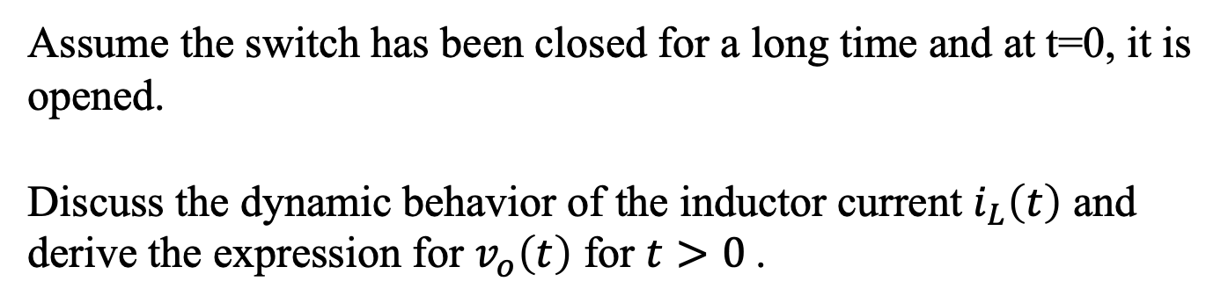
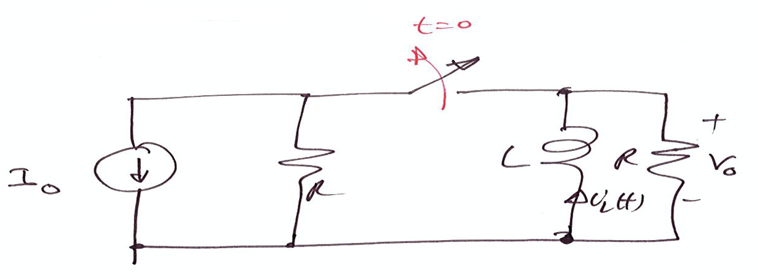


Example: Natural Response of R-L Circuit

Slide 6
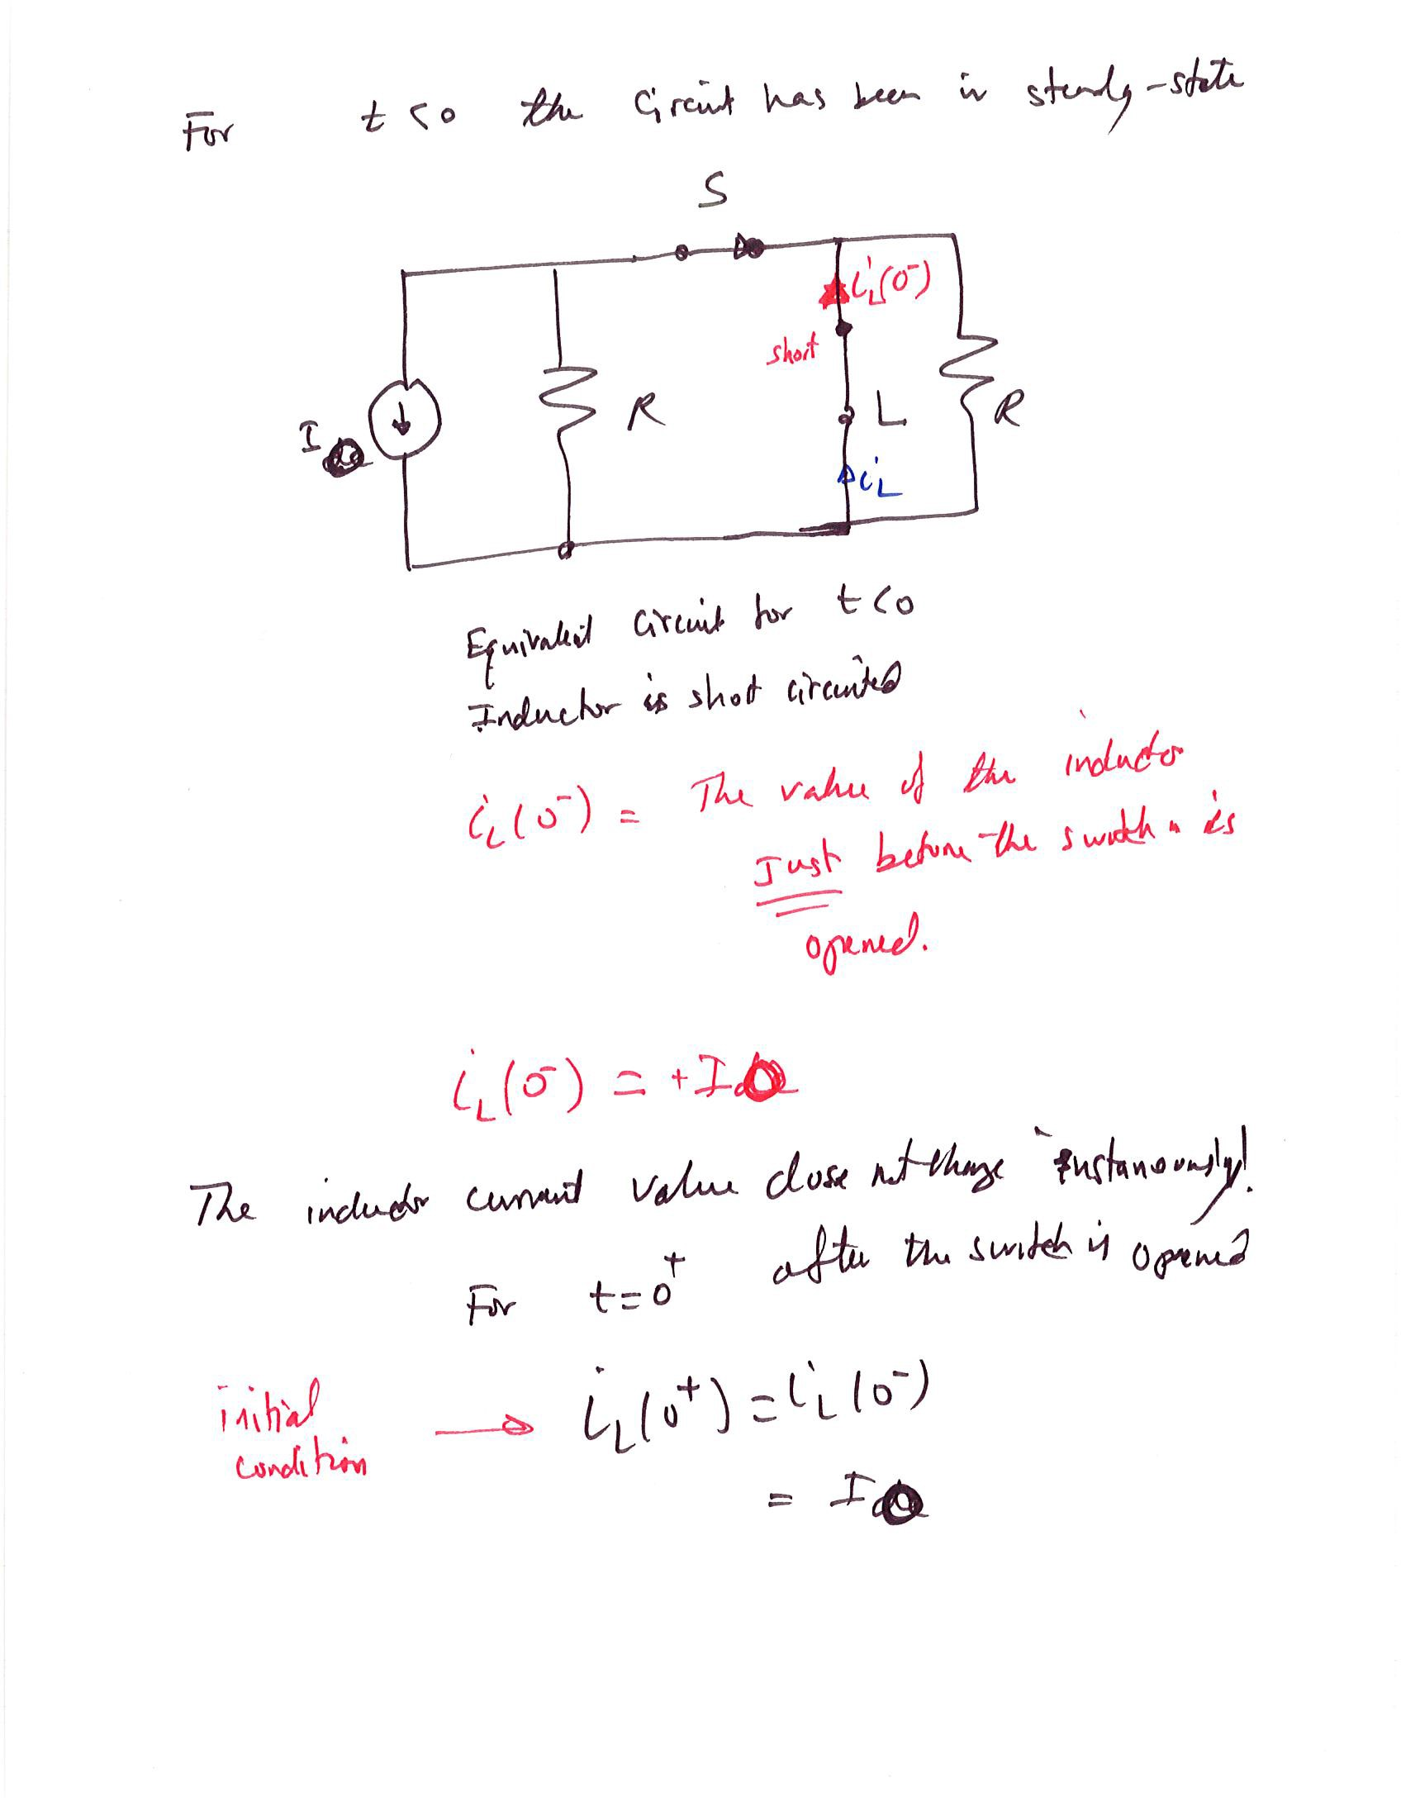

Slide 7
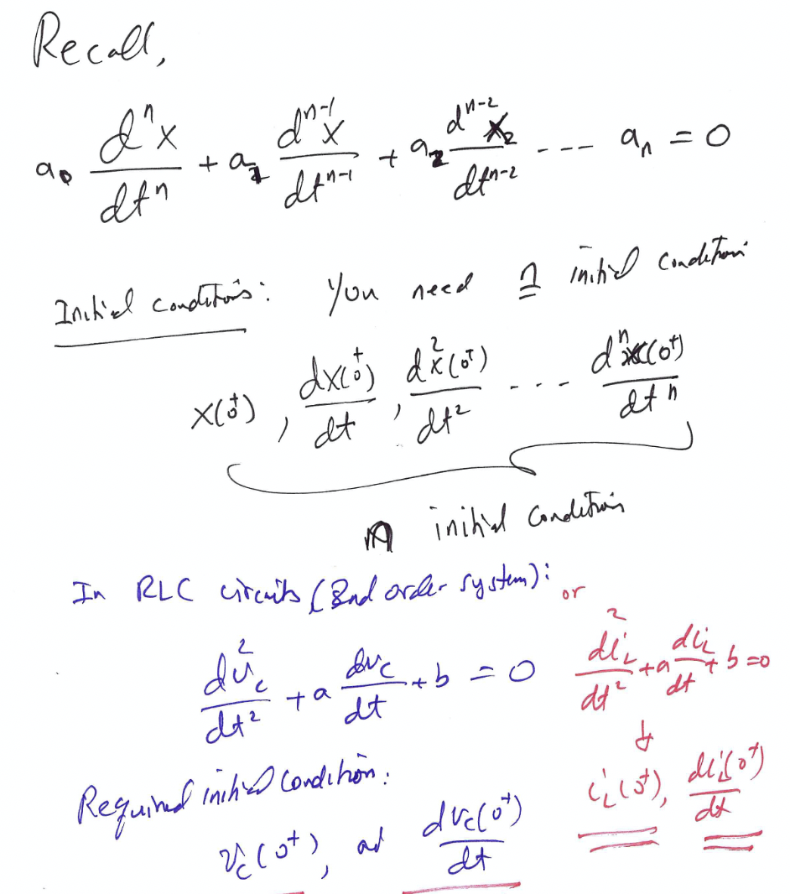
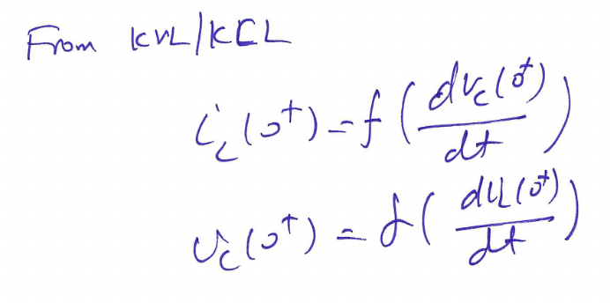


Recall a given n^{th} order differential equation:

Slide 8
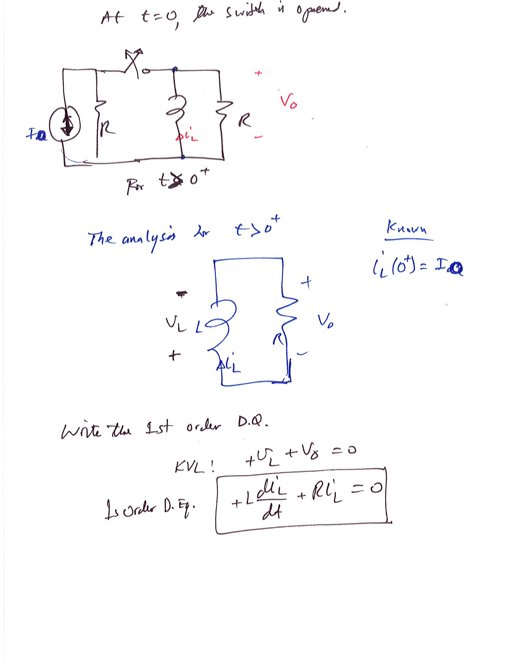

Slide 9
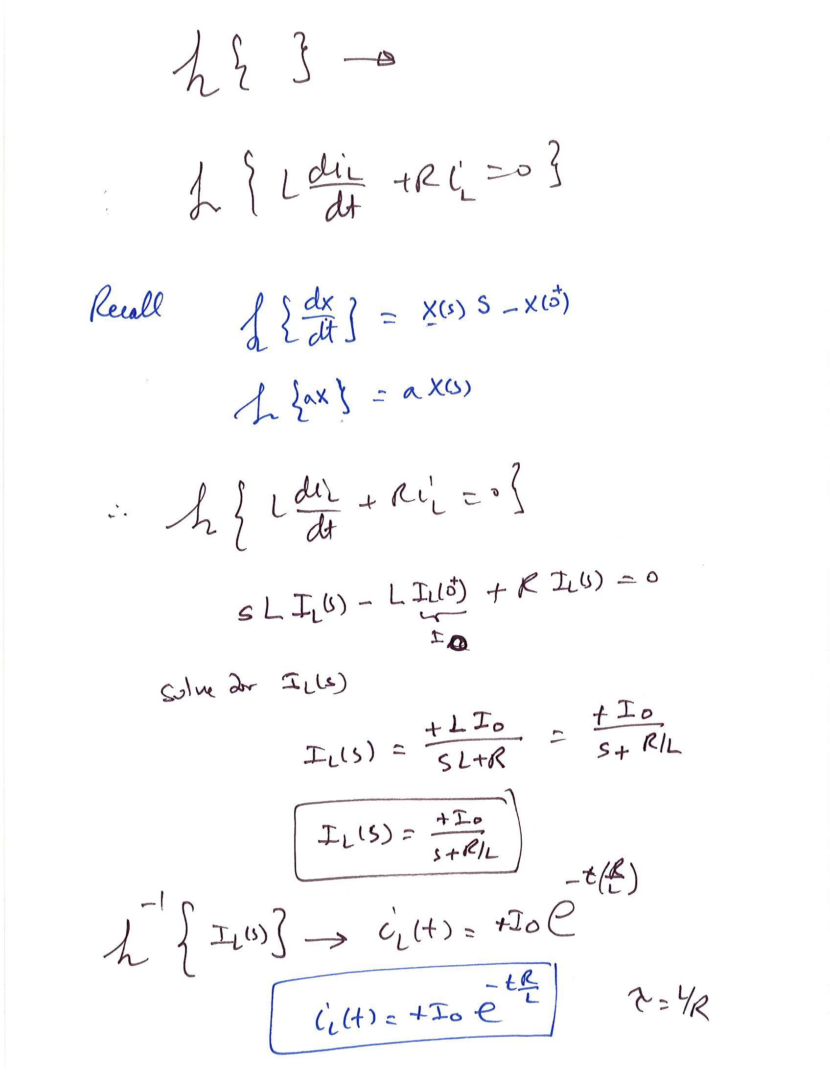

Slide 10
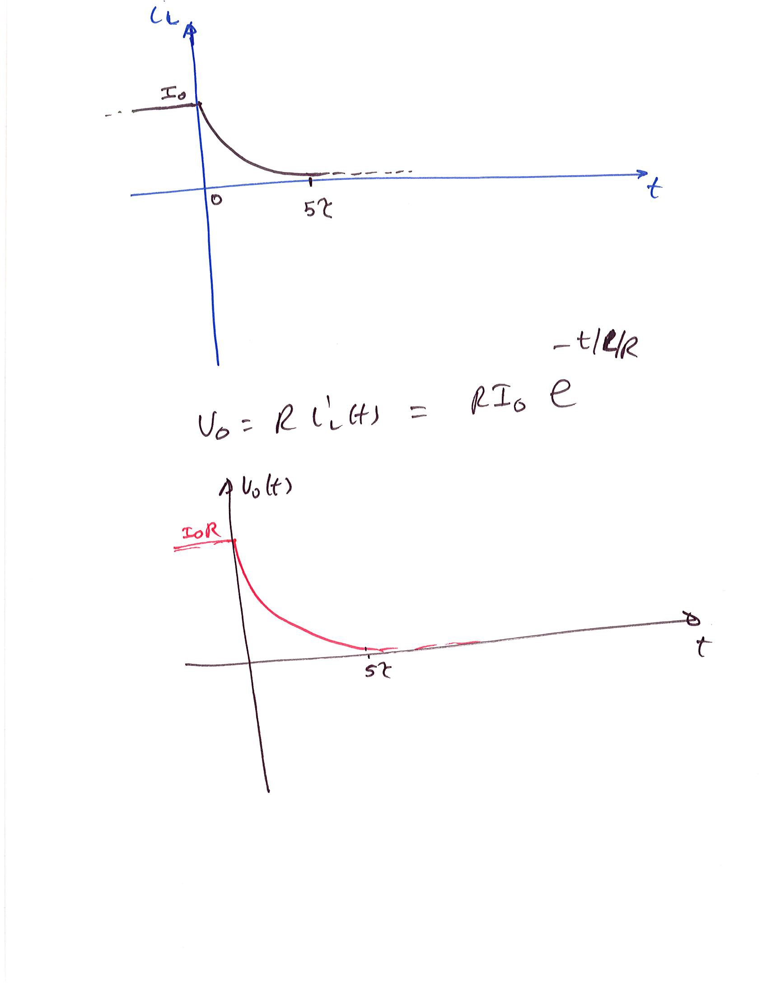


Slide 11
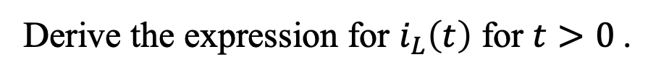
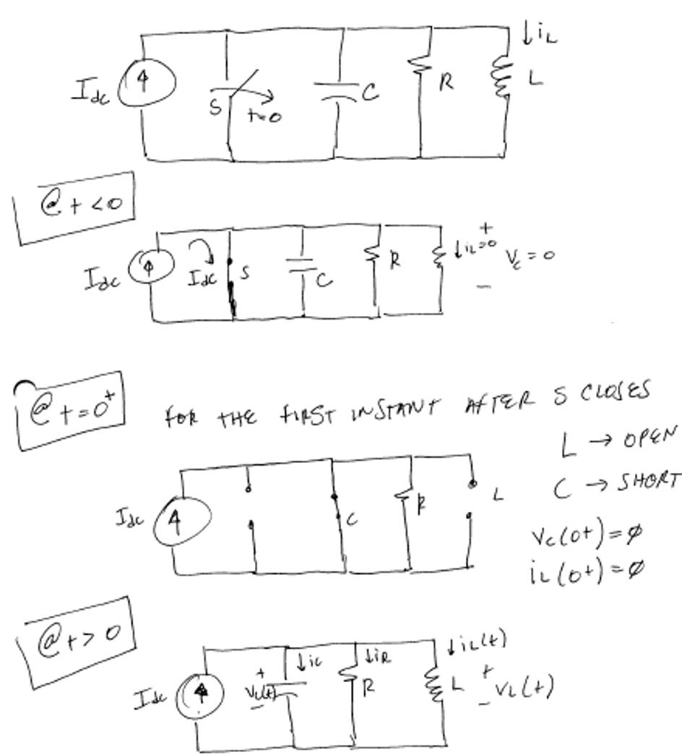

Example: Step Response for Parallel RLC
Assume i_{L}(0⁻)=0
v_{c}(0⁻)=0

Slide 12
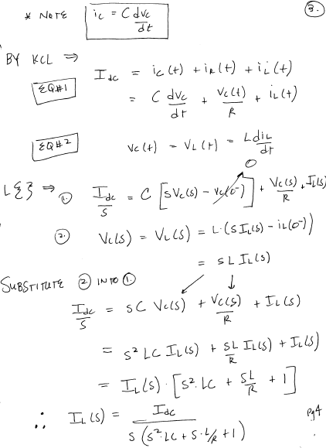



Slide 13
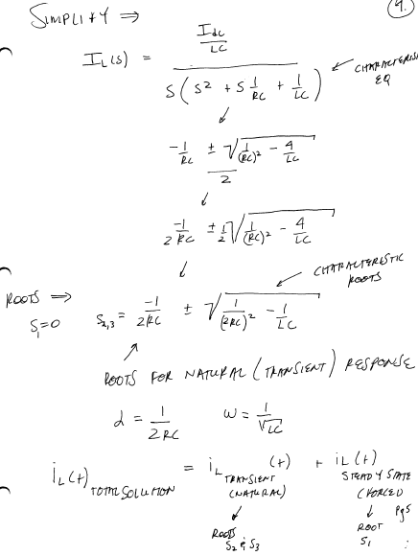


Slide 14
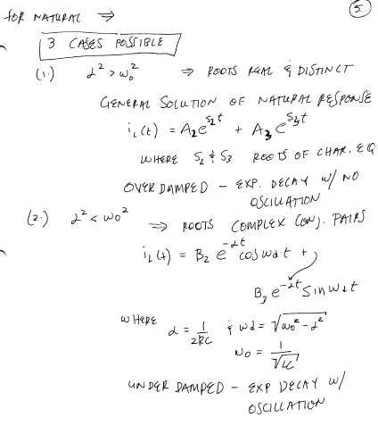




Slide 15
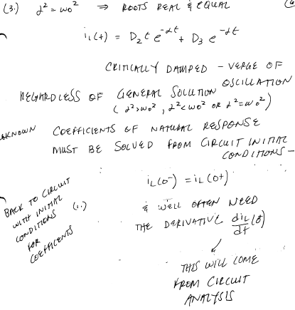

Slide 16
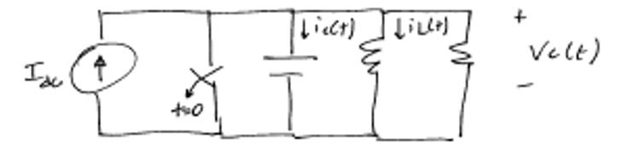
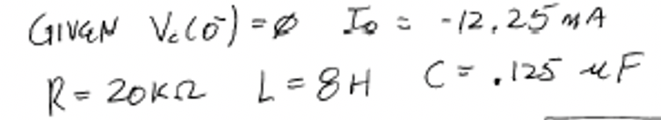
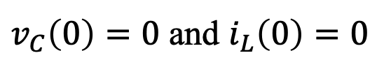
Numerical Example: Step Response for Parallel RLC
Assume the circuit initially was de-energized, i.e

Slide 17
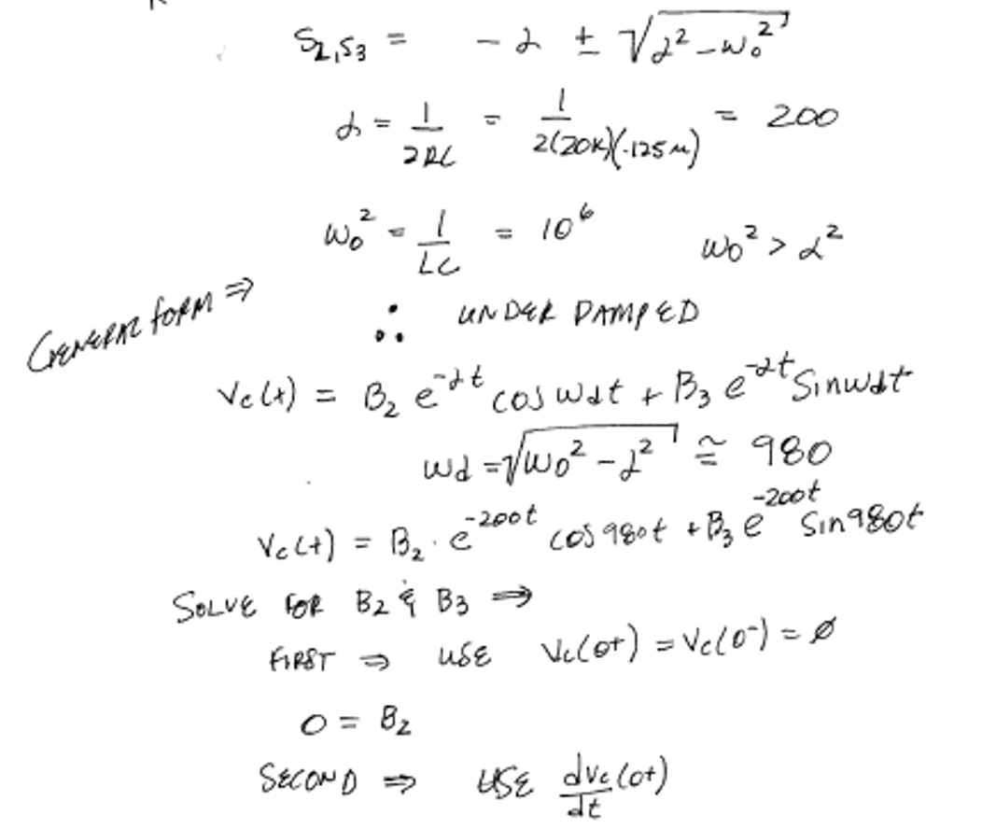
Numerical Example: Step Response for Parallel RLC
Solution:

Slide 18
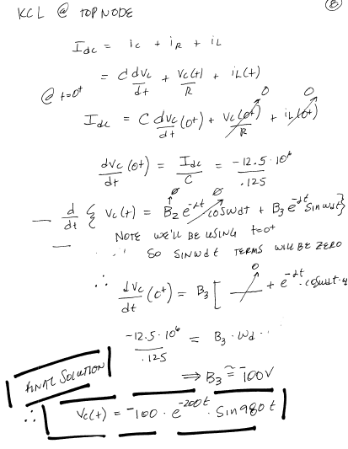

Slide 19
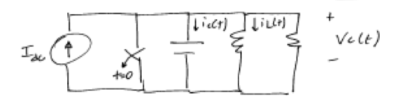
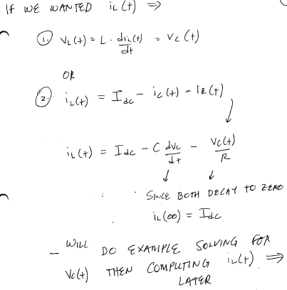

Slide 20
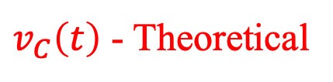
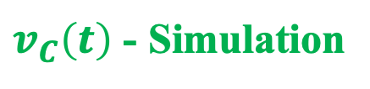
Parallel RLC Example-Verification

Slide 21
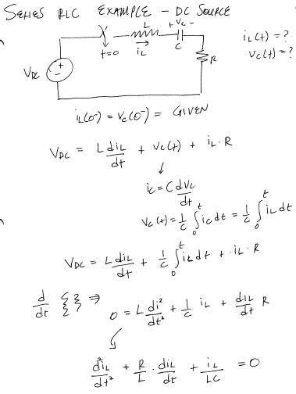




Series RLC Example – DC Source

Slide 22
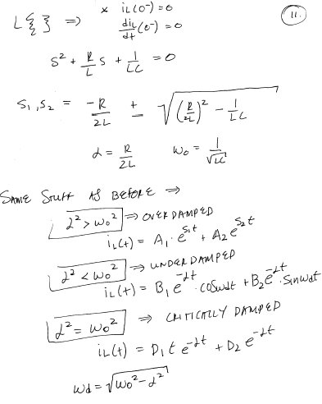


Slide 23
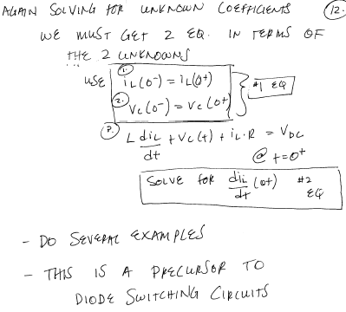


Slide 24
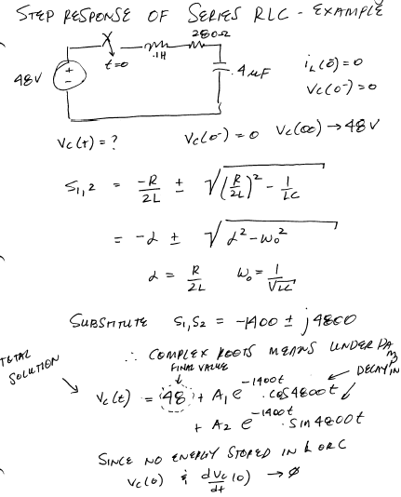


Numerical Example: Step Response of Series RLC

Slide 25
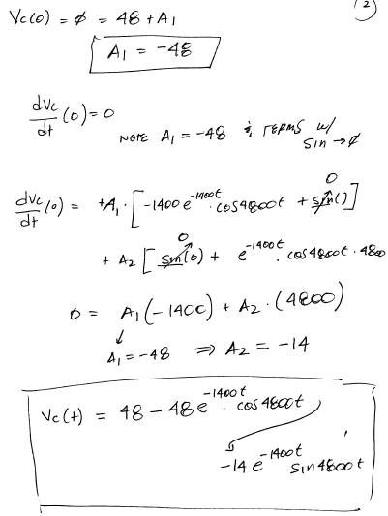


Slide 26
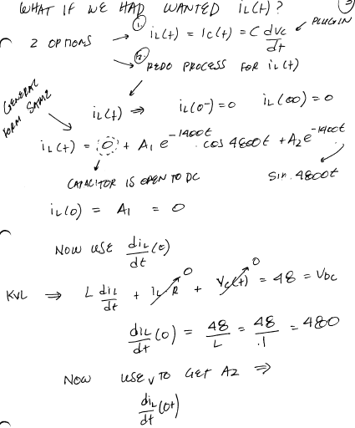
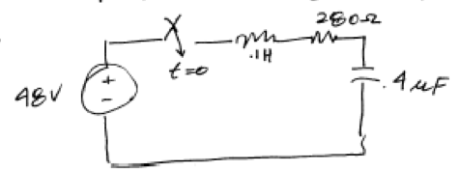

Slide 27
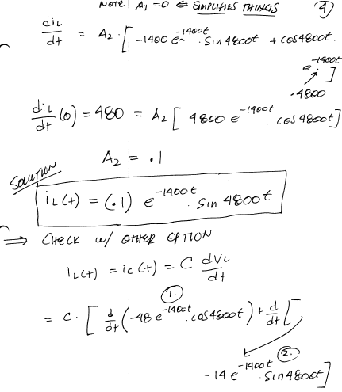



Slide 28
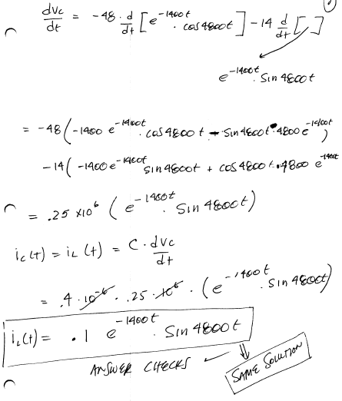

Slide 29
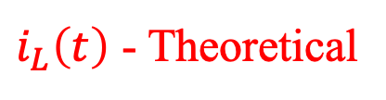
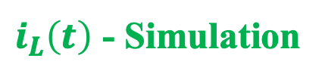
Series RLC Example-Verification

Slide 30

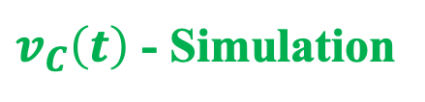
Series RLC Example-Verification

