Slide 1
EEL 5245 POWER ELECTRONICS I Lecture #5 Examples of Switching Functions

Slide 2
Discussion Topics
Several Examples on Switch Loss Calculation (Conduction and Switching components of Loss)

Slide 3
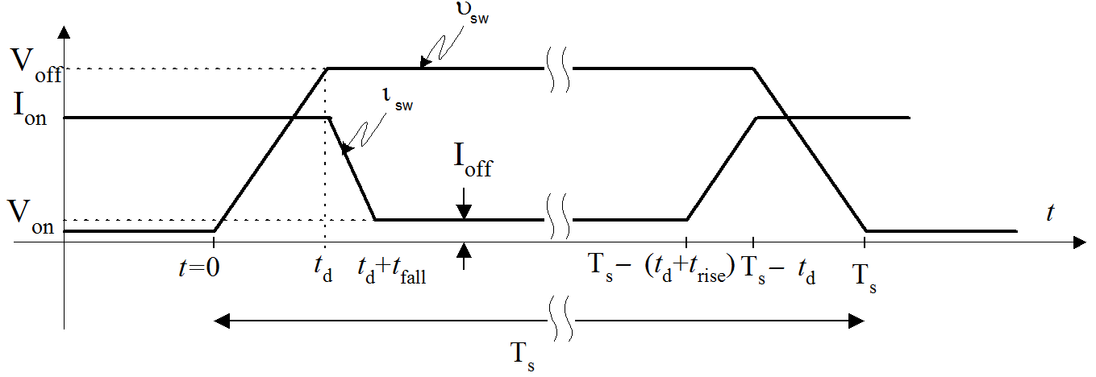
Exercise
For the switching waveforms shown below:
Derive the expression for the instantaneous switching and conduction power loss and sketch them.
Determine the total average power dissipated in the circuit during one switching period.
Find the maximum power.

Slide 4
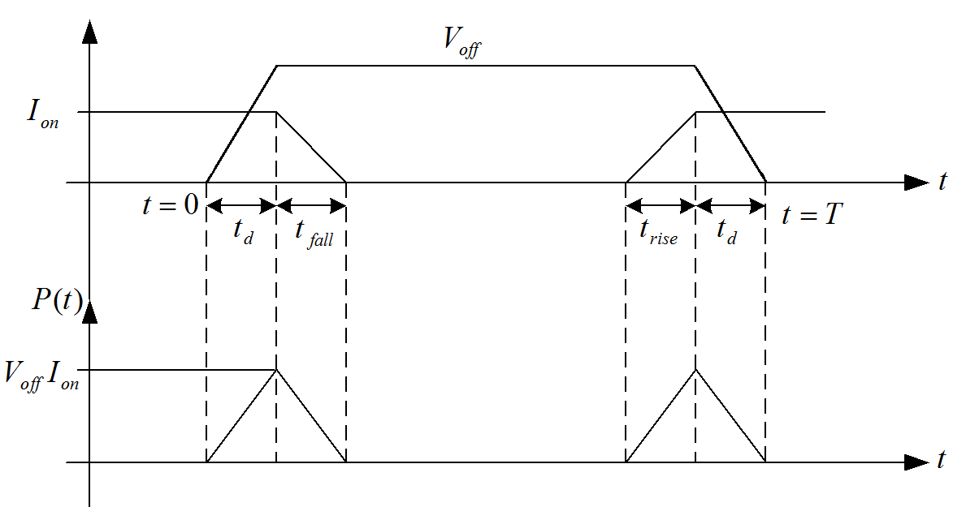
Solution
a) The switching waveforms
DT
Assume D=1.0

Slide 5
Solution
b) The instantaneous power is given by

Slide 6
Solution
c) The total average power dissipated
Area under the curves
d) The maximum power by observation,
Average conduction power loss=0

Slide 7
Numerical Example – P2.8
Determine the conduction and switching average power dissipation for Example 2.2 by using t_{on} = 5μs, t_{off} = 8μs, T_{s} = 150μs, V_{OFF} = 150V, V_{on} = 0.7V and I_{on} = 15A.
Recall, the switching waveforms:
Assume D=1.0

Slide 8
Numerical Example – P2.8
Solution: From Example 2.2, we have,
The average power dissipated

Slide 9
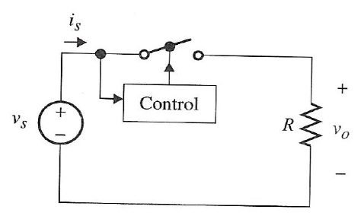
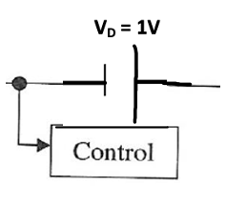
Exercise
For (I) V_{S}=12sinωt
(II) V_{S} is a square wave with peak-to-peak voltage equals ±12V.
Assume the switch is initially off, and its control works in such a way that it toggles every time V_{S}(t) crosses zero.
Determine:
(a)-(d) Assume Ideal switch:
a) Sketch the waveforms for is and Vo.
b) Calculate the average and rms values for the output voltage.
c) Calculate the average input power, average output power,
the efficiency.
d) Repeat parts (a)-(c) by assuming T=1 µs.
(e) Repeat parts (a)-(d) by assuming the switch is non-ideal with $V_{D}=1 V$drop when closed as follows:

Slide 10
Exercise
(I) V_{S}=12sinωt
(II) V_{S} square wave

Slide 11
Solution
I-a) The waveforms for i_{s} and V_{o}

Slide 12
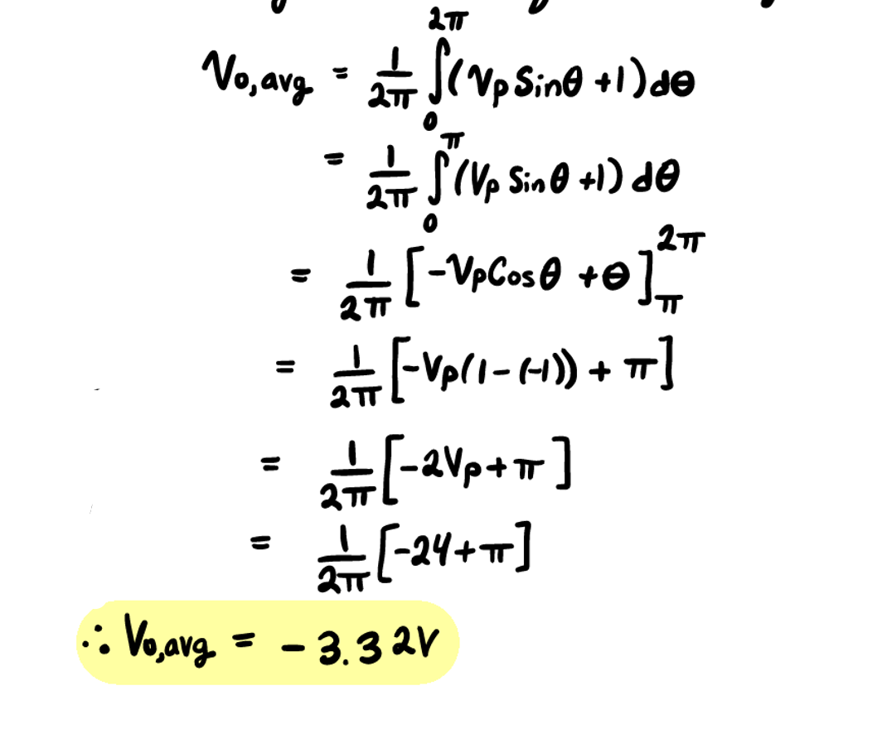
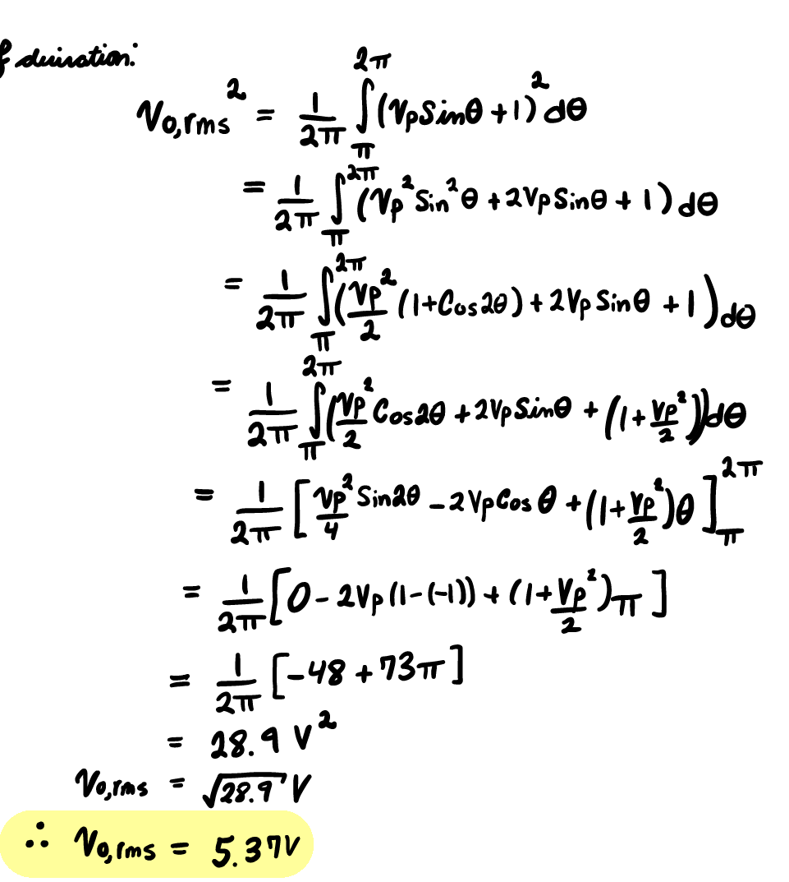
Solution (cont’d)
I-b) The average and rms values for the output voltage

Slide 13
Solution (cont’d)
I-b) The average and rms values for the output voltage
I-c) The average input power, average output power, and efficiency
The efficiency is given by,

Slide 14
Solution (cont’d)
d) Assuming T=1 µs. (Same as above)

Slide 15
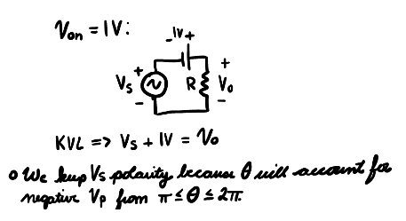
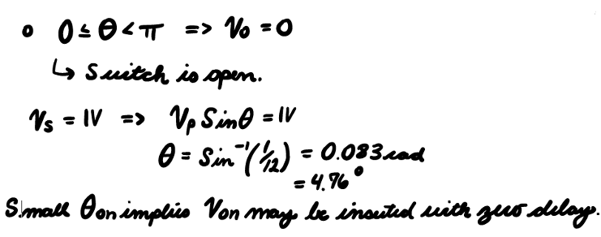
(e) Repeat parts (a)-(d) by assuming the switch is non-ideal with $V_{D}=1 V$drop when closed as follows:

Slide 16
I-e) With 1V drop across the switch, the equivalent circuit is :
For, 0≤t< T/2 switch is off,
For, T/2≤t< T switch is on, switch is replaced by V_{D}=1V

Slide 18
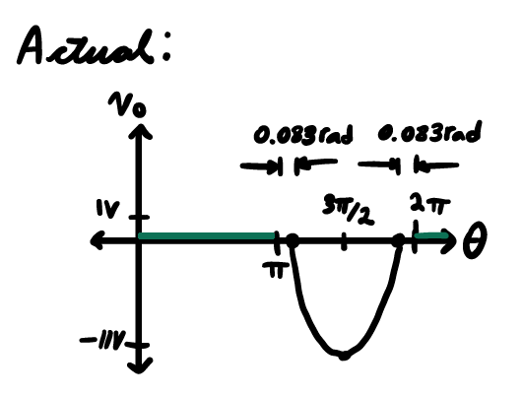
Solution (cont’d) Correction
Theoretical:

Slide 19
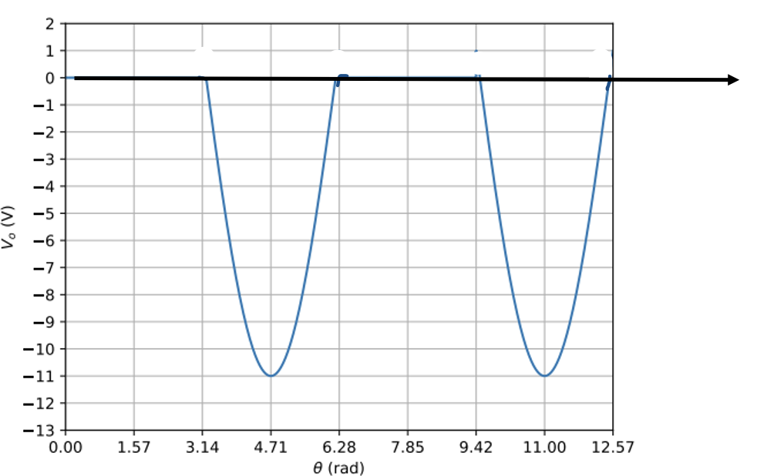
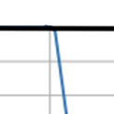
Solution (cont’d)
Simulation:

Slide 20
Solution (cont’d)
The efficiency is given by,

Slide 21
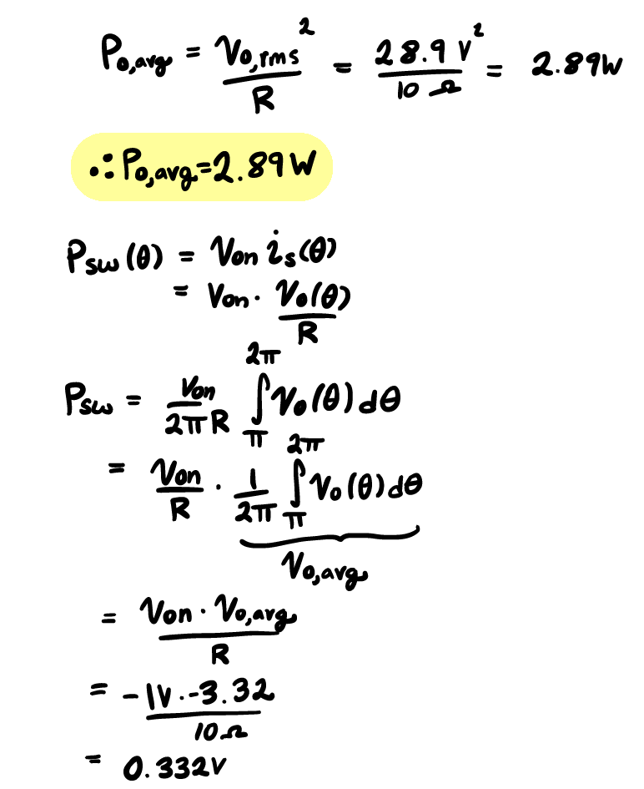
Solution (cont’d) Correction

Slide 22
Solution (cont’d) Correction

Slide 23
Solution (cont’d)
II-a) Vs(t) is a square wave with ± 12V.
The waveforms for is and Vo

Slide 24
Solution (cont’d)
II-b) The average and rms values for the output voltage
II-c) The average input power, average output power, and efficiency
The efficiency is given by,
II-d) Assuming T=1 µs. (Same as above)

Slide 25
Solution (cont’d)
II-e) Assuming the switch has 1 V voltage drop when closed.
The efficiency is given by,

Slide 26
Example
Consider the two-switch circuit given in the figure below. Assume ideal S1 and S2 with switching sequence shown. Sketch i_{sw1}, v_{sw1}, i_{sw2} and v_{sw2}. Determine (a) the average output voltage, (b) average power delivered to the load, and (c) efficiency

Slide 27
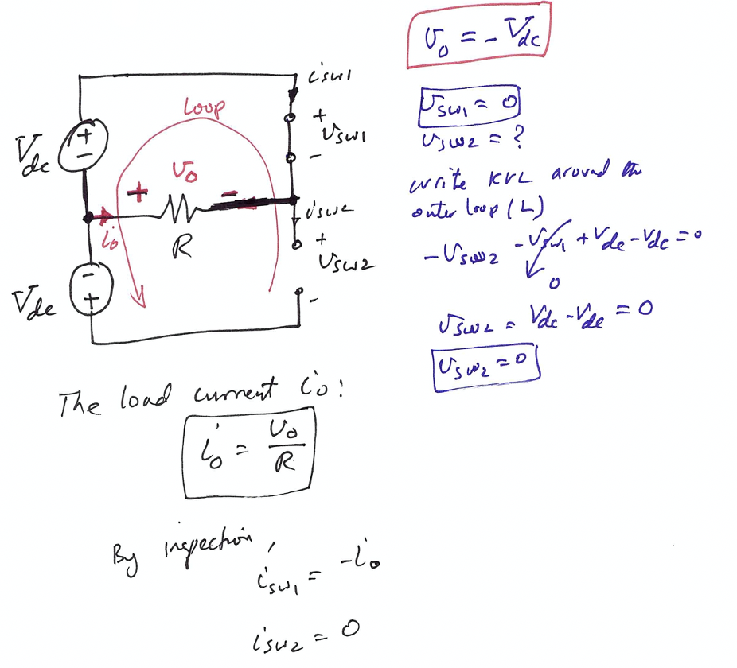
Analysis of the half-bridge circuit
There are three modes of operations:
Mode 1: For S₁ is ON and S₂ is OFF.

Slide 28
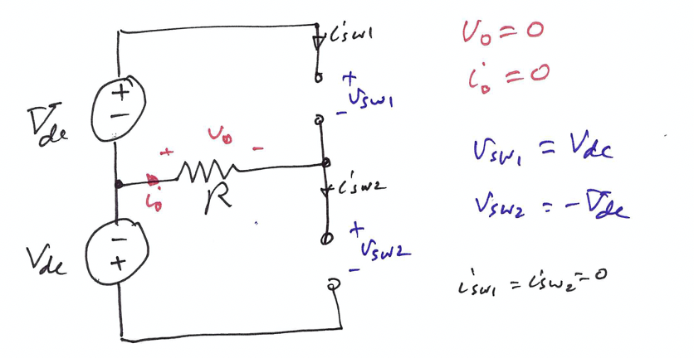
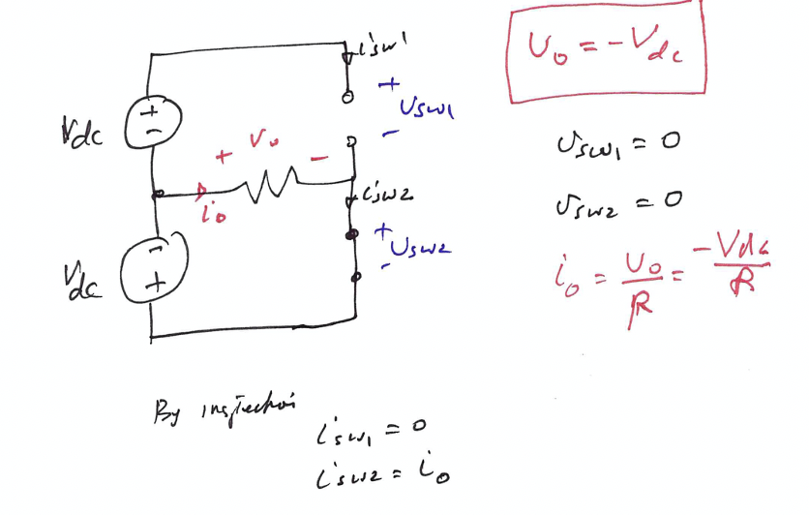
Mode 2: Both S₁ and S_{2 are} OFF.
Mode 3: For S₁ is OFF and S₂ is ON.

Slide 29
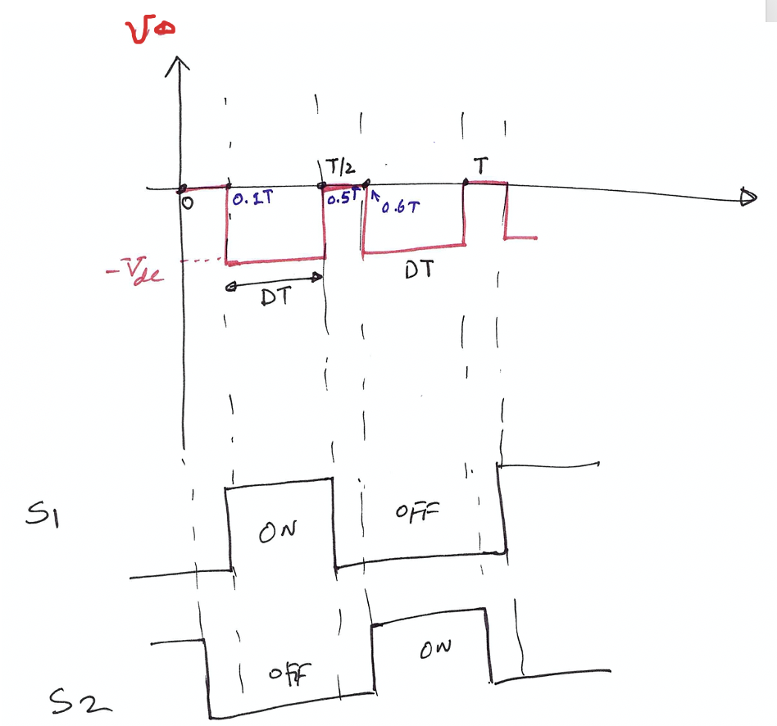
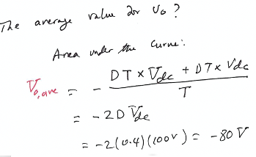

Slide 30
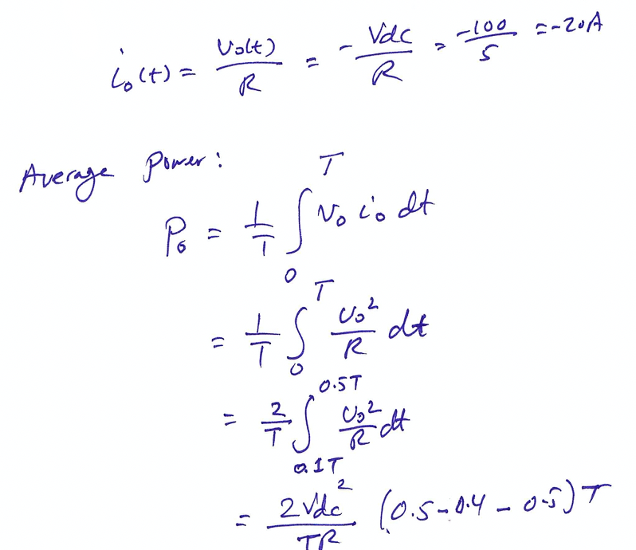
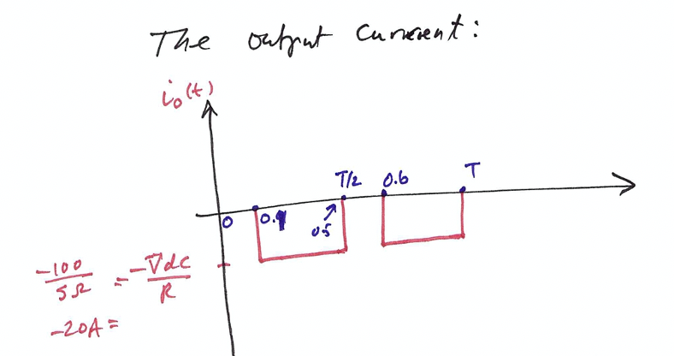

Slide 31
Solution

Slide 32
Solution (cont’d)
The average output voltage
The average power delivered to the load
Efficiency

Slide 33
Example
What about if we change the polarities of the dc voltage

Slide 34
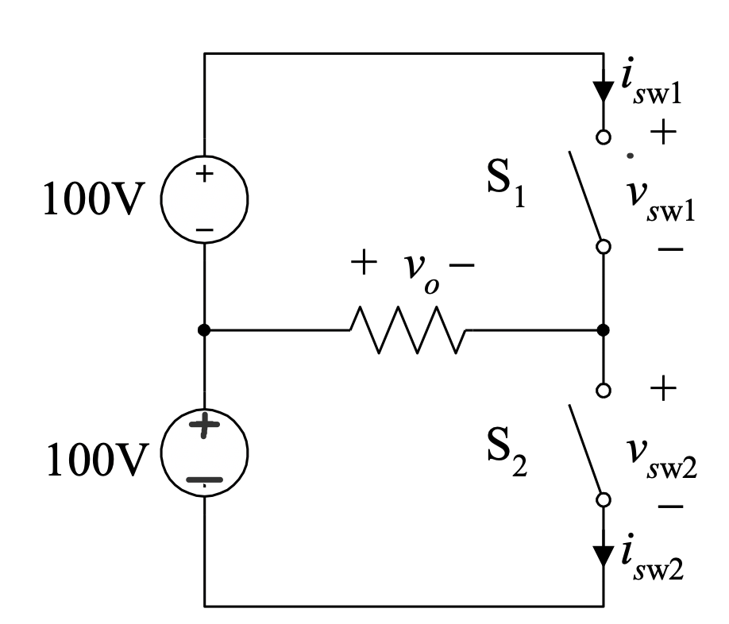
Example
For S₁ is ON and S₂ is OFF.
Apply KVL around Loop1 (L1):
S2 blocks twice the input dc voltage

Slide 35
Example
For S₂ is ON and S₁ is OFF.
Apply KVL around Loop2 (L2):
S1 blocks twice the input dc voltage

Slide 37
Example
The circuit shown in the figure below is known as current-driven full bridge inverter. Assume S1, S2, S3 and S4 are ideal with their switching waveforms as shown.
Sketch the waveforms for i_{o}, v_{o}, v_{sw1}, i_{sw1}, v_{sw4} and i_{sw4}, and
derive the expression for the average output voltage.

Slide 38
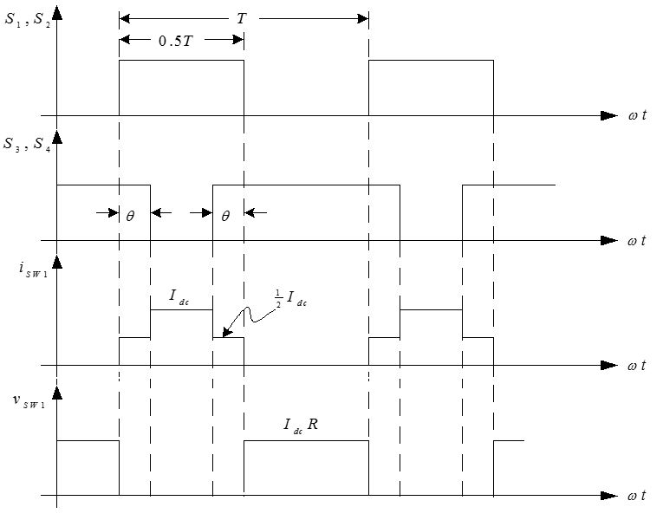
Solution

Slide 39
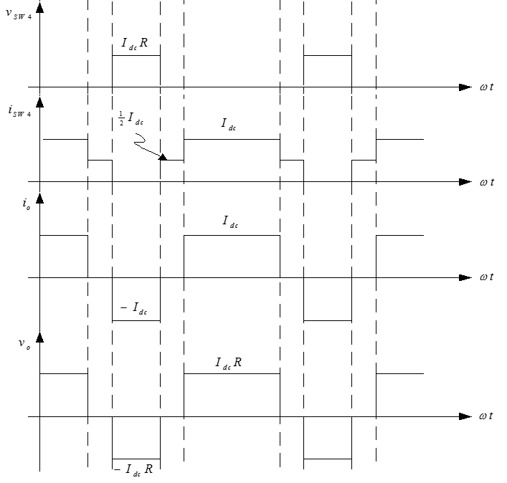
Solution (cont’d)

Slide 40
Solution (cont’d)
The average output voltage

Slide 41
Example
By assuming each switch has 0.2Ω on state resistance and 2V forward voltage drop during conduction.
Sketch the waveforms for i_{o}, v_{o}, v_{sw1}, i_{sw1}, v_{sw4} and i_{sw4}, and derive the expression for the average output voltage.

Slide 42
Solution
Define θ = dT

Slide 43
Solution (cont’d)
The average output voltage

