Slide 1
EEL 5245 POWER ELECTRONICS I Lecture #4: Chapter 2 Switching Concepts and Semiconductor Overview

Slide 2
Objectives of Lecture
Switch realizations
Objective is to focus on terminal characteristics
Blocking capability
Conduction direction
Device loss mechanisms
Qualitative relationships between
On state resistance
Breakdown Voltage
Switching Time
Survey of some commonly available commercial products
Comparison of Switching Devices

Slide 3
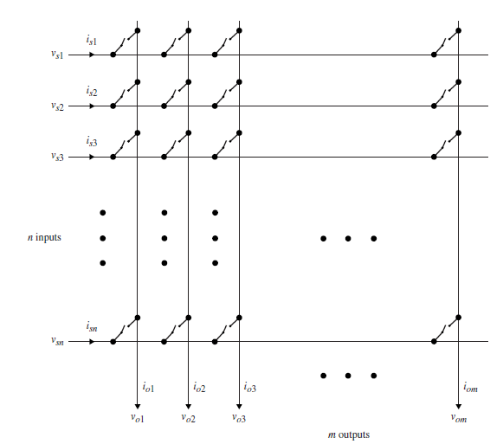
Switching Functions and Matrix Representation
nxm Switching Matrix

Slide 4
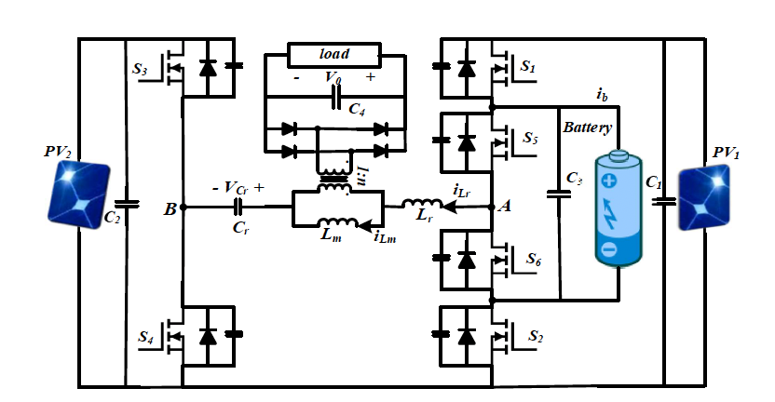
Photovoltaic Applications - Four port Dual-PV-Battery LLC converter

Slide 5
Photovoltaic Applications - Four port Dual-PV-Battery LLC converter

Slide 6
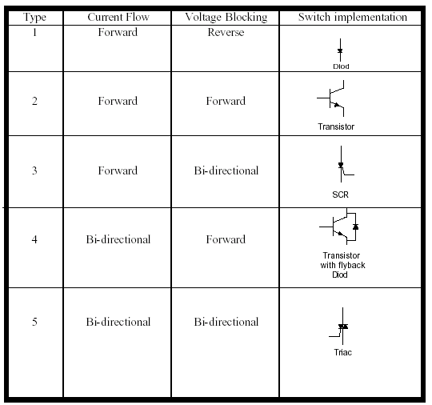
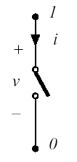
Switch Classifications

Slide 7
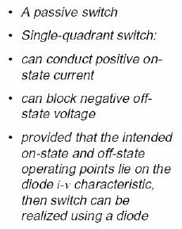
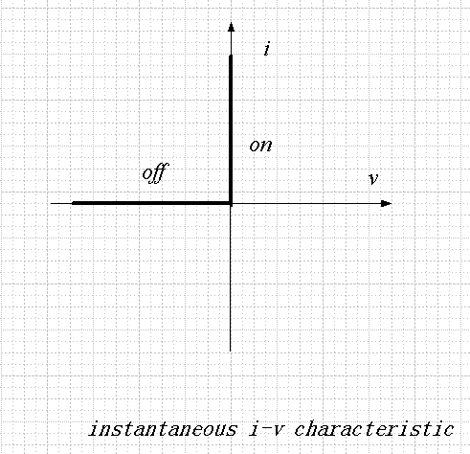
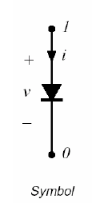
Switch Realizations-Power Diode
Passive means no active means of control
Device conducts in forward direction in response to positive forward voltages
Devices turns off with negative forward voltage

Slide 8
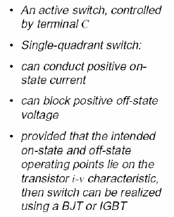
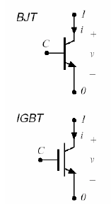
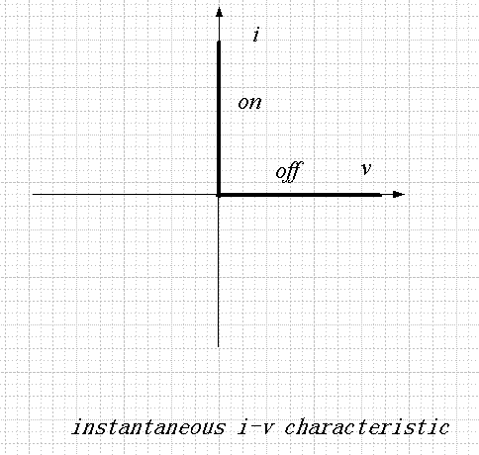
Switch Realizations-BJT/IGBT
Active-controlled turn on and turn off
BJT conduct in forward direction in response to control current at C
IGBT conduct in forward direction in response to control voltage at C (wrt terminal 0)
Devices turns off when control signal removed

Slide 9
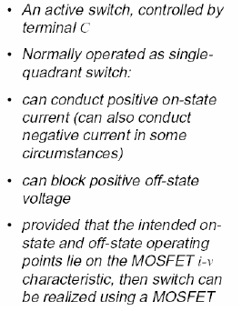
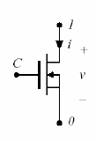
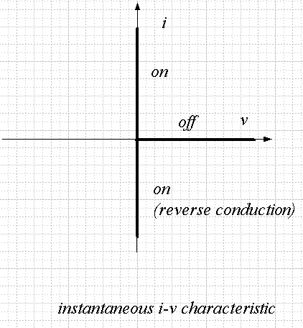
Switch Realizations-MOSFET
Active-controlled turn on and turn off
MOSFETs conduct in forward direction in response to control voltage at C (wrt terminal 0)
Devices turns off when control signal removed

Slide 10
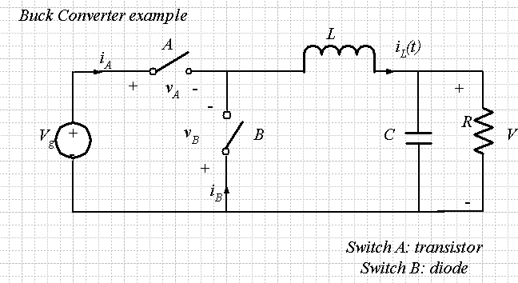
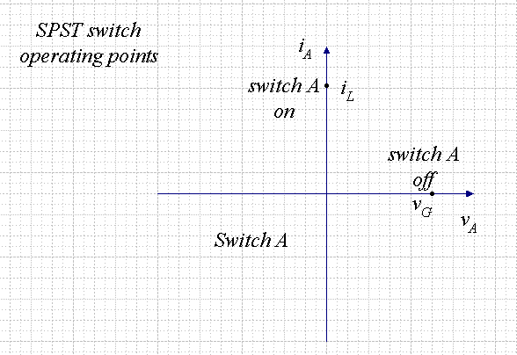
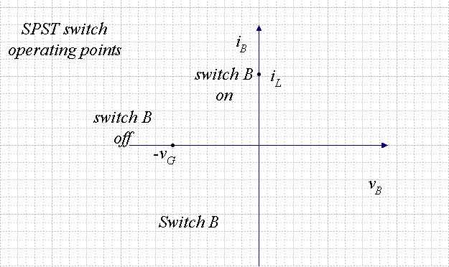
Switch Realizations-SPST

Slide 11
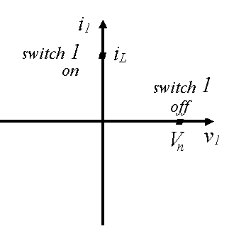
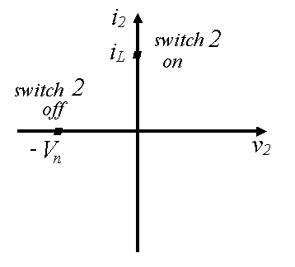
Switch Realizations-BJT and Diode

Slide 12
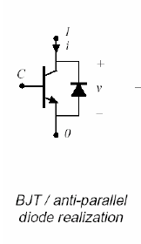
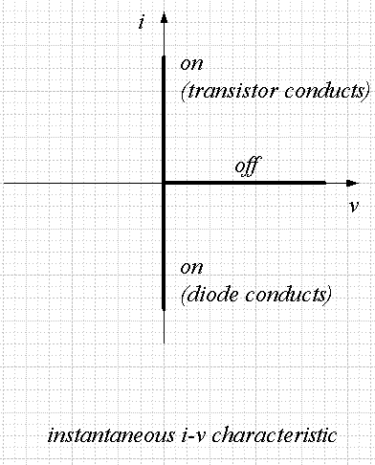
Switch Realizations- Anti-parallel Diode
Usually an active switch,
controlled by terminal C
Normally operated as two-
quadrant switch :
Can conduct positive or
negative on-state current
can block positive off-state
voltage
provided that the intended on-
state and the off-state operating
points lie on the composite i-v
characteristic, then switch can
be realized as shown

Slide 13
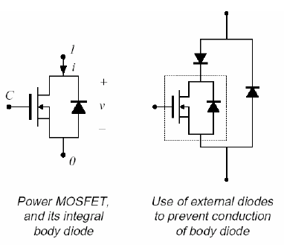
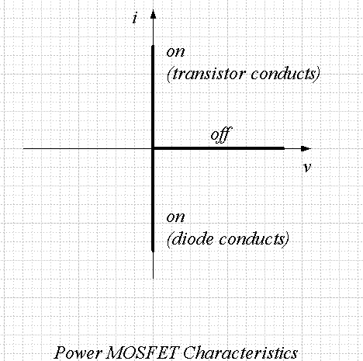
Switch Realizations- MOSFET Body Diode

Slide 14
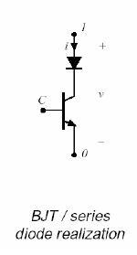
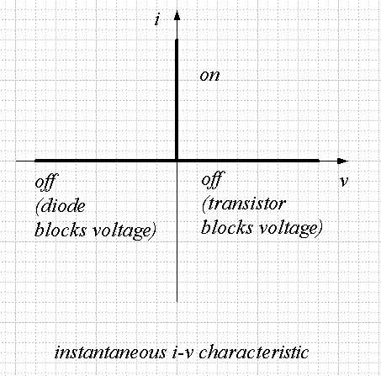
Switch Realizations- Bidirectional Voltage Blocking-SCR
Usually an active switch,
controlled by terminal C
Normally operated as two-
quadrant switch :
Can block positive off-state
voltage
Provided that the intended on-
state and the off-state operating
points lie on the composite i-v
characteristic, then switch can
be realized as shown
Thyristor family also has this i-v characteristic
Silicon Controller Rectifier (SCR)
Gate Turn Off Thyristor (GTO)

Slide 15
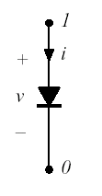
Power Diode Overview
Diode
Minority carrier device
Passively controlled device
Controlled by external circuitry
Forward Bias to turn on
Reverse Bias to turn off
Relatively low on state conduction losses
Turn-on is to charge the depletion capacitor across the pn-junction
Turn-off is more complex.

Slide 16
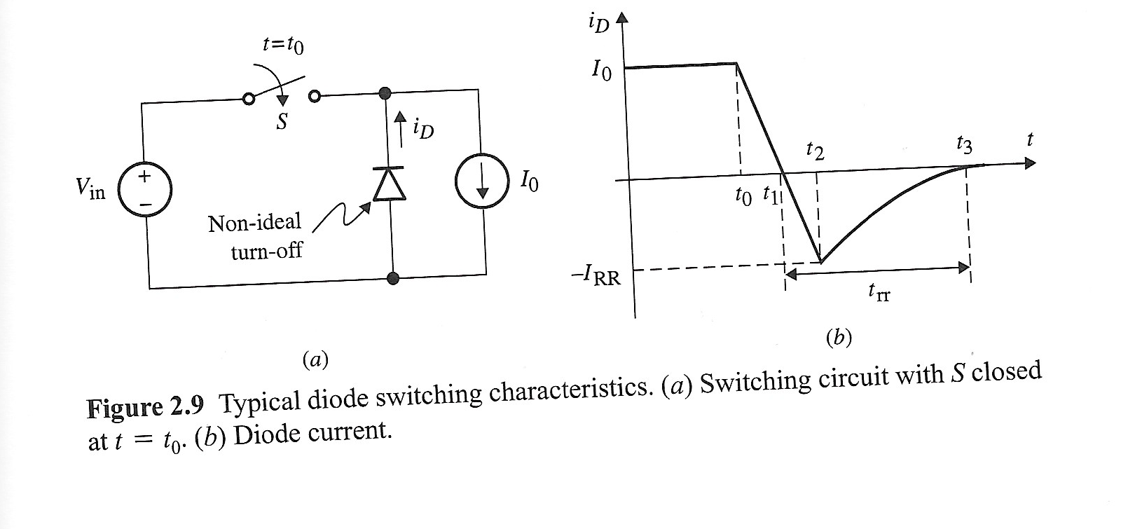
Diode Switching Characteristics Conventional

Slide 17
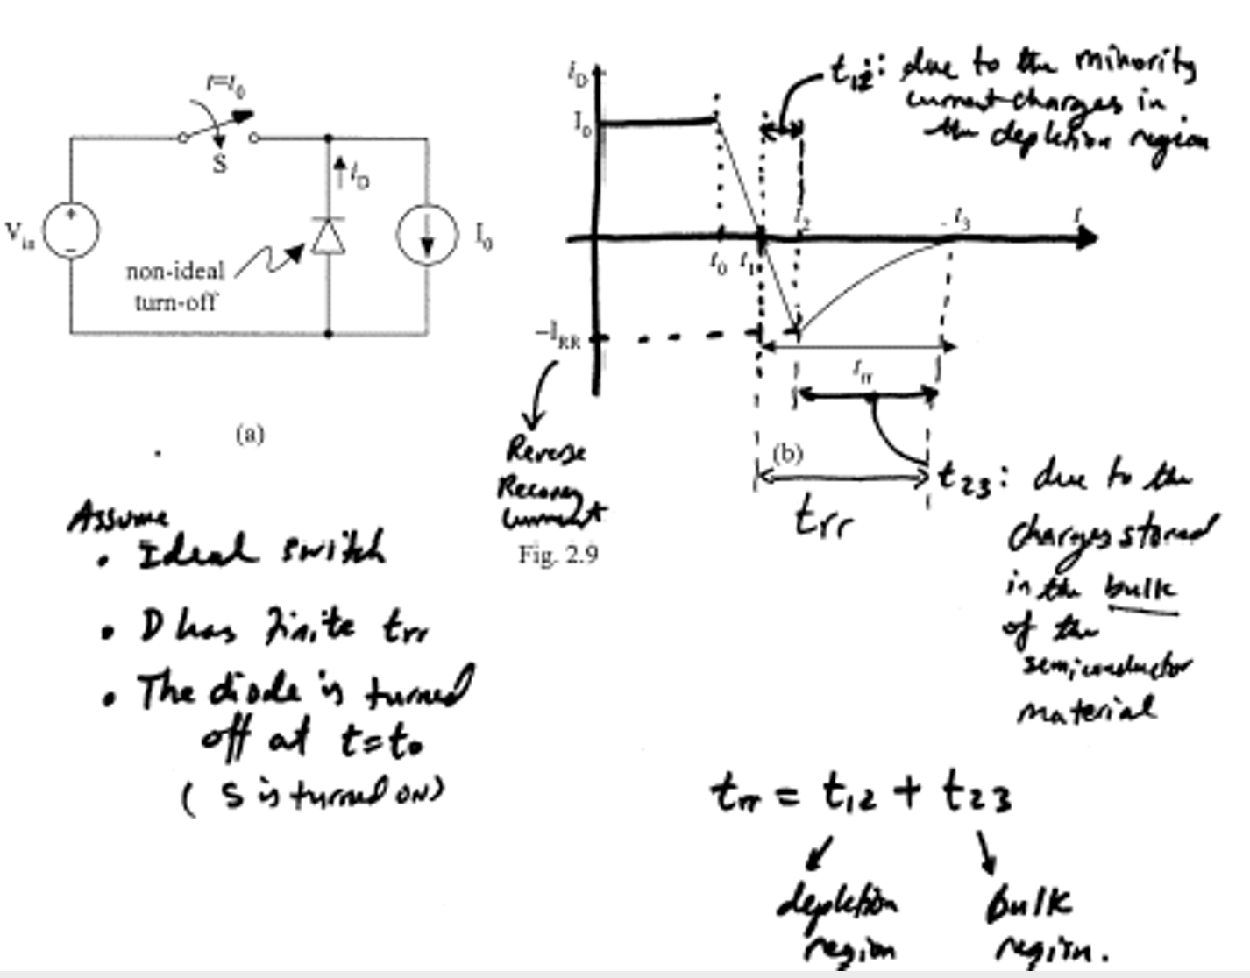
Diode Switching Characteristics Conventional

Slide 18
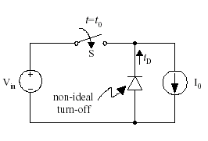
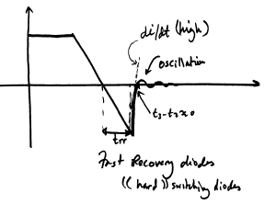
Diode Switching Characteristics Fast Recovery Type

Slide 19
Types of Power Diodes
Standard recovery
Reverse time not specified, intended for 50/60 Hz
Fast recovery and ultra-fast recovery
Reverse recovery time and recovered charge specified
Intended for converter applications
Schottky diode
A majority carrier device
Essentially no recovered charge
Model with equilibrium I-V characteristic, in parallel with depletion region capacitance
Restricted to low voltage (few devices can block 110V or more)

Slide 20
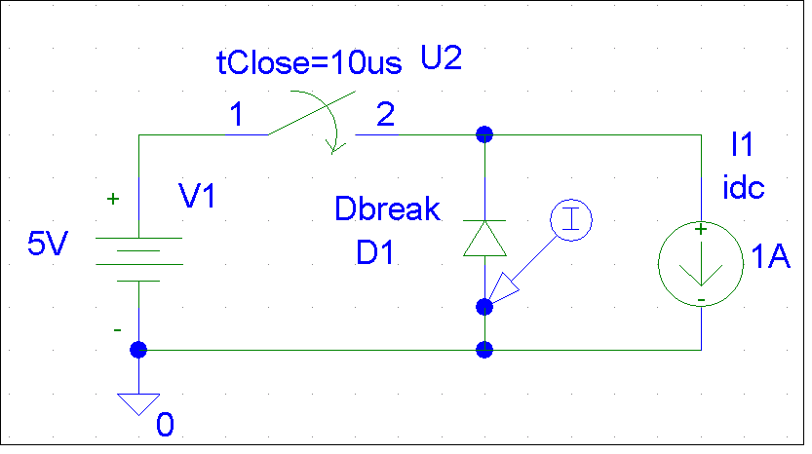
Diode Switching Characteristics Simulation-Dbreak
1.0A
0.5A
0A
10.0us
10.4us
10.8us
I(D1)
Time

Slide 21
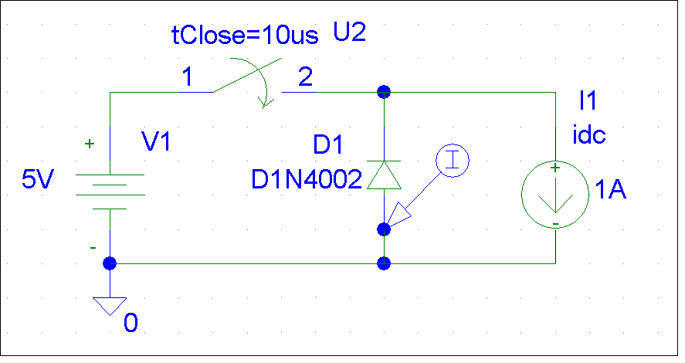
Diode Switching Characteristics Simulation-1N4002 General Purpose
40A
0A
0A
-40A
-40A
-80A
-71A
10.00us
10.25us
10.50us
10.75us
10.624us
10.700us
10.800us
I(D1)
I(D1)
Time
Time

Slide 22
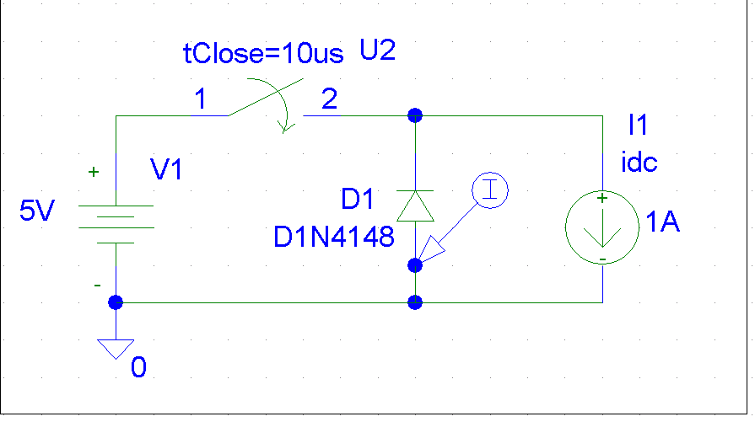
Diode Switching Characteristics Simulation-D1N4148-Fast Recovery
1.0A
200mA
0.5A
0A
-200mA
0A
10.583us
10.600us
10.620us
10.0us
10.2us
10.4us
10.6us
10.8us
I(D1)
I(D1)
Time
Time

Slide 23
Survey of Commercial Power Diodes

Slide 24
General Comments on Power Diodes
Inverse Relationship between Blocking voltage/Forward current and reverse recovery time/forward voltage drop
Generally, Diode turn on fast enough to be considered ideal
Device turn off generally considered ideal but can effect circuit operation
Diode turn off means negative current needed to remove stored charge
This charge removal is required for device turn off
In some instances, this negative current and delay can have an effect on circuit operation
Can result in inductive ringing (particularly when fast recovery used in an inductive environment)
When required, series diodes add to blocking capability

Slide 25
Thyristors - Overview
Thyristors
“Controlled diode”
In off state, can block positive forward polarity voltage and thus not conduct
Can be trigger into the on state by providing a short pulse of gate current provided that device is in forward blocking state
Once device begins to conduct, it is LATCHED on and gate current can be removed

Slide 26
Thyristors -SCR
Silicon Controlled Rectifier
Once device begins to conduct, it is LATCHED on and gate current can be removed
Cannot be turned off by active control (activity at gate)
When current reduces and tries to go to negative, device turns off
External circuit must reverse bias the SCR to achieve turn off
After turn off, gate regains control allowing active turn on once the device is in forward blocking state

Slide 27
Thyristors -SCR Symbol and Terminal Characteristics

Slide 28
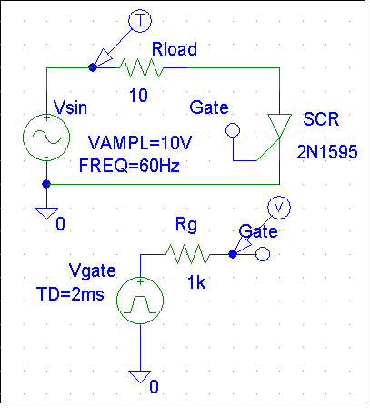
Thyristors -SCR Simulation
1.0A
0.5A
0A
I(Rload)
1.0V
0.5V
SEL>>
-0.1V
0s
5ms
10ms
15ms
V(Gate)
Time

Slide 29
Commercial SCR Survey
Product | Package | Circuit | VDRM | IT(RMS)
ST180C04C0 | TO-200AA (A-Puk) | DISCRETE | 400 | 660
ST230C04C0 | TO-200AA (A-Puk) | DISCRETE | 400 | 780
ST280C04C0 | TO-200AA (A-Puk) | DISCRETE | 400 | 960
ST280C06C0 | TO-200AA (A-Puk) | DISCRETE | 600 | 960
ST280CH06C0 | TO-200AA (A-Puk) | DISCRETE | 600 | 1130
ST230C08C0 | TO-200AA (A-Puk) | DISCRETE | 800 | 780
ST180C08C0 | TO-200AA (A-Puk) | DISCRETE | 800 | 660
ST180C12C0 | TO-200AA (A-Puk) | DISCRETE | 1200 | 660
ST230C12C0 | TO-200AA (A-Puk) | DISCRETE | 1200 | 780
ST230C14C0 | TO-200AA (A-Puk) | DISCRETE | 1400 | 780
ST230C16C0 | TO-200AA (A-Puk) | DISCRETE | 1600 | 780
ST180C16C0 | TO-200AA (A-Puk) | DISCRETE | 1600 | 660
ST180C18C0 | TO-200AA (A-Puk) | DISCRETE | 1800 | 660
ST180C20C0 | TO-200AA (A-Puk) | DISCRETE | 2000 | 660

Slide 30
General Comments on SCRs
Used to be device of choice for high power applications
SCR based Phase Controlled Rectifiers still common in three-phase industrial environment
A minority carrier device
SCR has highest blocking voltage and current carrying capabilities of all the semiconductor switches
Large reverse recovery current
Long carrier lifetimes allow low on state resistance but mean long turn off times
Switching very slow
Newer designs rarely use SCRs unless very high power required
Most newer designs use MOSFETs or IGBTs

Slide 31
Thyristors -Triac
Triac
“Back to back” SCR
Bidirectional current flow, bidirectional voltage blocking
Often used:
AC waveform chopping: dimmers, soldering stations, controlled heating elements

Slide 32
Thyristors -GTO
Gate Turn Off Thyristor
Like SCR, once device begins to conduct, it is LATCHED on and gate current can be removed
Unlike SCR, GTO can be turned off with a negative gate-cathode voltage (i.e. active turn off control)
This negative gate current pulse can be short duration but must be large magnitude (~ .33 i_{A} )
A controlled switch like BJT/MOSFET but not suitable for inductive turn off
Slow switching time (fs max ~10 kHz)

Slide 33
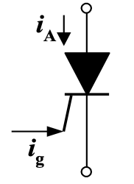
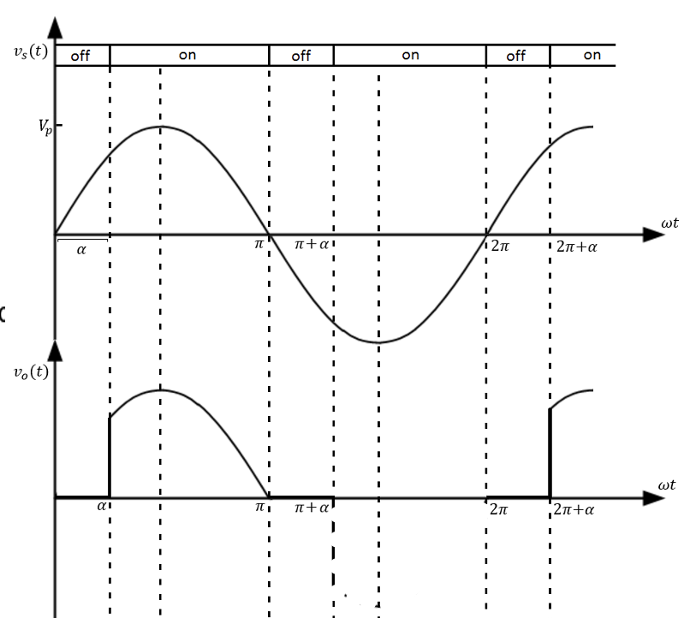
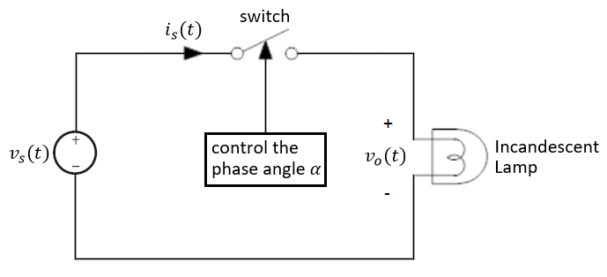
Example 2.4 – Light Dimming - SCR
The average power applied to the light is varied to change its brightness.

Slide 34
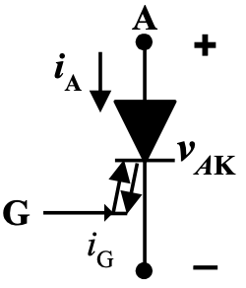
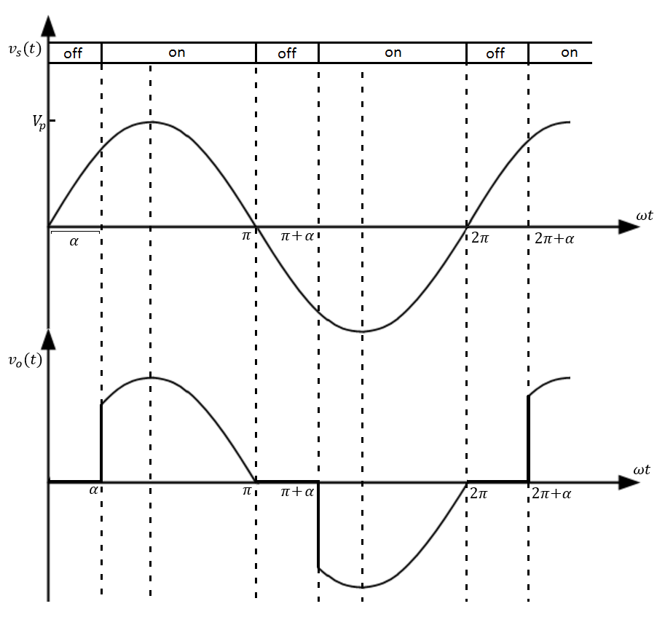
Example 2.4 – Light Dimming - Triac
The average power applied to the light is varied to change its brightness.

Slide 35
BJT - Overview
Bipolar Junction Transistor
A minority carrier device
Current controlled
Requires a continuous base current to remain in on (conducting) state
Significant delays during turn off transition
On-state resistance has negative temperature characteristic so device paralleling not always straightforward

Slide 36
BJT Symbol and i-v Characteristics

Slide 37
General Comments on BJT
BJT has been replaced by MOSFET in low-voltage (<500V) applications
BJT is being replaced by IGBT in applications at voltages above 500V
Design trade off between on-state losses and switching times
A minority-carrier device: compared with MOSFET, the BJT exhibits slower switching, but lower on-resistance at high voltages

Slide 38
MOSFET Overview
Metal-Oxide-Semiconductor Field Effect Transistor
A majority carrier device
Voltage controlled
Require continuous application of Gate to Source voltage to maintain on-state (conduction)
No gate current flows except during transitions to charge and discharge gate capacitance
Very short switching times
On-state resistance has positive temperature coefficient so device paralleling simple

Slide 39
MOSFET Symbol and i-v Characteristics

Slide 40
Survey of Commercially Available MOSFETs

Slide 41
General Comments on MOSFET
Majority carrier device: fast switching times
Typical switching frequencies: tens and hundreds of kHz
On state losses rise more rapidly with blocking voltage than in a comparable BJT
Easy to drive
The device of choice for blocking voltages less than 500V
1000V devices are available, but are useful only at low power levels (100W)
Generally, on state resistance most significant factor when selecting device

Slide 42
IGBT Overview
Insulated Gate Bipolar Transistor
Combination of BJT and MOSFET
Like MOSFET, has high impedance gate which requires small charge to turn on
Like BJT, small on state resistance even for devices with large blocking voltage ratings
Can be designed to block negative voltages like thysistors

Slide 43
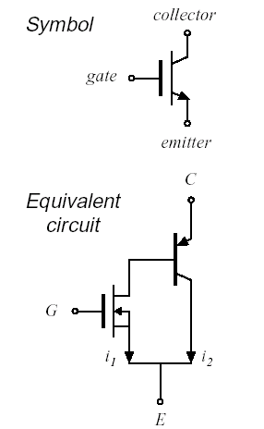
IGBT Symbol and i-v Characteristics

Slide 44
Survey of Commercially Available IGBTs

Slide 45
General Comments on IGBT
Faster than comparable BJT, Slower than a comparable MOSFET
On state losses smaller than MOSFET and are comparable to BJT
Turn on time can be effected by rate of change of v_{gs}
Most new designs in the industrial power electronics market use IGBTs for medium power applications

Slide 46
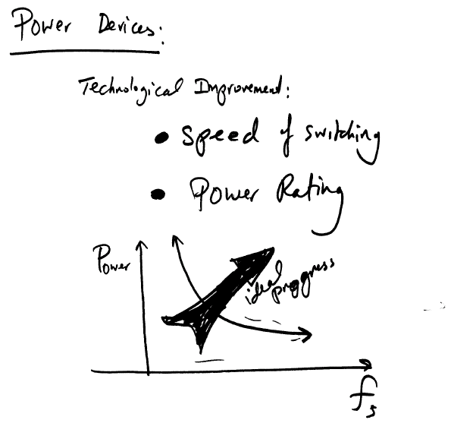
Future Trends in Device Progress

Slide 47
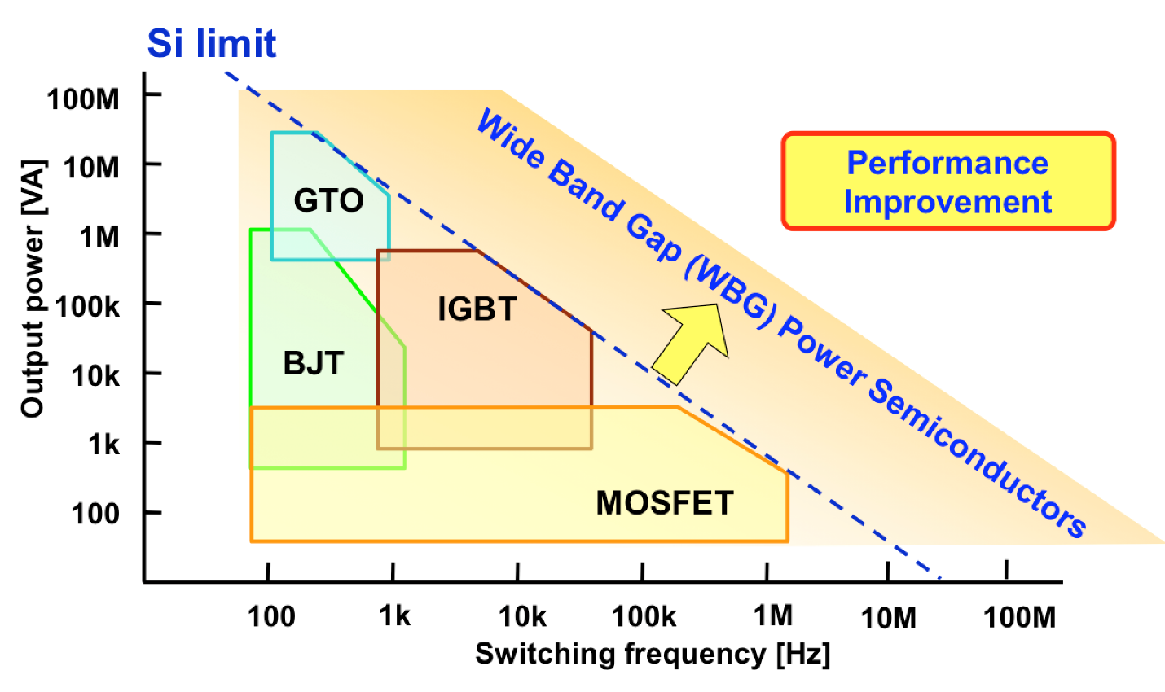
Device Comparison f_{s} vs. Power

Slide 48
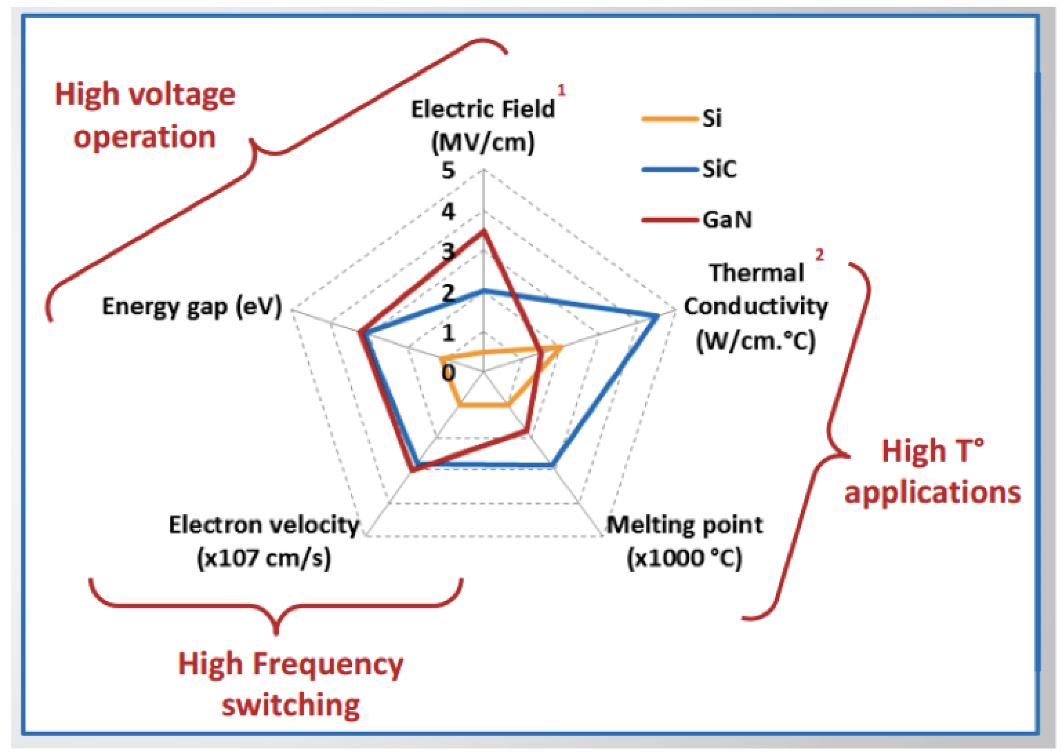
Device Comparison Voltage vs. Power vs. Temperature

Slide 49
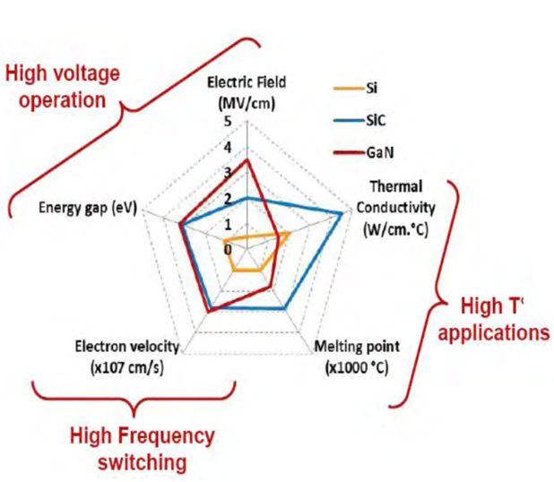
Wide Band-Gap Semiconductors For Power Electronic
Si devices limited to operate below 200 C
Si power devices not suitable for very high switching speed (HSS)
Si power devices not suitable for very high voltage (HV) applications

Slide 50
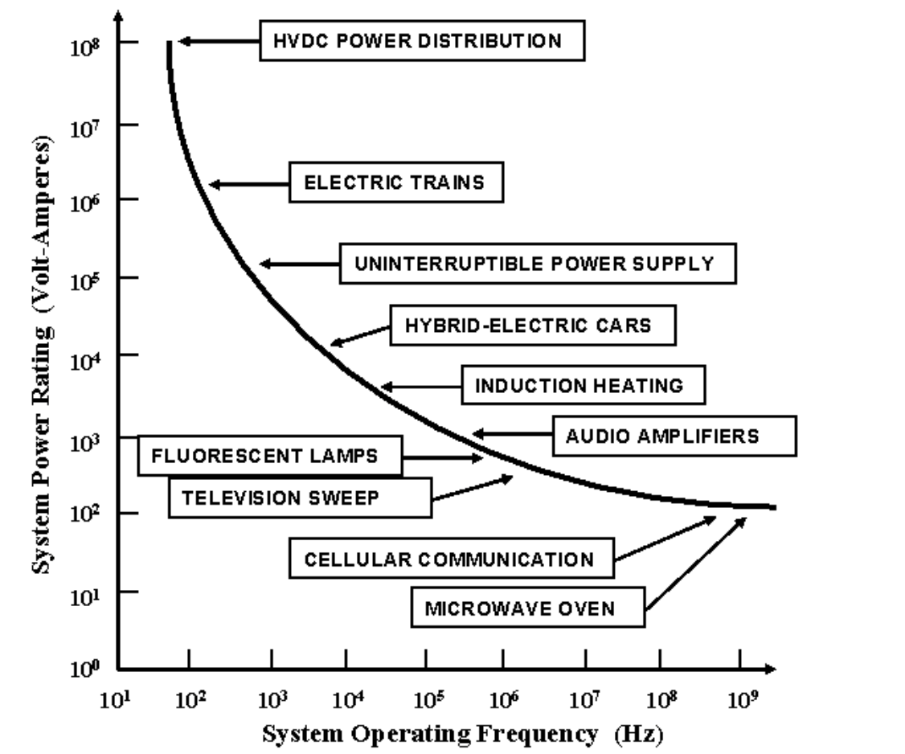
Applications f_{s} vs. Power

Slide 51
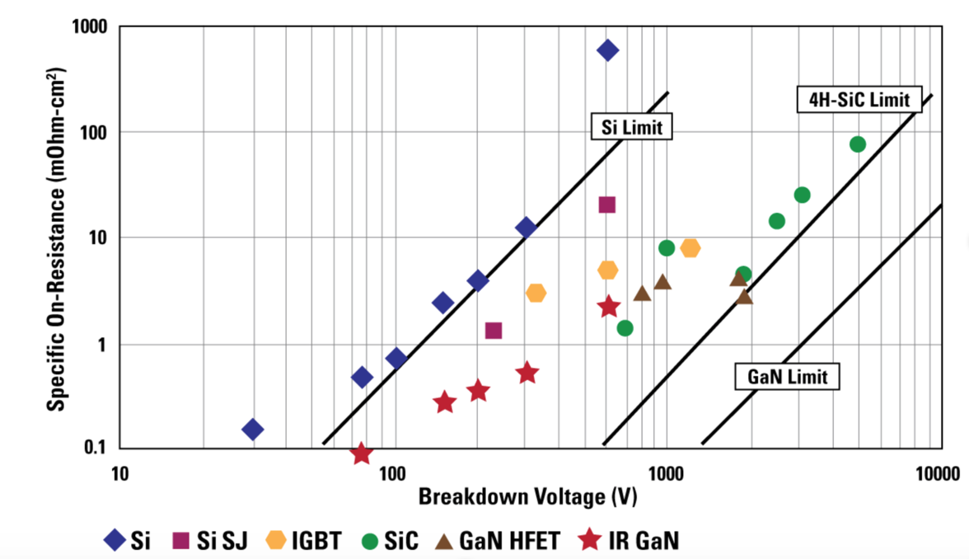
Comparison of the on-resistance (R_{on}) vs. Breakdown voltage

Slide 52
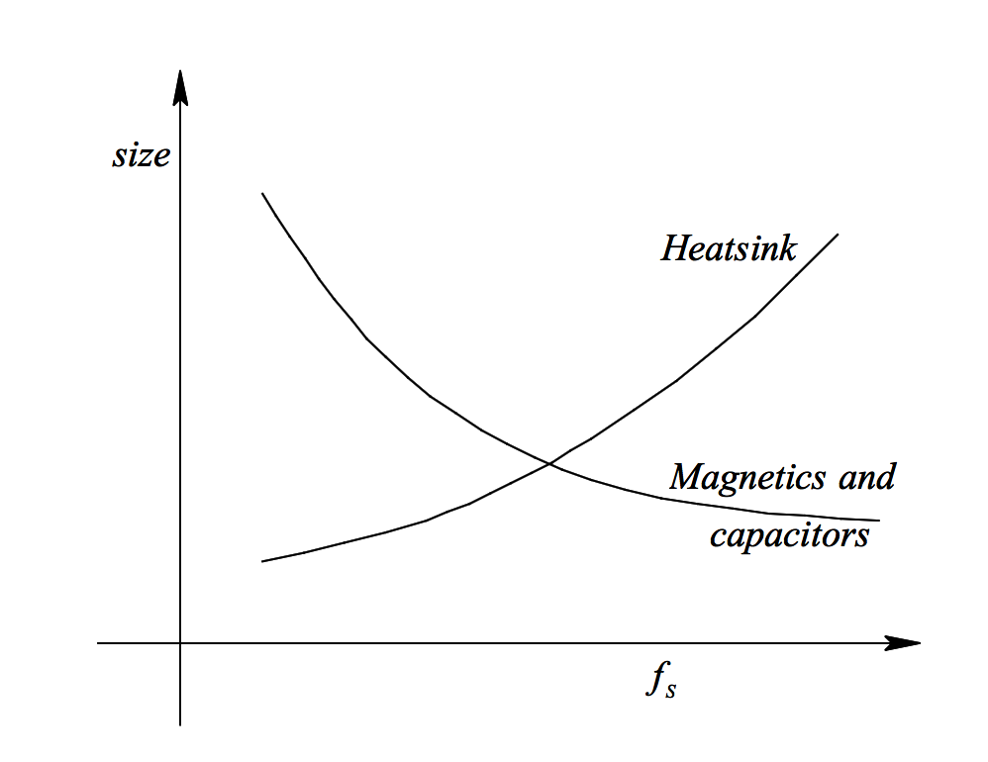
f_{o} vs. Size of Magnetic Component & Heat Sink

Slide 53
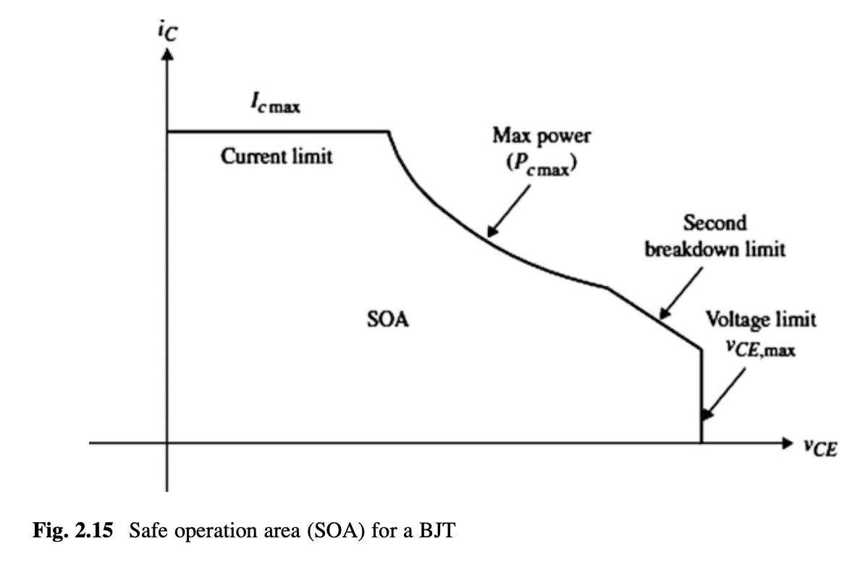
Device Maximum Power

