Slide 1
EEL 5245 POWER ELECTRONICS I Lecture #3: Chapter 2 Switching Concepts

Slide 2
Discussion Topics
Homework Assignment #1
Need for Switching in Power Electronic Converters
Example on Efficiency Comparison
Ideal Switch Characteristics
Comparison to Practical Switch
Power Loss in Practical Switch
Several Examples on Switch Loss Calculation (Conduction and Switching components of Loss)-(Batarseh)

Slide 3
Homework Assignment #1
Exercises:
E2.1, E2.3
Problems:
P2.1, P2.2, P2.3, P2.4, P2.6, P2.8, P2.10, P2.12, P2.14

Slide 4
Need for Switching
Why use semiconductor devices as switches?
Allows better output control
Allows for improved efficiency
Ideally 100%
What are effects of poor efficiency?
Energy costs
Design complications
Reduce reliability-(More losses mean more heat)
More component design
Heat transfer
Protection

Slide 5
Theoretical Efficiency Example
Example 2.1
We’ll do an example to underscore why switching is the most energy efficient choice
Consider the design of a DC-DC converter as shown above
Design requires 24V step down to 12V across a 6 Ohm resistive load
Let’s investigate, three possible options

Slide 6
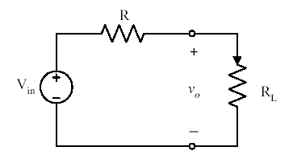
Theoretical Efficiency Example (1) Voltage Divider

Slide 7
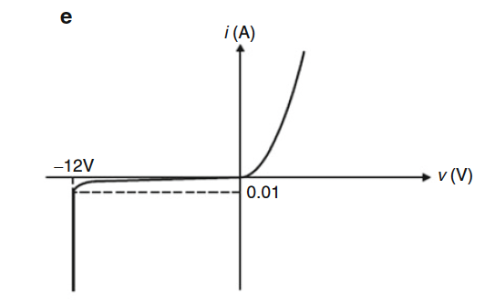
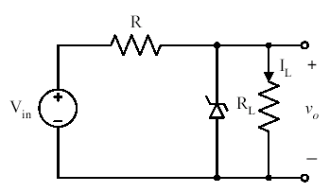
Theoretical Efficiency Example (2) Zener Regulator
Iz@12V=0.2A
Need some control (regulation)
A Zener Regulator will allow for load variation
Assume Vz=12V, Iz@12V=0.2A , Rdrop=5.5Ω
Pin=Pout+Prdrop+Pzener=24W+26.2W+2.4W=52.6W
η=46%

Slide 8
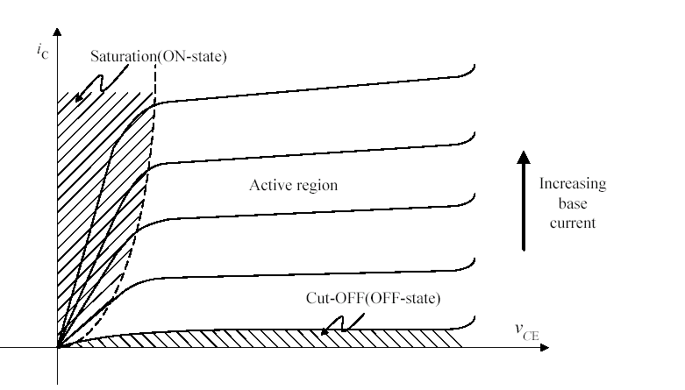
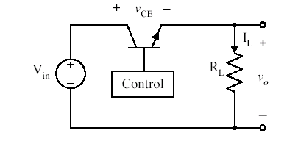
Theoretical Efficiency Example (3) Linear Regulator
Drop resistor inefficient means
Direct source connection is preferable
Try linear regulator
(Similar to implementation 7805, LM317 etc.
We regulate Vce=12V , so Vo=6 V, and IL=2 A
Pin=Pout+Pnpn,loss=(6x2)+(6x2)=24W+24W=50W
η=50%

Slide 9
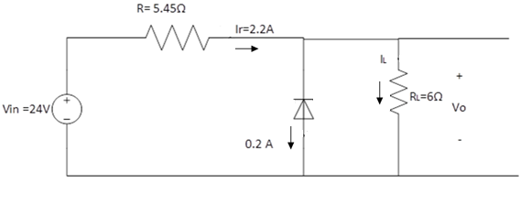
Exercise 2.1
Solution:
The designed circuit from Example 2.2 is shown in figure below:

Slide 10
Exercise 2.1
Note that for regulated output voltage at V₀= 12V and designed value R= 5.45Ω, the input current I_{R}= 2.2A is fixed.
Now varying R_{L} will cause I_{L} and I_{Z} to vary according to the following equation:
For I_{Zmin}= 0.1A and fixed I_{R}= 2.2A (assume Vo=12V-regulated) , then the maximum value for I_{Lmax} = 2.2-0.1= 2.1A resulting in minimum load resistance,
I_{L}= I_{R} - I_{Z}

Slide 11
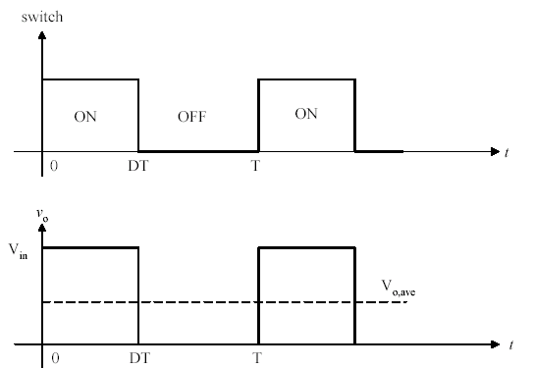
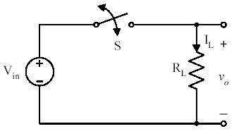
Theoretical Efficiency Example Duty Ratio Controlled Switch
Instead of operating transistor in active mode try using as switch
Low Pass filter required to extract DC
η=100%

Slide 12
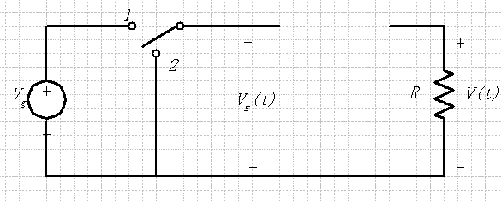
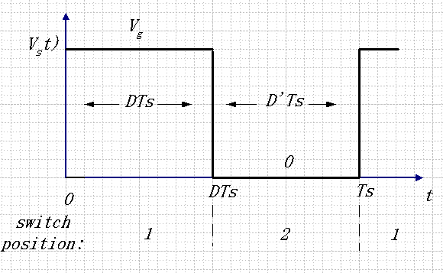
Circuit Implementation Duty Ratio Controlled Switch-SPDT

Slide 13
DC Component

Slide 14
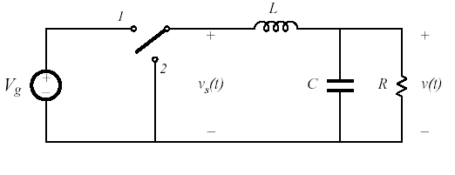
Step Down Converter-Buck
Electronic Filter
The solution insert a filter to smooth the signal

Slide 15
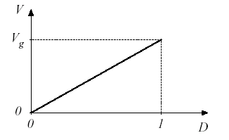
Step Down Converter-Buck
Low Pass extracts DC
Position 2 allows for current “freewheeling”
Vo can be controlled by adjusting D (Switching Period/Frequency Fixed), Vo/Vin = D
Ideally, is no switch/filter loss, η=100%
We assume an ideal switch here

Slide 16
Summary of Example
Step down converter (Buck) exemplifies how waveform “chopping” allows control output
Waveform modification by “chopping” is fundamental premise in Power Electronics
If switch ideal, no losses
By controlling D, Vo is controlled, independent of load
Clearly, for an ideal switch, this example is the best approach
In reality, switch not ideal (switching/conduction losses)
“Chopping” means harmonics at both input/output (EMI)
Is the assumption of an ideal switch reasonable?

Slide 17
Power Device Ratings (transistors & diodes)
Voltage Rating
Current Rating
Switching Speeds
On-State Voltage

Slide 18
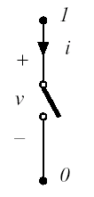
Ideal Switch Characteristics
Zero on-state resistance
No forward voltage drop when on
Infinite off-state resistance
No leakage current when off
Current limitless when on-either direction
Conduction current a function of external components only
No limit on amount of voltage across switch when off
Blocking voltage infinite (forward or reverse)
Switch can transition from on-off or off-on instantaneously when commanded to

Slide 19
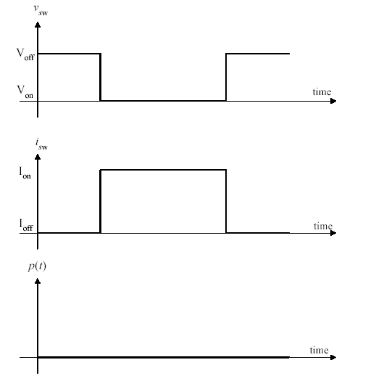
Ideal Switch i-v Characteristics (Transition)
Previous desirable conditions mean, no power loss by any mechanism (conduction, leakage, or switching)
Switch transition-No overlap
Von=0V, Ioff=0A

Slide 20
Practical Switch
Although Semiconductor Industry has produced amazing devices, the “real world” switch is not ideal
Limited conduction current when the switch on, limited blocking voltage when the switch is in the off
Both are directional in practical switch
Limited switching speed that caused by the finite turn-on and turn-off times
Real world (Semiconductor) switches are charge driven
Finite, nonzero on-state and off-state resistances
There is a I^2R loss when on and some leakage when off (very small)

Slide 21
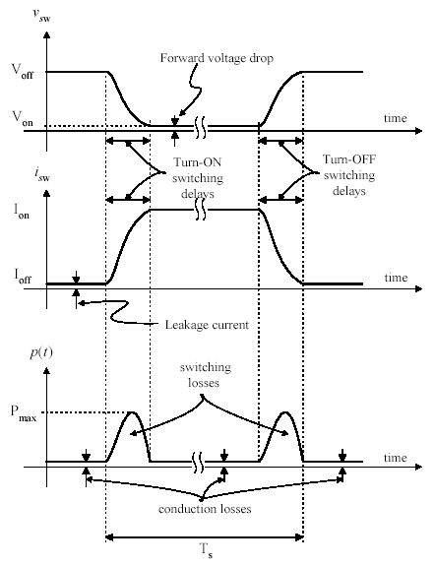
Practical Switch i-v Characteristics (Transition)
This is root cause of the single major source of loss in PE converters
Conduction- When switch is in on state (off state too, to a lesser degree)
Switching Losses- When switch is transitioning from on to off or off to on

Slide 22
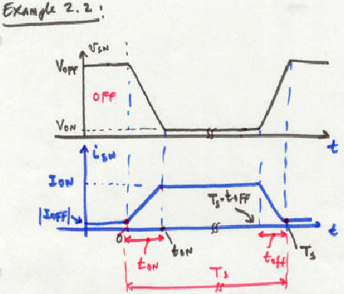
Switch Loss Example
Derive expression for instantaneous power, p(t)=v_{sw}*i_{sw}
Determine average power dissipation over one switching cycle, Ts

Slide 23
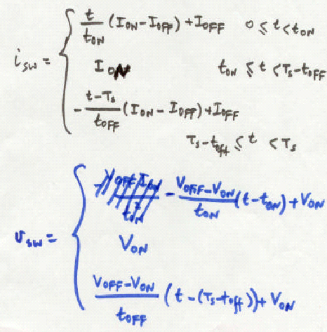
Switch Loss Example

Slide 24
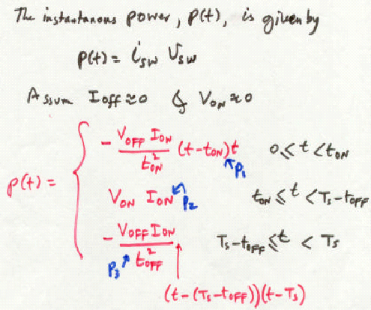
Switch Loss Example

Slide 25
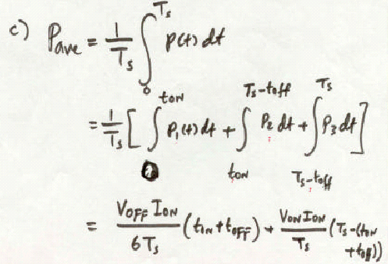
Switch Loss Example

Slide 26
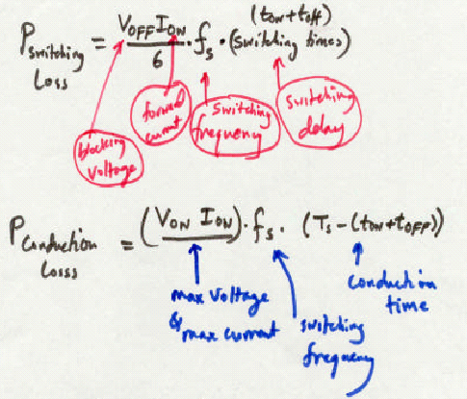
Switch Loss Example

Slide 27
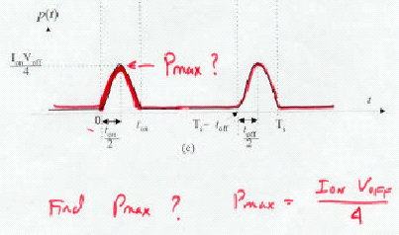
Switch Loss Example

Slide 28
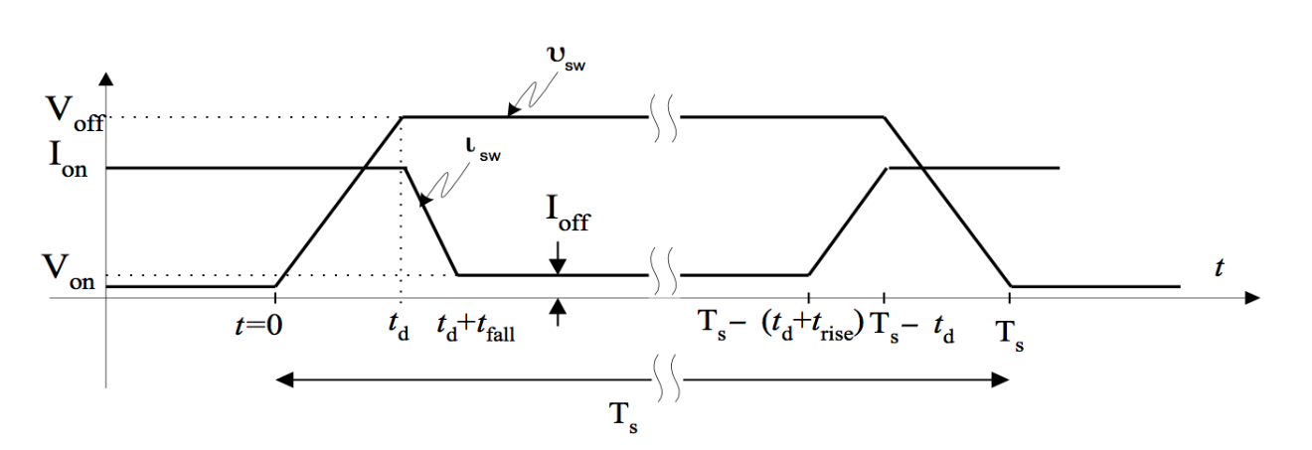
Another Switch Loss Example
Exercise 2.2
For Example 2.2, assume the parameters are given as follows: Von=0 V, Ioff=0A, Ion=100A, Voff=80 V, TS=10 μs, and td=100 ns. Determine the average switching and conduction losses, the maximum instantaneous power, and the switch voltage and current at 50 ns.

Slide 29
Another Switch Loss Example
Solution:
If I_{off} = 0 and V_{on}= 0

Slide 30
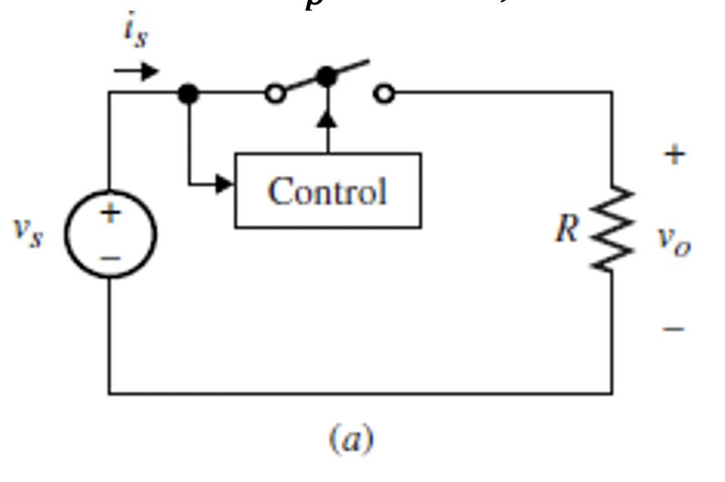
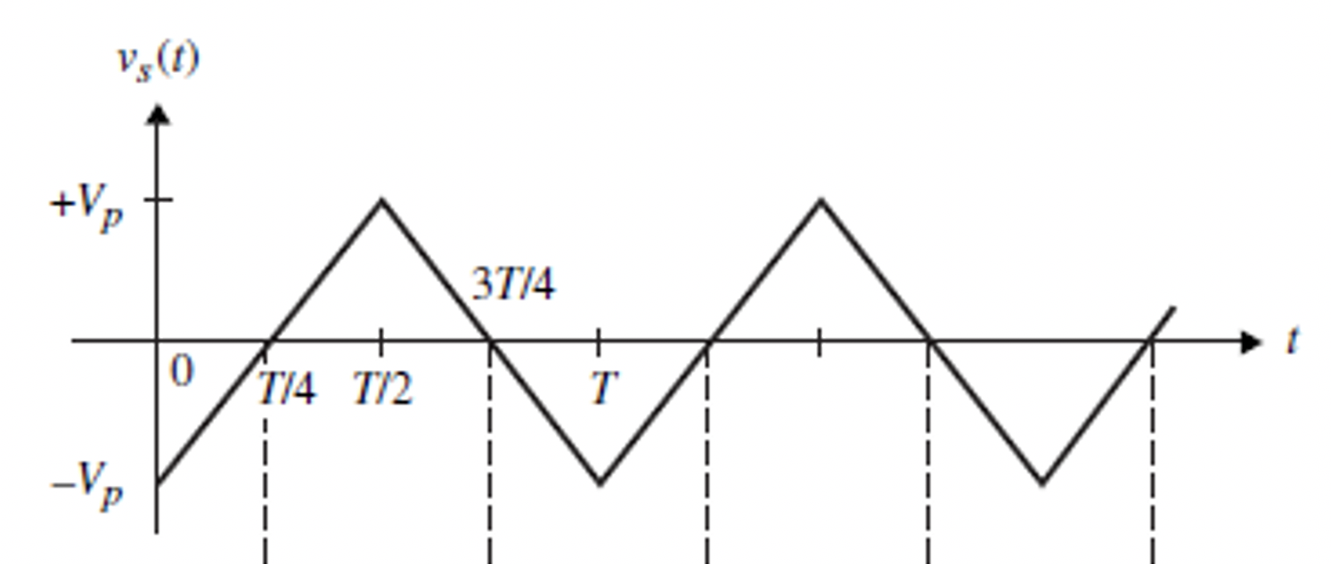
Example 2.3: Vo Control
Assume the switch is ideal and initially was off.
Fig. 2.7(b)
Fig. 2.7(a)

Slide 31
Example 2.3

Slide 32
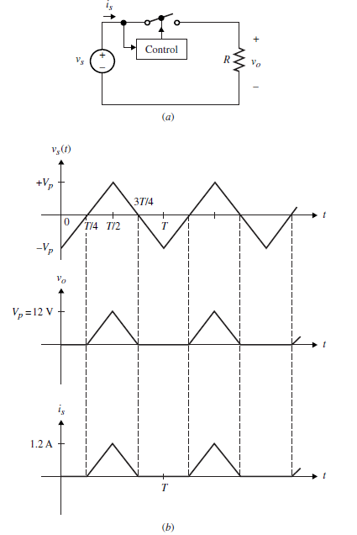
Example 2.3
Solution:
The output voltage and the source current waveform are shown here:
Assume the switch is ideal and initially was off.

Slide 33
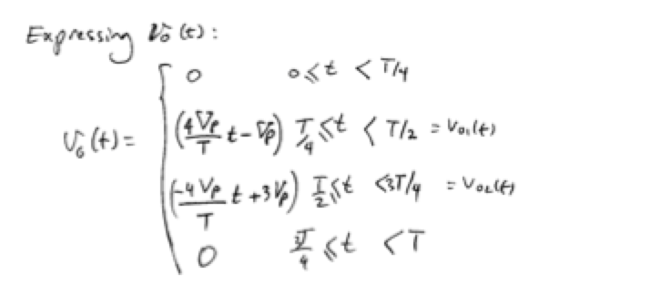
Expressing the Output Voltage

Slide 34
Review of Writing the straight lines equations

Slide 35
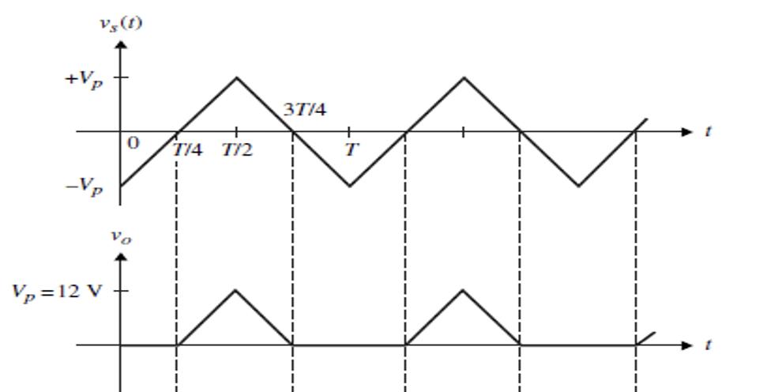
Example 2.3
Solution:

Slide 36
Example 2.3

Slide 37
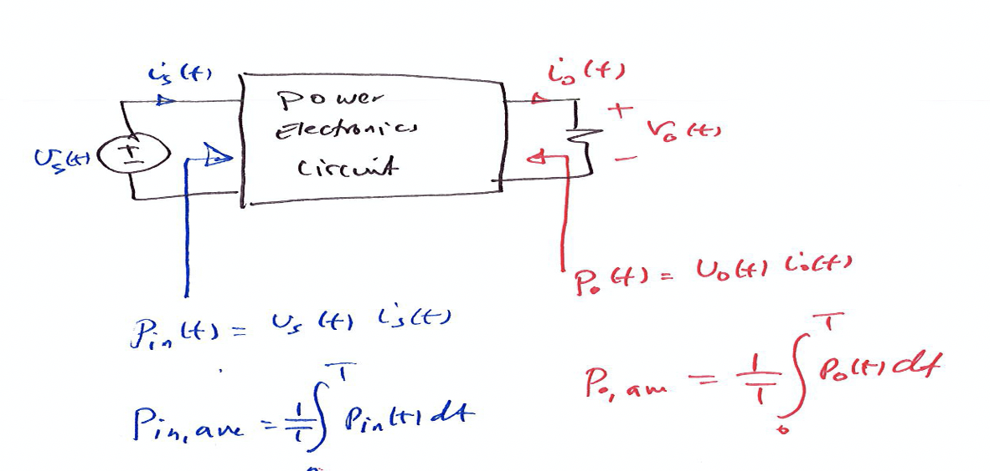
Example 2.3
Efficiency Calculations

Slide 38
Example 2.3
(e) Repeat parts (a)-(d) by assuming the switch has 1 volt voltage drop when closed.

Slide 39
Efficiency Calculations
Assuming the switch has 1 volt voltage drop when closed.

Slide 40
Efficiency Calculations
Assuming the switch has 1 volt voltage drop when closed.

Slide 41
Efficiency Calculations
Assuming the switch has 1 volt voltage drop when closed.
And the rms of the output voltage is

Slide 42
Efficiency Calculations
Assuming the switch has 1 volt voltage drop when closed.

Slide 43
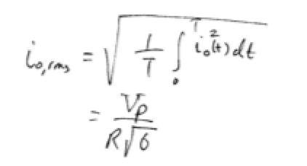

Slide 44
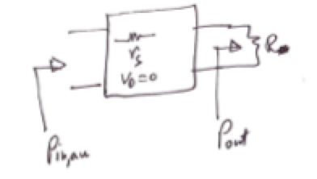
Exercise – Efficiency calculation
Consider the efficiency in the case that the switch has a resistive drop of r_{s} across it when conducting, and infinity when it is off.
Derive the expression for the efficiency, η, in terms of V_{p} and the ratio of r_{s}R.
Show that η →1.0 when r_{s}=0.

Slide 45
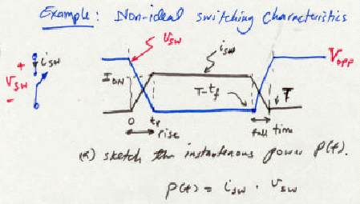
Another Switch Loss Example (Pmax)

Slide 46
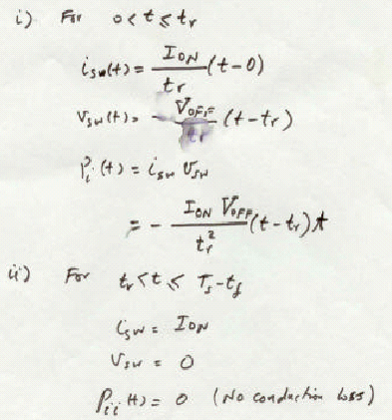
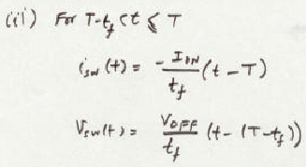
Another Switch Loss Example (Pmax)

Slide 47
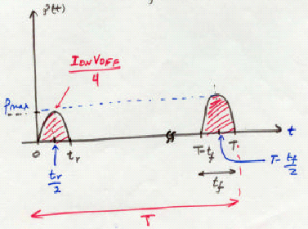
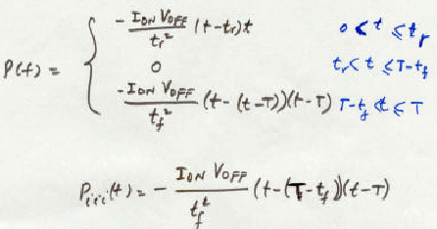
Another Switch Loss Example (Pmax)

Slide 48
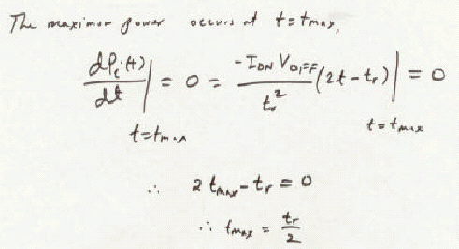
Another Switch Loss Example (Pmax)

Slide 49
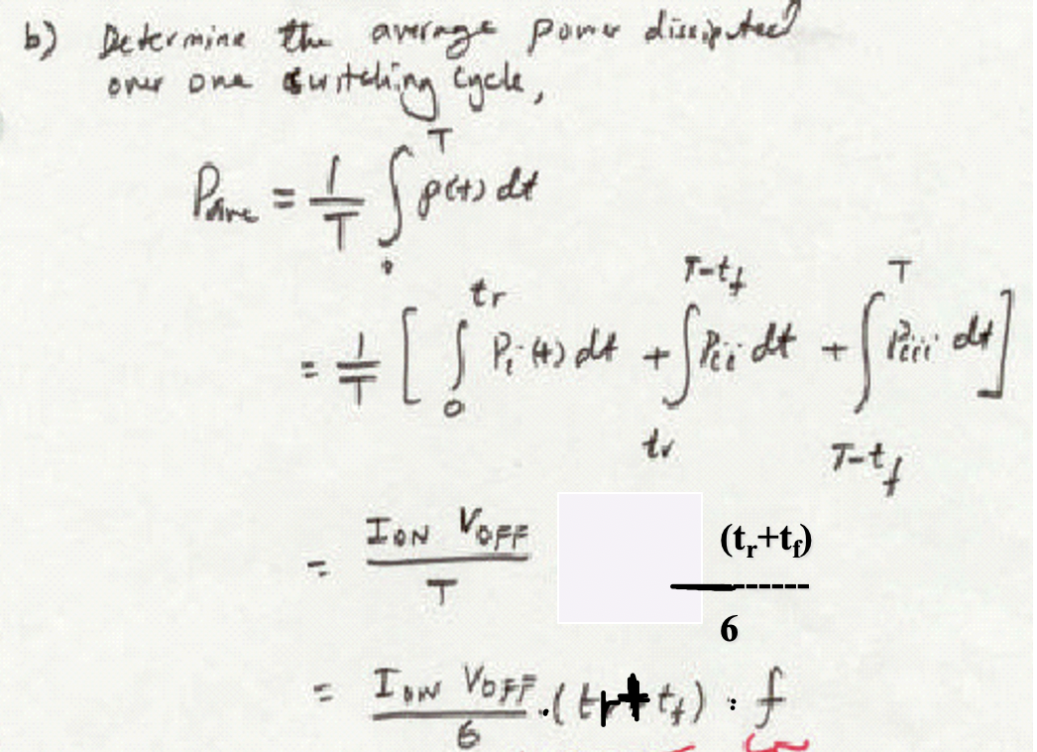
Another Switch Loss Example (Pmax)
(t_{r}+t_{f})
-------
6
+

