Slide 1
EEL 5245 POWER ELECTRONICS I Lecture #26 Ch 5: Push-Pull

Slide 2
Objectives
Study a new class of Converters
Push-Pull Converters
Current-fed Push-Pull Converters
Boost and Buck-boost derived topologies:
Analysis of Flyback Converter
Example of Flyback Converter

Slide 3
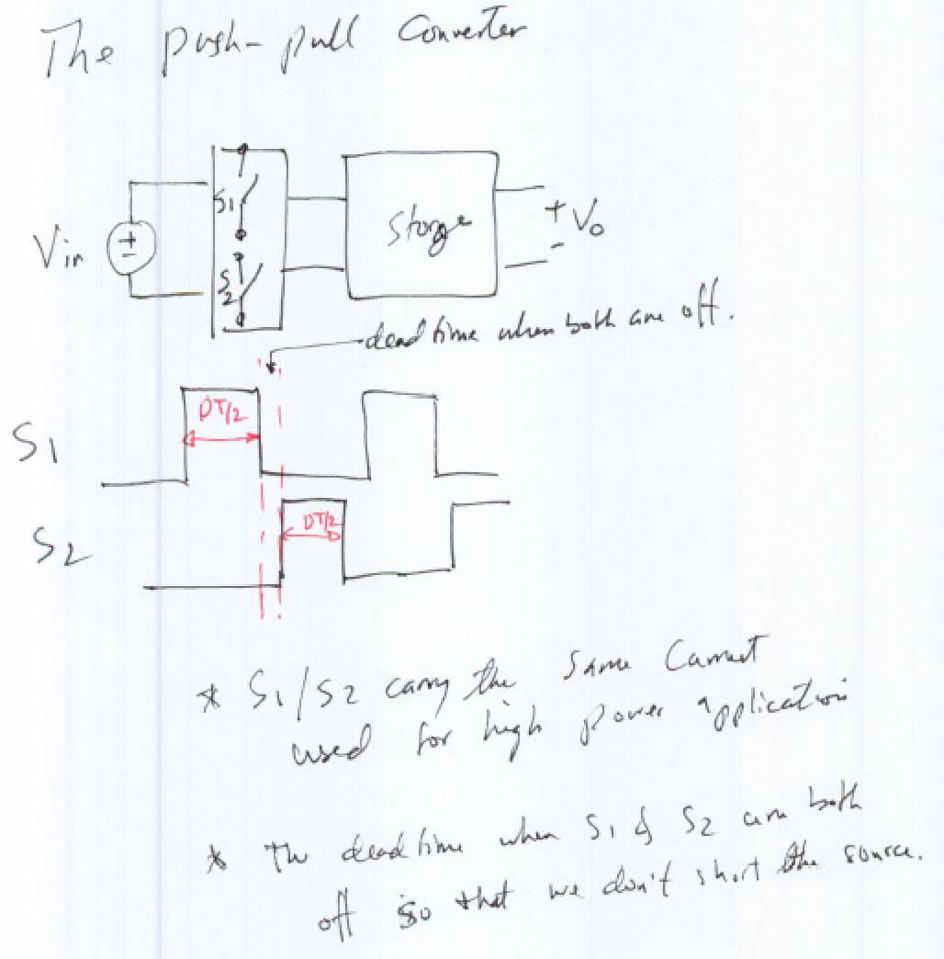

Slide 4
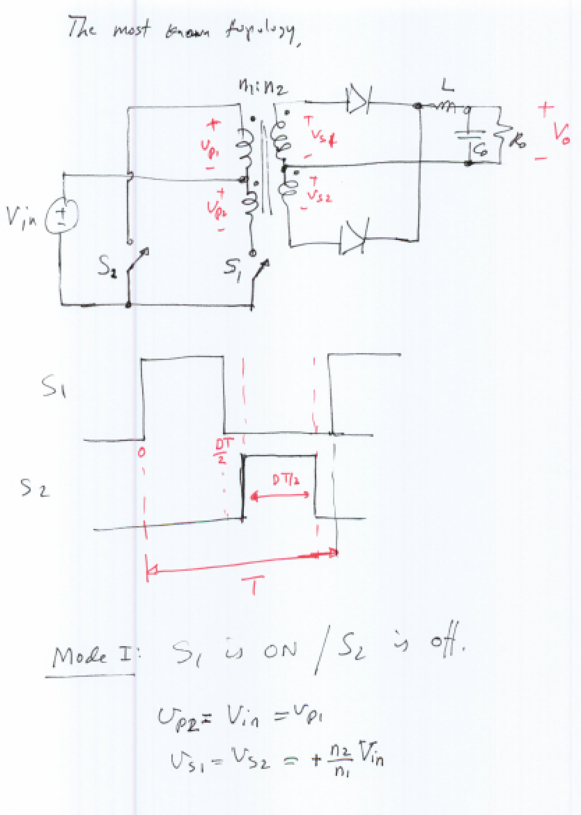

Slide 5
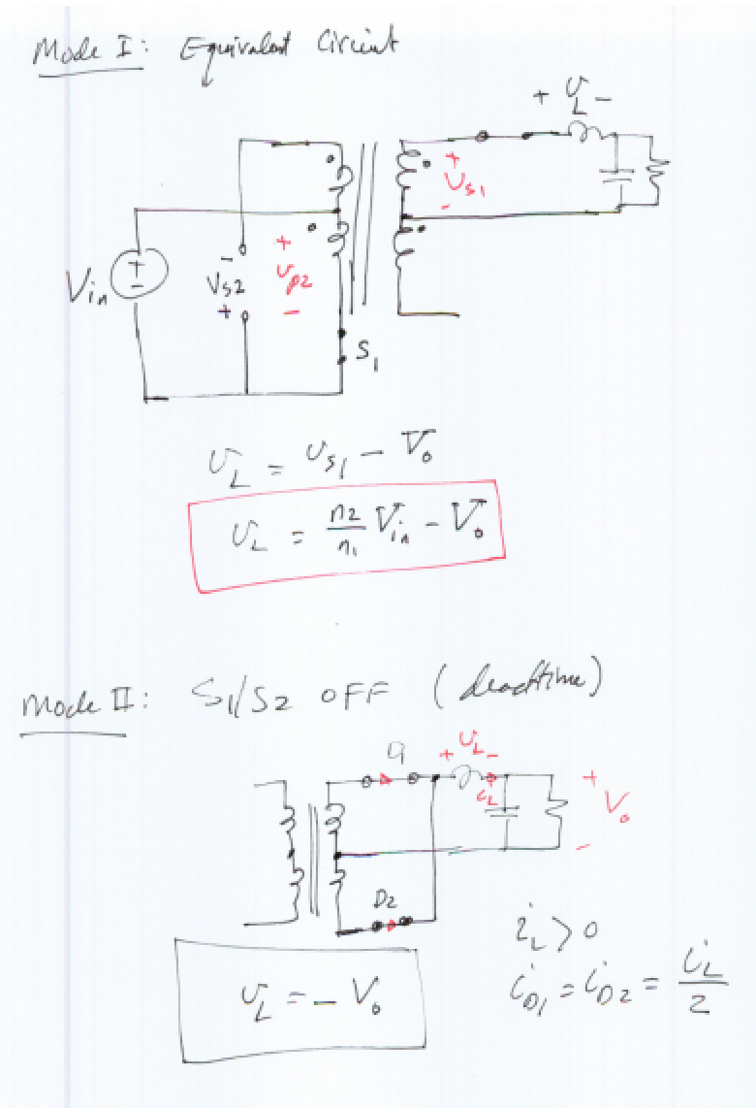

Slide 6
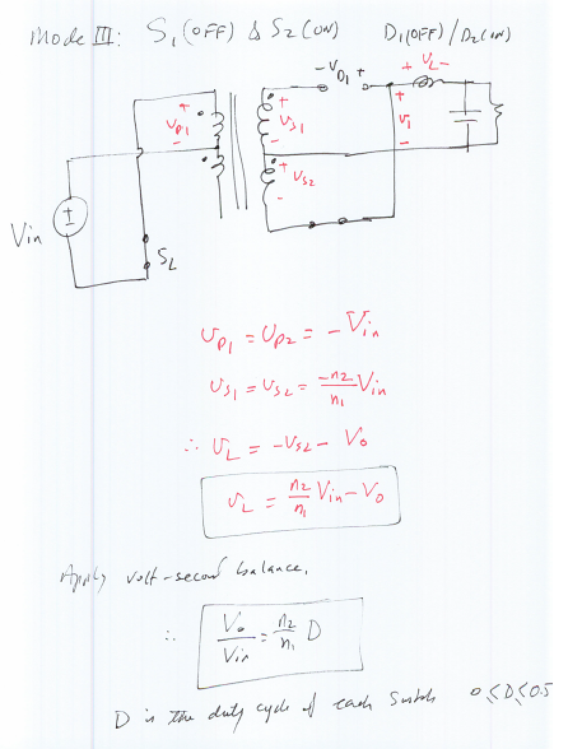

Slide 7
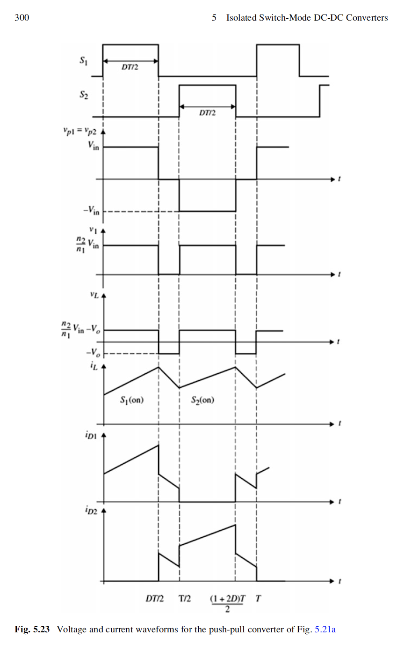

Slide 8
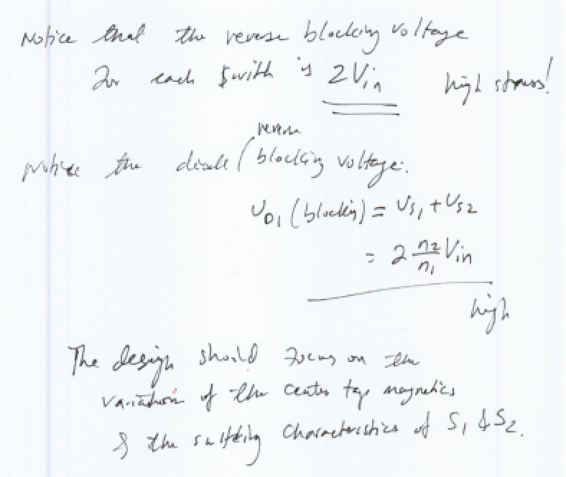

Slide 9
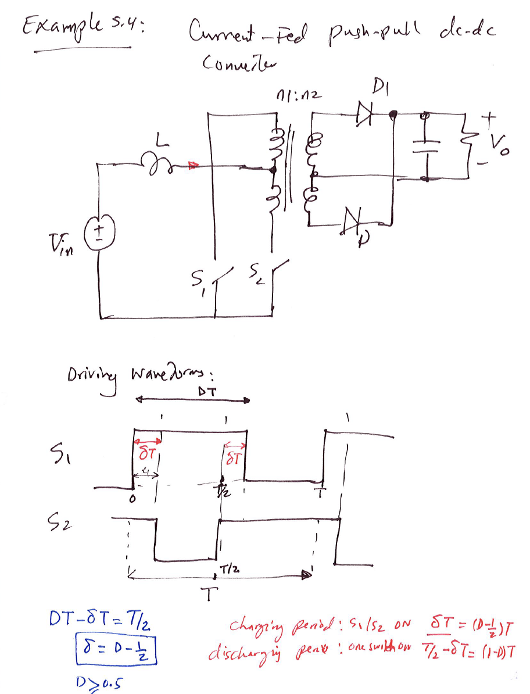

Slide 10
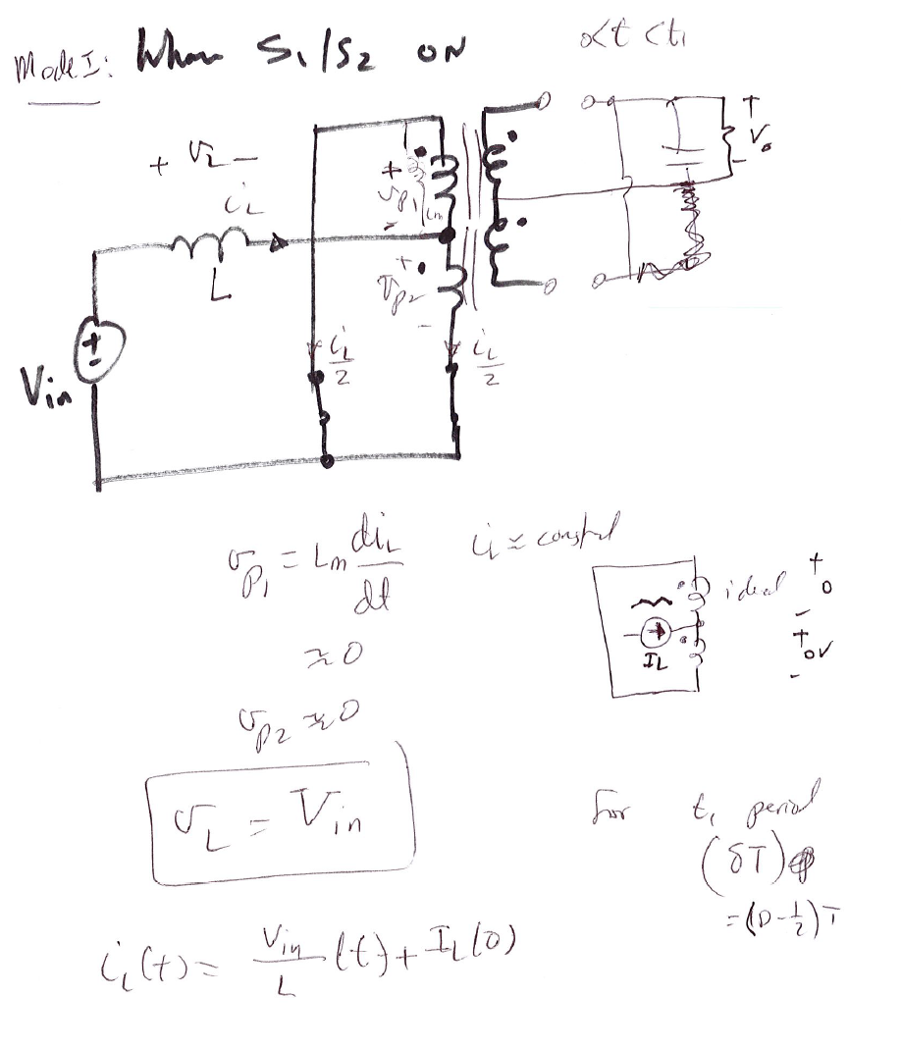

Slide 11
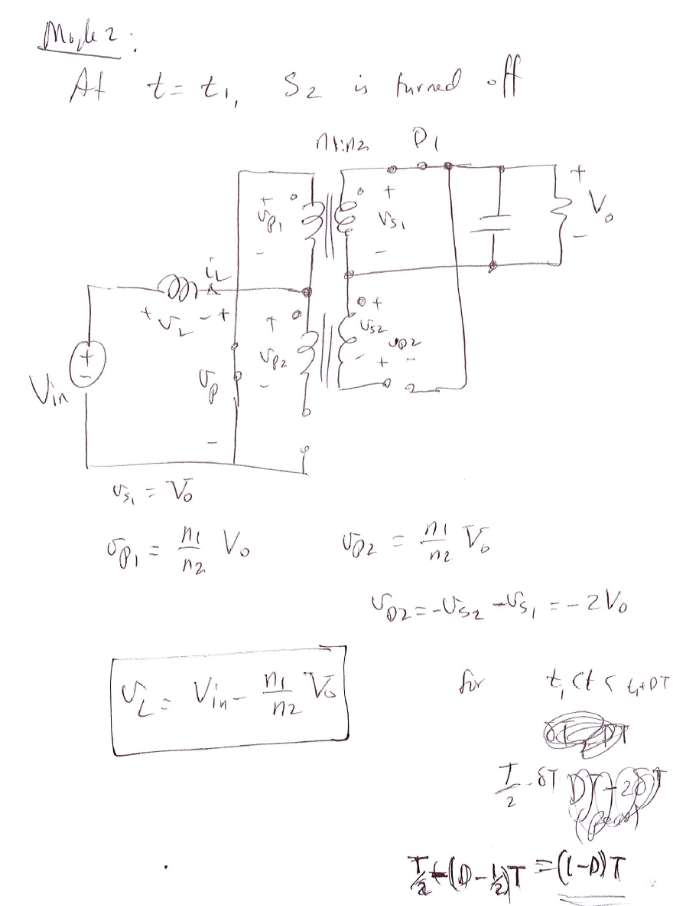

Slide 12
