Slide 1
EEL 5245 POWER ELECTRONICS I Lecture #26 Ch 5.4.1: Flyback Converters

Slide 2
Objectives
Boost and Buck-boost derived topologies:
Derivation of the Flyback Converter
Analysis of Flyback Converter
Example of Flyback Converter

Slide 3
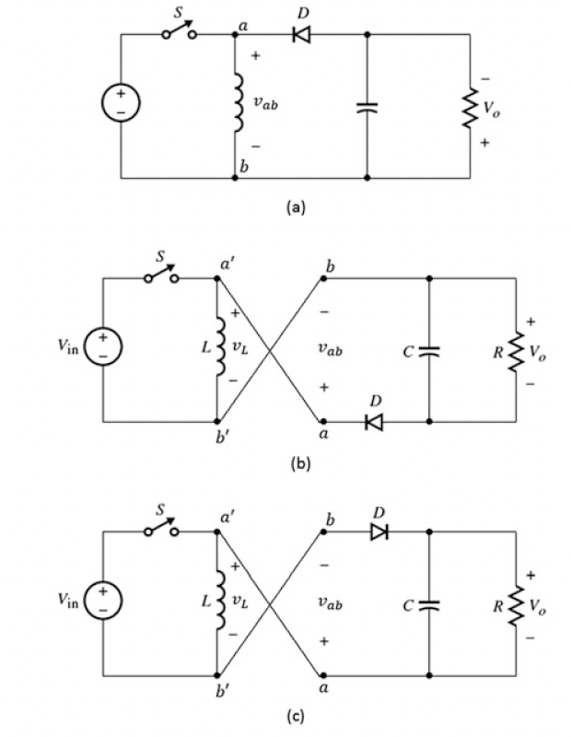
Flyback Converter
The Flyback Converter is derived from the buck-boost converter:

Slide 4
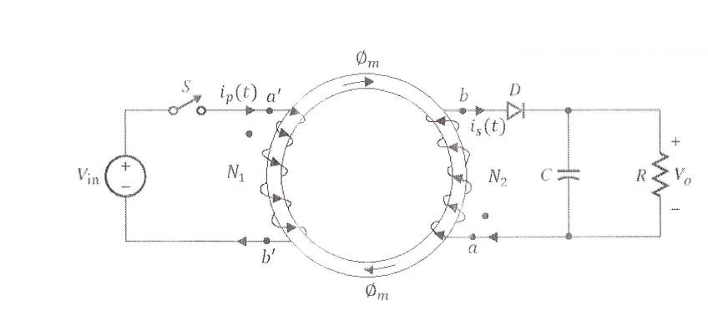
Simplified Flyback Converter with magnetizing inductance
One Possible Physical Winding

Slide 5
Steady-state analysis of the Flyback Converter
Mode I: Switch is on
Mode II: Switch is off

Slide 6
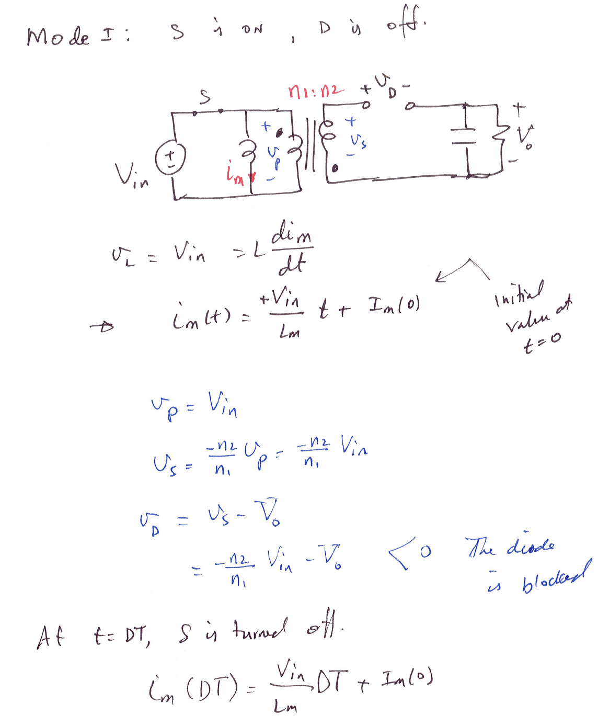

Slide 7
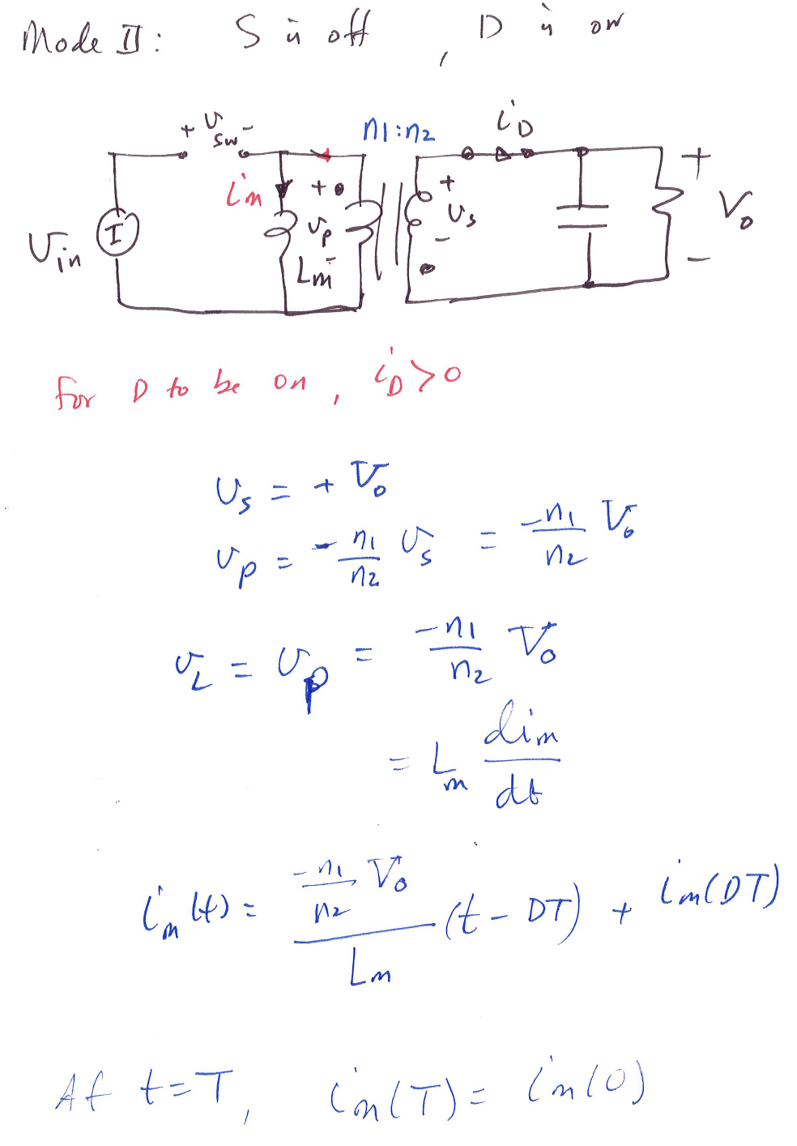

Slide 8
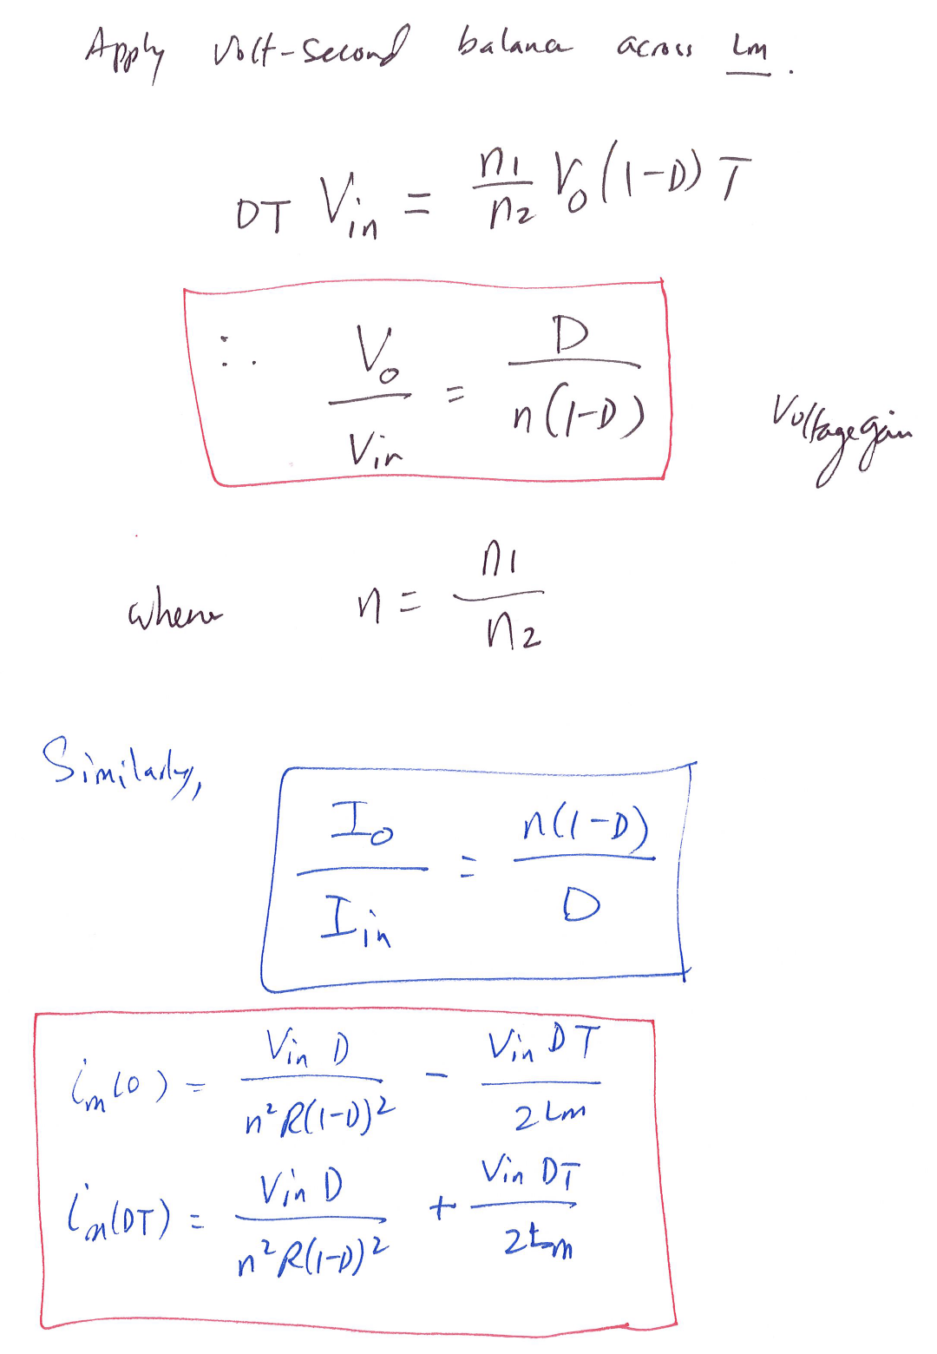

Slide 9
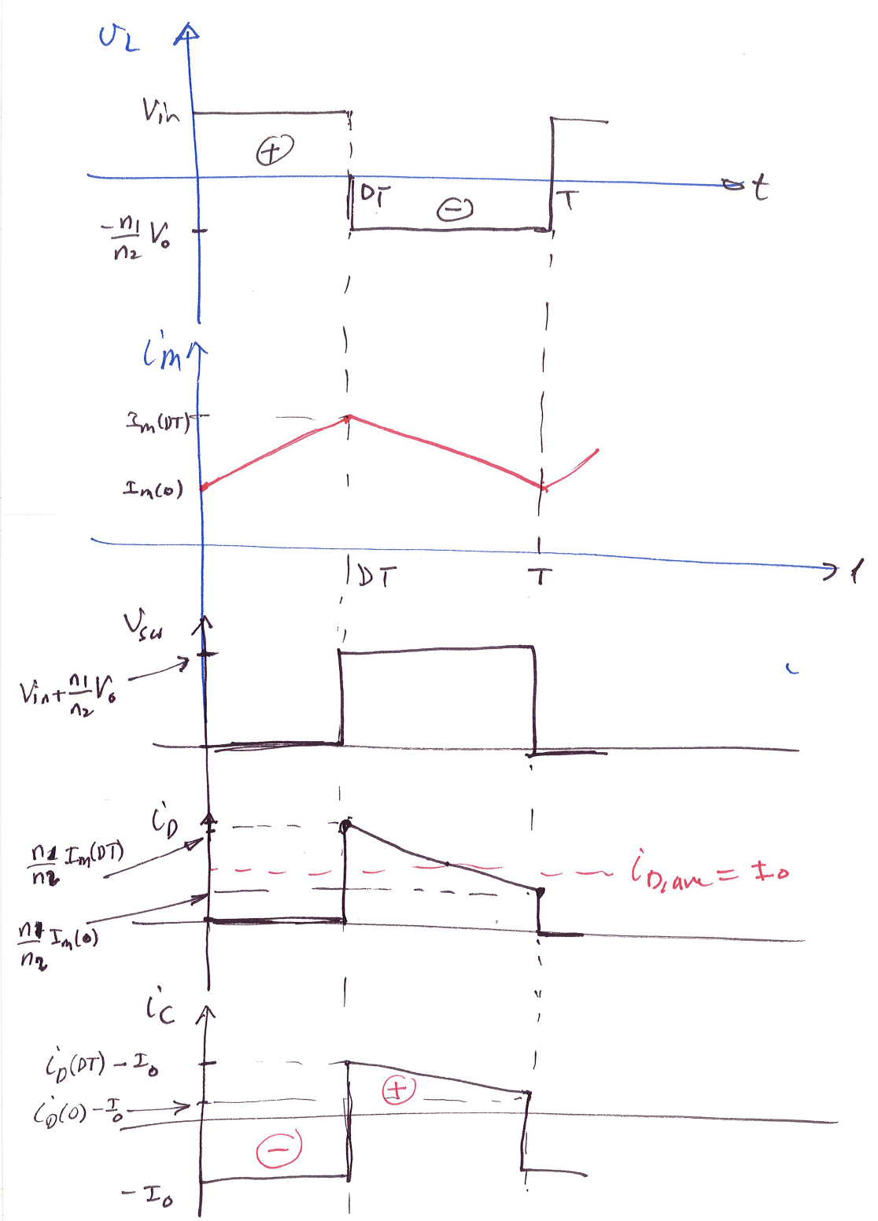

Slide 10
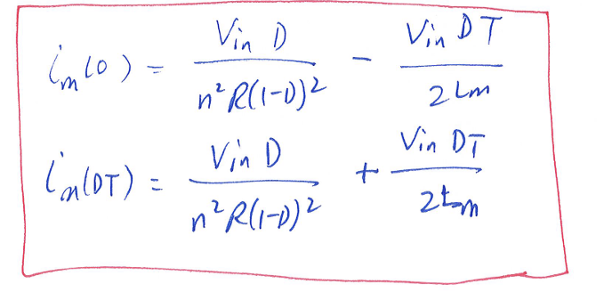
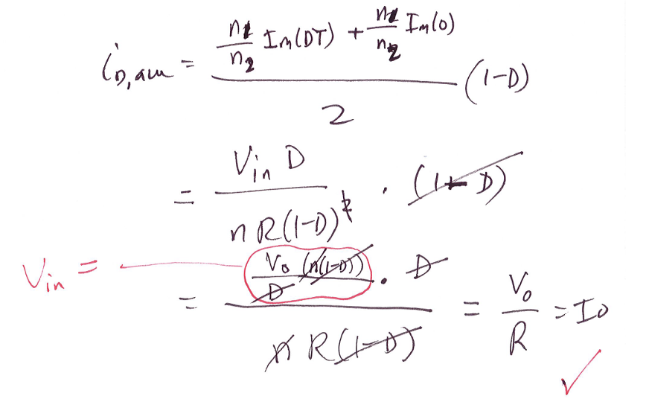
What is the average diode current in the Flyback converter?
By inspection:

Slide 12
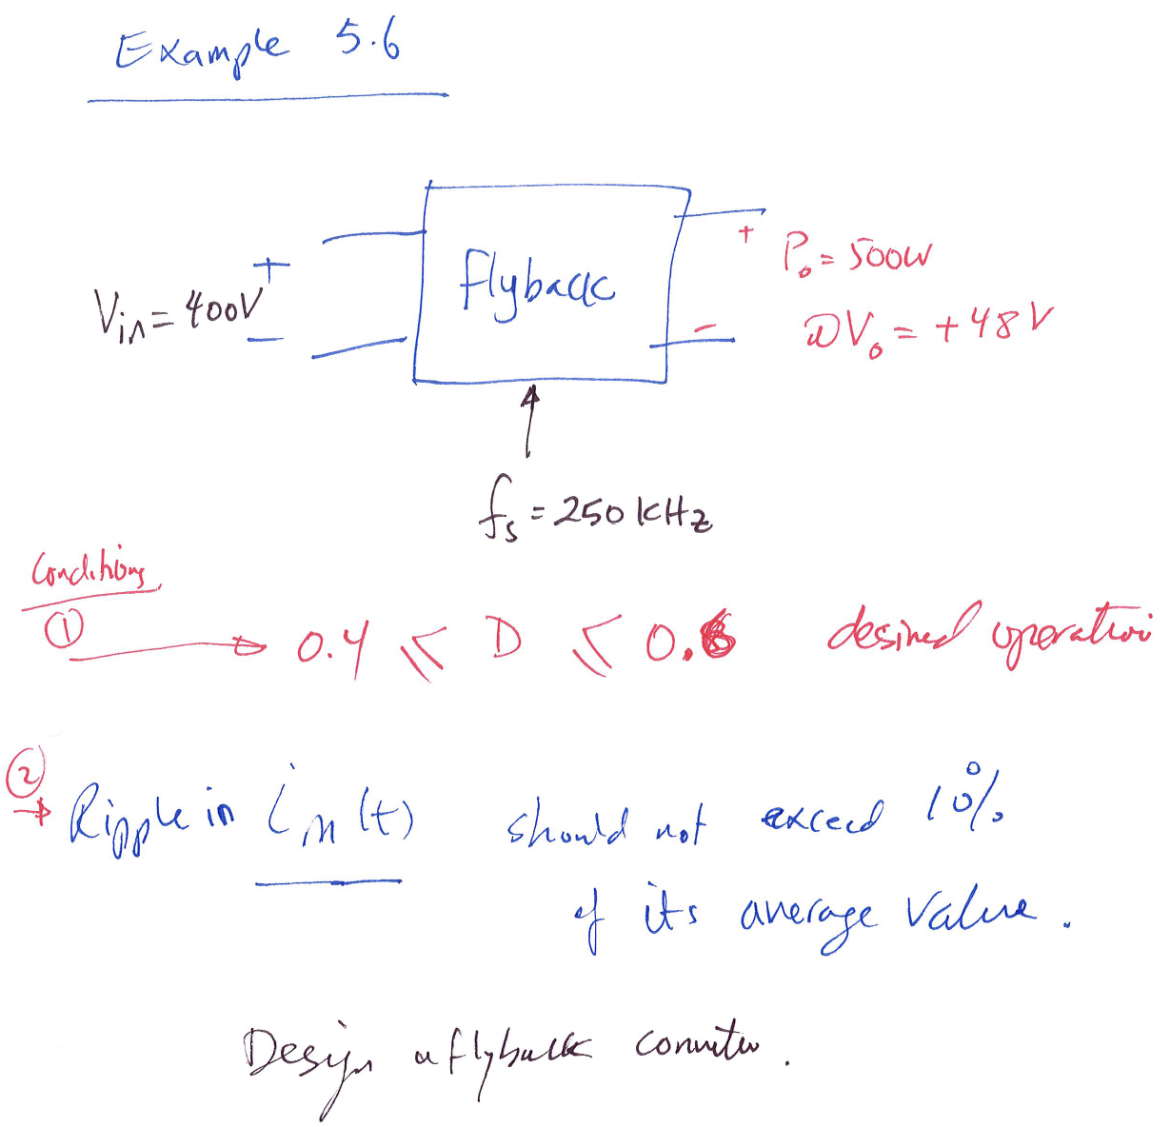

Slide 13
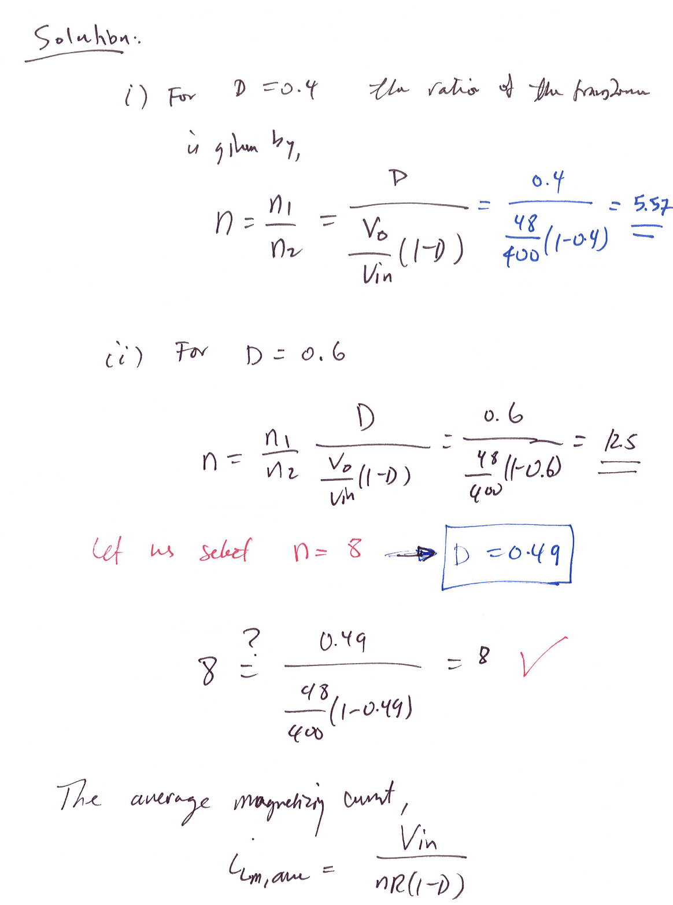

Slide 14
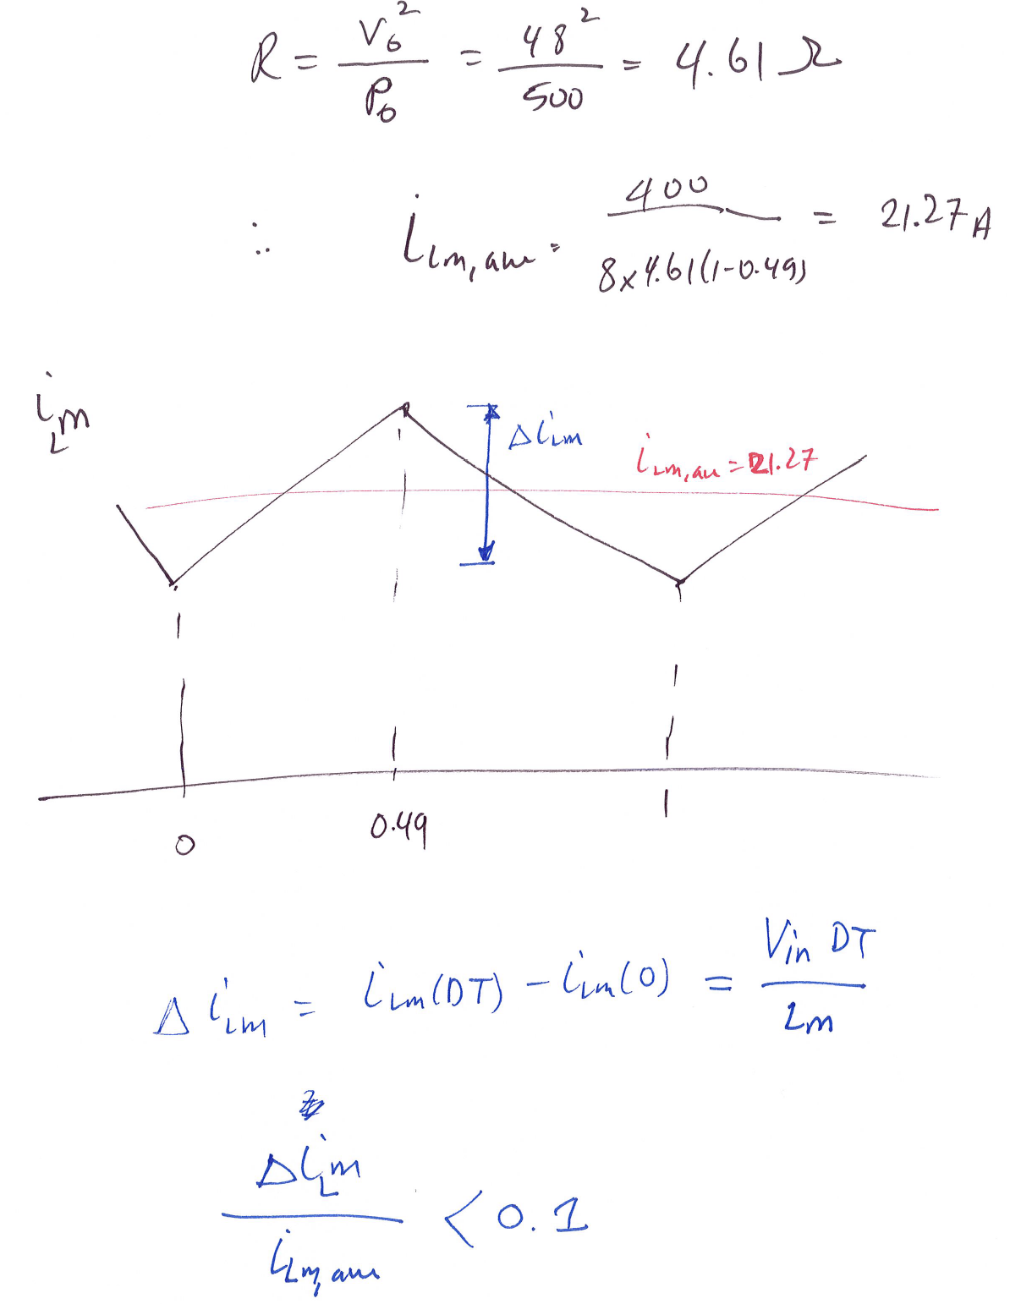

Slide 15
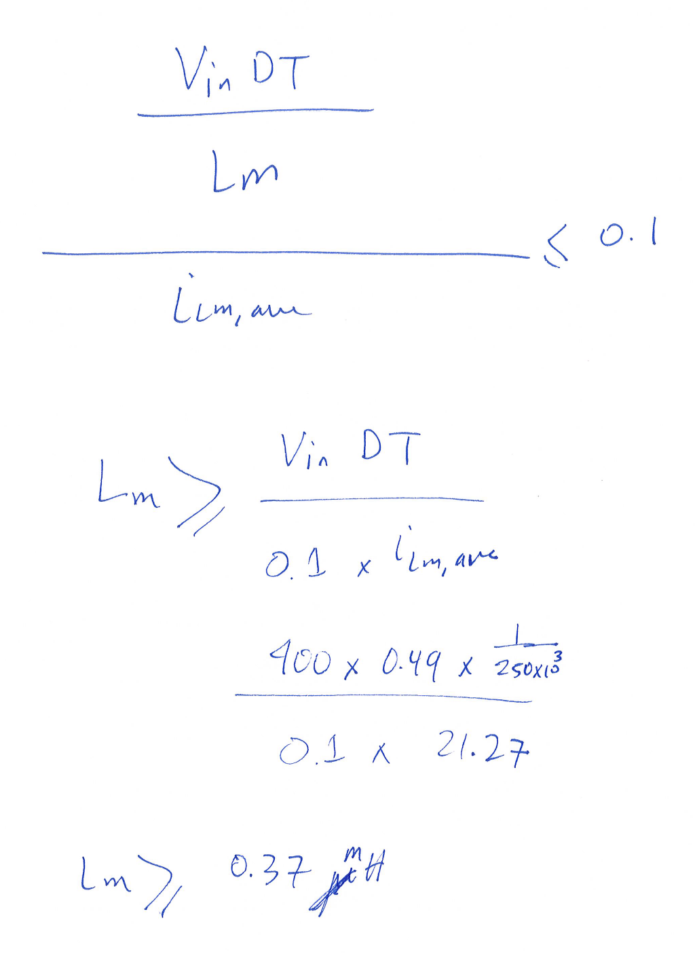

Slide 16
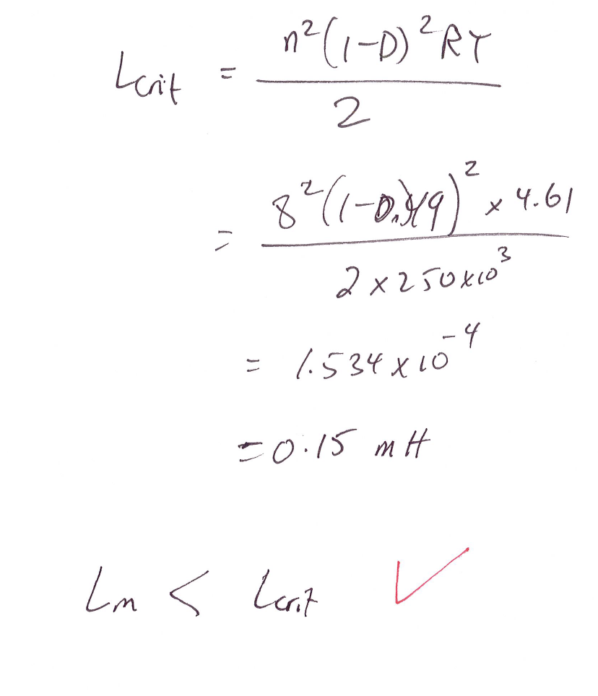

Slide 17
