Slide 1
EEL 5245 POWER ELECTRONICS I Lecture #25 Ch. 5: Half-Bridge and Full-Bridge Converters

Slide 2
Objectives
Circuit Configurations with transformers
Analysis of Half-Bridge and Full-Bridge Converters
Example of Full-bridge converter
Example of Half – Bridge Converter.

Slide 3
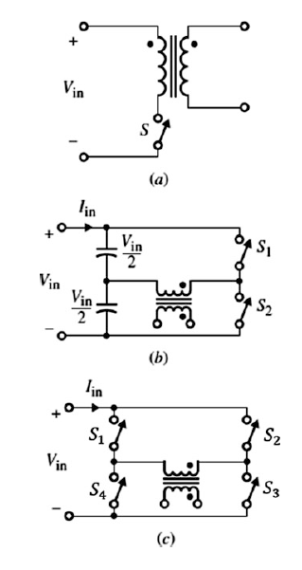
Circuit Configurations with transformers
Fig. 5.2 Transformer configurations:
(a) single-ended,
(b) half-bridge,
(c) full-bridge

Slide 4
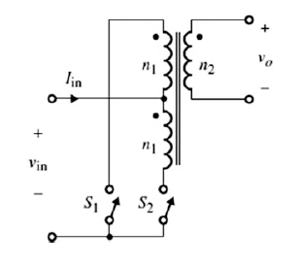
Circuit Configurations with transformers
Fig. 5.3 Push-pull transformer configuration

Slide 5
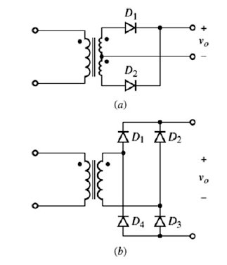
Circuit Configurations with transformers
Fig. 5.4 Transformer configuration in the secondary (load) side:
(a) center-tap full-wave,
(b) full-wave bridge

Slide 6
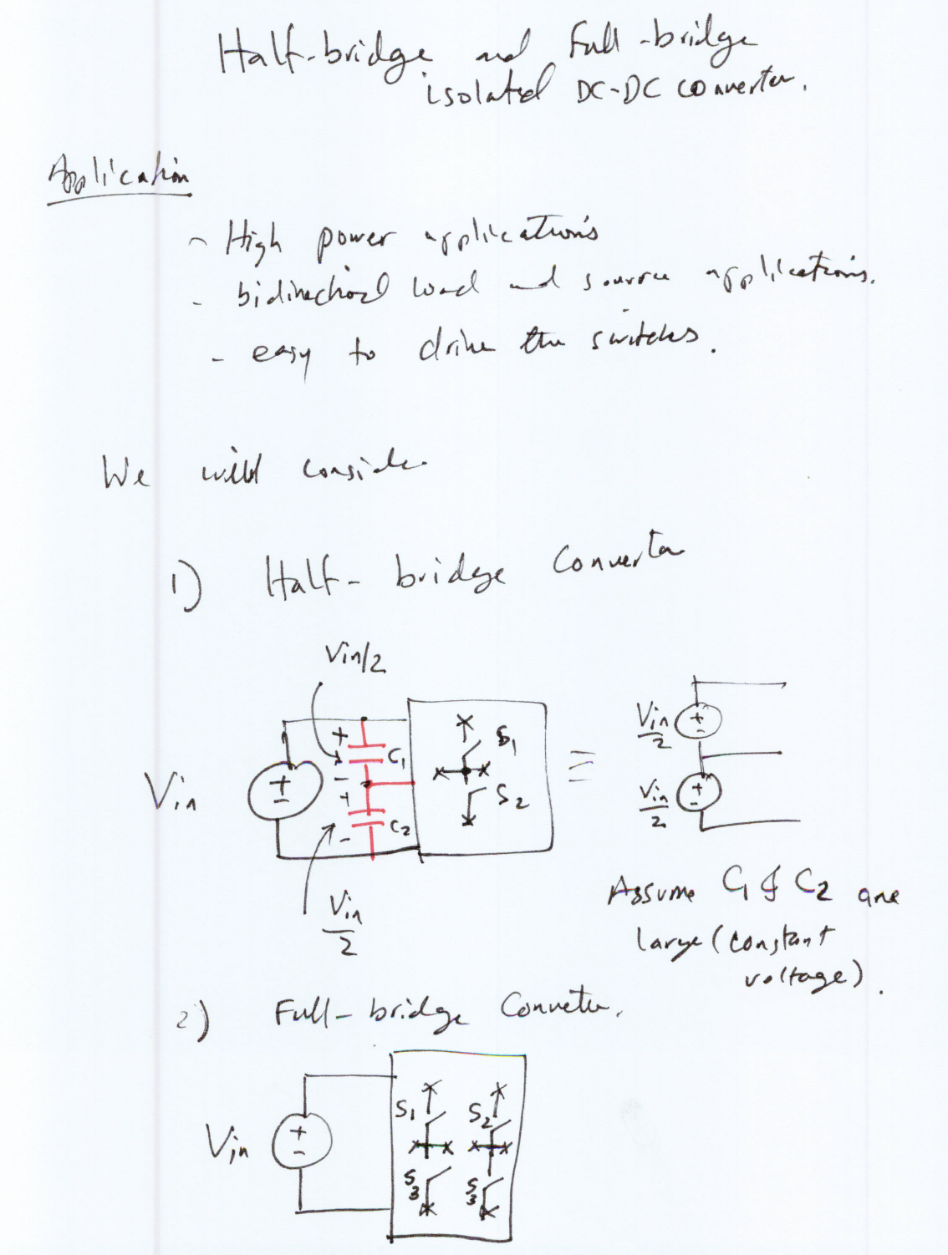

Slide 7
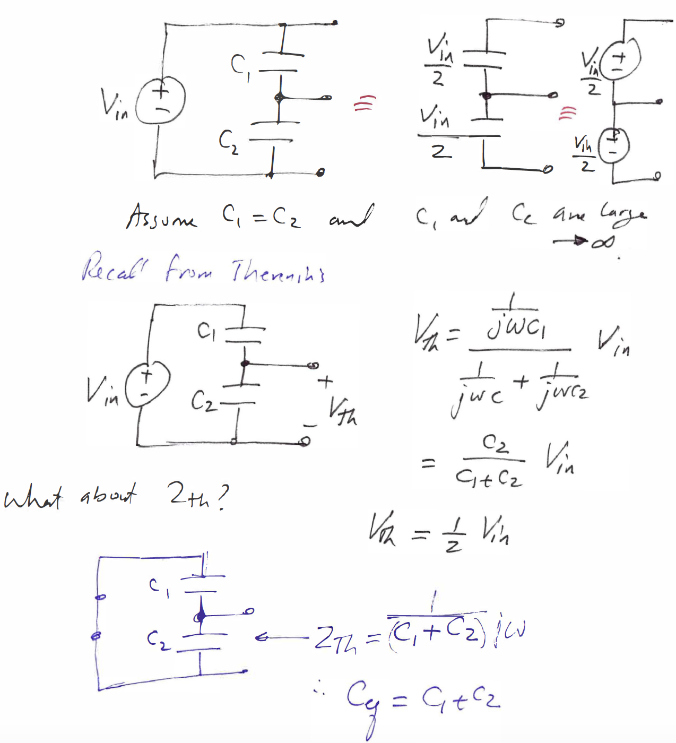
Let us use Thevenin’s Theorem to show that the following circuits are equivalent

Slide 9
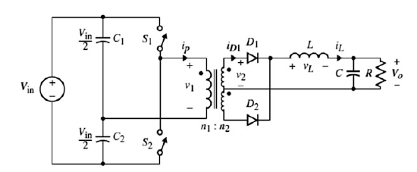
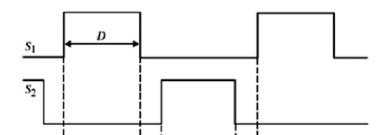
I – Half-Bridge Converters

Slide 10
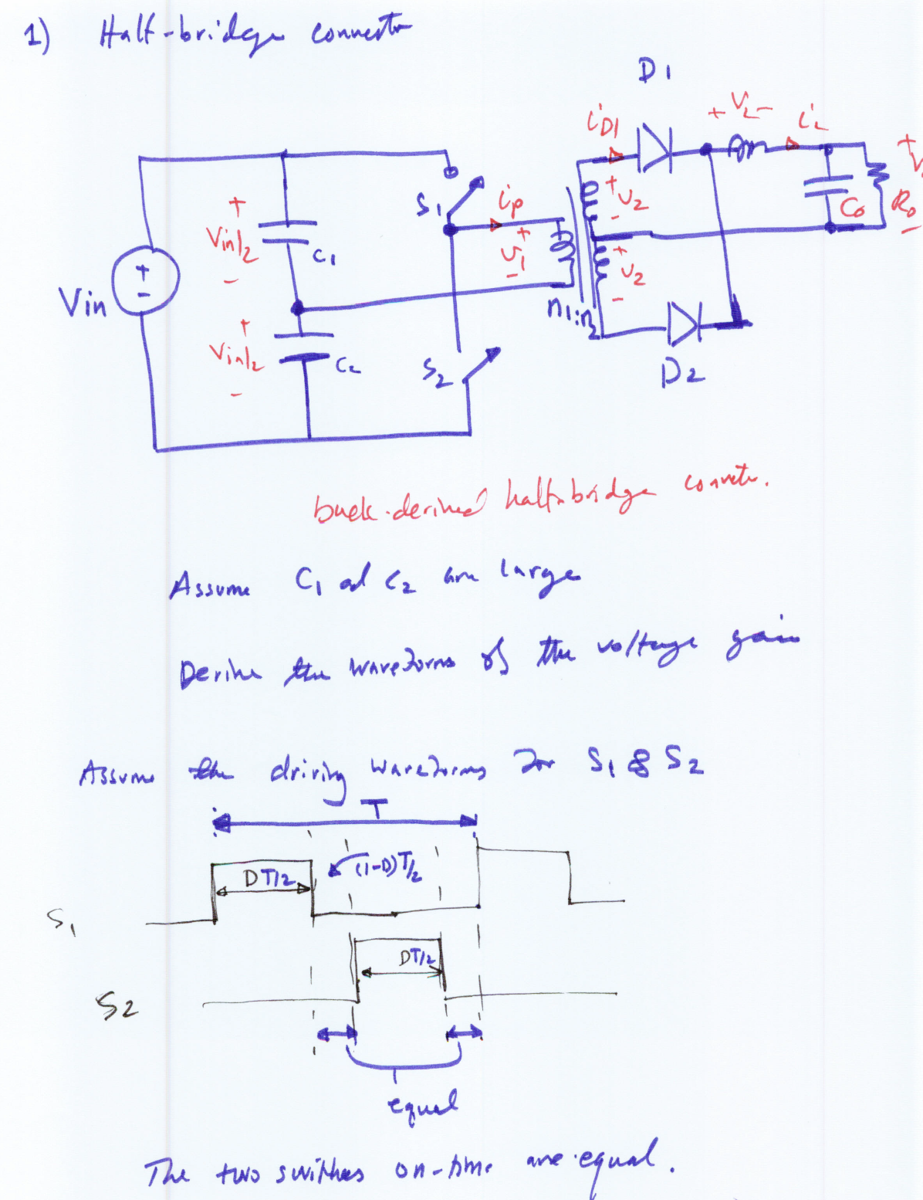

Slide 11
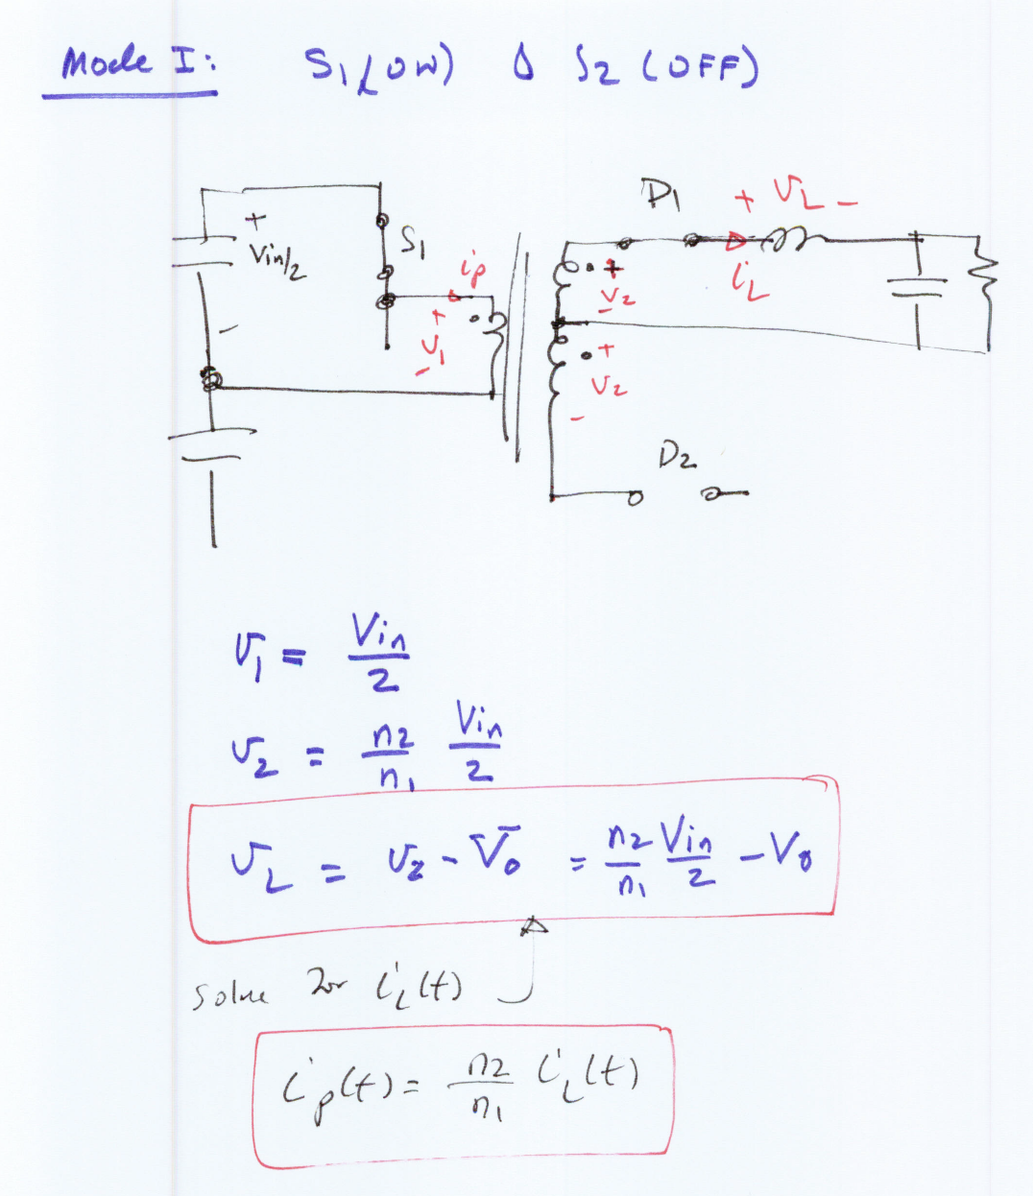

Slide 13
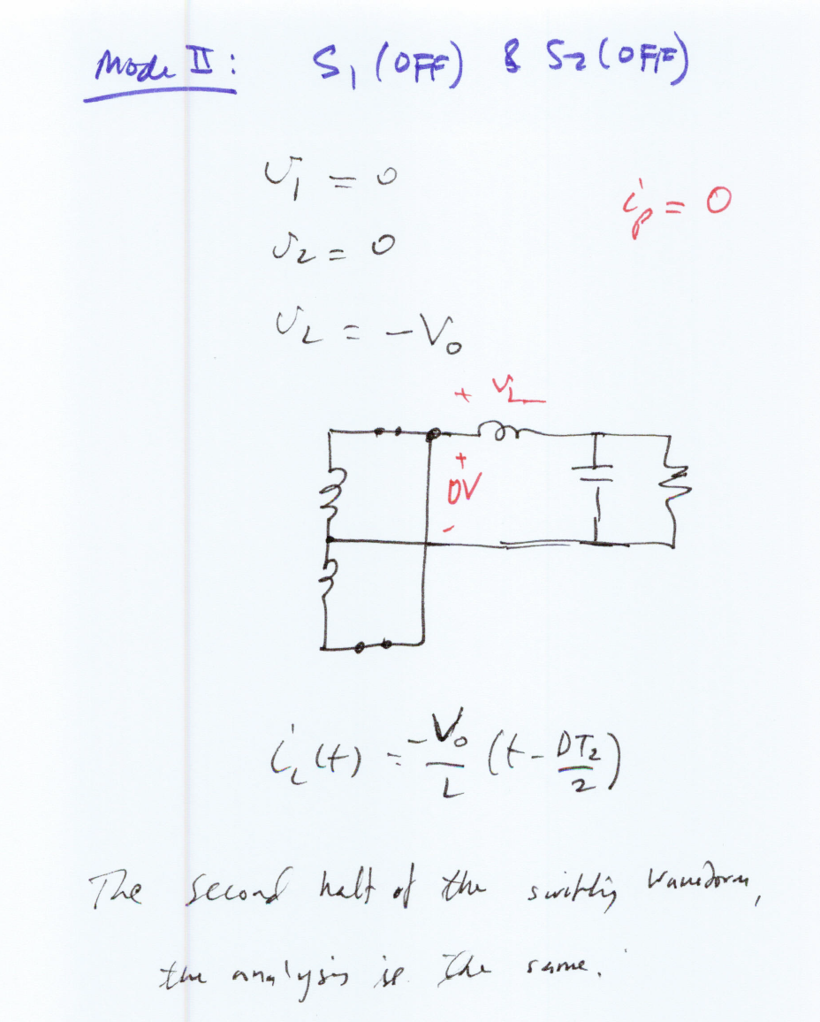

Slide 14
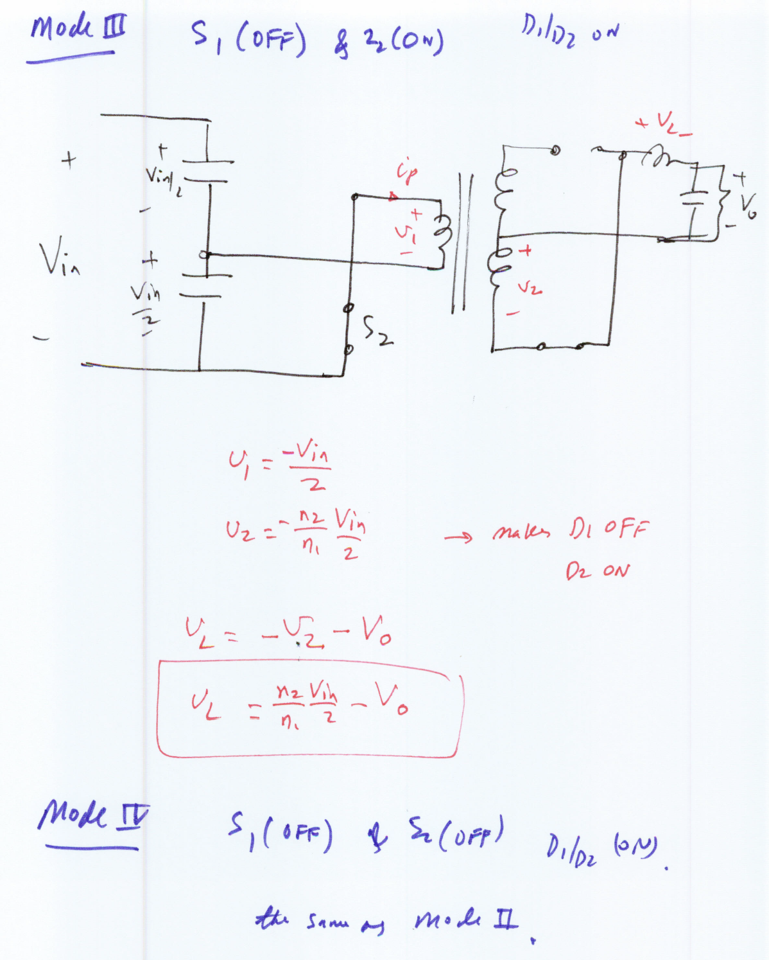

Slide 15
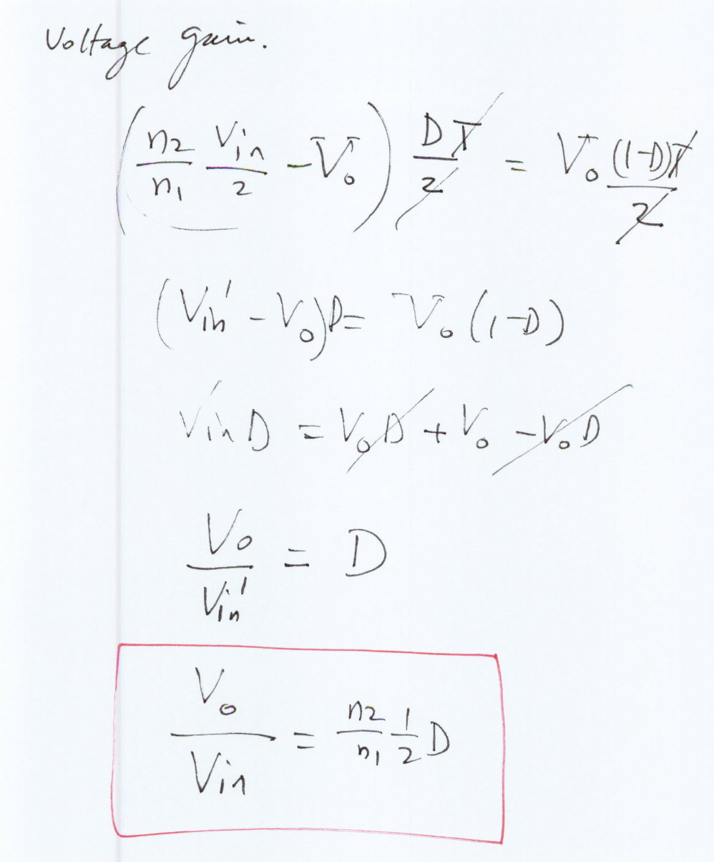

Slide 16
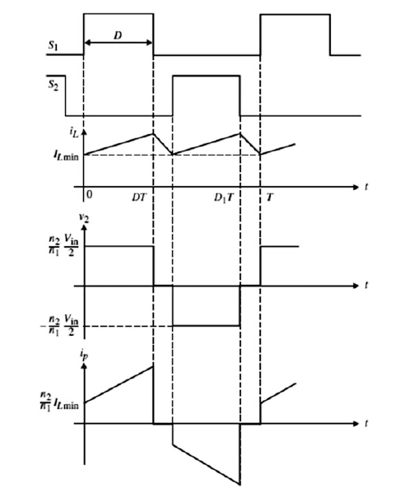
Waveforms for the Half-Bridge Converter

Slide 18
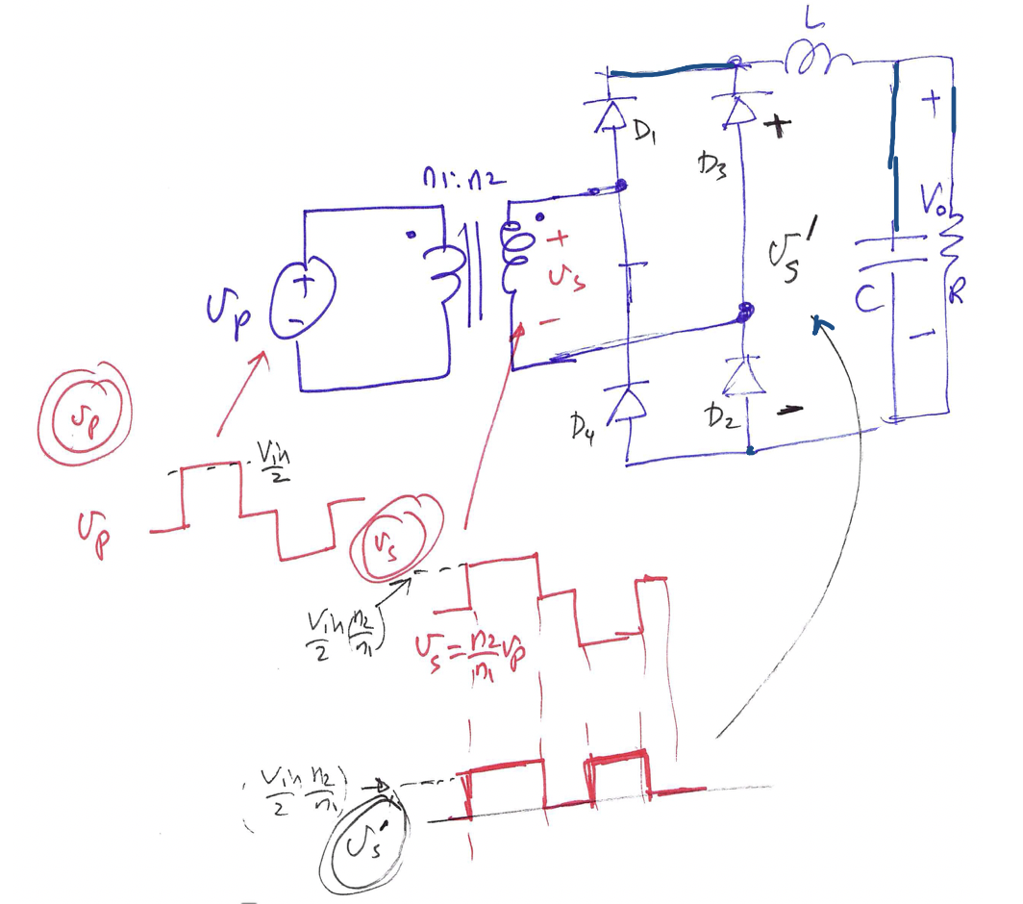
Instead of center-tap transformer in the secondary side, we can use full-bridge rectifier instead as shown:

Slide 19
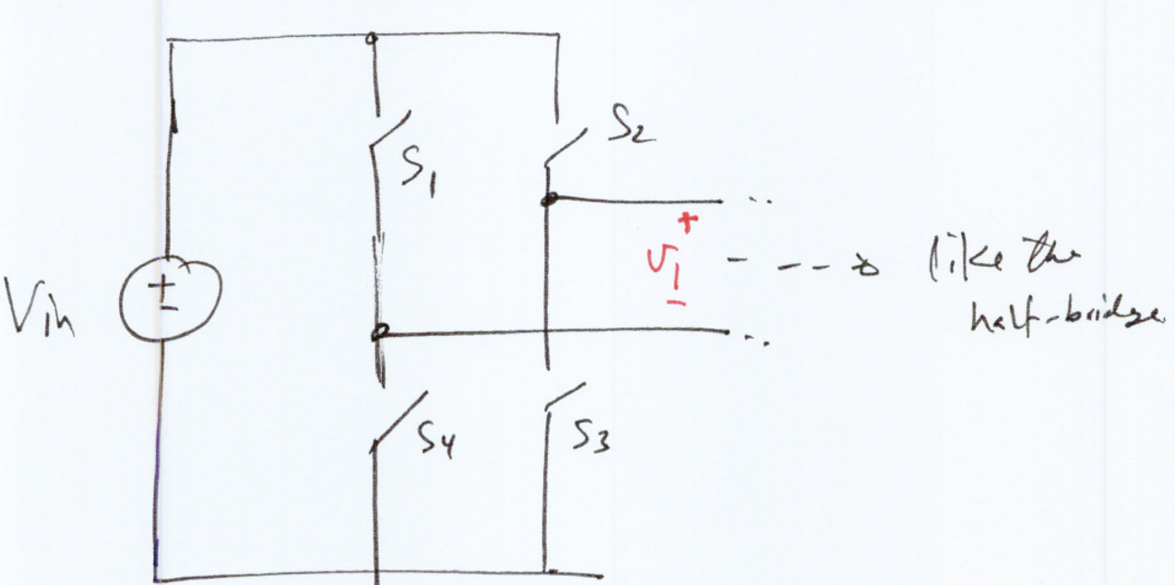
II – Full-Bridge Converters
Two modes of operation:
Mode I: S1/S3 ON and S2/S4 OFF
Mode II: S1/S3 OFF and S2/S4 ON

Slide 20
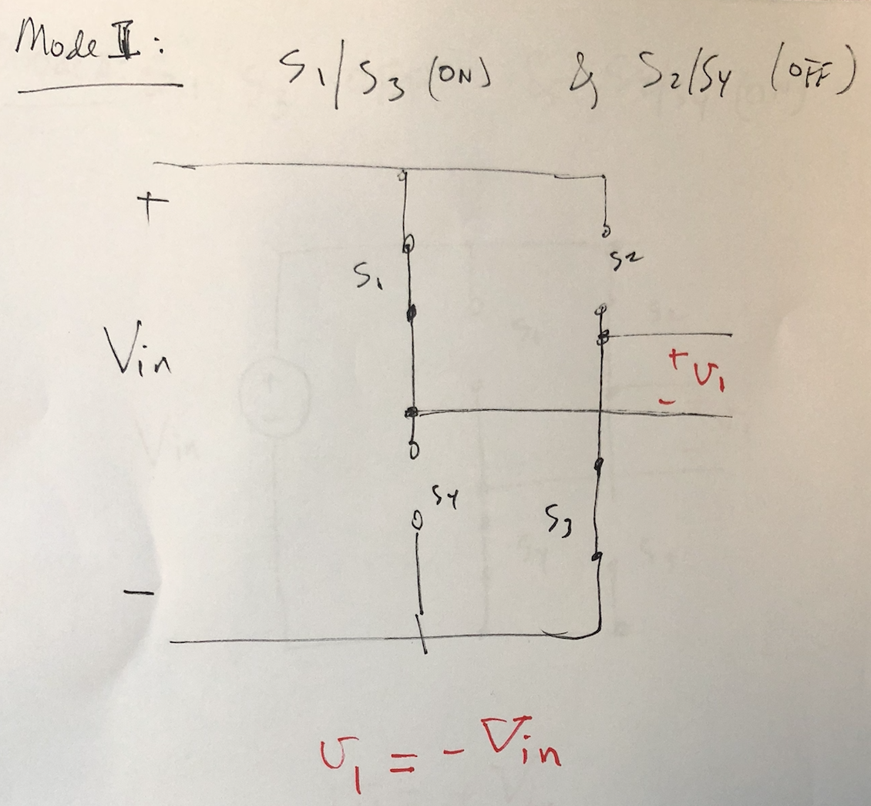

Slide 21
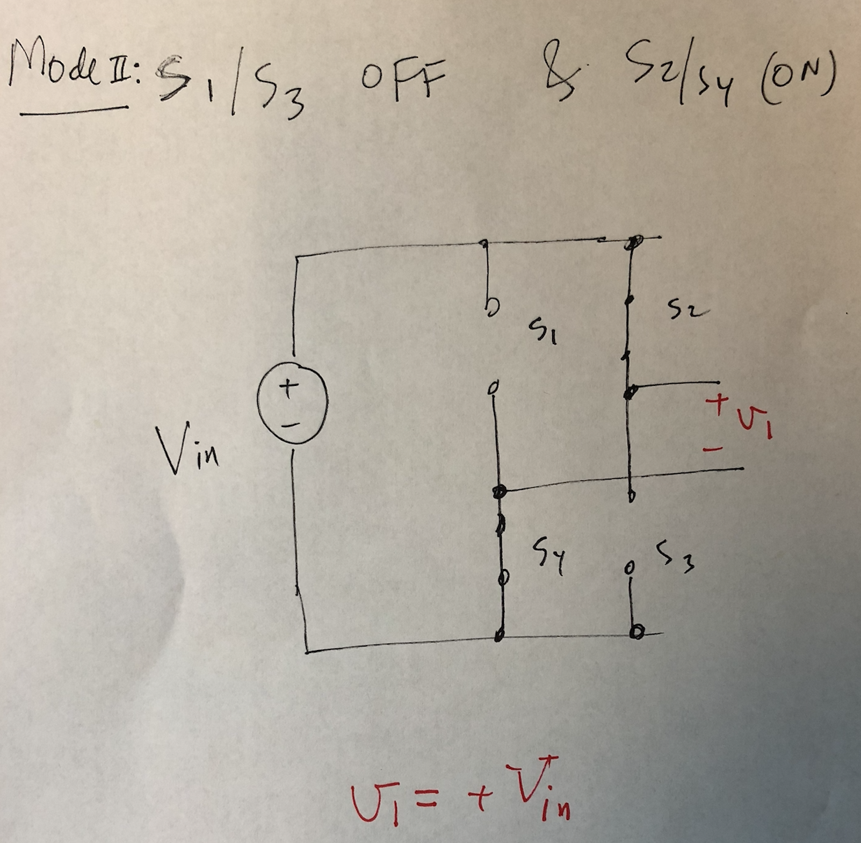

Slide 22
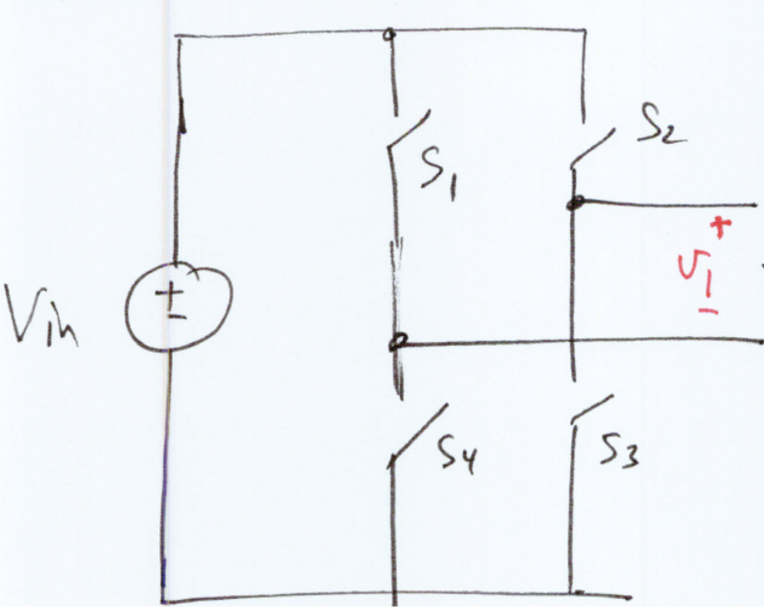
II – Full-Bridge Converters

Slide 23
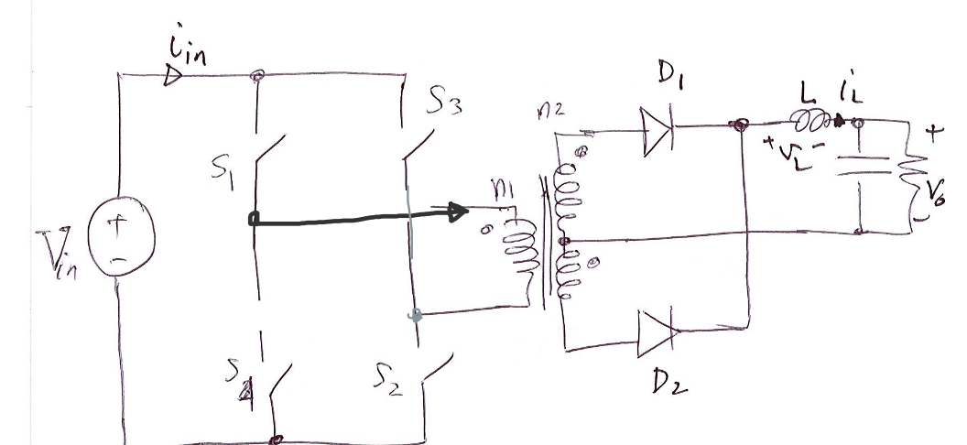
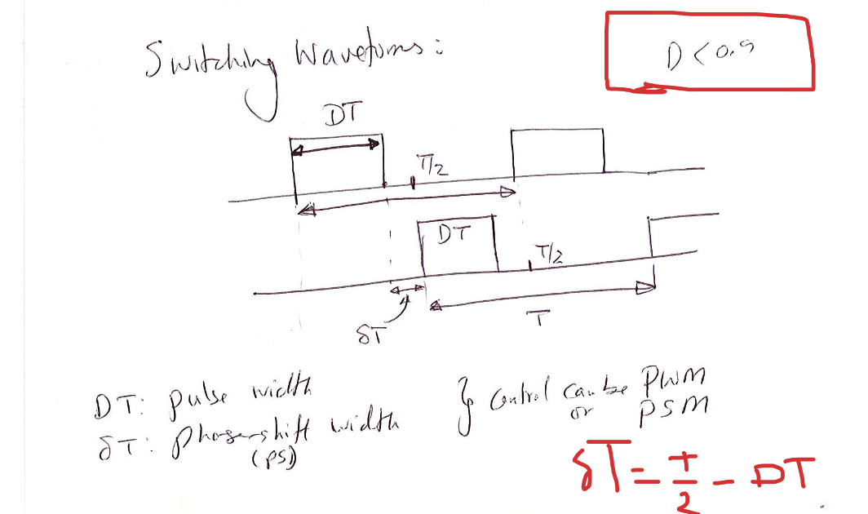
Half-Bridge Converter Analysis

Slide 38
Too high!

Slide 44
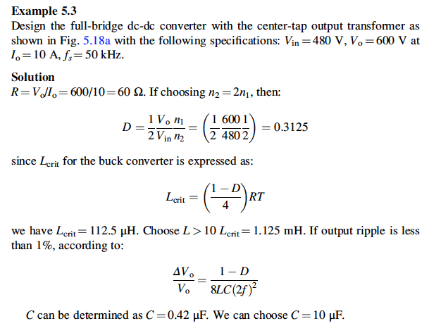

Slide 46
