Slide 1
EEL 5245 POWER ELECTRONICS I Lecture #24 Ch 5: Isolated DC-DC Converters Introduction

Slide 2
Objectives
Introduce isolated Switch-Mode DC-DC Converters
Buck Derived Converter
The Forward Converter

Slide 3
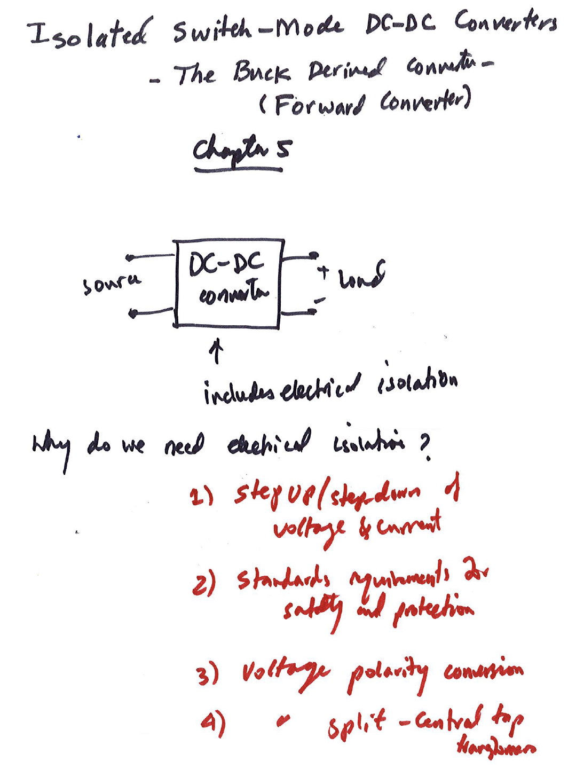

Slide 4
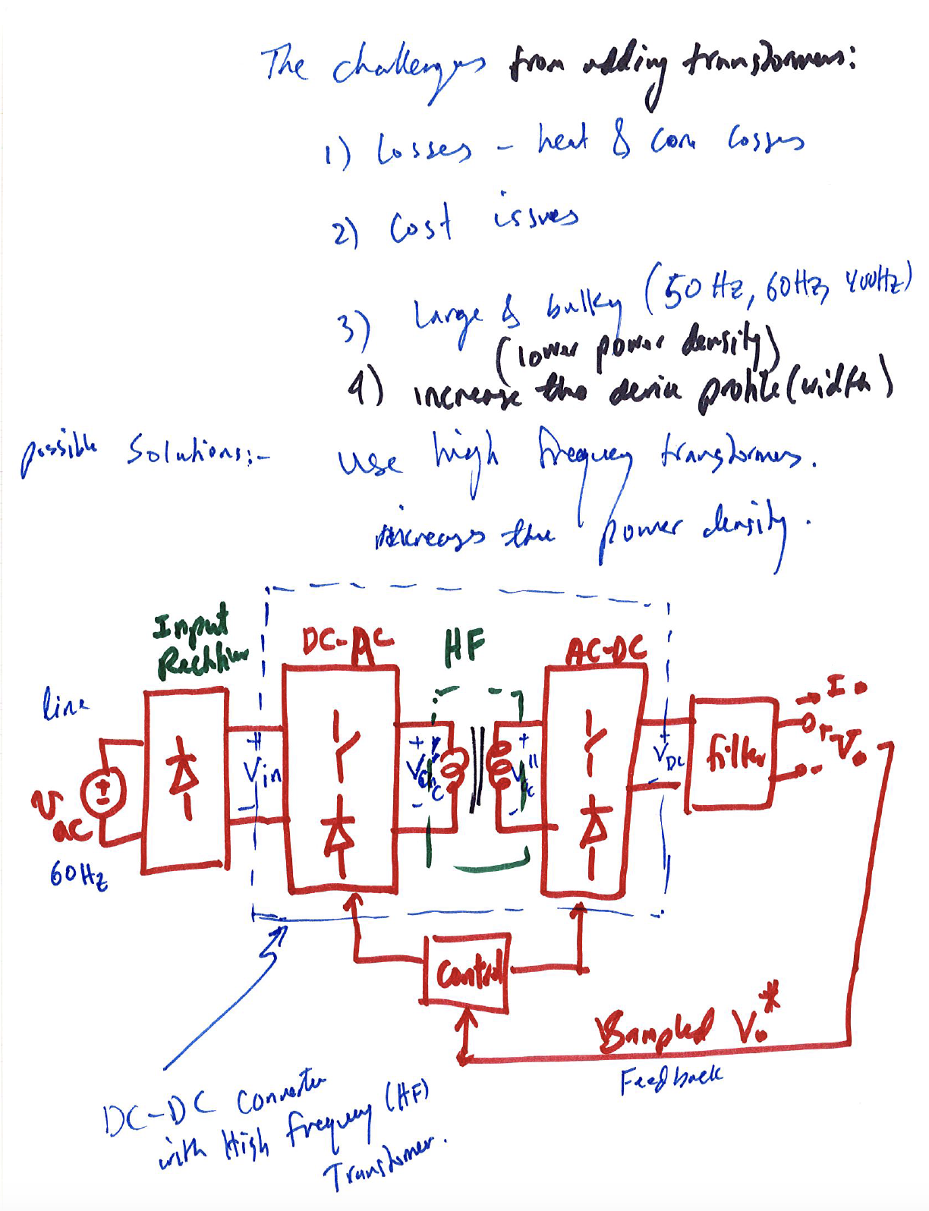

Slide 5
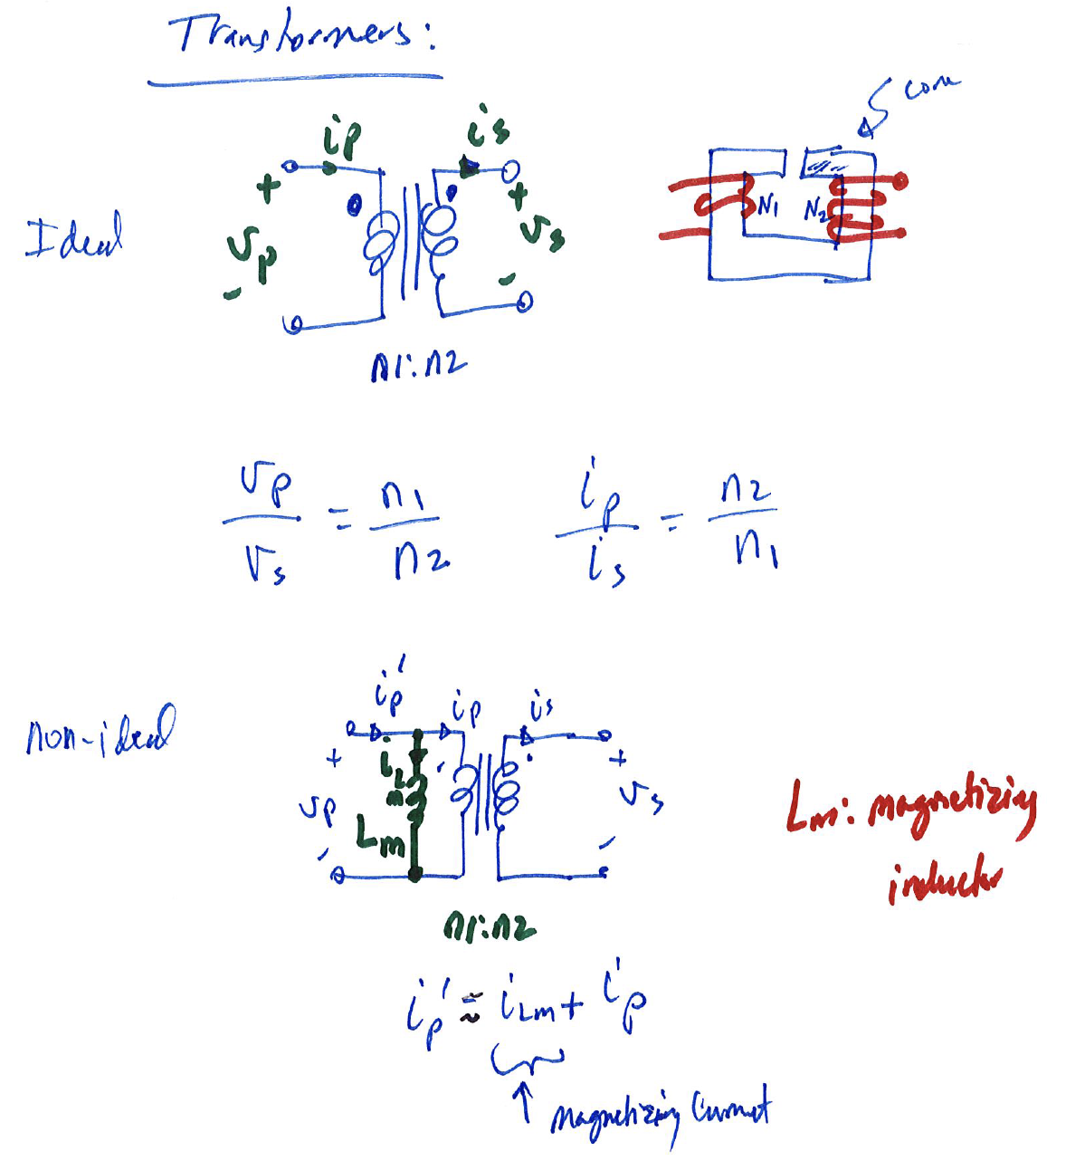

Slide 6
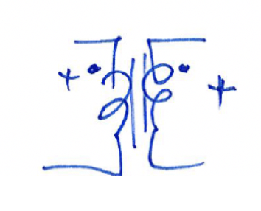
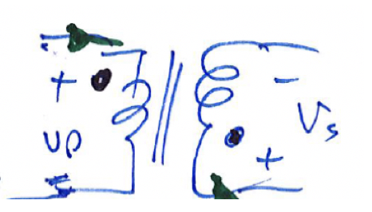
Dot Convention
No voltage polarity reversal:
Voltage polarity reversal:

Slide 7
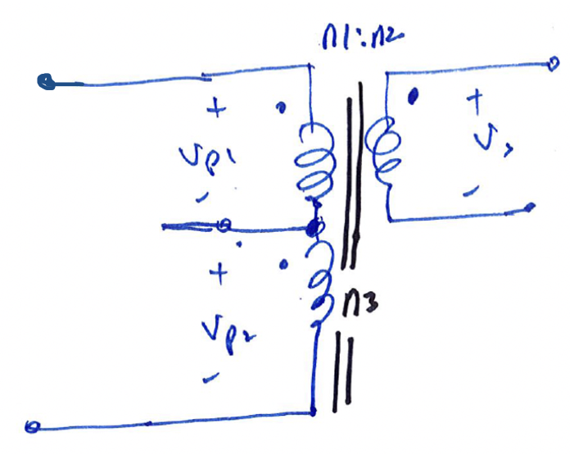
Transformer Configurations
Center-tap configuration
Useful for half-bridge and full bridge converters

Slide 8
Isolated DC-DC Converter - Classifications
1) Buck-derived dc-dc converters – forward converters
2) Buck-boost derived dc-dc converters – flyback converters
3) Buck-derived dc-dc half-bridge and full-bridge converters

Slide 9
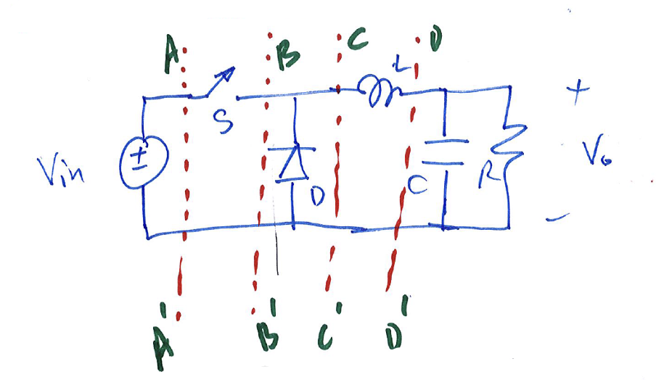
Buck Derived Isolated Converter
Which location(s) is(are) invalid?

Slide 10
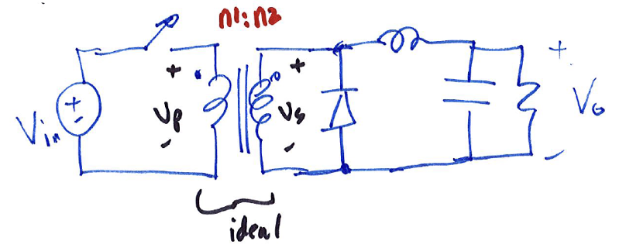
Buck Derived Isolated Converter
Derive the voltage gain by assuming ideal transformers

Slide 11
Analysis of the buck-derived converter with ideal transformer
Two modes of operation as before:
- Mode I: Switch is on
- Mode II: Switch is off

Slide 12
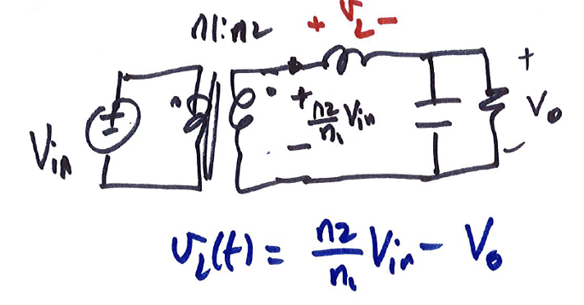
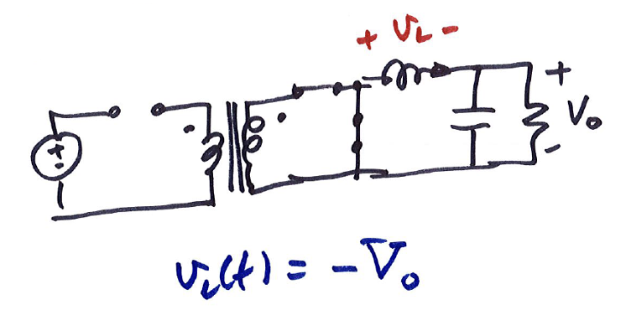
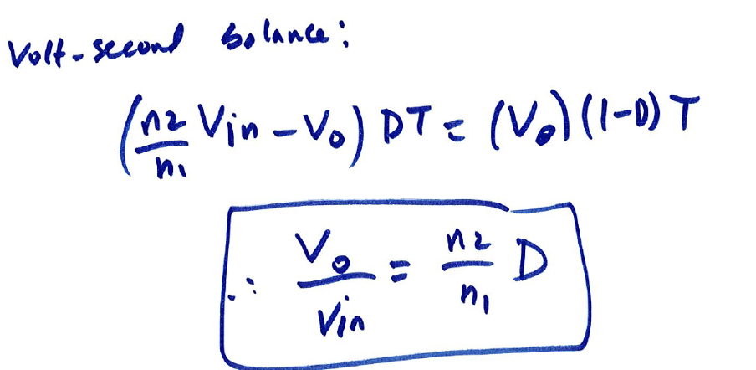
- Mode I: Switch is on & D is off
- Mode II: Switch is off & D is on

Slide 13
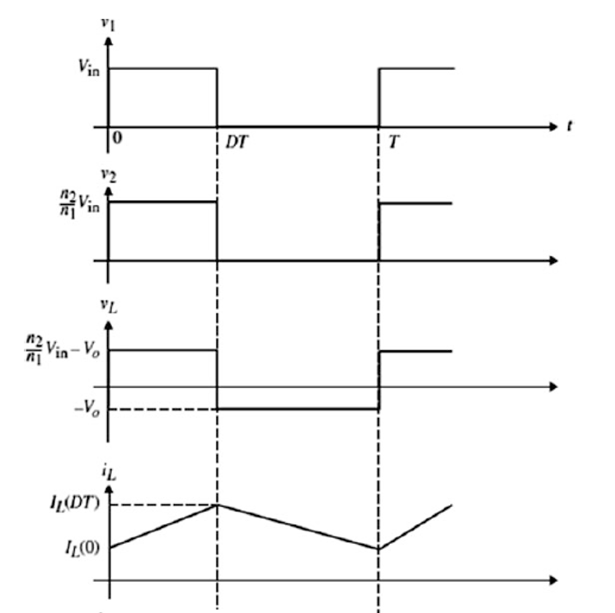
Steady-state waveforms

Slide 14
Analysis of the buck-derived converter with non-ideal transformer
Two modes of operation as before:
- Mode I: Switch is on
- Mode II: Switch is off

Slide 15
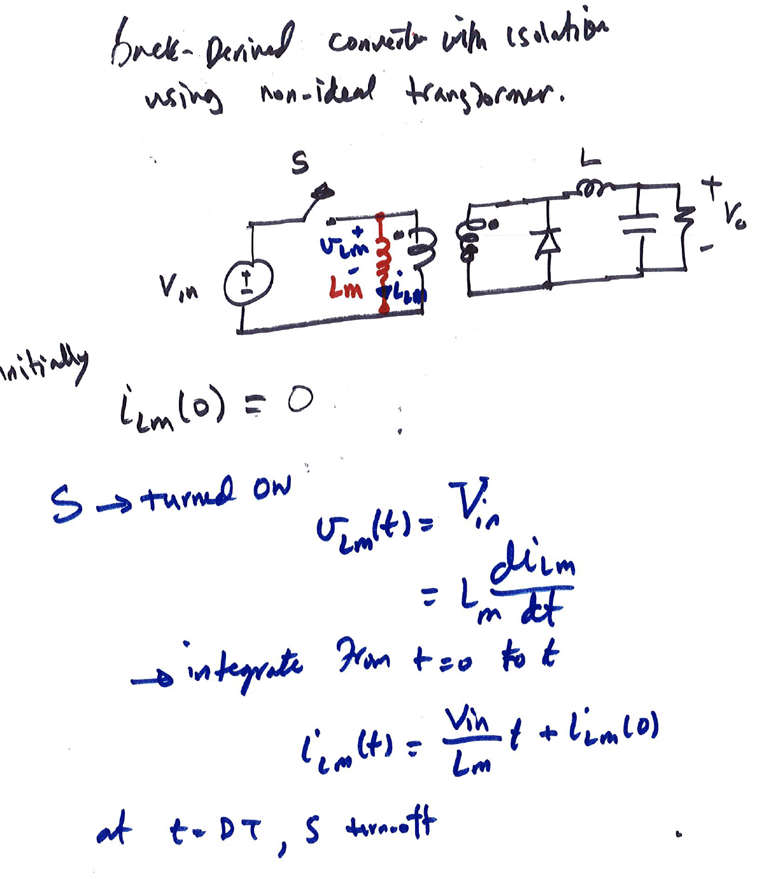

Slide 16
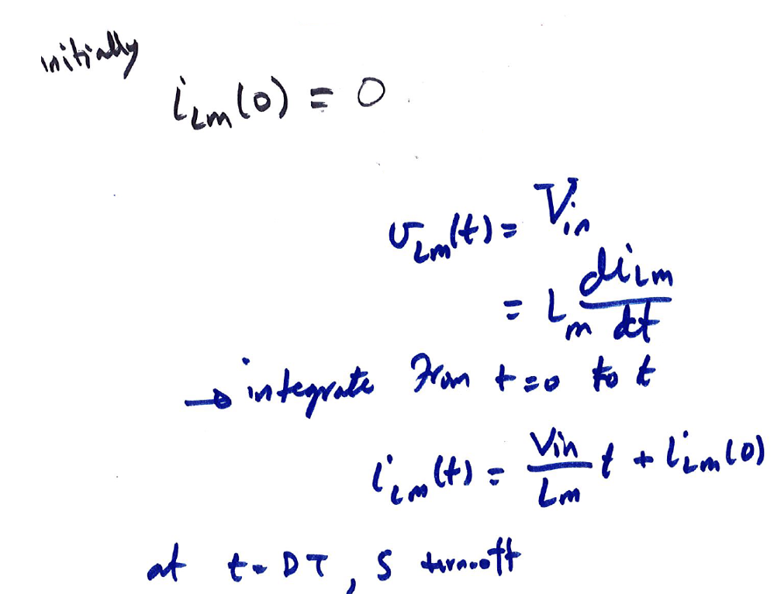
- Mode I: Switch is on & D is off
- Mode II: Switch is off & D is on

Slide 17
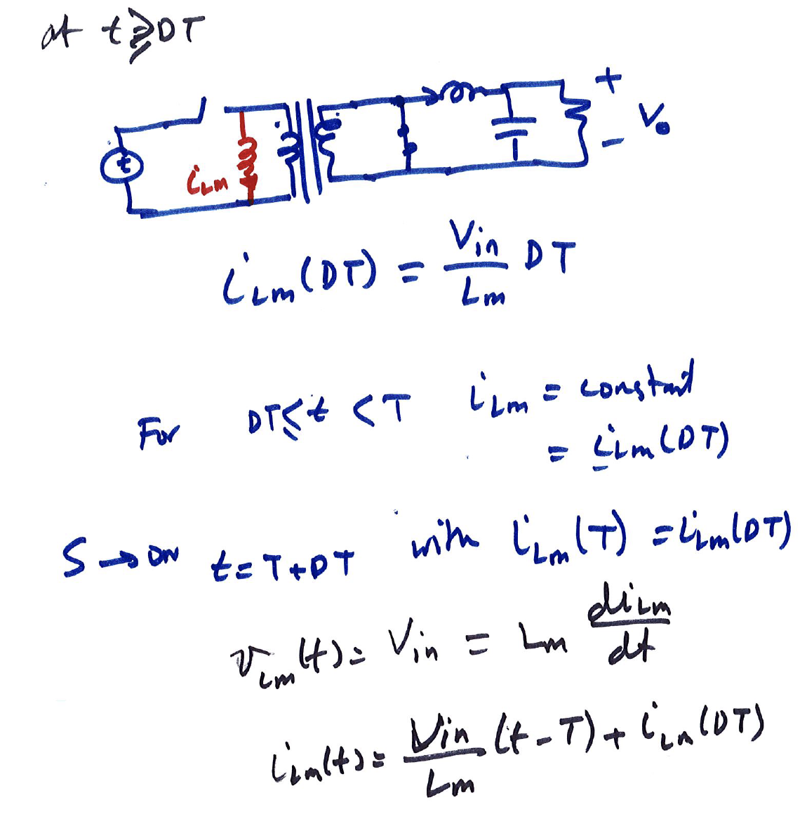

Slide 18
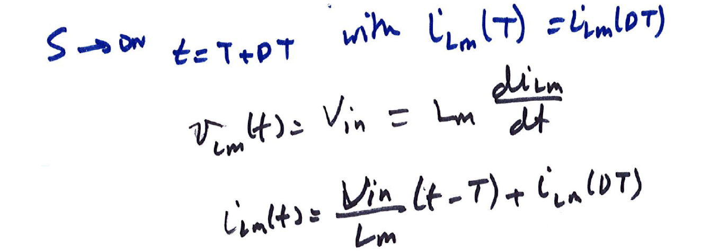

Slide 19
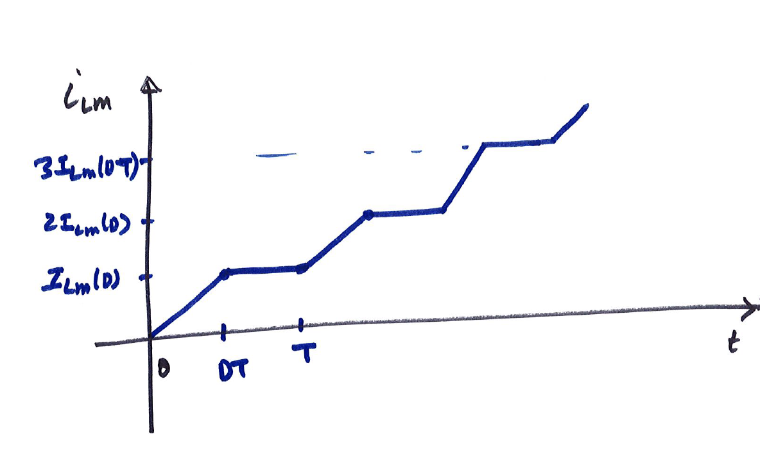

Slide 20
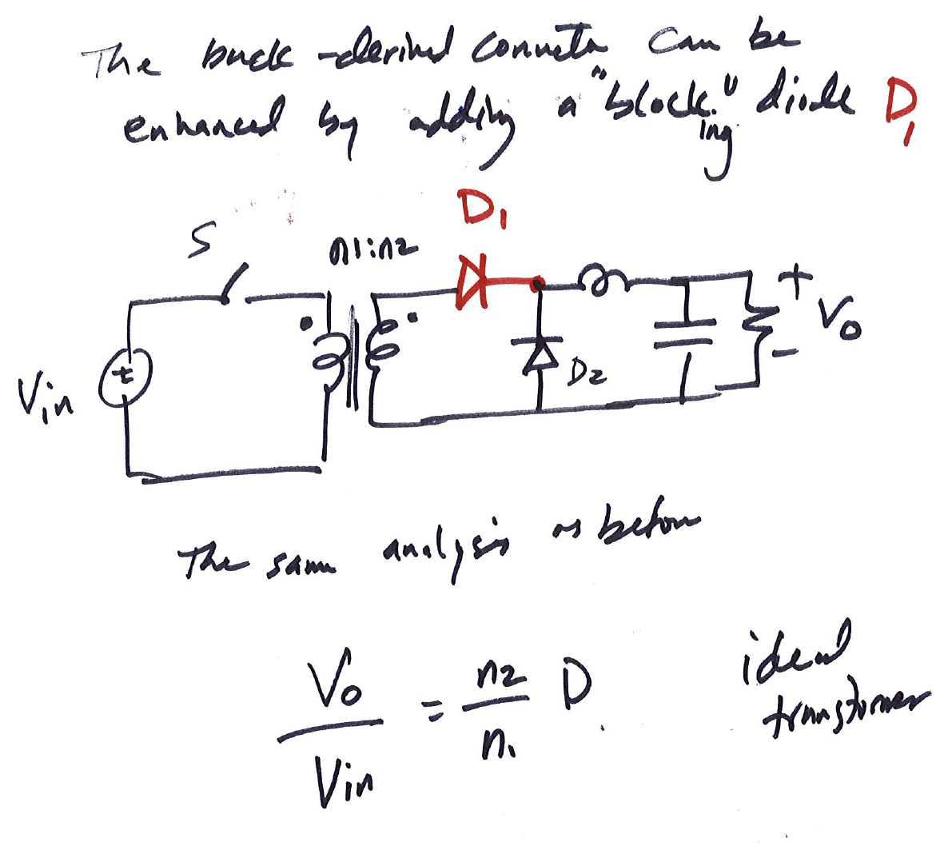

Slide 21
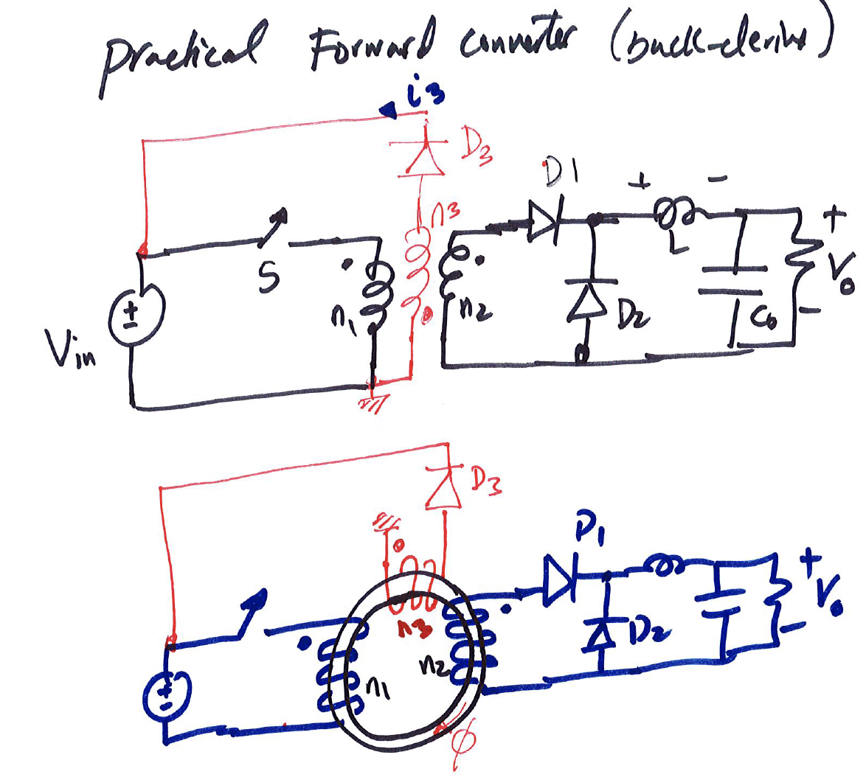

Slide 22
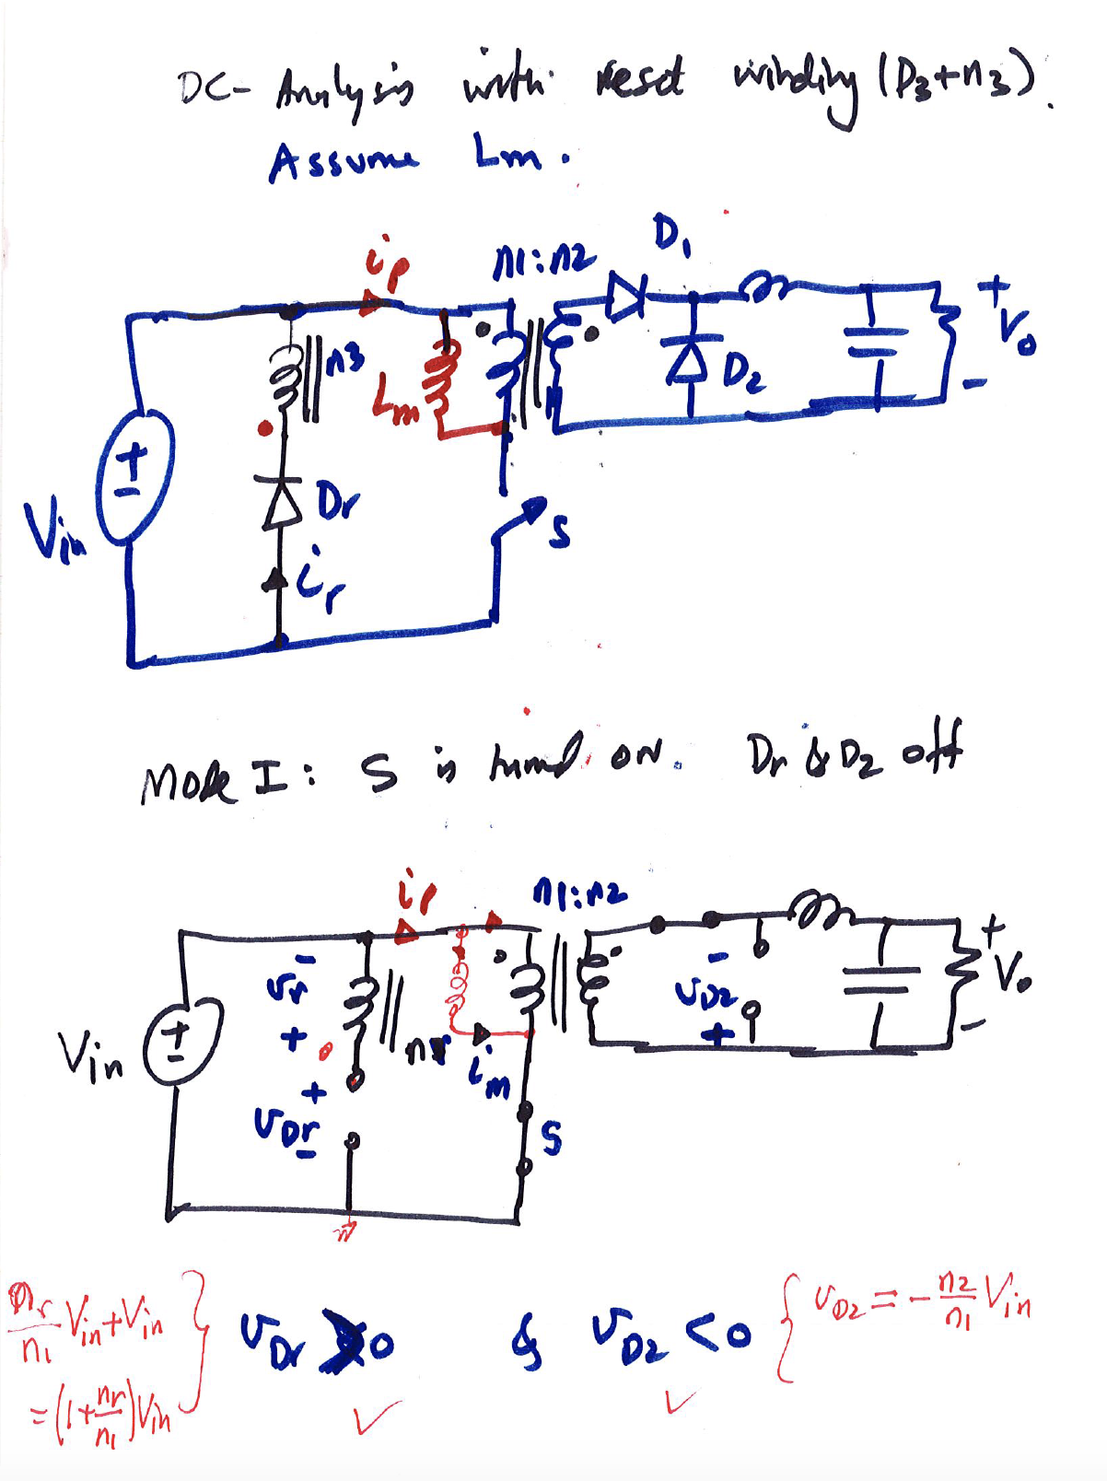

Slide 23
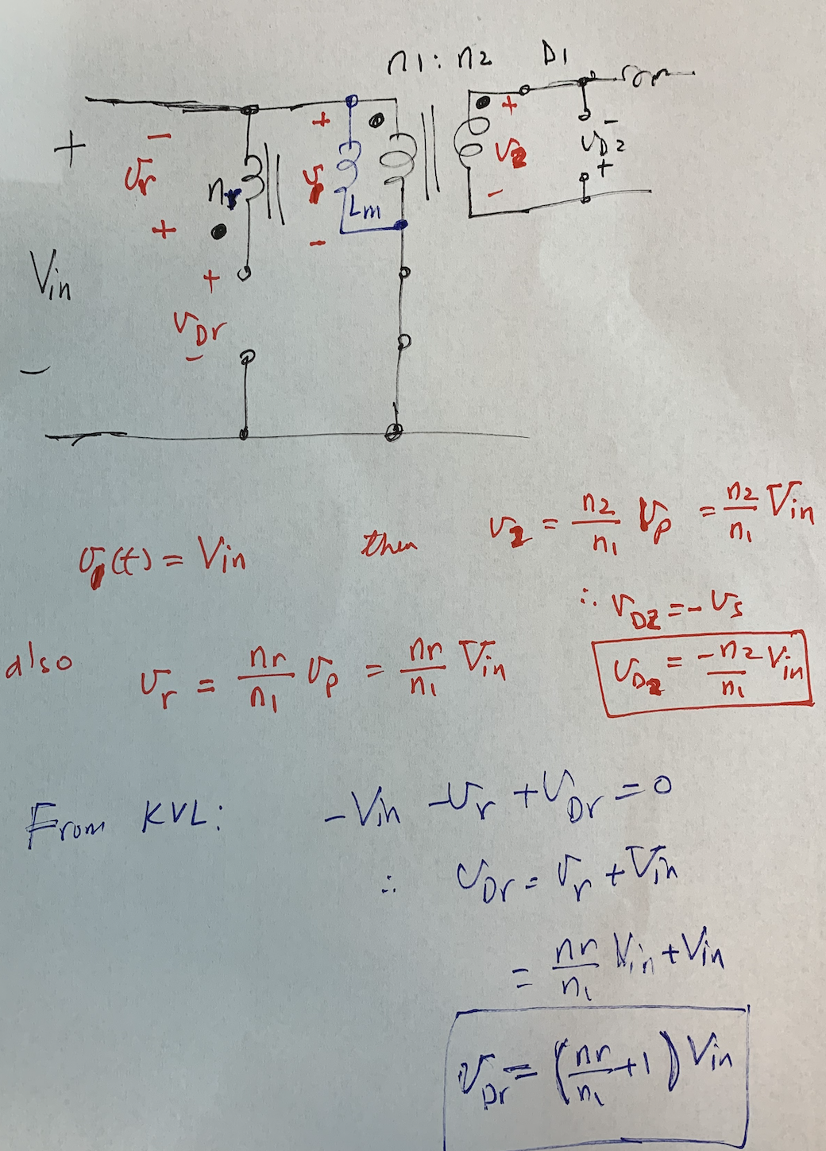

Slide 24
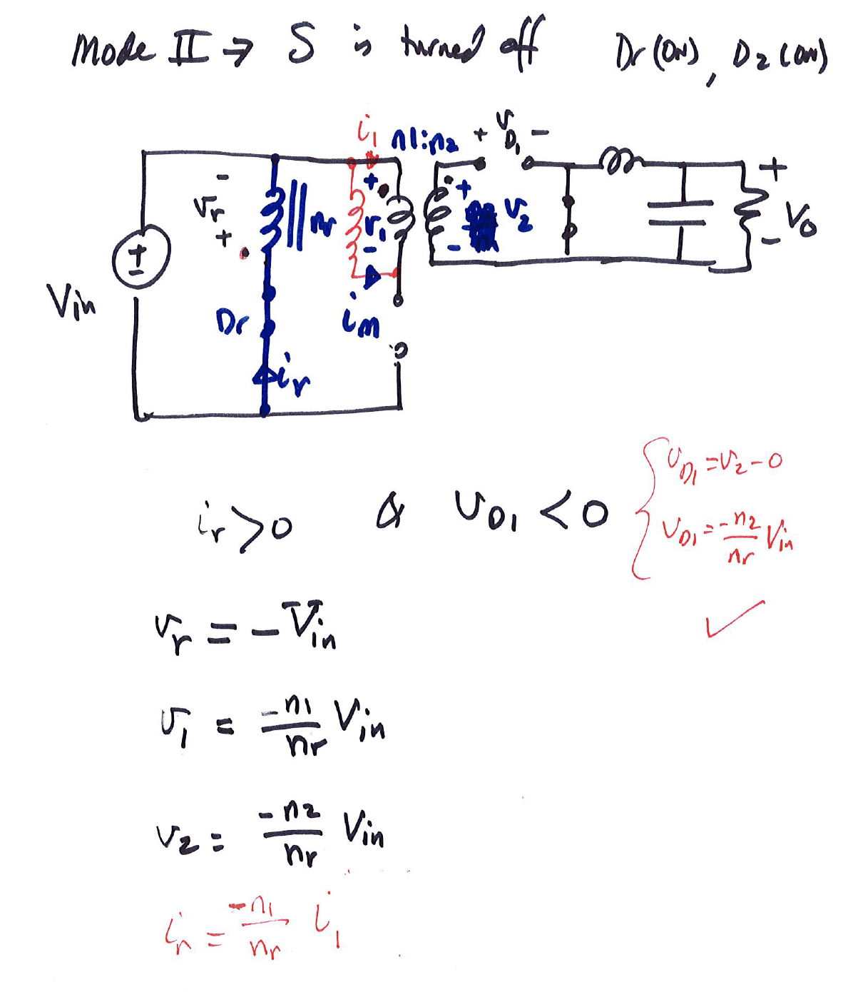

Slide 25
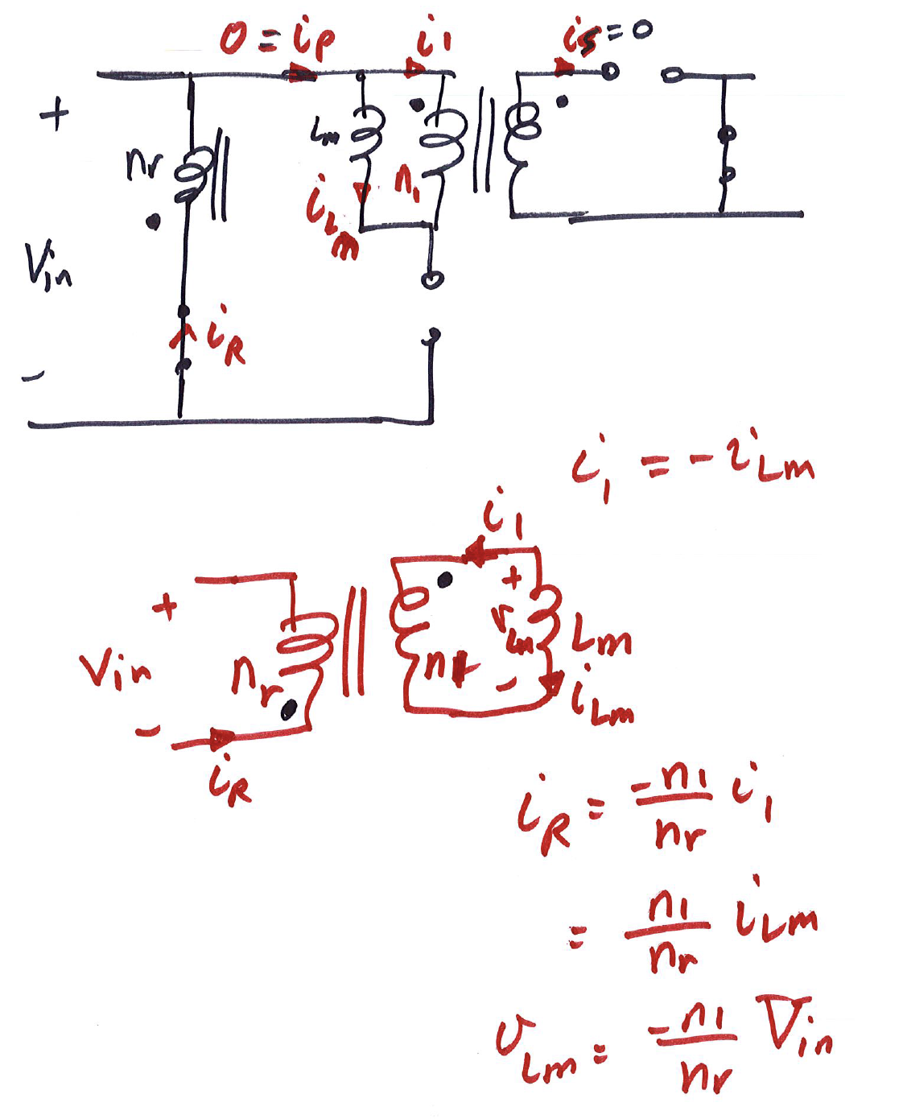

Slide 26
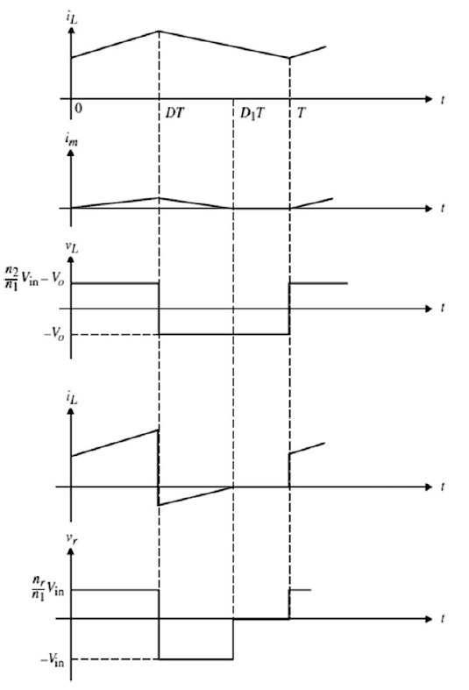

Slide 28
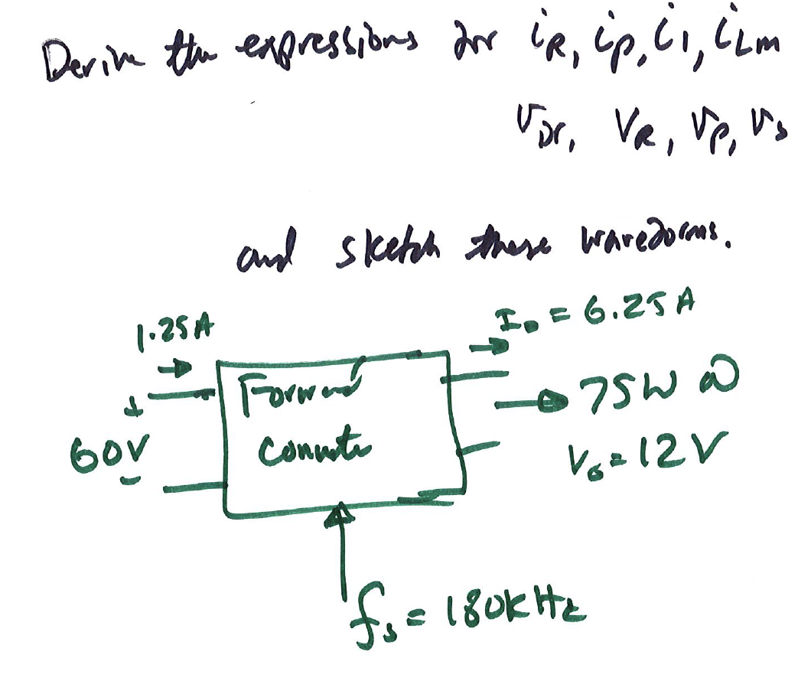

Slide 29
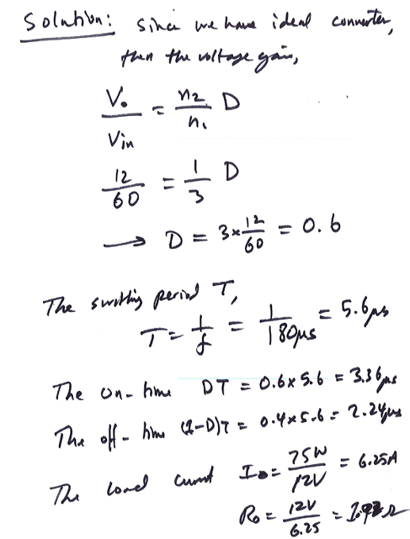

Slide 30
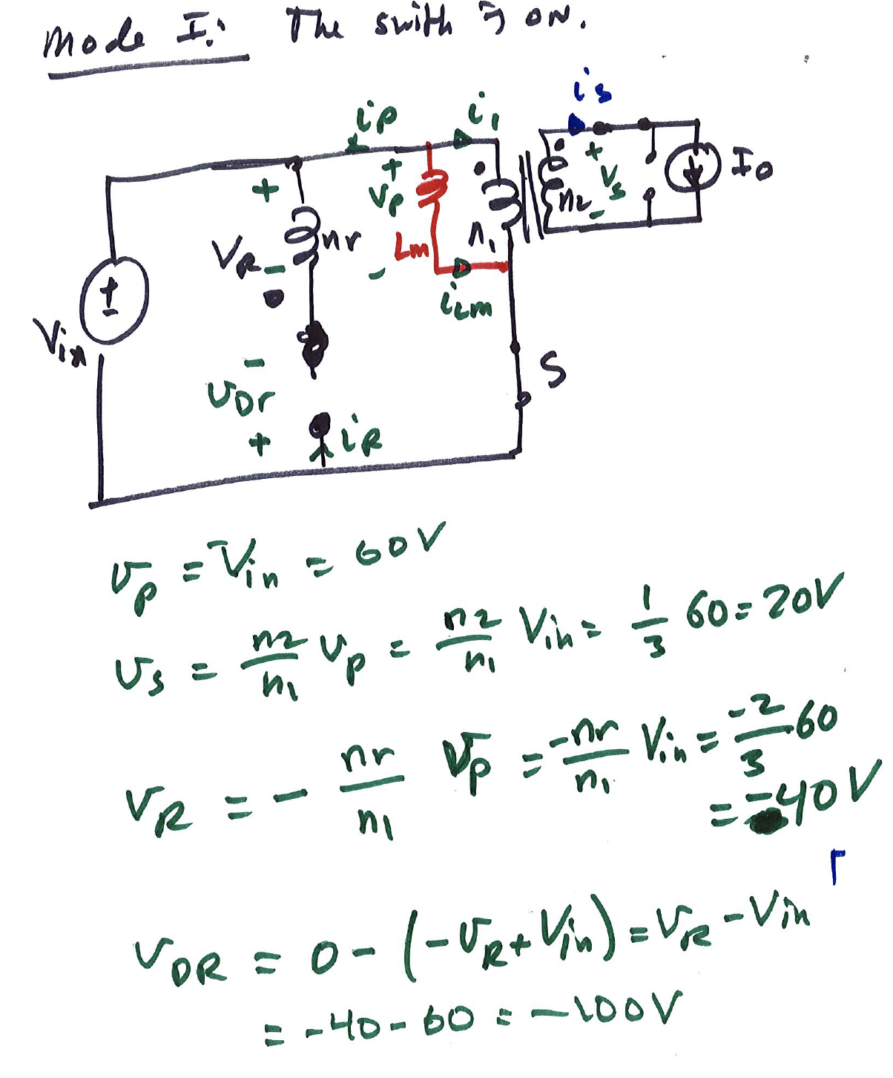

Slide 31
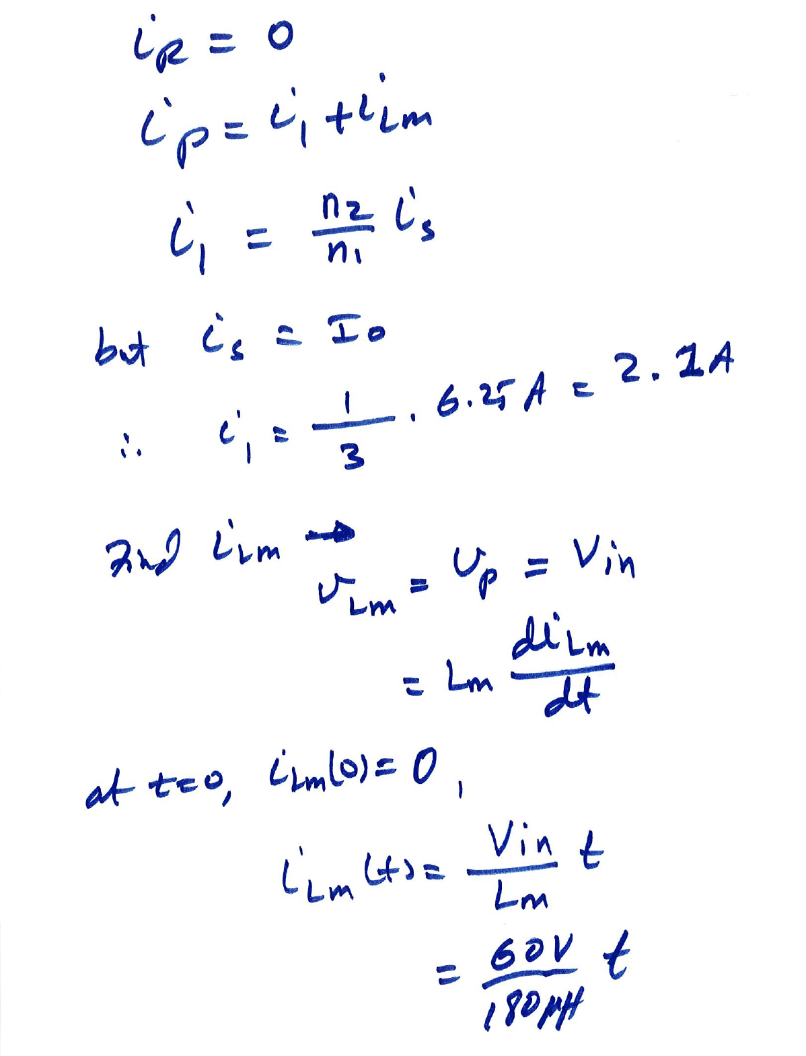

Slide 32
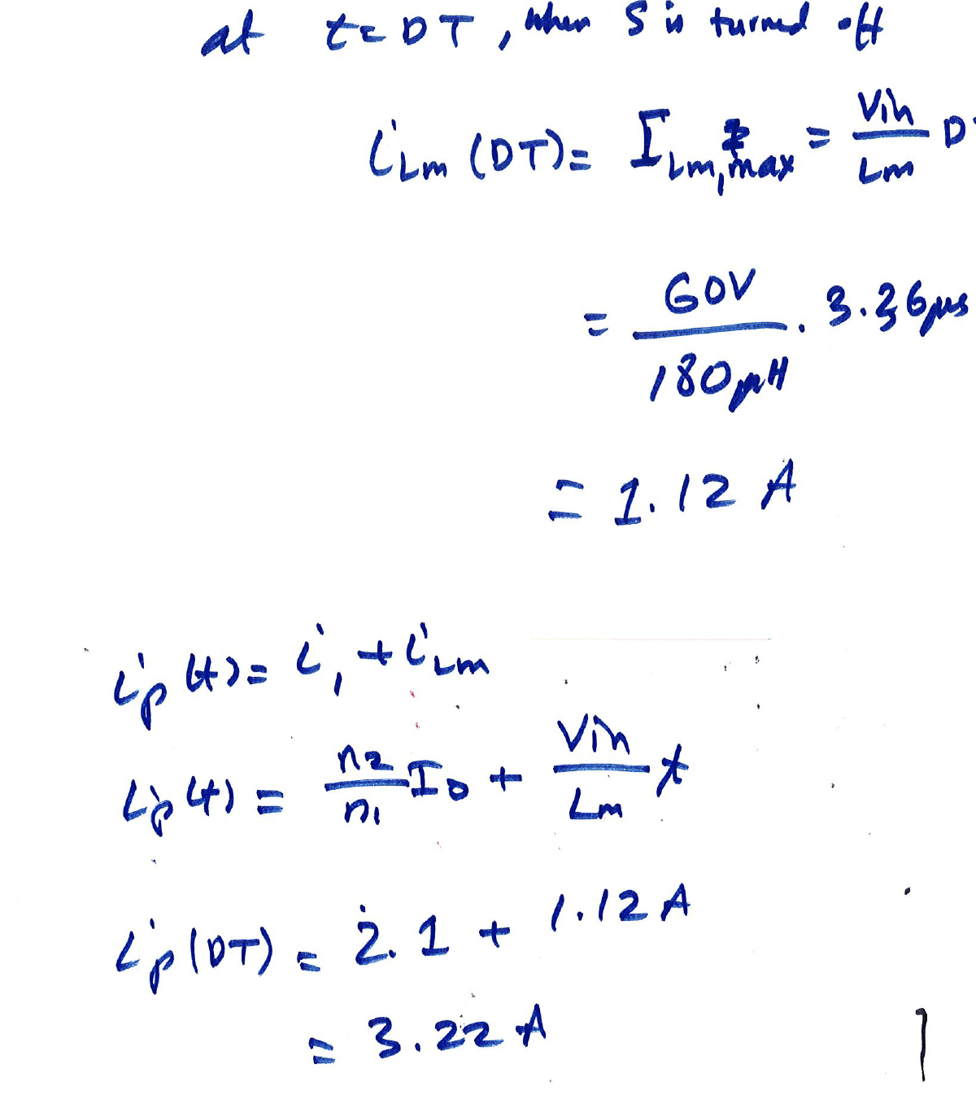

Slide 33
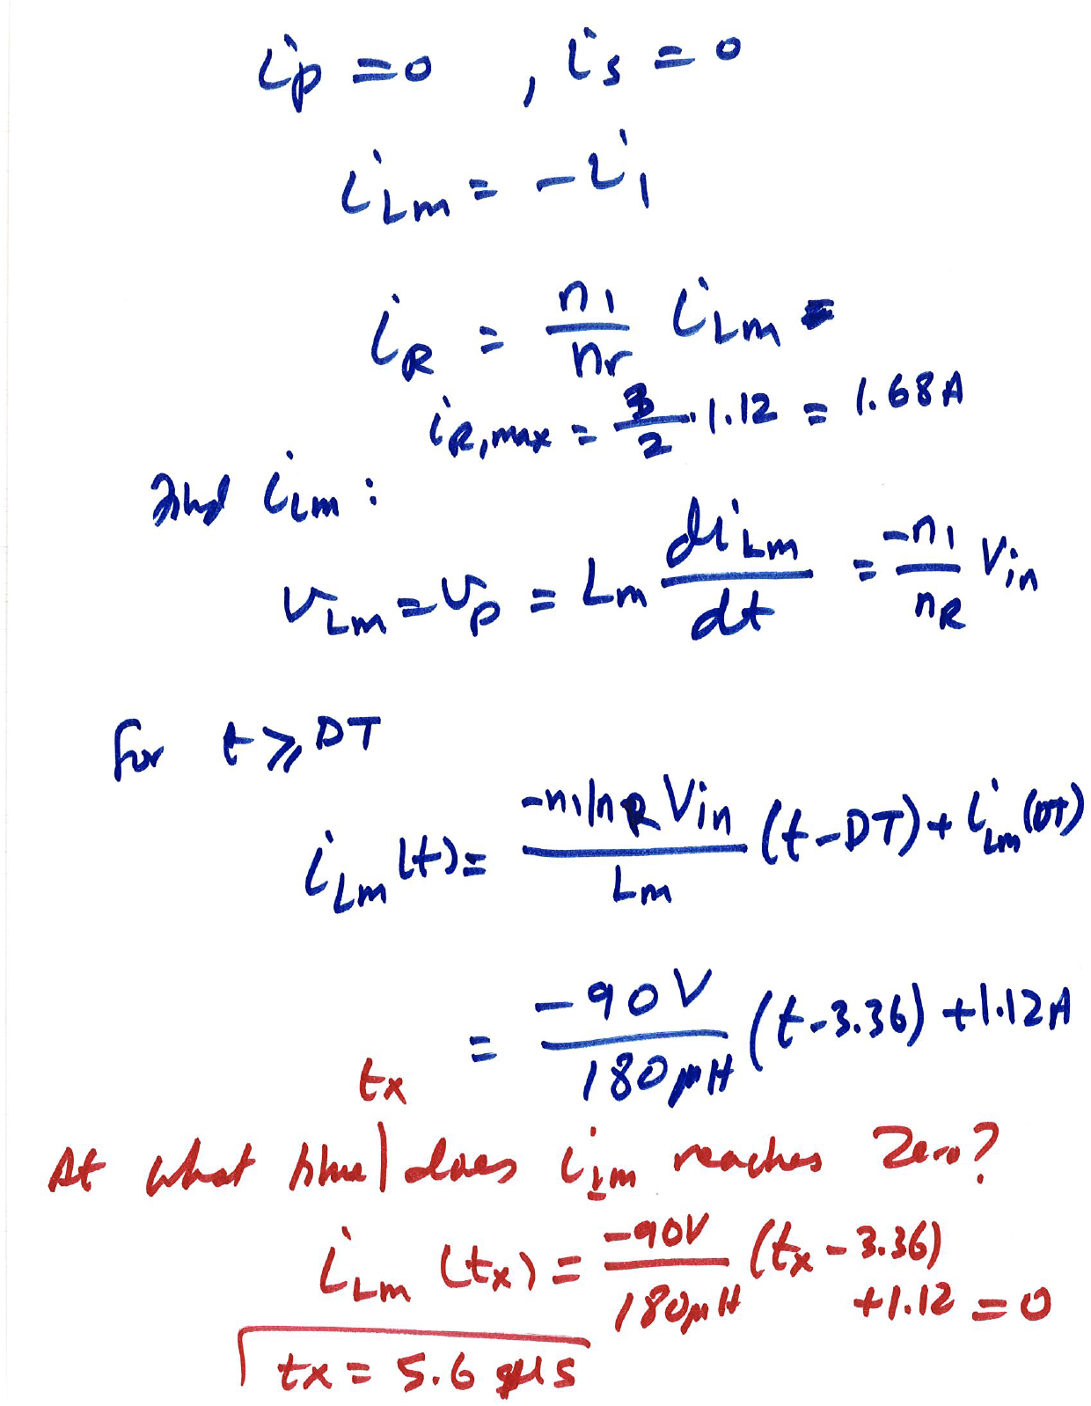

Slide 34
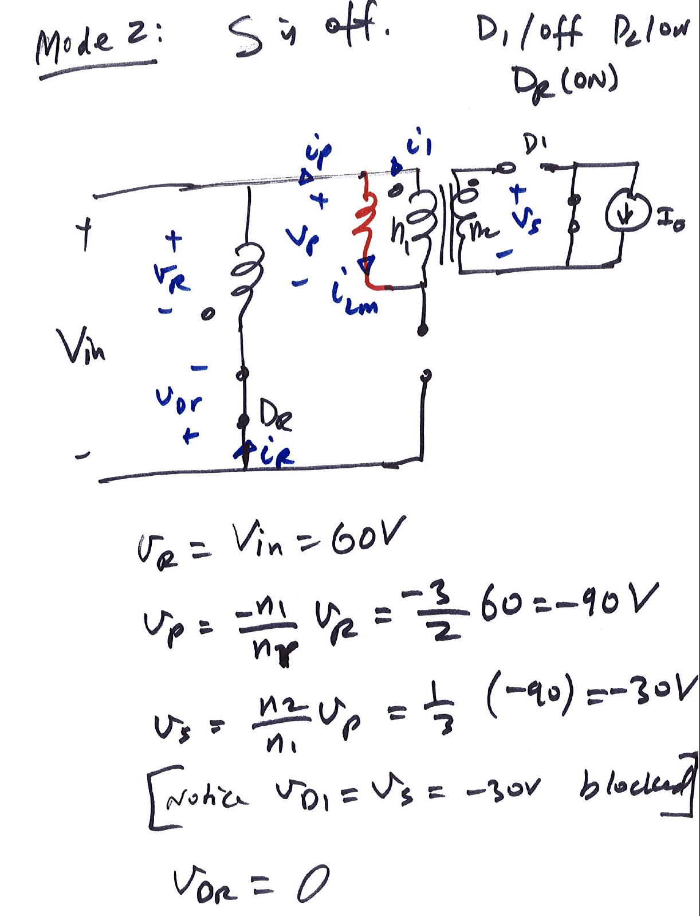

Slide 35
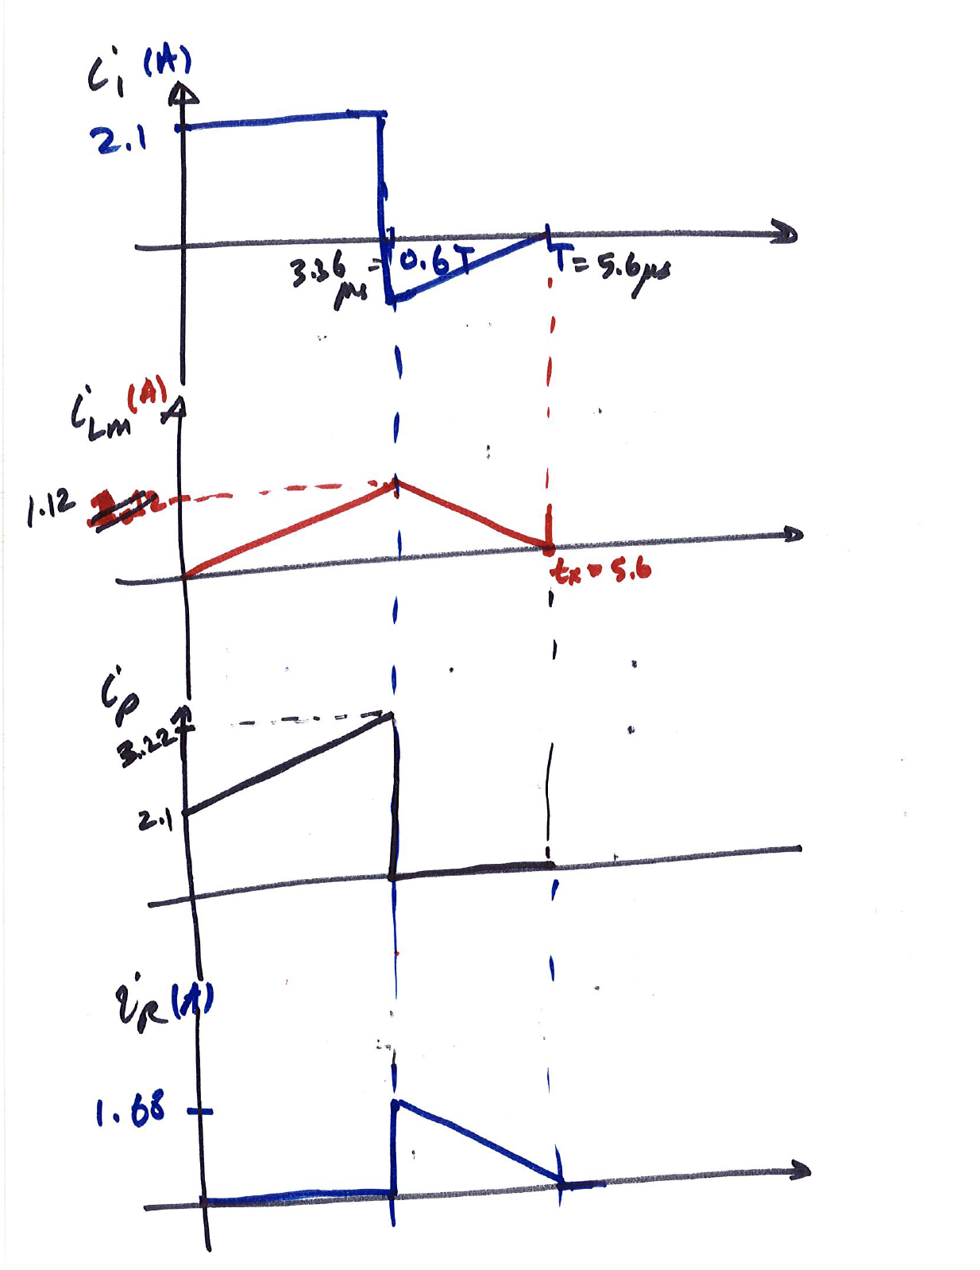

Slide 36
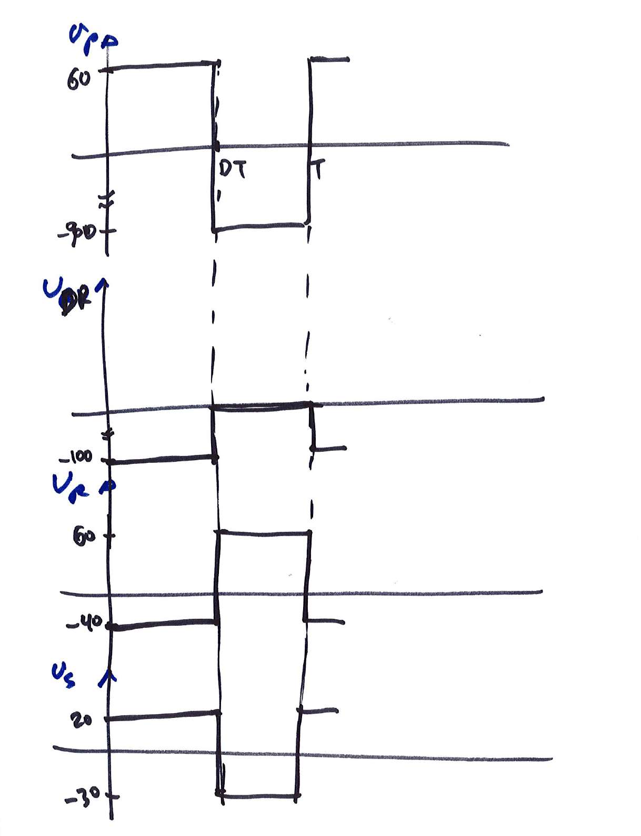

Slide 37
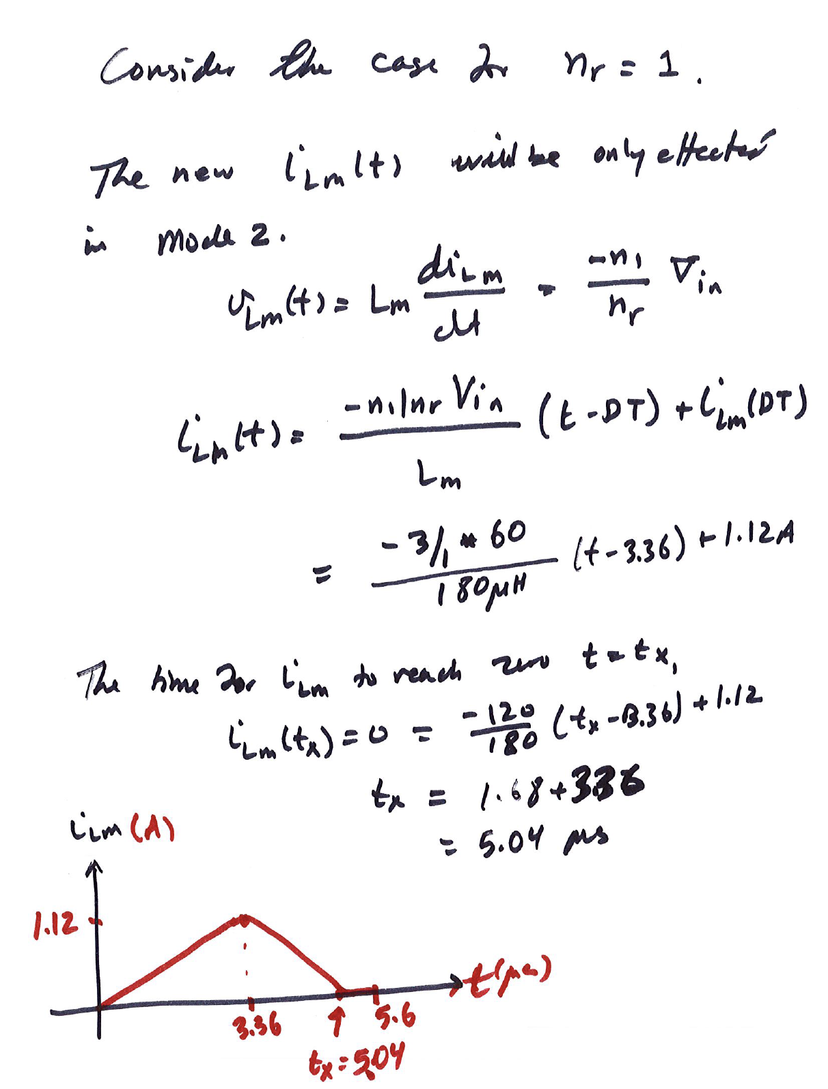

Slide 38
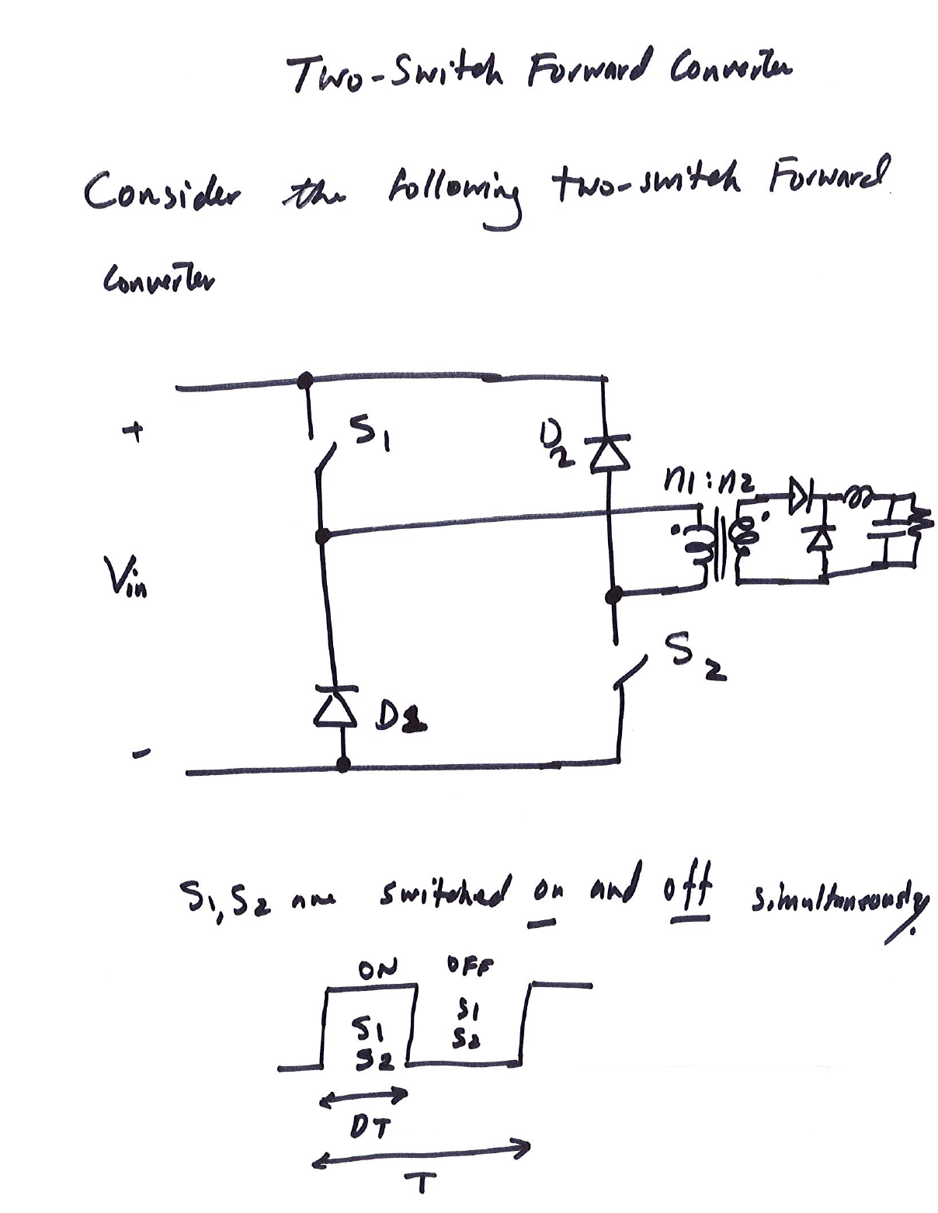

Slide 39
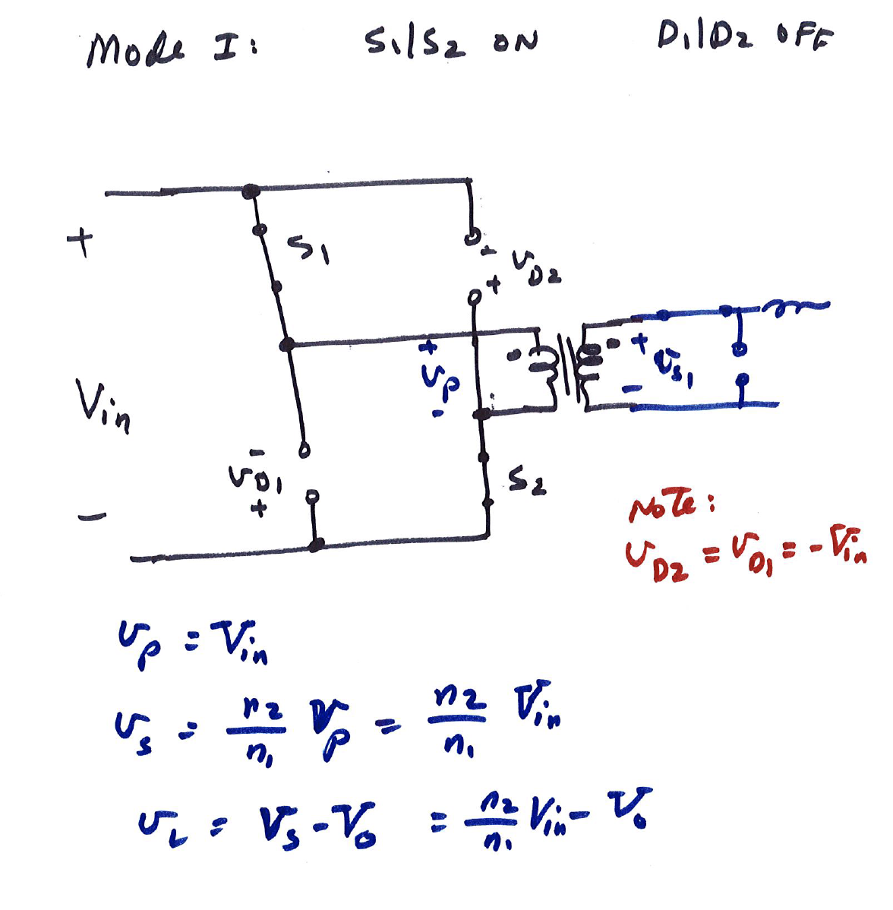

Slide 40
