Slide 1
EEL 5245 POWER ELECTRONICS I Lecture #23 Ch 4 Examples

Slide 2
Objectives
Examples of 4th order with non-idealities
Example of Current Driven DC-DC converter
Average and rms values

Slide 3
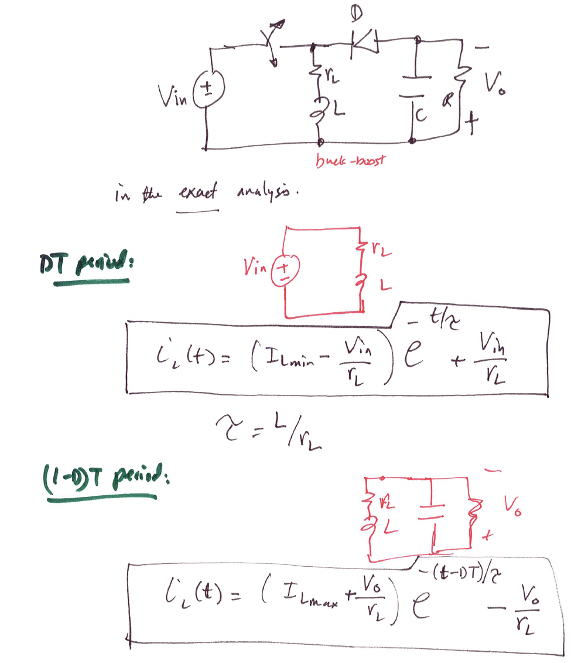
P4.28 Derive the expressions for V_{o} /V_{in} for the buck-boost converters by including r_{L} .

Slide 4
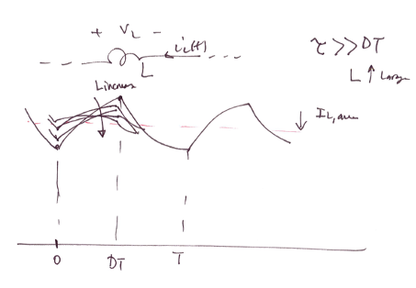
The larger L, i.e. L/R>>T, the ripple becomes smaller then we can assume
+
+

Slide 5
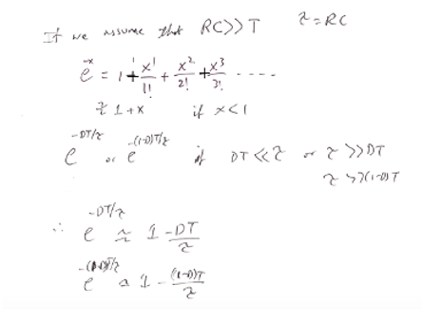

Slide 6
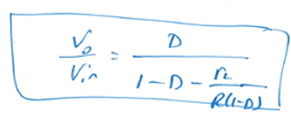

Slide 7
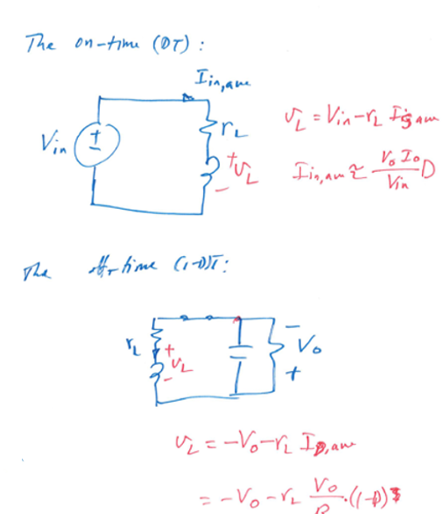
Use the second-volt balance concept across L:

Slide 8
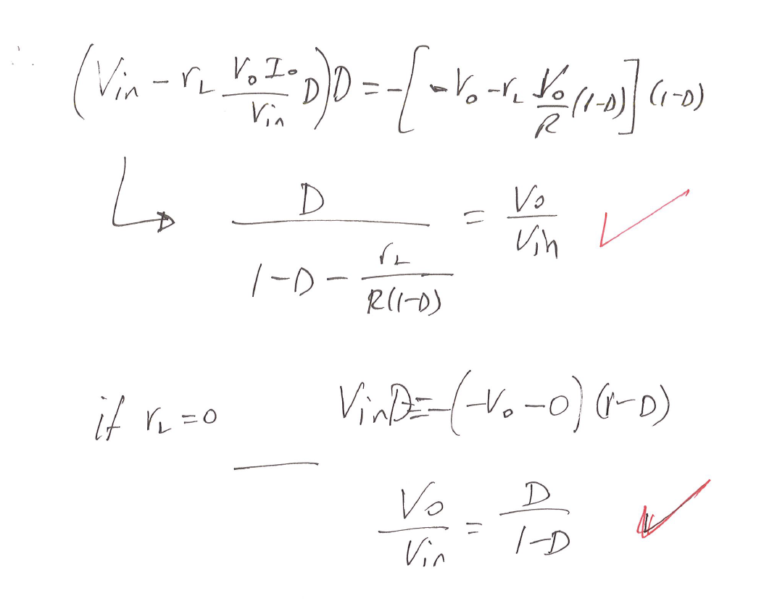

Slide 9
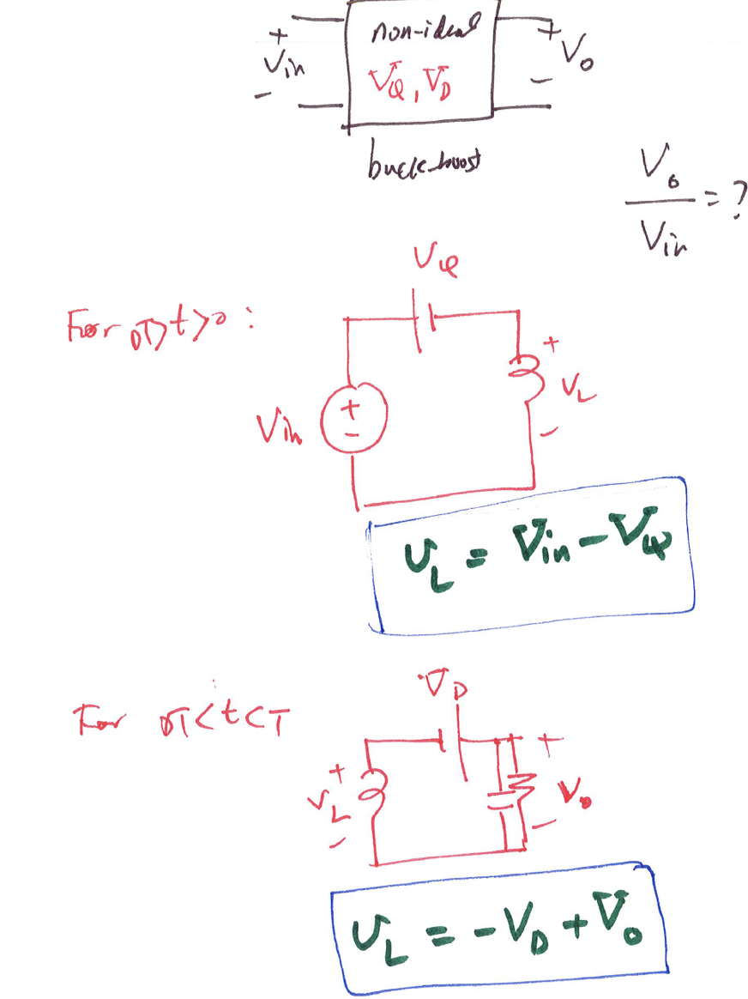
4.29 Derive the expressions Vo /Vin for the buck-boost by including VD and VQ .

Slide 10
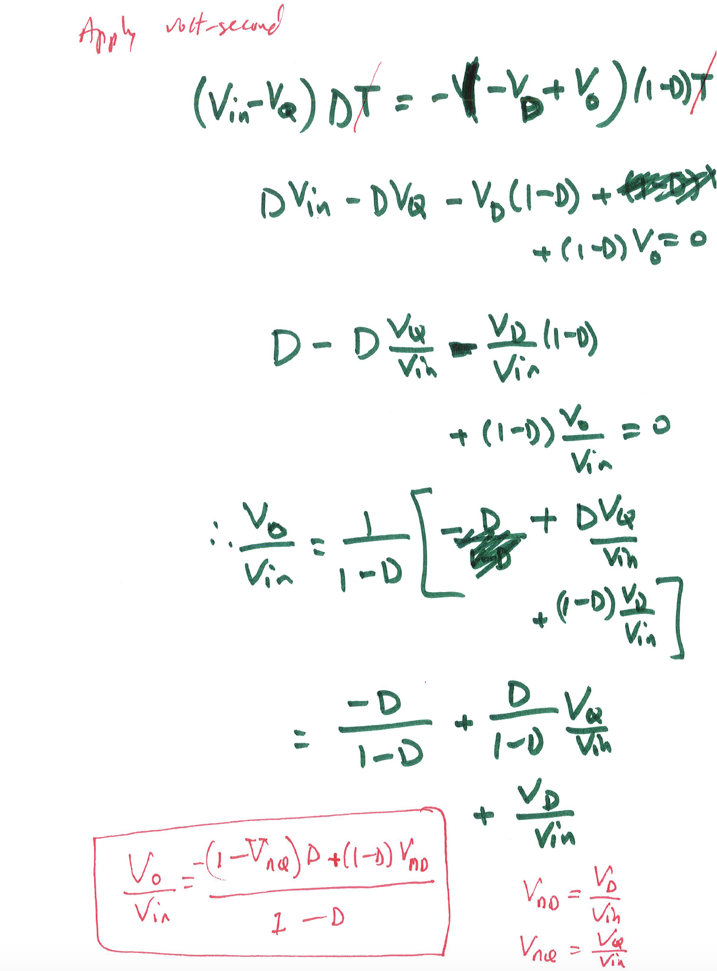

Slide 11
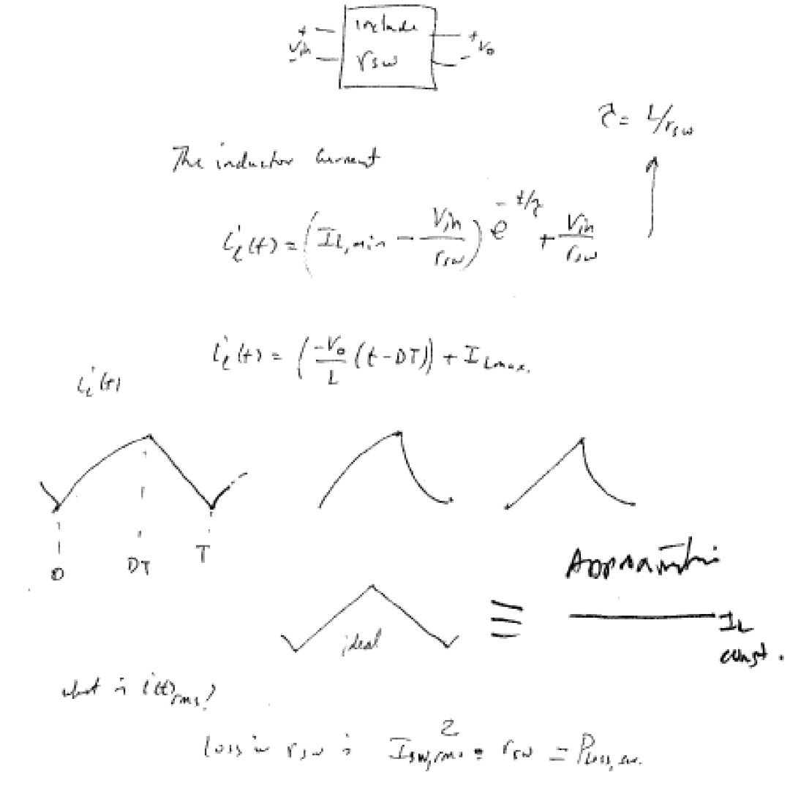
4.30 Derive the expression for Vo /Vin for the buck-boost converter by including rsw .

Slide 13
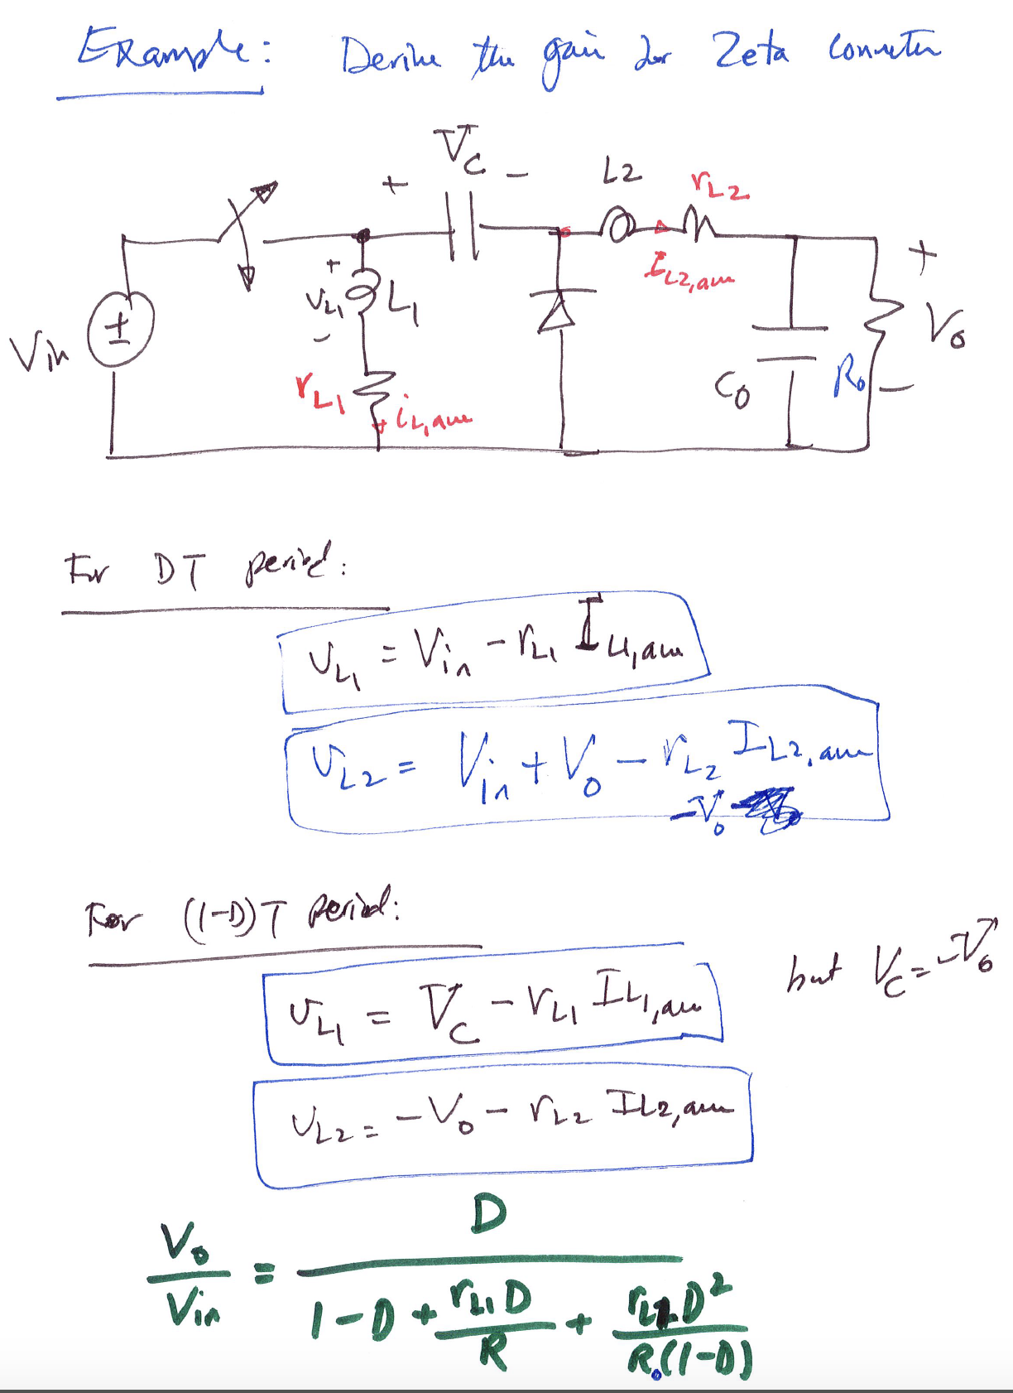

Slide 14
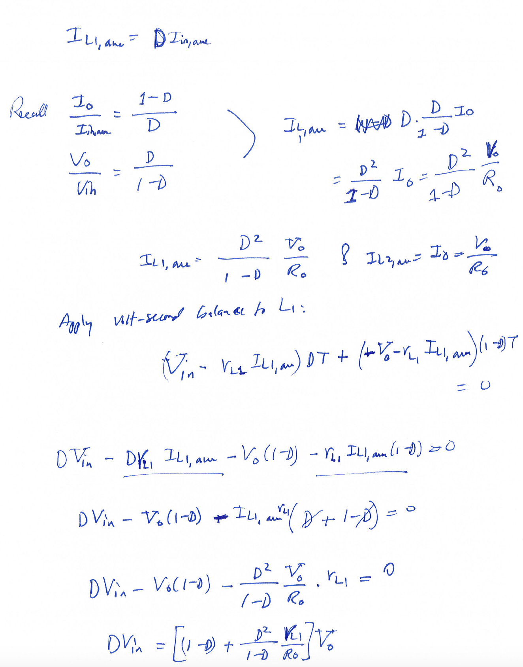

Slide 15
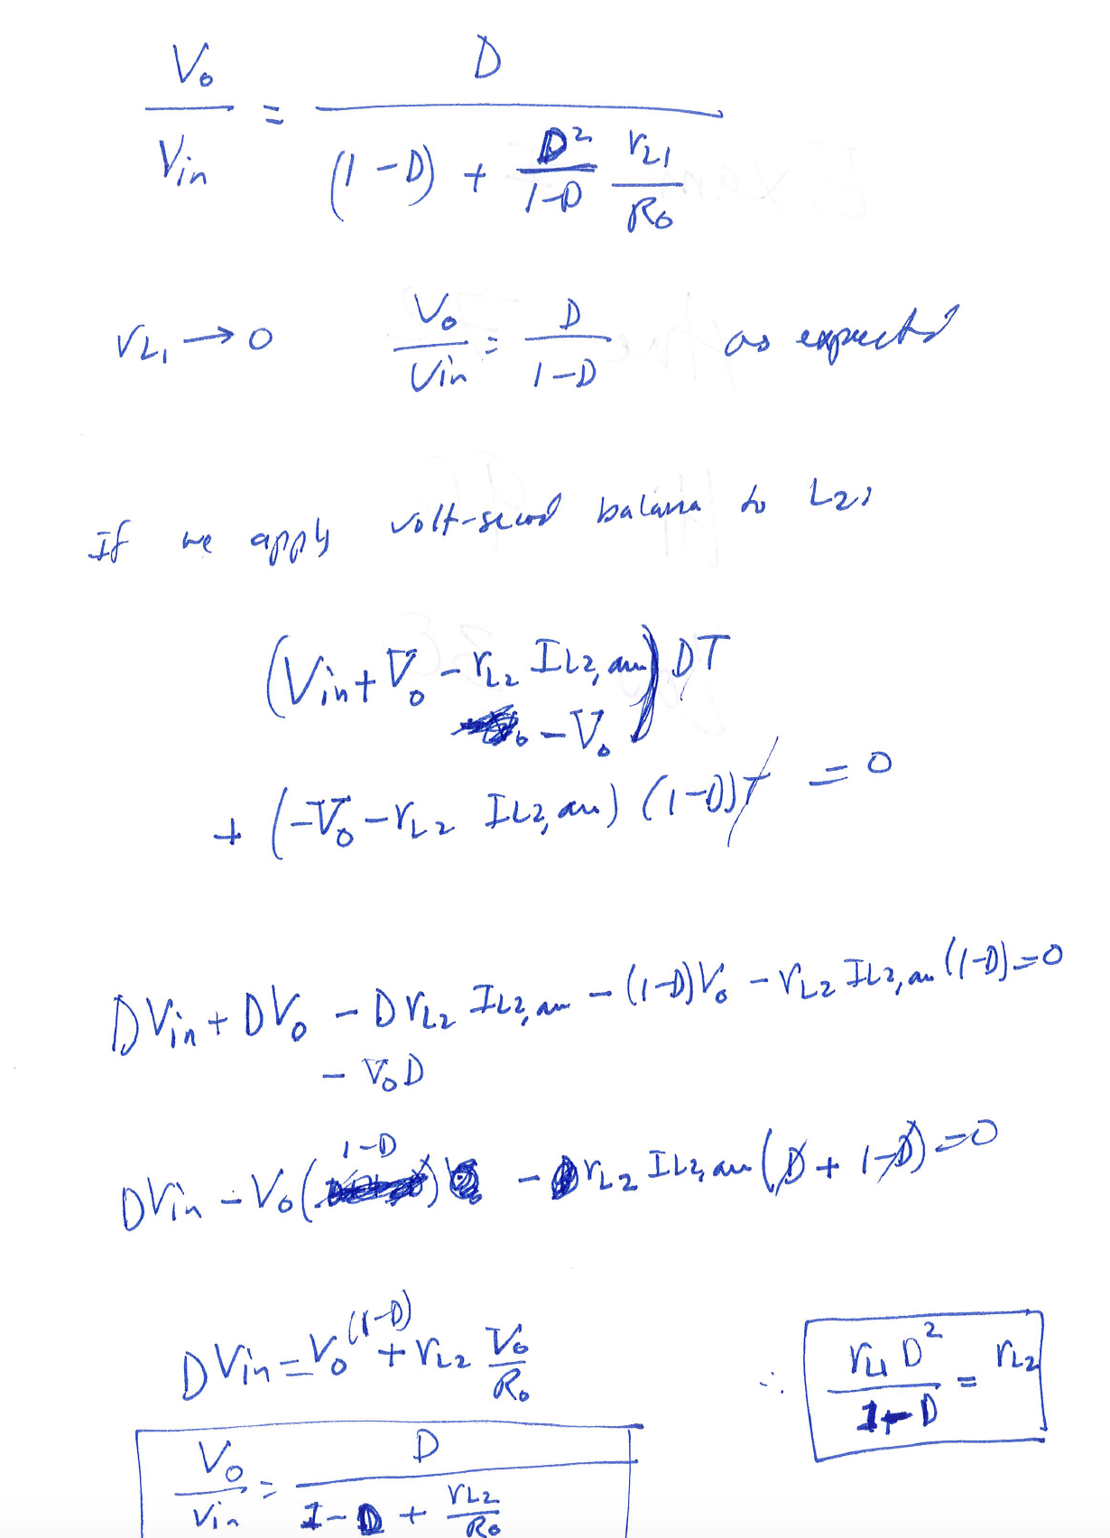

Slide 16
Current Driven conventional DC-DC Converters

Slide 17
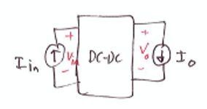
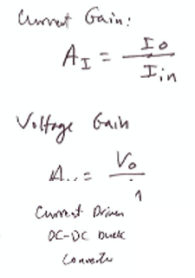
Example – Current driven DC-DC converters
Consider the following current driven converter:

Slide 21
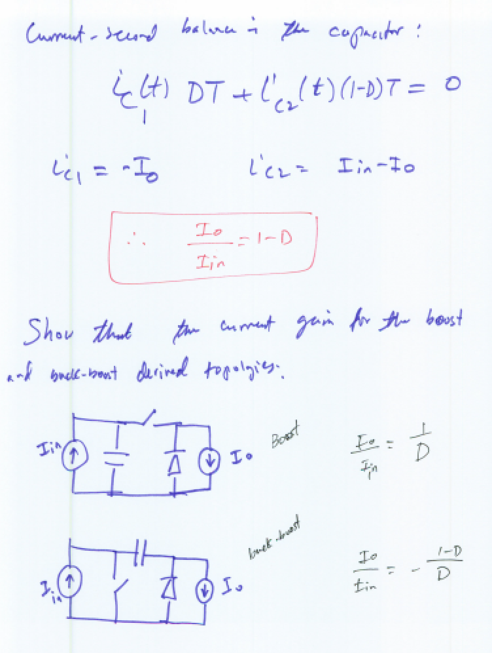

Slide 22
