Slide 1
EEL 5245 POWER ELECTRONICS I
Lecture #21
Examples of Ripple in 4th order DC-DC Converters

Slide 2
Objectives
• Voltage Ripple in Cuk and Zeta Converters
• Examples of Analysis and Design PSPICE Simulation Verification

Slide 3
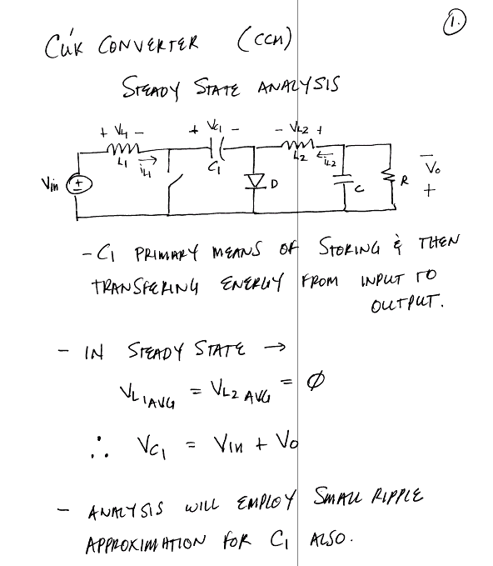
EEL 5245

Slide 4
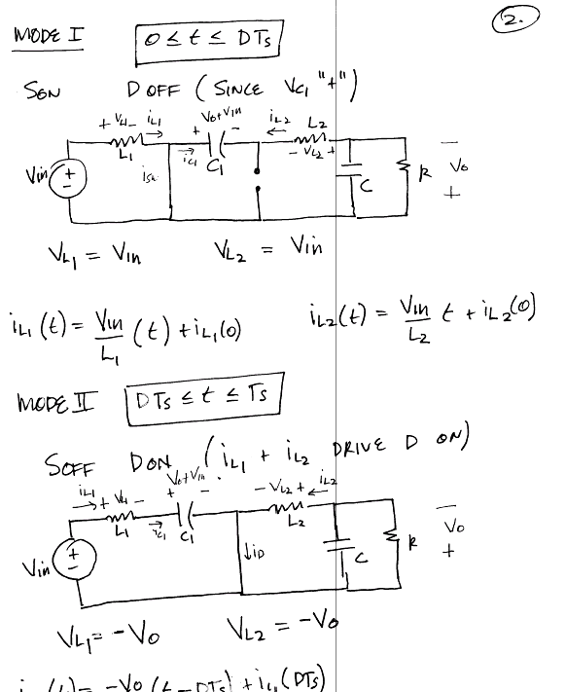
EEL 5245

Slide 5
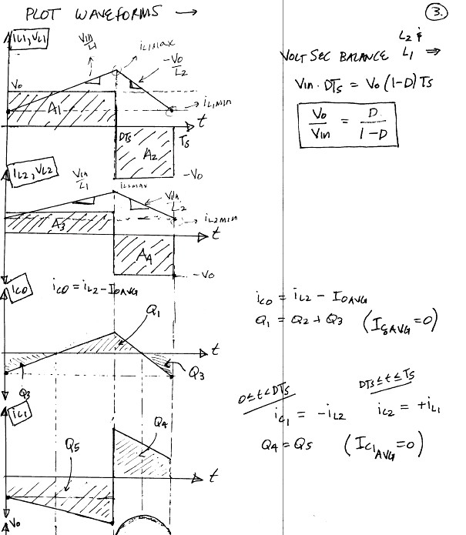
EEL 5245

Slide 6
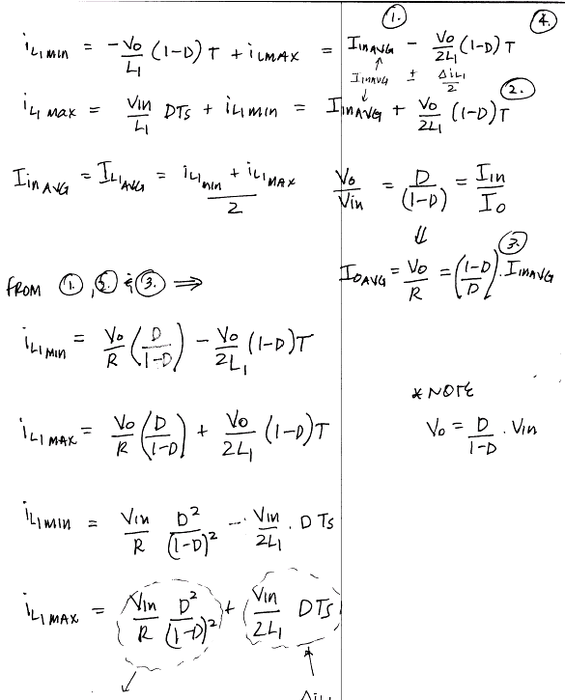
EEL 5245

Slide 7
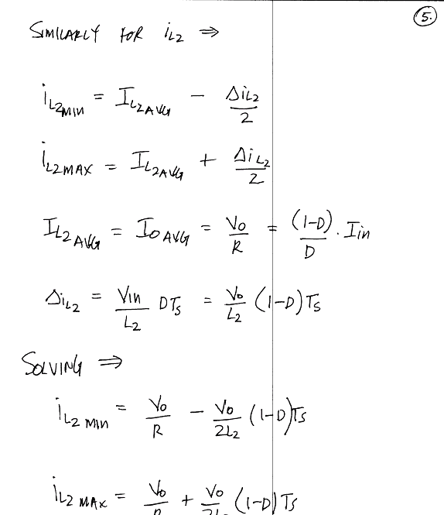
EEL 5245

Slide 8
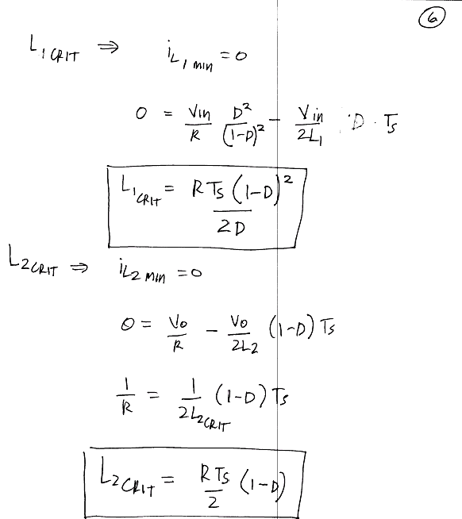
EEL 5245

Slide 9
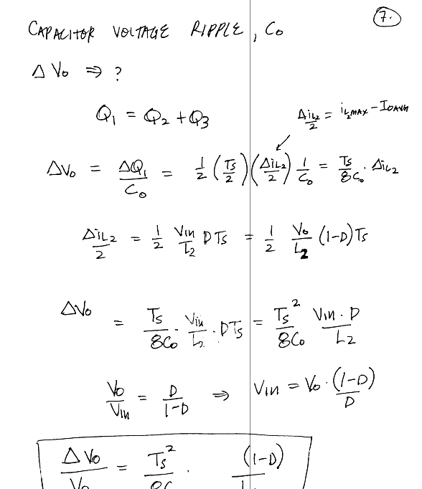
EEL 5245

Slide 10
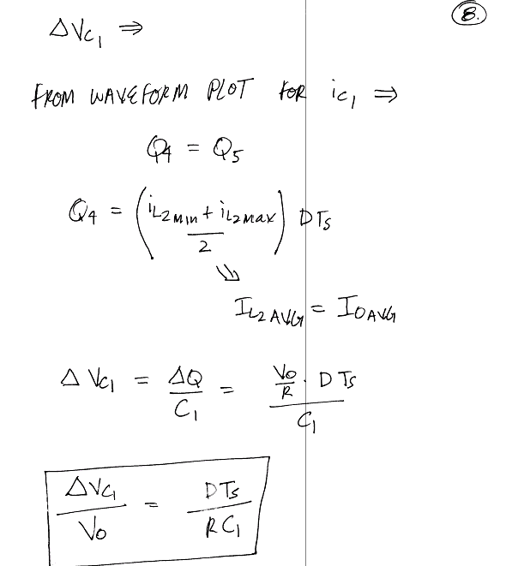
EEL 5245

Slide 11
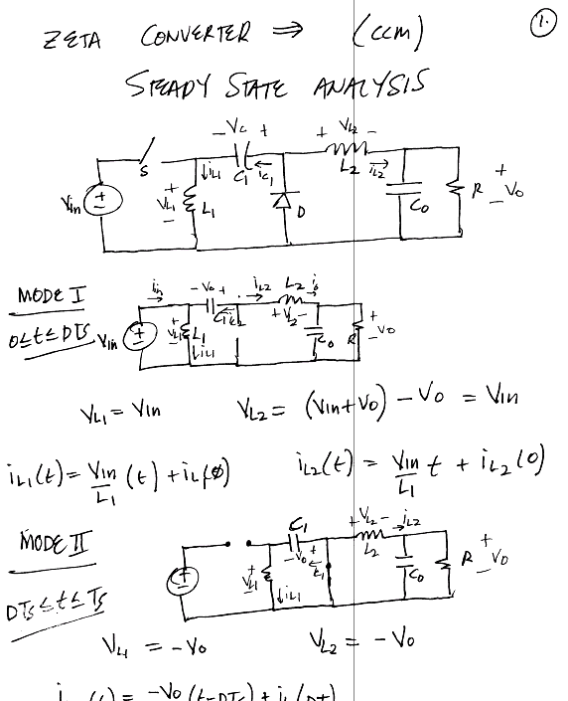
EEL 5245

Slide 12
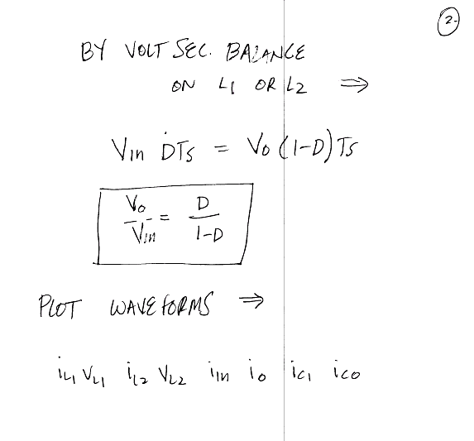
EEL 5245

Slide 13
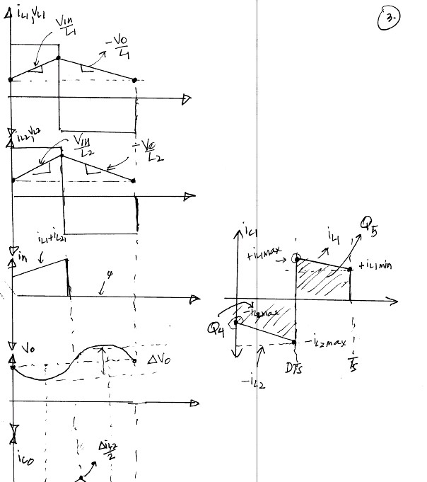
EEL 5245

Slide 14
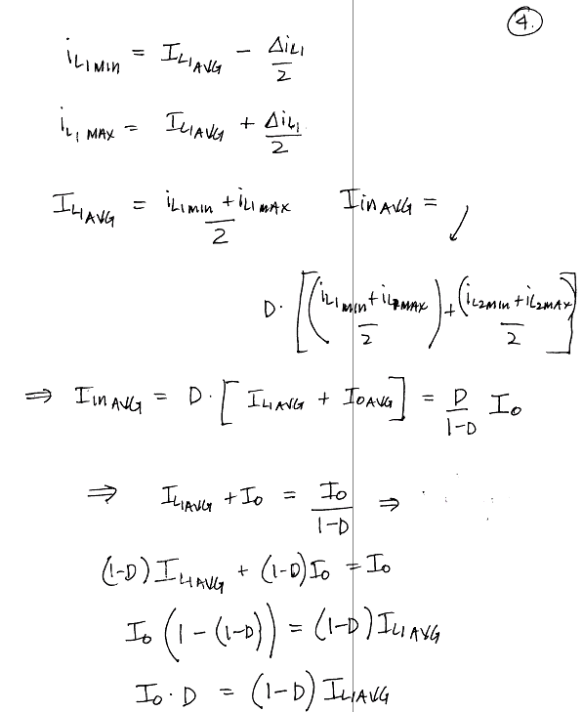
EEL 5245

Slide 15
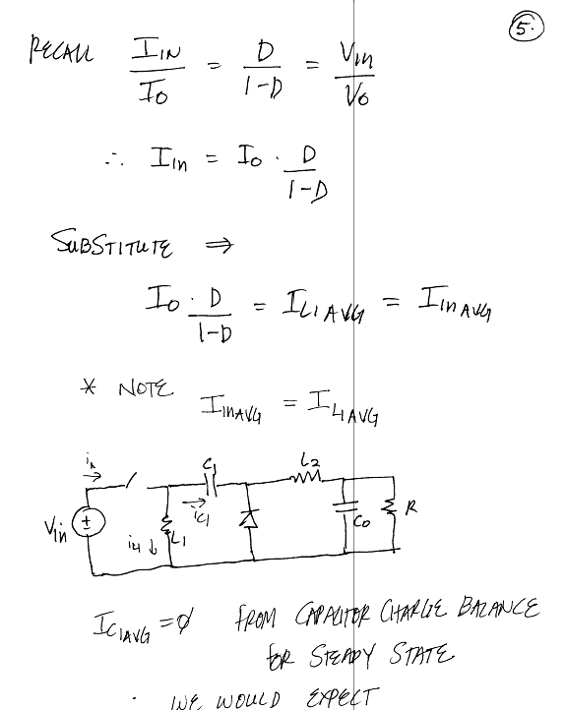
EEL 5245

Slide 16
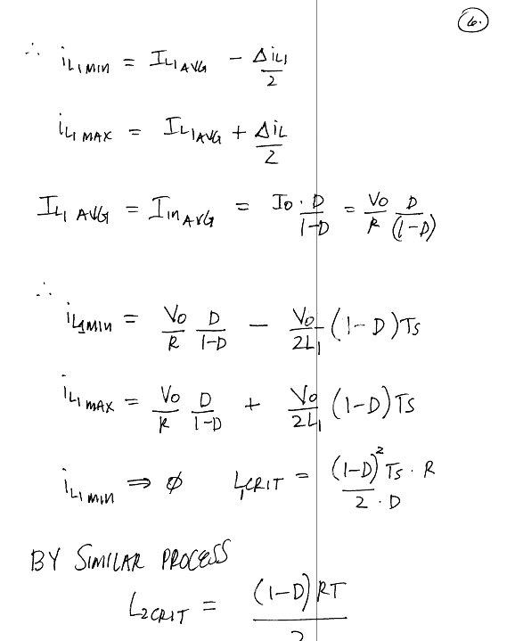
EEL 5245

Slide 17
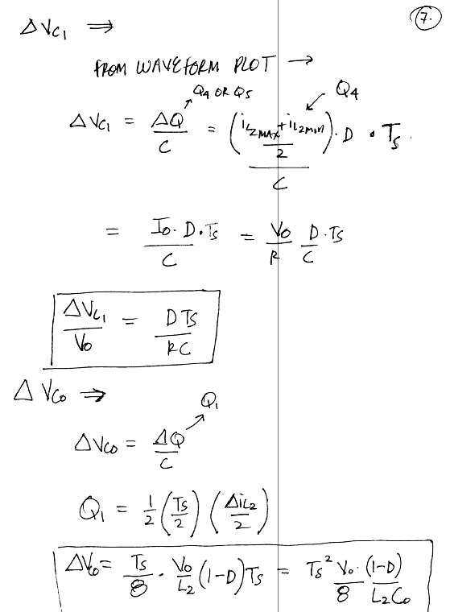
EEL 5245

