Slide 1

EEL 5245 POWER ELECTRONICS I
Lecture #2
Introduction to Power Electronics

Slide 2
Introduction to Power Electronics I
Agenda
Definition of Power Electronics
Industry Overview and Market Share Analysis
Multidisciplinary Nature of the Field
Block Diagrams of Power Electronic Systems
The Need for Power Electronics
Types of Power Conversion
Need for Control
Figures of Merit for Power Electronic Converters
Future Trends

Slide 3


Slide 4
What is Power Electronics?
Electronics: Solid State Electronics Devices and their Driving Circuits.
Power: Static and Dynamic Requirements for Generation, Conversion and Transmission of Power.
Control: The Steady State and Dynamic Stability of the Closed Loop system.
POWER ELECTRONICS may be defined as:
The application of Solid State Electronics for the Control and conversion of Power.

Slide 5
Multidisciplinary Nature of Power Electronics
Power electronics comprised of several disciplines:
  Semiconductor Devices
  Analog Circuits
  Control Design
  Magnetics
  Electric Machines
  Power Systems Engineering
  Circuit Simulation
  Communications and networking
  Storage

Slide 6
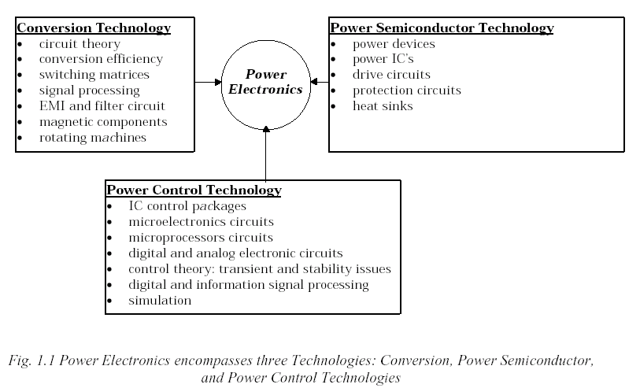
Power Electronics
In terms of topical areas

Slide 7
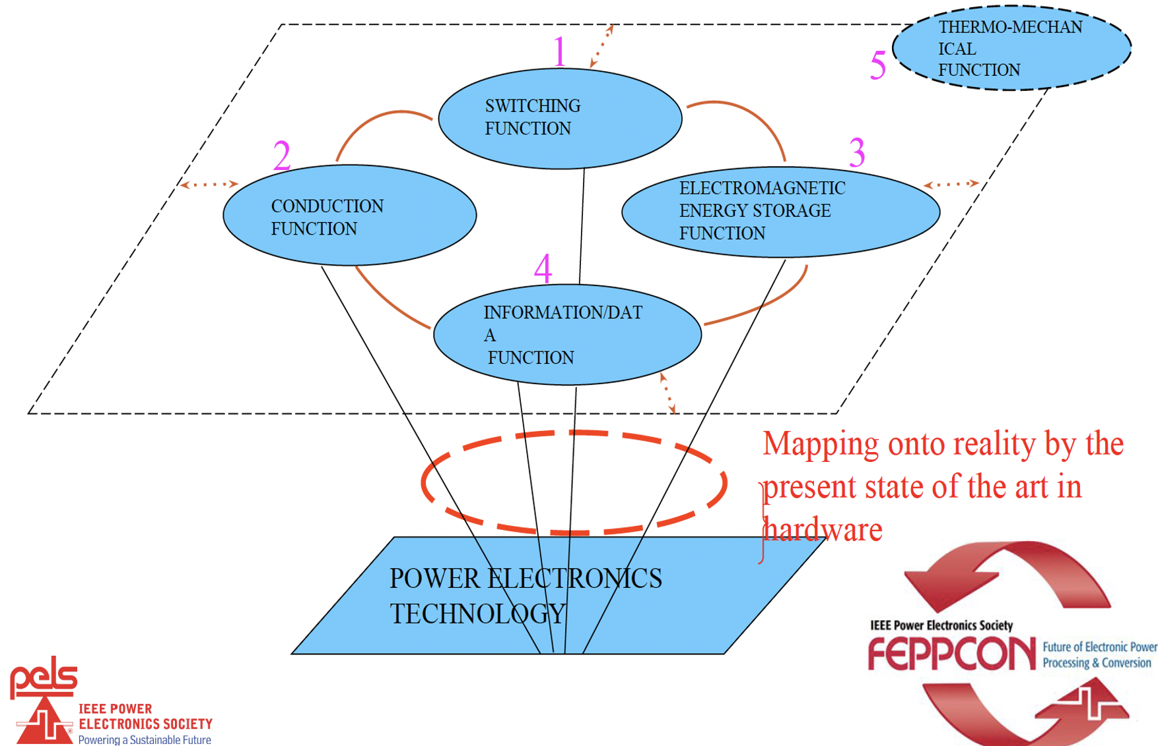
Power Electronics
In terms of Fundamental Functions

Slide 8
Power Electronics as an Enabler
Technology

Slide 9
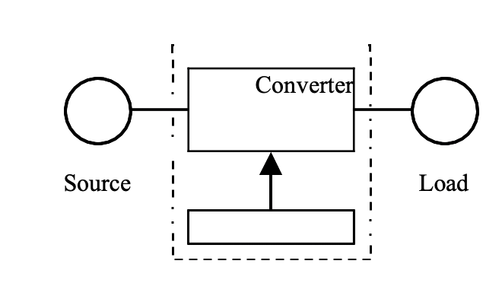
Power Electronics is the Interface Technology – Physical and Virtual
Controller

Slide 10
Power Electronics as an Enabler
Technology
Power electronics is considered as one of the most vibrant technology sectors due to ever increasing applications in renewable energy, computing, sensing and communication, IoT and because of its overlap with many other industry verticals.
From interfacing a mobile phone battery, hybrid cars wheels, power plant power generation and distribution to a nuclear reactor.
Require efficient power handling, from mW to GW!
To facilitate the transfer and conditioning of power from the source to the load.
To be achieved with less cost, high energy-efficiency, high power density, high reliability and neatly.

Slide 11
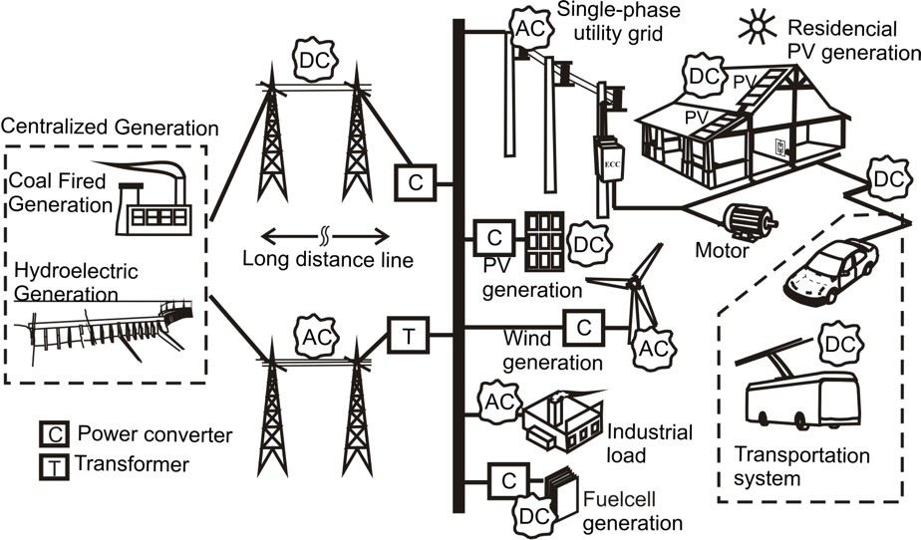
Power Electronics as an Enabler Technology
Power electronic systems are everywhere
Projected that by 2030, 80% of electricity could flow through power electronics at generation, storage, transmission, distribution, and end use
Figure Source: Power Electronics for Renewable and Distributed Energy Systems, Eds. S. Chakraborty, M.G. Simoes, W. Kramer; Springer 2013 (Chapter 2 – Fundamentals of Power Electronics)

Slide 12
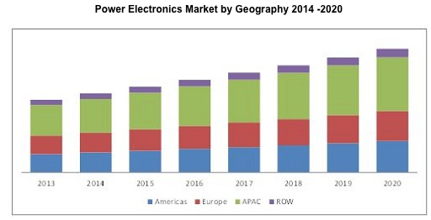
Power Electronics – Market
Expected to grow from $35 billion in 2013 to $50 billion in 2026.
Estimated growth of 7.74% from 2014 to 2020.
Source: MarketstandMarkets Analysis

Slide 13
Power Electronics Applications

Slide 14
Applications Areas
Renewables: Solar Energy & Wind Conversion (PV)
Switch Mode Power Supplies (SMPS)
  PFC
  Universal Input
  Soft-Switching
LED Drivers
Uninterruptible Power Supplies
Grid Forming and Resiliency
Process Control
  DC and AC outputs
  Motor Drives

Slide 15
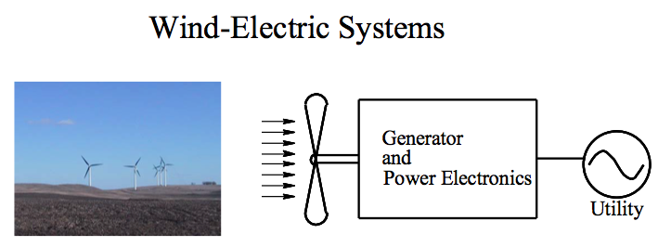
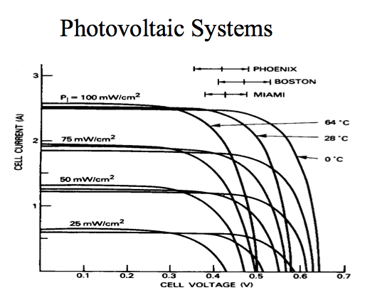
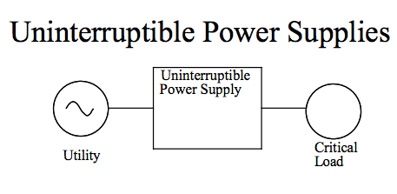
Applications – Renewable Energy

Slide 16
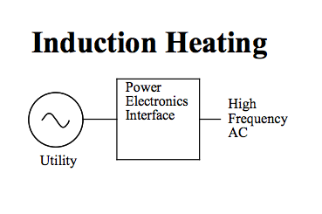
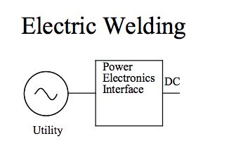
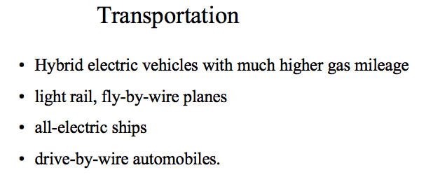
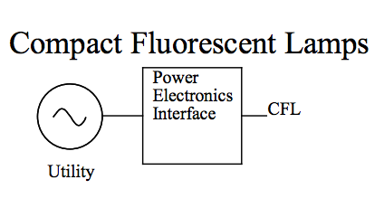
Applications – Industrial

Slide 17
Applications – Communications
Sensing/IoT/cloud/data centers/AI
24 V (dc)
5 V (dc)
Utility
3.3 V (dc)
0.5 V (dc)

Slide 18
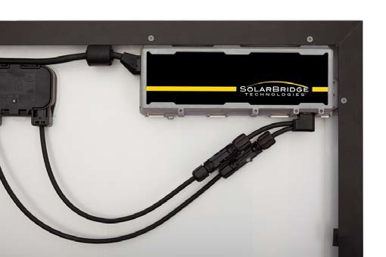
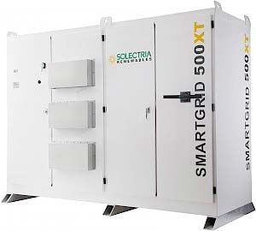
Power Electronics in Solar Energy
Microinverters Module inverters
(DC optimizers - Not
an inverter but part of the system)
Residential inverters string inverters
Central inverters
Figure Source: http://solarbridgetech.com/products/our-solution/pantheon2/ Accessed March 10, 2015
Microinverter mounted on PV module
More on power electronics for Solar Energy can be found at: proceedings from the DOE-NREL-NETL-ORNL workshop titled “Enabling High Penetration PV Solar through Next Generation Power Electronic Technologies,” October 11-12, 2016. https://energy.gov/eere/sunshot/downloads/2016-systems- integration-power-electronics-workshop
Figure Sources: www.solectria.com Accessed March 10, 2015

Slide 19
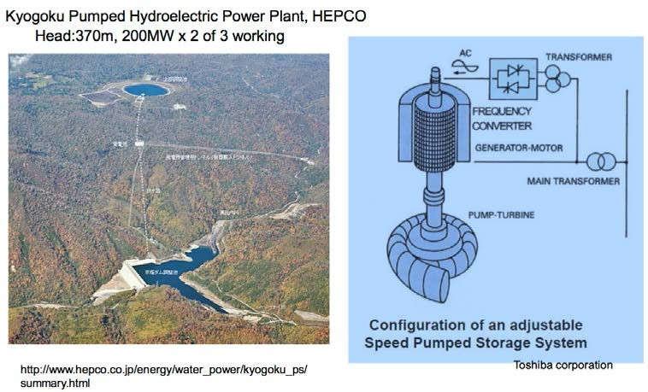
Power Electronics in Hydro Power
Globally, there are 270 pumped hydroelectric storage (PHS) stations either operating or under construction.
This represents a combined generating capacity of over 120,000 megawatts (MW).
Of these total installations, 36 units consist of variable- speed machines
A double-fed induction motor- generator is the current standard design for variable- speed machines.
Source: https://www.icef- forum.org/platform/speakers/topic1/CS2_5_Yoshiro_Owadan o_161007.pdf
5
Source: http://energystorage.org/energy- storage/technologies/variable-speed-pumped-hydroelectric-

Slide 20
Power Electronics – Adjustable Speed Drives
Electric Drive
Power Processing Unit (PPU)
Motor
Load
fixed
form
adjustable form
speed / position
Electric Source
(utility)
Sensors
Controller
measured
Power
speed/ position
Signal
input command (speed / position)
Block diagram of adjustable speed drives.

Slide 21
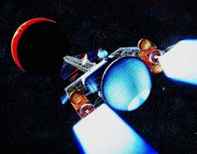
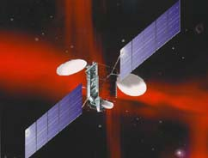



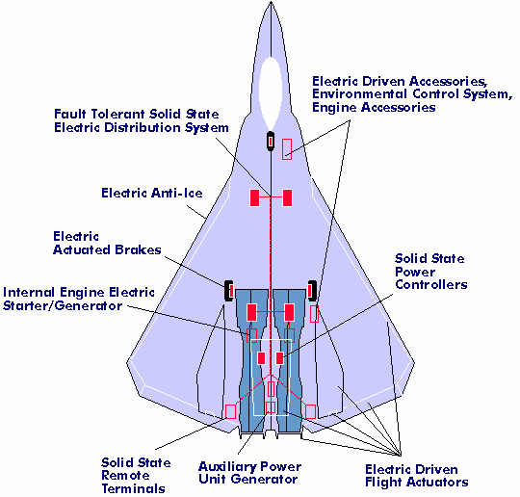
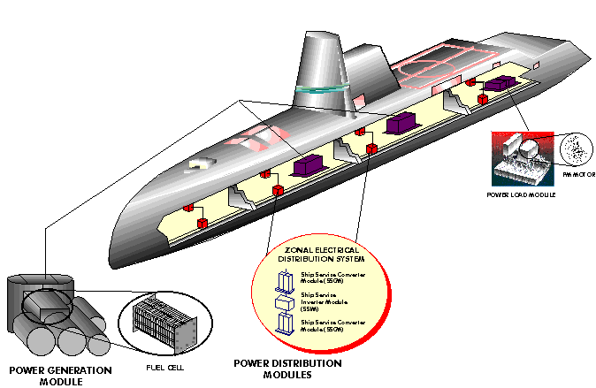
Power Electronics – Space & Defense
More Electric Aircraft
Electric Warship
Source: James Soeder, NASA and Terry Ericsen, ONR.

Slide 22
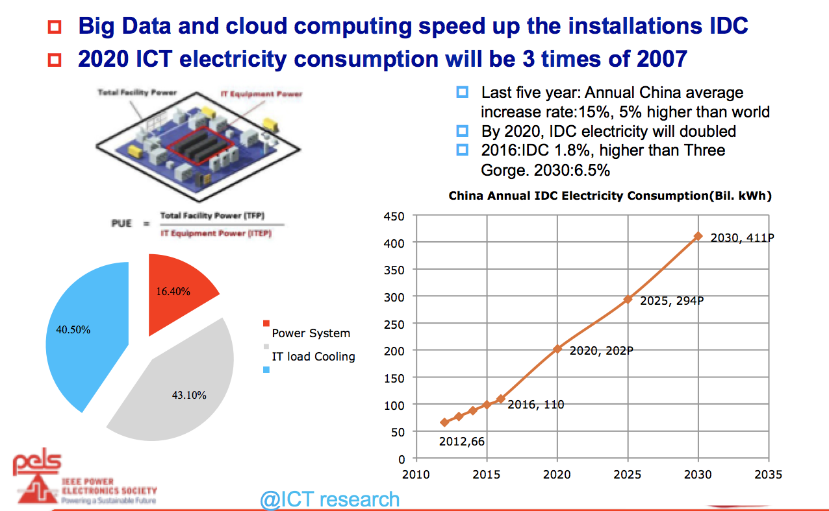
ICT Energy Needs….Big Data has arrived

Slide 23
Renewable Energy Systems: The Growth

Slide 24
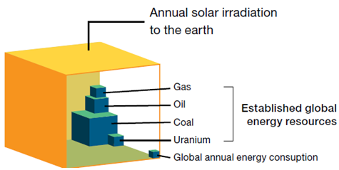
Solar is the Answer … Looking up !
Inexhaustible
Near Zero impact on environment
The technology is ready
Proven economic feasibility.
Highly flexible
No water
Foreseen improvements in grid integration
Easy to integrate with batteries
Earth’s Energy Resources
Notes:
http://www.dailymail.co.uk/news/article-2055520/Feed-tariffs-Entire-area-Nottingham-gets-solar-panels-fitted-roofs.html
http://www.treehugger.com/solar-technology/powering-20000-homes-the-worlds-largest-pv-solar-farm-opens.html
http://www.motherjones.com/blue-marble/2015/07/obama-just-made-it-easier-low-income-communities-go-solar

Slide 25
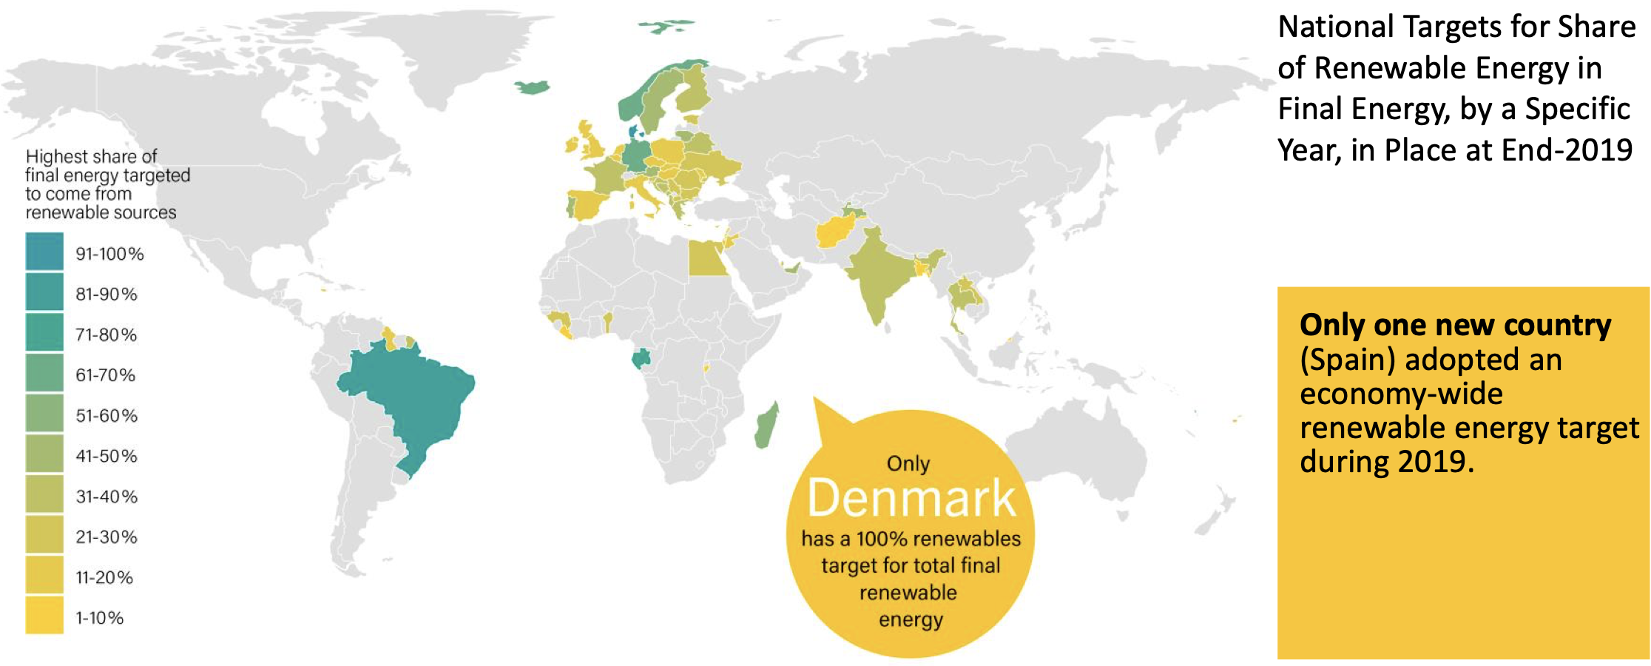
Global Energy Targets
https://www.ren21.net/wp-content/uploads/2019/05/gsr_2020_presentation.pdf

Slide 26
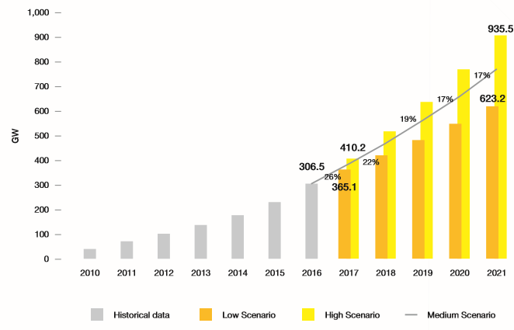
World Total Solar PV Market Scenario 2017-2021
+300GW milestone was reached in 2016
Exceed 400 GW in 2018
500 GW in 2019
600 GW in 2020
700 GW in 2021
（in medium scenario）
With the top 3 solar countries responsible for over 75% of global demand in 2016
（One major country’s policy
decision will affect ）
+ 97 GW
Steady Growth Rate Avg 15% in Solar over past 15 years !!!
+70 GW
+37 GW
Selected from Global Market Outlook for Solar Power/2017-2021

Slide 27
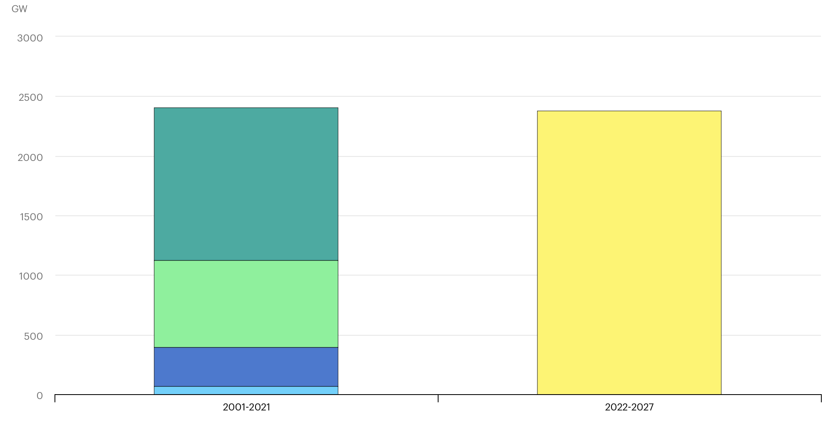
Global Renewable Electricity Capacity additions, 2001-2027
https://www.iea.org/reports/renewables-2022/executive-summary#

Slide 28
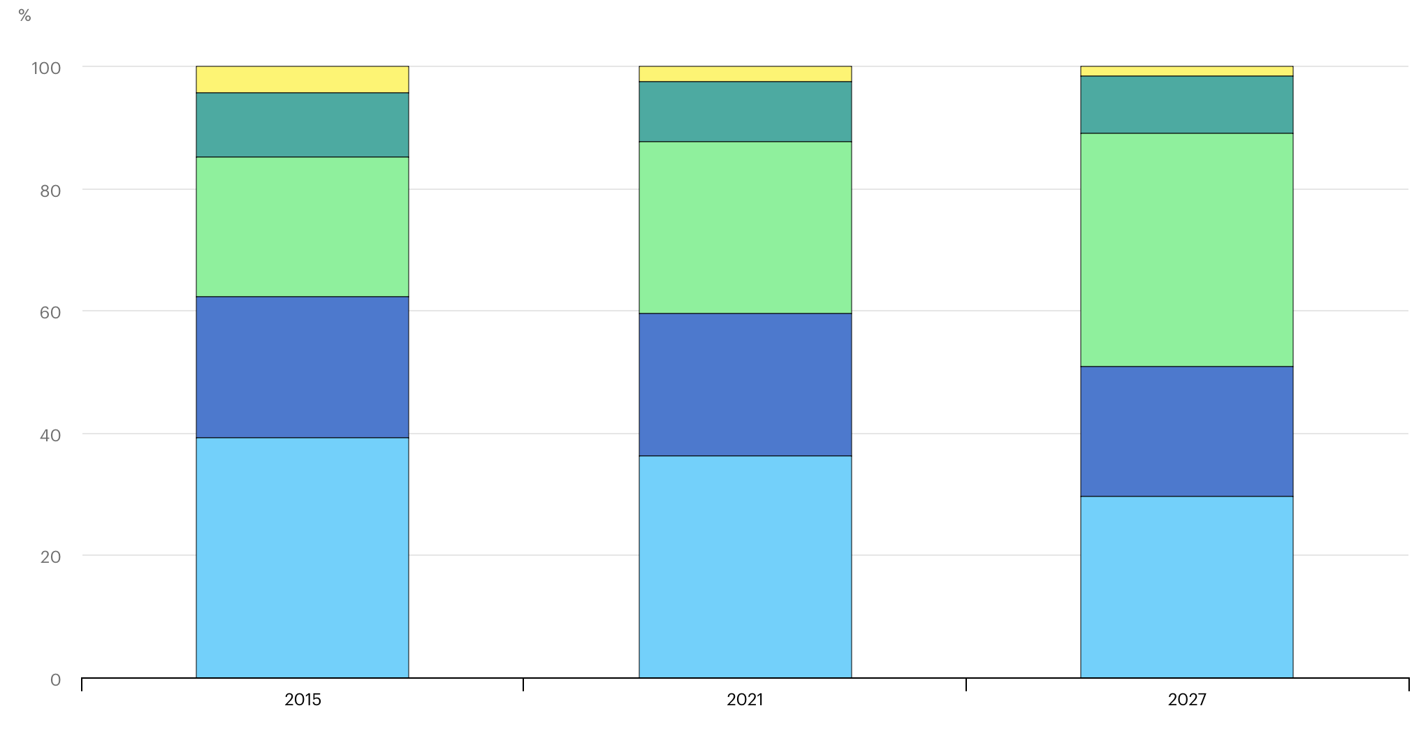
Global electricity generation by technology
2015, 2021 and 2027
https://www.iea.org/reports/renewables-2022/executive-summary#

Slide 29
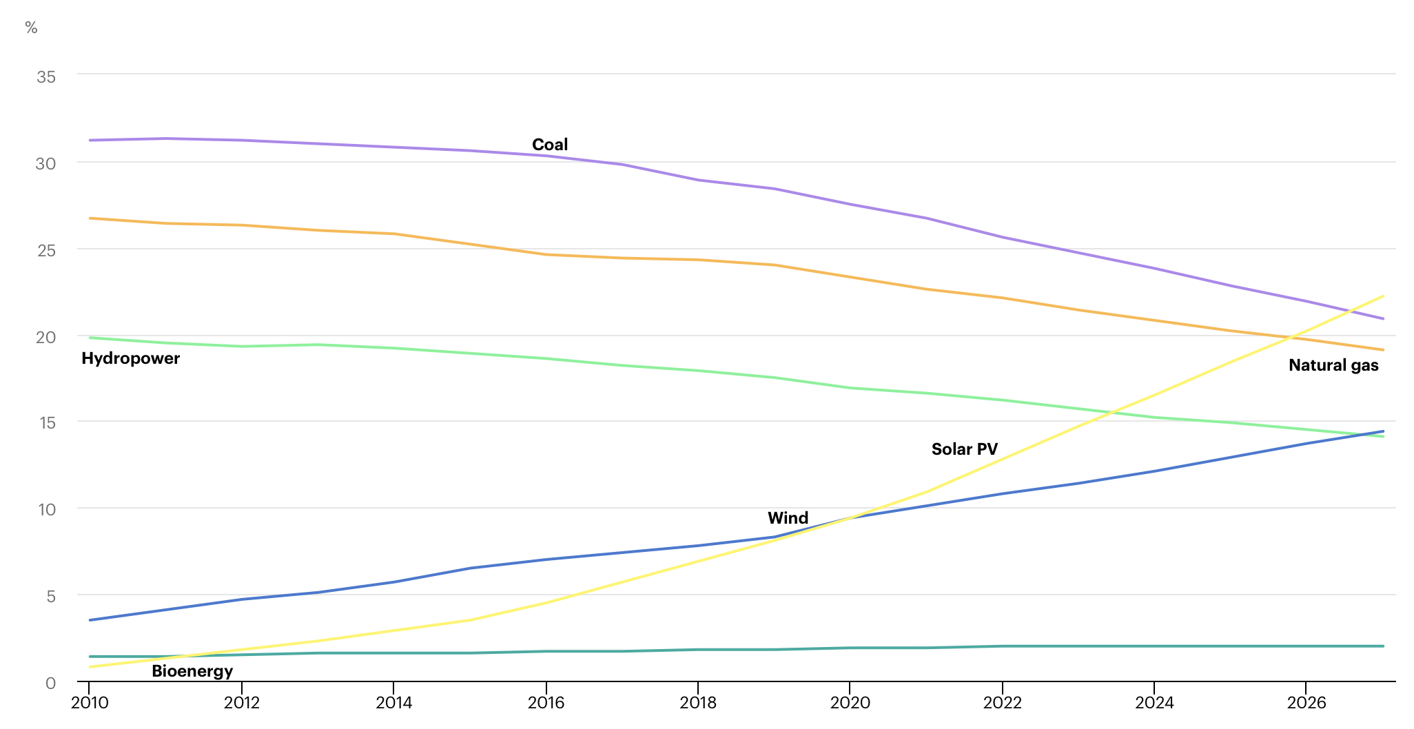
Share of cumulative power capacity by technology
2010-2027
https://www.iea.org/reports/renewables-2022/executive-summary#

Slide 30
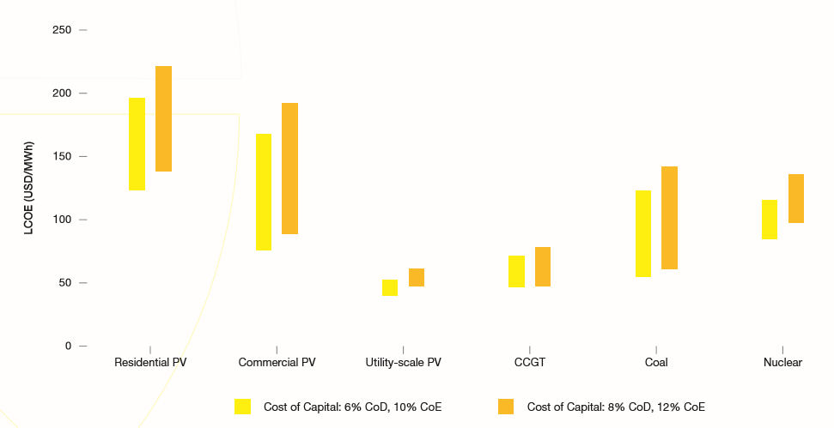
Solar Electricity Generation Cost in Comparison with Other
Power Sources
Utility-scale solar is today already cheaper than new CCGT, coal and nuclear power plants.
When companies borrow funds from outside lenders, the interest paid on these funds is called the cost of debt
The cost of equity is inferred by comparing the investment to other investments (comparable) with similar risk profiles
Selected from Global Market Outlook for Solar Power/2017-2021
Notes:
Cost of Equity (CoE)
Cost of Debt (CoD)

Slide 31
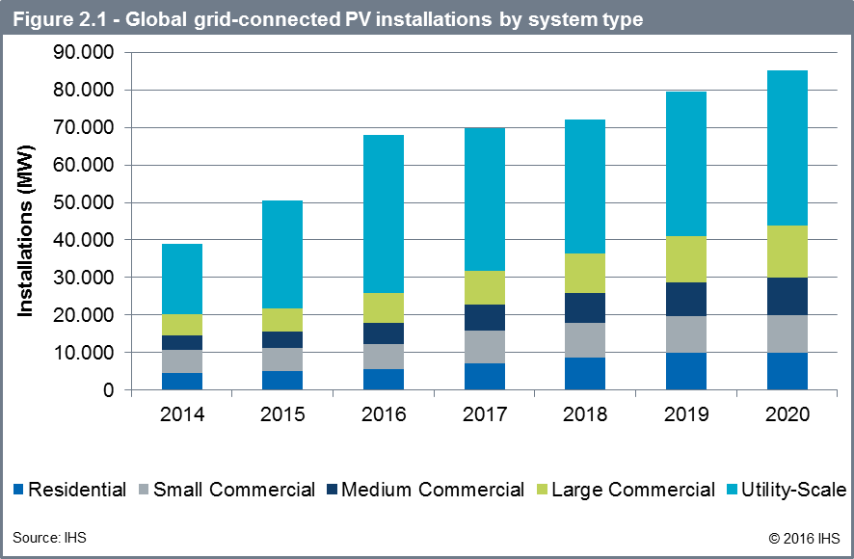
The world market for PV is mainly driven by utility Scale and Large Commercial Installations

Slide 32
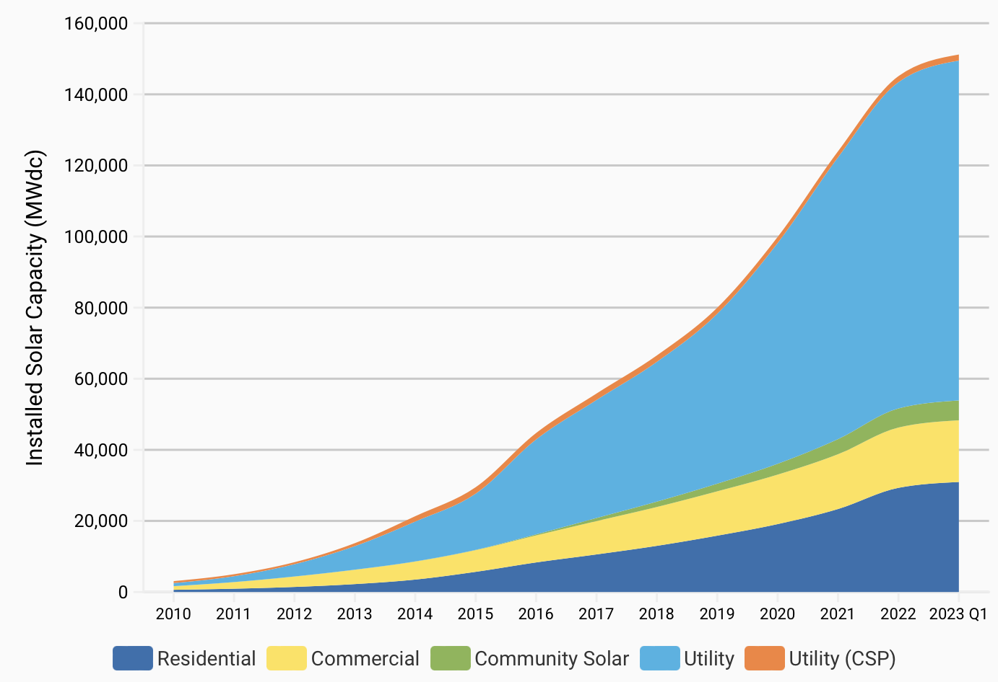
Cumulative U.S. Solar Installations
https://www.seia.org/solar-industry-research-data

Slide 33


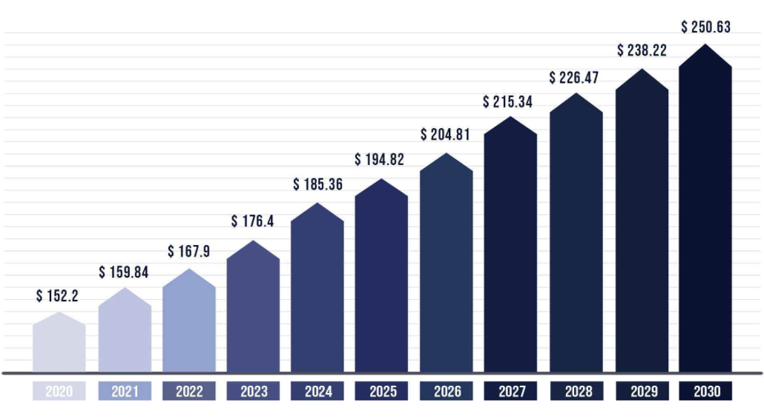
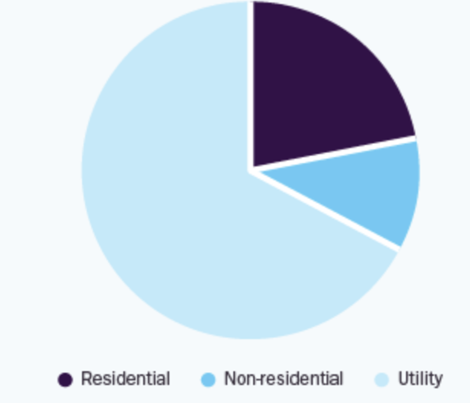
Solar PV Market Market 2020-2-3- $ Billion
https://www.precedenceresearch.com/solar-photovoltaic-market

Slide 34
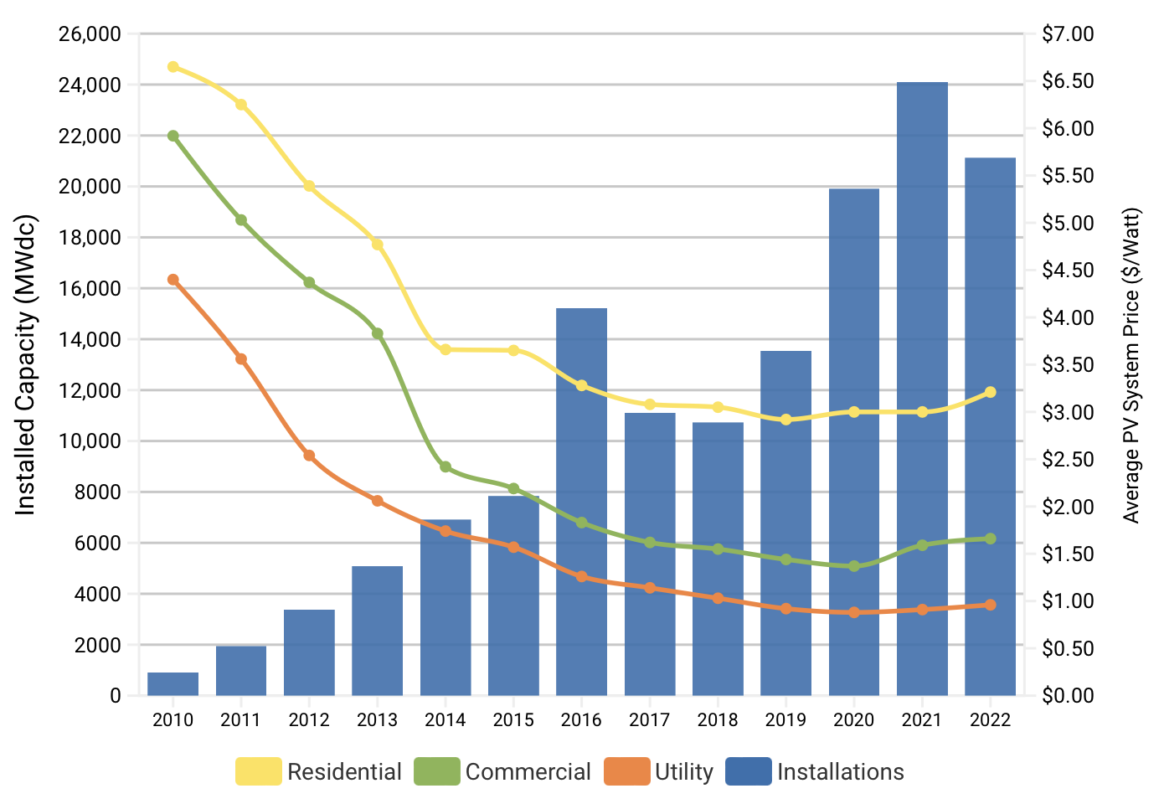
U.S. Solar PV Pricing Trends & Deployment Growth
https://www.seia.org/solar-industry-research-data

Slide 35
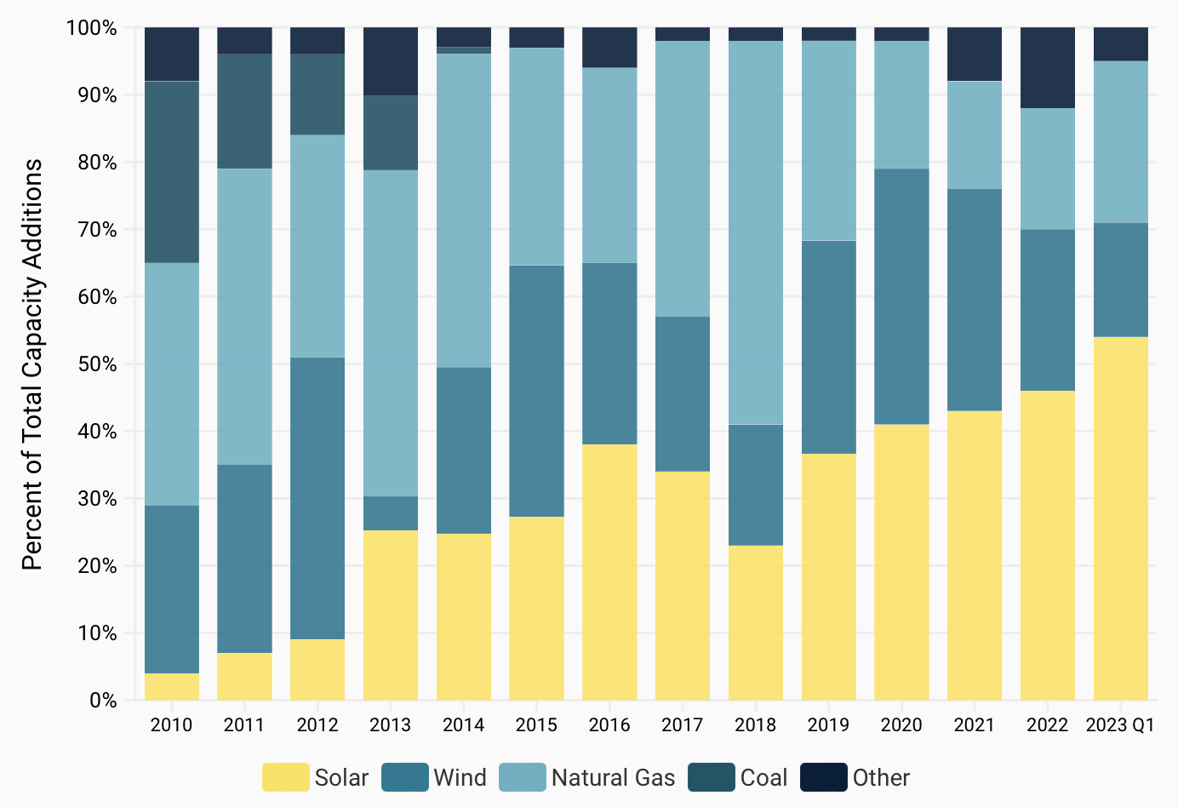
U.S. Annual Additions of New Electric Generating Capacity
https://www.seia.org/solar-industry-research-data

Slide 36
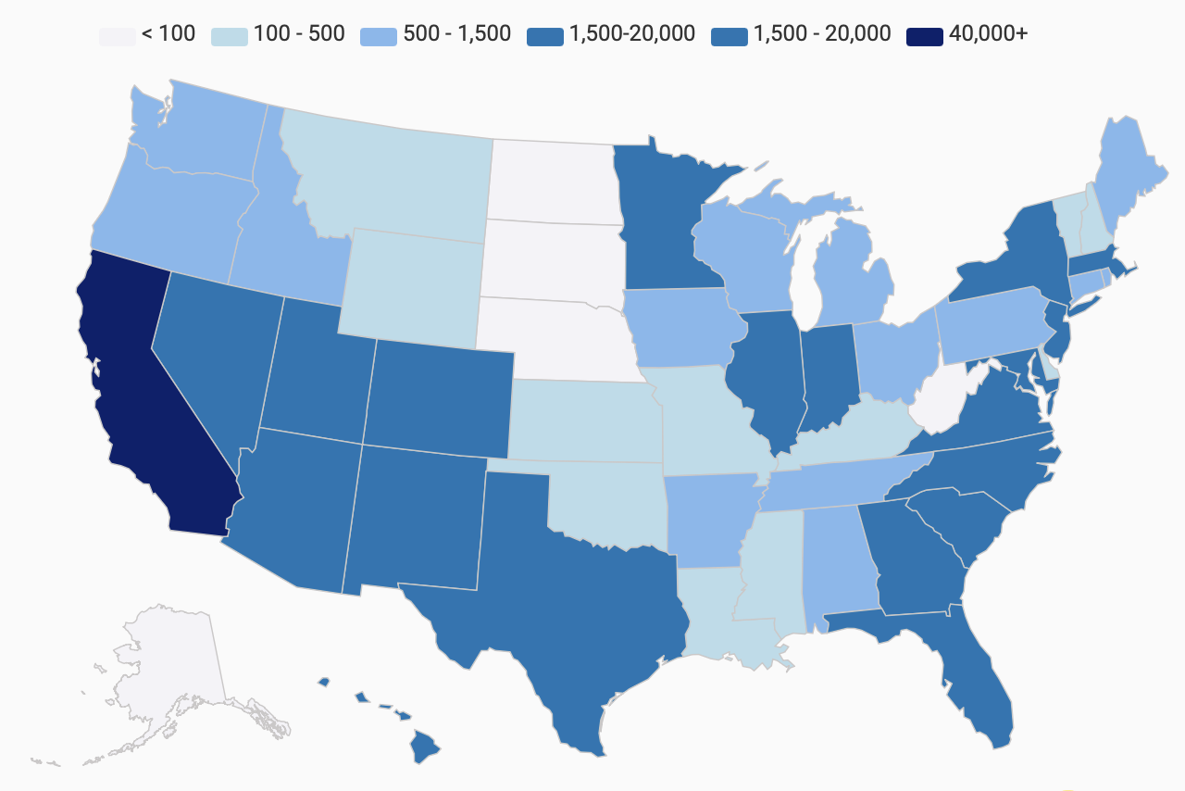
Cumulative U.S. Solar Installations by State
https://www.seia.org/solar-industry-research-data

Slide 37
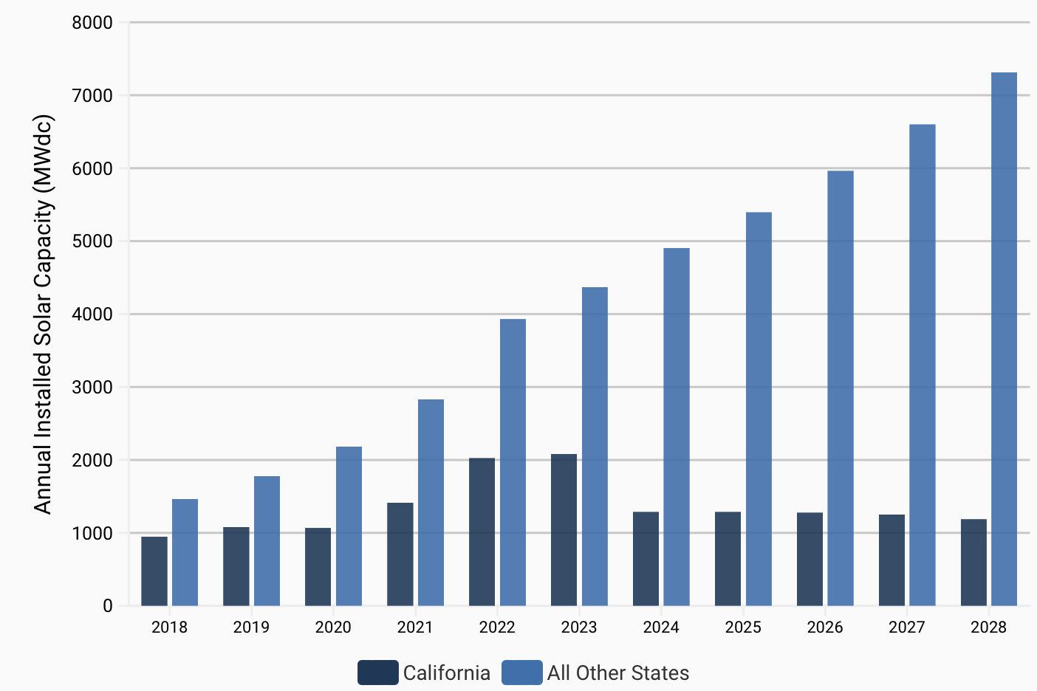
US Annual Residential Solar PV Installations
https://www.seia.org/solar-industry-research-data

Slide 38
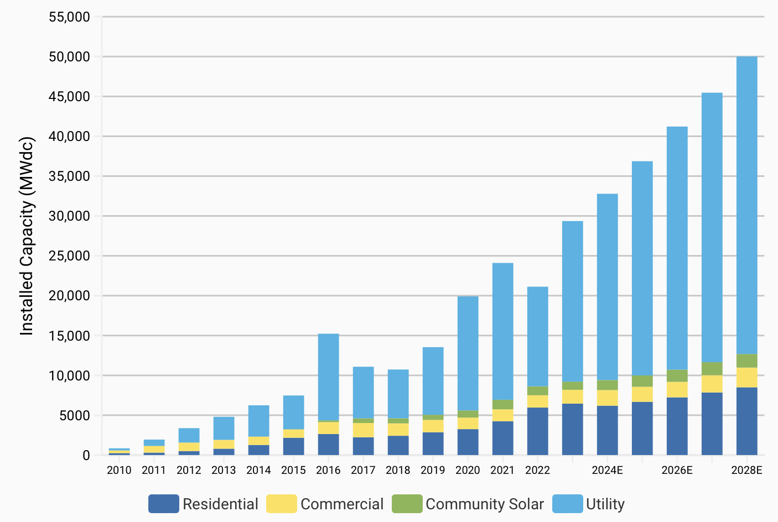
U.S. Solar PV Deployment Forecast
https://www.seia.org/solar-industry-research-data

Slide 39
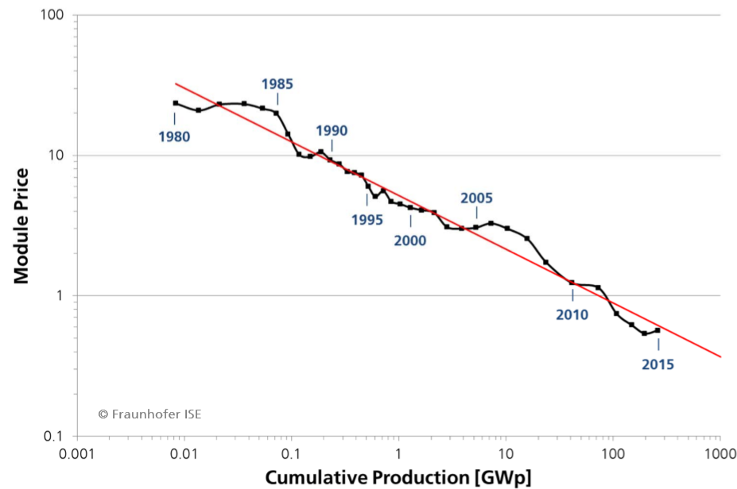
Prices trends for Solar PV module
The cumulative production
Doubled, the price went down by 23% for last 35 years
Ref: PHOTOVOLTAICS REPORT Frauhofer Institute for Solar Energy

Slide 40
Solar and energy storage are complementary and
both are dropping in cost

Slide 41
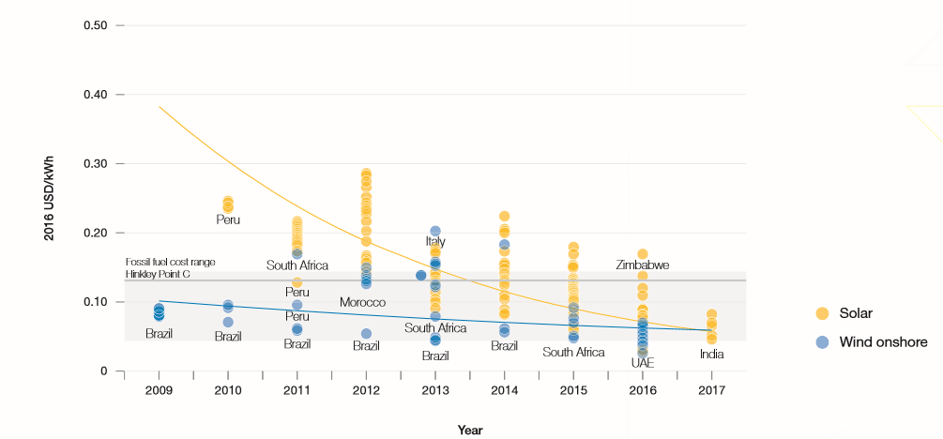

Prices for Solar PV and Wind Onshore Power Plants in
Different Countries
2.4US cents/kWh : the world’s
Lowest solar supply contract
signed in 2016, Sweihan project
In UAE
Selected from Global Market Outlook for Solar Power/2017-2021

Slide 42
Three-Phase Low-power Dominates
All PV Modules
With 3 to 5 Bypass Diodes
Optimizer
µInverter
PV Module Level Power Electronics

Slide 43
Strong price decline continues, low and high power approach similar price line

Slide 44
Where the PV market heading?
The Past (2010)
The Present (2020)
The Future (2030)
Deployment
Integration
PV Module Prices
$2-$3/W $0.37/W $0.23/W
Global PV Generation
10+ TWh 300+ TWh 2000+ TWh
Global PV Installations
10+ GW 300+ GW 1000+ GW

Slide 45
Predicting the Future Energy Growth and grid Evolution

Slide 46
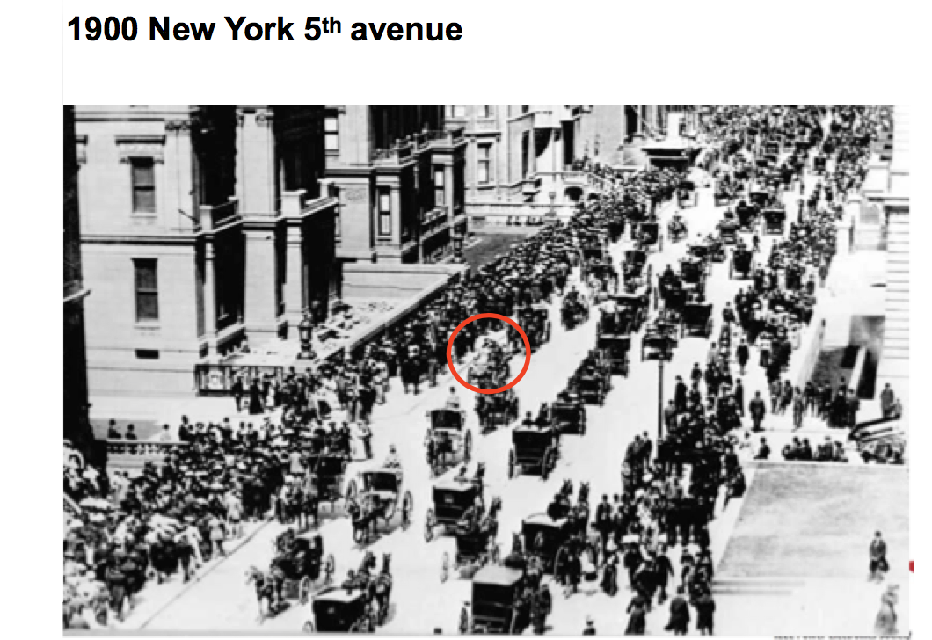

Slide 47
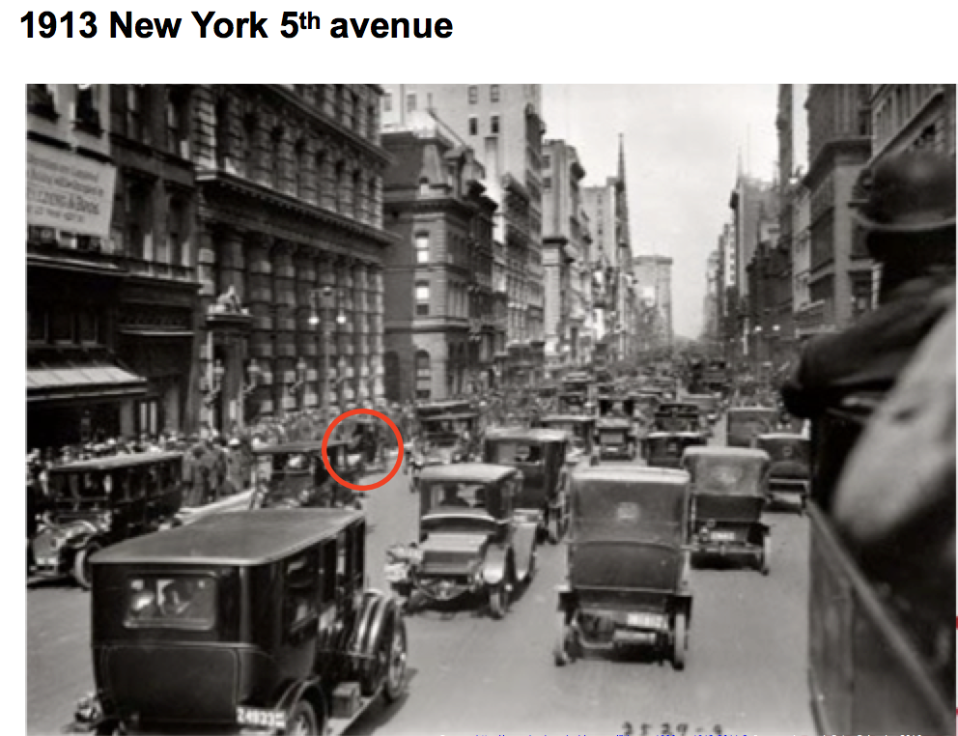

Slide 48
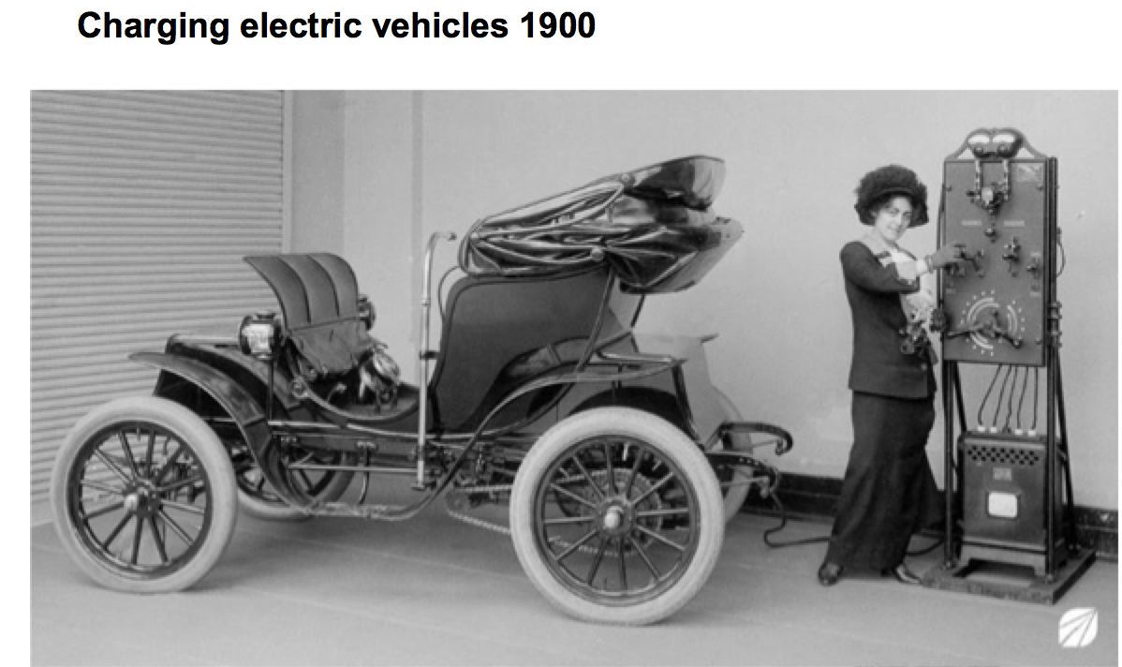
EV Charging

Slide 49
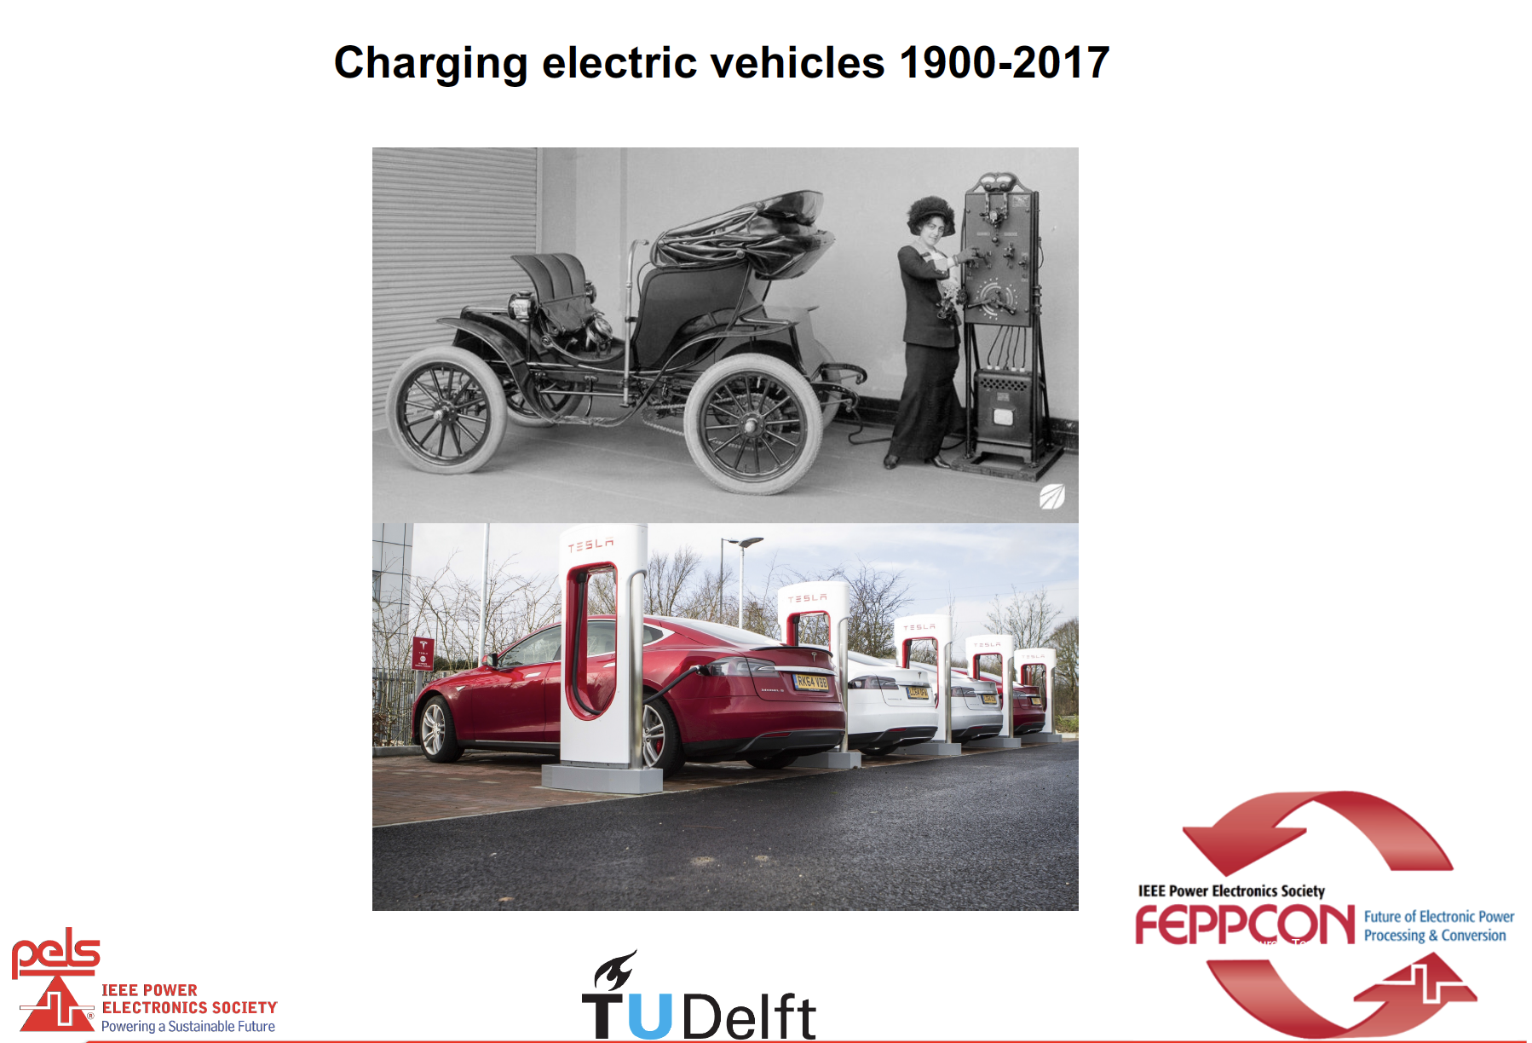

Slide 50
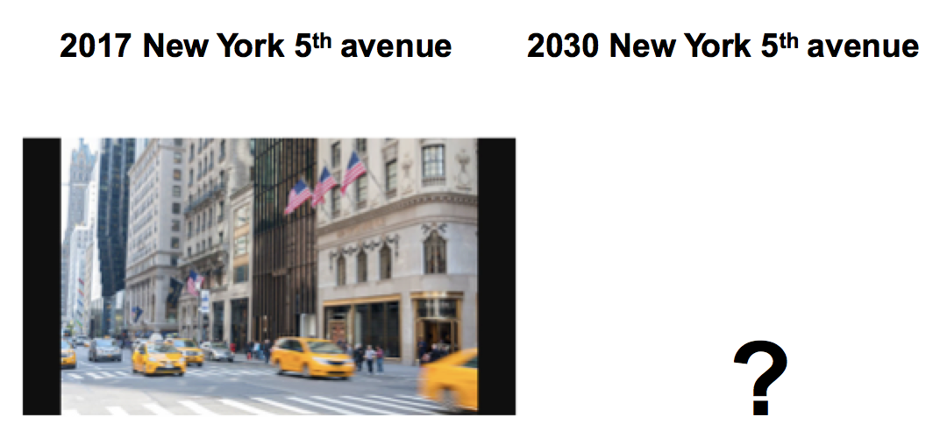

Slide 51
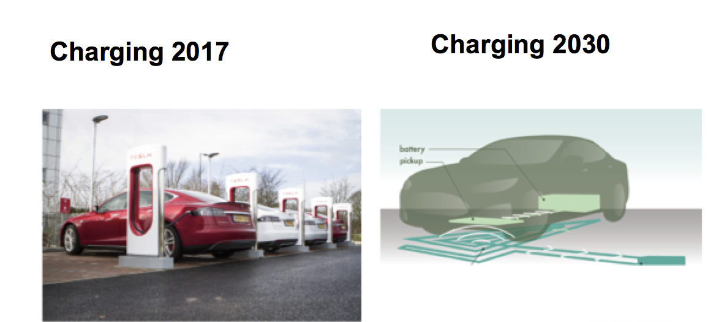

Slide 52
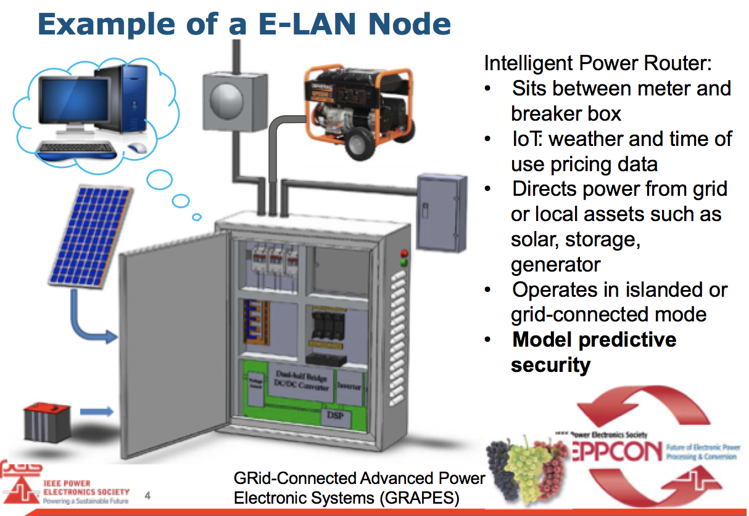
Future Grid System Nodes – Europe

Slide 53
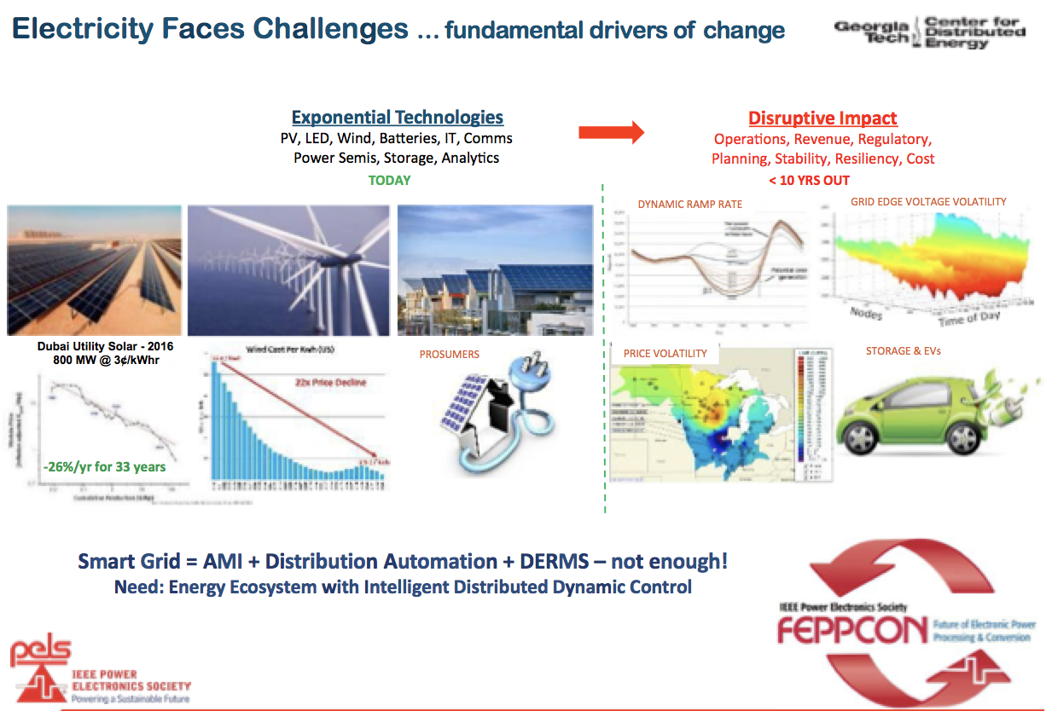

Slide 54
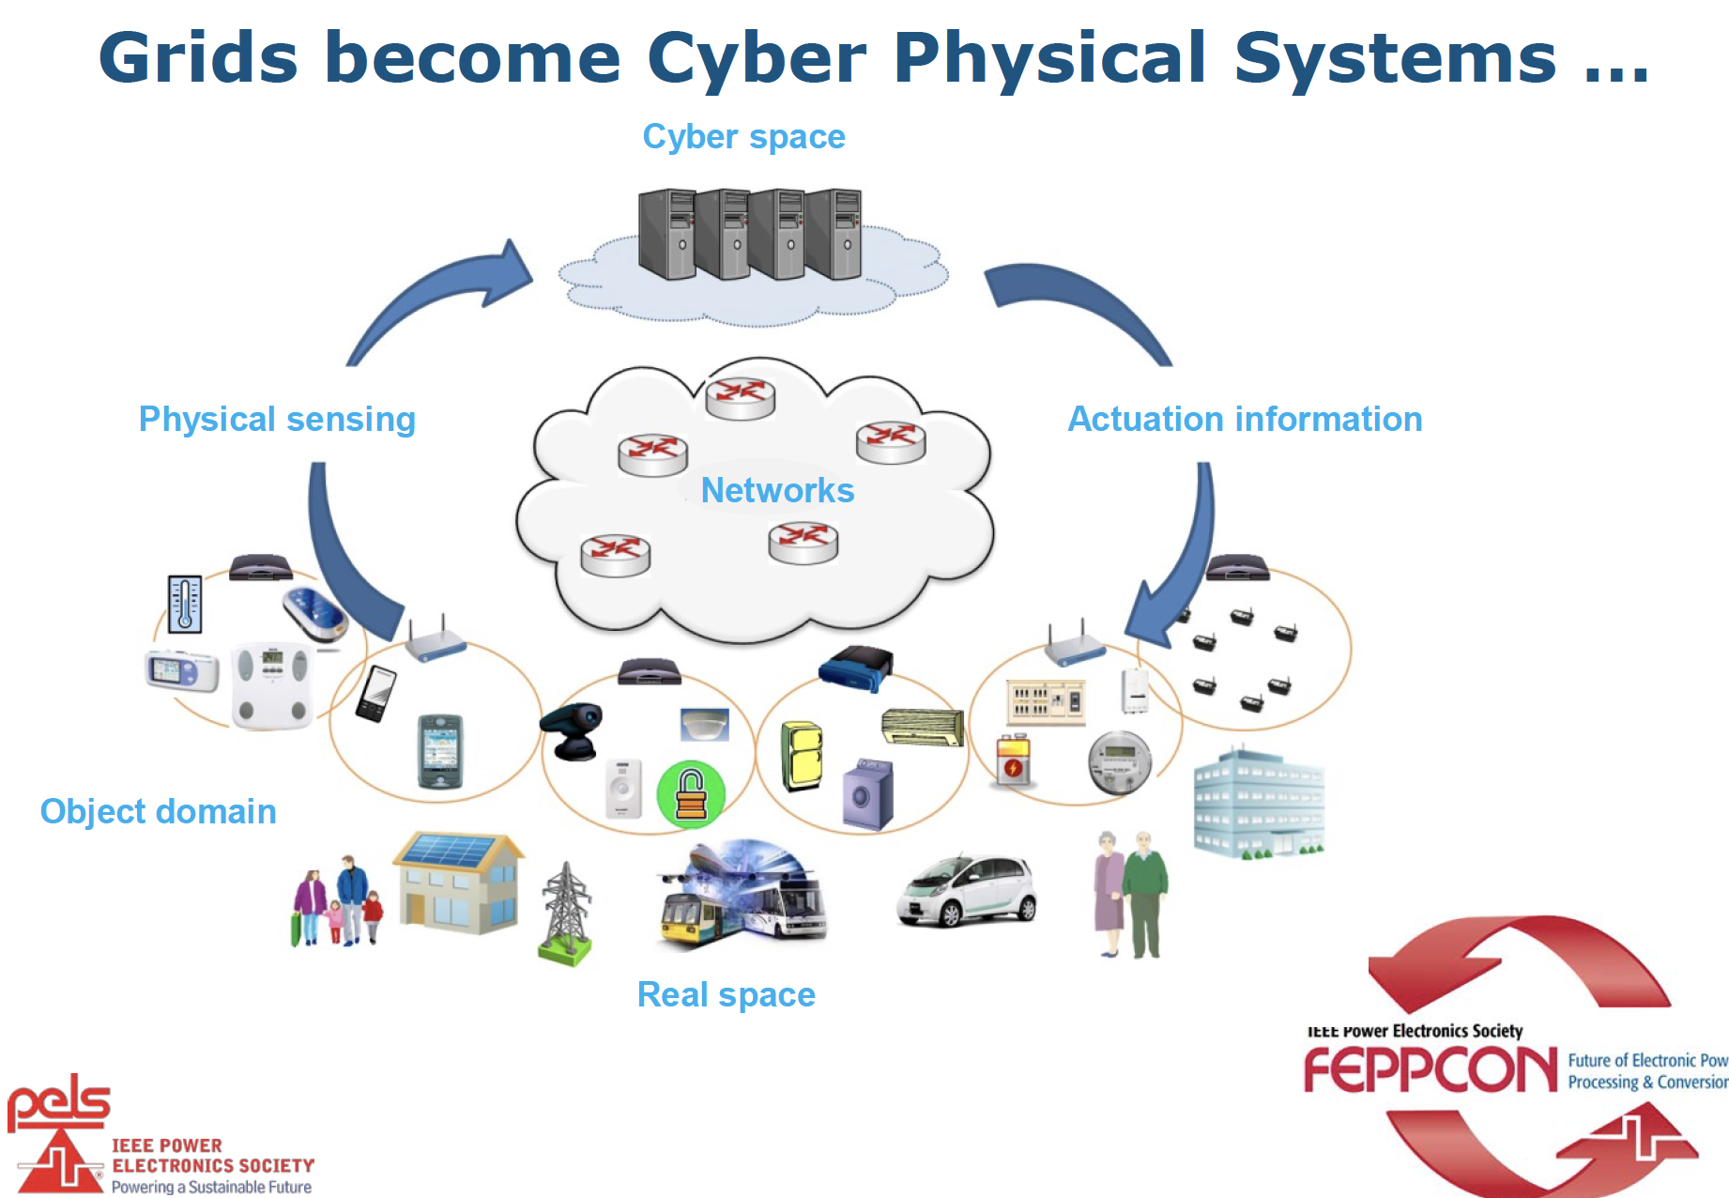

Slide 55
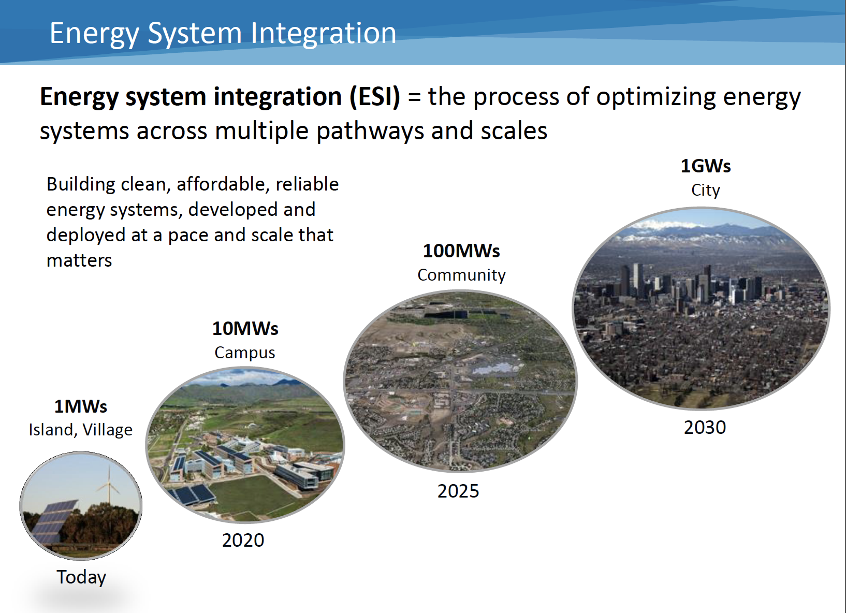
Courtesy of NREL

Slide 56
Electrification – The Power Grid

Slide 57
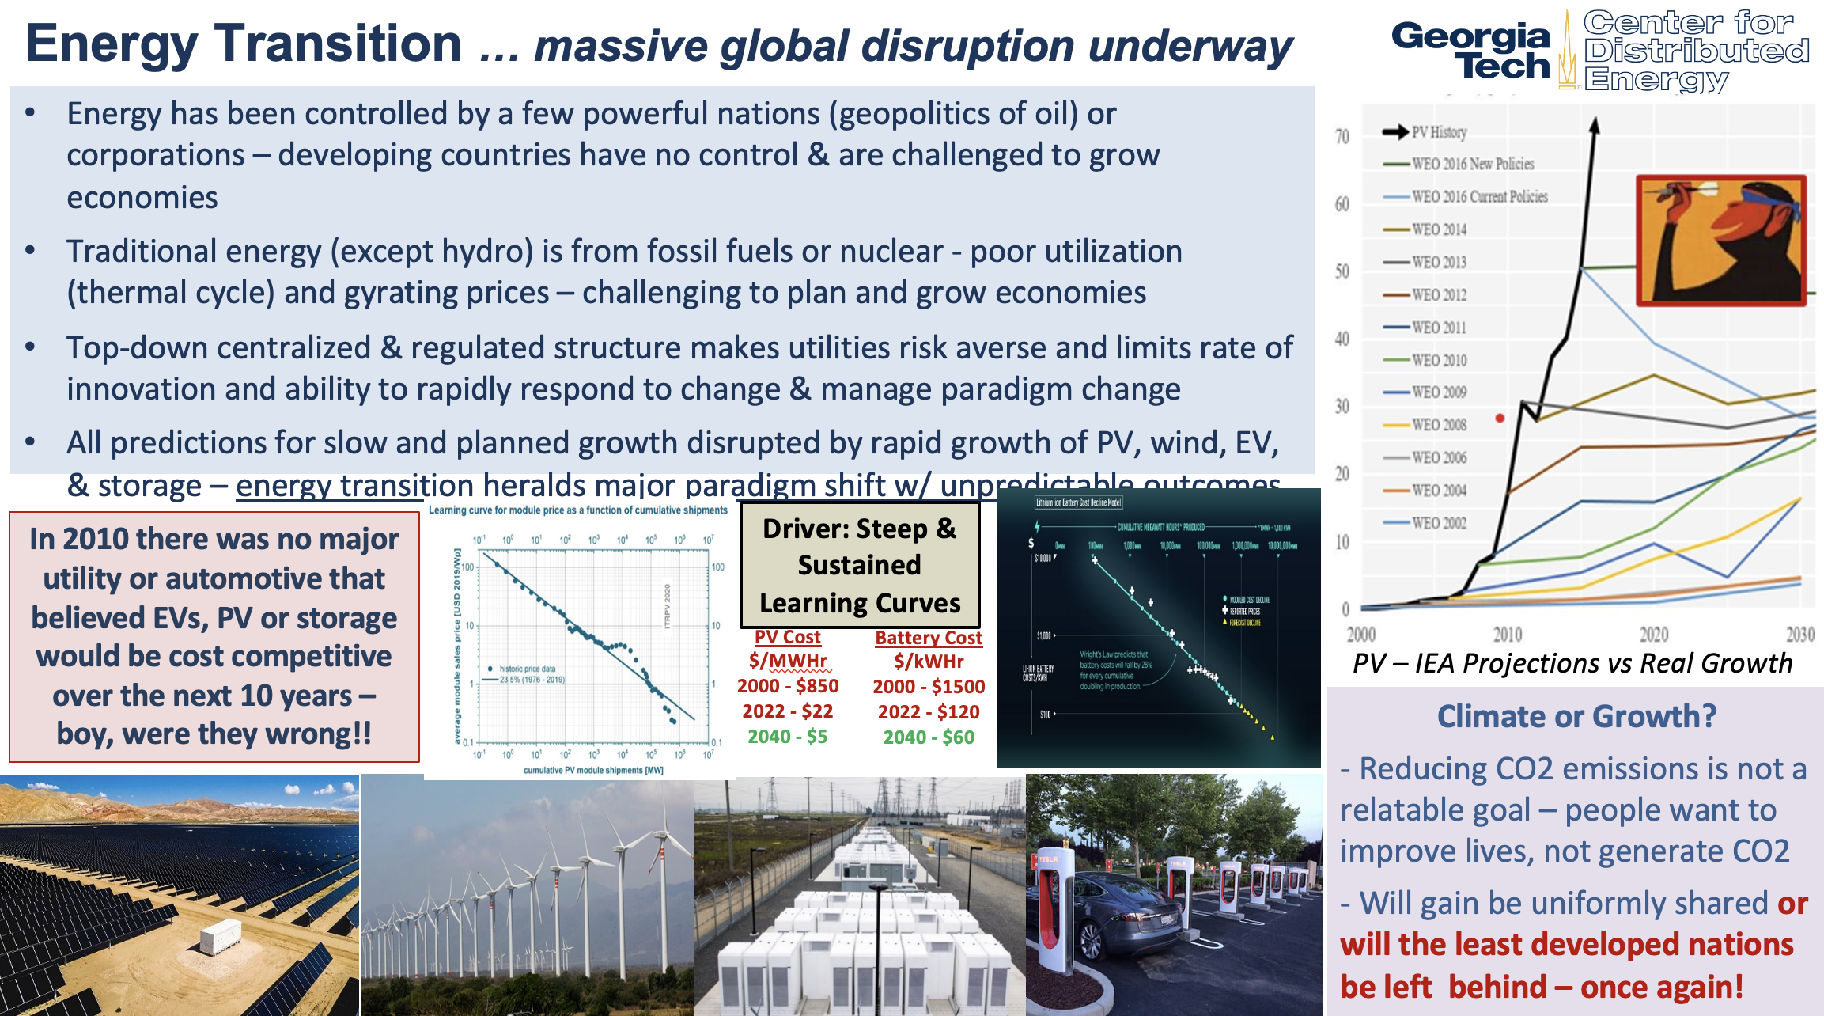

Slide 58
U.S. Electric Grid Today
850GW baseload, 1250 GW summer peak, 7,000 operational power plants
3,200 utilities, 60k substations, 642k miles of HV transmission lines, 6.2 million miles of distribution circuit, 159 million customers.
In 2015, total U.S. electricity generation was 4.1 Trillion kWh
Increasing NG and renewable generation (6.1% hydropower and 7.3% from wind and solar)
Revenues reaching $400 b
Major grid infrastructure is aging
Accelerating retirements of coal
fired power plants
T&D congestion starting to
impact deployment of renewables
Sources: EIA, EEI
Babu Chalamala, Sandia National Laboratories
http://www.nerc.com
Notes:
Let us look at the US electric grid as we know. It is a unique interconnected system and has been a 100+ year build out to what it is today. The electric grid is a big machine. Any changes in the electricity infrastructure are slow. Any major transitions in energy have long cycles.
Looking at the US electric grid, we have a baseload of ~850GW, with a 1250 GW summer peak. Across the country, there are about 7000 power plants with at least 1 MW of nameplate capacity. There is also additional 700GW of captive capacity at industrial plants.
In addition to the 3000 utilities, roughly 80 larger IOUs, and rest are municipal utilities and coops. IOUs and munis account for 80% of capacity, where as the coops account for almost 20% of consumption, 80% of the geographical area and a large chunk of the distribution circuit.

Slide 59
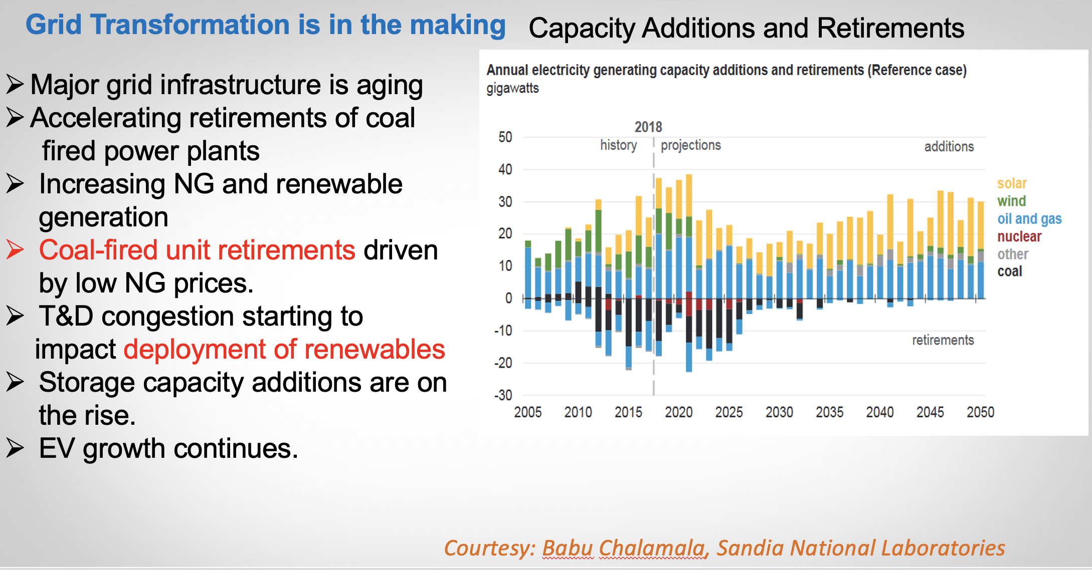

The Grid Transformation
Capacity Additions and Retirements

Slide 60














Grid Evolution
Power Plant
Distribution
Substation
Transmission
PHEV
PHEV
Courtesy of Gluon.Power

Slide 61
Grid Evolution
Power Plant
Distribution
Substation
Transmission
PHEV
PHEV
Opportunity for innovation
Courtesy of Gluon.Power

Slide 62
Power Electronics Systems

Slide 63
Power Electronics: A Historical Perspective
Traditional power conversion
  Linear Electronics- Transistors in active mode (linear region)
    Transistor acts as variable resistor for control
    Terrible efficiency (50% not uncommon)
    Low conversion range (greater Vd smaller efficiency)
    Low power applications
  Motor-Generator Sets (AC-DC or AC-AC)
    Can still be found in use
    Large physical size
    Maintenance intensive
    Low efficiency
    Poor Load regulation

Slide 64

Simplified Block Diagram of Power Electronics System

Slide 65

Detailed Block Diagram of Power Electronics System

Slide 66

Typical PC Power Supply Conversion Block Diagram

Slide 67
Conversion Type Description
Power Electronic systems perform one or more of the following conversion functions:
a)Rectification (ac-to-dc)
b) Inversion (dc-to-ac)
c) Cycloconversion
(ac-to-ac different frequencies) or
(ac-to-ac same frequency)
d) Conversion (dc-to-dc)

Slide 68


Power Flow
Unidirectional: input-to-output

Slide 69


Power Flow – Bi-directional

Slide 70



Example of Non-isolated DC-DC Converter
Continuous Conduction Mode (CCM)
Principles of Steady State Converter Analysis
  Definition of Steady State
  Inductor Volt-Second Balance
  Capacitor Charge Balance
  Small Ripple Approximation
  Average Values in Steady State
  Use of Power Conservation Principle in Converter Analysis
Application of Analysis Techniques to Classic Converter Topologies
  Buck, Boost, and Buck Boost
Analysis of Fourth Order Converters

Slide 71

Course Content Overview:
Non-isolated DC-DC Converters
Discontinuous Conduction Mode (DCM)
Description of DCM
At what operating condition does DCM occur?
Application of Steady State Analysis Principles to Converters in DCM
  Buck
  Boost
  Buck-Boost
  Cuk
Properties of Converters in DCM

Slide 72


Example - Classic Inverter Scheme

Slide 73



Switching concepts
The Need for Switching in Power Electronic Circuits
Efficiency Example Comparing Power Supply Designs
Ideal Switch Discussion
Ideal Switch Types
Practical Switch Characteristics

Slide 74


Semiconductor Device Overview
Discussion of Available Power Semiconductor Devices
  Power Diode
  BJT
  Power MOSFET
  IGBT
  SCR
  GTO
  TRIAC
Focus on Device i-v Characteristics
Comparison of Switching Devices
Survey of Commercially Available Devices
Future Trends

Slide 75


Slide 76
Figures of Merit for Power Electronic Converters
What is the objective?
  Overall goal: To produce a converter that performs well in these areas:
    Efficiency
    Transient Response
    Load and Line Regulation
    Power Density
    Input/Output Distortion (Input Power Factor)
    Reliability (MTBF)
    Cost
  In the final analysis, the job is to process and control the flow of electric energy by supplying currents/voltages in a form most suited to both the load and energy source

Slide 77
Modern Power Electronics
Can have efficiencies approaching 100%
  Uses switches in saturation mode (On of Off)
  On state-resistance can be down in tenths of Ohms
Are much smaller than predecessors
  High switching frequency means smaller magnetic components.
  Reduced losses means smaller package size
Net effect is better efficiency, greater power density (10’sW/in^3 attainable)

Slide 78
Today’s Barriers to Scalable PV+Storage
Why the Battery + PV Integration has not taken off yet.
The revenue models are not clear
PV module improvements in efficiency and cost alone will not accomplish the anticipated revenue model
Complex installation, maintance and Expensive Value Chain
PV Generation and Load Profile Mismatch
PV Intermittency
Battery Operation at high ambient Temperature

Slide 79
Scaling the Global Innovation
The Energy Access Challenge

Slide 80

The Energy Access Challenge

Slide 81

The Energy Access Challenge

Slide 82

The Energy Access Challenge

Slide 83

The Energy Access Challenge

Slide 84

The Energy Access Challenge

Slide 85

The Energy Access Challenge

Slide 86

www.empowerabillionlives.org
Thank you

