Slide 1

EEL 5245 POWER ELECTRONICS I
Lecture #19
Examples of 4th Order DC-DC

Slide 2
Objectives
Introduce the Zeta Converter
4th order Example - Boost- Buck (Cuk)
Analysis of General examples
Introducing The concept of Regulation

Slide 3
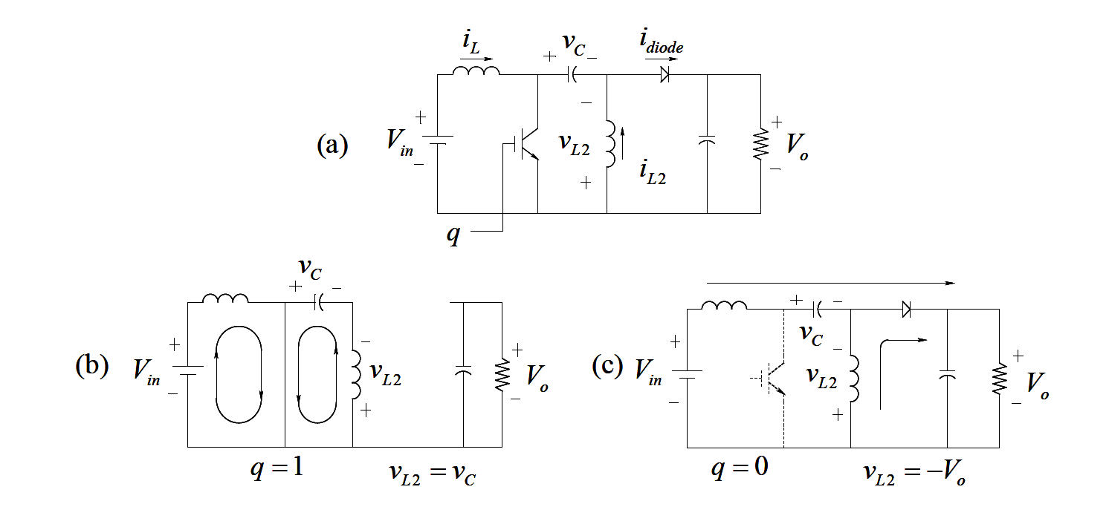
Single-Ended Primary Inductor (SEPIC) Converter
SEPIC Converters (Single-Ended Primary Inductor Converters)
Mode I – Switch is on
Mode II – Switch is off

Slide 4
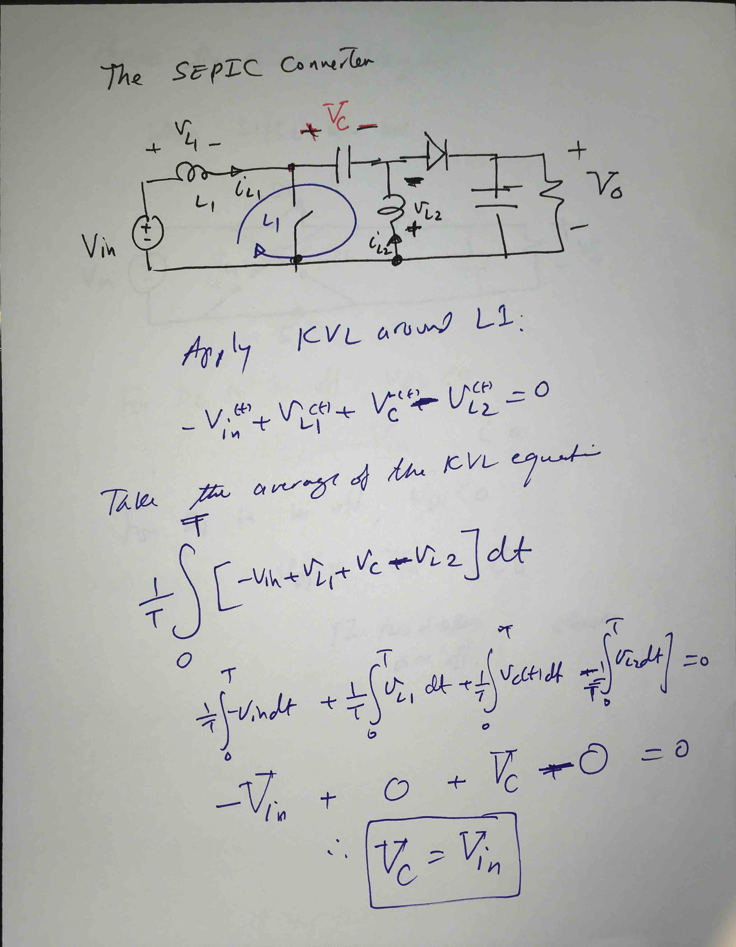

Slide 5
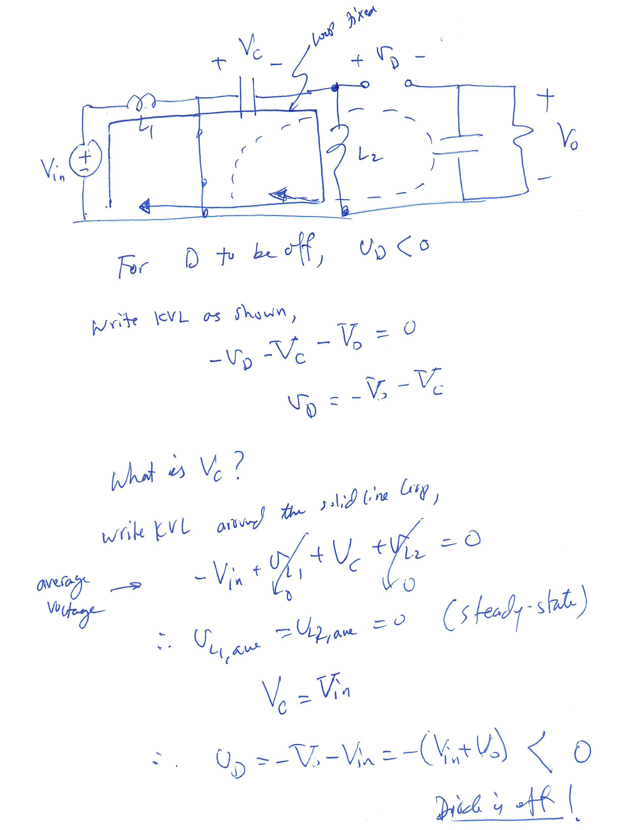
Single-Ended Primary Inductor (SEPIC) Converter

Slide 6
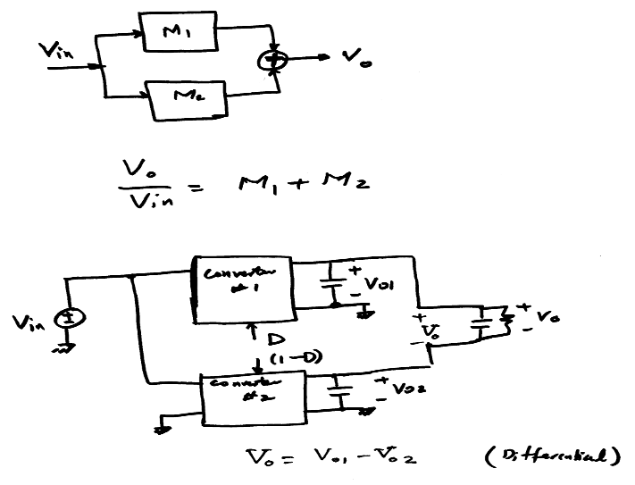
Example – Cascode Configuration

Slide 7
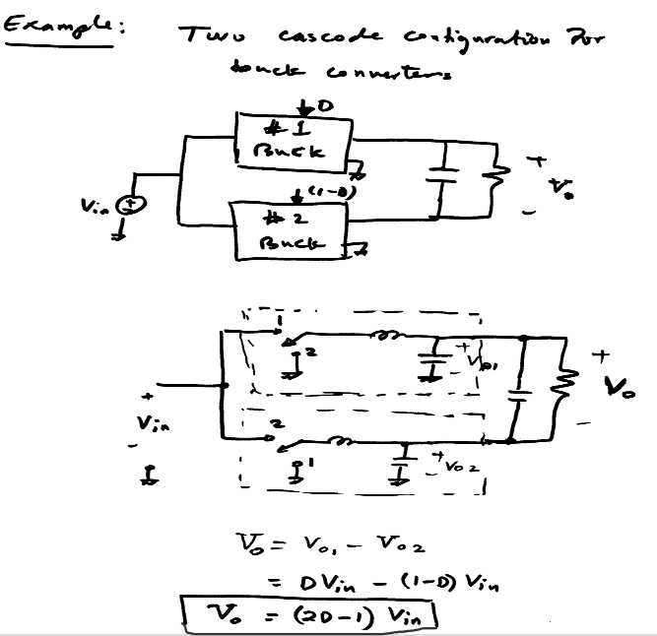

Slide 8
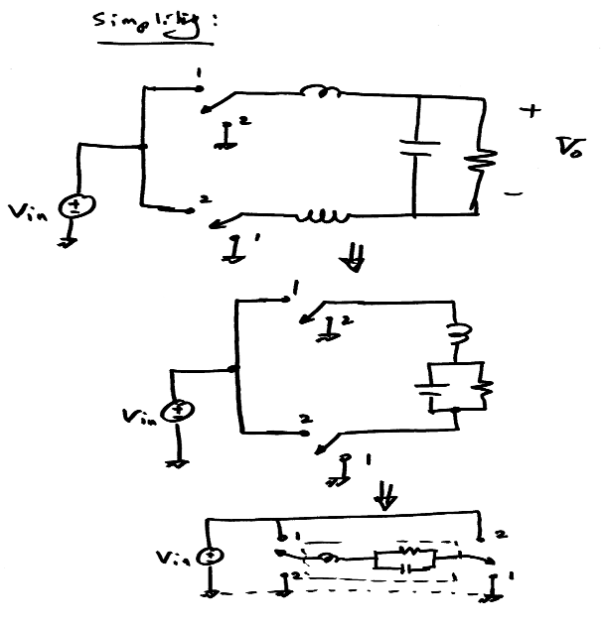

Slide 9
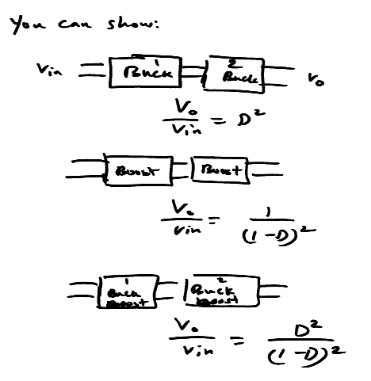

Slide 10
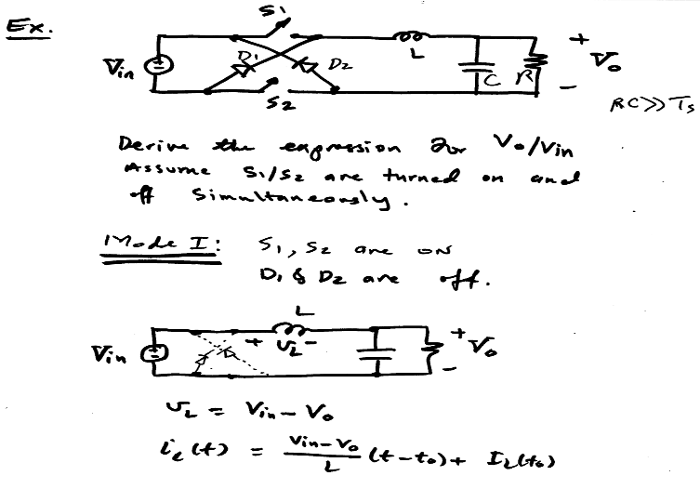

Slide 11
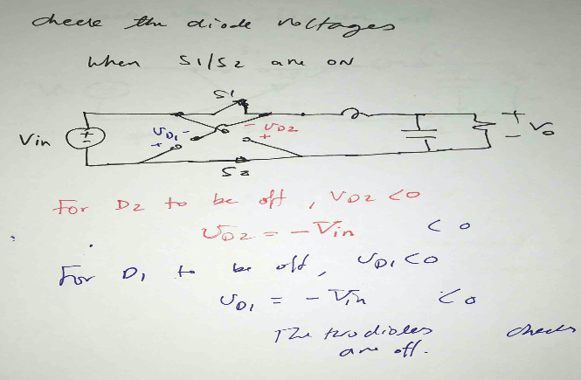

Slide 12
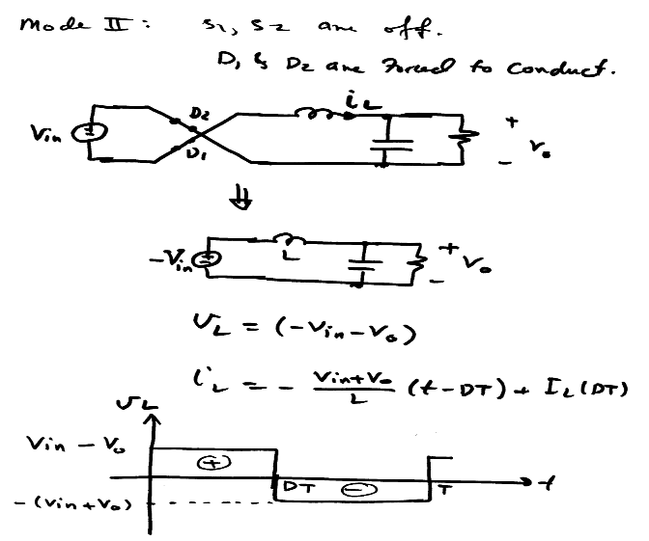

Slide 13
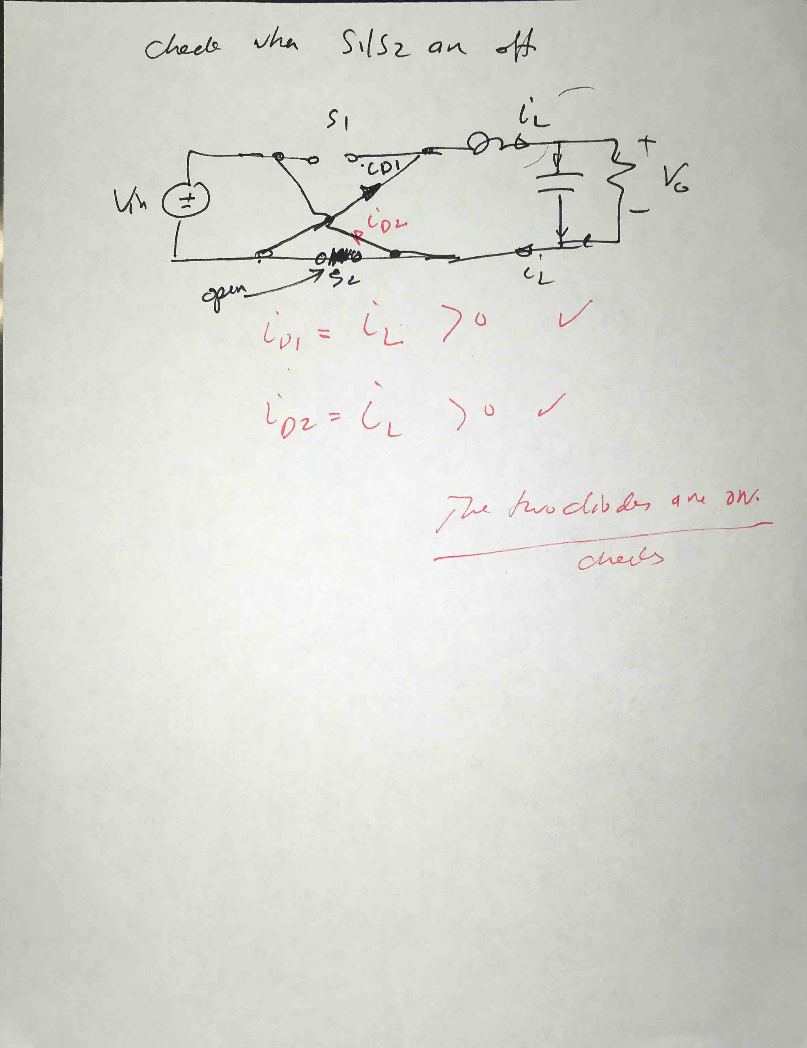

Slide 14
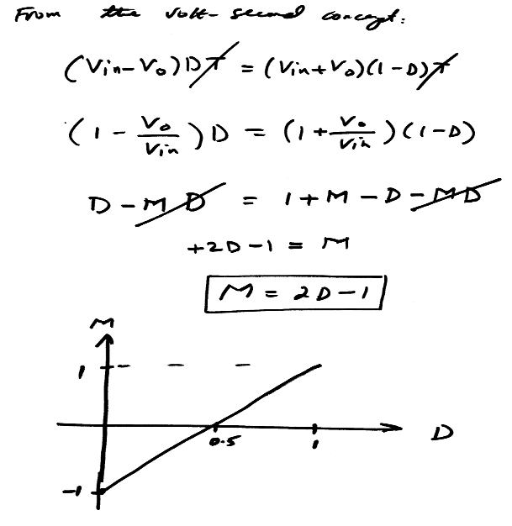

Slide 15

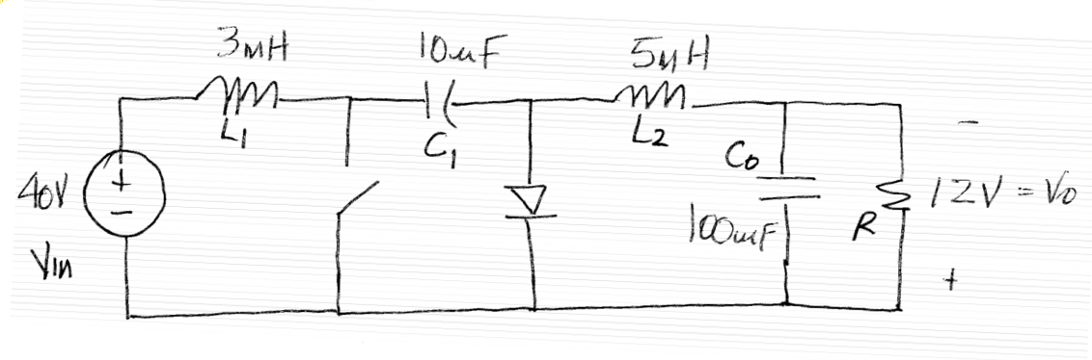
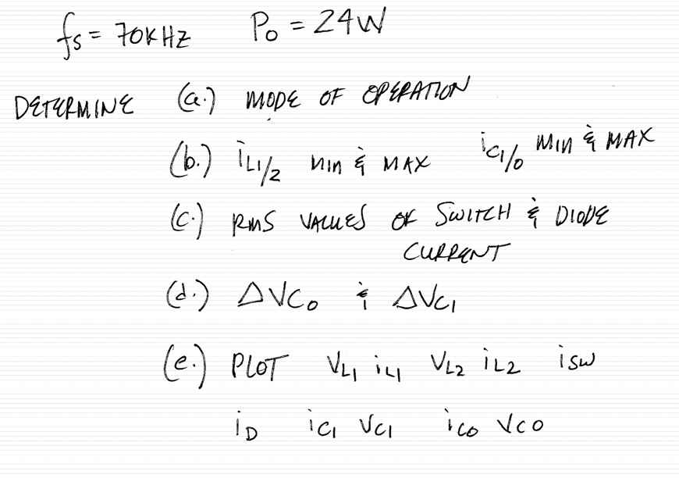

Example of a Cuk Converter
Consider the following Cuk Converter:

Slide 16
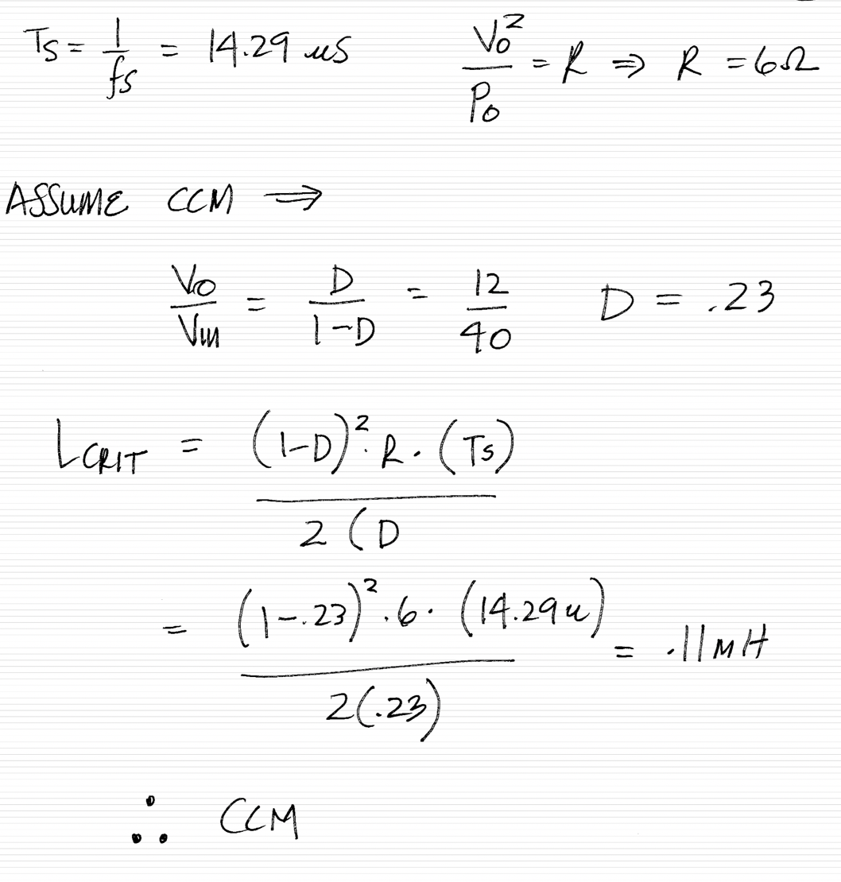
Finding the duty cycle D
EEL 5245

Slide 17
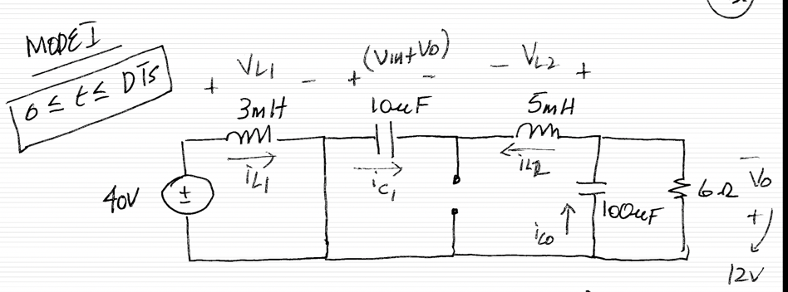
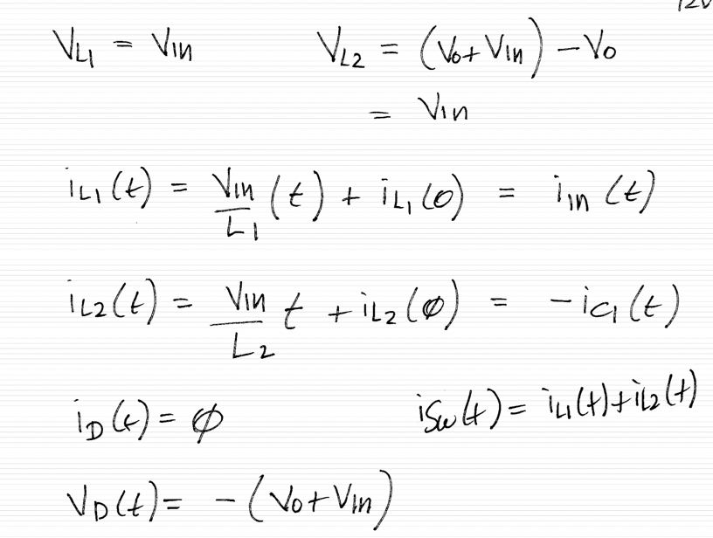
Steady-state operation
EEL 5245

Slide 18
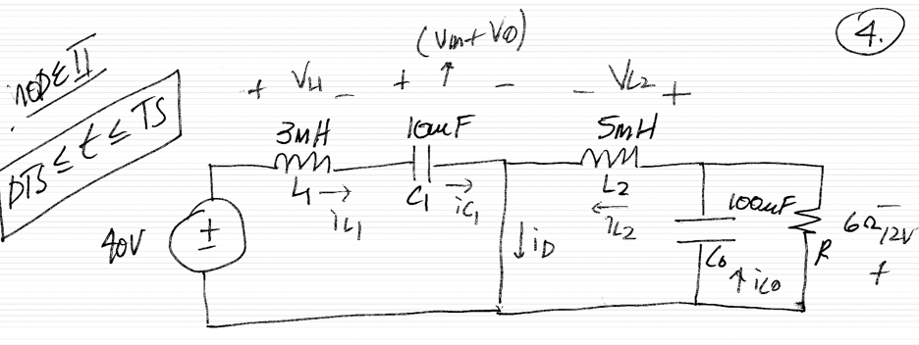
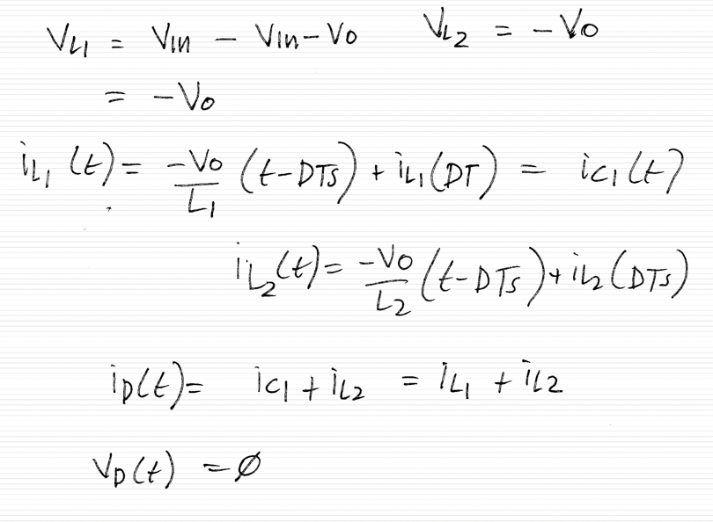
Steady-state operation
EEL 5245

Slide 19
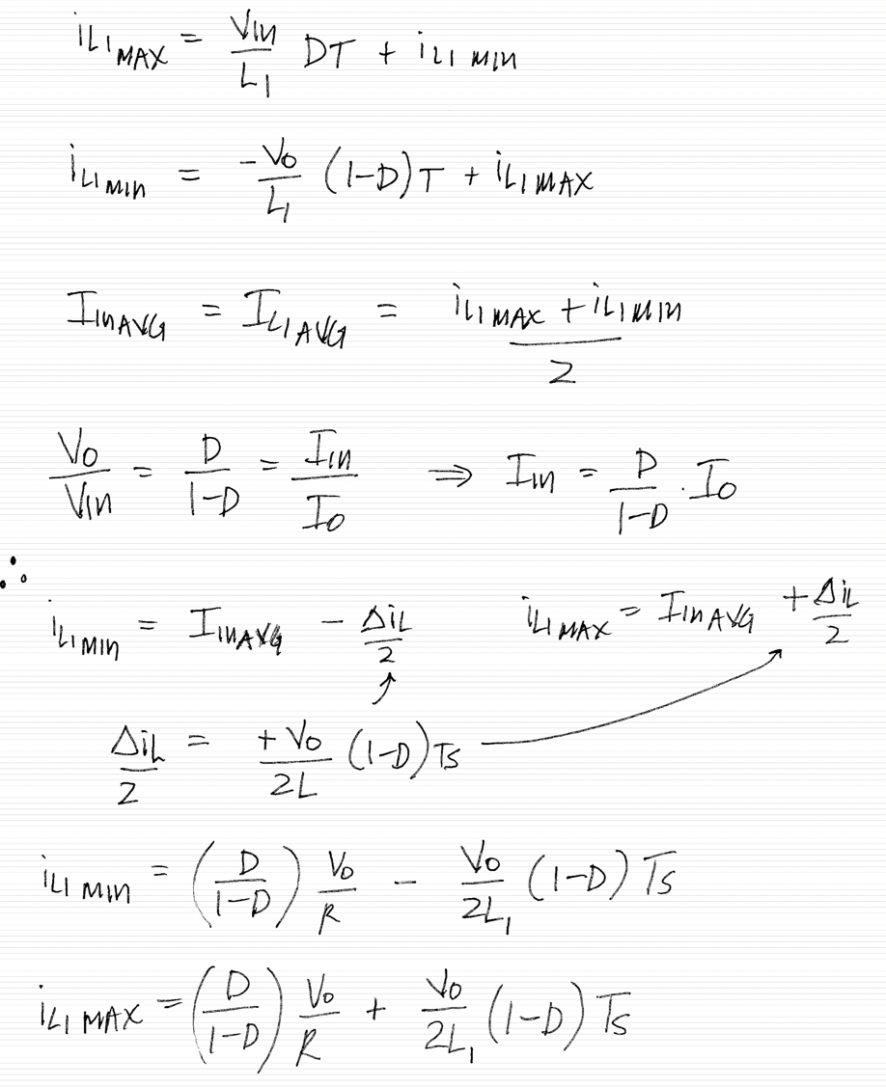
Steady-state analysis

Slide 20
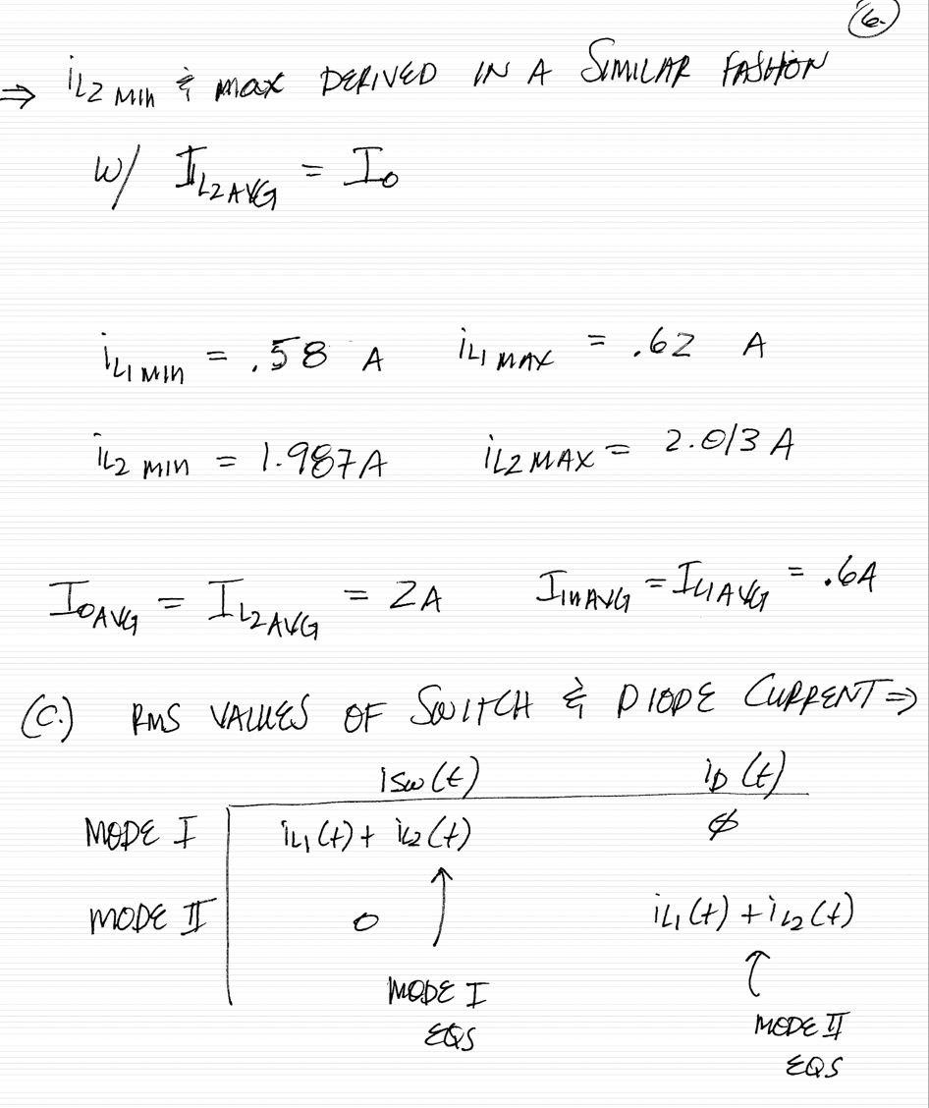
Steady-state analysis

Slide 21
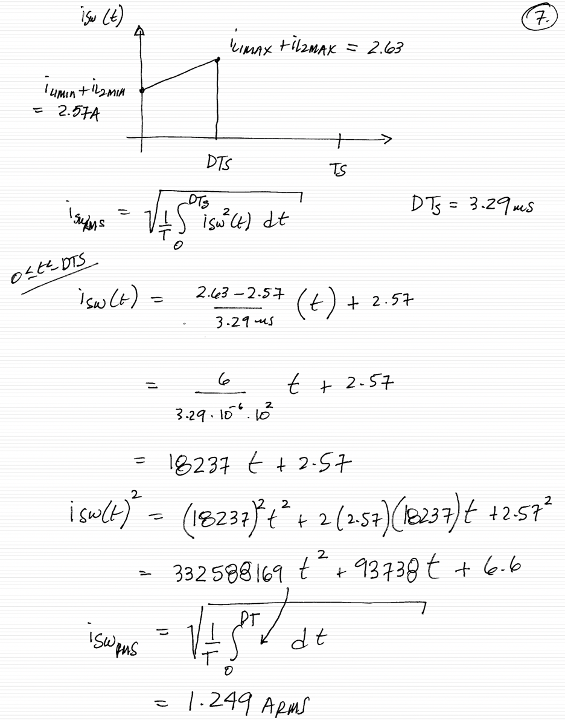
Steady-state analysis

Slide 22
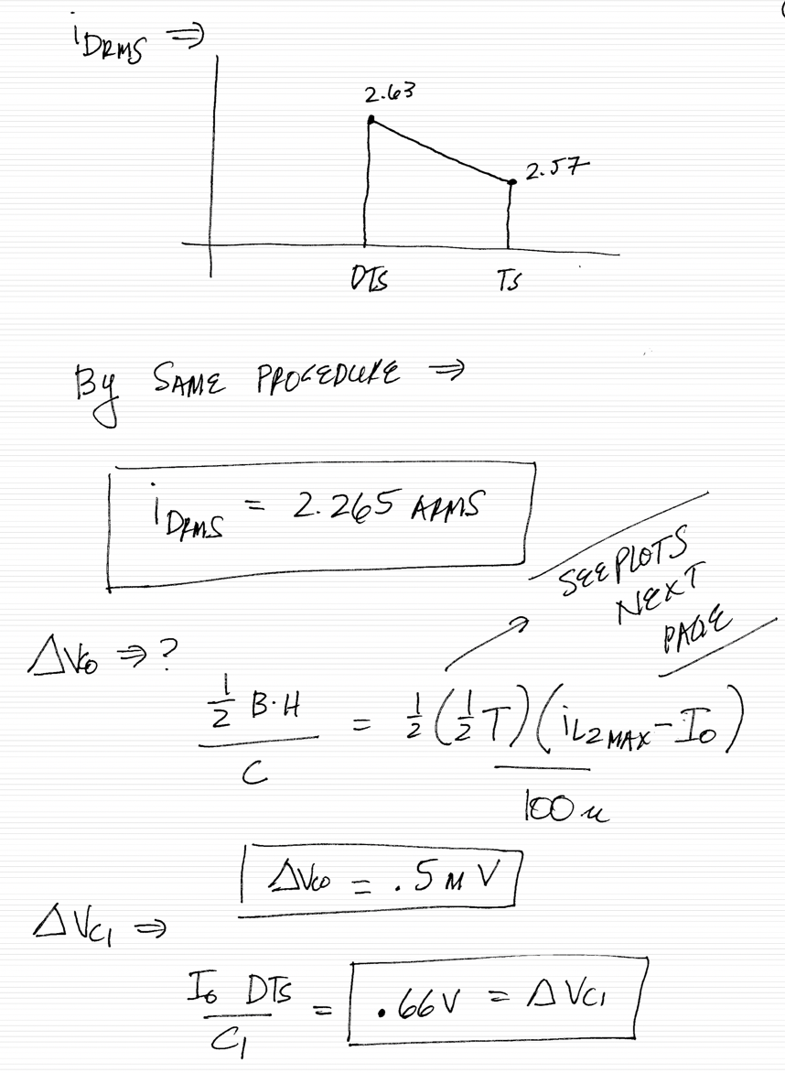
Steady-state analysis

Slide 23
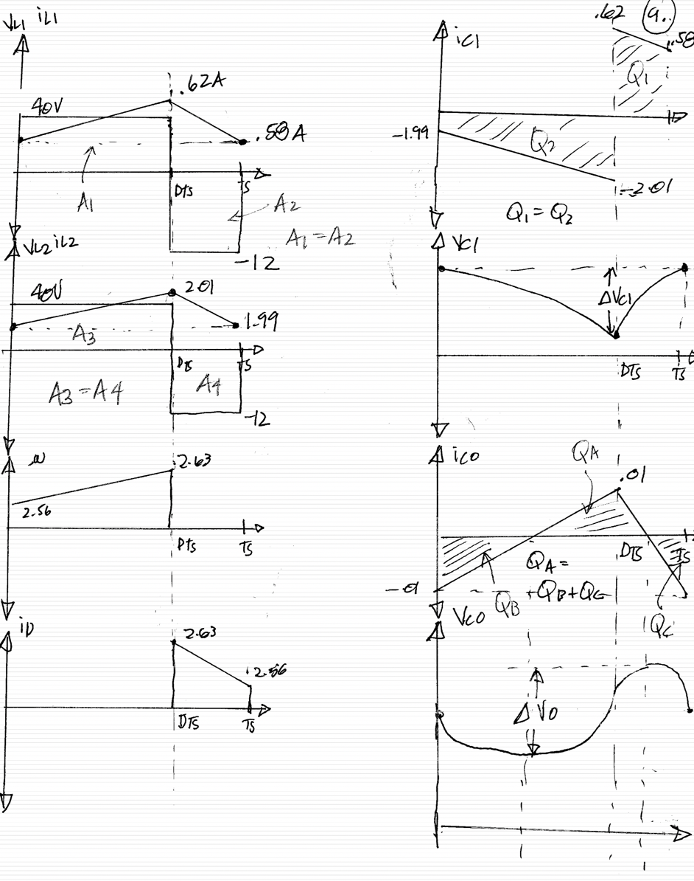
Steady-state analysis

Slide 31
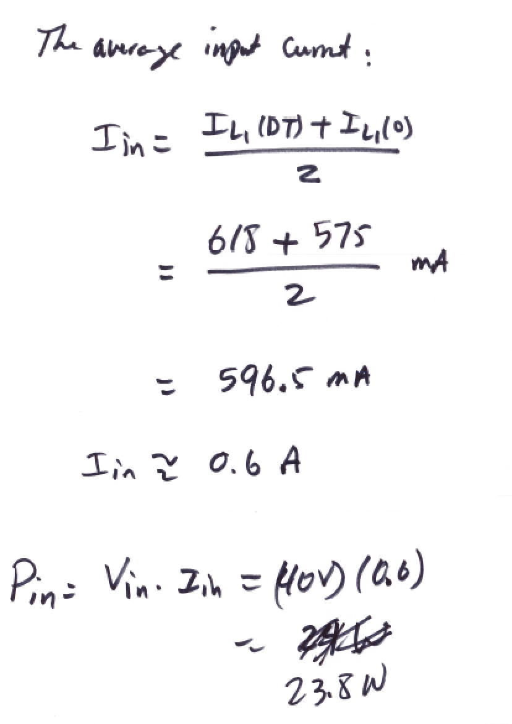

EEL 5245

Slide 32
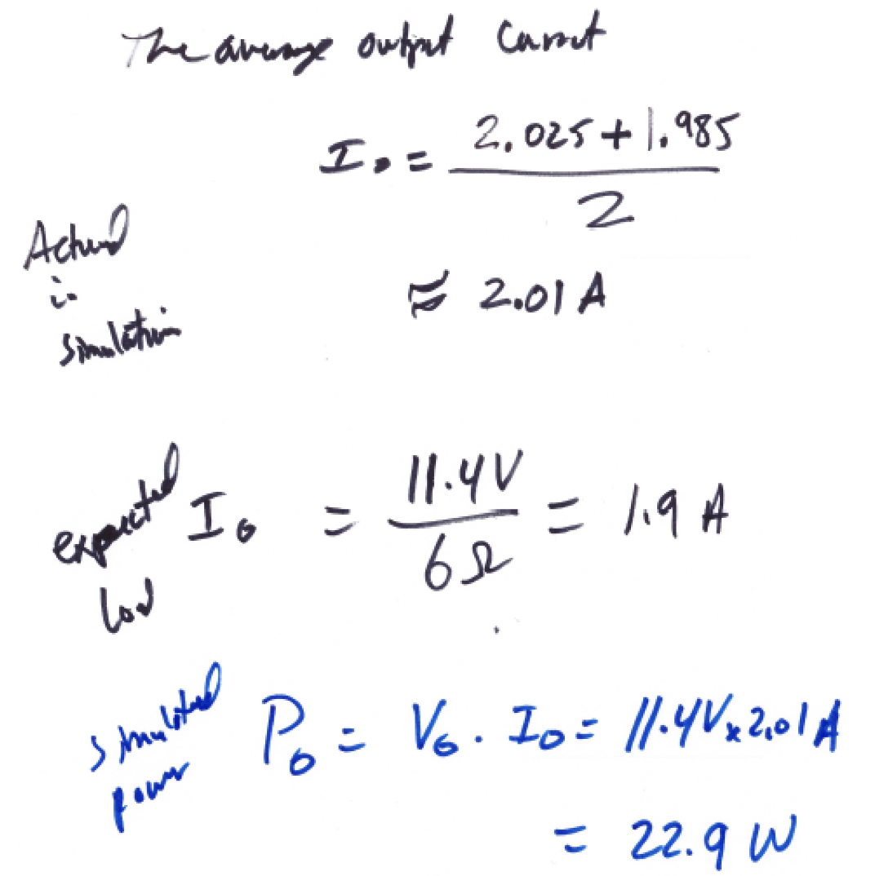
EEL 5245

Slide 33
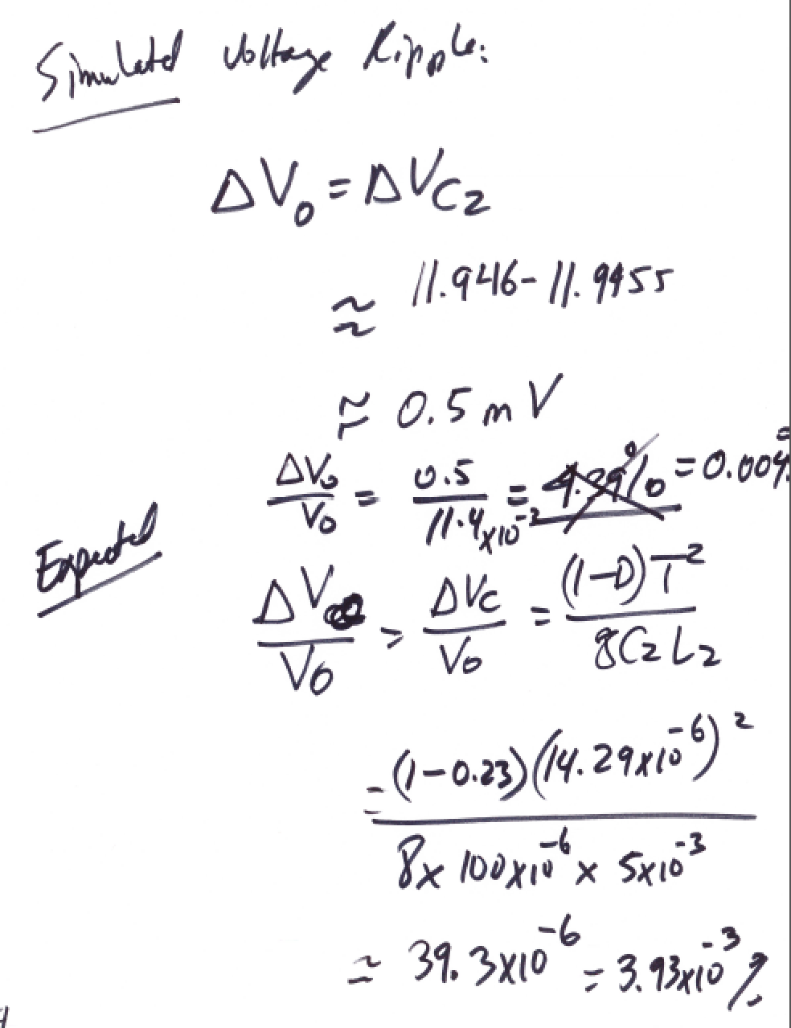



EEL 5245

Slide 34
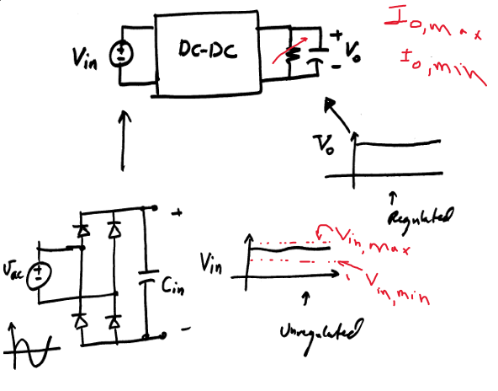
Introducing The concept of Regulation

Slide 35
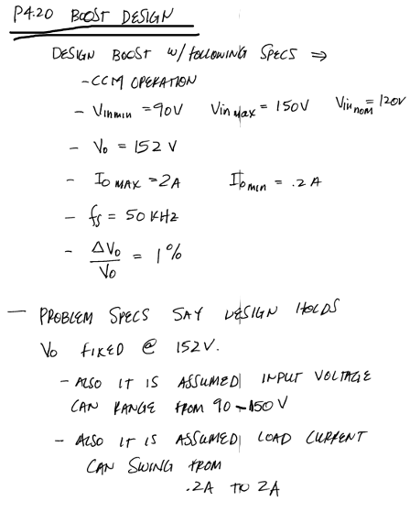


Slide 36
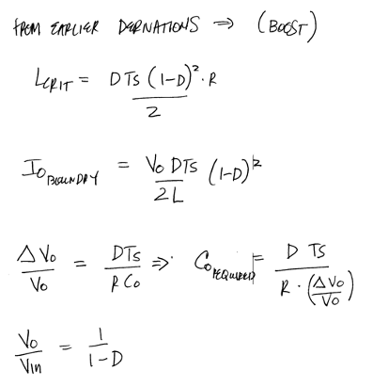


Slide 37
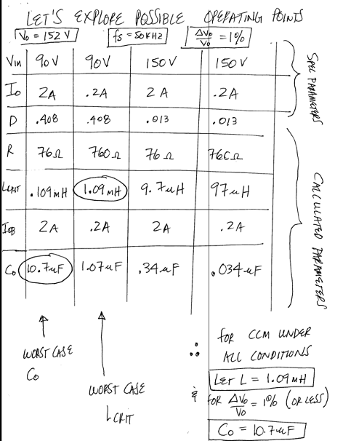


Slide 38
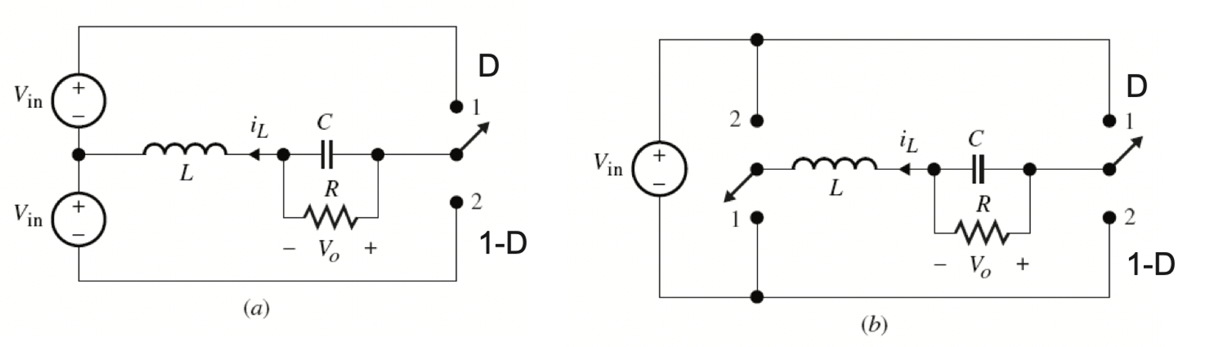

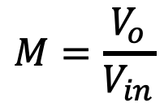
Examples of bipolar voltage converters:
Half bridge dc-dc converter
Full bridge dc-dc converter
Derive the voltage gain M for both converters.
Compare the two converters.

