Slide 1

EEL 5245 POWER ELECTRONICS I
Lecture #18
Ch 4: High Order DC-DC PWM Converters - CCM
(Cuk & Zeta Converters)

Slide 2

Objectives
4th Order Converter (CCM)
–Cuk
– Zeta
Analysis Example
PSPICE Verification

Slide 3
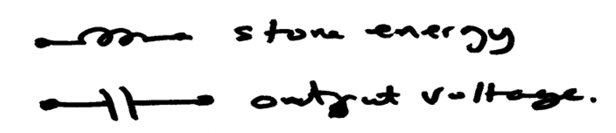
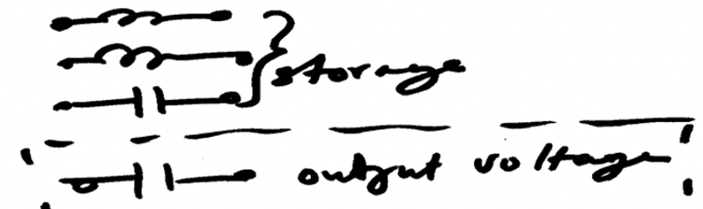
4th Order DC-DC Converters
Buck, boost, and buck-boost conventional topologies combination (2nd order).
Two possible configurations can be designed by suing two of the conventional types:
* In series – cascade connection (4th order)
* In parallel – cascode connection (4th order)
The resultant topology has four storage elements:

Slide 4
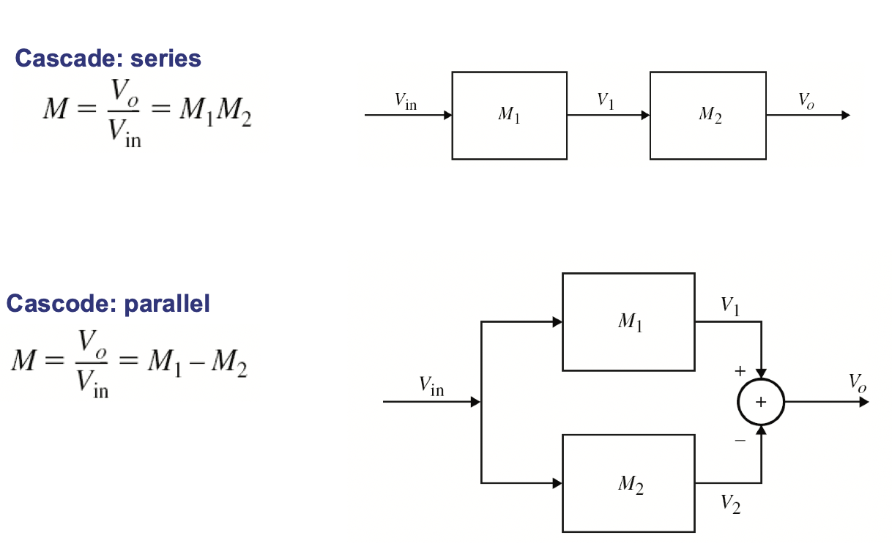
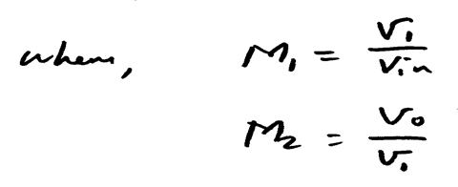

4th Order DC-DC Converters

Slide 5
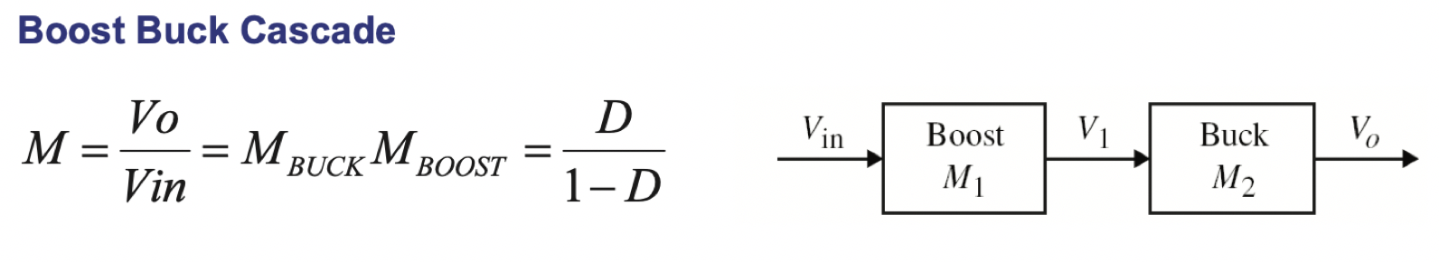
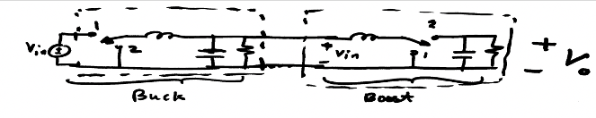
Example – Buck-Boost

Slide 6
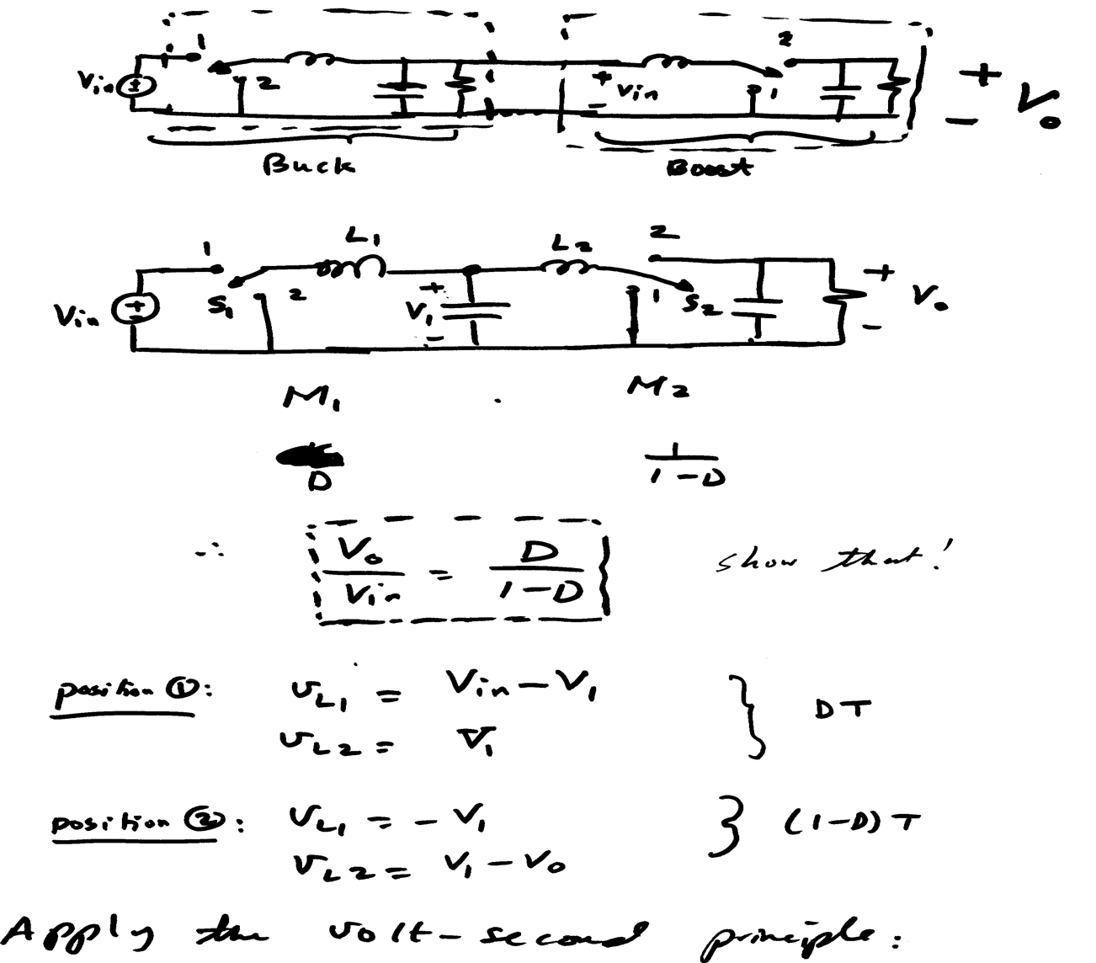

Slide 7
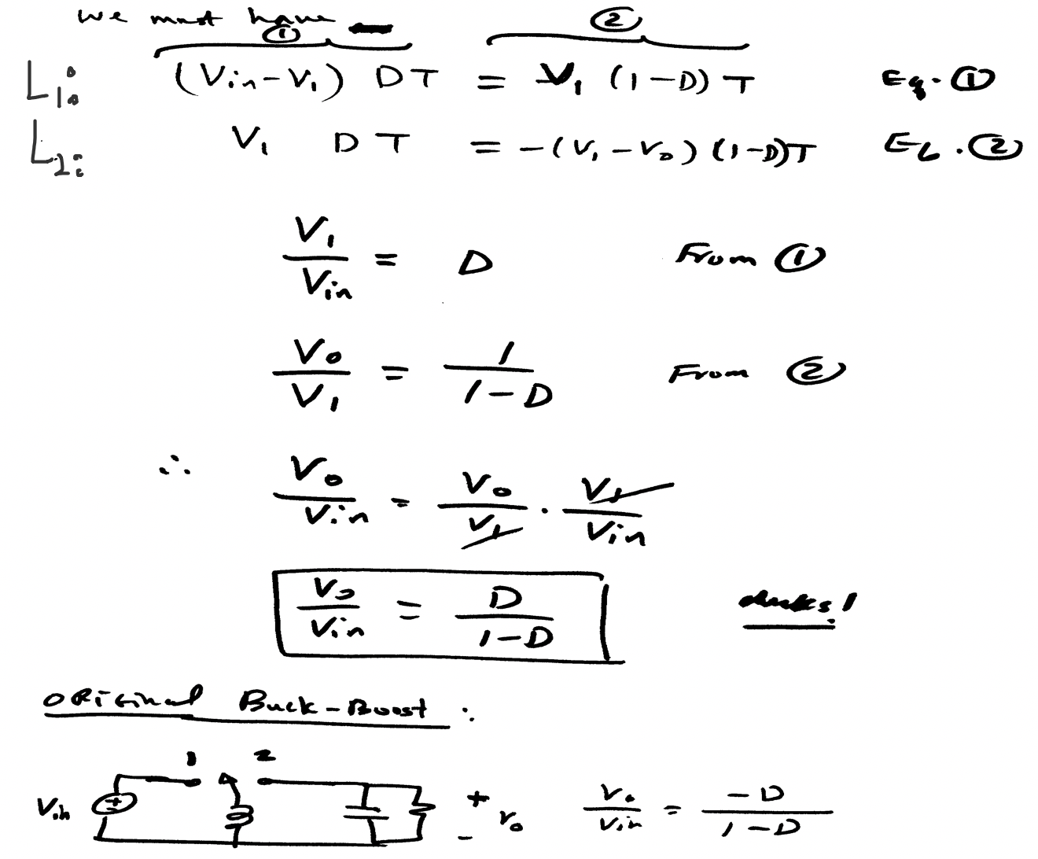



Slide 8
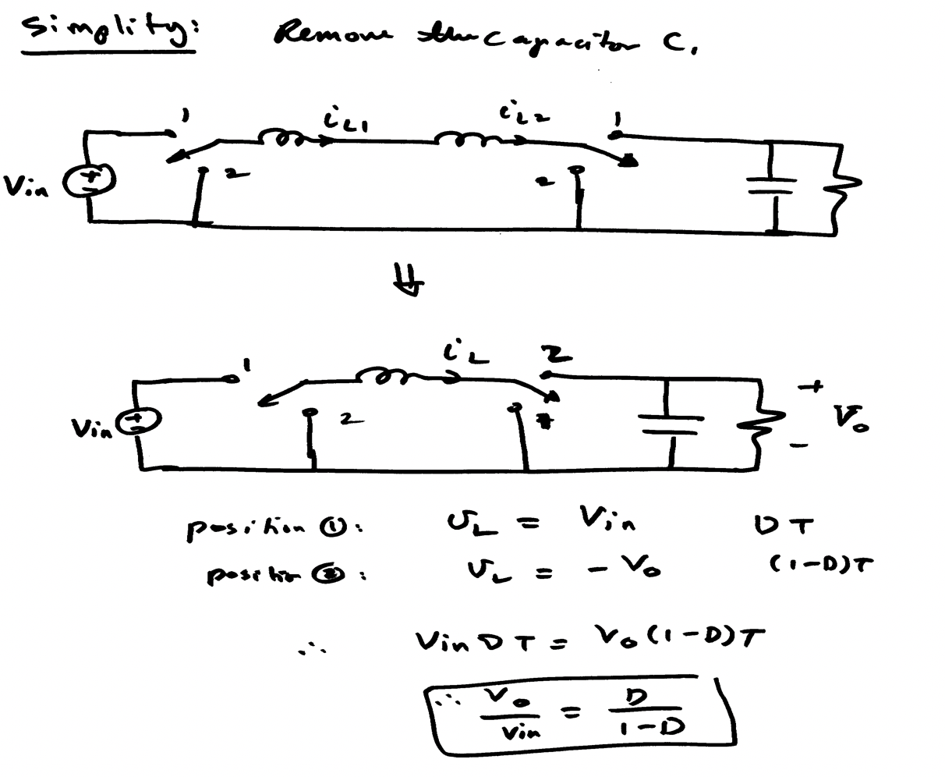

Slide 9
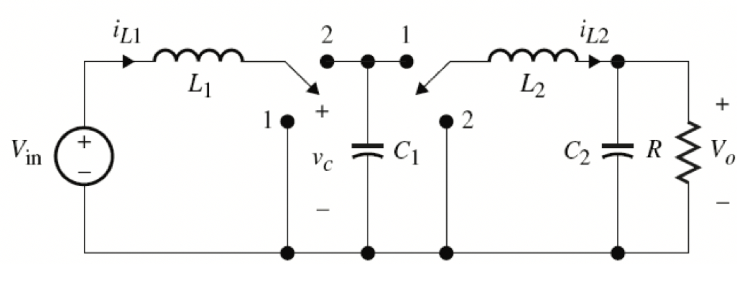
More Simplification

Slide 10
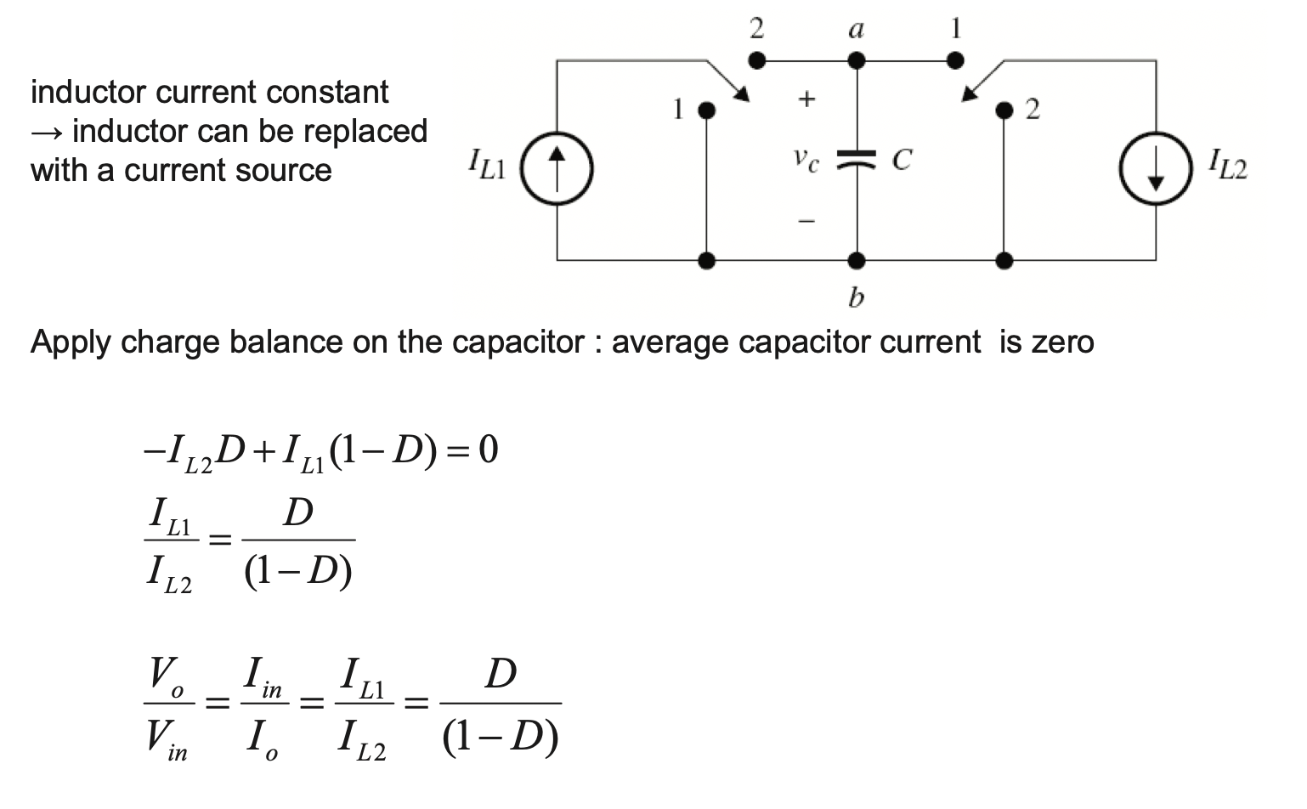

Slide 11
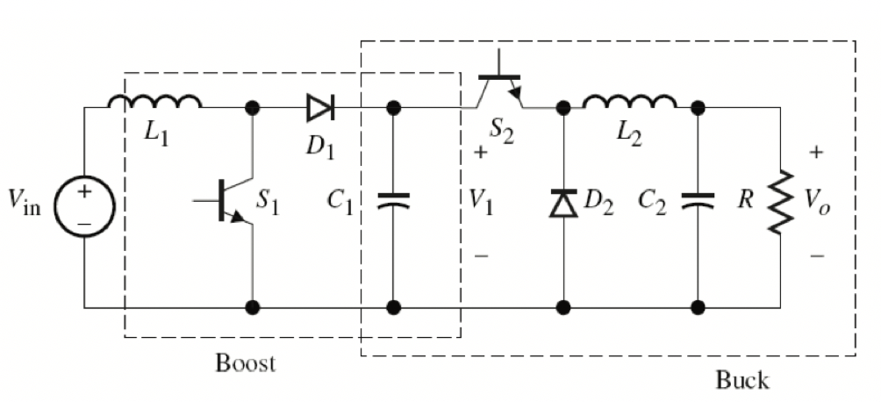
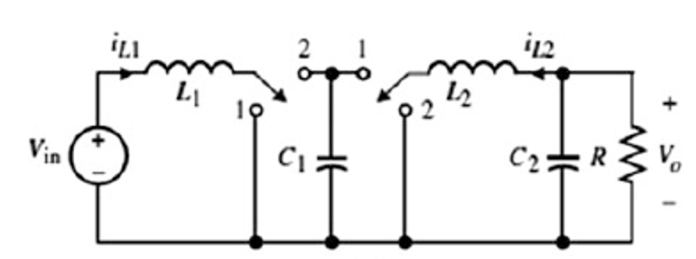
Example

Slide 12
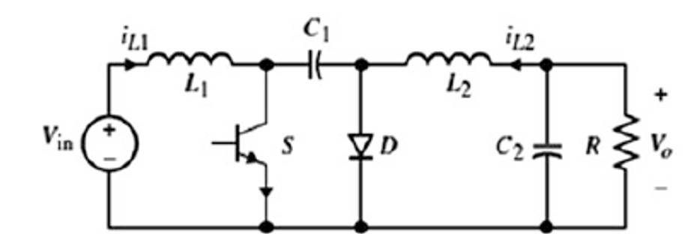
Cuk Converter
4th order new converter named after its inventor, Dr. Slobodan Cuk:

Slide 13
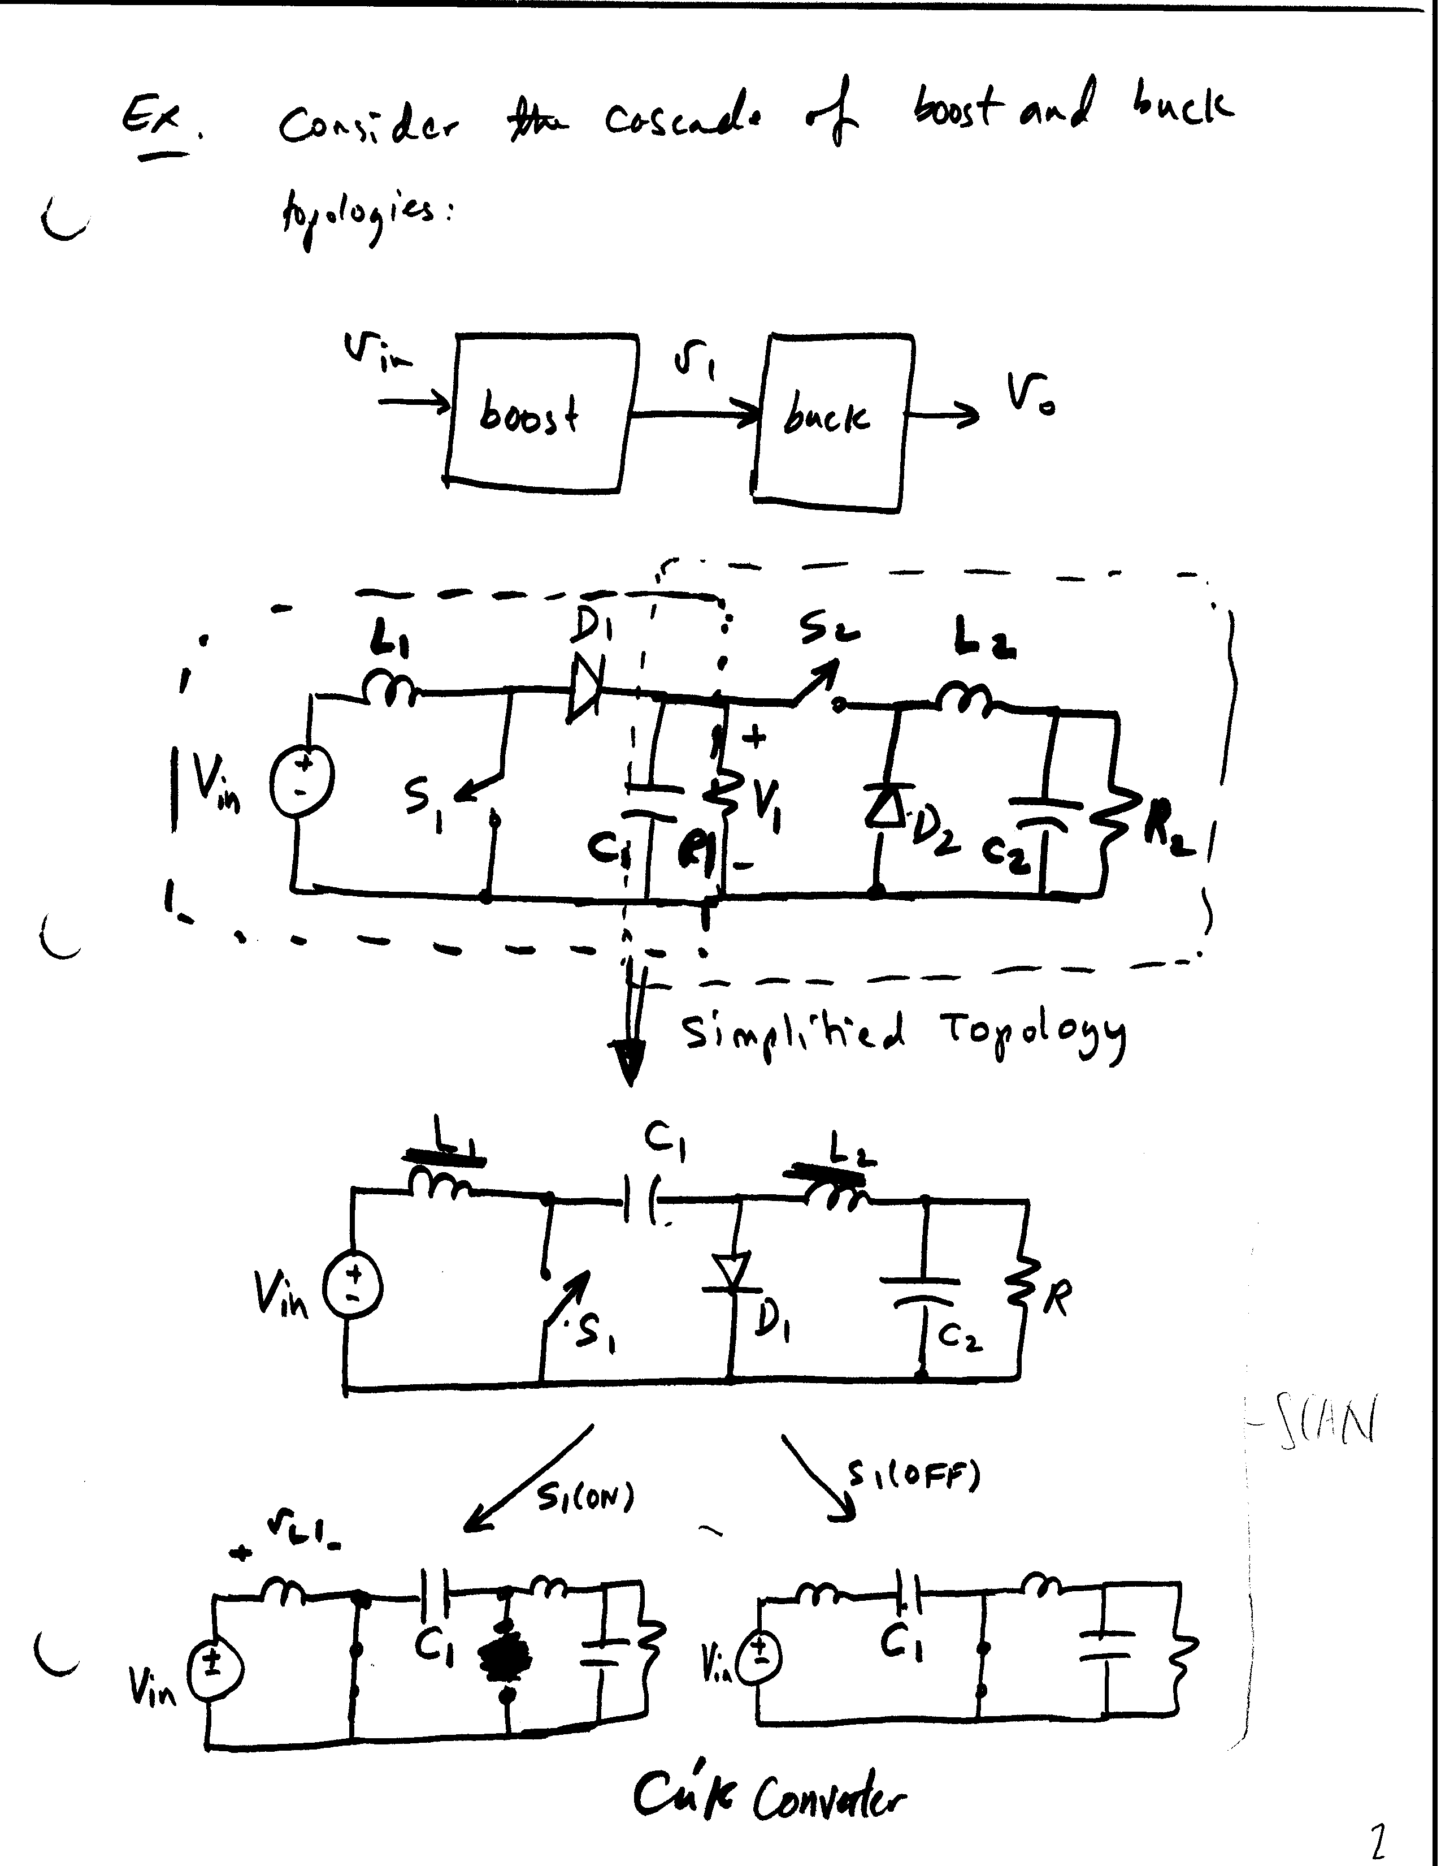






Slide 14
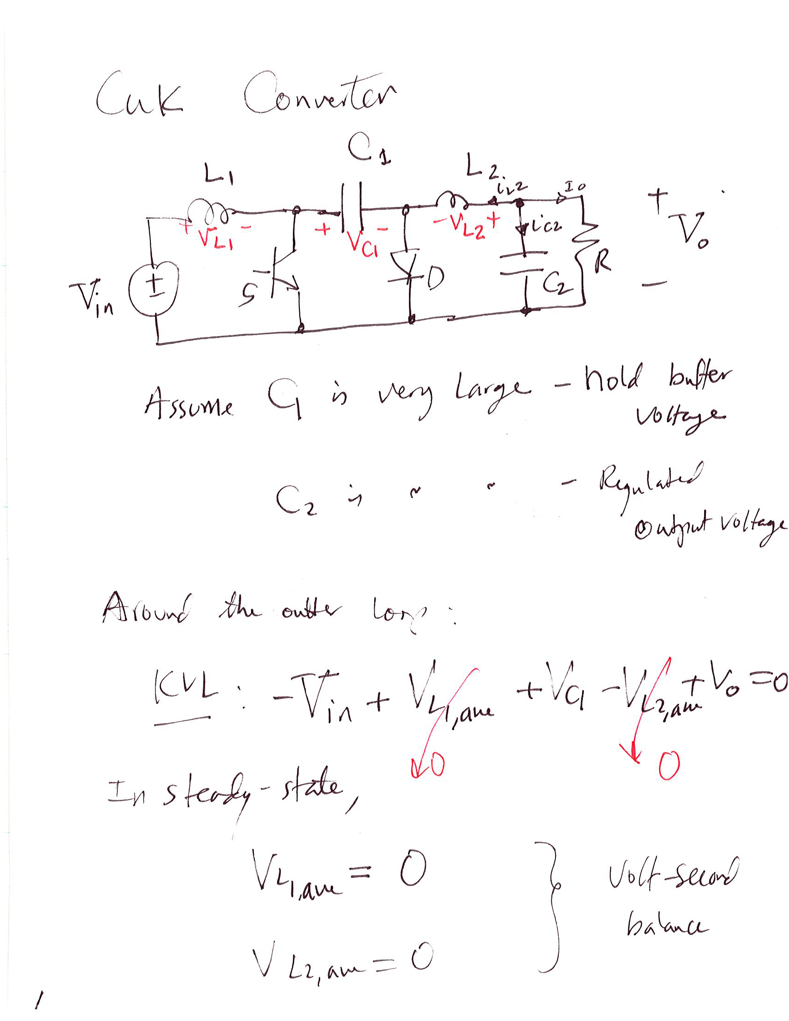


Analysis of the Cuk Converter

Slide 15
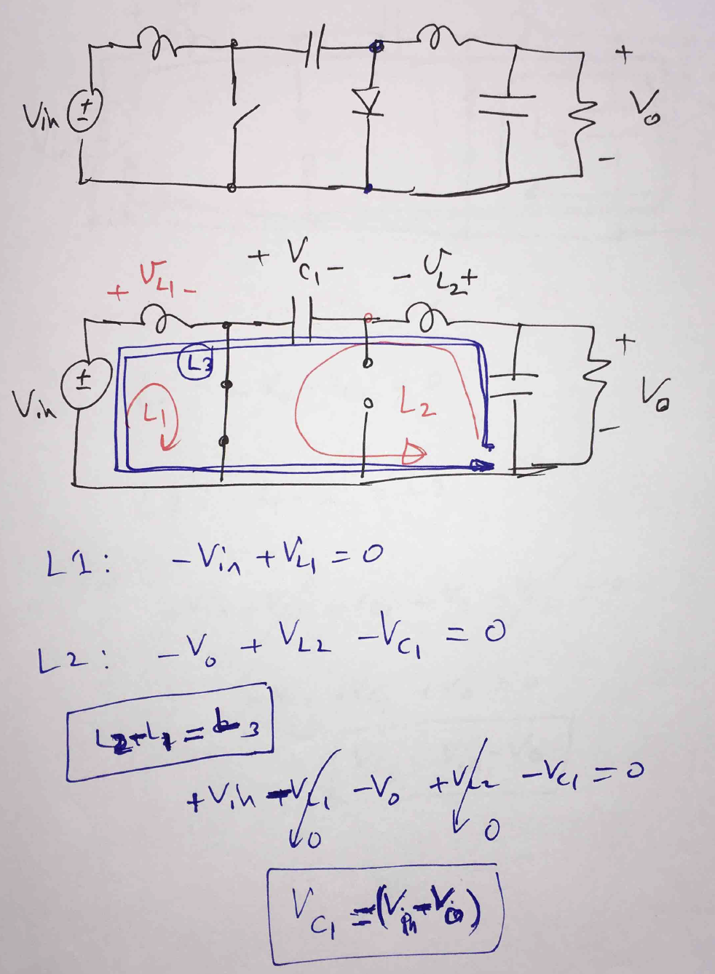
Why the Outer loop works?
The outer loop L3 below consists of the difference between L2 and L1 shown below
During Mode I

Slide 16
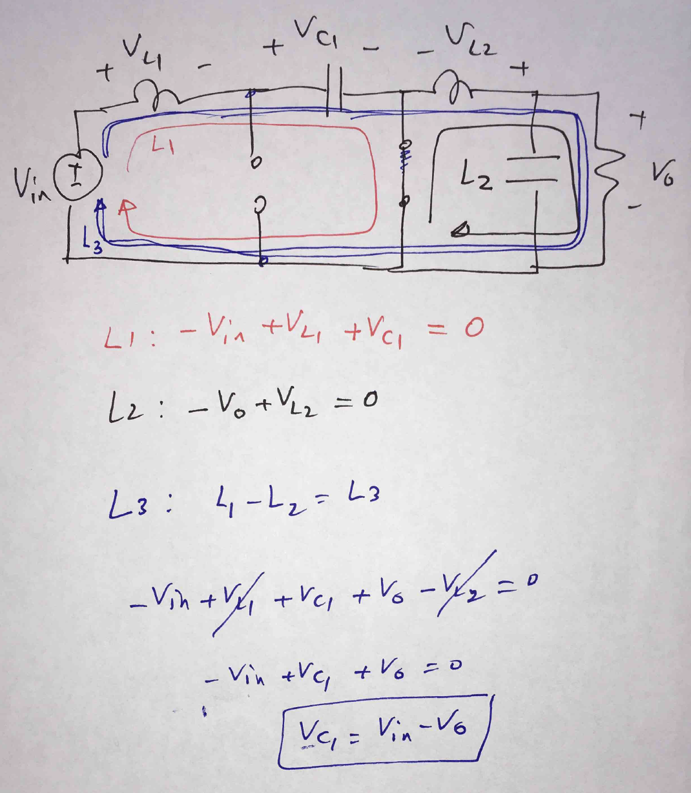
During Mode II

Slide 17
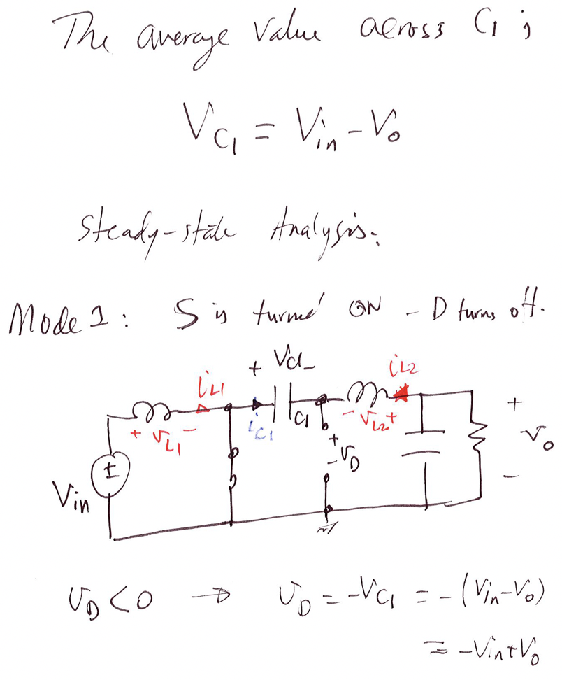
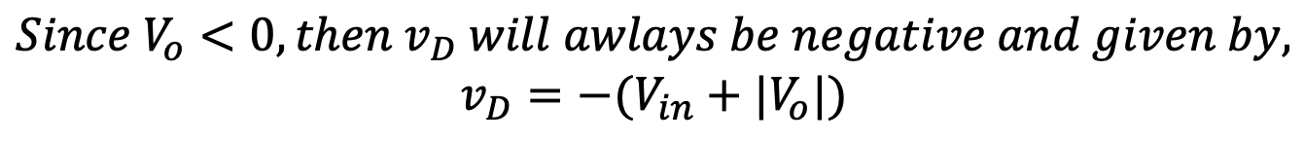

Slide 18
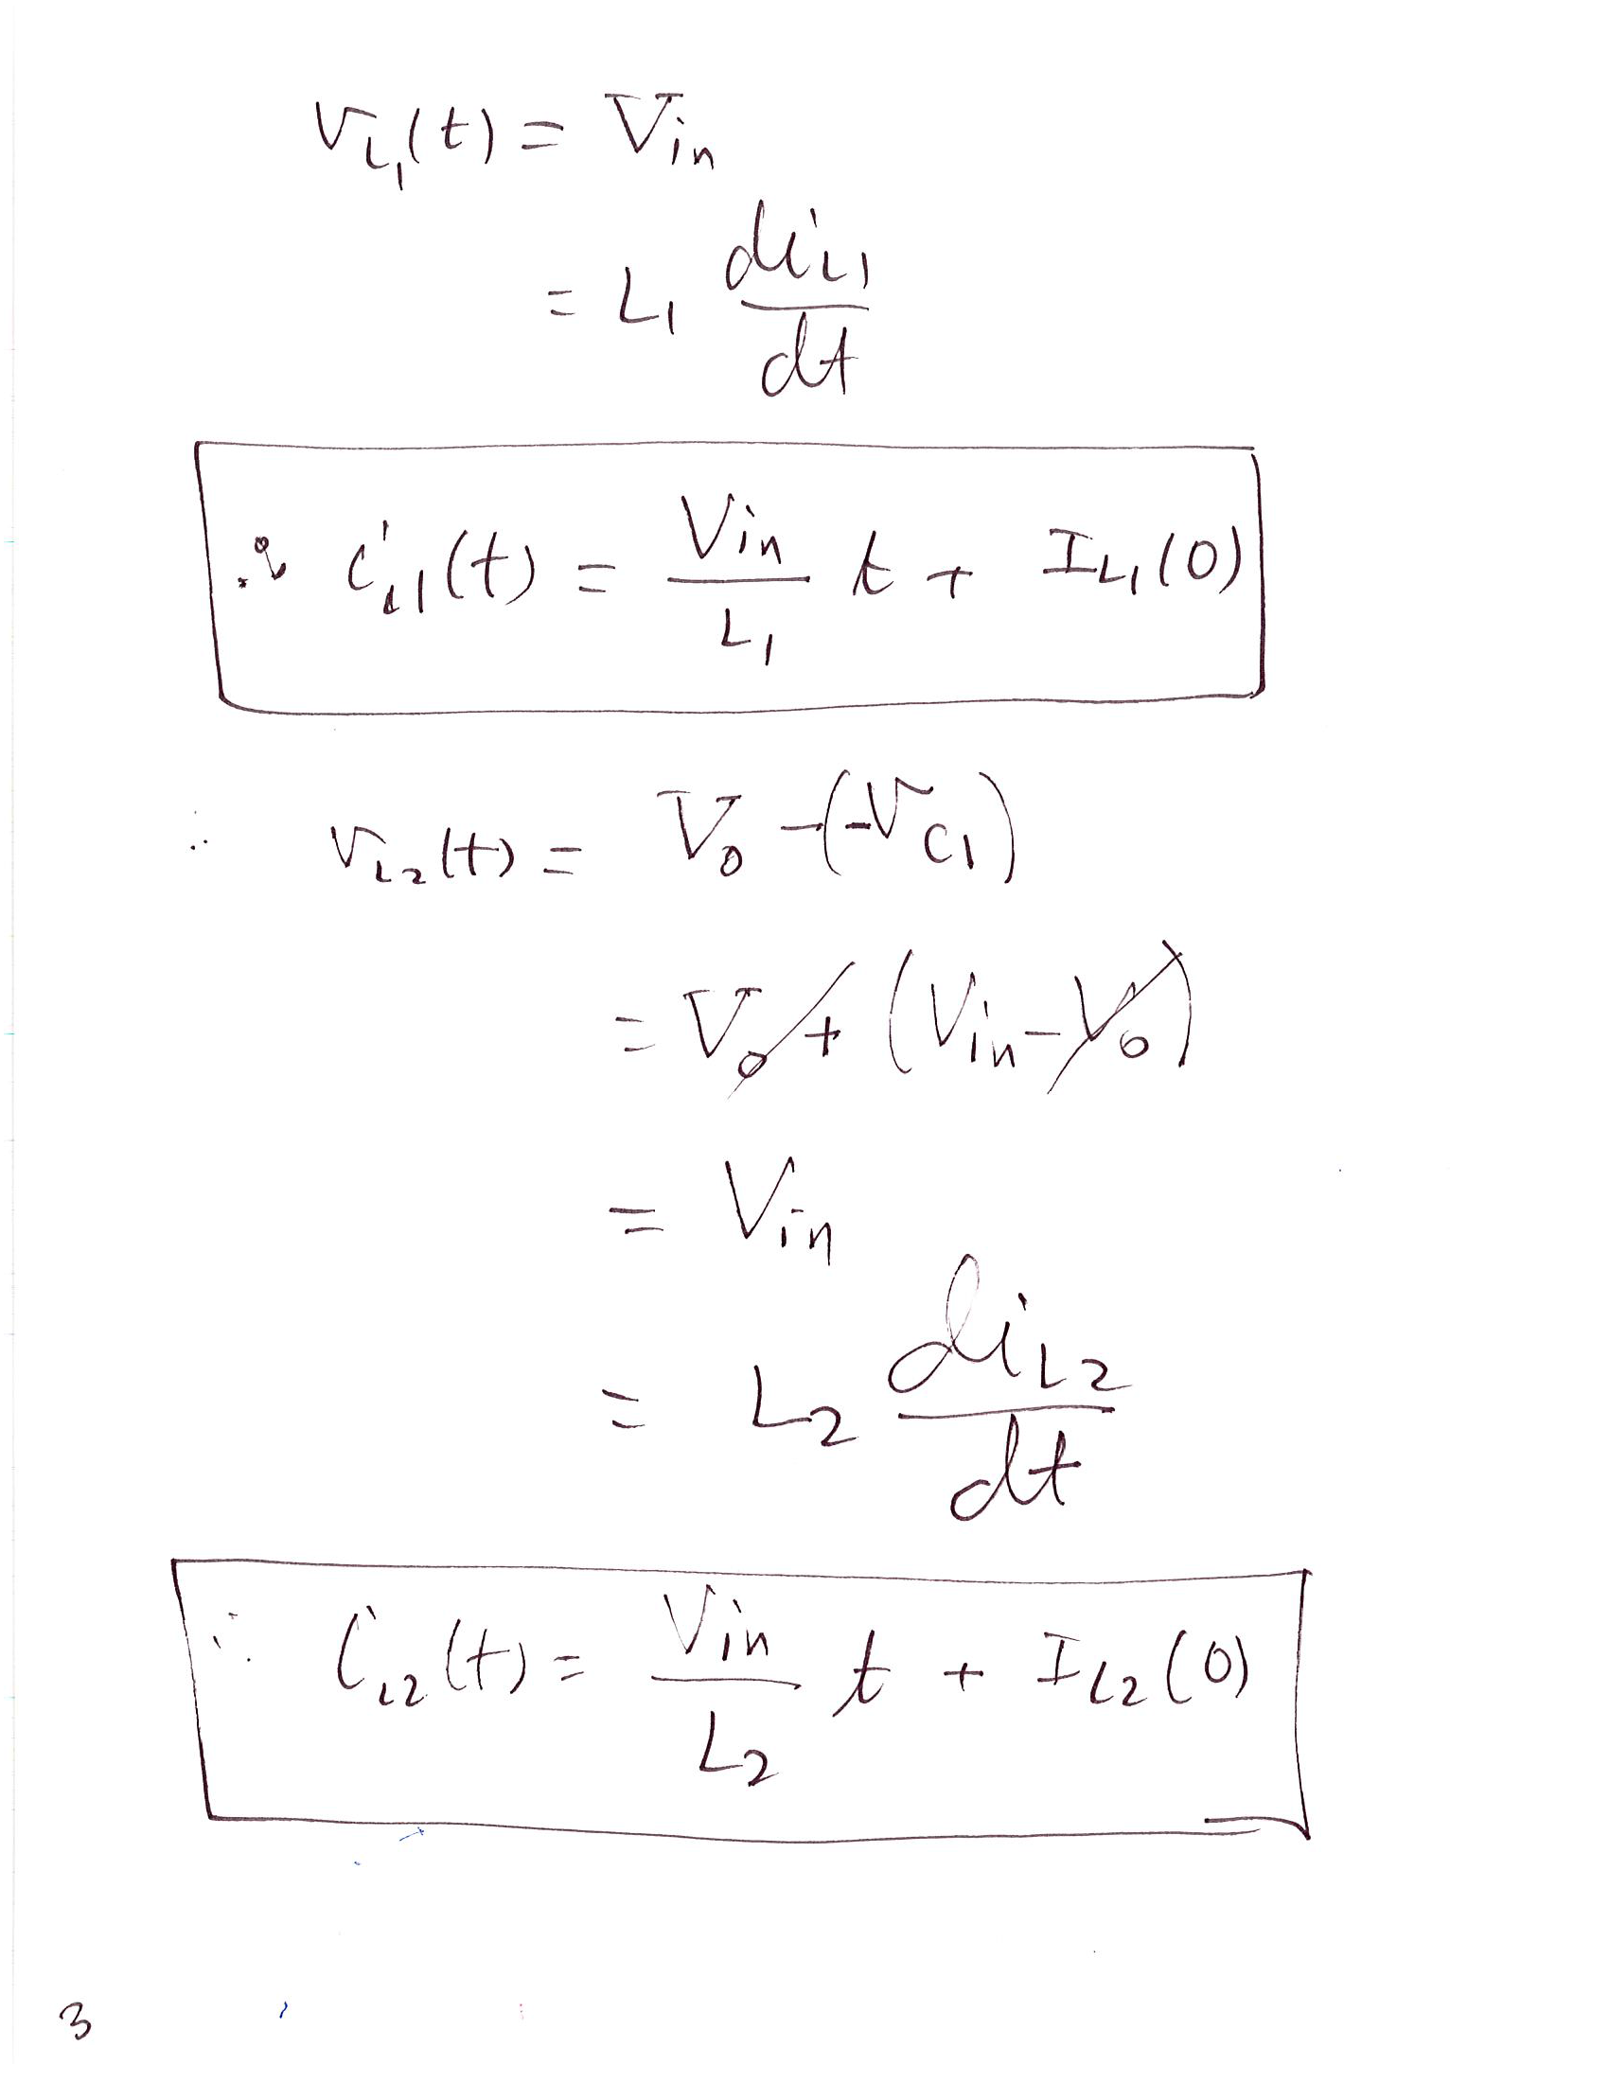

Slide 19
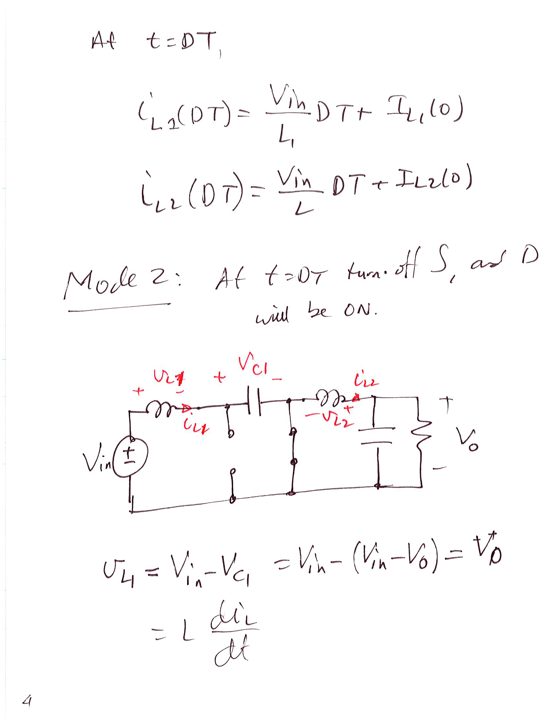

Slide 20
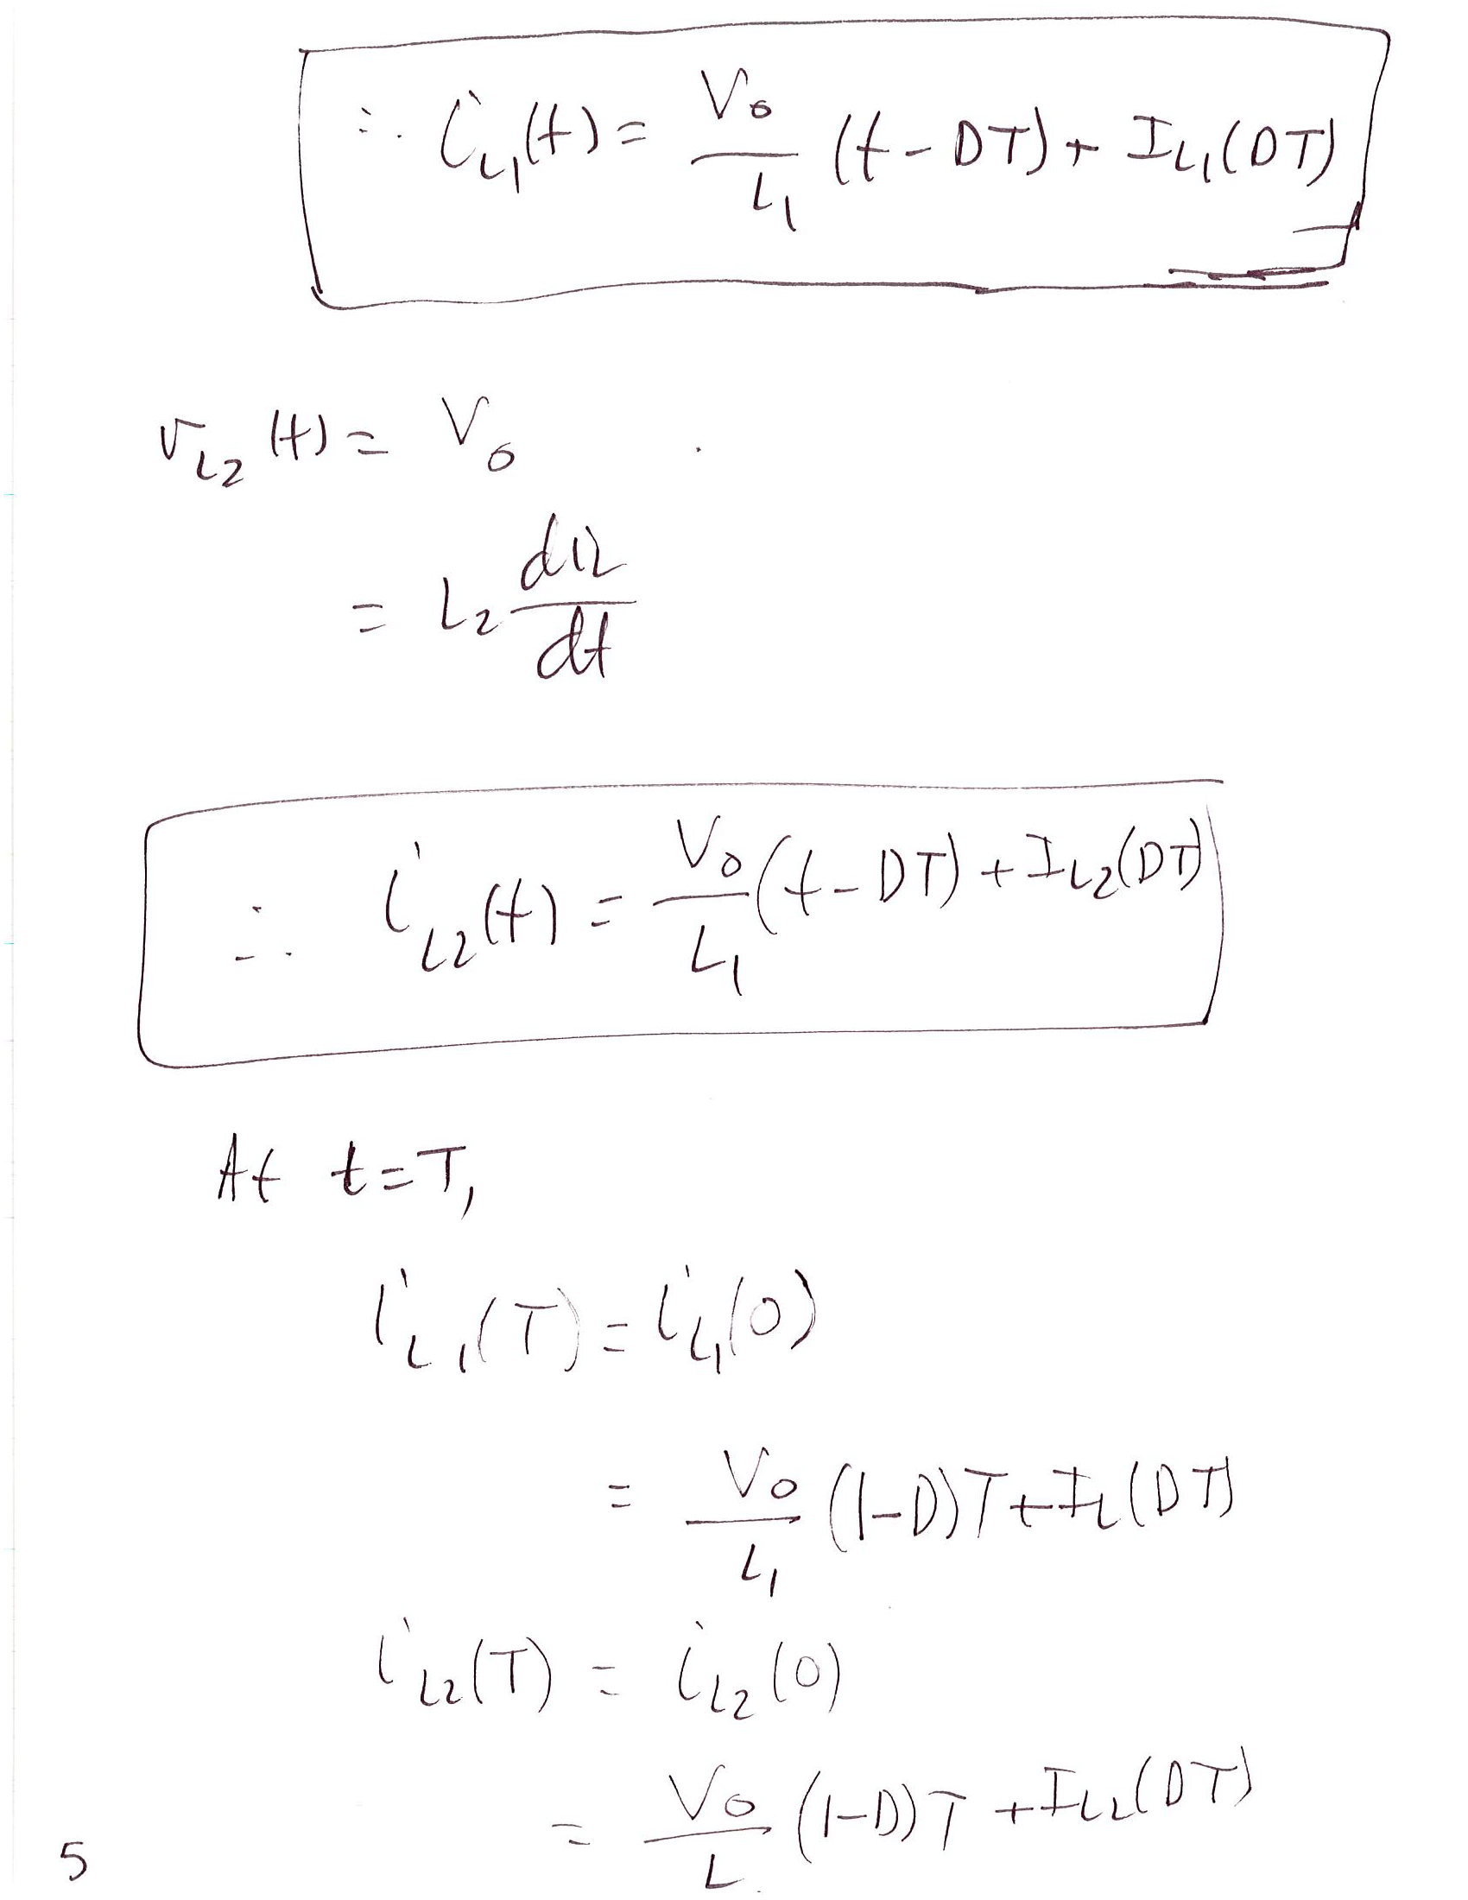

Slide 21
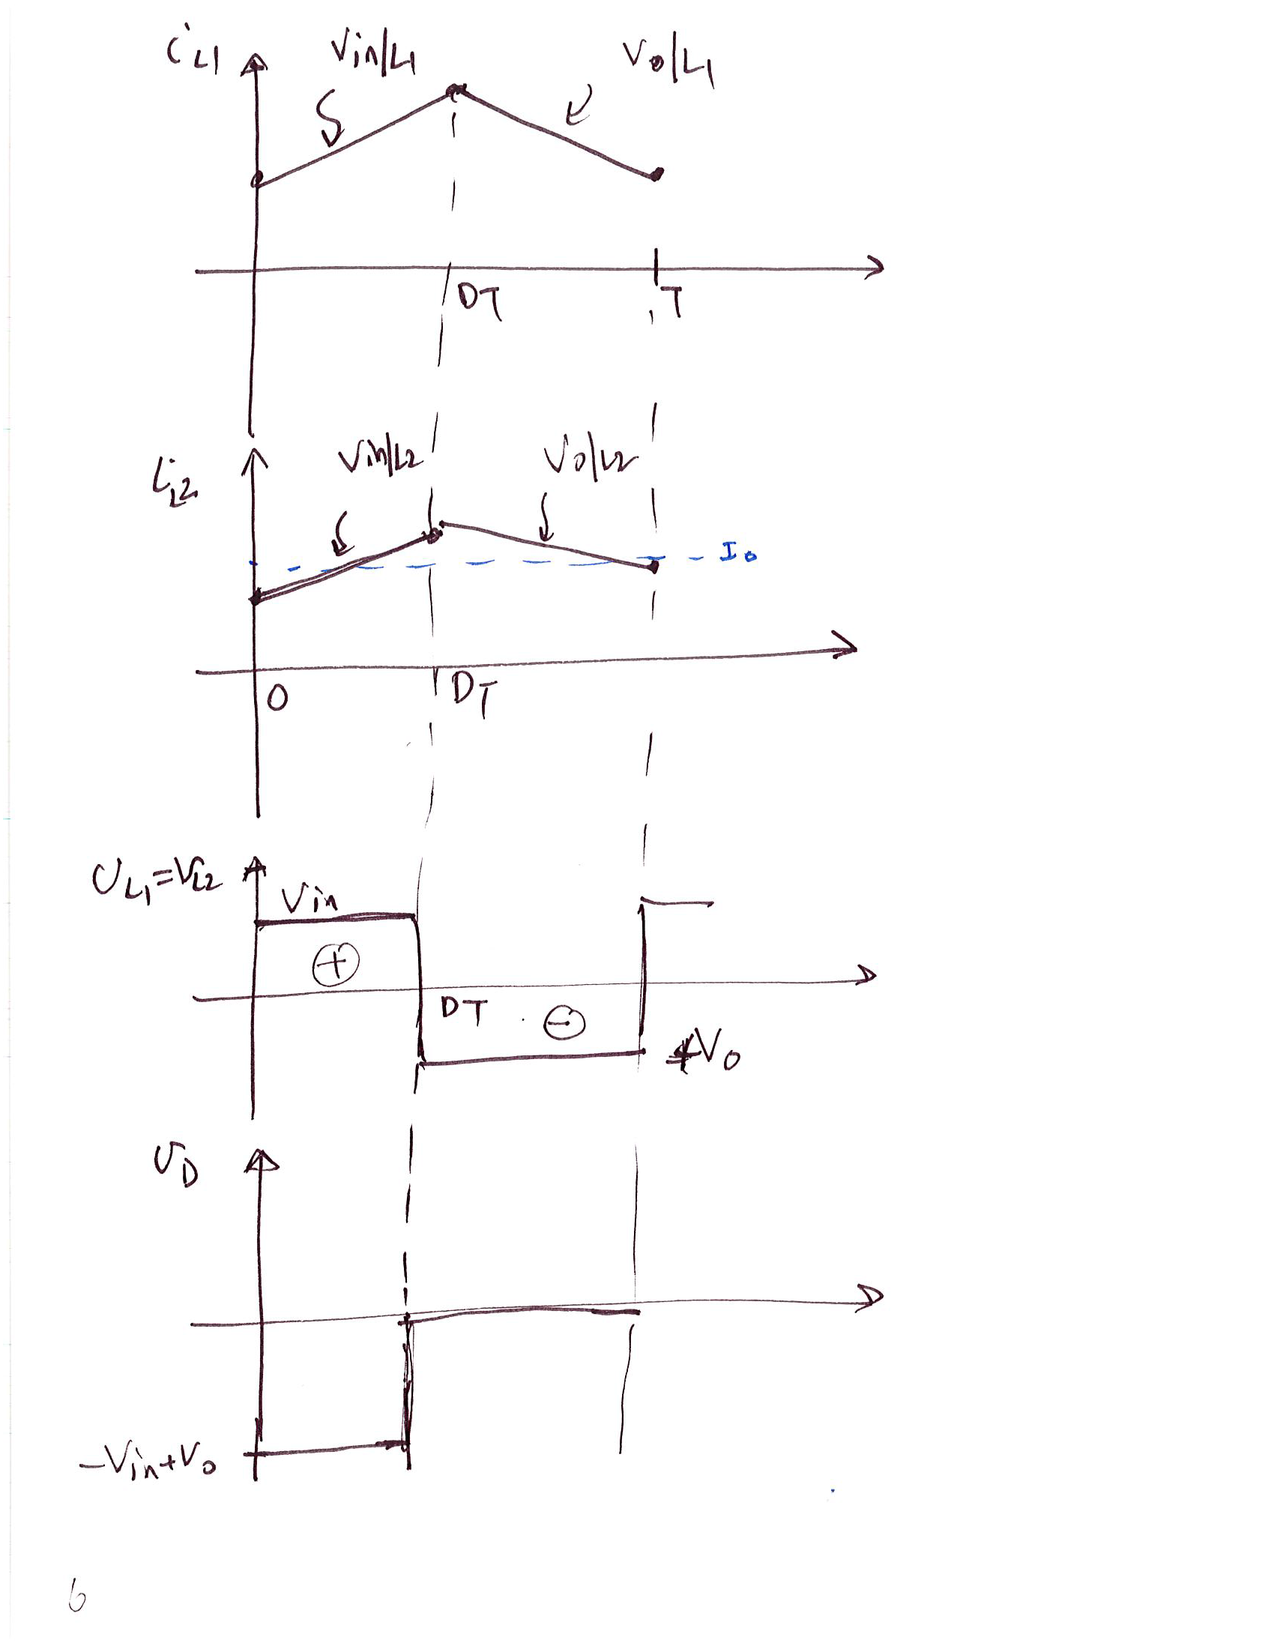

Slide 22
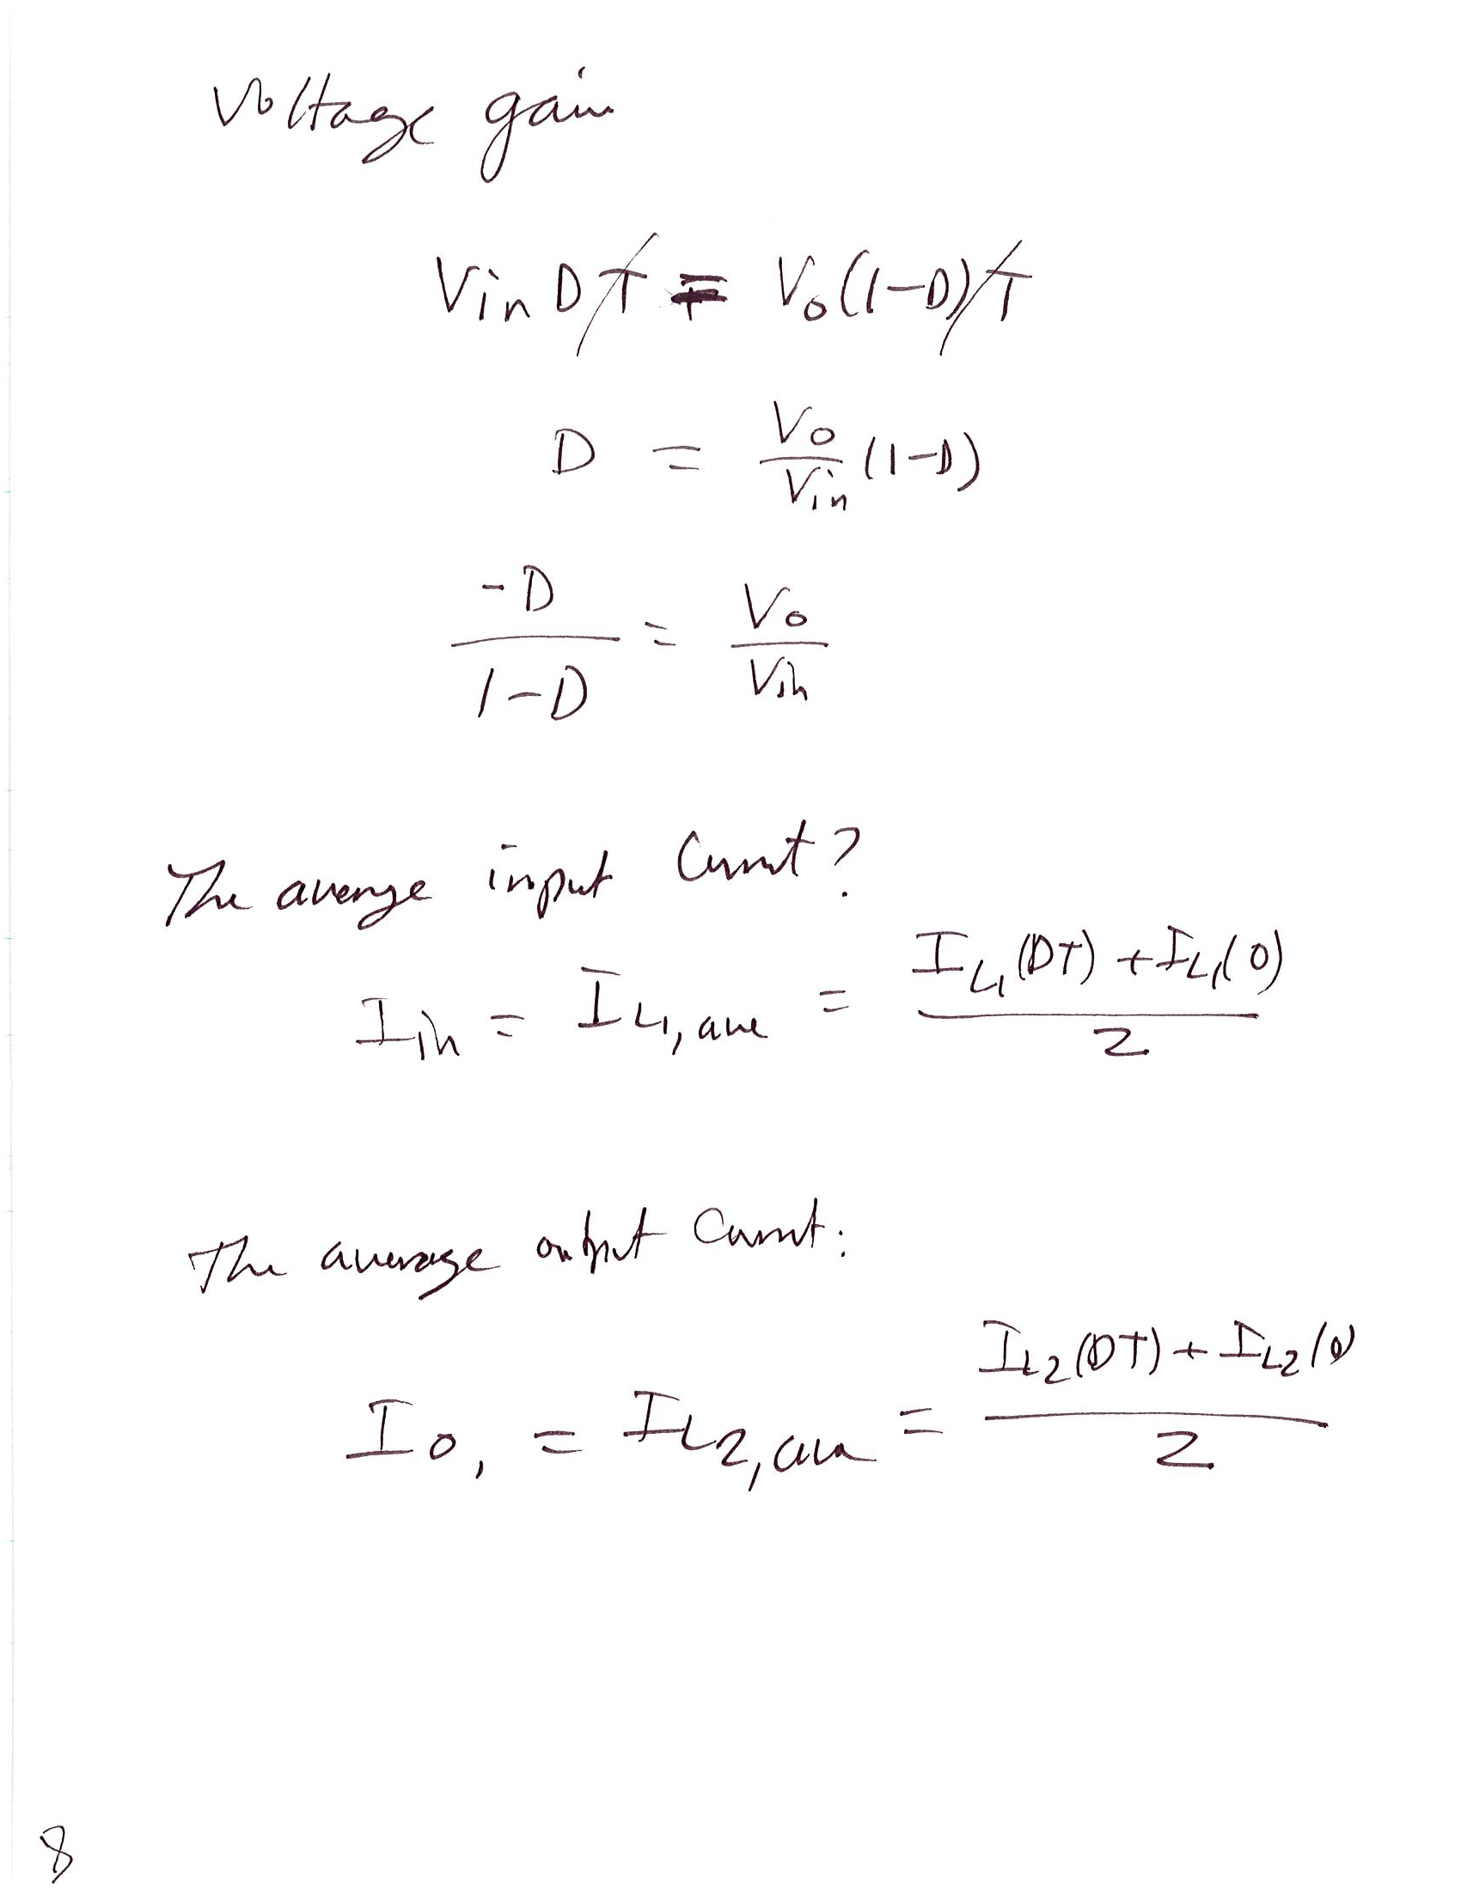
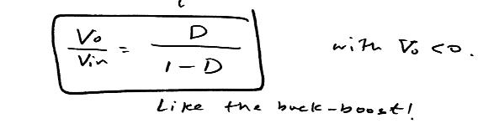

Slide 23
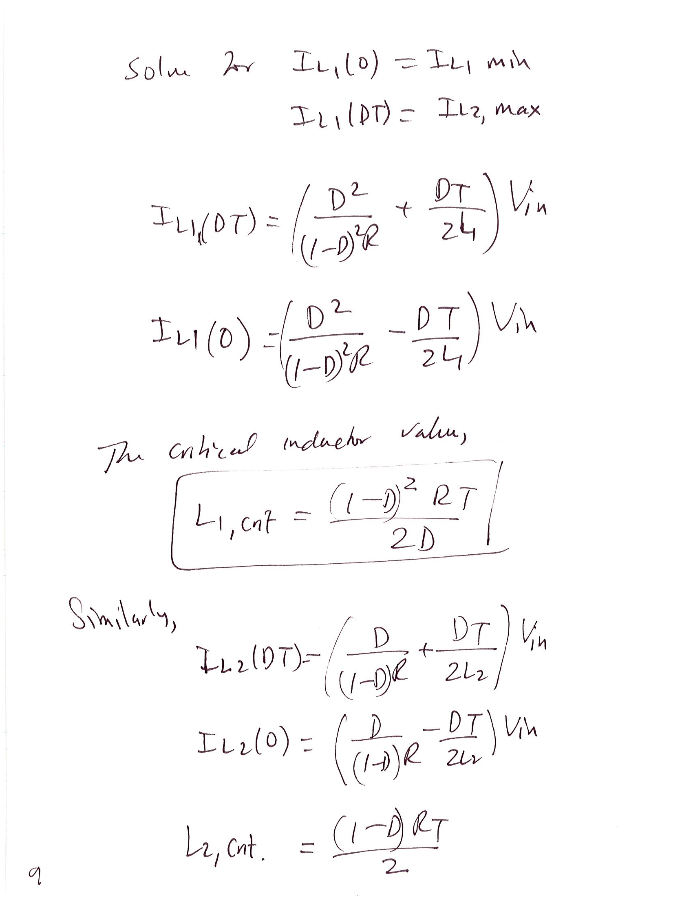

Slide 24
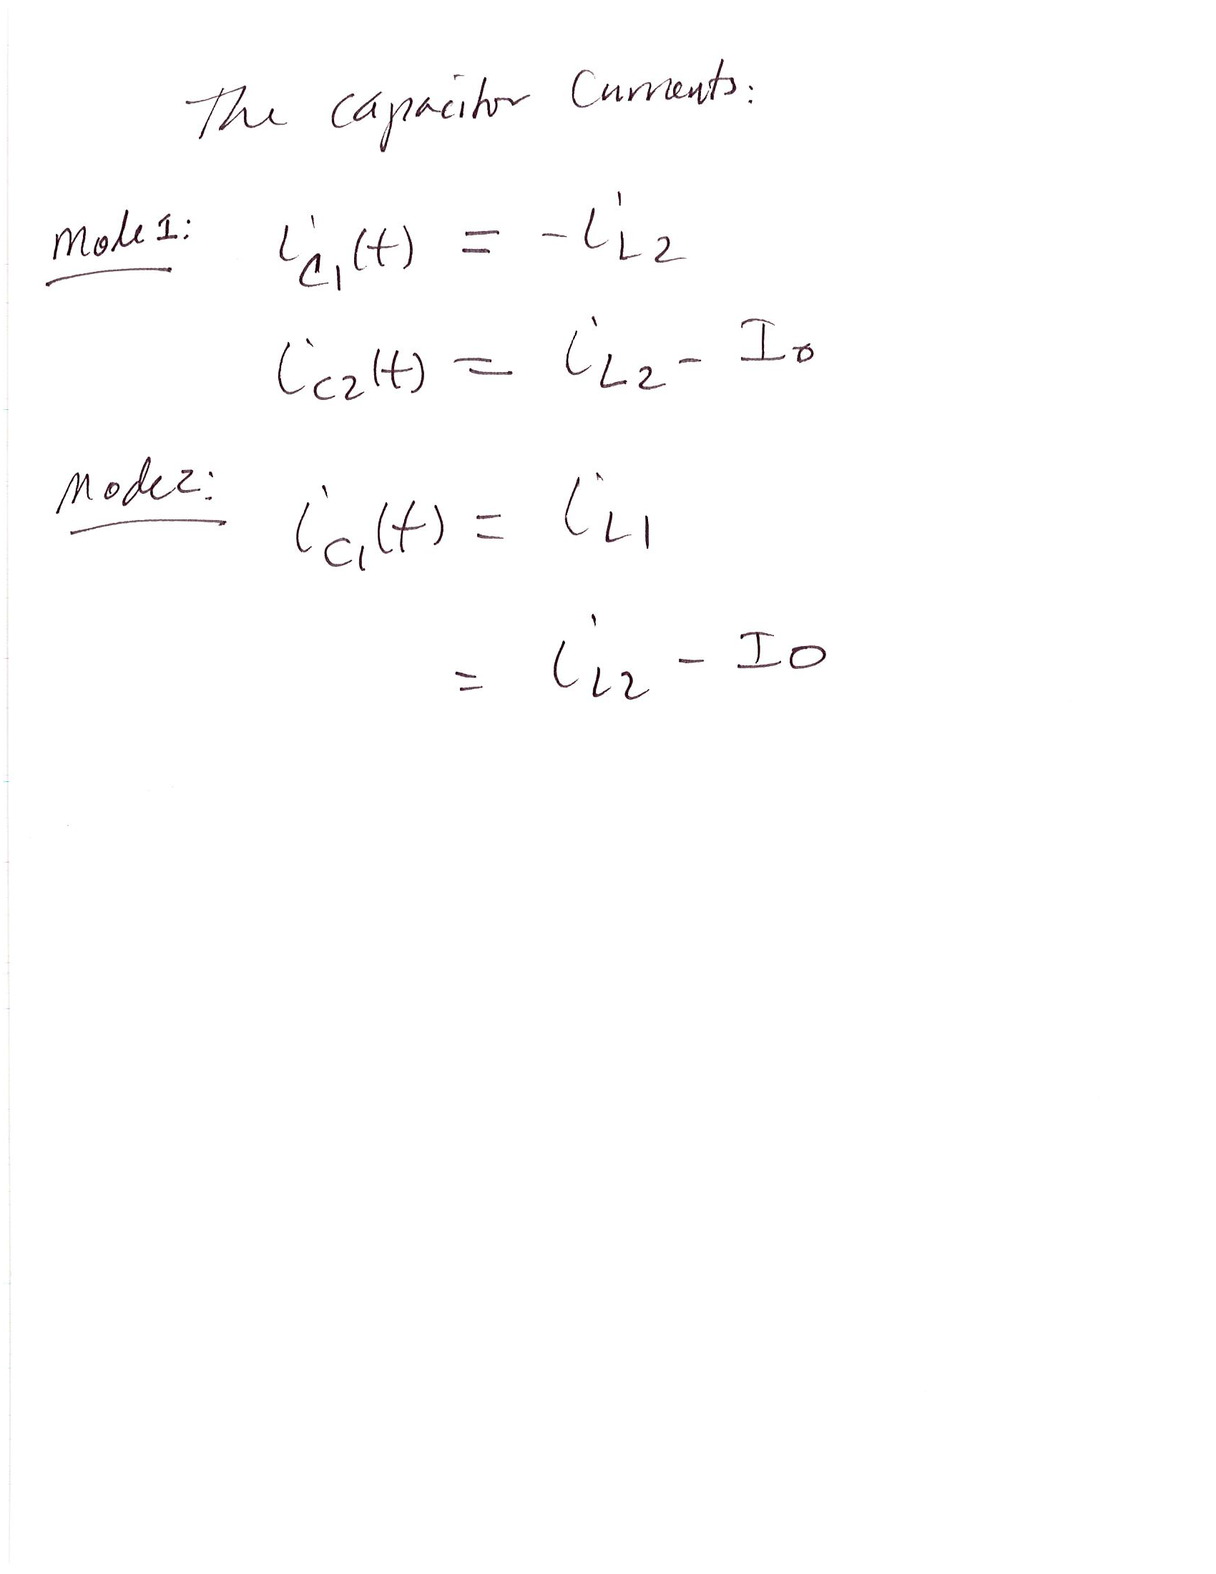

Slide 25
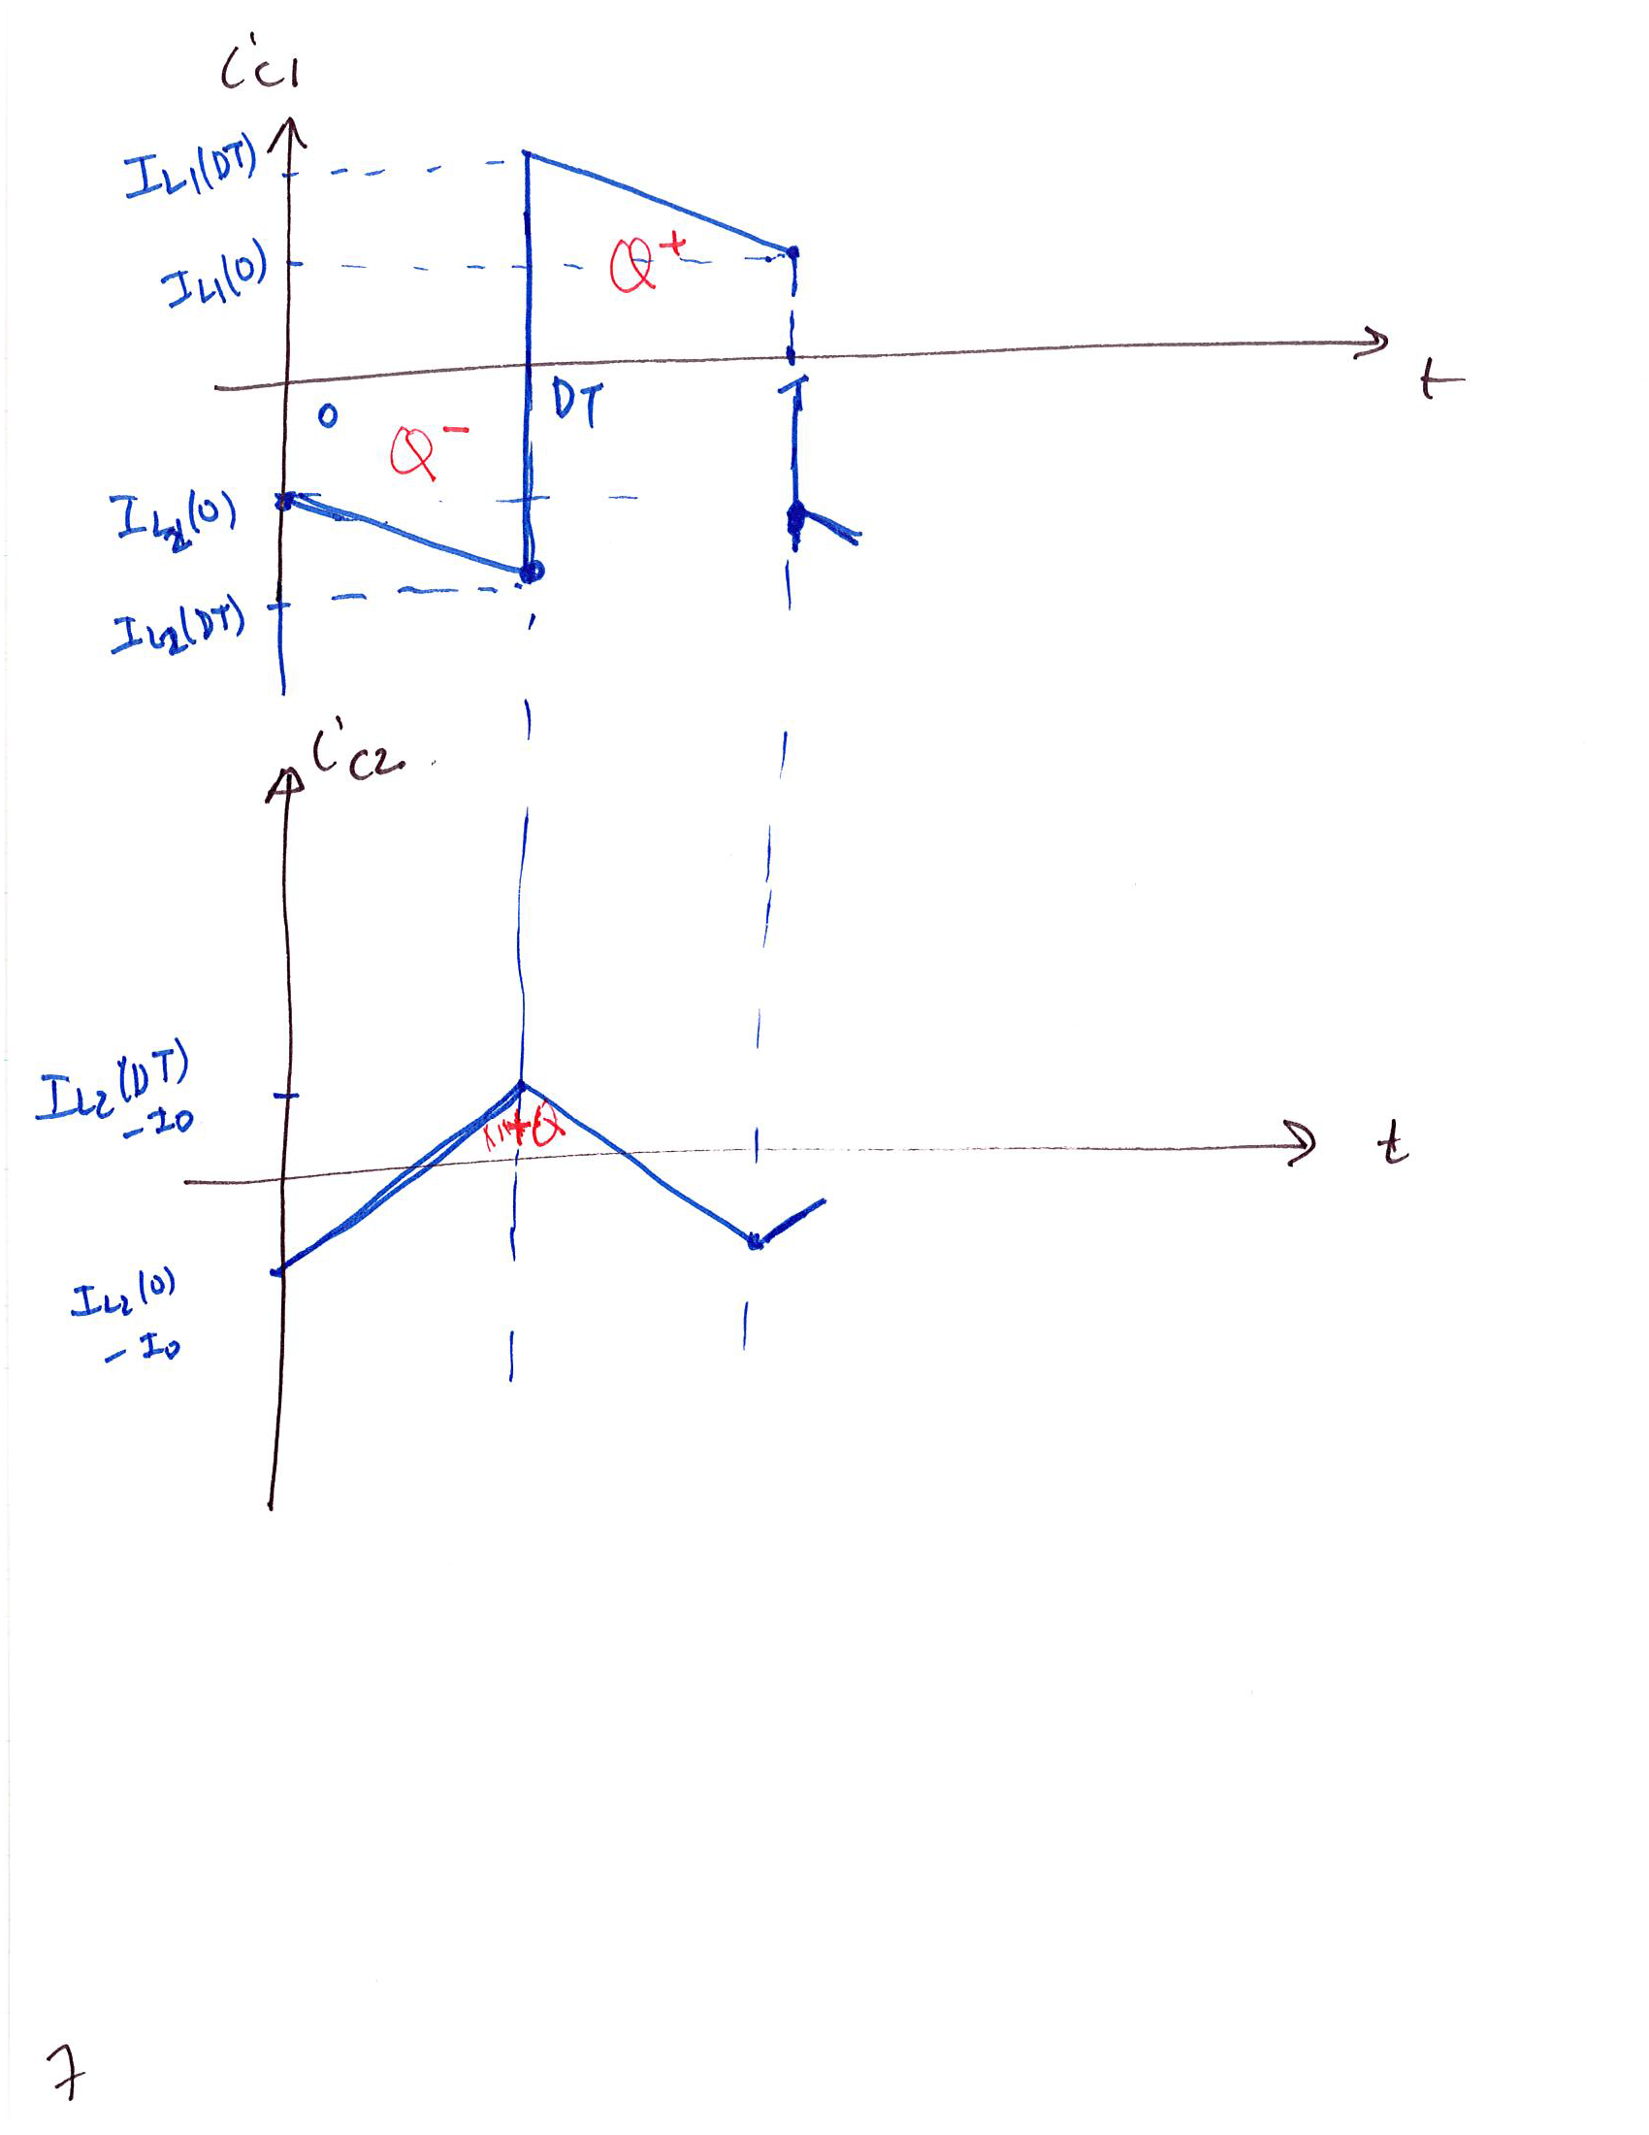

Slide 26
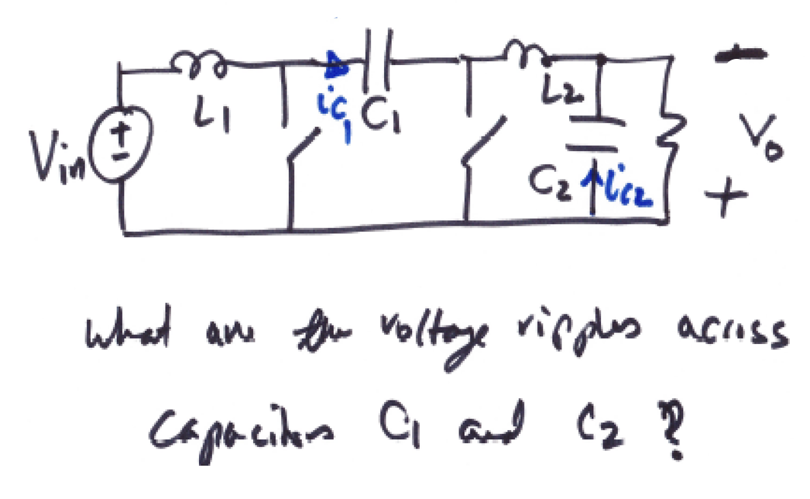
EEL 5245
Ripple Analysis of the Cuk Converter

Slide 27
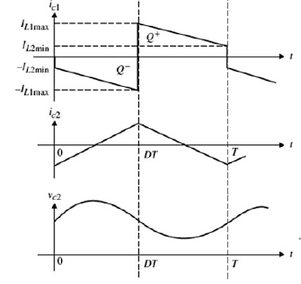
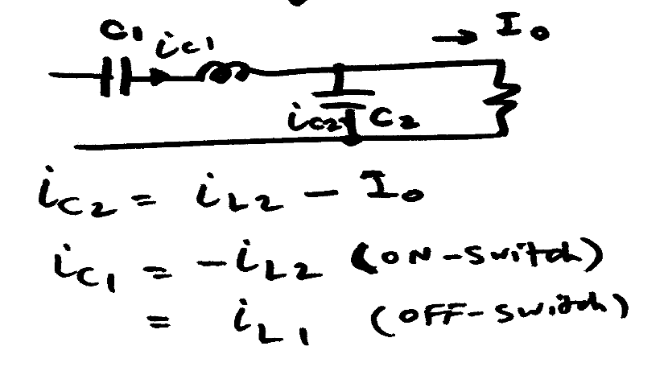
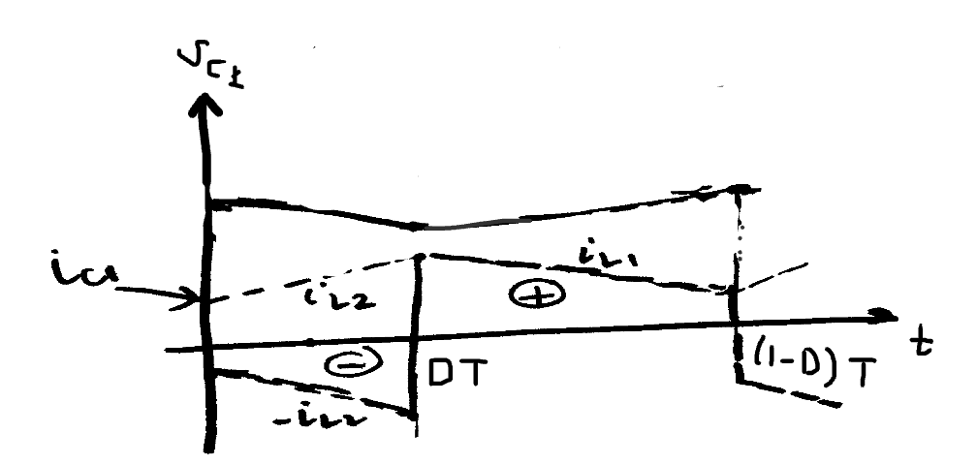
EEL 5245
Ripple Analysis – Capacitor wavefroms

Slide 28
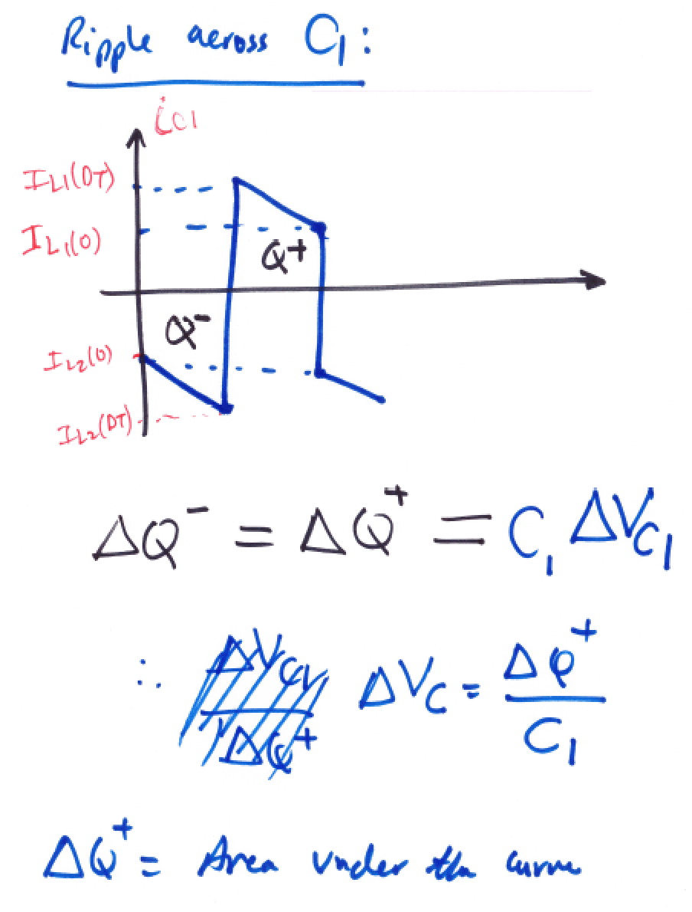

EEL 5245

Slide 29
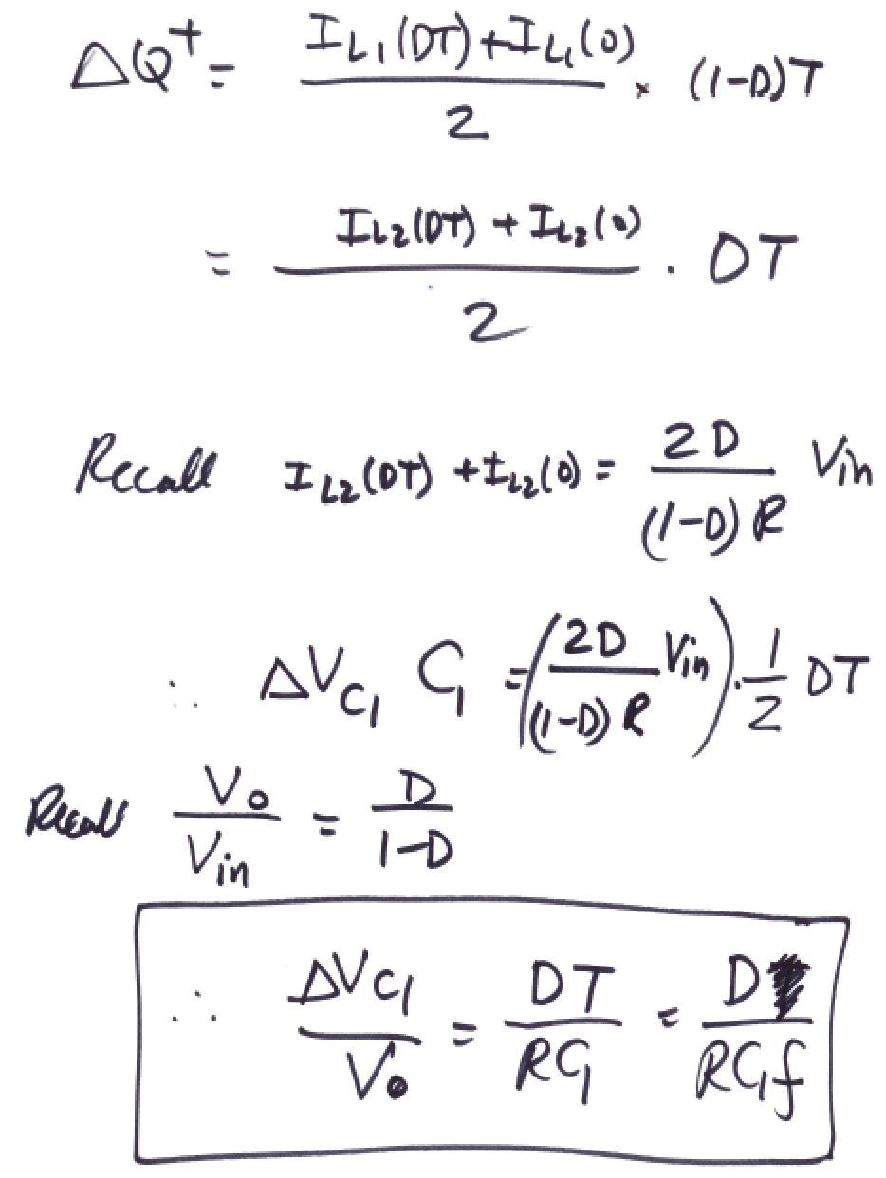
EEL 5245

Slide 30
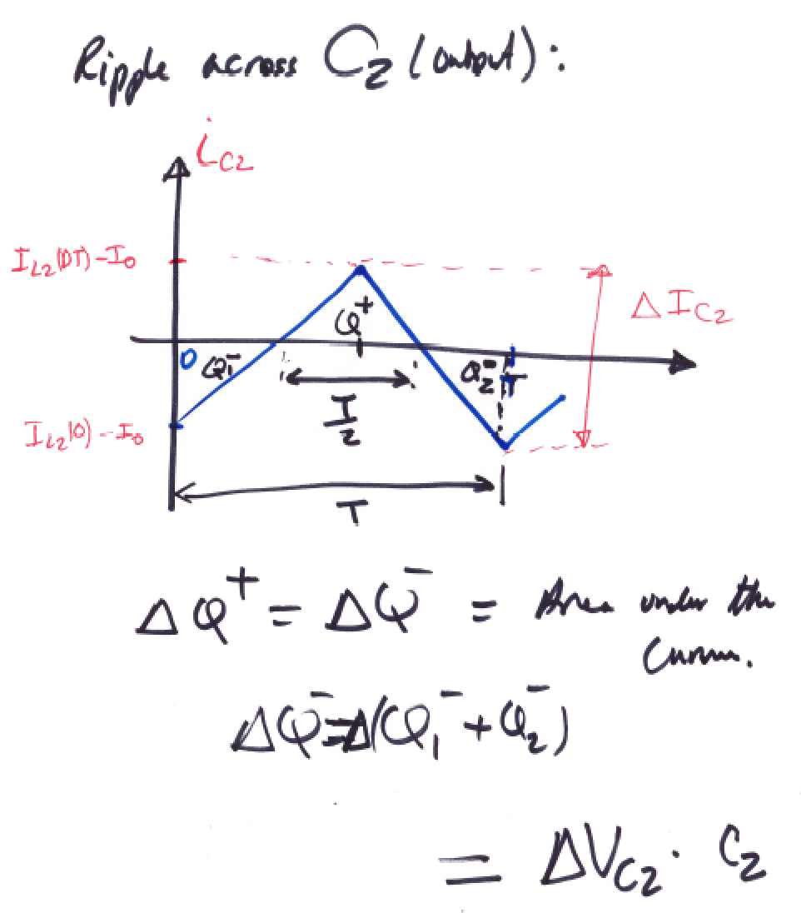
EEL 5245

Slide 31
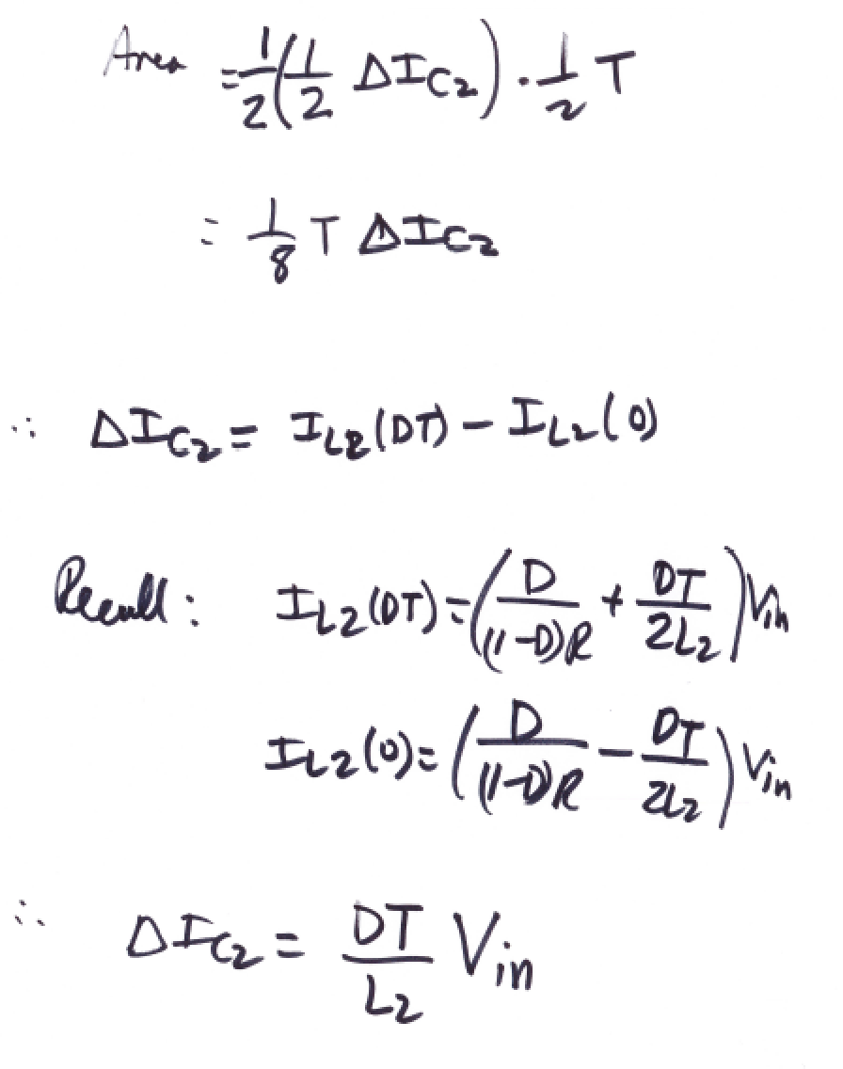
EEL 5245

Slide 32
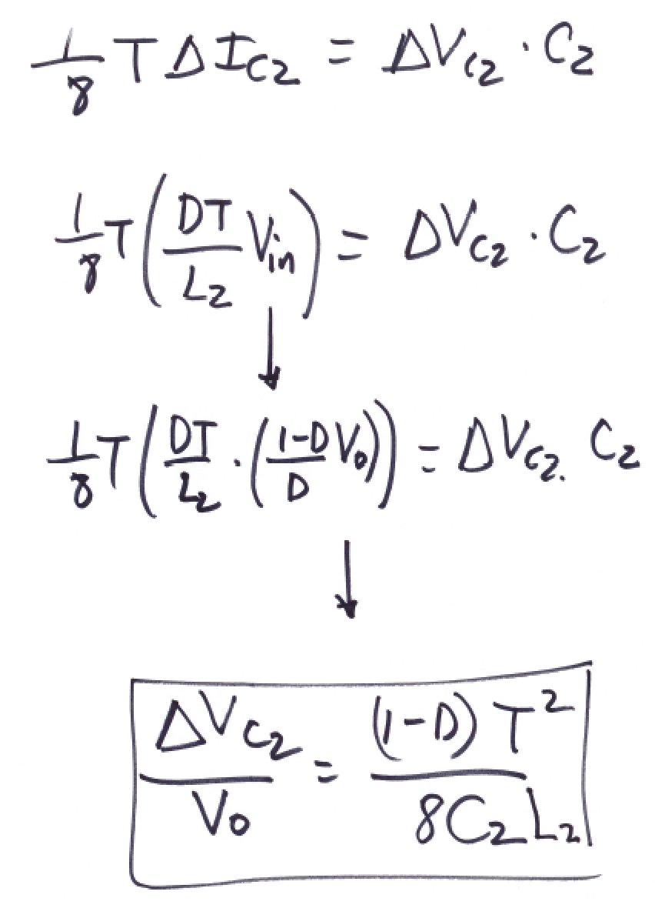
EEL 5245

Slide 33
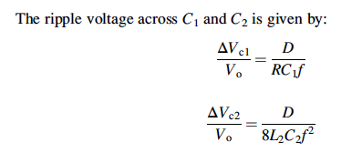

Slide 34
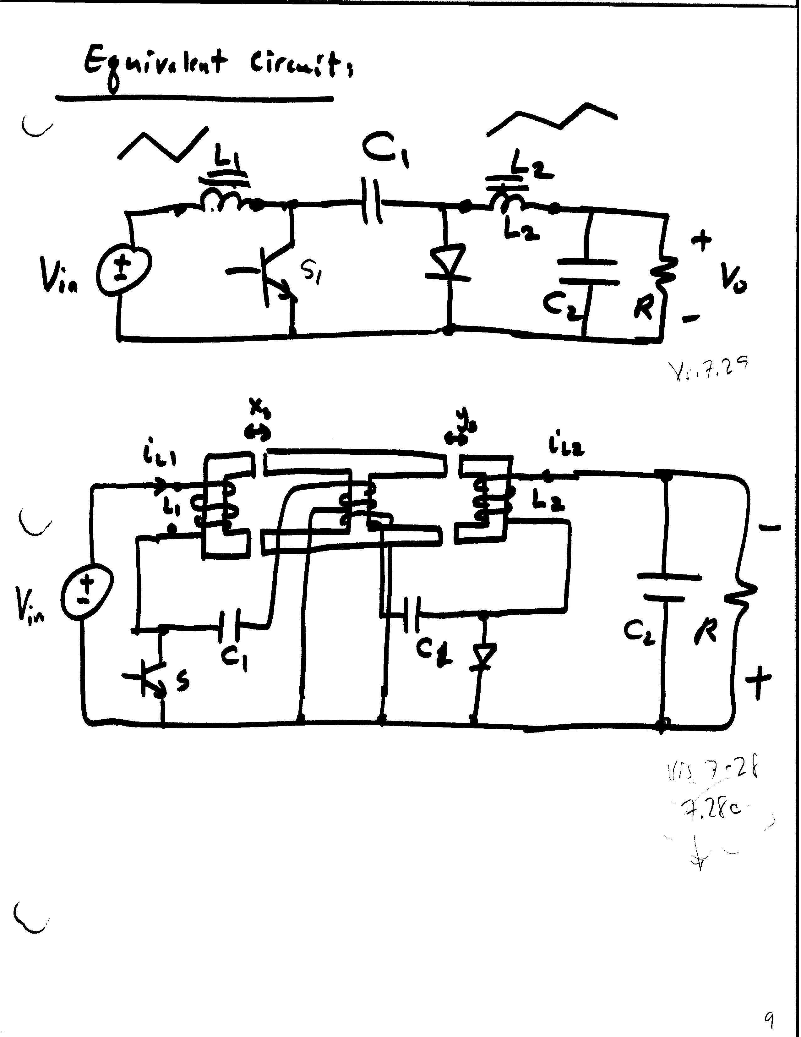
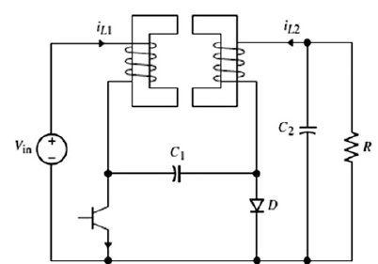




Slide 35
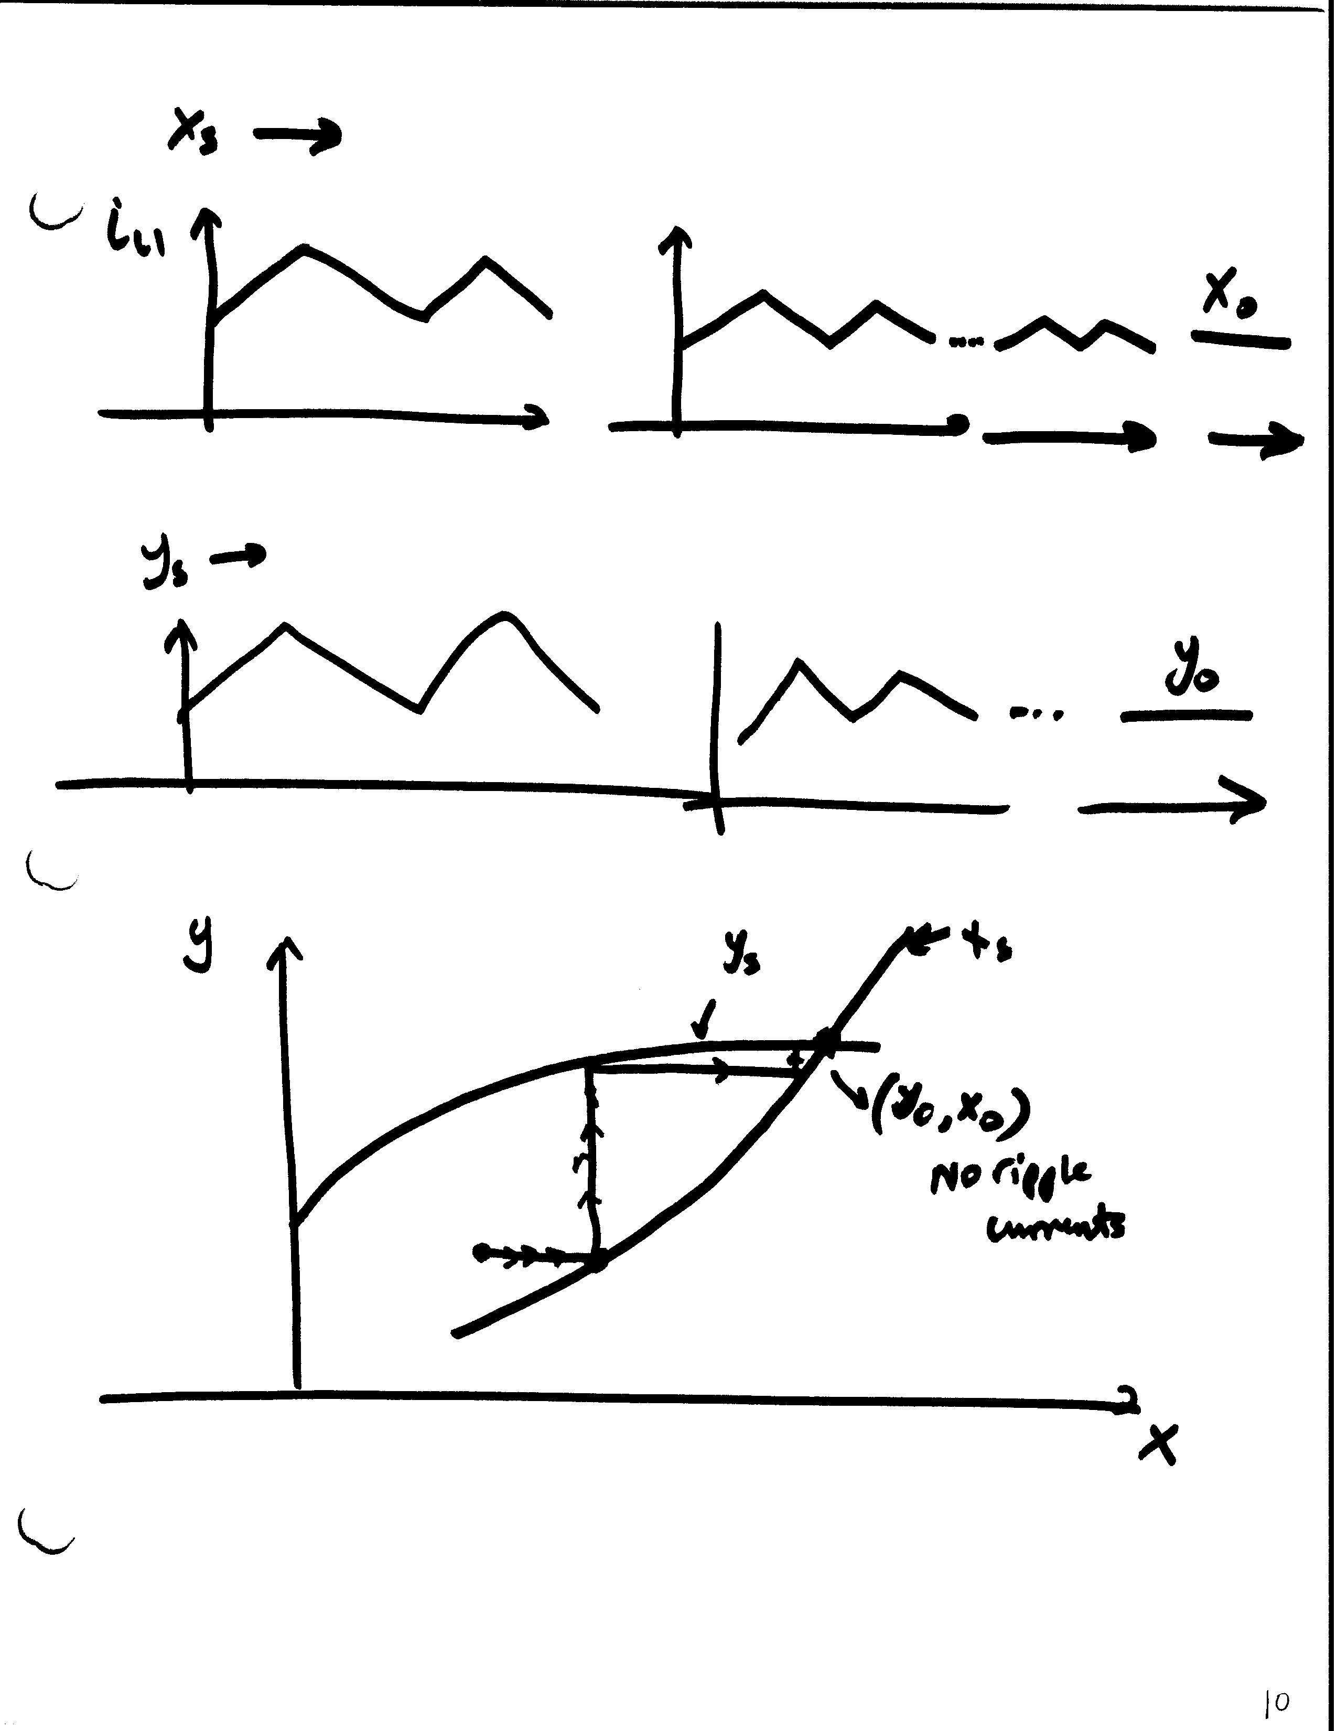




Slide 36
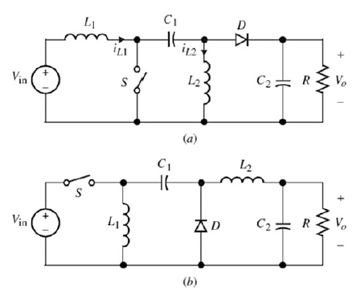
Zeta & SEPC Converters (CCM)
SEPIC
Single-Ended Primary Inductor Converter
ZETA
Inverse of SEPIC

Slide 37
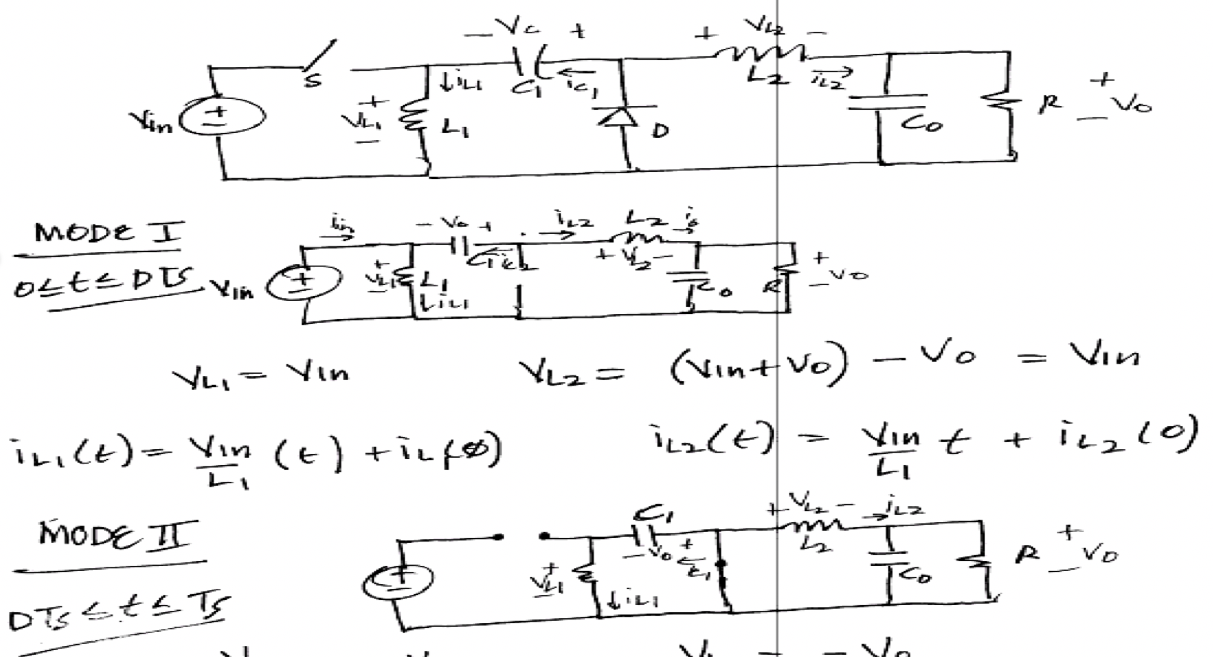


Zeta Converter
Steady-State Analysis (CCM)

Slide 38
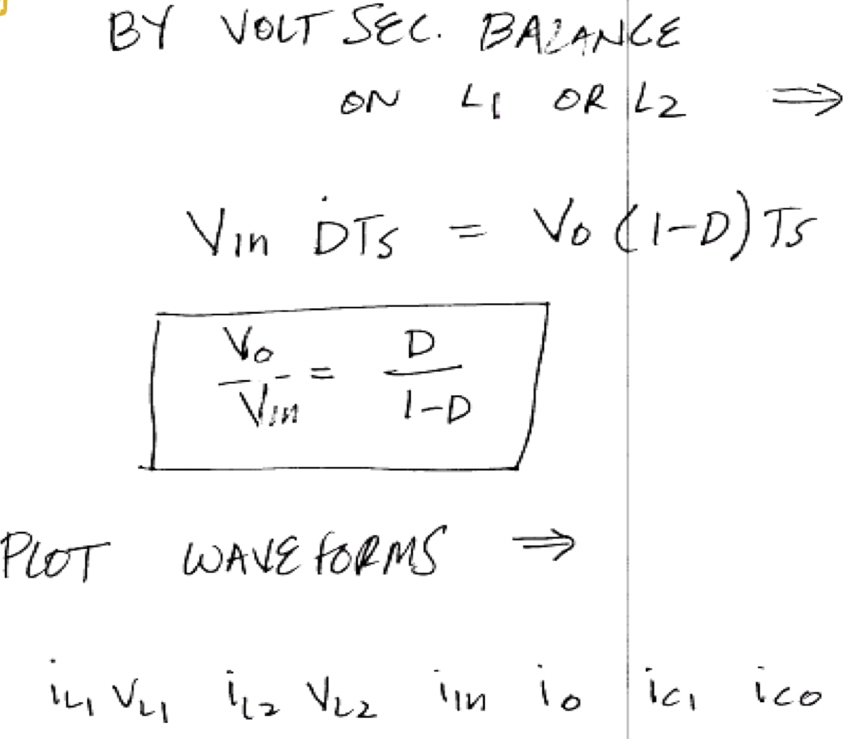

Slide 40
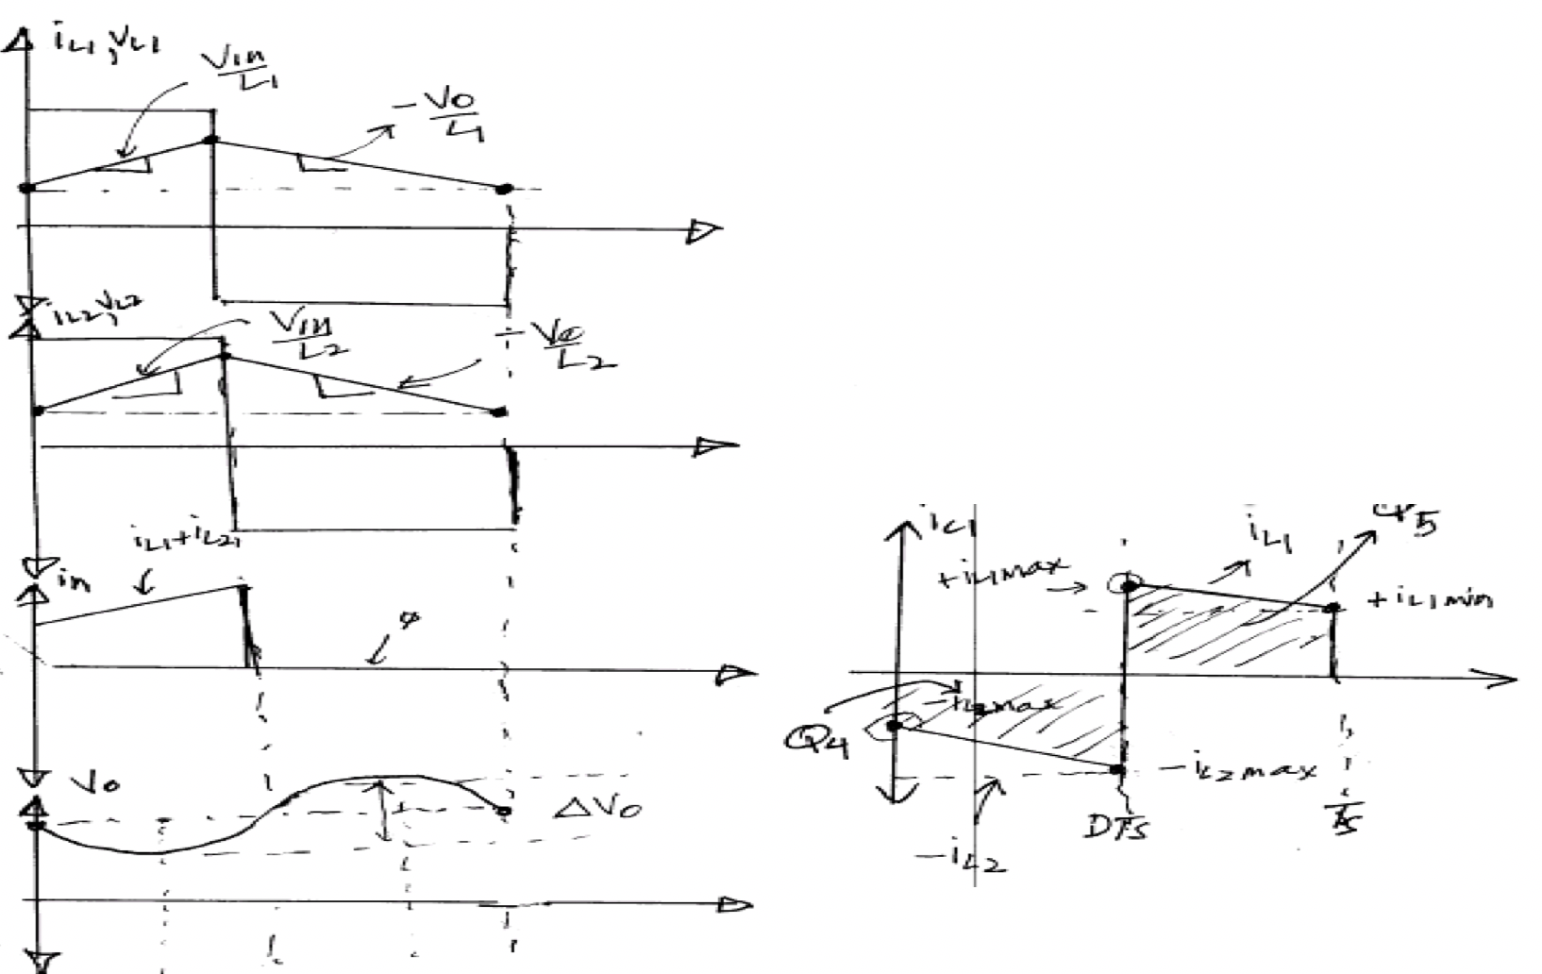

Slide 45
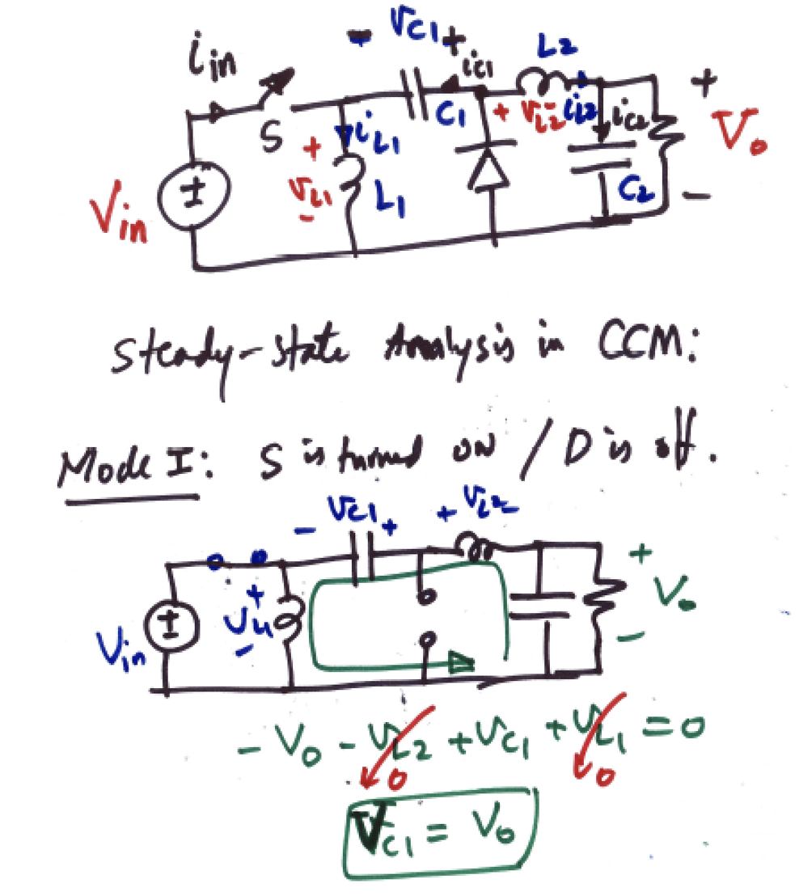
Analysis of the Zeta Converters (CCM)

Slide 46
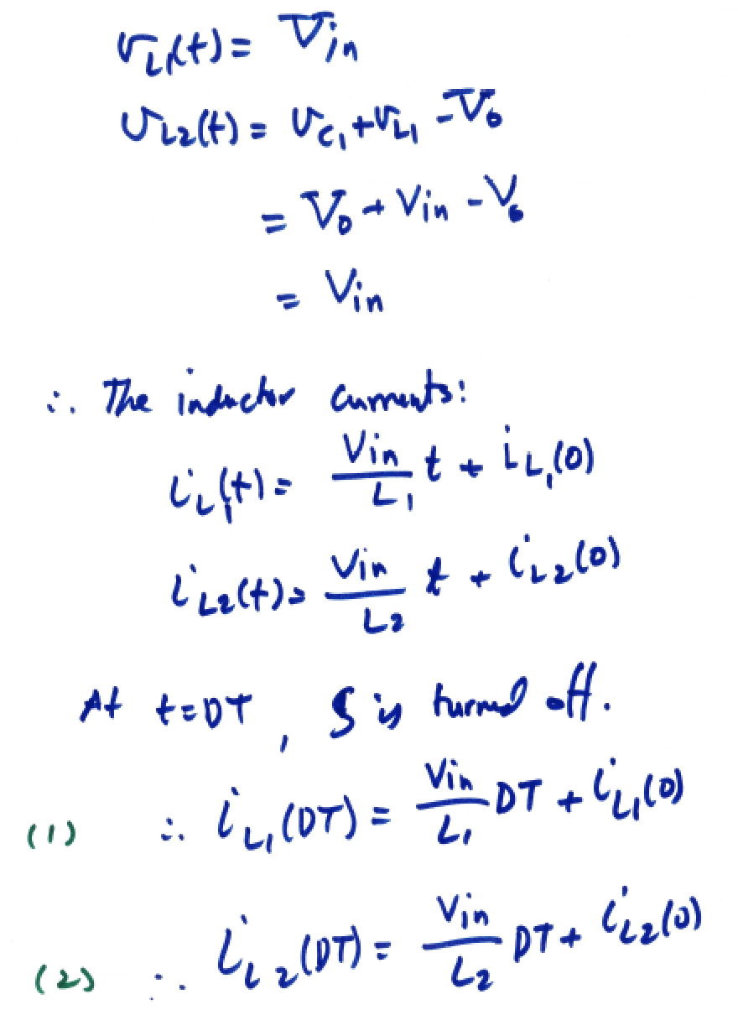

Slide 47
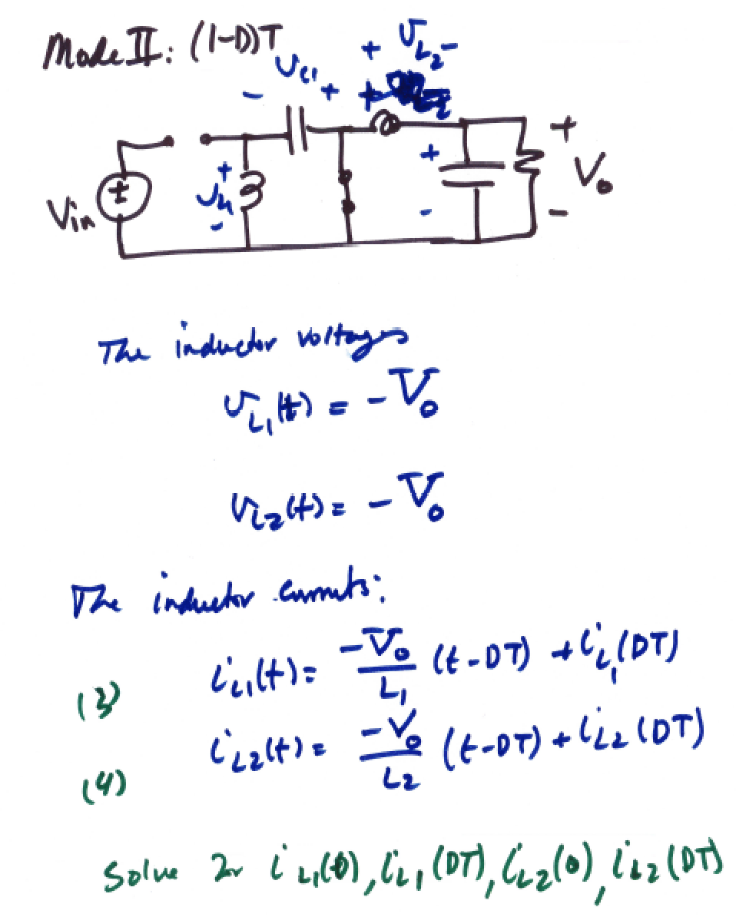


Slide 48
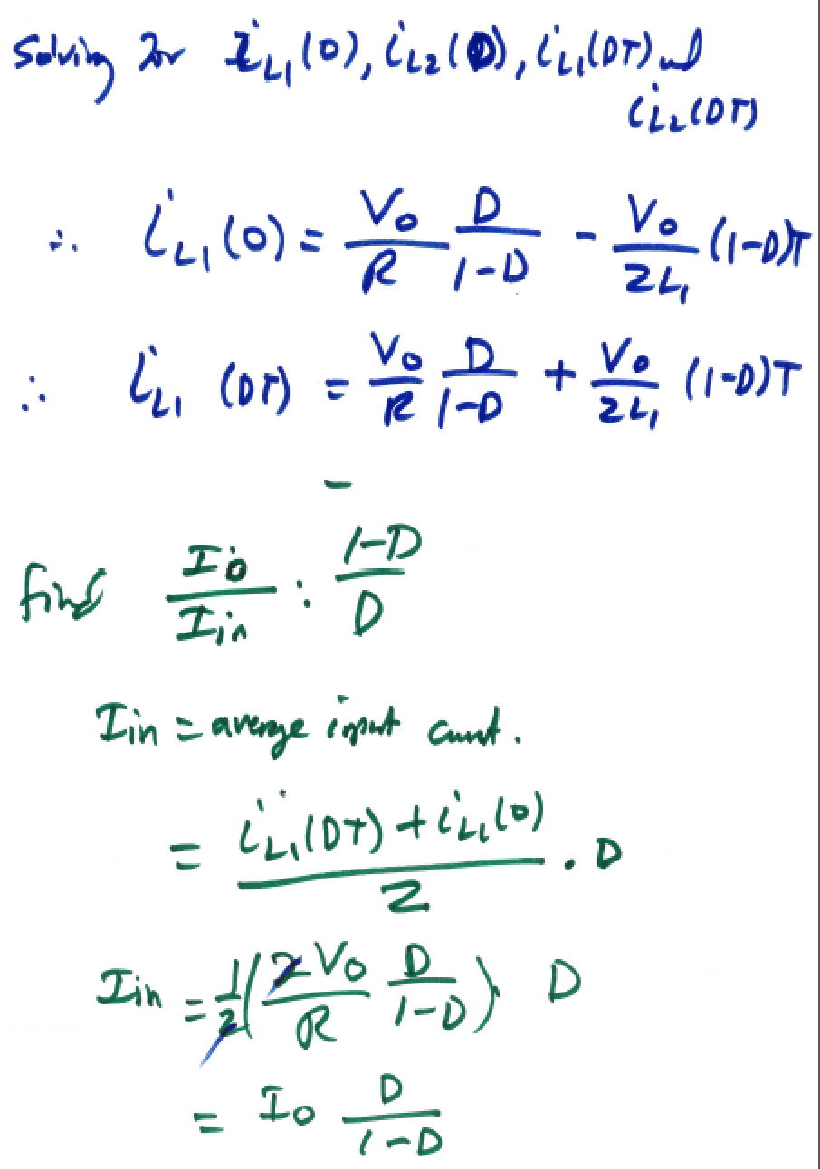





Slide 49


Slide 50


Slide 51


Slide 52


Slide 53


