Slide 1
EEL 5245 POWER ELECTRONICS I Lecture #14: Ch 4: Non-Isolated DC-DC Converters PWM Converters Buck Analysis (CCM)

Slide 2
Midterm Exam
Oct. 30 (Monday)
Chapters 2,3 and Sections 4.1-4.4
In class with open notes and book

Slide 3
Objectives
Overview of DC-DC Conversion
Linear Regulators: Regulated vs. Unregulated
Overview of Pulse Width Modulation Converters
PWM Converter Analysis Principles/Tools
Buck Converter Analysis (Continuous & Discontinuous Conduction Mode (CCM&DCM)
Voltage Conversion Ratio (M=Gain)
Average Input and Output Currents
Output Voltage Ripple via Charge approximation
Boundary Between CCM and DCM
Calculation Example
Analysis Verification by Simulation

Slide 4
Classic Converter Topologies
Voltage Gain → M=V/Vg

Slide 5
Analysis of Classic Converter Topologies
Analysis will assume lossless components
Exact steady state analysis would involve solution of nonlinear, 2nd Order system, we will simplify to a 1st Order System with:
Since RC>>Ts, output voltage nearly constant over switching period
Since ripple is assumed small, we assume Vo a constant during analysis (output cap not considered)
We assume analysis of converter takes place at after it has reached steady state
Since steady state, average inductor voltage equals zero over switching interval (volt-sec balance)
Since steady state, average capacitor current over one switching interval equals zero (charge balance)

Slide 6
Analysis of Classic Converter Topologies
The preceding concepts can be expressed in terms of mathematical relations.
These are tools for analysis:
P_{out}=P_{in} (Power Conservation)
i_{L}(t_{o})=i_{L}(t_{o}+T_{s}) (Steady State)
V_{Lavg}=0 (volt-sec balance)
v_{C}(t_{o})=v_{C}(t_{o}+T_{s}) (Steady State)
I_{cavg}=0 (Charge Balance)

Slide 7
Converter Analysis Principle Small Ripple Approximation

Slide 8
Converter Analysis Principle Inductor Volt-Second Balance
Inductor defining relation :
Integrate over one complete switching period :
In periodic steady state, the net change in inductor current is zero :
Hence, the total area (or volt-seconds) under the inductor voltage
waveform is zero whenever the converter operates in steady state.
An equivalent form:
The average inductor voltage is zero in steady state

Slide 9
Converter Analysis Principle Capacitor Charge Balance
Capacitor defining relation:
Integrate over one complete switching period
In periodic steady state, the net change in capacitor voltage is zero:
Hence, the area (or charge) under the capacitor current
waveform is zero whenever the converter operates in steady state.
The average capacitor current is then zero.

Slide 10
Figures of Merit for the PWM DC-DC Converter
Classic Converter Analysis (CCM&DCM)
Voltage Conversion Ratio (M=Gain)
Use Inductor Volt-second balance
Average Input and Output Currents
Use waveform analysis and
Capacitor charge balance and small ripple approximation (Icavg=0)
Output Voltage Ripple via Charge approximation
Small ripple approximation meeans all ac component of output current seen by capacitor, DC to load R
Inductor current Ripple
Derived from inductor current waveform
Boundary Between CCM and DCM
Concept of Critical Inductance derived from iL expressions

Slide 11
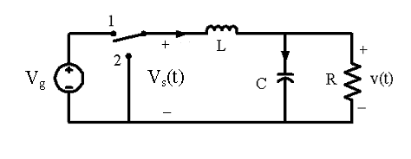
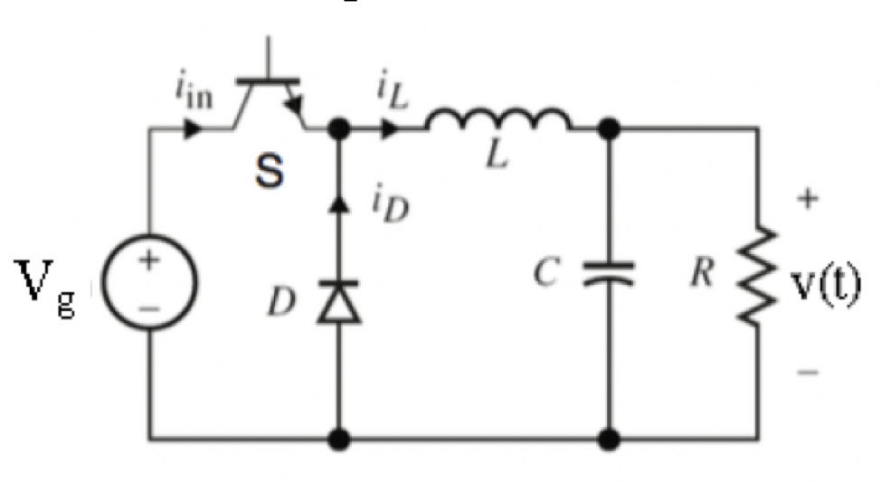
Buck Converter
Switch Position 2 for allow for uninterrupted inductor current flow
LPF for smoothing of pulse for constant DC output
Capacitor hold a DC value for the load when switch in position 1 (Inductor current charge)
2nd Order-1 L, 1 C
Switch-diode implementation
Switch is in Position 1: S is on and D is off
Switch is in Position 2: S is off and D is on

Slide 12
Buck Converter Analysis: Mode by Mode

Slide 13
Buck Converter Analysis: Mode I
Inductor voltage
Small ripple approximation :
Solve for the slope :
The inductor current changes with an essential constant slope

Slide 14
Buck Converter Analysis: Mode II
Inductor voltage
Small ripple approximation :
Solve for the slope :
The inductor current changes with an essential constant slope

Slide 15
Buck Converter Analysis: Waveforms Start up Transient
i_{L}(DT_{s})
2T_{s}
3T_{s}

Slide 16
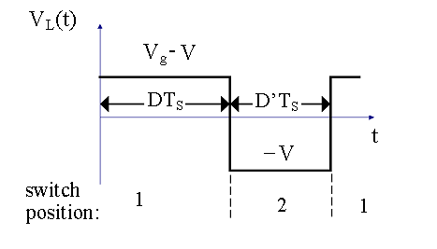
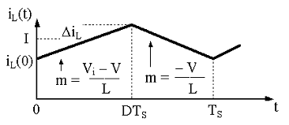
Buck Converter Analysis: Waveforms Inductor Voltage and Current

Slide 17
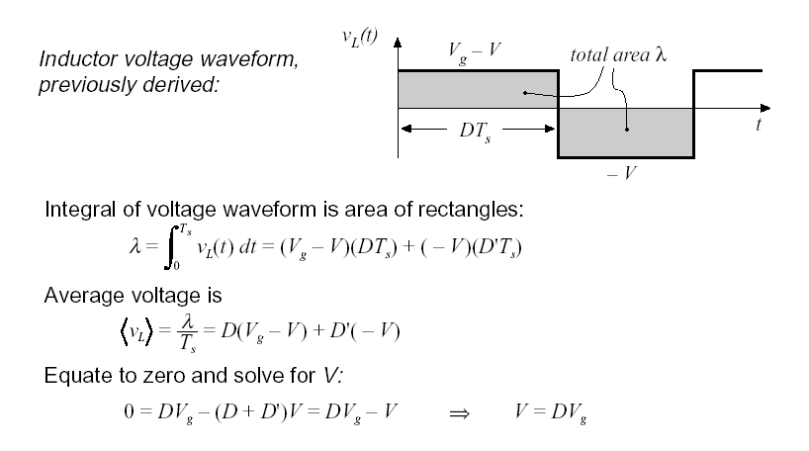
Converter Analysis Principle Volt-Second Balance gives Voltage Gain, M

Slide 18
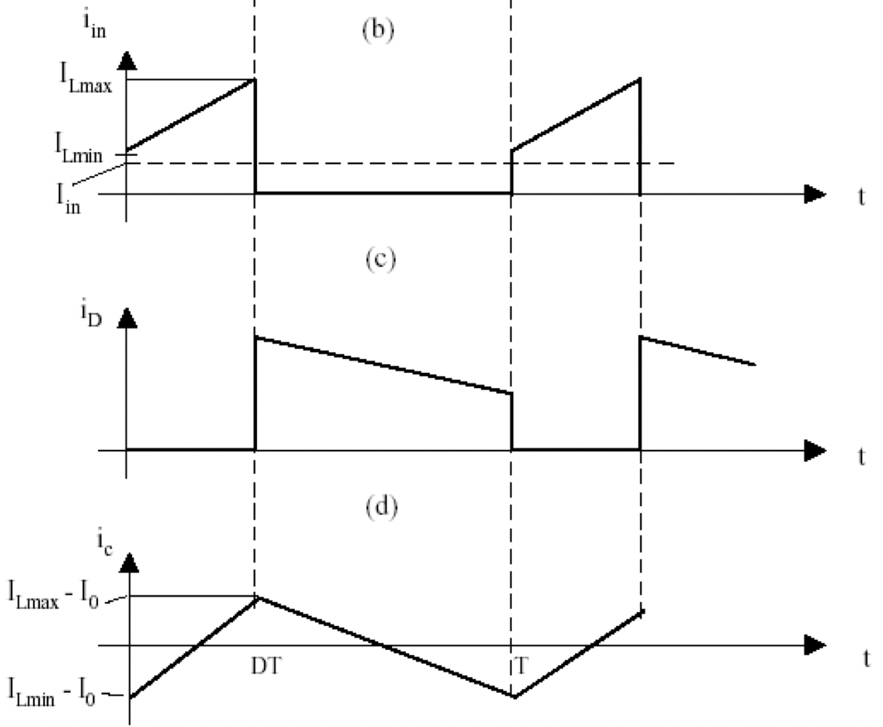
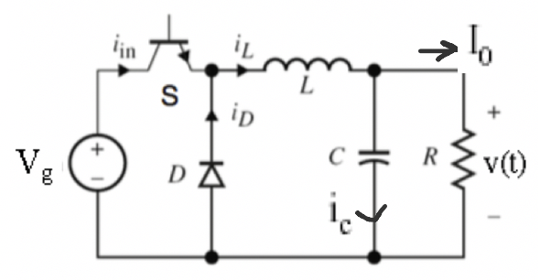
Waveforms Input, Diode and Capacitor Currents

Slide 19
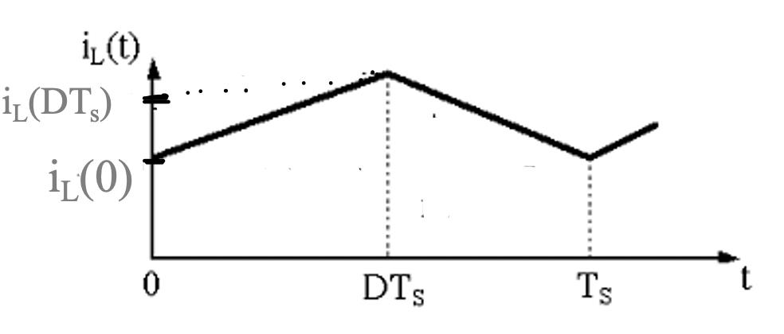
Inductor Current Initial and Final Values
We need to find the values for i_{L}(0) and i_{L}(DT_{s}) in terms of the
Converter parameters.
Let us label:
Output volage (V) : V_{o}
Input voltage (V_{g}): V_{in}
Switching period (T_{s}): T

Slide 20
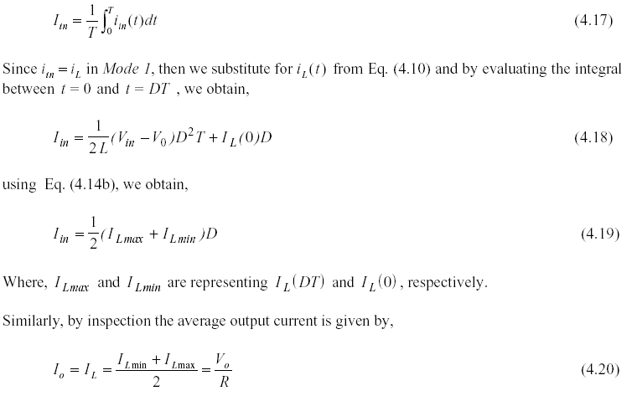
Buck Converter Analysis: Waveforms Average Input and Output Currents
By inspection from the plot for I_{in},

Slide 21
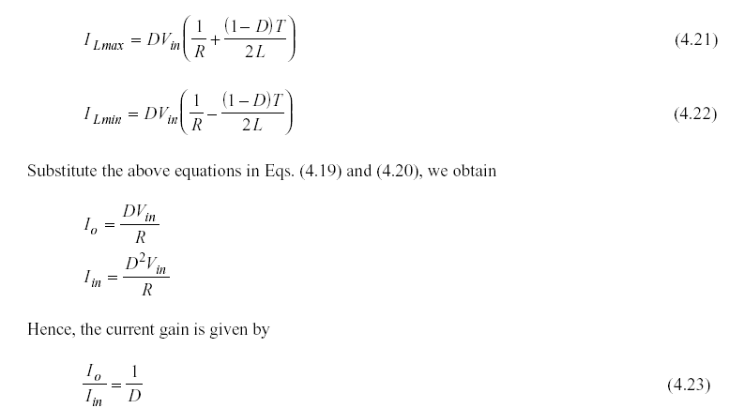
Buck Converter Analysis Using Average Current to get i_{L}min/i_{L}max

Slide 22
Buck Converter Analysis L_{critical}
Notice that there is a value when I_{Lmin}=0, hence the inductor become discontinuous – we enter what is called Discontinuous Conduction Mode (DCM):

Slide 23
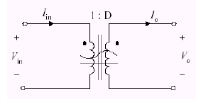
Buck Converter Analysis Concept of DC Transformer

Slide 24
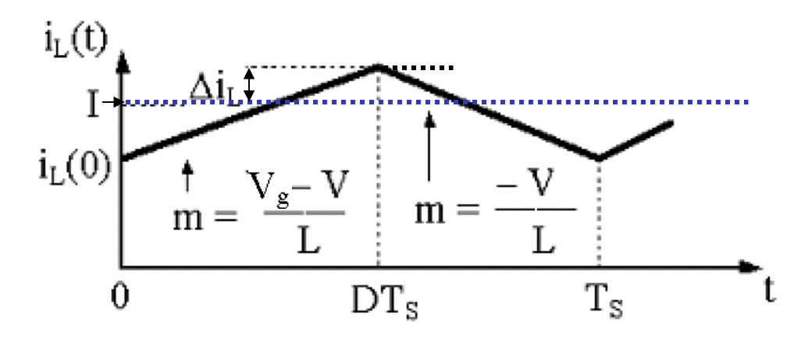
Inductor Current Ripple
$$I_{max}$$
$$I_{o}$$
$$I_{min}$$
$$m=\frac{V_{in}{−V}_{o}}{L}$$
$$V_{o}$$
$$2Δi_{L}=I_{max}−I_{min}=\left(\frac{V_{in}{−V}_{o}}{L}\right)DT$$
$$Δi_{L}=\left(\frac{V_{in}{−V}_{o}}{2L}\right)DT$$
In terms of the inductor,
$$L=\left(\frac{V_{in}{−V}_{o}}{2Δi_{L}}\right)DT$$
$$L$$
$$Δi_{L}$$

Slide 25
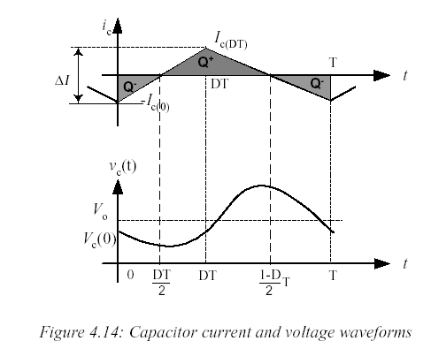
Output Voltage Ripple
It will be shown that by equating Q⁺=Q⁻ we obtain,

Slide 26
Buck Converter Analysis: Hand Calculation Example 4.2

Slide 27
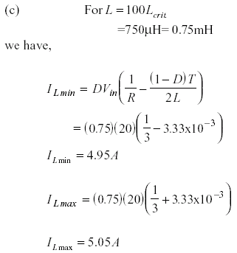
Example 4.2 Solution (cont’d)

Slide 28
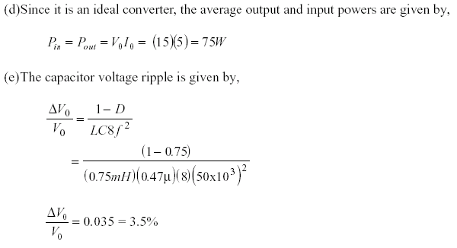
Example 4.2 Solution (cont’d)

Slide 29
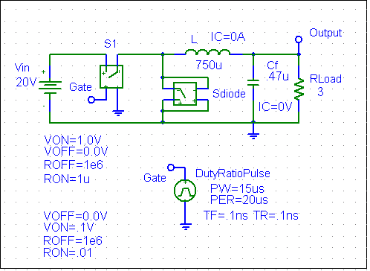
Example 4.2 Simulation Verification

Slide 30
Simulation Verification Example 4.2-Startup
20
V_{o}= 15V
10
0
0s
0.5ms
1.0ms
1.5ms
2.0ms
I(L)
V(Gate)
V(Output)
Time

Slide 31
Simulation Verification Example 4.2 Various Waveforms
10V
20mA
0V
0A
-20mA
-10V
-40mA
-20V
1.96ms
1.98ms
2.00ms
1.96ms
1.98ms
2.00ms
I(Cf)
V(L:1,L:2)
Time
Time

Slide 32
Simulation Verification Example 4.2 Various Waveforms
5.05A
15.2V
(1.9954m,15.102)
5.00A
15.0V
4.95A
4.90A
(1.9819m,14.863)
1.96ms
1.98ms
2.00ms
14.8V
I(L)
1.96ms
1.98ms
2.00ms
Time
V(Output)
Time

Slide 33
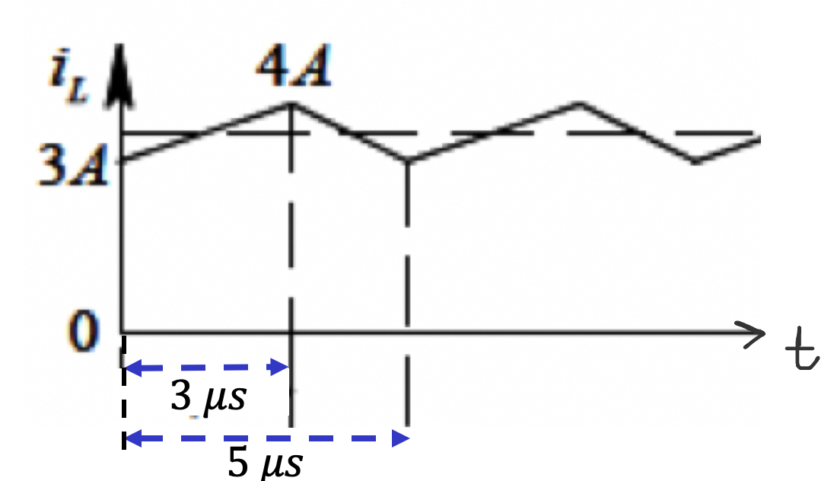
Example of Buck Converter Waveform

Slide 34
Example of Buck Converter Waveform
Solution:
For the first mode of operation, current i_{L} is rising, we have this relation:
For the second mode of operation, current i_{L} is falling, we have this relation:

Slide 35
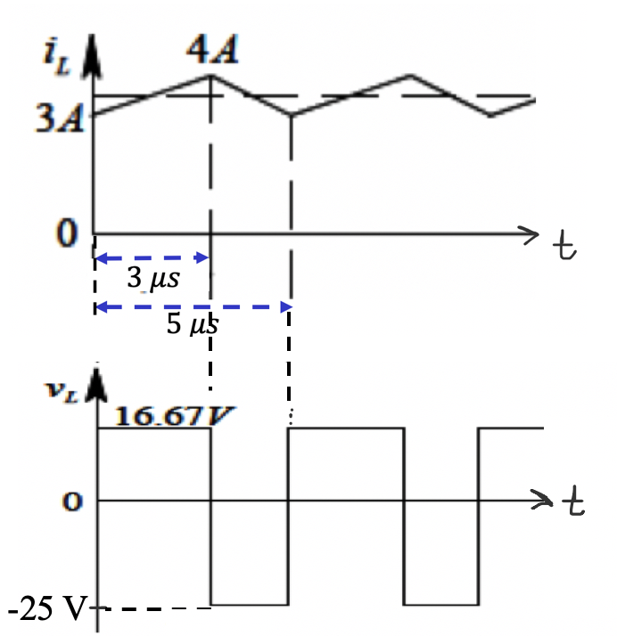
Buck Converter Analysis: Waveforms Inductor Current Ripple
Solution (cont’d):

