Slide 1
EEL 5245 POWER ELECTRONICS I Lecture #12 Ch 3:Examples of Power Factor and PF Corrections

Slide 2
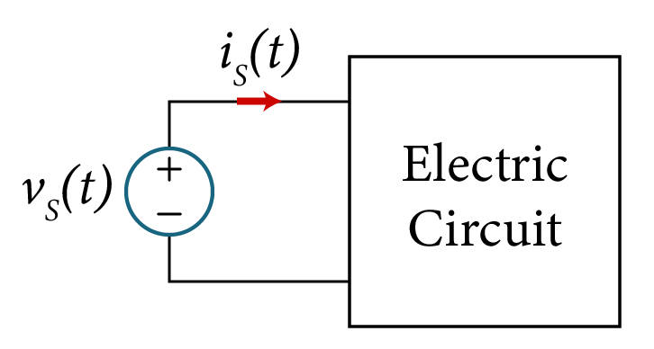
Example – Finding THD
Consider a power source with its terminal voltage and current given as
v_{s}(t)=100+80sin(ωt-100⁰)+70cos(2ωt+120⁰)+25sin3ωt V
i_{s}(t)=12+10sin(ωt+25⁰)+5sin(2ωt-30⁰)+2cos3ωt A
Where ω is the fundamental angular frequency
Calculate:
The rms value of i_{s}(t) and v_{s}(t)
The average input power supplied by the source
The rms values of the fundamental components of is(t) and vs(t)
THDi and THDv
$\left(e\right) k_{dist}$, $k_{disp}, and pf$

Slide 3
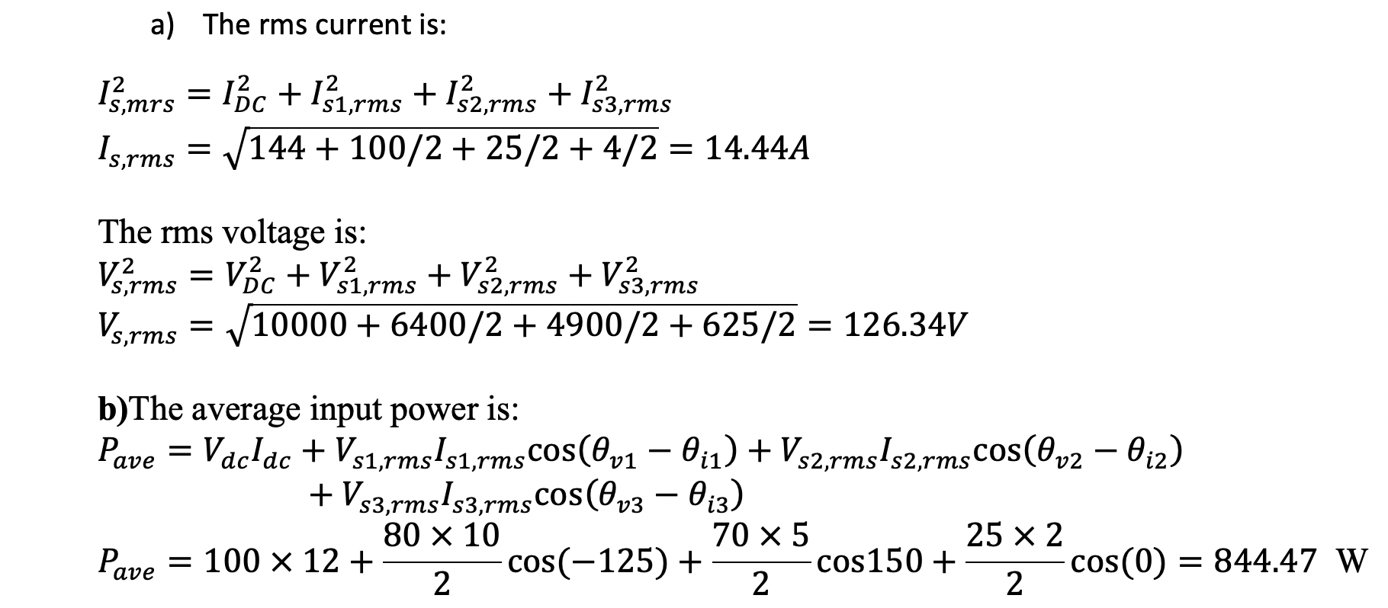
Solution:

Slide 4
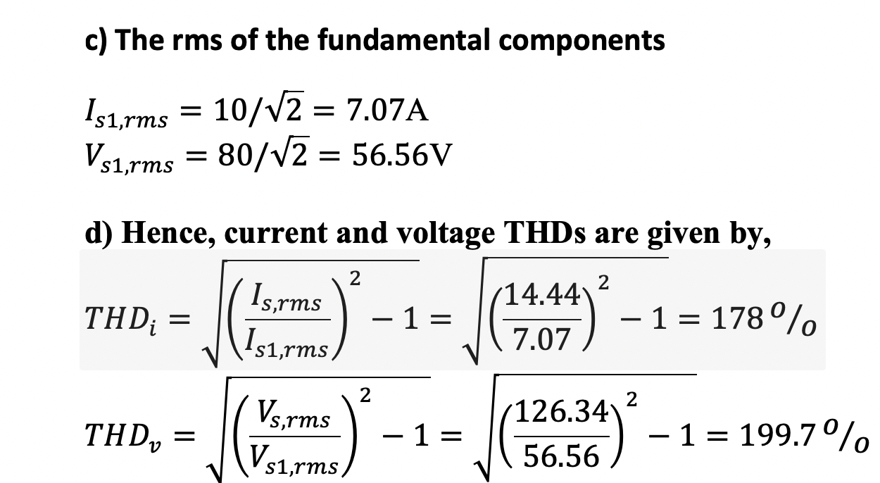
Solution:

Slide 5
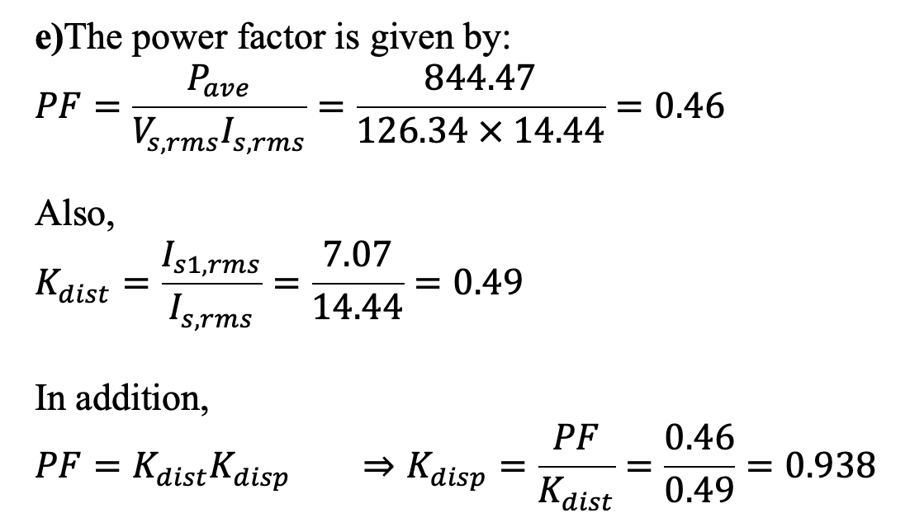
Solution:

Slide 6
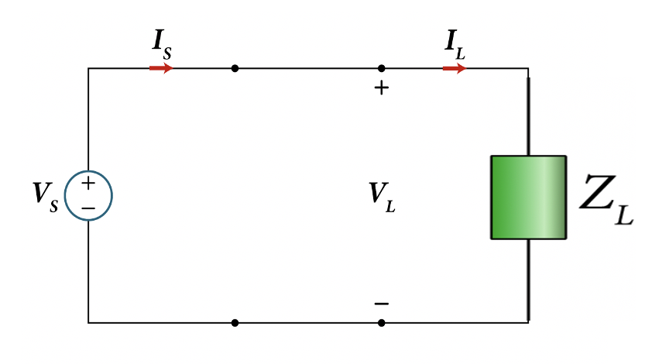
Example:
Consider the power transmission network with the load $Z_{L}$ as shown.
Determine the value of the required capacitor C to be connected in parallel with $Z_{L}$ that would improve the ${pf}_{new}$ to 0.9 lagging.
What is the Q and S in the load $Z_{L}$
What is the Q and S in the load $Z_{L,new}$
$P_{ave}=200$ kW
$$pf=0.71$$
$V_{L,rms}=10$ kV
(lagging)

Slide 7
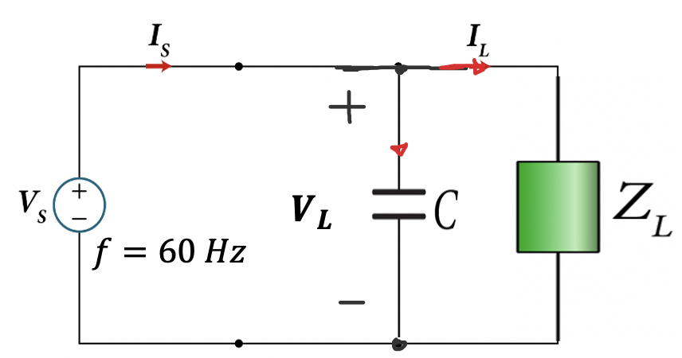
Solution:
The phase angle $θ_{Z_{L}}$is the same as the angle of the power factor,
$$pf=cos{θ_{Z_{L}}=0.71}$$
$$θ_{Z_{L}}={44.77}^{o}$$
$P_{ave}=200$ kW
$$pf=0.71$$
The phase angle $θ_{Z_{L,new}}$ is the same as the angle of the new power factor,
(lagging)
$P_{ave}=200$ kW
$$pf=cos{θ_{Z_{L,new}}={25.84}^{o}}$$
$${pf}_{new}=0.9$$
Next we need to find R and L of the load $Z_{L}$.
(lagging)
$$Z_{eq,new}$$
To find the load $Z_{L}$ we need to find $I_{L,rms}$

Slide 8
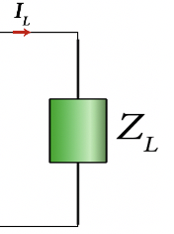
To find the load $current I_{L,rms} we use the original definition of pf:$
$$pf=\frac{Average Power}{Apparent}=\frac{P_{ave}}{{V_{L,rms}I}_{L,rms}}$$
$$I_{L,rms}=\frac{P_{ave}}{V_{L,rms }x pf}=\frac{200 kW}{10kVx 0.71}=28.17 A$$
The load $Z_{L},$
$$\left|Z_{L}\right|=\frac{V_{L,rms }}{I_{L,rms }}=\frac{10kV}{28.17 kA}=0.5 Ω$$
$$Z_{L} =R+jX_{L}$$
$$R=\left|Z_{L}\right|cosθ_{Z_{L}}=0.35x0.71=0.25 Ω$$
$$X_{L}=\left|Z_{L}\right|sinθ_{Z_{L}}=0.35 mΩxsin{44.77}^{o}=0.246 Ω$$
$$L=\frac{X_{L}}{ω}=\frac{0.246Ω}{2πx60}=0.653 mH$$

Slide 9
Finding Q and S in the load $Z_{L}:$
$P_{ave}=200$ kW
$$pf=0.71$$
$V_{L,rms}=10$ kV
(lagging)
Recall from the old pf, we found
$$I_{L,rms}=28.17 kA$$
Therefor, $\left|S_{L}\right|$, is given by:
$\left|S_{L}\right|=I_{L,rms}$ $V_{L,rms }=28.17 A x 10 kV=281.17 kVA$
Recall the complex power $S_{L} across the load Z_{L}$
$P_{ave}=\left|S_{L}\right|$cos $θ_{Z_{L}}=281.17x\cos{{44.77}^{o}≈200 kW}$
$$S_{L}=P_{ave}+j Q$$
$$Q=\left|S_{L}\right|\text{sin} θ_{Z_{L}}=281.17x\sin{{44.77}^{o}=198 kVAR}$$
$$S_{L}=200+j198=\sqrt{{200}^{2}+{198}^{2}}∠\tan^{−1}\frac{198}{200}=281.4∠{44.71}^{o} kVA$$

Slide 10
Recall from the old pf, we found
$$I_{L,rms,new}=\frac{P_{ave}}{V_{L,rms }x pf}$$
$P_{ave}=200$ kW
$$=\frac{200 kW}{10kVx 0.9}=22.22 A$$
$${pf}_{new}=0.9$$
(lagging)
Therefor, $\left|S_{L}\right|$, is given by:
$$Z_{eq,new}$$
$\left|S_{L,new}\right|=I_{L,rms,new}$ $V_{L,rms }=22.22 A x 10 kV=222.22 kVA$
Recall the complex power $S_{L} across the load Z_{L}$
$$S_{L}=P_{ave}+j Q$$
$P_{ave}=\left|S_{L,new}\right|$cos $θ_{Z_{L,new}}=222.22x\cos{{25.84}^{o}≈200 kW}$
$$Q_{new}=\left|S_{L},new\right|\text{sin} θ_{Z_{L,new}}=222.22x\sin{{25.84}^{o}=96.86 kVAR}$$
$$S_{L,new}=200+j222.22=\sqrt{{200}^{2}+222.22}∠\tan^{−1}\frac{222.22}{200}=298.97∠{48}^{o} kVA$$

Slide 11
Final observations:
To correct pf , we must to reduce the angle of $Z_{L,new}$ by reducing the overall Q of the load
$$I_{L,new}$$
(lagging)
$$Q_{C}=−101.14KVAR$$
$$Q=198kVAR$$
The negative Q produced by C is given by,
$$Q_{new}=96.86 kVAR$$
$${Q_{C}=Q}_{new}−Q=96.86−198$$
$P_{ave}=200$ kW
$${pf}_{new}=0.9$$
$$=−101.14 kVAR$$
$$X_{C}=\frac{Q_{C}}{{\left(V_{L,rms }\right)}^{2}}=\frac{101.14 KVAR}{{\left(10KV\right)}^{2}}$$
$C=\frac{1}{X_{C}ω}=$ $\frac{{\left(10KV\right)}^{2}}{101.14 KVAR x377}=2.74 μF$

