Slide 1
EEL 5245 POWER ELECTRONICS I Lecture #11 Ch 3:Non-Sinusoidal Systems and Harmonics Overview

Slide 2
Discussion Topics
Real World Power System Data
What is its harmonic content? And why?
Decomposition of non-sinusoidal waveforms into Fourier Series
Significant Effects of Harmonics on Power System
Power Parameters for Non-sinusoidal Systems
Harmonics in Three Phase Systems
Regulatory Standards for Harmonic Content
PC Power Supply Analysis

Slide 3
Nature of Modern Electrical Loads
Historically, electrical loads in the power system were predominately linear (purely sinusoidal input voltage draws a sinusoidal current in a linear load)
Incandescent lighting, motor loads (cooling)
Semiconductor advances paved the way for boom in electronic equipment development
PC, laptops, iPhones, Audio/Video Equipment, Lighting Controls, etc.
These electronic loads are generally nonlinear (purely sinusoidal line voltage draws distorted, non-sinusoidal, line current)
The nonlinear load means the current waveform, while periodic, is not sinusoidal and has harmonics
Harmonic content is a result of proliferation of nonlinear loads in the modern power system.

Slide 4
Nature of Modern Electrical Loads Real Data Examples
Note-
Voltage nearly sinusoidal,
Current moderately distorted

Slide 5
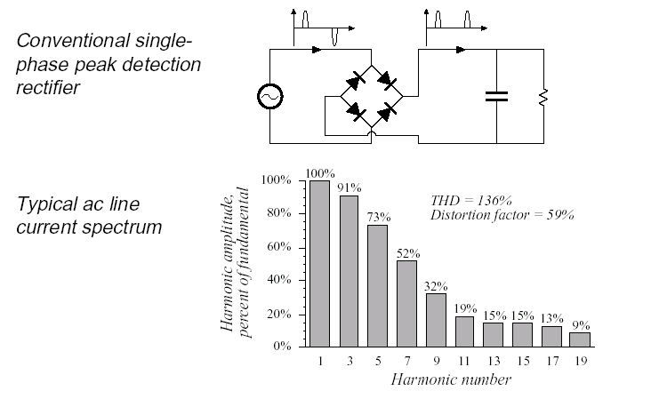
Harmonic Content of Full-Wave Rectifier with Filtering Cap
Most electronic loads employ a “peak detection rectifier” at their front end
Source current present only when input sinusoidal exceeds DC voltage across capacitor

Slide 6
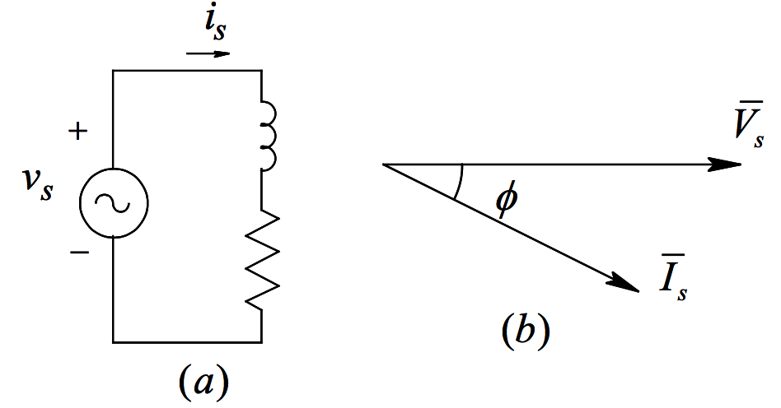
Linear Loads – RL Circuits
(b) Phasor Diagram
(a) Simple Liner RL

Slide 7
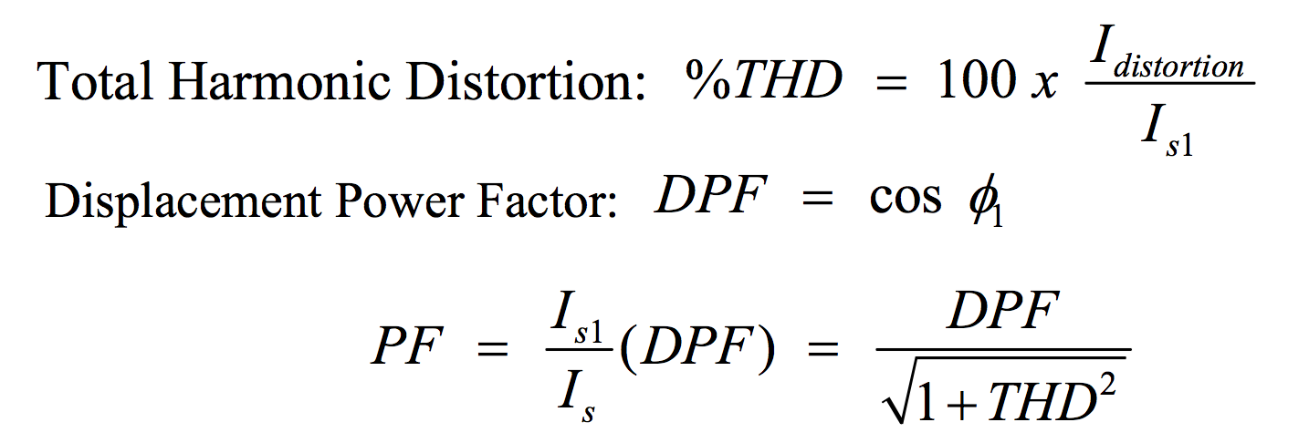
None-Linear Loads – Power Electronics Circuits
(a) Source voltage and current
(b) Distortion current

Slide 8
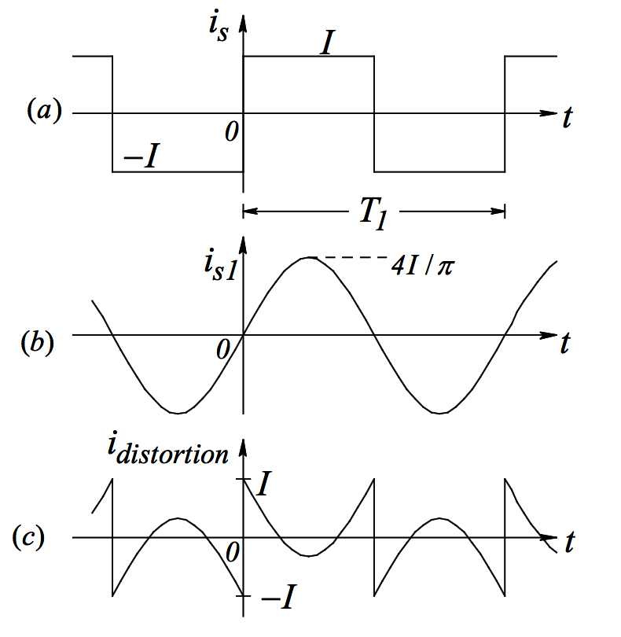
None-Linear Loads – Power Electronics Circuits
Example of Distortion current

Slide 9
Fourier Analysis for Harmonics Calculation
Where constant F_{o} and the coefficients a_{n} and b_{n} given by,
Periodic waveforms can be resolved into an infinite Fourier Series
Series is comprised of a summation of pure sinusoids each with frequencies that are integer multiples of the fundamental frequency of the periodic waveform

Slide 10
Decomposition of v & i into Harmonic Components
DC Component
Fundamental Component
Harmonic Components

Slide 11
Most Significant Effects of Harmonics in the Power System
Harmonics reduced True Power Factor (add to RMS but do no real work)
Less of power system capacity available with no benefit
EMI Created interferes with other equipment operation such as communications signals and control electronics in other devices
Comm equipment doesn’t work well near harmonic generators
Neutral Current in 3 Phase Wye connected systems can be larger than phase current causing overloaded conductors
Historically neutral conductors had been design with smaller ampacity than phase conductors
Only high end metering devices detect harmonic content
If it doesn’t say “True RMS” it will read incorrectly for most electronic loads
Transformers and motors are subjected to additional heating due to harmonics
K-Factor rated equipment for additional I^2*R Losses
Notes:
K-Factor rated equipment:
What is K-Factor?
K-factor is a weighting of the harmonic load currents according to their effects on transformer heating, as derived from ANSI/IEEE C57.110. A K-factor of 1.0 indicates a linear load (no harmonics). The higher the K-factor, the greater the harmonic heating effects.
http://www.xitrontech.com/assets/002/5787.pdf

Slide 12
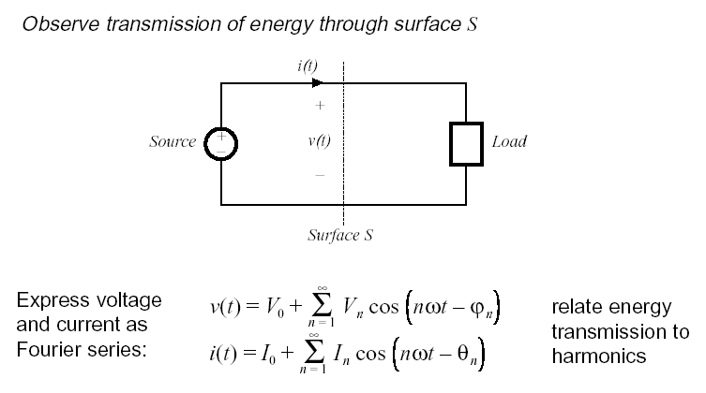
Harmonics in the Power System

Slide 13
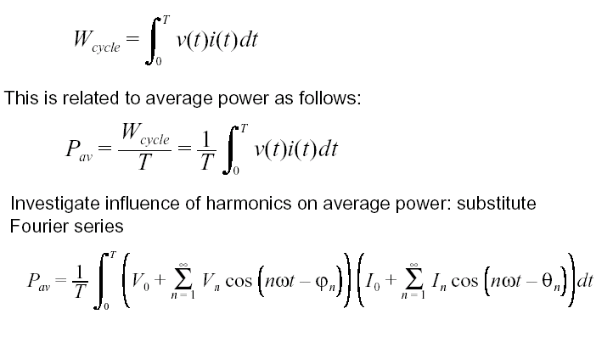
Real Power and Harmonics

Slide 14
Real Power and Harmonics

Slide 15
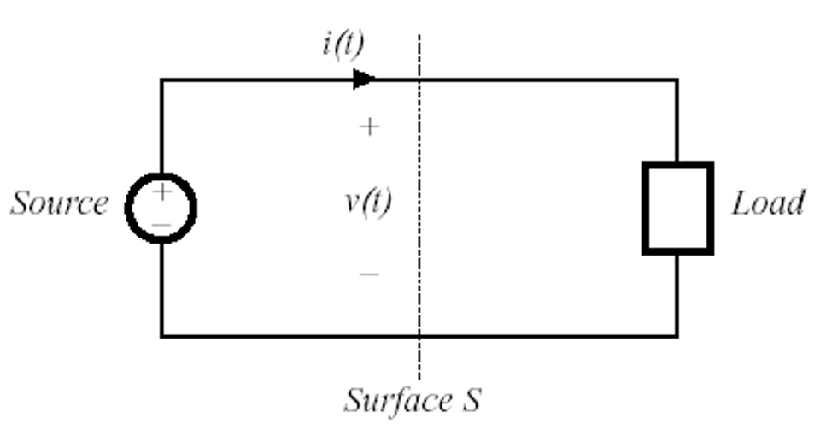
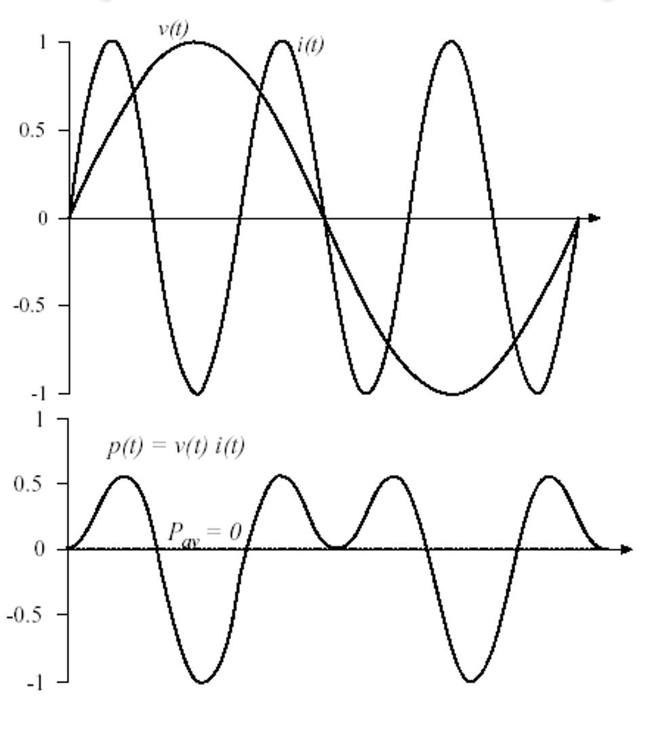
Power Transfer – Different Harmonics
$$i\left(t\right)Third harmonic at 3ω$$
$$t$$
$$v\left(t\right):Fundamental at ω$$
$$p\left(t\right):Instantenous power$$
$$t$$
$$P_{av} :Average power$$

Slide 16
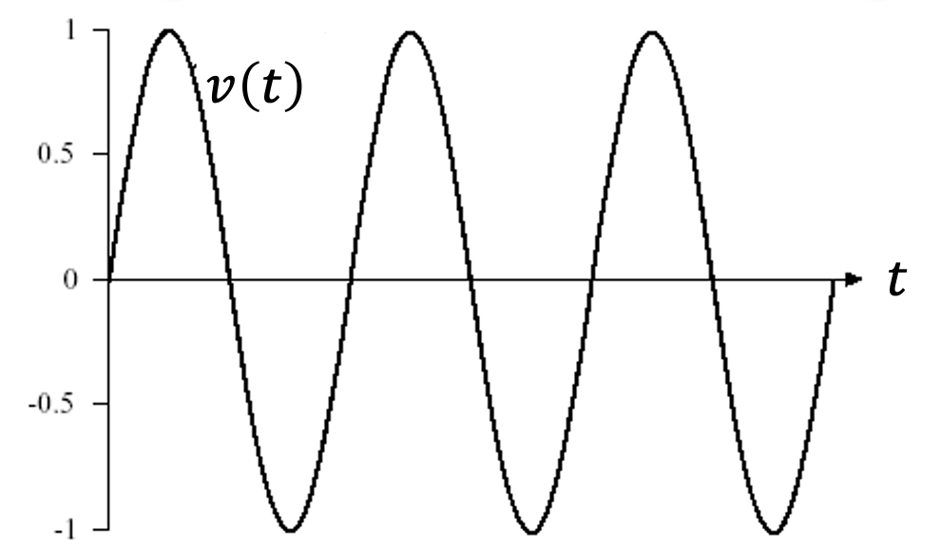
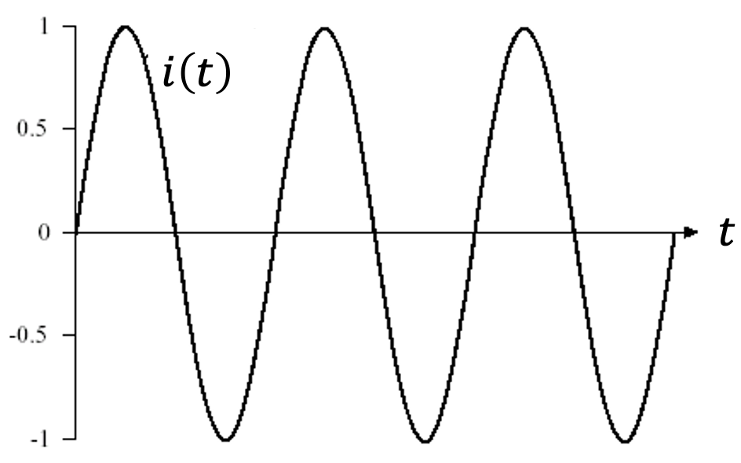
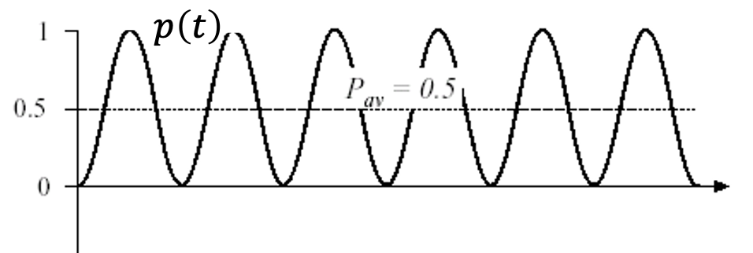
Power Transfer – Same Harmonics
$$v\left(t\right):Third harmonic at 3ω$$
$$i\left(t\right):Third harmonic at 3ω$$
$$p\left(t\right):Instantenous power$$
$$P_{av} :Average power$$

Slide 17
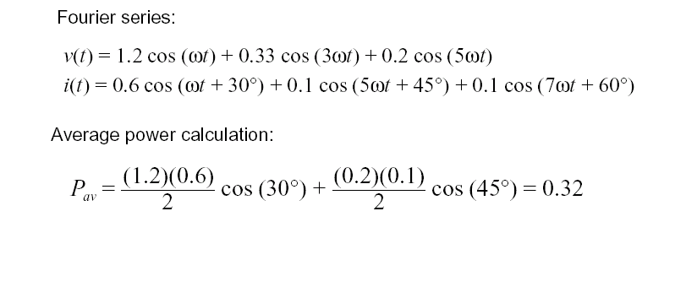
Example – Average power calculation

Slide 18
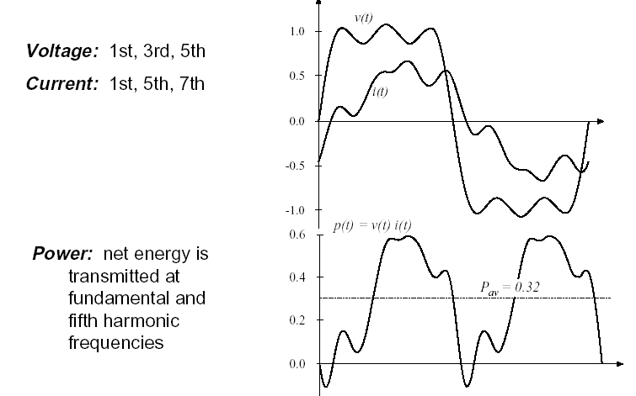
Example – Average power calculation(con’d)

Slide 19
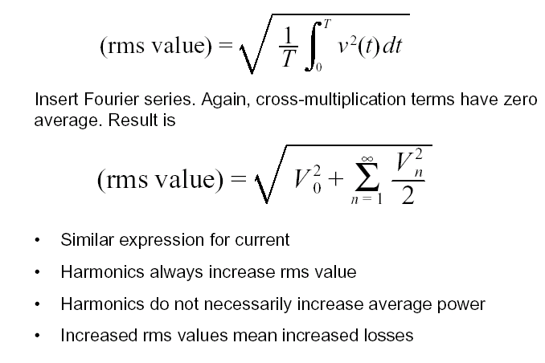
RMS Value of Nonlinear Waveform

Slide 20
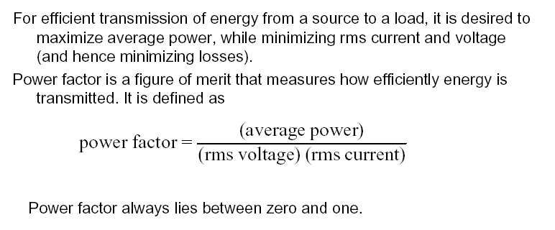
Power Factor Definition

Slide 21
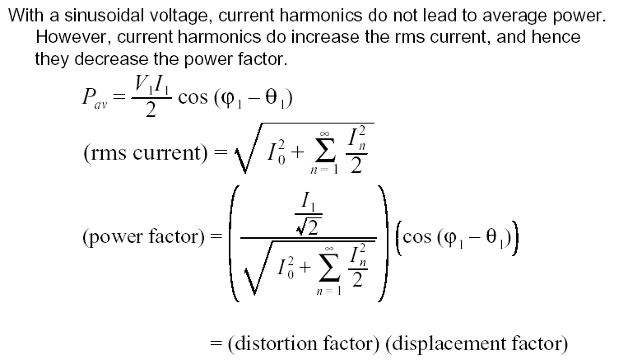
True Power Factor Definition

Slide 22
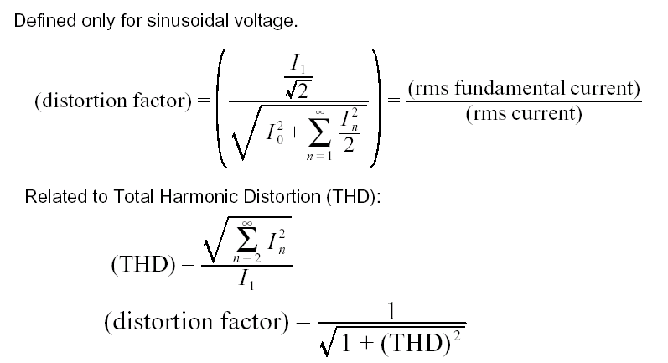
Distortion Factor and THD

Slide 23
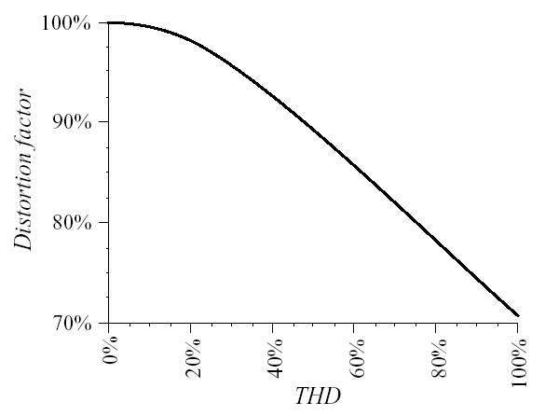
DF vs. THD

Slide 24
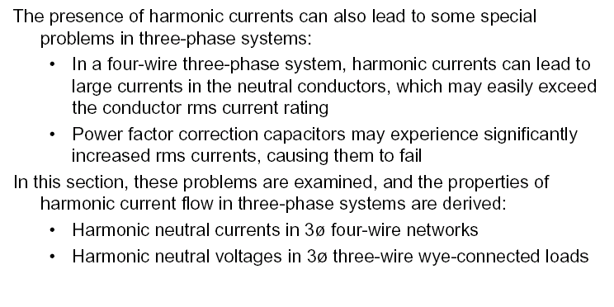
Harmonics in Three Phase Systems

Slide 25
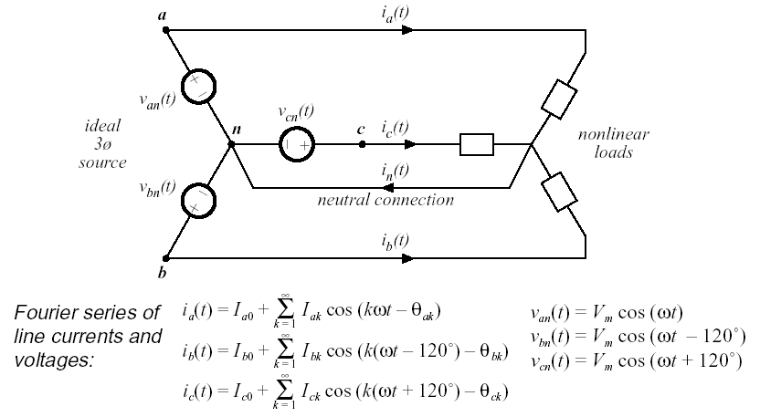
Harmonics in Three Phase Systems

Slide 26
Harmonics in Three Phase Systems

Slide 27
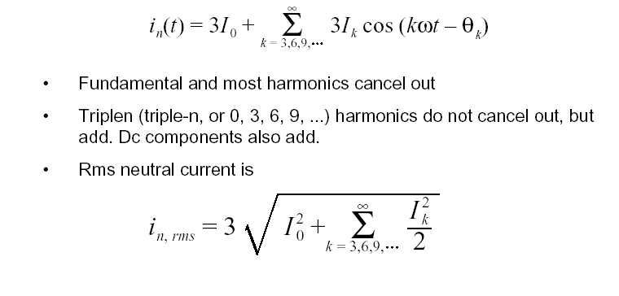
Harmonics in Three Phase Systems

Slide 28
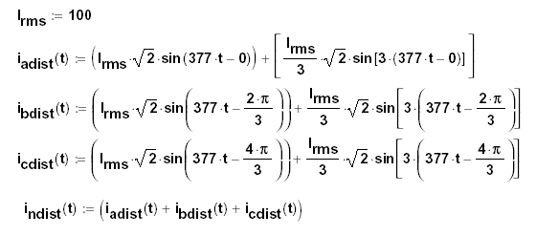
Neutral Currents in 3 Phase, Wye Connected Systems
Assuming a balanced load with no phase shift (V and I in phase)
Assuming line current composed of fundamental, 60Hz, and third harmonic, 180 Hz only (In practice other harmonics would be present
Third harmonic set at 33% of fundamental current amplitude
Assume power system fully loaded such that phase conductors are rated for 100 A_{RMS}

Slide 29
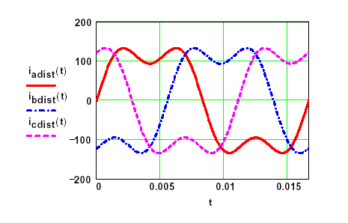
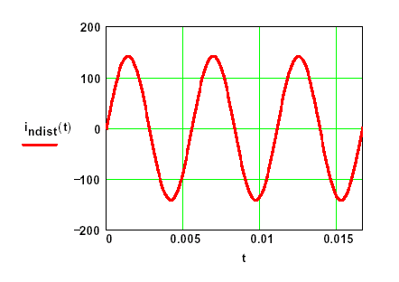
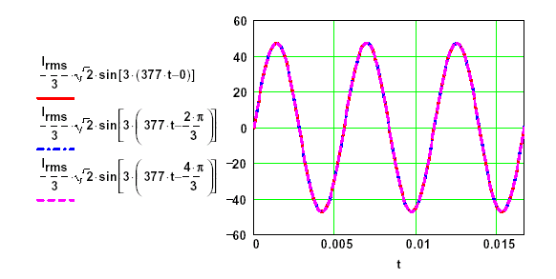
Neutral Currents in 3 Phase, Wye Connected Systems

Slide 30
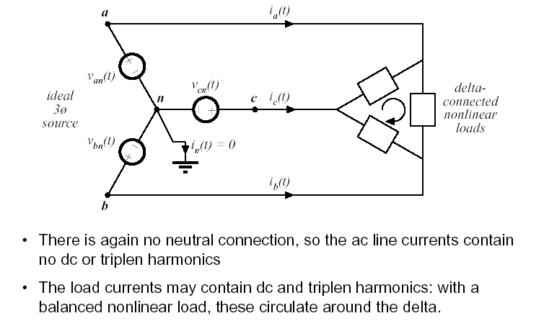
Harmonics in Three Phase Systems

Slide 31
Standards Regulating Harmonic Content
US MIL-STD-461B
US Military Standard (Mandatory)
Harmonic limits now enforced by all US Armed Forces
International Electro-technical Commission Standard 555
European Standard (Mandatory)
Limits based on actual current values specified by harmonic number by class of equipment
IEEE 519
US Suggested Guidelines by IEEE
Harmonic limits are based on the ratio of fundamental component of load current to short circuit current at the utility interface point

Slide 32
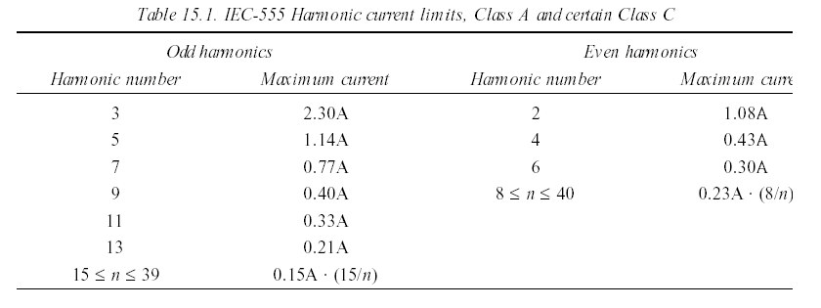
IEC 555: Class A limits

Slide 33
IEEE-519 Current Limits, Low Voltage Systems

Slide 34
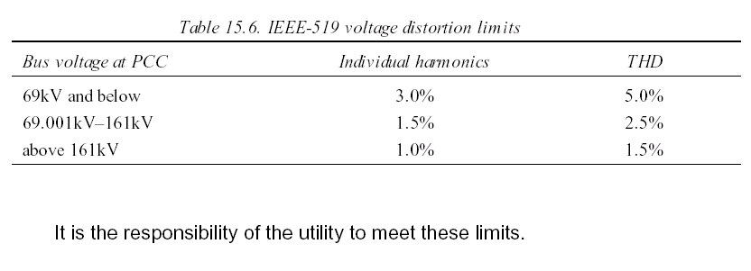
IEEE-519 voltage limits

Slide 35
PC Power Supply Analysis
To investigate the nature of Harmonics in the modern power system, the personal computer load is representative
Quantity in service increasing in residential, commercial, and industrial use
Not uncommon to have an office area with many PCs
PC Power supply is Switch Mode Power Supply (SMPS) with peak detection rectifier at front end for rectification
Moderate harmonic generator
For this analysis, experimental data is collected on a Pentium 4 Dell Machine, 80Gb Hard Drive, 250W Power Supply, and 19” CRT Monitor
Data is collected with a Fluke 41, Power Harmonics Analyzer

Slide 36
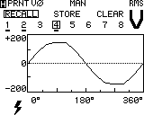
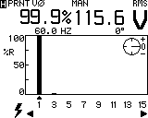
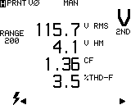
PC Power Supply Analysis

Slide 37
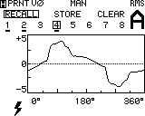
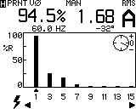
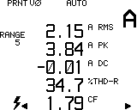
PC Power Supply Analysis

Slide 38
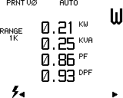
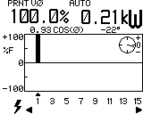
PC Power Supply Analysis

Slide 39
Fourier Analysis for Harmonics Calculation (
Periodic waveforms can be resolved into an infinite Fourier Series
Series is comprised of a summation of pure sinusoids each with frequencies that are integer multiples of the fundamental frequency of the periodic waveform

Slide 40
Fourier Analysis for Harmonics Calculation
Book
Correction
Pay attention to Quadrant
Trigonometric Form often used
industrial test equipment uses this format
FFT function gives complex form, angle derived assumes a cosine function is used to recreate f(t) so Sine and Cosine not interchangeable without proper shifting
Note if function either even or odd, A_{n} reduces to either a_{n} (even) or b_{n} (odd) and Theta_{n} is either 0 (even) or -90 (odd)

Slide 41
Use of Symmetry in Fourier Analysis

Slide 42
Observations on Symmetry
Can save alot of time
Converter circuit waveforms often not symmetric
Converter input current and voltage generally has symmetry
Odd and Half Wave very common
Be able to recognize this combination and its effect on Fourier Components on sight
In Industrial Power System (on AC side of things, most everything is odd with half wave symmetry, so no even harmonics and no DC value

