Slide 1
Example
Use the source transformation method to solve for all currents in the circuit.
For:
Variable | Values | Unit
V | 10 | V
I₁ | 8 | A
I₂ | 8 | A
R₁ | 5 | Ω
R₂ | 3 | Ω
R₃ | 6 | Ω

Slide 2
KVL:
− V + R₁i_{a} + R₂i_{a} − I₁ R₂ + R₃i_{a} + I ₂ R₃ = 0
_{i =} V + R₂ I₁ − R₃ I ₂
a
R + R + R
1
2
3
= −1 A

Slide 3
Example
By using source transformation, solve for v_{x} and i_{x}.
For:
Variable | Values | Unit
V | 12 | V
I | 8 | A
R₁ | 4 | Ω
R₂ | 3 | Ω

Slide 4
KCL: to the upper node
− V ₊ v_{x}
v_{x}
+ + I = 0
₌ − v_{x}
i
R₁ R₁ R₂
x
R₂
R₂
= 2.9 A
v =
(V − R I )
x
R₁ + R₂
1
= −8.6 V

Slide 5
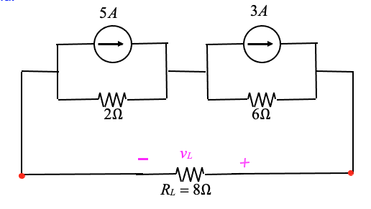
Example
Use source transformation to find v_{L}:

Slide 6
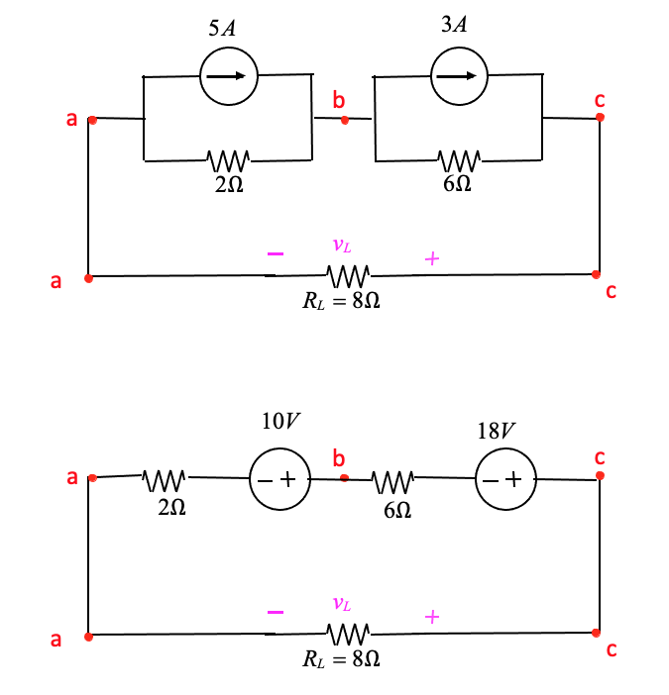
Solution:

Slide 7
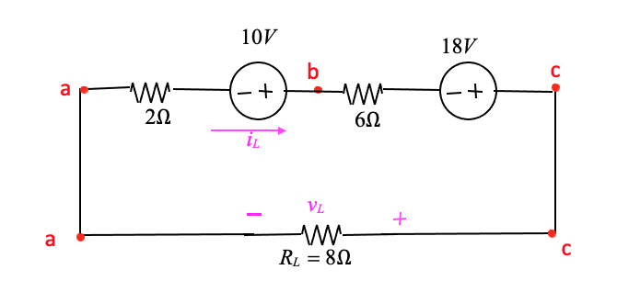
KVL:
-10 + 6i_{L} − 18 + 8i_{L} + 2i_{L} = 0
16i_{L} = 28
i_{L} = 1.75A
v_{L} = 1.75(8) = 14V

Slide 8
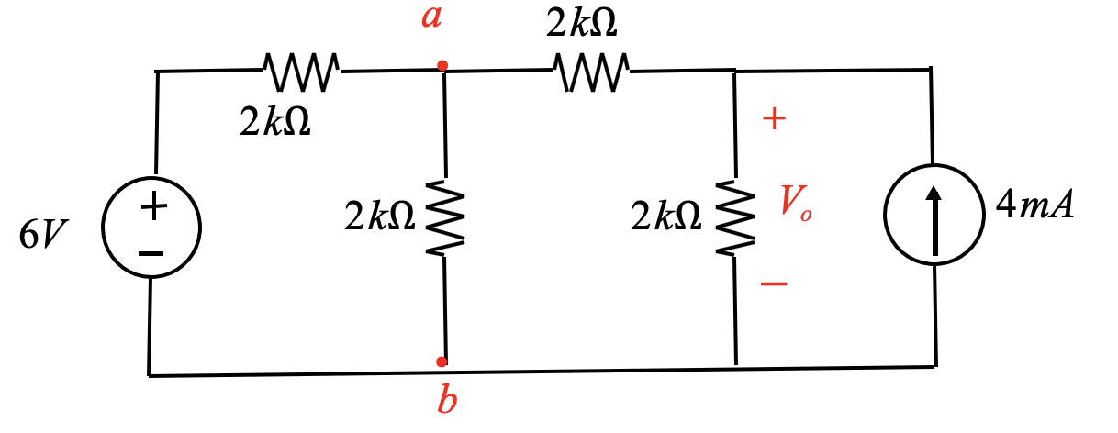
Example: Use Source Transformation to find V_{o}
Solution:
Identify series V+R or Parallel I+R:
Since we need V_{o,} we start at the other end to keep V_{o} as is.

Slide 9
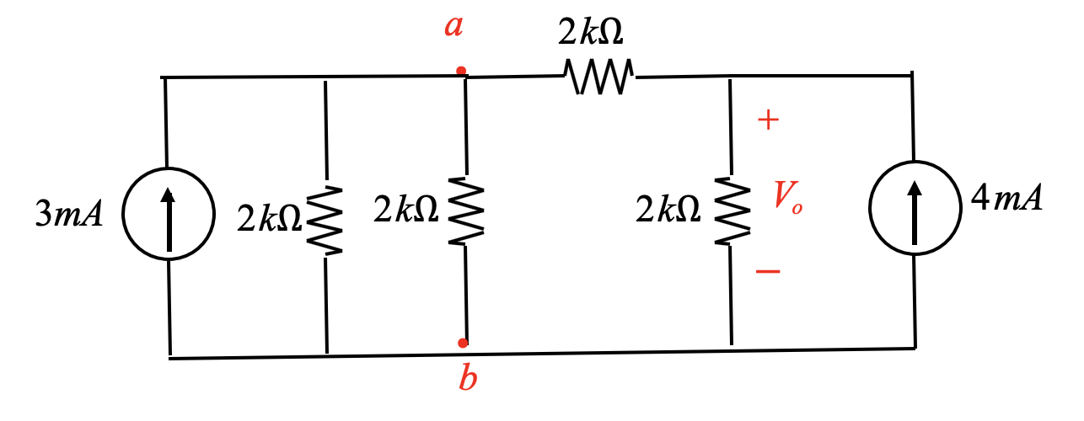
Solution:

Slide 10
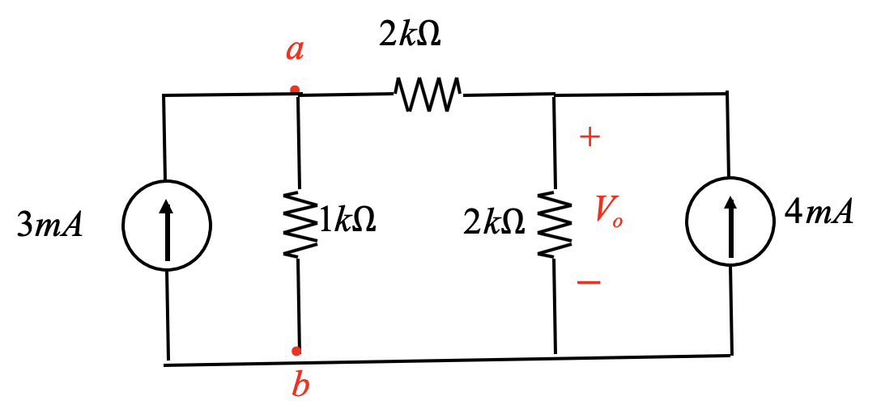
Solution:

Slide 11
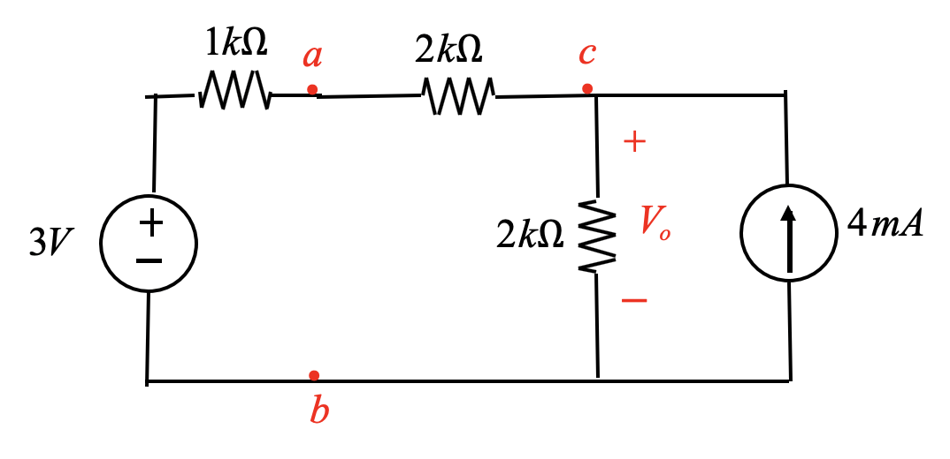
a
•
2kΩ
+
3mA
1kΩ
2kΩ
V_{o}
−
4mA
•
b
1kΩ
a
•
2kΩ
c
•
+
3V
2kΩ
V_{o}
−
4mA
•
b

Slide 12
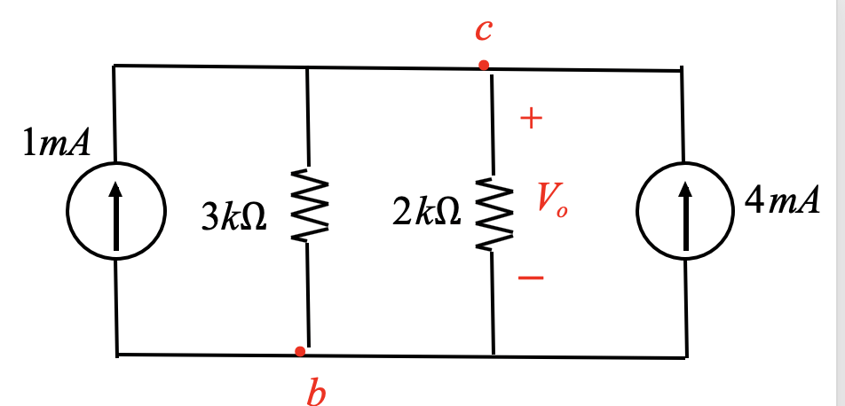
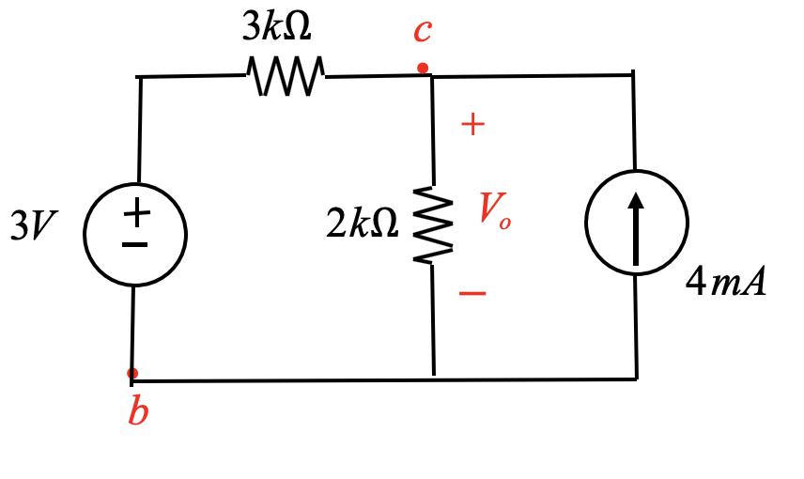
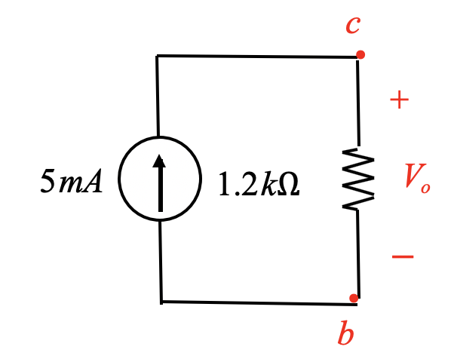
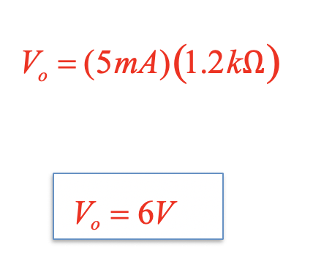
c
•
3kΩ
c
•
+
+
1mA
3kΩ
2kΩ
V_{o}
−
4mA
3V
2kΩ
V_{o}
−
4mA
•
b
•
b
c
•
V = (5mA)(1.2kΩ)
+
o
5mA
4mA 1.2kΩ
V_{o}
−
V_{o} = 6V
•
b

Slide 13
Example of Source Transformation – Find v_{x}

Slide 14
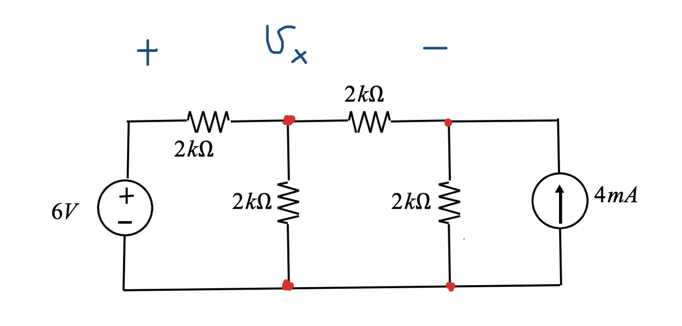
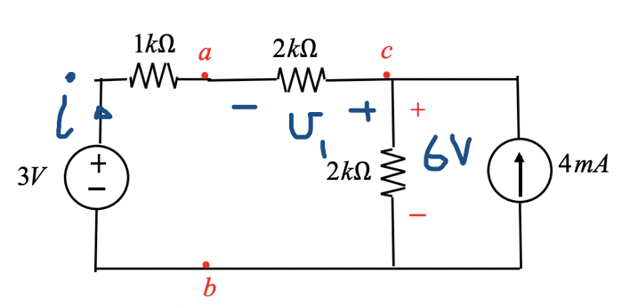
Recall before that we can find
Apply KVL around the left loop:
$$−3+1x i+2i+6=0$$
$$i=\frac{3}{3}=1 mA$$
$$v_{1}=−2xi=−2x1=−2V$$

Slide 15
Apply KVL:
$$−v_{2}−v_{1}+6=0$$
$$v_{2}=−2+6=4 V$$

Slide 16
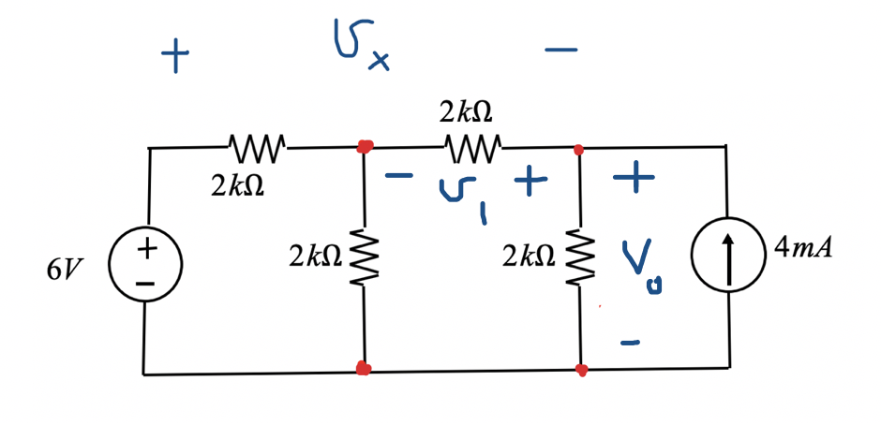
Apply KVL:
$${−6+v}_{3}+v_{2}=0$$
$${−6+v}_{3}+8=0$$
$$v_{3}=−2 V$$
Apply KVL:
$$−v_{2}−v_{1}+6=0$$
$$v_{2}=−(−2)+6=8 V$$
Apply KVL:
$$v_{3}−v_{1}−v_{x}=0$$
$$v_{x}=v_{3}−v_{1}=−2 −\left(−2\right)=0 V$$
$$v_{x}=0 V$$

Slide 17
Check
$$v_{x}=0 V$$
Apply KVL to the outer loop:
$${−6+v}_{x}+V_{o}=0$$
$$−6+0+6=0$$

Slide 18
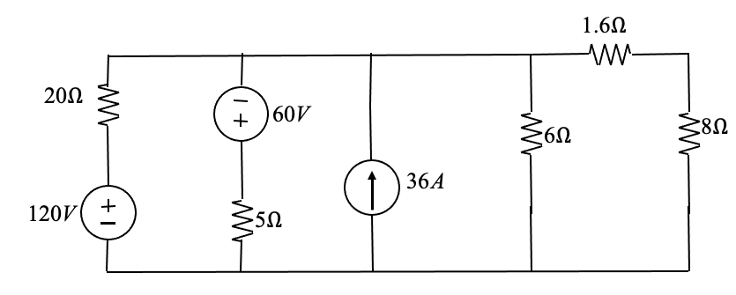
Example
Use source transformation to find :
The voltage across the 8 Ohms resistor. The power related to the current source
The power related to the 120V source

Slide 19
Solution:
1.6Ω
a
20Ω
i
i
20
60V
v
8Ω
6Ω
8
36A
120V
5Ω
b
Approach:
Find the current through the 8 Ohm resistor,
Find the voltage across the current source Find the current through the 120V source.

Slide 20
1.6Ω
a
20Ω
60V
8Ω
6Ω
36A
120V
5Ω
b
Use Source Transformation to get
1.6Ω
a
6Ω
8Ω
6A
12A
36A
20Ω
5Ω
b

Slide 21
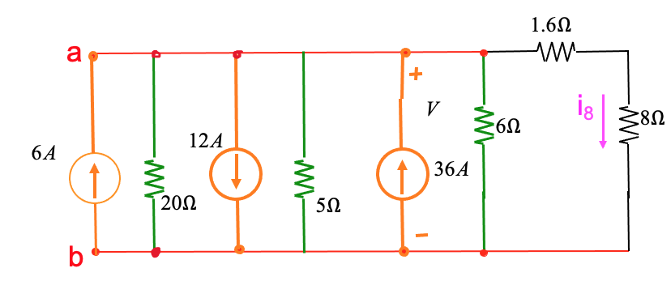
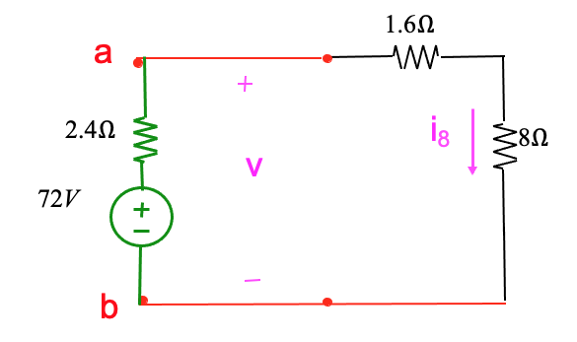
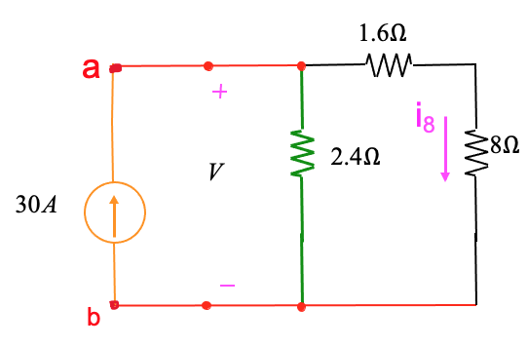
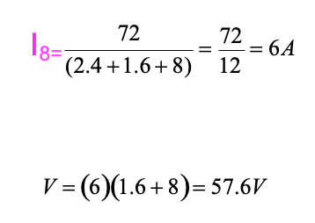
Combine the resistors in parallel and the current sources in parallel to get:

Slide 22
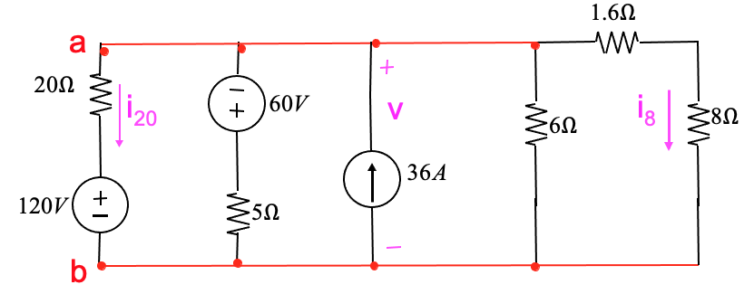
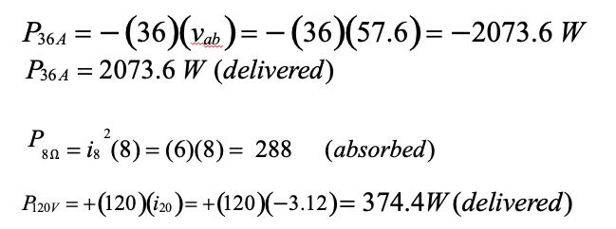
KVL:
120 + 20(i₂₀ ) − V = 0
120 + 20(i₂₀ ) − 57.6 = 0
i₂₀ = −3.12 A

Slide 23
Example
By using source transformaHon, solve for v_{x} and i_{x}.
Variable | Values | Unit
V₁ | 20 | V
V₂ | 12 | V
I | 8 | A
R₁ | 5 | Ω
R₂ | 10 | Ω
R₃ | 15 | Ω

Slide 24
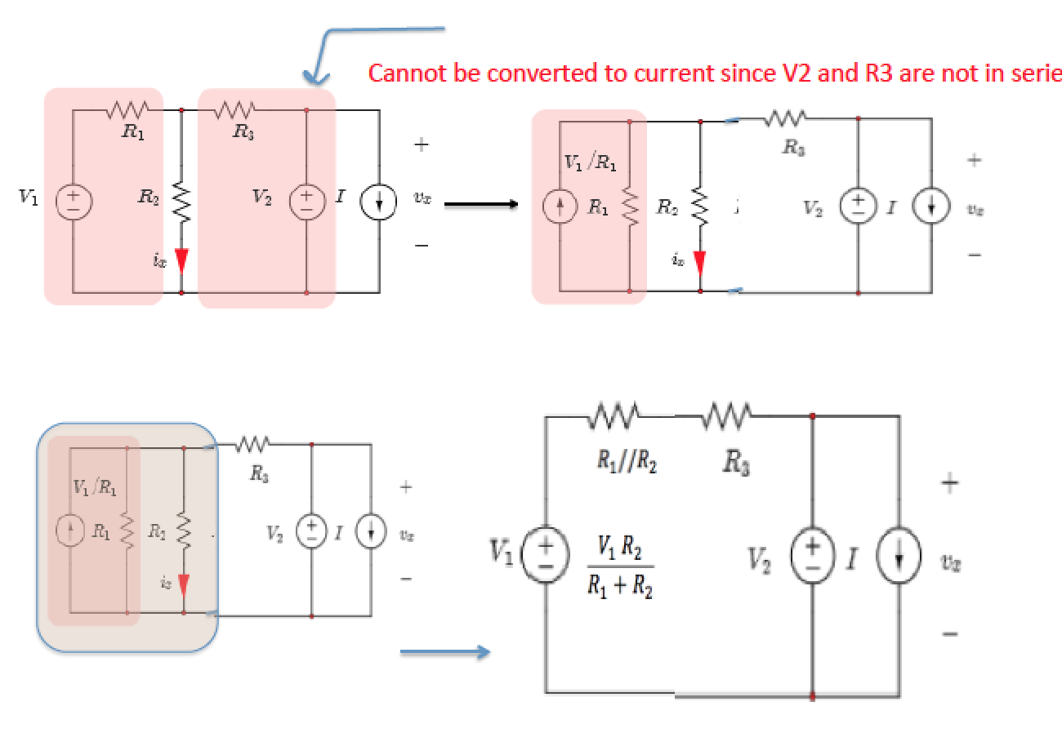
s

Slide 25
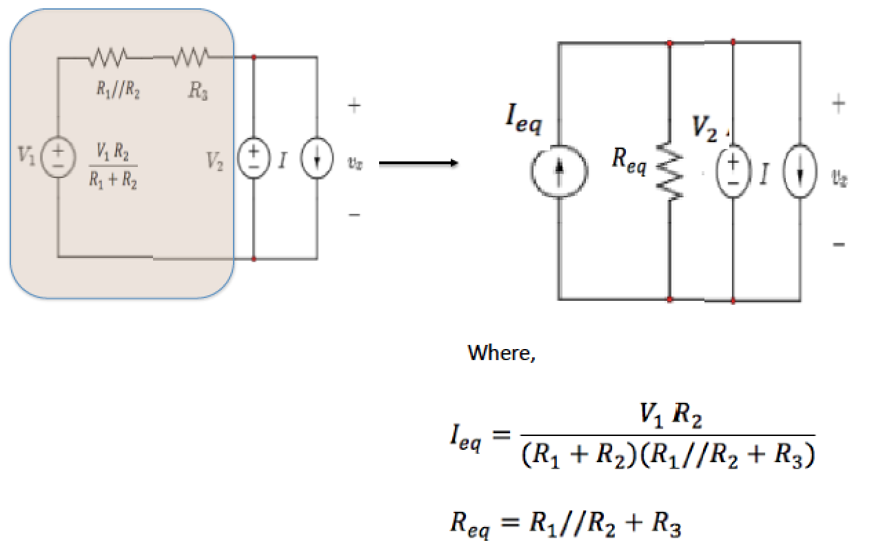

Slide 26
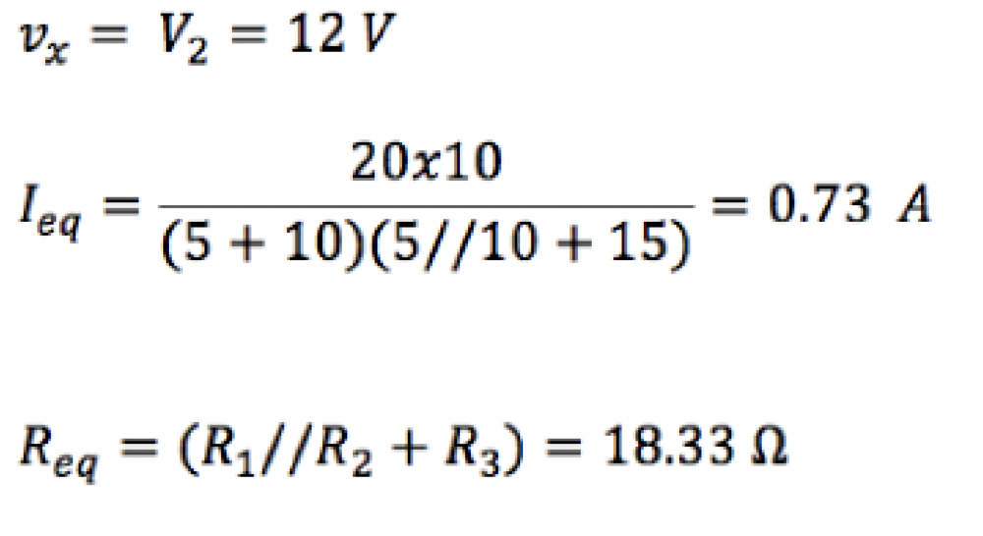
What about i_{x}?

Slide 27
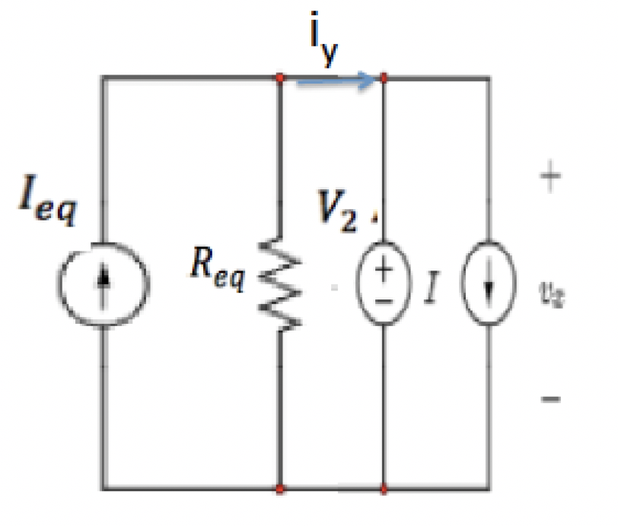
Notice, i_{x} has been removed.
We must work backward to solve for ix in the original circuit.
Let us assign i_{y} as shown

Slide 28
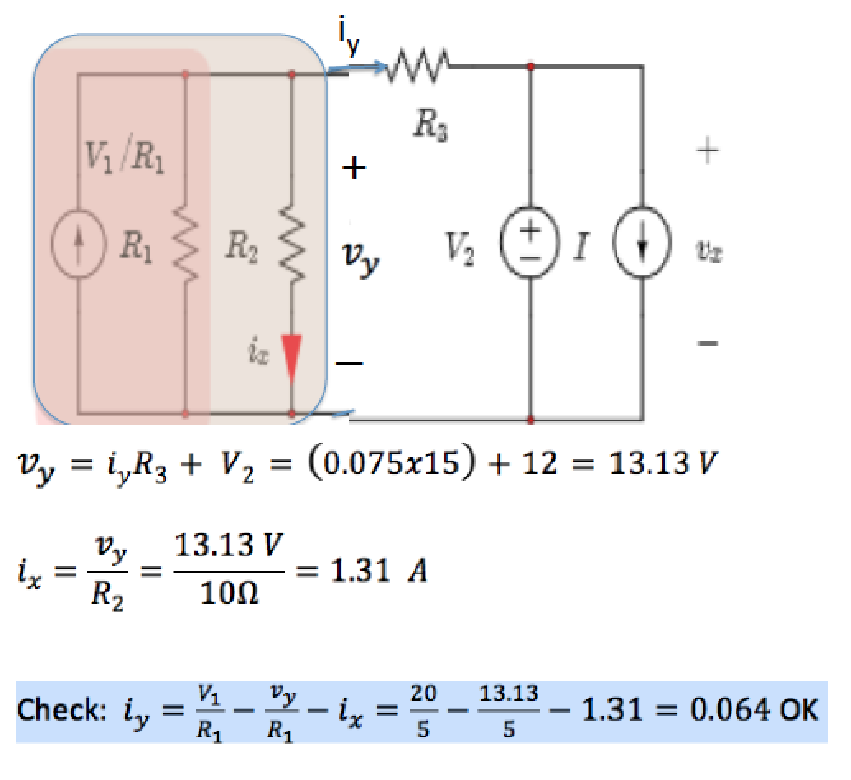

Slide 29
Problem 1:
Source Transformation
6kΩ
a
3kΩ
b
b
6kΩ
a
3kΩ
b
3kΩ
I_{o}
6V
I_{o}
6V
2kΩ
2mA
3kΩ
2kΩ
6V
c
c
c
c
c
c
6kΩ
a
6kΩ
a
I_{o}
I_{o}
6V
6kΩ
2kΩ
6kΩ
2kΩ
6V
1mA
1mA
c
c
a
I_{o}
3kΩ
2kΩ
I_{o} = 2m
3k
2mA
3k + 2k
I = 1.2mA
o
c

Slide 30
Problem (2) Source Transformation
a
•
2kΩ
2kΩ
+
2kΩ
2kΩ
V_{o}
−
4mA
6V
•
b
a
•
2kΩ
+
3mA
2kΩ
2kΩ
V_{o}
−
4mA
2kΩ
•
b

Slide 31
a
•
2kΩ
+
3mA
1kΩ
2kΩ
V_{o}
−
4mA
•
b
1kΩ
a
•
2kΩ
c
•
+
3V
2kΩ
V_{o}
−
4mA
•
b

Slide 32
c
•
3kΩ
c
•
+
+
1mA
3kΩ
2kΩ
V_{o}
−
4mA
3V
2kΩ
V_{o}
−
4mA
•
b
•
b
c
•
V = (5mA)(1.2kΩ)
+
o
5mA
4mA 1.2kΩ
V_{o}
−
V_{o} = 6V
•
b

Slide 33
Problem (3)-­‐ Source transformation
3kΩ
c
•
1kΩ
a
•
5V
+
6V
2kΩ
2mA 1kΩ
V_{o}
2kΩ
−
•
•
b
b
c
•
1kΩ
a
• ₊
2mA
2.5mA
3kΩ
2kΩ
_{2mA} 1kΩ
V_{o}
2kΩ
−
•
•
b
b

Slide 34
c
1kΩ
a
• ₊
•
1.5mA
0.75kΩ
1kΩ
V_{o}
−
•
•
b
b
0.75kΩ
c
•
1kΩ
a
• ₊
V_{o} = (1.125)
1k
1kΩ
V_{o}
2.75k
1.125V
−
V_{o} = 0.41V
•
b
•
b

Slide 35
Problem (4) Source Transformation
6kΩ
3kΩ
12kΩ
I_{o}
12V
6kΩ
2mA
6kΩ
3kΩ
Find the current
I_{o} = ?

Slide 36
Solution:
6kΩ
b
•
3kΩ
6kΩ
b
3kΩ
a
•
•
c
a
c
12kΩ
I_{o}
12kΩ
I_{o}
12V
6kΩ
2mA
6kΩ
12V
6kΩ
6kΩ
e
•
•
d
e
d
e
e
3kΩ
_{e} •
d
6V
3kΩ
6kΩ
b
b
6kΩ
b
a
a
12kΩ
I
12kΩ
I_{o}
12V
o
6kΩ
12kΩ
12V
6kΩ
0.5mA
12kΩ
e
e
e
e
6V

Slide 37
b
I_{o}
2mA
6kΩ
12kΩ
6kΩ
0.5mA
12kΩ
e
b
I_{o}
1.5mA
3kΩ
6kΩ
e
3k
I_{o} = −0.5mA
I_{o} = −1.5m _{3k + 6k}

Slide 38
Problem (5)
1A
6Ω
5Ω
17Ω
i_{o}
2A
6Ω
1.5Ω
34V
Use source transformation to find :
i_{o} = ?

Slide 39
1A
Problem (6)
a
•
6Ω
b
5Ω
c
•
•
17Ω
i_{o}
2A
6Ω
1.5Ω
34V
•
d
•
d
6Ω
5V
a
•
b
5Ω
c
•
•
6Ω
17Ω
i_{o}
+
−
•
d
1.5Ω
12V
34V
•
d

Slide 40
c
17Ω
c
•
•
17Ω
i_{o}
17Ω
i_{o}
1A
2A
17Ω
1.5Ω
17V
1.5Ω
34V
•
d
•
d
c
•
i_{o}
8.5
1A
8.5Ω
1.5Ω
i_{o} = −1 = −0.85A
8.5 + 1.5
•
d

Slide 41
Problem ( 7)
20kΩ
3kΩ
5kΩ
i_{o}
100V
80kΩ
12mA
60kΩ
10kΩ
1kΩ
Find
i_{o} = ?

Slide 42
20kΩ
a
•
3kΩ
b
b
•
5kΩ
•
i_{o}
100V
80kΩ
12mA
60kΩ
10kΩ
•
•
d
•
d
c
1kΩ
a
•
3kΩ
b
b
•
5kΩ
•
20kΩ
i_{o}
5mA
80kΩ
12mA
60kΩ
10kΩ
•
•
d
•
d
c
1kΩ

Slide 43
a
•
3kΩ
b
b
•
5kΩ
•
i_{o}
5mA
16kΩ
12mA
60kΩ
10kΩ
•
c
•
d
•
d
1kΩ
a
•
3kΩ
b
b
•
5kΩ
•
i_{o}
80V
12mA
60kΩ
10kΩ
16kΩ
•
c
•
d
•
d
1kΩ

Slide 44
20kΩ
b
b
•
5kΩ
•
i_{o}
80V
12mA
60kΩ
10kΩ
•
d
•
b
b
•
5kΩ
•
i_{o}
20kΩ
4mA
12mA
60kΩ
10kΩ
•
d
•

Slide 45
b
 |  |  | 5kΩ
 |  |  |  | i_{o}
 | 8mA |  | 15kΩ |  | 10kΩ
b
•
d
15kΩ
b
•
5kΩ
120
i_{o} =
(15 + 5 + 10)k
i_{o}
120V
10kΩ
i = 4mA
o
•
d

Slide 46
Problem (8)
520V
16Ω
4Ω
260Ω
+
1A
40Ω
v_{o}
250Ω
6Ω
−
520V
v_{o} =?

Slide 47
Example
520V
16Ω
a
•
4Ω
c
•
+
b
260Ω
1A
40Ω
v_{o}
250Ω
6Ω
−
•
_{d}
e
520V
a
•
b
4Ω
c
•
+
1A
40Ω
v_{o}
250Ω
6Ω
−
•
_{d}
e

Slide 48
520V
a
•
b
4Ω
c
•
+
40V
250Ω
v_{o}
40Ω
−
•
e
_{d}
6Ω
( 520 − 40 )( 250 )
(40 + 4 + 6 + 250)
v_{o} =
v_{o} = 400V

