Slide 1
Sample online Questions

Slide 2
What is the rms value for the following sinusoidal voltage
$$v\left(t\right)=24cos\left(2000πt+30°\right) V$$
Solution:
To find the rms value we apply the formula,
$$V_{rms}=\sqrt{\frac{1}{T}\int_{0}^{T}{{v_{T}}^{2}\left(t\right)}dt}=\frac{24}{\sqrt{2}}=16.97 V$$
What is the rms value for the following sinusoidal voltage
Solution:
$$v\left(t\right)=24sin\left(2000πt°\right) V$$
To find the rms value we apply the formula,
$$V_{rms}=\sqrt{\frac{1}{T}\int_{0}^{T}{{v_{T}}^{2}\left(t\right)}dt}=\frac{24}{\sqrt{2}}=16.97 V$$

Slide 3
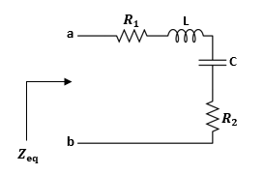
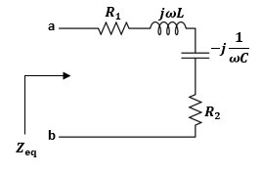
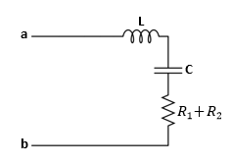
Example
Determine the equivalent impedance$Z_{eq}$, seen between the terminals “ab” of the circuit shown
Draw the equivalent simplified circuit consisting of single R, L or C connected in series.
Where $ω=1000 rad/s, R_{1}=10 KΩ, R_{2}=6 KΩ, L=20 mH, C=180 μF.$
Solution:
a)First we transfer the circuit to the phasor domain,
The equivalent impedance $Z_{eq}$ is equal to,
$$Z_{eq}=R_{1}+R_{2}+jωL−j\frac{1}{ωC}$$
$$\left.=\left(R_{1}+R_{2}\right)+j(ωL−\frac{1}{ωC}\right)$$
$$=16000+j14.44 Ω$$
b)The equivalent simplified circuit is shown
The equivalent simplified RLC circuit

Slide 4
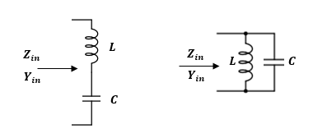
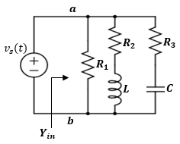
Example
Determine the equivalent impedance$and adimittance$ seen between the terminals “ab” of the circuit shown

Slide 5
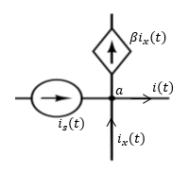
Example
Consider a portion of a steady-state circuit at node ‘a’ shown. By applying a KCL equation at node ‘a’, find the expression for $i(t)$. Assume $β=0.2$.
Where the source currents are given by,
$$i_{s}\left(t\right)=5\sin{(800t}+{45}^{o}) A$$
$$i_{x}\left(t\right)=4\cos{(800t}+{45}^{o}) A$$
Solution:
$$i_{s}\left(t\right)=5\sin{(800t}+{45}^{o}) A$$
$$= 5\cos{(800t}+{45}^{o}−90) A$$
$=5\cos{(800t}−{45}^{o}$) $A$
$$I_{s}=\left(5∠−45°\right)$$
$$I_{x}=4∠45°)$$
The KCL equation
$$i\left(t\right)+βi_{x}\left(t\right)=i_{s}\left(t\right)+i_{x}\left(t\right)$$
$I=I_{s}+I_{x}−βI_{x}=I_{s}+I_{x}(1−β$)
$=\left(5∠−45°\right)+(1−\text{0.2}\text{)}$($4∠45°)$
$=\left(5∠−45°\right)+0.8$($4∠45°)=5.82−j1.27 A$
$I=\left(5.96 ∠−12.31°\right)$ A

Slide 6
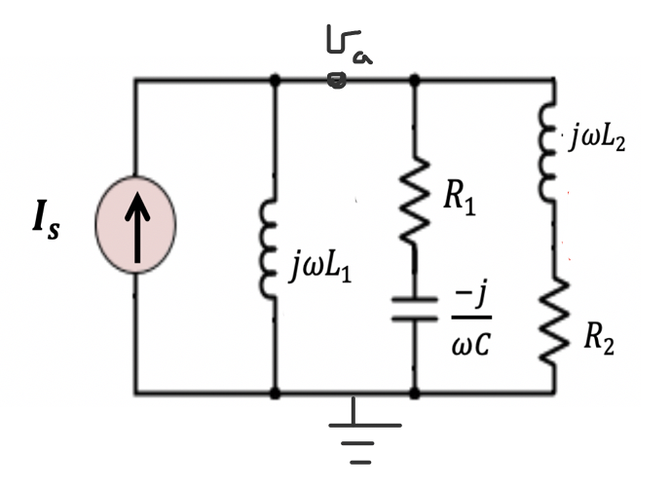
Example
Consider the following phasor equivalent circuit. Write KCL equation at node “a”.
Solution
$${−I}_{s}+\frac{V_{a}}{jωL_{1}}+\frac{V_{a}}{R_{1}−\frac{j}{ωC}}+\frac{V_{a}}{jωL_{2}+R_{2}}=0$$
Example
Consider the following phasor equivalent circuit. Write the correct equation for the current $I_{x}$
$$I_{x}=\frac{V_{a}}{jωL_{2}+R_{2}}$$
$$I_{x}$$

Slide 7
Example
Consider the following phasor equivalent circuit. Write KCL equation for $I_{y}$
Solution
$${I_{y}=I}_{s}−\frac{V_{a}}{jωL_{1}}$$
Example
Consider the following phasor equivalent circuit. Write the correct equation for the voltage $V_{x}$
$$+$$
$$V_{x}$$
$$V_{x}=R_{1}\frac{V_{a}}{R_{1}−\frac{j}{ωC}}$$
$$−$$

Slide 8
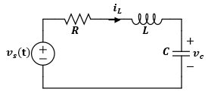
Examples
For the given RLC circuit I time domain, write the expression for the KVL equation around the loop in phasor domain .
$$+$$
$$v_{x}$$
$$−$$
Solution
$${−V}_{s}+I_{L}\left(R+jωL−\frac{j}{ωC}\right)=0$$
$$I_{L}=\frac{V_{s}}{R+jωL−\frac{j}{ωC}}$$
$$V_{x}=I_{L}\left(jωL−\frac{j}{ωC}\right)=V_{s}−I_{L}R$$

Slide 9
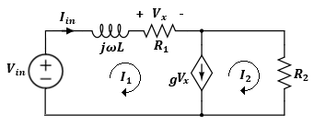
Example
W$rite the two mesh ccurrent equations in the follwong circuits:.$
Solution:
$V_{in}=I_{1}(R_{1}+jωL)+I_{2}(R_{2})$
$I_{1}−I_{2}=g(I_{1}R_{1})$
It can be seen that,
$$I_{in}=I_{1}$$

Slide 10
Example
Assume $A=24 V,B=30 V, a=20 mA, b=45 mA, D=24 mA, ω=1000\frac{rad}{s},θ_{1}=30°,θ_{2}=60°, θ=75°$. Find the time-domain expression for:
$$V=A∠θ_{1}−B∠−θ_{2}$$
Solution:
Before we transform to the time-domain, let us simplify the voltage expression,
$$V=(A∠θ_{1})−(B∠−θ_{2})$$
$$C=\sqrt{{\left[A\cos{θ_{1}}−B\cos{θ_{2}}\right]}^{2}+{\left[A\sin{θ_{1}}+B\sin{θ_{2}}\right]}^{2}}$$
$$=(A\cos{θ_{1}}+jA\sin{θ_{1}})−(B\cos{{−θ}_{2}}+jB\sin\left.−θ_{2}\right)$$
$$C=\sqrt{{\left[24\cos{30}−30\cos{60}\right]}^{2}+{\left[24\sin{30}+30\sin{60}\right]}^{2}}$$
$$=\left(A\cos{θ_{1}}+jA\sin{θ_{1}}\right)−B\cos{θ_{2}}+jB\sin\left.θ_{2}\right)$$
$$=\sqrt{{\left[5.784\right]}^{2}+{\left[37.98\right]}^{2}}$$
$$=\left[A\cos{θ_{1}}−B\cos{θ_{2}}\right]+j\left[A\sin{θ_{1}}+B\sin{θ_{2}}\right]$$
$$=38.41$$
$$=C∠θ_{V}$$
$$θ_{V}=\tan^{−1}{\frac{A\sin{θ_{1}}+B\sin{θ_{2}}}{A\cos{θ_{1}}−B\cos{θ_{2}}}}$$
$$=\tan^{−1}{\frac{37.98}{5.78}}$$
$$=81.35$$
$$=38.41∠81.35° v$$
Now we can transform the voltage to the time-domain,
$$v\left(t\right)=C cos⁡(ωt+θ_{V})$$
$$=38.41\cos\left(1000t+81.35°\right) v$$

Slide 11
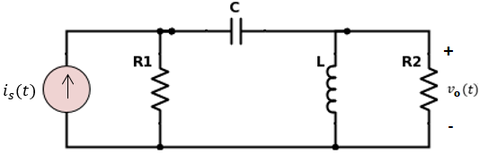
Problem 9:
For the circuit shown, find the steady state expression for$v_{o}\left(t\right),$with $i_{s}\left(t\right)=I_{m}cos⁡(ωt+θ)A$ with $I_{m}=22 mA , {ω=10000\frac{rad}{s}, R}_{1}=0.5 kΩ, R_{2}=0.3 kΩ, R_{3}=0.2 kΩ, L=11.6 mH,θ={35}^{°}, and C=0.8 μF$.
Please see all the steps from the Discussion session.

Slide 12
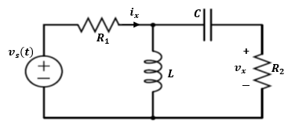
Problem 10:
For the given circuit shown below. The voltage input is given by
$v_{s}(t)=V_{m}\cos{(ωt+θ)}$, where $R_{1}=5Ω, R_{2}=18Ω, C=0.8 mF, V_{m}=10v, ω=3000 \frac{rad}{s}, θ=π/3 rad, L=0.2 mH.$Determine the expression for$i_{x}(t)$ and$v_{x}\left(t\right)$.
RLC circuit in time-domain
Please see all the steps from the Discussion session.

Slide 13
Example:
For the circuit shown below, find the current $i_{1}(t)$ and $v_{o}(t)$. Given $i\left(t\right)=I_{m}\cos{(ωt)}$, $I_{m}=22mA,ω=10000\frac{rad}{s}, R=500Ω, L_{1}=11.6mH, L_{2}=15.4mH,C=0.8μF, γ=0.25$
Please see all the steps from the Discussion session.

