Slide 1
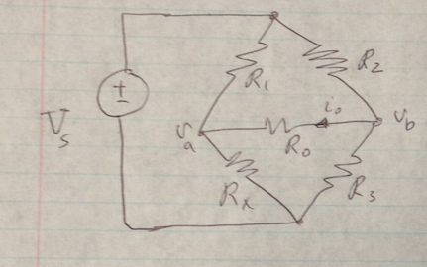
Practical Relevance
-Wheatstone-Bridge-
Example
The circuit represents a balanced Wheatstone-bridge circuit with applied d.c. source. Find the voltages V_{a} and V_{b}.
Variable | Default | Unit
V_{S} | 28 | V
R₁ | 10 | Ω
R₂ | 100 | Ω
R₃ | 15 | Ω
R_{X} | 1.5 | Ω

Slide 2
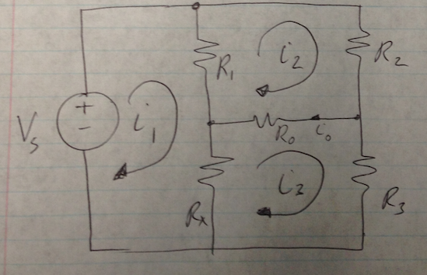
KVL around loops
Solving for i₁, i₂ and i₃:
Is the circuit balanced?

Slide 3
Solving for v_{a} and v_{b},
Notice va=vb

