Slide 1
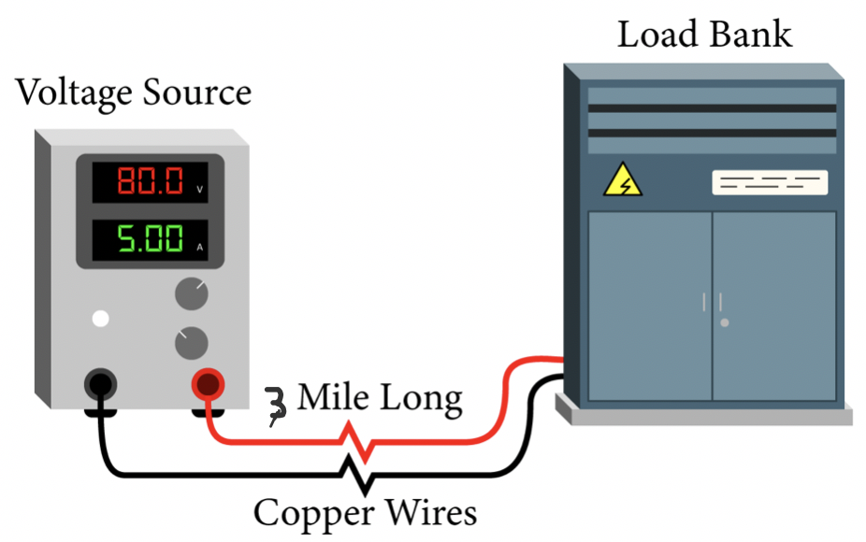
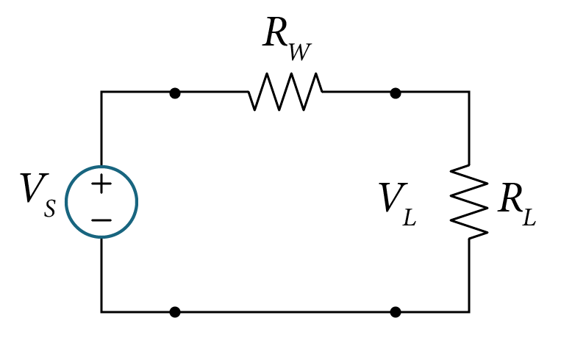
Example 3.8
Figure 3.14 shows a circuit and its model with a voltage source (V_{s}) supplying a load, represented by a resistance ${(R}_{L})$, that is located 3 miles away from the source V_{s}. The voltage source and the load are connected by a long copper wire that has a resistance $R_{W}$ value that is measured at 0.2 Ω/1000ft. Consider the case with V_{s} =100 V, $R_{L}=10 Ω$and $R_{W}$ is the total equivalent resistance for the copper wire as shown in Fig. 3.14(b), where $R_{W}$ is the total resistance for the copper wire.
If we desire that the voltage at the load bank be set at least V_{L} = 80 V, will this setup work? Why? What should we do to make it work?
Figure 3.14 Power System consisting of a voltage source supply electric load three miles away
simplified electrical equivalent model

Slide 2
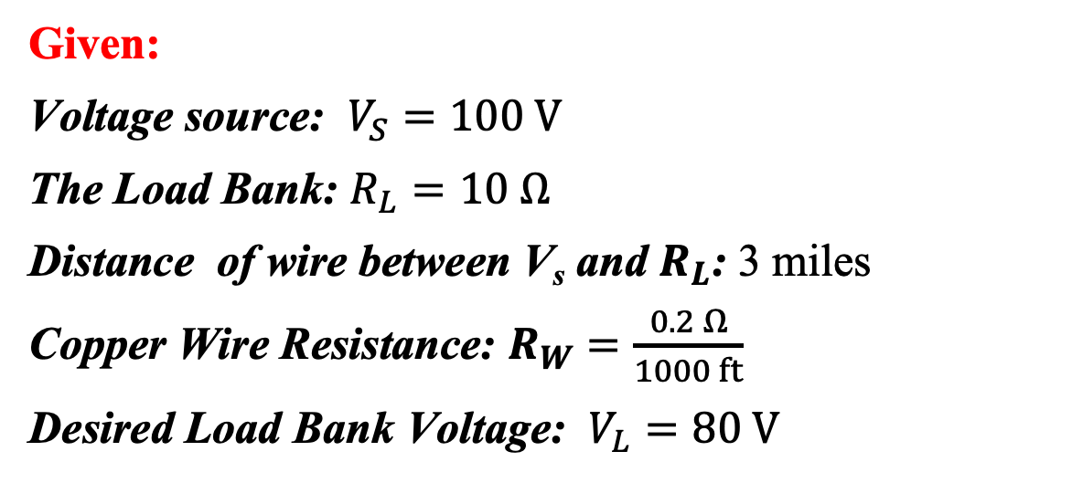
Solution
Given:
Voltage source: $V_{S}=100 V$
The Load Bank: $R_{L}=10 Ω$
Distance of wire between V_{s} and $R_{L}$: 3 miles
Copper Wire Resistance: $R_{W}=\frac{0.2 Ω}{1000 ft}$
Desired Load Bank Voltage: $V_{L}=80 V$

Slide 3
Solution
First calculate the equivalent resistance $R_{W}$for a 3-mile copper wire:
The length of the copper wire (L) in feet is given by.
$$L=3 milex5280 ft/mile =15,840 ft$$
Then, the total equivalent resistance for the copper wire is:
$$R_{W}= \frac{0.2Ω}{1000ft}x15,840ft≈3.17Ω$$
Since the equivalent circuit represents a single loop circuit, we write one the KVL eq.
$$−V_{s}+I_{L}R_{W}+V_{L}=0$$
Solving for the resultant load current $I_{L}$,
$$I_{L}=\frac{{V_{s}−V}_{L}}{R_{W}}=\frac{100−80}{3.17}=6.31 A$$
$$I_{L}$$

Slide 4
Solution
Using Ohm’s law, the load voltage is given by,
$$V_{L}=R_{L} I_{L}=10x6.31=63.1 V$$
The resultant load voltage is below the desired value of V_{L} = 80 V.
Unfortunately, this setup will not deliver the required load voltage, hence it will not work.

Slide 5
Solution
For this setup to work, we have three options:
move the load closer to the source , i.e less than 2 miles,
increase the source voltage Vs above 100V,
change the copper wire with one has less line resistance/feet.
Options 1 and 2 are too difficult, costly and maybe not practical, as they are part of condition of the source and load.
This leaves with Option 3!
What should the measured value Ω/1000ft of the new cable?
What should the load current be for V_{L} = 80 V?
$I_{L}=\frac{V_{L}}{R_{L}}=\frac{80}{10}=8 A$ !
We need at least 8A reach the load!

Slide 6
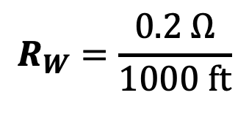
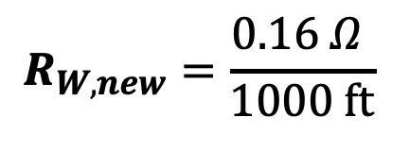
Solution
From KVL we have,
$$−V_{s}+I_{L}R_{W,new}+V_{L}=0$$
Solving for the value of the copper resistance,
$$R_{W,new}=\frac{{V_{s}−V}_{L}}{I_{L}}=\frac{100−80}{8}= 2.5 Ω$$
For a $10,560ft$ (3 mile) length of the copper wire (L), the maximum wire resistance/feet that can be used:
$$\frac{2.5Ω }{15,840ft}=0.16 mΩ/ft=0. 16Ω/1000ft$$
$$R_{W}=\frac{0.2 Ω}{1000 ft}$$
$$R_{W,new}=\frac{0.16 Ω }{1000 ft}$$

