Slide 1

Example: Practical Relevance
Frequency Response of the Transistor Voltage Amplifier
One common electronic device used in many applications is the transistor voltage amplifier.
Examples are the Consumer Electronics: Radios, T.Vs., phones, satellites, VCRs and DVD.
The smart phone is one example of commercial device that has many amplifiers within its electronics and communication circuits.
Smart Phone

Slide 2
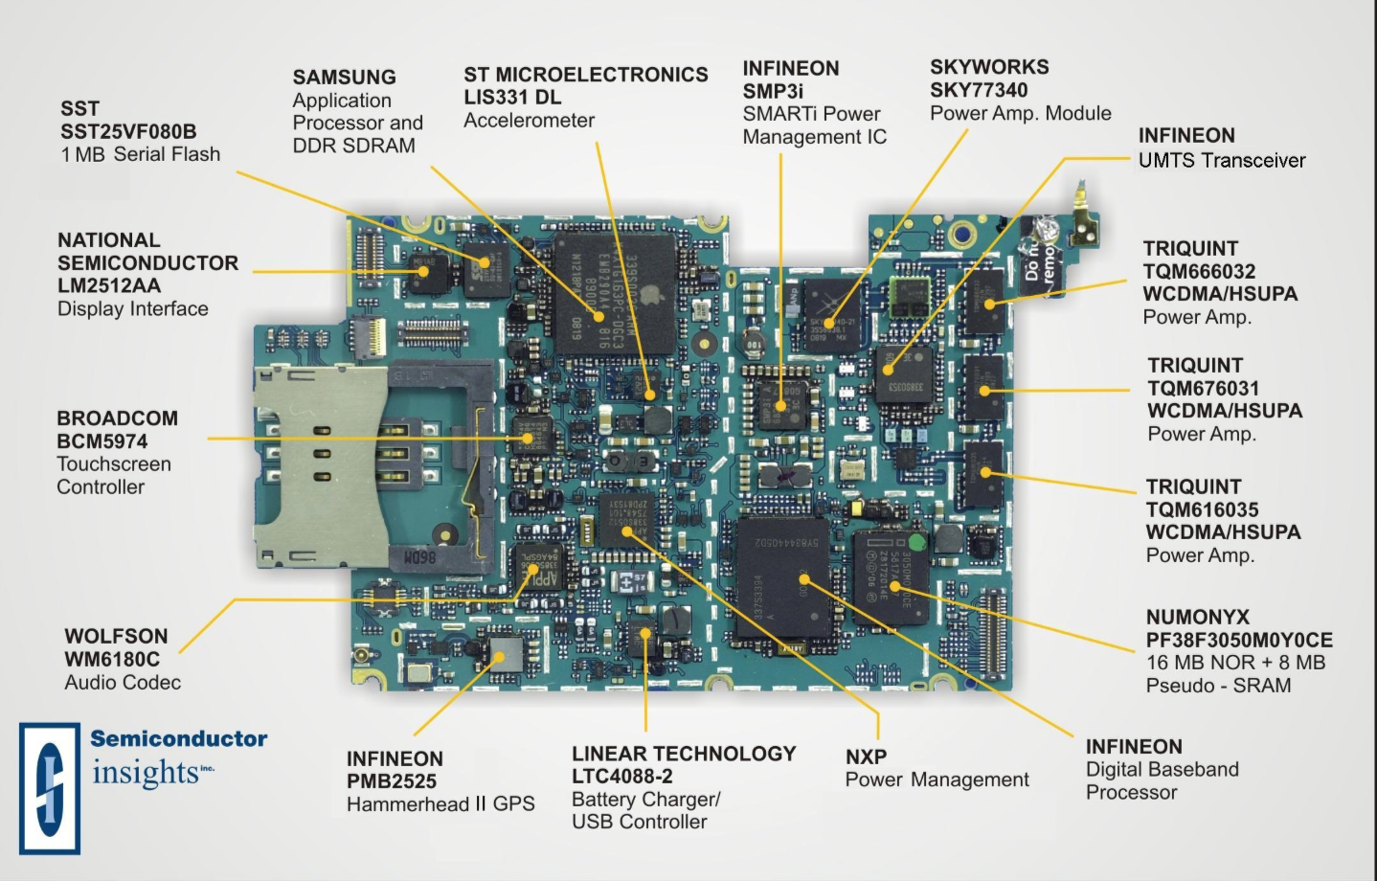
Practical Example
Apple iPhone
Voltage/Power Amplifier
http://maltiel-consulting.com/iPhone_Components_maltiel_semiconductor-Update.htm#Inside_Apple_iPhone_3G

Slide 3
Practical Example
Smart iPhone
Voltage/Power Amplifier
http://maltiel-consulting.com/iPhone_Components_maltiel_semiconductor-Update.htm#Inside_Apple_iPhone_3G

Slide 4

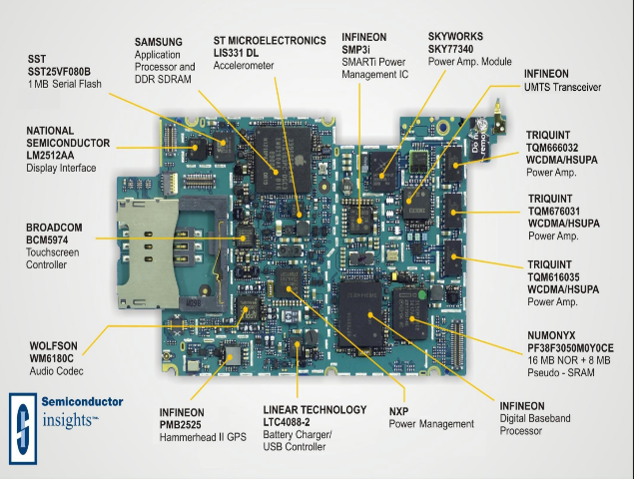
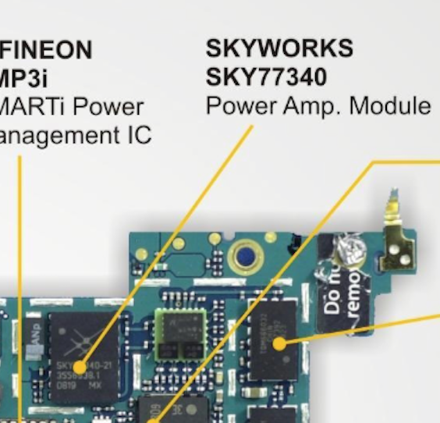
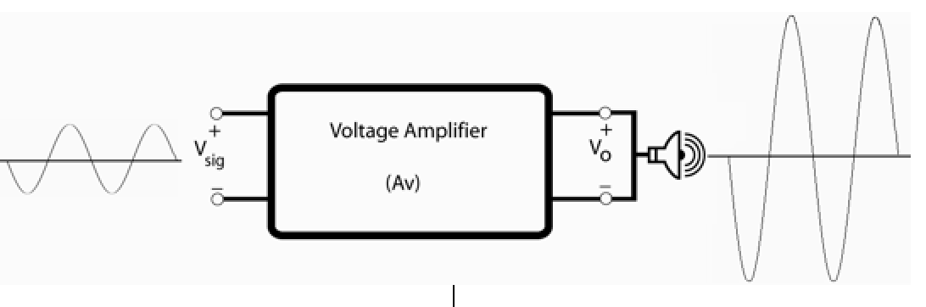
Commercial Product
Printer Circuit Board
Power Amplifier IC
Voltage Amplifier block Diagram
Voltage Amplifiers are electronic circuits that are used to amplify (enlarge) a weak input signal (voltage/current) and produce a stronger output signal.
Mathematical Representation:
A_{v}: Stands for Voltage Gain

Slide 5
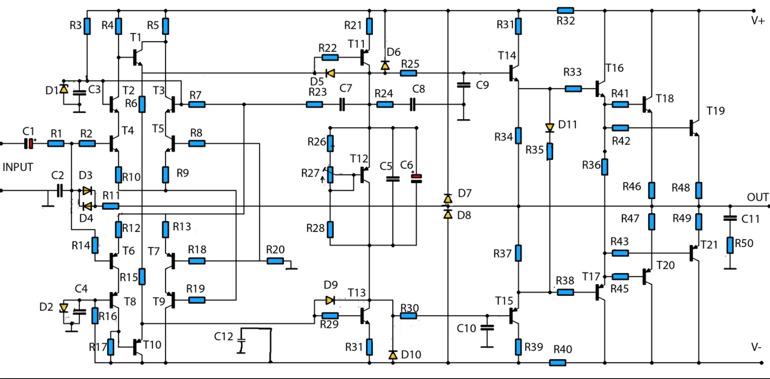
Practical Voltage amplifier
Multi-stage amplifier

Slide 6


Example: Practical Relevance
Frequency Response of the Transistor Voltage Amplifier
One common electronic device used in many applications is the transistor voltage amplifier.
The transistor has revolutionized the electronics and digital industries at the global level.
One popular voltage amplifier is known as the Metal Oxide Semiconductor Field Effect Transistor (MOSFET).
Active device
Transistor
Highly Simplified Equivalent Circuit: The MOSFET Voltage Amplifier

Slide 7
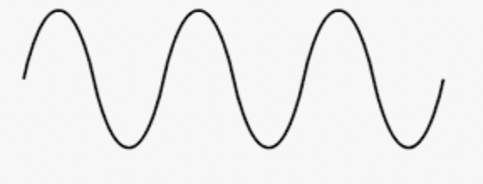
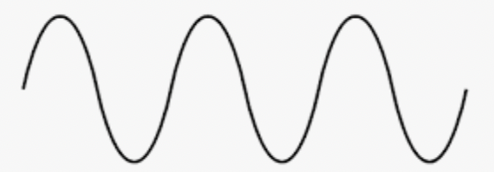
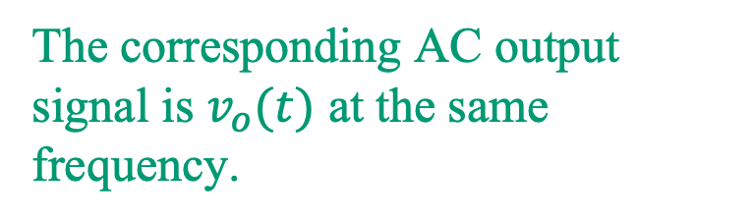
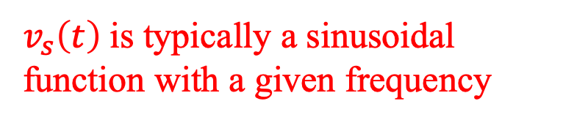
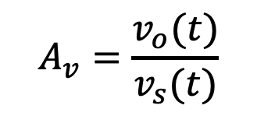
Example: Practical Relevance
Frequency Response of the Transistor Voltage Amplifier
Once an AC input is applied, the corresponding output voltage will be amplified by a constant. This constant, known as the voltage amplifier gain, is defined as,
The corresponding AC output signal is $v_{o}(t)$ at the same frequency.
$$A_{v}=\frac{v_{o}(t)}{v_{s}(t)}$$
$v_{s}\left(t\right)$is typically a sinusoidal function with a given frequency
Voltage gain

Slide 8
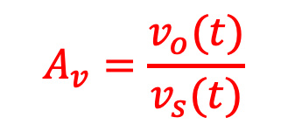
Example: Practical Relevance
Frequency Response of the Transistor Voltage Amplifier
Block diagram of a voltage amplifier
The Voltage gain is given by,
$$A_{v}=\frac{v_{o}(t)}{v_{s}(t)}$$

Slide 9

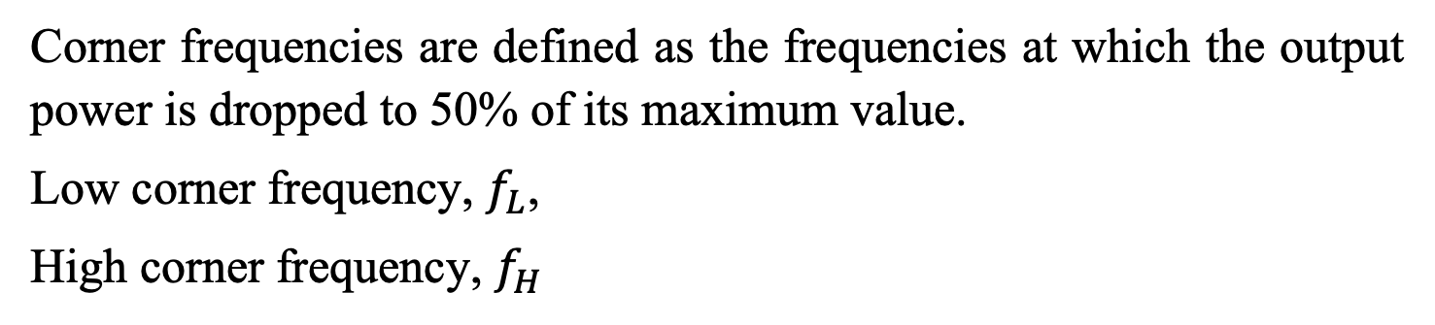
Example: Transistor Voltage Amplifier
Frequency Response
Corner frequencies are defined as the frequencies at which the output power is dropped to 50% of its maximum value.
Low corner frequency, $f_{L}$,
High corner frequency, $f_{H}$
Band Width (B.W.)
$$B.W. = f_{H}− f_{L}$$

Slide 10
Example: Transistor Voltage Amplifier
Amplifier Model for all frequencies

Slide 11
Example: Transistor Voltage Amplifier
Amplifier Model for all frequencies
Time-domain
Phasor-domain
$A_{v}= \frac{v_{o}(jω) }{v_{s}(jω) }$ Complex number expression as a function of frequency $ω$.

Slide 12
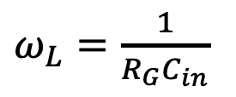

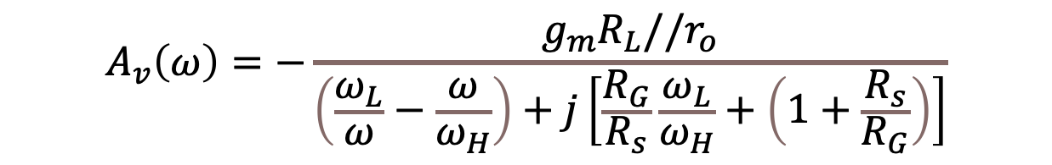


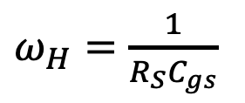
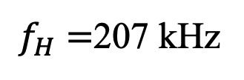
Example: Practical Relevance
Frequency Response of the Transistor Voltage Amplifier
$$A_{v}\left(ω\right)=−\frac{g_{m}R_{L}//r_{o}}{\left(\frac{ω_{L}}{ω}−\frac{ω}{ω_{H}}\right)+j\left[\frac{R_{G}}{R_{s}}\frac{ω_{L}}{ω_{H}}+\left(1+\frac{R_{s}}{R_{G}}\right)\right]}$$
$ω_{L}=\frac{1}{R_{G}C_{in}}$
$ω_{H}=\frac{1}{R_{S}C_{gs}}$
Example:
$${|A}_{v}\left(ω\right)|=13.3$$
$f_{L}=16 Hz$
$B.W. = f_{H}− f_{L}$=207-0.06=206.4 kHz
$f_{H}=$207 kHz

