Slide 1
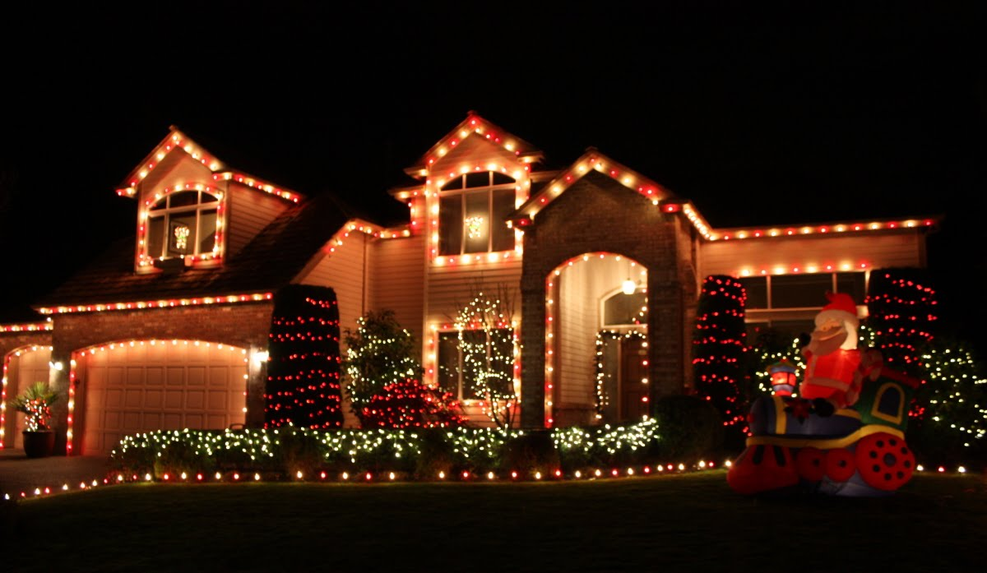
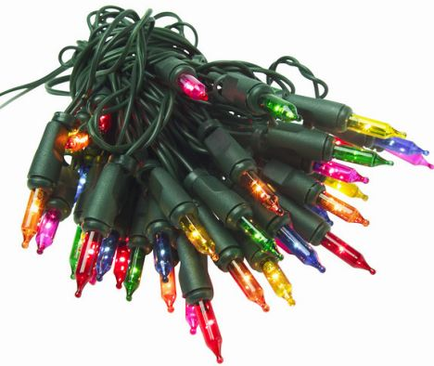
Practical Relevance Example - Christmas Lights
Christmas lights are strands of electric lights used to decorate homes, buildings and Christmas trees during the Christmas season.
The types of lamps used in Christmas lighting sets may be based on a variety of technologies. Common lamp types are incandescent light bulbs and light-emitting diodes (LEDs).
Figure 3.1: (a) Commercial (Residential) Applications of Christmas lights, (b) one strand or string of lights

Slide 2
Practical Relevance Example - Christmas Lights
Christmas lights are connected in series to one voltage source, and the same current flows through each element of the circuit. Christmas lights are strands of electric lights used to decorate homes, buildings and Christmas trees during the Christmas season.
The types of lamps used in Christmas lighting sets may be based on a variety of technologies. Common lamp types are incandescent light bulbs and light-emitting diodes (LEDs).
Figure 3.1: (a) Commercial (Residential) Applications of Christmas lights, (b) one strand or string of lights

Slide 3
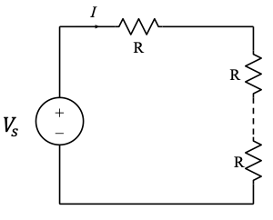
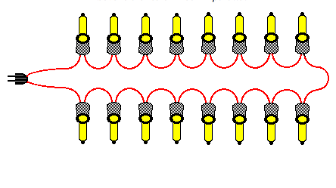
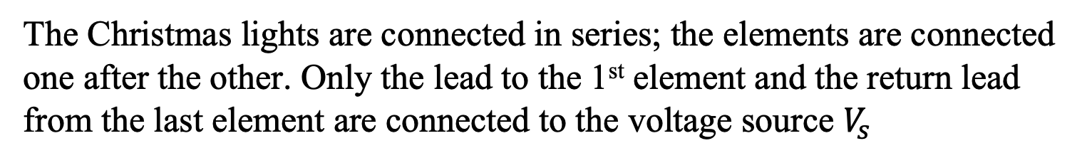
Series Connected Strands - model
The Christmas lights are connected in series; the elements are connected one after the other. Only the lead to the 1st element and the return lead from the last element are connected to the voltage source $V_{s}$
Schematic Representation of Christmas light chain, (b) Simplified circuit model of Christmas lights connected in series

Slide 4
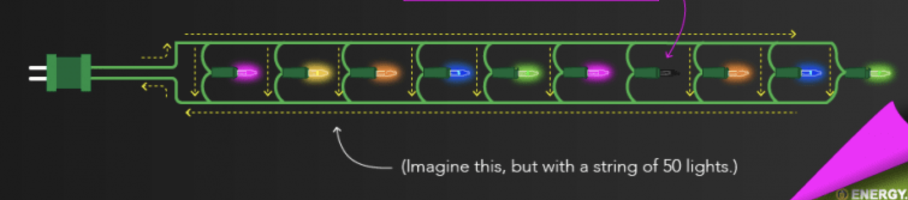
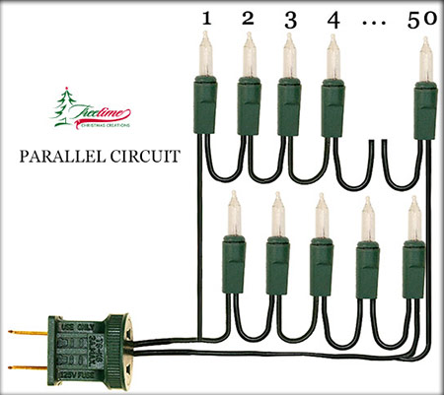
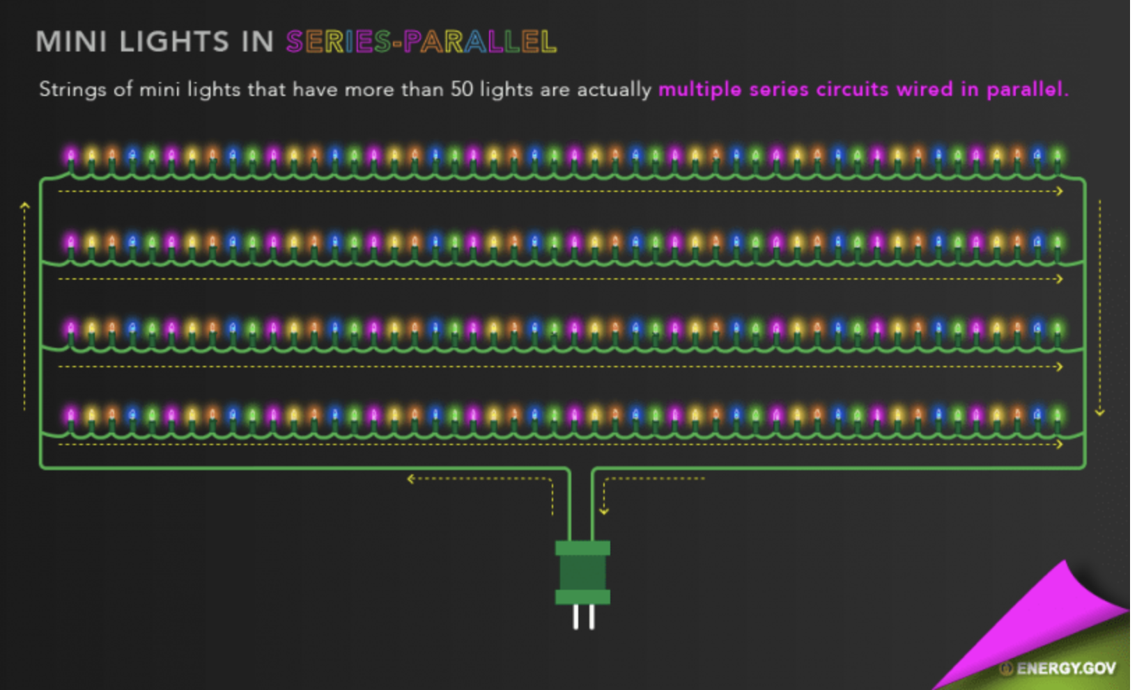
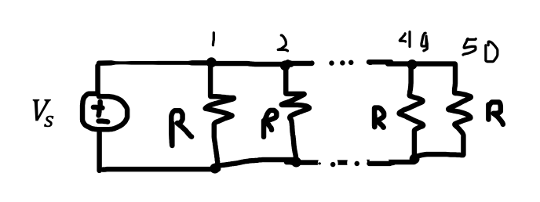
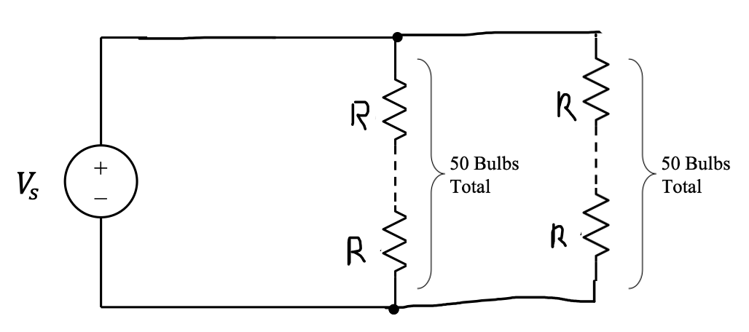
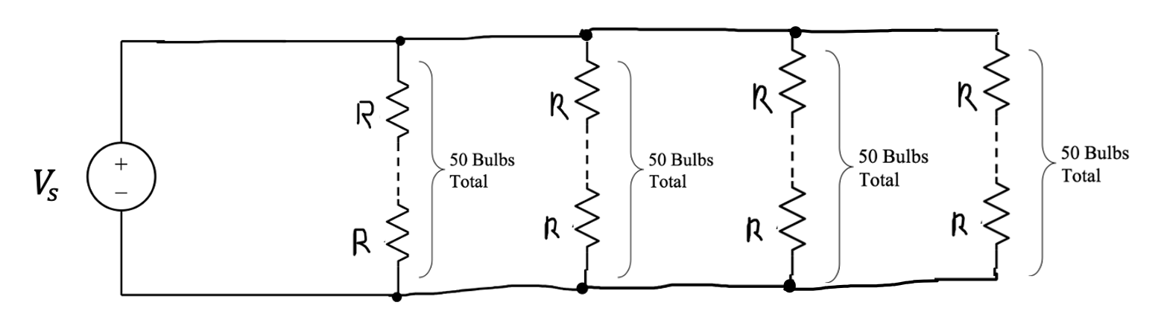
Parallel Connected Strands - model
When Christmas lights are connected in parallel configuration, then each light has its own closed-loop circuit as shown in the fifty lights example of Fig. 2.92(a).
Schematic Representation of parallel strand Christmas light chain, Simplified circuit model of Christmas lights connected in series

Slide 5
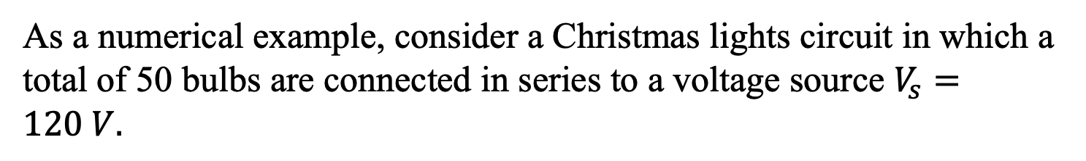
Example of 50 Lights
As a numerical example, consider a Christmas lights circuit in which a total of 50 bulbs are connected in series to a voltage source $V_{s}=120 V.$
Christmas lights schematic with 50 light bulbs
What is the current I?

Slide 6
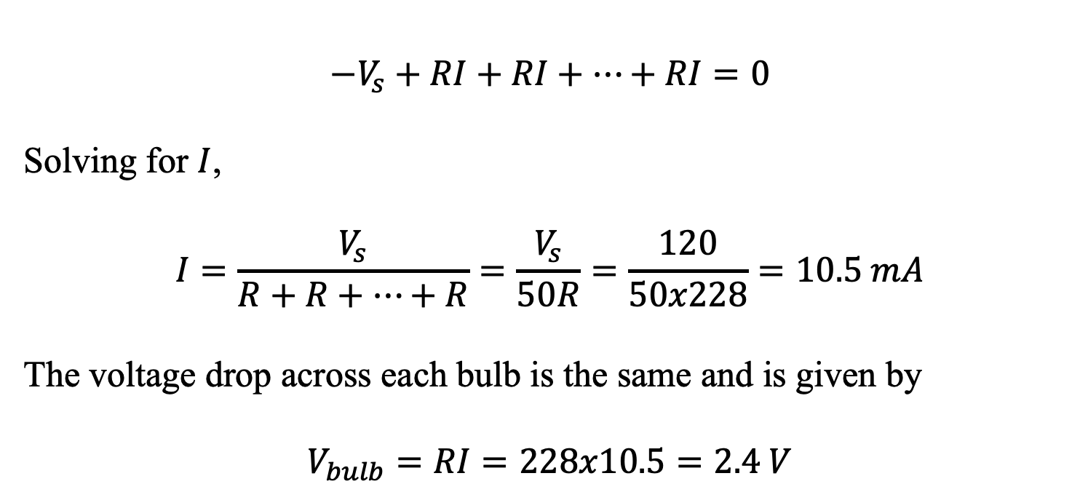
Example of 50 Lights
Solution:
Since the equivalent circuit represents a single loop circuit, we write one the KVL eq.
$${−V}_{s}+RI+RI+…+RI=0$$
Solving for $I$,
$$I=\frac{V_{s}}{R+R+…+R}=\frac{V_{s}}{50R}=\frac{120}{50x228}=10.5 mA$$
The voltage drop across each bulb is the same and is given by
$$V_{bulb}=RI=228x10.5=2.4 V$$

