Slide 1
Practical Application: Voltage Division Formula
The Wheatstone Bridge
A Wheatstone bridge is a measuring instrument used to measure an unknown electrical resistance.
R_{x} is the unknown resistance to be measured; R₁, R₂ and R₃ are resistors of known resistance and the resistance of R₃ is adjustable.
Unknown
Resistor
Variable resistor

Slide 4
$$ε$$

Slide 5
(foil)

Slide 6
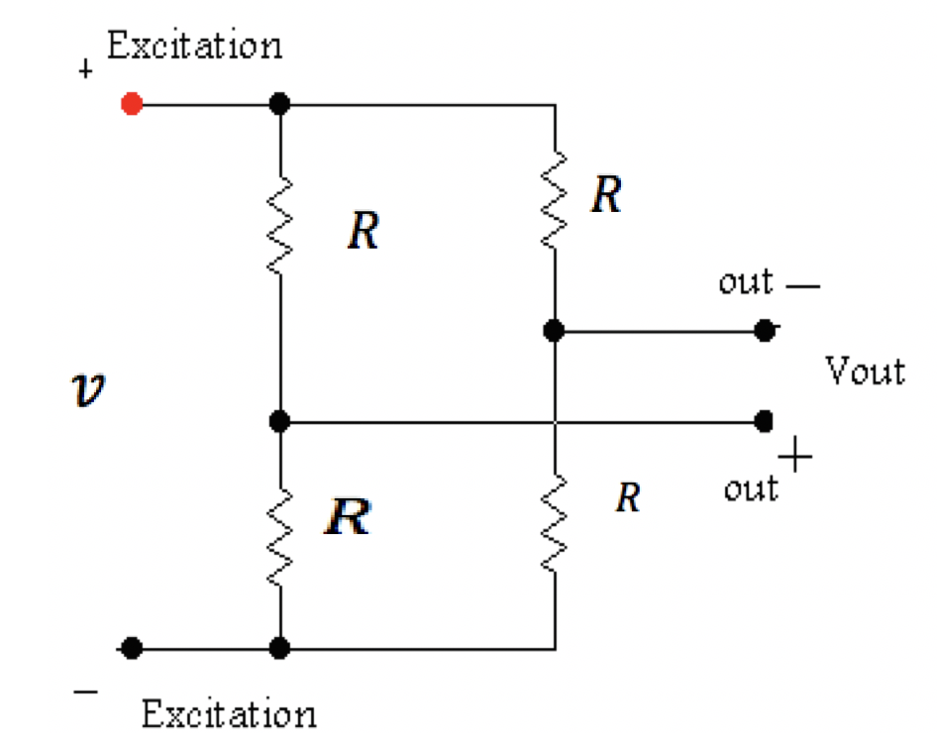
Practical Application
- Voltage Division Formula -
When all the resistors are equal to R:
$v_{out}$ = 0

Slide 7
Practical Application
- Voltage Division Formula -
When all the resistors are equal to R:
$v_{out}=0$

Slide 8
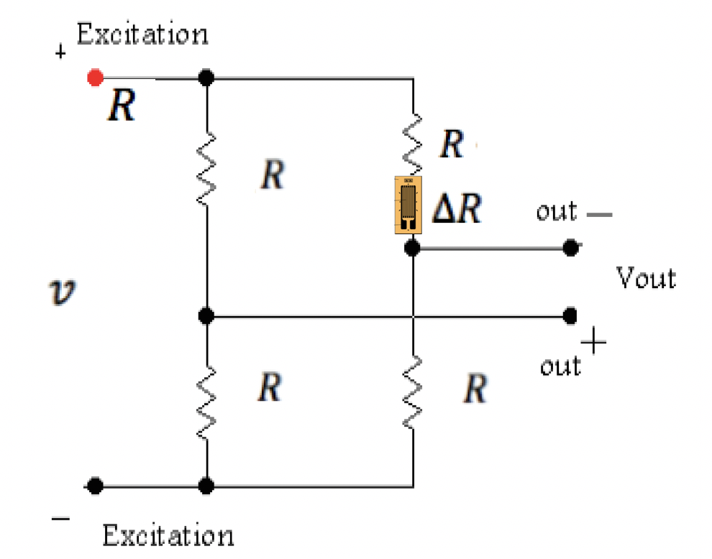
Practical Application
- Voltage Division Formula -
With strain gage is connected,
$v_{out}= \frac{△R}{4R+2△R}v$

Slide 9
Practical Application- Strain Gauge - Voltage Division Formula -
The output of the bridge changes nonlinearly with applied force.
However, R is several hundred ohms, while ∆R is typically 0.01 Ω, a factor of 10,000 times smaller.
So, we assume that
$v_{out}= \frac{△R}{4R+2△R}v$
$v_{out}≈ \frac{△R}{4R}v$
Small strain produced
measurable voltage ☺

