Slide 1
Example 9.x
For the general network of figure 9.x whose voltage and current are given as shown
Determine the instantaneous, average, reactive, apparent and complex powers, as well as the power factor for each of the following cases:
a. v(t)=240cos(400t) V
i(t)=20sin(400t-45°)A
b. v (t)=20sin(377t-120°) V
it=2cos(377t-40°)A
c. V=24∠30° V
I=1.5∠45° A
d. V=5+j3*I V
I=2.5∠72° A
e. V=1∠-90° V
I=-jV A

Slide 2
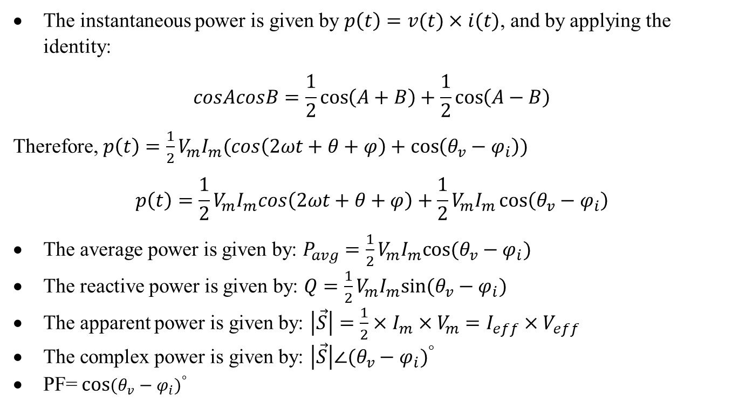
Solution
The instantaneous power is given by $p\left(t\right)=v(t)×i(t)$, and by applying the identity:
$$cosAcosB=\frac{1}{2}\cos\left(A+B\right)+\frac{1}{2}\cos\left(A−B\right)$$
Therefore, $p\left(t\right)=\frac{1}{2}V_{m}I_{m}(cos\left(2ωt+θ+φ\right)+\cos\left(θ_{v}−φ_{i}\right))$
$$p\left(t\right)=\frac{1}{2}V_{m}I_{m}cos\left(2ωt+θ+φ\right)+\frac{1}{2}V_{m}I_{m}\cos\left(θ_{v}−φ_{i}\right)$$
The average power is given by: $P_{avg}=\frac{1}{2}V_{m}I_{m}cos⁡(θ_{v}−φ_{i})$
The reactive power is given by: $Q=\frac{1}{2}V_{m}I_{m}sin⁡(θ_{v}−φ_{i})$
The apparent power is given by: $\left|\vec{S}\right|=\frac{1}{2}×I_{m}×V_{m}=I_{eff}×V_{eff}$
The complex power is given by: $\left|\vec{S}\right|∠{(θ_{v}−φ_{i})}^{°}$
PF= cos${(θ_{v}−φ_{i})}^{°}$

Slide 3
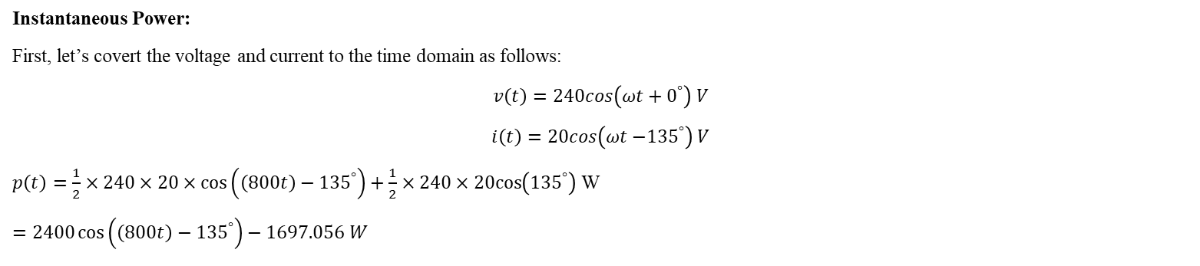
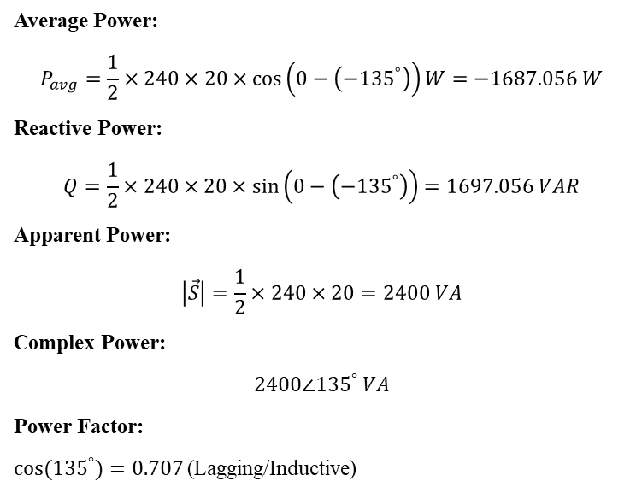
Instantaneous Power:
First, let’s covert the voltage and current to the time domain as follows:
$$v\left(t\right)=240cos\left(ωt+0^{°}\right) V$$
$$i\left(t\right)=20cos\left(ωt{−135}^{°}\right) V$$
$p\left(t\right)=\frac{1}{2}×240×20×\cos\left(\left(800t\right)−{135}^{°}\right)+\frac{1}{2}×240×20cos\left({135}^{°}\right)$ W
$=2400\cos\left(\left(800t\right)−{135}^{°}\right)−1697.056 W$
Average Power:
$$P_{avg}=\frac{1}{2}×240×20×\cos\left(0−\left(−{135}^{°}\right)\right)W=−1687.056 W$$
Reactive Power:
$$Q=\frac{1}{2}×240×20×\sin\left(0−\left(−{135}^{°}\right)\right)=1697.056 VAR$$
Apparent Power:
$$\left|\vec{S}\right|=\frac{1}{2}×240×20=2400 VA$$
Complex Power:
$$2400∠{135}^{°} VA$$
Power Factor:
${cos⁡(135}^{°})=0.707$(Lagging/Inductive)

Slide 4
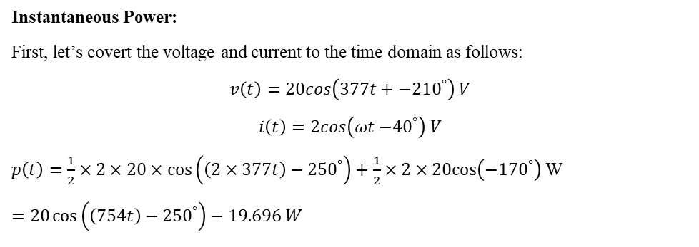
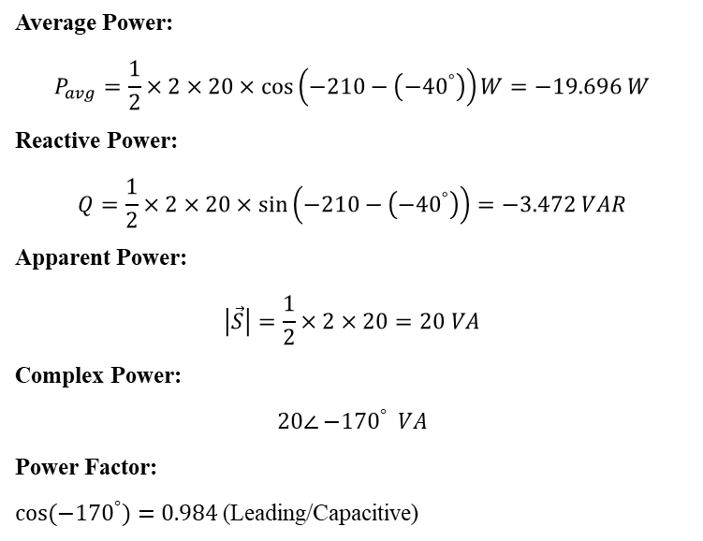
Instantaneous Power:
First, let’s covert the voltage and current to the time domain as follows:
$$v\left(t\right)=20cos\left(377t+{−210}^{°}\right) V$$
$$i\left(t\right)=2cos\left(ωt{−40}^{°}\right) V$$
$p\left(t\right)=\frac{1}{2}×2×20×\cos\left(\left(2×377t\right)−{250}^{°}\right)+\frac{1}{2}×2×20cos\left({−170}^{°}\right)$ W
$=20\cos\left(\left(754t\right)−{250}^{°}\right)−19.696 W$
Average Power:
$$P_{avg}=\frac{1}{2}×2×20×\cos\left(−210−\left(−{40}^{°}\right)\right)W=−19.696 W$$
Reactive Power:
$$Q=\frac{1}{2}×2×20×\sin\left(−210−\left(−{40}^{°}\right)\right)=−3.472 VAR$$
Apparent Power:
$$\left|\vec{S}\right|=\frac{1}{2}×2×20=20 VA$$
Complex Power:
$$20∠{−170}^{°} VA$$
Power Factor:
${cos⁡(−170}^{°})=0.984$(Leading/Capacitive)

Slide 5
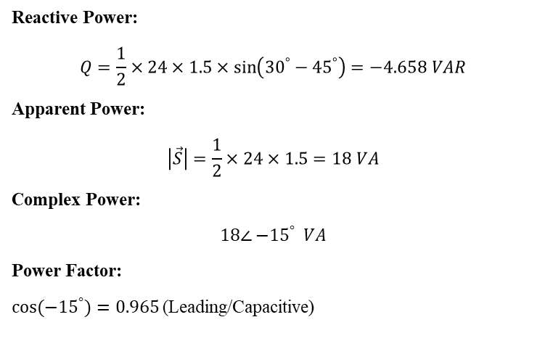

Instantaneous Power:
First, let’s covert the voltage and current to the time domain as follows:
$$v\left(t\right)=24cos\left(ωt+{30}^{°}\right) V$$
$$i\left(t\right)=1.5cos\left(ωt+{45}^{°}\right) V$$
$p\left(t\right)=\frac{1}{2}×24×1.5×\cos\left(\left(2ωt\right)+{75}^{°}\right)+\frac{1}{2}×24×1.5cos\left({−15}^{°}\right)$ W
$=18\cos\left(\left(2ωt\right)+{75}^{°}\right)+17.386 W$
Average Power:
$$P_{avg}=\frac{1}{2}×24×1.5×\cos\left({30}^{°}−{45}^{°}\right)W=17.386 W$$
Reactive Power:
$$Q=\frac{1}{2}×24×1.5×\sin\left({30}^{°}−{45}^{°}\right)=−4.658 VAR$$
Apparent Power:
$$\left|\vec{S}\right|=\frac{1}{2}×24×1.5=18 VA$$
Complex Power:
$$18∠{−15}^{°} VA$$
Power Factor:
${cos⁡(−15}^{°})=0.965$(Leading/Capacitive)

Slide 6
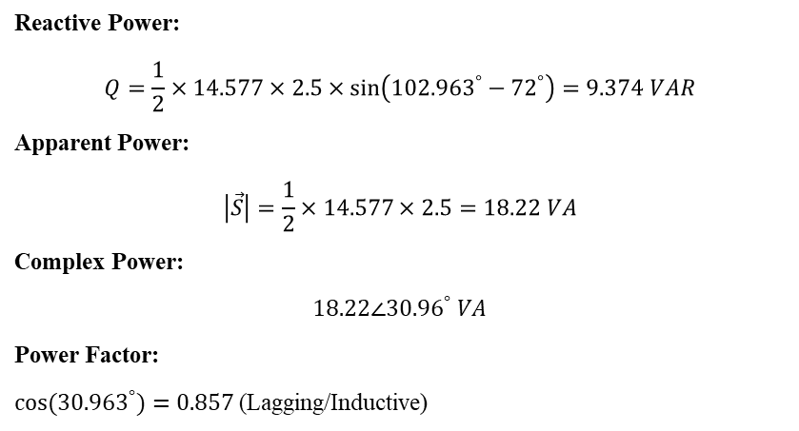

d.
Instantaneous Power:
First, $V=\left(5+j3\right)\left(2.5∠{72}^{°}\right)=14.577∠{102.963}^{°} V$
Now, let’s covert the voltage and current to the time domain as follows:
$$v\left(t\right)=14.577cos\left(ωt+{102.963}^{°}\right) V$$
$$i\left(t\right)=2.5cos\left(ωt+{72}^{°}\right) V$$
$p\left(t\right)=\frac{1}{2}×14.577×2.5×\cos\left(\left(2ωt\right)+174.963\right)+\frac{1}{2}×14.577×2.5cos\left({30.96}^{°}\right)$ W$=18\cos\left(\left(2ωt\right)+{75}^{°}\right)+15.625 W$
Average Power:
$$P_{avg}=\frac{1}{2}×14.577×2.5×\cos\left({102.963}^{°}−{72}^{°}\right)W=15.624 W$$
Reactive Power:
$$Q=\frac{1}{2}×14.577×2.5×\sin\left({102.963}^{°}−{72}^{°}\right)=9.374 VAR$$
Apparent Power:
$$\left|\vec{S}\right|=\frac{1}{2}×14.577×2.5=18.22 VA$$
Complex Power:
$$18.22∠{30.96}^{°} VA$$
Power Factor:
${cos⁡(30.963}^{°})=0.857$(Lagging/Inductive)

Slide 7
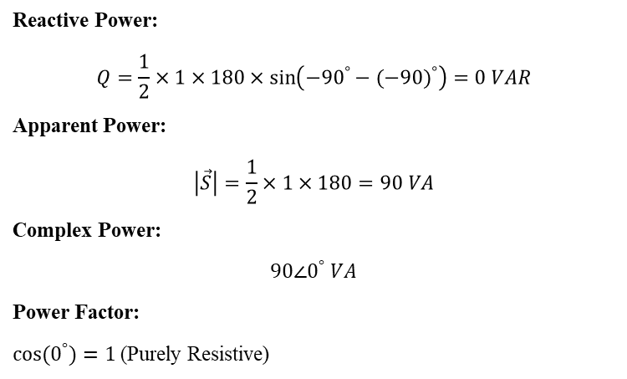
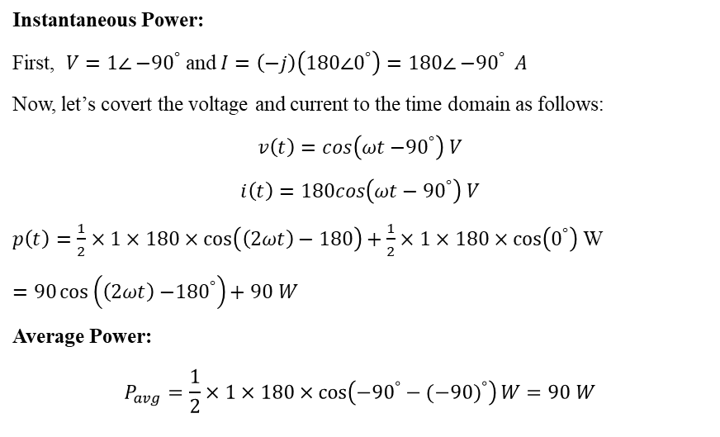
Instantaneous Power:
First, $V=1∠{−90}^{°}$ and $I=\left(−j\right)\left(180∠0^{°}\right)=180∠{−90}^{°} A$
Now, let’s covert the voltage and current to the time domain as follows:
$$v\left(t\right)=cos\left(ωt{−90}^{°}\right) V$$
$$i\left(t\right)=180cos\left(ωt−{90}^{°}\right) V$$
$p\left(t\right)=\frac{1}{2}×1×180×\cos\left(\left(2ωt\right)−180\right)+\frac{1}{2}×1×180×cos\left(0^{°}\right)$ W
$=90\cos\left(\left(2ωt\right){−180}^{°}\right)+90 W$
Average Power:
$$P_{avg}=\frac{1}{2}×1×180×\cos\left({−90}^{°}−{(−90)}^{°}\right)W=90 W$$
Reactive Power:
$$Q=\frac{1}{2}×1×180×\sin\left({−90}^{°}−{(−90)}^{°}\right)=0 VAR$$
Apparent Power:
$$\left|\vec{S}\right|=\frac{1}{2}×1×180=90 VA$$
Complex Power:
$$90∠0^{°} VA$$
Power Factor:
${cos⁡(0}^{°})=1$(Purely Resistive)

Slide 8
Example 9.x -Power Factor Correction
Consider the power transmission line circuit shown in the figure 9.x
Determine the load voltage, current, average and reactive powers. The complex power and the power factor.
Determine the required capacitor across the load needed to be added in order to make the load power factor unity.
(Assume the voltage source frequency is 400Hz).

Slide 9
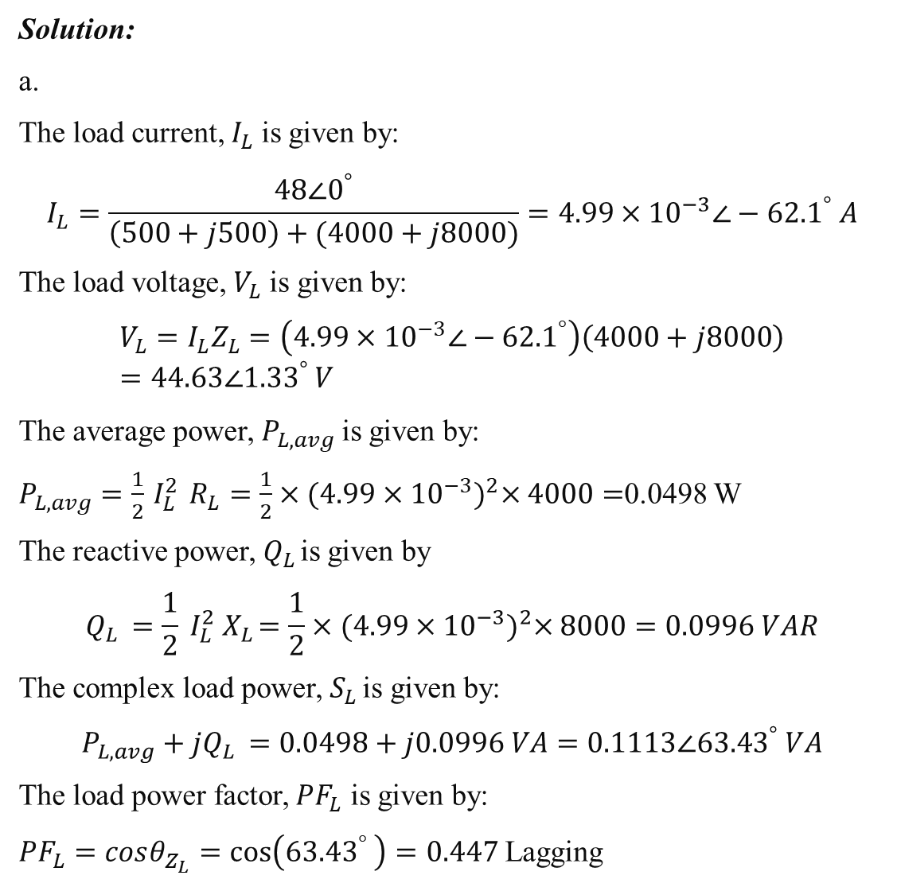
Solution:
a.
The load current, $I_{L}$is given by:
$$I_{L}=\frac{48∠0^{°}}{\left(500+j500\right)+(4000+j8000)}=4.99×{10}^{−3}{∠−62.1}^{°} A$$
The load voltage, $V_{L}$ is given by:
$$V_{L}=I_{L}Z_{L}=\left(4.99×{10}^{−3}{∠−62.1}^{°}\right)\left(4000+j8000\right)=44.63{∠1.33}^{°} V$$
The average power, $P_{L,avg}$is given by:
$P_{L,avg}=\frac{1}{2}{ I}_{L}^{2} R_{L}=\frac{1}{2}×{(4.99×{10}^{−3})}^{2}×4000=$0.0498 W
The reactive power, $Q_{L }$is given by
$$Q_{L }=\frac{1}{2}{ I}_{L}^{2}{ X}_{L}=\frac{1}{2}×{(4.99×{10}^{−3})}^{2}×8000=0.0996 VAR$$
The complex load power, $S_{L }$is given by:
$$P_{L,avg}+jQ_{L }=0.0498+j0.0996 VA=0.1113∠{63.43}^{°} VA$$
The load power factor, ${PF}_{L}$ is given by:
${PF}_{L}=cosθ_{Z_{L}}=\cos\left({63.43}^{°} \right)=0.447$Lagging

Slide 10
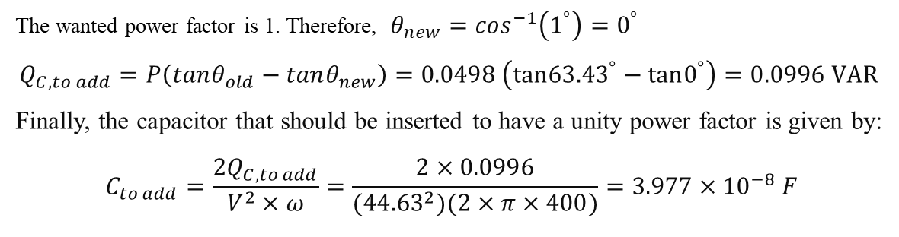
The figure below shows the power triangle for the question
The wanted power factor is 1. Therefore, $θ_{new}=\cos^{−1}\left(1^{°}\right)=0^{°}$
$$Q_{C, to add}=P\left(tanθ_{old}−tanθ_{new}\right)=0.0498 \left(tan{63.43}^{°}−tan0^{°}\right)=0.0996 VAR$$
Finally, the capacitor that should be inserted to have a unity power factor is given by:
$$C_{to add}=\frac{2Q_{C, to add}}{V^{2}×ω}=\frac{2×0.0996}{({44.63}^{2})(2×π×400)}=3.977×{10}^{−8} F$$

Slide 11
The figure below shows the final circuit:

