Slide 1

EEL 3004 Linear Circuits I
Lecture #8
(Chapter 4)
Advanced Circuit Analysis – Mesh Method

Slide 2
Lecture Objectives
The lecture today will focus on:
Analysis of the Mesh current method and observations.
Using the super mesh to solve a special case of the Mesh current method.
Solve examples to better understand the Mesh current method.

Slide 3
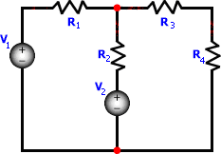
Mesh Current Analysis
This method is based on the concept of assigning ONE CURRENT for each loop so that all loops are covered.
Such current is called MESH CURRENT.
So, mesh current analysis method is based on the flow of currents in mesh loops.

Slide 4



Mesh Current Analysis
This method is based on the concept of assigning ONE CURRENT for each loop so that all loops are covered.
Such current is called MESH CURRENT.
So, mesh current analysis method is based on the flow of currents in mesh loops.
1st Mesh Loop

Slide 5

Mesh Current Analysis
This method is based on the concept of assigning ONE CURRENT for each loop so that all loops are covered.
Such current is called MESH CURRENT.
So, mesh current analysis method is based on the flow of currents in mesh loops.
1st Mesh Loop

Slide 6


Mesh Current Analysis
This method is based on the concept of assigning ONE CURRENT for each loop so that all loops are covered.
Such current is called MESH CURRENT.
So, mesh current analysis method is based on the flow of currents in mesh loops.
2nd Mesh Loop

Slide 7

Mesh Current Analysis
This method is based on the concept of assigning ONE CURRENT for each loop so that all loops are covered.
Such current is called MESH CURRENT.
So, mesh current analysis method is based on the flow of currents in mesh loops.
2nd Mesh Loop

Slide 8
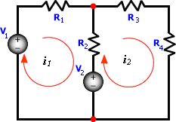

Mesh Current Analysis
Assign one current variable for each loop in a given planar circuit.
The objective is to assign one branch current for each loop so that all loops are covered.
Mesh Loop
Mesh Current

Slide 9


Mesh Current Analysis
Mesh-current i₁ flows through branch elements V₁, R₁, R₂, and V₂ forming the first mesh-loop.

Slide 10

Mesh Current Analysis
Assign one current variable for each loop in a given planar circuit.
The objective is to assign one branch current for each loop so that all loops are covered.
Mesh Loop
Mesh Current

Slide 11

Mesh Current Analysis
Mesh-current i₁ flows through branch elements V₁, R₁, R₂, and V₂ forming the first mesh-loop.
Mesh-current i₂ flows through branch elements R₃, R₄, V₂, and R₂ forming the second mesh-loop.

Slide 12



Mesh Current Analysis
Mesh-current i₁ flows through branch elements V₁, R₁, R₂, and V₂ forming the first mesh-loop.
Mesh-current i₂ flows through branch elements R₃, R₄, V₂, and R₂ forming the second mesh-loop.
Note: the elements R₂ and V₂ in the circuit have two mesh currents flowing through them.

Slide 13
Observations
Mesh-current in each mesh-loop may be arbitrarily assigned (clockwise or counter clockwise).
Mesh-currents automatically satisfy KCL since they enter and leave the same node in a given mesh-loop.
The number of independent equations is equal to the number of mesh-loops and must be expressed in terms of branch currents.

Slide 14
Observations
Elements that are part of only one mesh loop, have their branch currents equal to their mesh-currents.
Elements that are common between two mesh loops, have each of their branch currents expressed in terms two mesh currents.

Slide 15
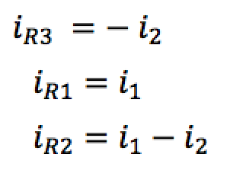

Relationships between element currents and mesh currents
Elements that are part of only one mesh loop, have their branch currents equal to their mesh-currents.
Elements that are common between two mesh loops, have each of their branch currents expressed in terms two mesh currents.
i_{R1}
i_{R3}
Mesh Currents:
$$i_{1} and i_{2}$$
Note: the branch current in R₂ and V₂ is given in terms of mesh-currents i₁ and i₂.
Element Currents:
i_{R2}

Slide 16
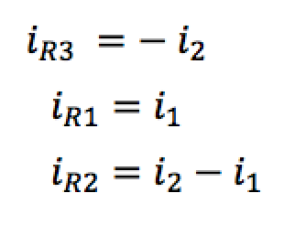
Relationships between element currents and mesh currents
Observations
Elements that are part of only one mesh loop, have their branch currents equal to their mesh-currents.
Elements that are common between two mesh loops, have each of their branch currents expressed in terms two mesh currents.
i_{R1}
i_{R3}
Mesh Currents:
$$i_{1} and i_{2}$$
Note: the branch current in R₂ and V₂ is given in terms of mesh-currents i₁ and i₂.
Element Currents:
i_{R2}

Slide 17
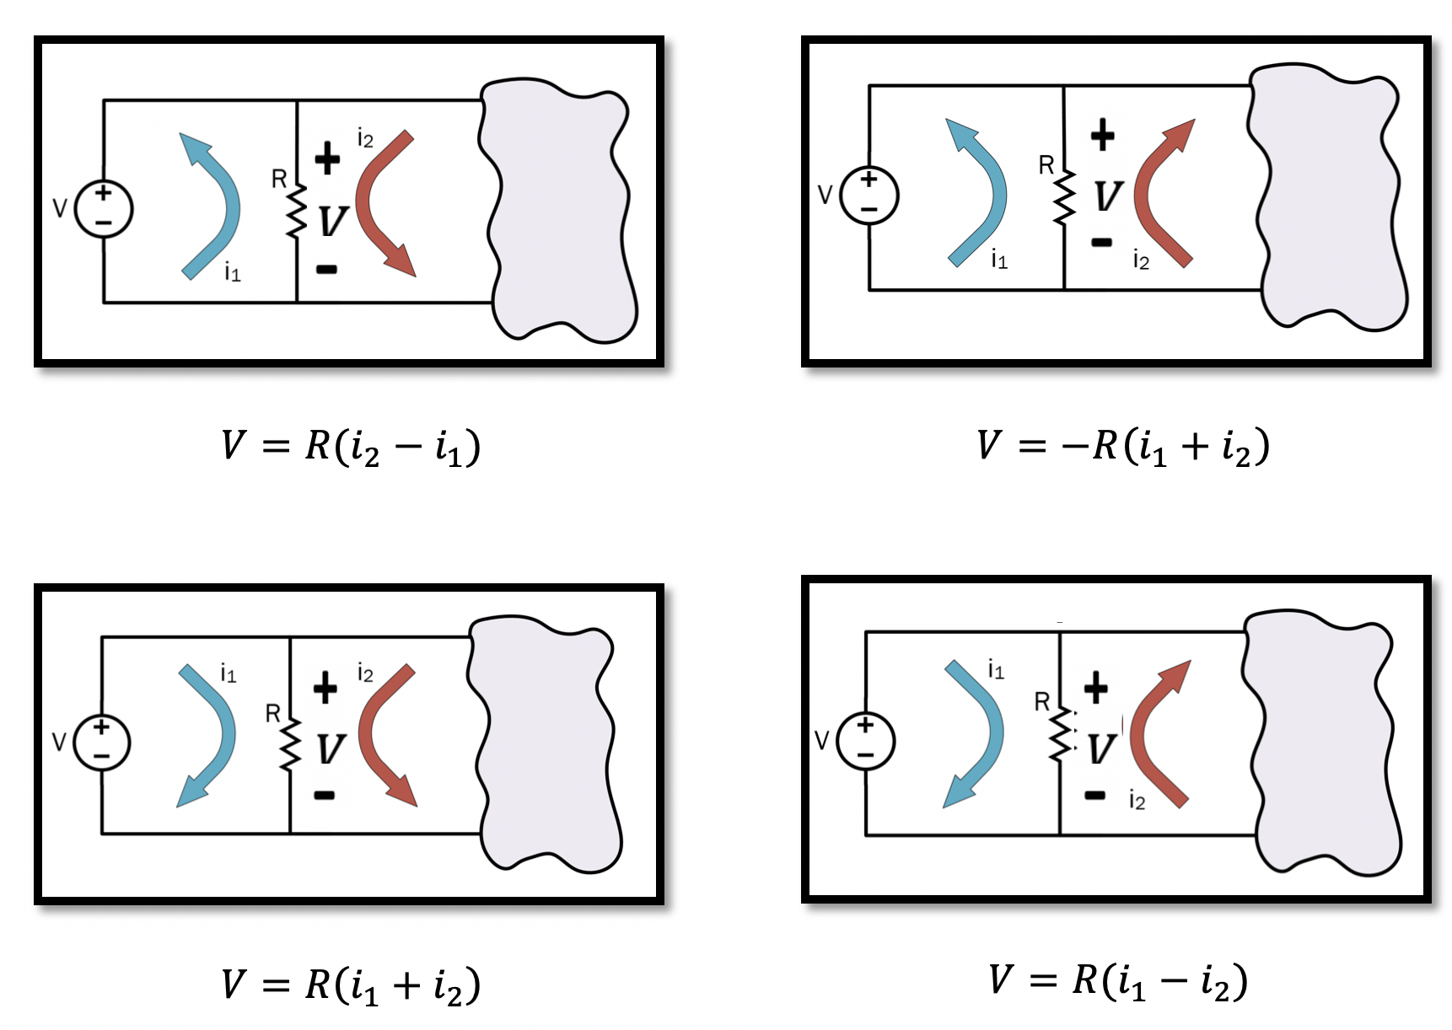
Four possible mesh current assignments for i₁ and i₂

Slide 18
Example
Use the mesh current analysis method to find the current passing in all resistors.
Variable | Values | Unit
V₁ | 10 | V
V₂ | 8 | V
R₁ | 14 | Ω
R₂ | 6 | Ω
R₃ | 4 | Ω
R₄ | 4 | Ω

Slide 19





Solution A (Assume we choose the clockwise direction)
Step #1: Identify the number of meshes and assign a mesh current to each.
Step #1: Identify the number of meshes and assign a mesh current to each in any arbitrary direction.
->We have two mesh loops, we assign mesh currents $i_{1}$ and $i_{2}$ in clockwise direction.
Step #2: Write KVL equations for each mesh loop in terms of assigned currents.
-> Writing KVL in the left mesh loop in terms of the assigned mesh currents $i_{1}$ and $i_{2}$
We have two equations and
two unknowns:
$$+\left(R_{1}+R_{2}\right)i_{1}−{R_{2}i}_{2}=V_{1}−V_{2}$$
$$−V_{1}+R_{1}i_{1}+R_{2}\left(i_{1}−i_{2}\right)+V_{2}=0$$
$$(1)$$
-> Writing KVL in the right mesh loop in terms of the assigned mesh currents $i_{1}$ and $i_{2}$
$$-R_{2}i_{1}+(R_{2}+R_{3}+R_{4})i_{2}=V_{2}$$
$$(2)$$
$$−V_{2}+R_{2}\left(i_{2}−i_{1}\right)+R_{3}i_{2}+R_{4}i_{2}=0$$
Step #3: Solve for the assigned mesh currents.

Slide 20
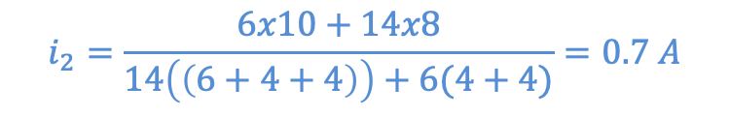

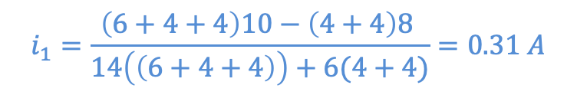
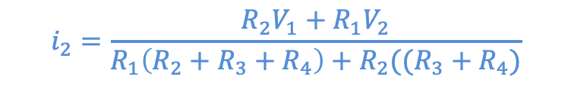
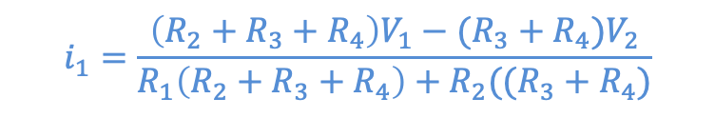
Solution A (Assume we choose the clockwise direction)
Solving for $i_{1}$ and $i_{2}$,
$$i_{1}=\frac{\left(R_{2}+R_{3}+R_{4}\right)V_{1}−(R_{3}+R_{4})V_{2}}{R_{1}\left(R_{2}+R_{3}+R_{4}\right)+R_{2}((R_{3}+R_{4})}$$
$$i_{2}=\frac{R_{2}V_{1}+R_{1}V_{2}}{R_{1}\left(R_{2}+R_{3}+R_{4}\right)+R_{2}((R_{3}+R_{4})}$$
Substitute for values:
Variable | Values | Unit
V₁ | 10 | V
V₂ | 8 | V
R₁ | 14 | Ω
R₂ | 6 | Ω
R₃ | 4 | Ω
R₄ | 4 | Ω
$$i_{1}=\frac{\left(6+4+4\right)10−\left(4+4\right)8 }{14\left(\left(6+4+4\right)\right)+6(4+4)}=0.31 A$$
$$i_{2}=\frac{6x10+14x8}{14\left(\left(6+4+4\right)\right)+6(4+4)}=0.7 A$$

Slide 21
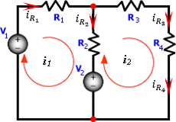
Solution A (Assume we choose the clockwise direction)
The branch currents can now be found as:

Slide 22
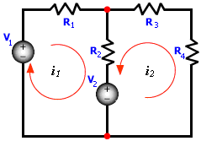
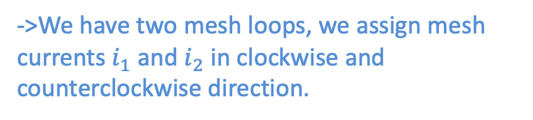
Solution B (Assume we choose the both clockwise & counterclockwise direction)
Step #1: Identify the number of meshes and assign a mesh current to each in any arbitrary direction.
->We have two mesh loops, we assign mesh currents $i_{1}$ and $i_{2}$ in clockwise and counterclockwise direction.
Step #2: Write KVL equations for each mesh loop in terms of assigned currents.
-> Writing KVL in the left mesh loop in terms of the assigned mesh currents $i_{1}$ and $i_{2}$
We have two equations and
two unknowns:
$$+(R_{1}+R_{2})i_{1}+{R_{2}i}_{2}=V_{1}−V_{2}$$
$$−V_{1}+R_{1}i_{1}+R_{2}\left(i_{1}+i_{2}\right)+V_{2}=0$$
$$(1)$$
-> Writing KVL in the right mesh loop in terms of the assigned mesh currents $i_{1}$ and $i_{2}$
$$−R_{2}i_{1}−(R_{2}+R_{3}+R_{4})i_{2}=V_{2}$$
$$(2)$$
$$−V_{2}−R_{2}\left(i_{2}+i_{1}\right)−R_{3}i_{2}−R_{4}i_{2}=0$$
Step #3: Solve for the assigned mesh currents.

Slide 23
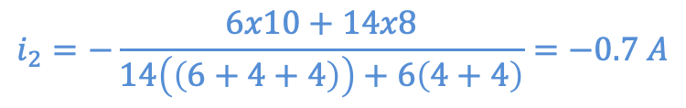
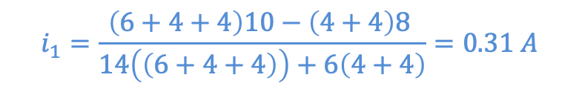
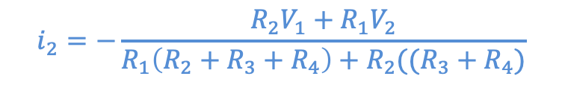
Solution B (Assume we choose the both clockwise & counterclockwise direction)
Solving for $i_{1}$ and $i_{2}$,
$$i_{1}=\frac{\left(R_{2}+R_{3}+R_{4}\right)V_{1}−(R_{3}+R_{4})V_{2}}{R_{1}\left(R_{2}+R_{3}+R_{4}\right)+R_{2}((R_{3}+R_{4})}$$
$$i_{2}=−\frac{R_{2}V_{1}+R_{1}V_{2}}{R_{1}\left(R_{2}+R_{3}+R_{4}\right)+R_{2}((R_{3}+R_{4})}$$
Substitute for values:
Variable | Values | Unit
V₁ | 10 | V
V₂ | 8 | V
R₁ | 14 | Ω
R₂ | 6 | Ω
R₃ | 4 | Ω
R₄ | 4 | Ω
$$i_{1}=\frac{\left(6+4+4\right)10−\left(4+4\right)8 }{14\left(\left(6+4+4\right)\right)+6\left(4+4\right)}=0.31 A$$
$$i_{2}=−\frac{6x10+14x8}{14\left(\left(6+4+4\right)\right)+6\left(4+4\right)}=−0.7 A$$

Slide 24
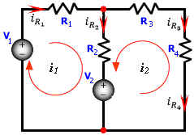
Solution B (Assume we choose the both clockwise & counterclockwise direction)
The branch currents can now be found as:
Note: Same final answers

Slide 25
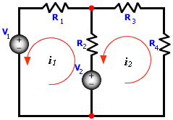

Solution C (Assume we choose the counterclockwise direction)
Step #1: Identify the number of meshes and assign a mesh current to each in any arbitrary direction.
->We have two mesh loops, we assign mesh currents $i_{1}$ and $i_{2}$ in counterclockwise direction.
Step #2: Write KVL equations for each mesh loop in terms of assigned currents.
-> Writing KVL in the left mesh loop in terms of the assigned mesh currents $i_{1}$ and $i_{2}$
We have two equations and
two unknowns:
$$-(R_{1}+R_{2})i_{1}+{R_{2}i}_{2}=V_{1}−V_{2}$$
$$−V_{1}−R_{1}i_{1}+R_{2}\left(i_{2}−i_{1}\right)+V_{2}=0$$
$$(1)$$
-> Writing KVL in the right mesh loop in terms of the assigned mesh currents $i_{1}$ and $i_{2}$
$$−R_{2}i_{1}−(R_{2}+R_{3}+R_{4})i_{2}=V_{2}$$
$$(2)$$
$$−V_{2}+R_{2}\left(i_{1}−i_{2}\right)−R_{3}i_{2}−R_{4}i_{2}=0$$
Step #3: Solve for the assigned mesh currents.

Slide 26
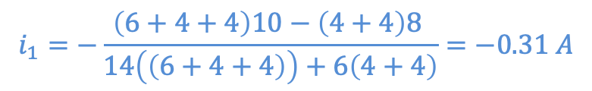
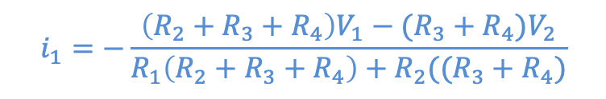
Solution C (Assume we choose the counterclockwise direction)
Solving for $i_{1}$ and $i_{2}$,
$$i_{1}=−\frac{\left(R_{2}+R_{3}+R_{4}\right)V_{1}−(R_{3}+R_{4})V_{2}}{R_{1}\left(R_{2}+R_{3}+R_{4}\right)+R_{2}((R_{3}+R_{4})}$$
$$i_{2}=−\frac{R_{2}V_{1}+R_{1}V_{2}}{R_{1}\left(R_{2}+R_{3}+R_{4}\right)+R_{2}((R_{3}+R_{4})}$$
Substitute for values:
Variable | Values | Unit
V₁ | 10 | V
V₂ | 8 | V
R₁ | 14 | Ω
R₂ | 6 | Ω
R₃ | 4 | Ω
R₄ | 4 | Ω
$$i_{1}=−\frac{\left(6+4+4\right)10−\left(4+4\right)8 }{14\left(\left(6+4+4\right)\right)+6\left(4+4\right)}=−0.31 A$$
$$i_{2}=−\frac{6x10+14x8}{14\left(\left(6+4+4\right)\right)+6\left(4+4\right)}=−0.7 A$$

Slide 27
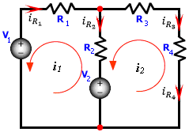
Solution C (Assume we choose the counterclockwise direction)
The branch currents can now be found as:
Note: Same final answers

Slide 28

















Compare the solutions
Solution C
Solution B
Solution C
$$+\left(R_{1}+R_{2}\right)i_{1}−{R_{2}i}_{2}=V_{1}−V_{2}$$
$$+(R_{1}+R_{2})i_{1}+{R_{2}i}_{2}=V_{1}−V_{2}$$
$$-(R_{1}+R_{2})i_{1}+{R_{2}i}_{2}=V_{1}−V_{2}$$
$$-R_{2}i_{1}+(R_{2}+R_{3}+R_{4})i_{2}=V_{2}$$
$$−R_{2}i_{1}−(R_{2}+R_{3}+R_{4})i_{2}=V_{2}$$
$$−R_{2}i_{1}−(R_{2}+R_{3}+R_{4})i_{2}=V_{2}$$
Mesh currents:
$$i_{1}=0.31 A$$
$$i_{1}=0.31 A$$
$$i_{1}=−0.31 A$$
$$i_{2}=0.7 A$$
$$i_{2}=−0.7 A$$
$$i_{2}=−0.7 A$$
Branch currents:
$$i_{R2}=i_{1}−i_{2}$$
$$i_{R2}=i_{1}+i_{2}$$
$$i_{R2}=−i_{1}+i_{2}$$
$$=0.31−0.7$$
$$=0.31−0.7$$
$$=0.31−0.7$$
$$=−0.39 A$$
$$=−0.39 A$$
$$=−0.39 A$$

Slide 29
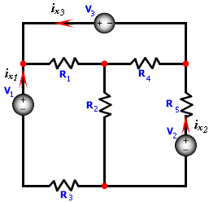
Example
Use the mesh-current method to solve for $i_{x1}$, $i_{x2}$ and $i_{x3}$and the power delivered by each voltage source, and the power dissipated in R₅.
Variable | Values | Unit
V₁ | 24 | V
V₂ | 18 | V
V₃ | 14 | V
R₁ | 8 | Ω
R₂ | 10 | Ω
R₃ | 6 | Ω
R₄ | 12 | Ω
R₅ | 4 | Ω

Slide 30
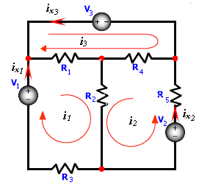



Solution:
We have three mesh loops, we assign mesh currents $i_{1},i_{2}$ and $i_{3}$ in counterclockwise direction.
KVL around the three mesh loops:
$$=0$$
$$=0$$
$$=0$$
Solve for the three assigned mesh currents.

Slide 31
The currents i_{x1}, i_{x2} and i_{x3} are given by:
The power delivered by the sources,
Note: Since the power delivered is positive, then the power is actually dissipated in V₁.

Slide 32
The current passing through R₅ is given by:
The power dissipated in R₅,

Slide 33
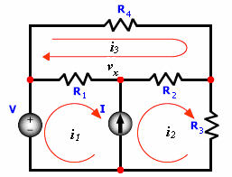

Special Cases - Supermesh
If the circuit contains current sources:
Only one KVL is written around the two loops combined.
The current source I is written in terms of the branch currents.

Slide 34
Special Cases
If the circuit contains current sources:
Only one KVL is written around the two loops combined.
The current source I is written in terms of the branch currents.
Super mesh

Slide 35
Special Cases
If the circuit contains current sources:
Only one KVL is written around the two loops combined.
The current source I is written in terms of the branch currents.

Slide 36
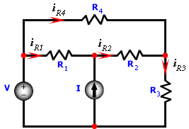
Example
Use the mesh current analysis method to find the current passing in all resistors.
Variable | Values | Unit
V | 12 | V
I | 4 | A
R₁ | 12 | Ω
R₂ | 10 | Ω
R₃ | 8 | Ω
R₄ | 6 | Ω

Slide 37
KVL around the upper loop:
KVL around the super mesh loop:
By inspection:

Slide 38
KVL around the upper loop:
KVL around the super mesh loop:
By inspection:

Slide 39
KVL around the upper loop:
KVL around the super mesh loop:
By inspection:

Slide 40
KVL around the upper loop:
KVL around the super mesh loop:
By inspection:
Solving for i₁, i₂ and i₃,

Slide 41
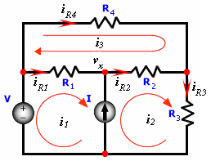
The branch currents can now be found as:

Slide 42
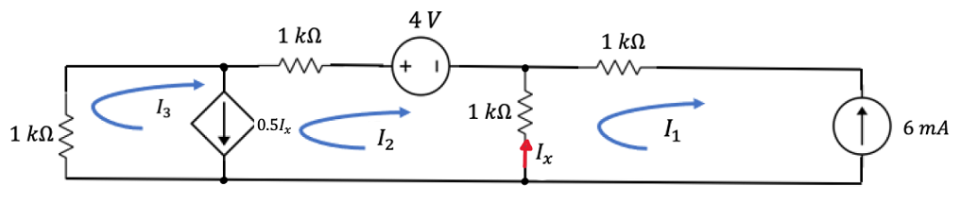
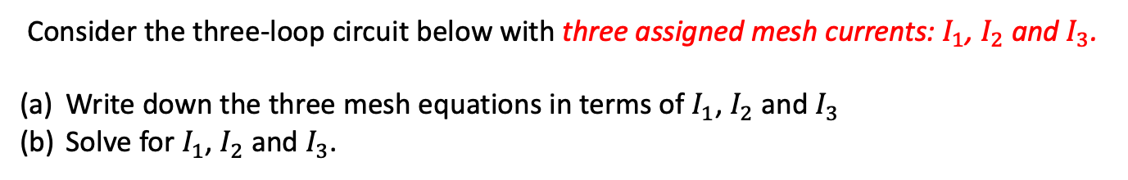
Example: Mesh Analysis with super mesh – Three Loops
Consider the three-loop circuit below with three assigned mesh currents: $I_{1}$, $I_{2}$ and $I_{3}$.
Write down the three mesh equations in terms of $I_{1}$, $I_{2}$ and $I_{3}$
Solve for $I_{1}$, $I_{2}$ and $I_{3}$.

Slide 43
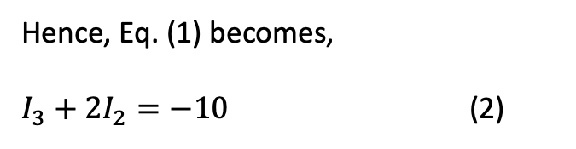



Solution:
The super-mesh equation for the two mesh loops is in the left side:
$$1xI_{3}+1xI_{2}+4+1x\left(I_{2}−I_{1}\right)=0$$
$I_{1}−I_{3}−{2I}_{2}=4$ (1)
By inspection,
$$I_{1}=−6 mA$$
Hence, Eq. (1) becomes,
$I_{3}+{2I}_{2}=−10$ (2)

Slide 44
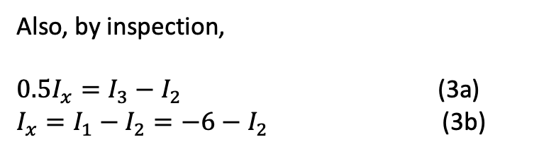

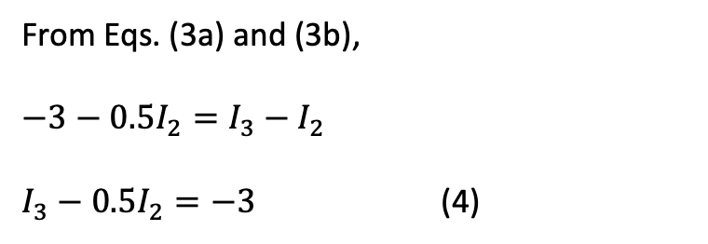
Solution:
Also, by inspection,
$0.5I_{x}=I_{3}−I_{2}$ (3a)
$I_{x}=I_{1}−I_{2}=−6−I_{2}$ (3b)
From Eqs. (3a) and (3b),
$−3−0.5I_{2}=I_{3}−I_{2}$
$I_{3}−0.5I_{2}=−3$ (4)
From Eqs. (2) and (4) we solve for $I_{2}$ and $I_{3}$,

Slide 45

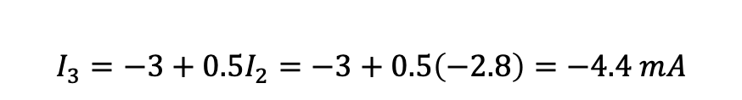




Solution:
From Eqs. (2) and (4) we solve for $I_{2}$ and $I_{3}$,
$I_{3}+{2I}_{2}=−10$ (2)
$I_{3}−0.5I_{2}=−3$ (4)
$$\left(−3+0.5I_{2}\right)+{2I}_{2}=−10$$
$$2.5I_{2}=−7$$
$$I_{2}=\frac{−7}{2.5}=−2.8 mA$$
Substitute $I_{2}$ in Eqs. (2), we solve for $I_{3}$,
$$I_{3}=−3+0.5I_{2}=−3+0.5\left(−2.8\right)=−4.4 mA$$

Slide 46

Solution:
Check Your Answers:
Apply KCL at this node:
$$I_{2}=I_{1}−I_{x}$$
Check:
$$I_{2}=I_{1}−I_{x}$$
$$−2.8=I_{1}−\left(I_{1}−I_{2}\right)=I_{2}=−2.8$$

Slide 47
Example: Mesh Analysis with supermesh – Three Loops
Consider the three-loop circuit below with three assigned mesh currents: $I_{1}$, $I_{2}$ and $I_{3}$.
Write down the three mesh equations in terms of $I_{1}$, $I_{2}$ and $I_{3}$
Solve for $I_{1}$, $I_{2}$ and $I_{3}$.

Slide 48




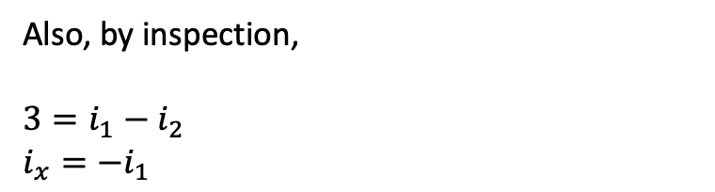
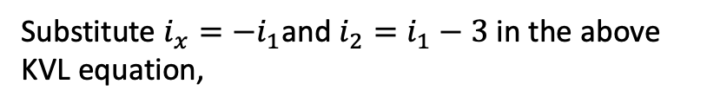

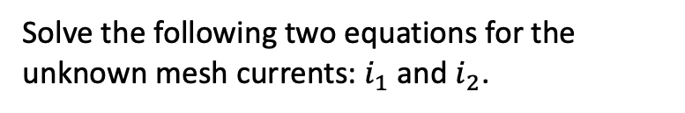
Example: Mesh Analysis with supermesh – Three Loops
Solution:
Write down the three mesh equations in terms of $I_{1}$, $I_{2}$ and $I_{3}$
The super-mesh equation for the two mesh loops is in the left side has the following KVL:
$$12i_{1}+20\left(i_{2}−i_{3}\right)+2i_{x}=0$$
Also, by inspection,
$3=i_{1}−i_{2}$
$i_{x}={−i}_{1}$
super-mesh
Substitute the above into the KVL equation,
$$2i_{1}+20\left(i_{3}−i_{1}+3\right)+10i_{3}+20=0$$
$$30i_{1}−20i_{3}=50$$
$$(1)$$
$$-18i_{1}+30i_{3}=40$$
$$(2)$$
The right mesh loop has the following KVL,
$$−2i_{x}+20\left(i_{3}−i_{2}\right)+10i_{3}+20=0$$
Solve the following two equations for the unknown mesh currents: $i_{1}$ and $i_{2}$.
Substitute $i_{x}={−i}_{1}$and $i_{2}=i_{1}−3$ in the above KVL equation,

Slide 49
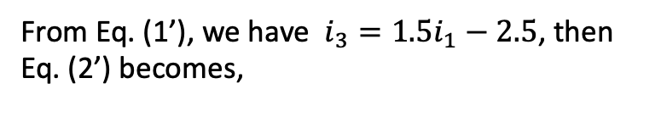








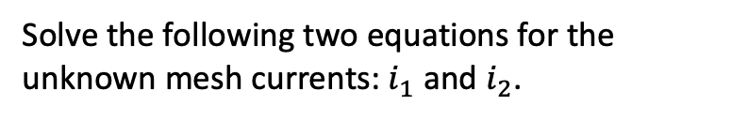




Example: Mesh Analysis with supermesh – Three Loops
Solution:
(b) Solve the following two equations for the unknown mesh currents: $i_{1}$ and $i_{2}$.
$$30i_{1}−20i_{3}=50$$
$$(1)$$
$$−18i_{1}+30i_{3}=40$$
$$(2)$$
Solve the following two equations for the unknown mesh currents: $i_{1}$ and $i_{2}$.
$$3i_{1}−2i_{3}=5$$
$$(1′)$$
$$−9i_{1}+15i_{3}=20$$
$$(2′)$$
super-mesh
From Eq. (1’), we have $i_{3}=1.5i_{1}−2.5$, then Eq. (2’) becomes,
The current $i_{2}$ becomes
$$−9i_{1}+15(1.5i_{1}−2.5)=20$$
$i_{2}=i_{1}−3=4.26−3=1.26 A$
Solve for $i_{1}$,
From Eq. 91’) we solve for $i_{3}$,
$$i_{1}=4.26 A$$
$$i_{3}=3.89 A$$

