Slide 1
EEL 3004 Linear Circuits I Lecture #7B Practical Relefence The Bipolar Junction Transistor Amplifier

Slide 2
Lecture Objectives
The lecture today will focus on:
Learn about the voltage amplifier and why it is important in today’s electronic products
Understand the function of the transistor as an amplifier
Understand the model of the transistor
Learn the how to analyze simple voltage amplifier model

Slide 3
Smart Phones with its Printed Circuit Board (PCB)
iPhonse
Printed Circuit Board (PCB)
Four possible power amplifiers are identified

Slide 4
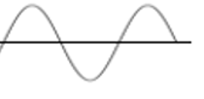
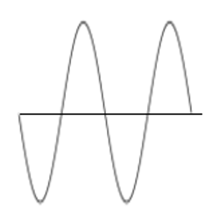
Voltage Amplifier
Block diagram of a voltage amplifier
$$A_{v}=\frac{v_{o}}{v_{s}}$$

Slide 5
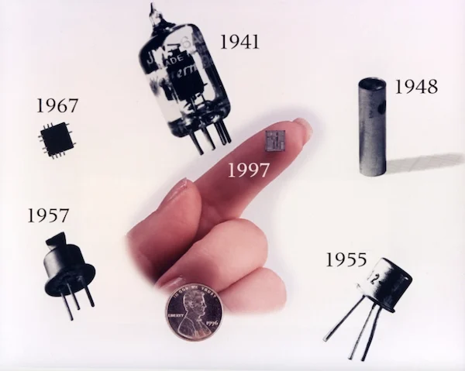
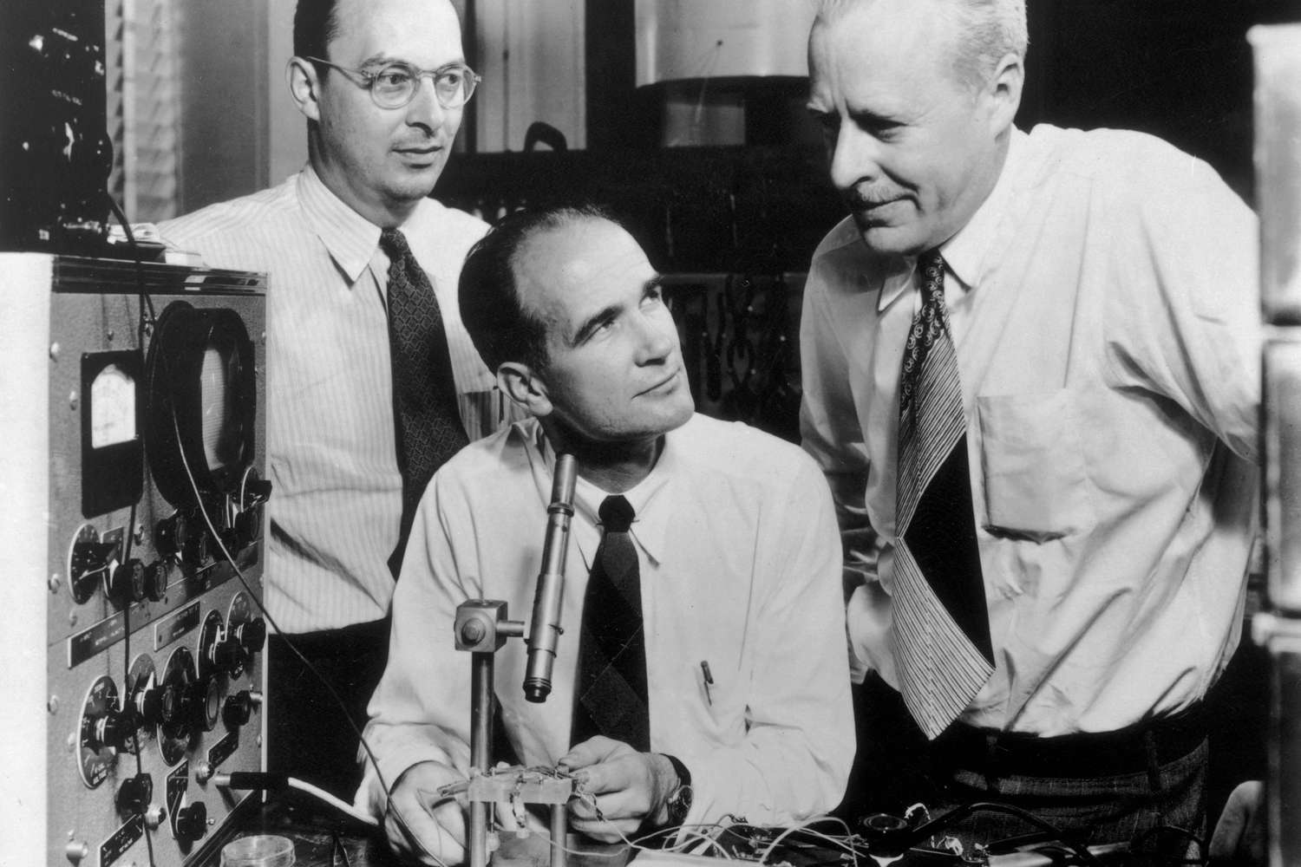
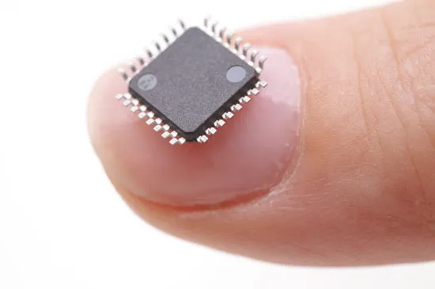
The MOSFET Transistor Amplifier
The invention of the transistor is a rare revolutionary event in the history of civilization when a single invention is so powerful that it alters the course of human history
Before the invention of the transistor, the early electronic switching (not mechanical switching) and signal amplification were done by using what was vacuum tubes
The breakthrough came in December 1947 when three scientists at Bell Labs in the United States, invented the world’s first working solid-state transistor known as a point-contact transistor.
Vacuum tube.
John Bardeen (1908-1991)
William Shockley (1910-1989)
Walter Brattain (1902-1987)
They shared the Nobel Prize in Physics in 1956.
Bardeen won again Nobel Prize in Physics in 1972.
Two popular types of transistors:
Metal Oxide Semiconductor Field Effect Transistor (MOSFET)
Bipolar Junction Transistor (BJT)
Today’s IC has billions of transistors.
Bardeen won 2nd Nobel Prize in Physics in 1972 on developing the theory of superconductivity.

Slide 6
Transistor Technology - BJT
As a switch, the BJT was the work horse of the early computer technology in the 1980’s and 1990’s however, today’s computer switching functions are doe almost all by the CMOS technology. Whereas as an amplifier application, BJT are widely used signal amplifications and radio-frequency amplifiers. For example, in most of consumer electronics, radiofrequency and audio-frequency power amplifiers, the BJT transistor is used as an analog amplifier to amplify a weak power and voltage signal as discussed in this example.
Qualitatively, the $npn$ BJT works as follows: Since the base-emitter junction is made of an opposite type, a p-type and an a-type, the physics dictates that the current will not flow unless a positive voltage is applied across this junction to allow this junction to conduct current in the device. Under such condition, it is said that that base-emitter junction is forward biased, and the device operates in the active region as an amplifier.

Slide 7
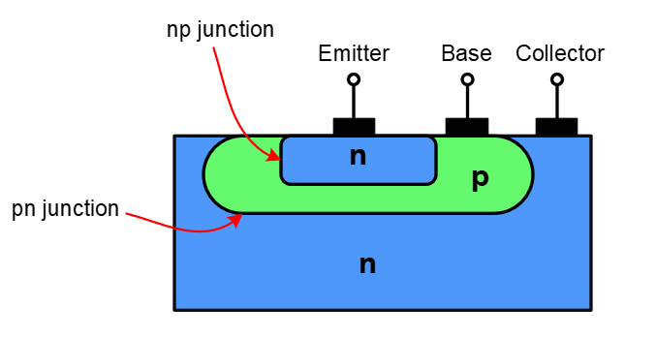
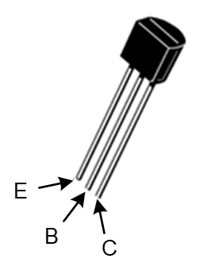
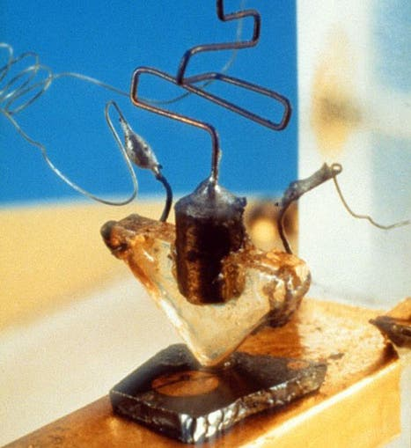
Transistor Technology - BJT
Simplified vertical cross section view of a planar npn BJT
Symbol of the npn BJT
a commercial type of a General Purpose npn Silicon Transistors model 2N3903 by Motorola Semiconductor,
The first transistor, assembled by Walter Brattain and successfully tested for the first time on December 16, 1947 (Computer History Museum)

Slide 8
Transistor Technology - MOSEFT
Simplified vertical cross section view of a planar npn BJT
Symbol of the npn BJT
The first transistor, assembled by Walter Brattain and successfully tested for the first time on December 16, 1947 (Computer History Museum)
a commercial type of a General Purpose npn Silicon Transistors model 2N3903 by Motorola Semiconductor,

Slide 9
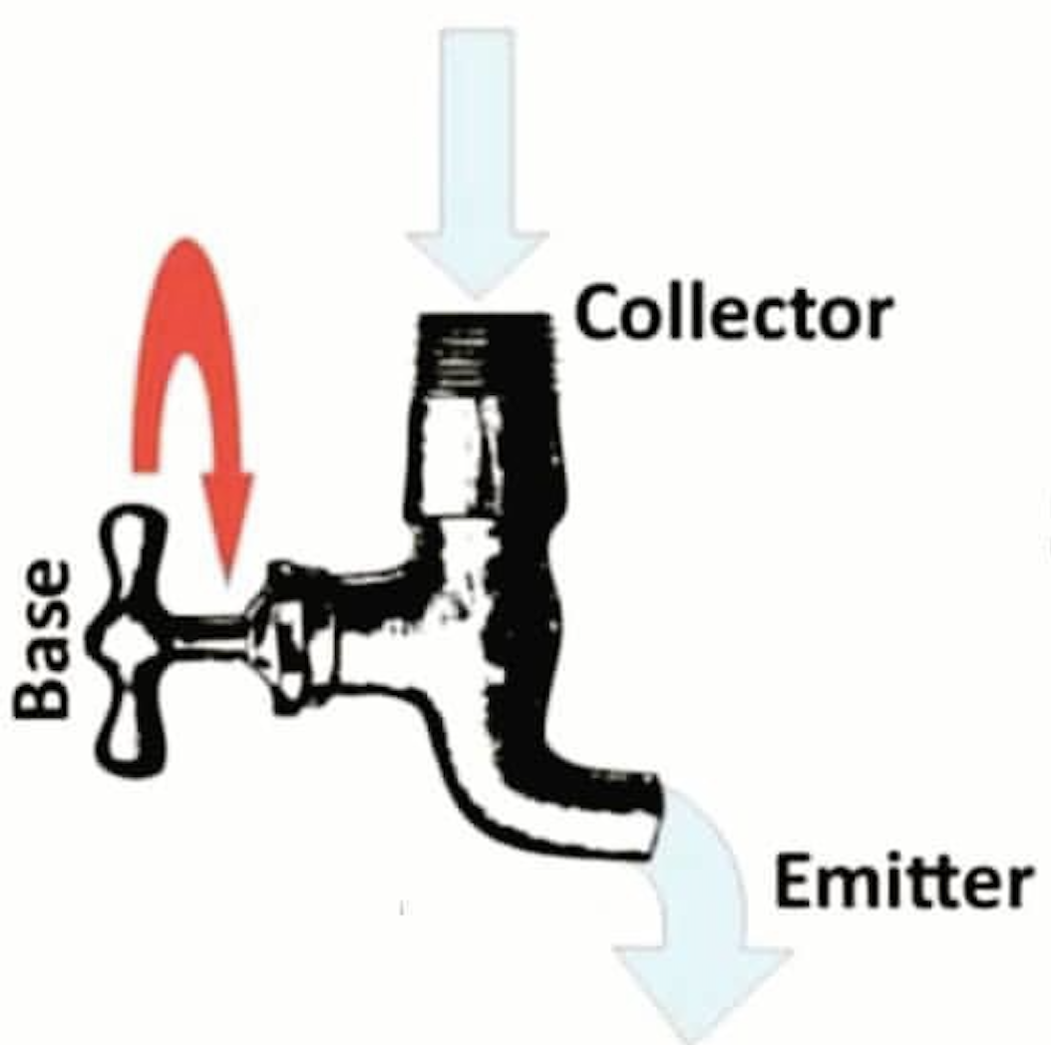
The BJT Transistor Operation (Function)
The BJT Transistor has two major applications:
Amplifier circuits as an analog device
Digital circuits as an electronic switch

Slide 10
The Transistor as a switch
If the faucet is turned all the way to stop the current flow from the Collector to the Emitter, it is said that the transistor is OFF
The transistor is OFF
The transistor is ON
The switch is OFF (0)
The switch is ON (1)

Slide 11
The Transistor as a switch
If the faucet is turned all the way to stop the current flow from the Collector to the Emitter, it is said that the transistor is OFF
The transistor is OFF
The transistor is ON
The switch is OFF (0)
The switch is ON (1)

Slide 12
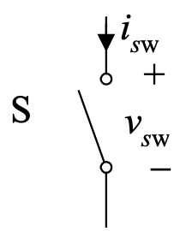
The Transistor as a switch
If the faucet is turned all the way to stop the current flow from the Collector to the Emitter, it is said that the transistor is OFF
The transistor is OFF
The transistor is ON
The switch is OFF (0)
The switch is ON (1)

Slide 13
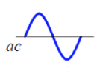
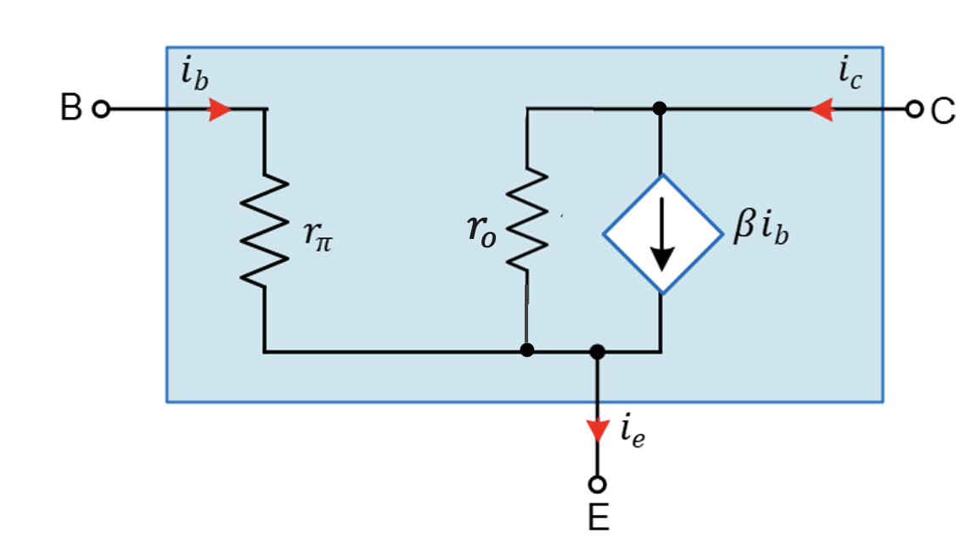
The Transistor as an Amplifier
The transistor operate in a linear region (active region) and signal get amplified as the base current is controlled.

Slide 14
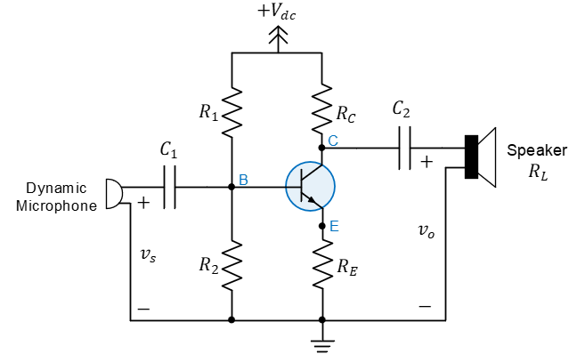
The BJT Voltage Amplifier
Common-Emitter Amplifier with the npn-type Bipolar Junction Transistor (BJT)

Slide 15
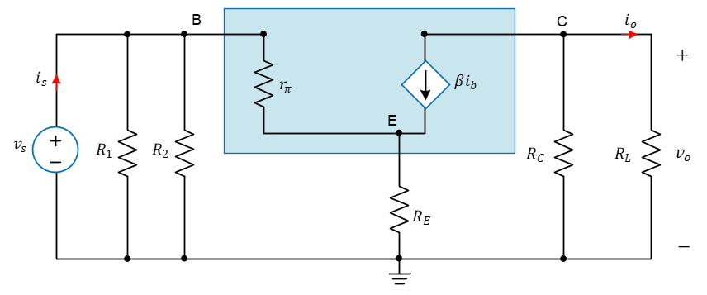
The BJT Voltage Amplifier
Small signal model of BJT Common-Emitter voltage amplifier

Slide 16
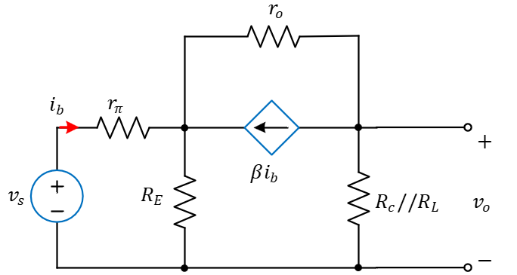
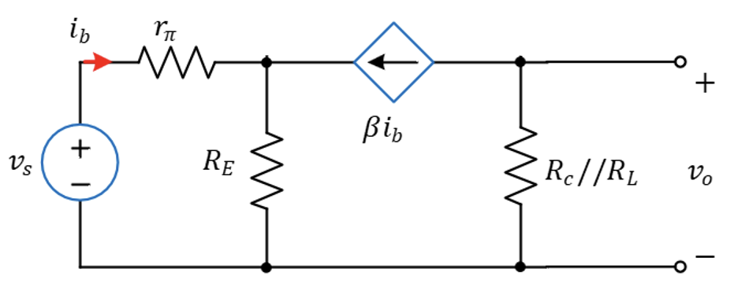
The MOSFET Voltage Amplifier
Simplified equivalent circuit
$$A_{v}=\frac{v_{o}}{v_{s}}=−\frac{\left({R_{C}}//R_{L}\right)β}{\left(1+β\right)R_{E}+r_{π} }=\frac{R_{C}R_{L}}{\left(R_{C}+R_{L}\right)\left(\left(1+β\right)R_{E}+r_{π}\right)}β$$

Slide 17
The BJT Voltage Amplifier
$$\frac{\left({R_{C}}//R_{L}\right)β}{\left(1+β\right)R_{E}+r_{π} }$$
Simplified equivalent circuit
$$v_{S}$$
$$v_{E}$$
$$v_{o}$$
$$i_{b}$$
The nodal equations:
$$\frac{v_{s}−v_{E} }{r_{π} }=\frac{v_{E} }{R_{E} }−βi_{b}$$
Solving for the voltage gain,
$$i_{b}=\frac{v_{s}−v_{E} }{r_{π} }$$
$$A_{v}=\frac{v_{o}}{v_{s}}=\frac{R_{C}R_{L}}{\left(R_{C}+R_{L}\right)\left(\left(1+β\right)R_{E}+r_{π}\right)}β$$
Applying KCL at $v_{o}$,
The power gain is given by,
$$v_{o}=−βi_{b}({R_{C}}//R_{L}$$
$$A_{P}=\frac{p_{o}}{p_{in}}=\frac{R_{C}}{R_{C}+R_{L}}\frac{1}{\frac{{R_{C}}//R_{L}}{{R_{1}}//R_{2}}−A_{v}}$$

Slide 18
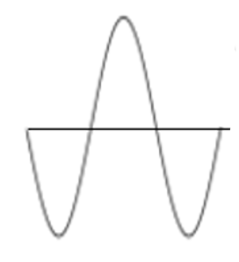
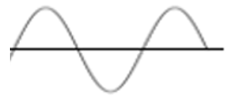
Example : BJT Voltage Amplifier
Let us consider specific voltage amplifier driven by an input audio signal of $v_{s}=10 mV$ to a speaker whose load resistance is $R_{L}=2 kΩ$. Assume the rest of the amplifier parameters are given by, $R_{1}=25 kΩ,R_{2}=15 kΩ,$ $R_{E}=0.1 kΩ$,$r_{π}=0.25 kΩ,$ $β=300, R_{C}=2.2 kΩ$.
$v_{o}=−103.6 mV$
$v_{s}=10 mV$
The voltage gain is given by
$$A_{v}=−\frac{R_{C}R_{L}}{\left(R_{C}+R_{L}\right)\left(\left(1+β\right)R_{E}+r_{π}\right)}β=−\frac{2.2x2}{\left(2.2+2\right)\left(\left(1+300\right)x0.1+0.25\right)}300$$
$$A_{v}=−10.36$$
The output voltage,
The power gain,
$v_{o}=A_{v}v_{S}=−10.36x\left(10mV\right)=−103.6 mV$
$$A_{P}=\frac{p_{o}}{p_{in}}≈10 W$$

