Slide 1
EEL 3004 Linear Circuits I Lecture #7 (Chapter 4) Advanced Circuit Analysis – Nodal methods

Slide 2
Lecture Objectives
Chapter 4
Advanced Circuit Analysis Techniques
1) Voltage Node analysis
2) Mesh Current Analysis

Slide 3
Lecture Objectives
The lecture today will focus on:
The concept of node voltages vs. element voltages
Introducing Nodal Analysis of circuits with current sources.
The circuit can be analyzed completely by only KCL equations.
Explaining Nodal Analysis of circuits with voltage sources, solving using the supernode, and external resistor insertion.
Illustration through solving examples.

Slide 4
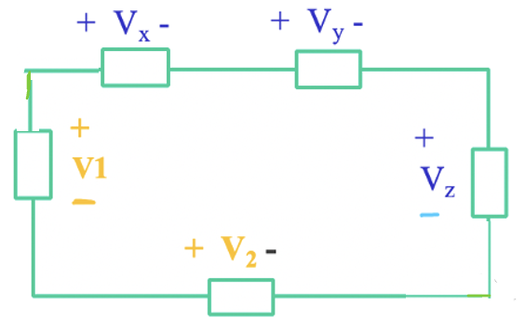
Node Voltages vs. Element voltages
Element Voltages:
The voltage across elements like V_{x ,}V_{y},V_{z} V_{1,}V₂
Apply KVL
-V₁+V_{x}+V_{y}+V_{z} -V₂=0
Closed loop

Slide 5
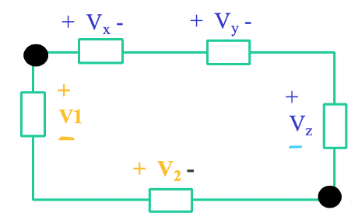
Node Voltages vs. Element voltages
Element Voltages:
The voltage across elements like V_{x ,}V_{y},V_{z} V_{1,}V₂
Apply KVL
-V₁+V_{x}+V_{y}+V_{z} -V₂=0
Node Voltages:
Node voltages V_{a} and V_{b}

Slide 6
Node Voltages vs. Element voltages
What are the voltage values at V_{a} and V_{b} ?
Closed loop

Slide 7
Node Voltages vs. Element voltages
Valid Question:
What is the voltage value of V_{ab} as shown?
V_{ab}= V_{a} -V_{b}
Apply KVL around the left lopp
-V₁+V_{ab}-V₂=0
V_{ab}= V₁ +V₂

Slide 8
Node Voltages vs. Element voltages
What are the voltage values at V_{a} and V_{b} ?
Place ground at V_{b}
V_{a}= V₁ +V₂
V_{b}= 0

Slide 9
Node Voltages vs. Element voltages
What are the voltage values at V_{a} and V_{b} ?
Place ground at V_{a}
V_{b}= -V₂ –V₁
V_{a}= 0

Slide 10
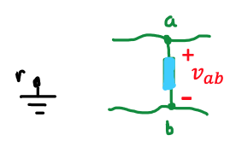
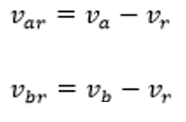
Nodal Analysis – Important Concept
The Potential Difference:
Important concept: The voltage (potential difference) is always measured between two nodes.
Each node is references to a Reference Node “r “ we call ground
Consider any arbitrary two nodes in a circuit
$$v_{ab}=v_{a}−v_{b}$$
Reference Node (ground)

Slide 11
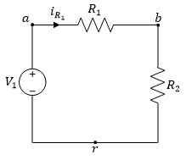
Nodal Analysis – Important Concept
The Potential Difference in a given circuit:
+
$$v_{ab}$$
-
Ground (reference) = 0 V
v_{r}=0
$$v_{ab}=v_{a}−v_{b}$$
$$i_{R_{1}}=\frac{v_{a}−v_{b}}{R_{1}}$$

Slide 12
Nodal Analysis Method
I. Circuits without voltage sources (including current sources)
II. Circuits with voltage sources (including current sources)

Slide 13
Nodal Analysis with Current Sources
The circuit can be described completely by the required number of independent KCL equations.
KCL is simply the algebraic summation of all currents entering each node is zero.
The key is to express all currents in terms of the node voltage
variables

Slide 14
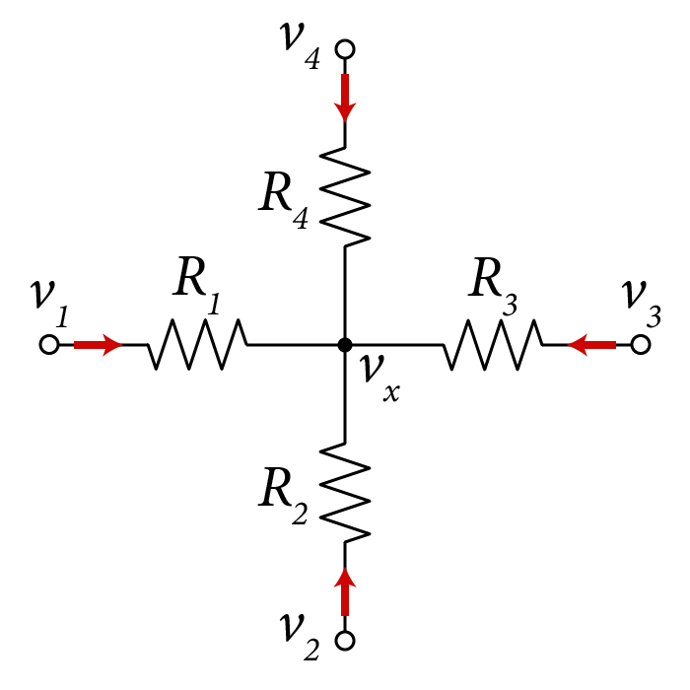
Examples of expressing currents in terms of the
node voltage variables
Assuming all currents flowing into the node “x”
$$\frac{v_{1}−v_{x}}{R_{1}}+\frac{v_{2}−v_{x}}{R_{2}}+\frac{v_{3}−v_{x}}{R_{3}}+\frac{v_{4}−v_{x}}{R_{4}}=0$$

Slide 15
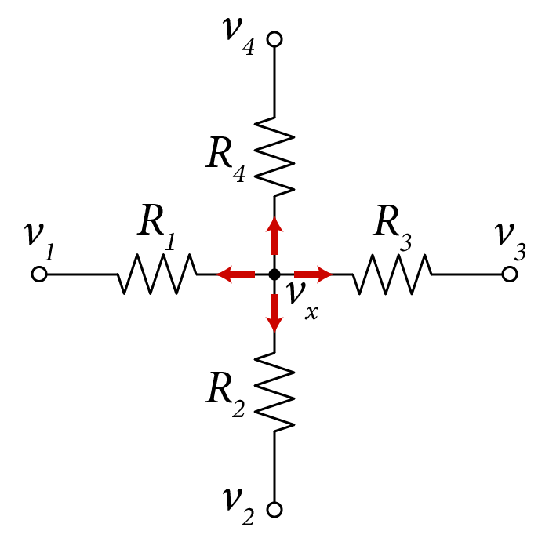
Examples of expressing currents in terms of the
node voltage variables
Assuming all currents flowing out of the node “x”
$$\frac{v_{x}−v_{1}}{R_{1}}+\frac{v_{x}−v_{2}}{R_{2}}+\frac{v_{x}−v_{3}}{R_{3}}+\frac{v_{x}−v_{4}}{R_{4}}=0$$

Slide 16
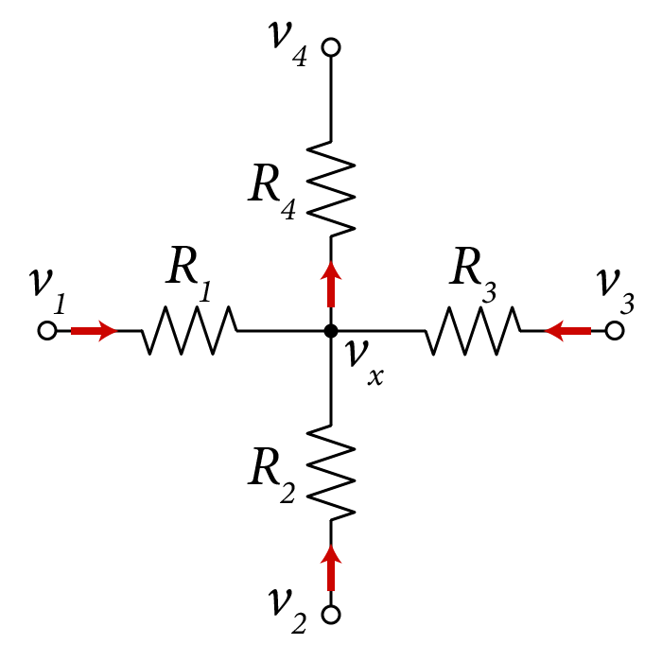
Examples of expressing currents in terms of the
node voltage variables
Assuming all currents flowing mixed direction into & out of the node “x”
$$\frac{v_{1}−v_{x}}{R_{1}}+\frac{v_{2}−v_{x}}{R_{2}}+\frac{v_{3}−v_{x}}{R_{3}}−\frac{v_{x}−v_{4}}{R_{4}}=0$$

Slide 17
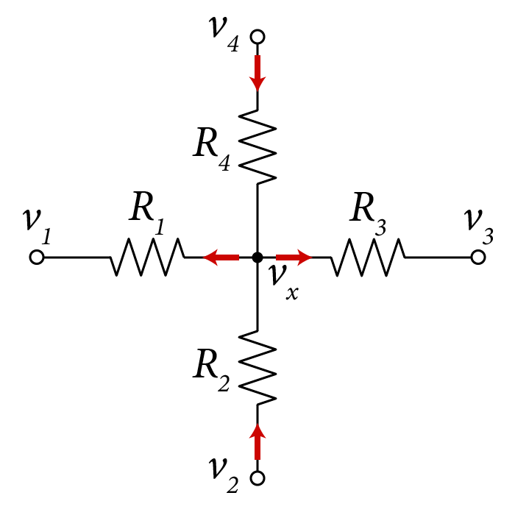
Examples of expressing currents in terms of the
node voltage variables
Assuming all currents flowing mixed direction into & out of the node “x”
$$−\frac{(v_{x}−v_{1})}{R_{1}}+\frac{v_{2}−v_{x}}{R_{2}}−\frac{v_{x}−v_{3}}{R_{3}}+\frac{v_{4}−v_{x}}{R_{4}}=0$$

Slide 18
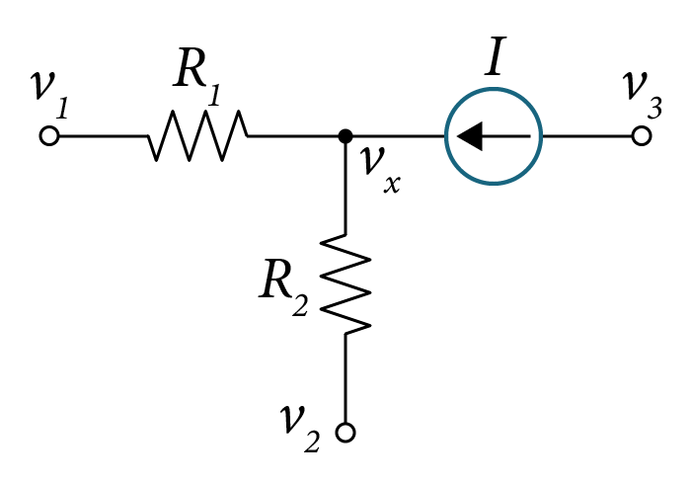
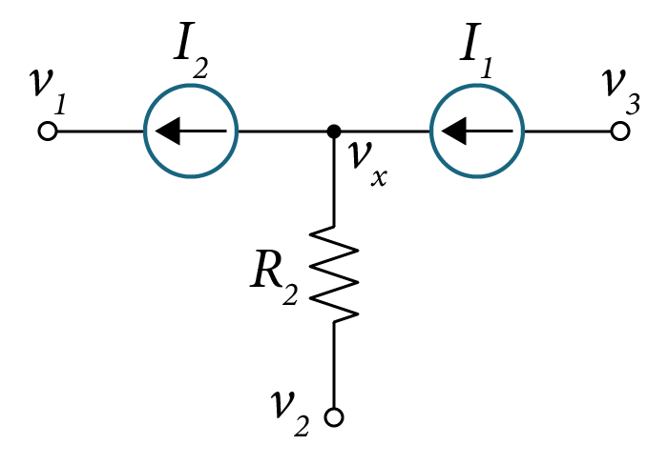
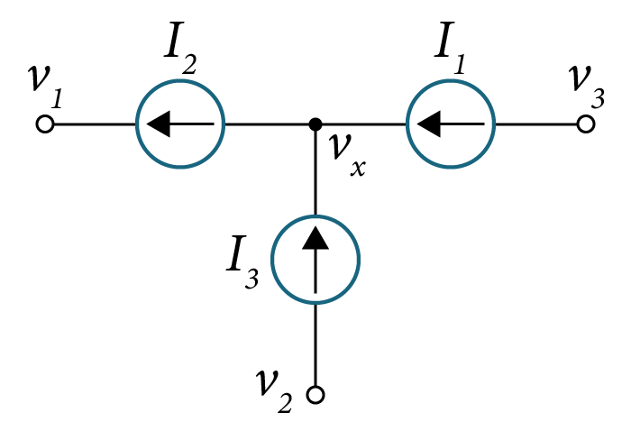
Examples of expressing currents in terms of the
node voltage variables
$$\frac{v_{1}−v_{x}}{R_{1}}+\frac{v_{2}−v_{x}}{R_{2}}+I=0$$
$$\frac{v_{1}−v_{x}}{R_{1}}+\frac{v_{2}−v_{x}}{R_{2}}−I=0$$
$$−I_{2}+\frac{v_{2}−v_{x}}{R_{2}}+I_{1}=0$$
$$−I_{1}+I_{2}−I_{3}=0$$

Slide 19
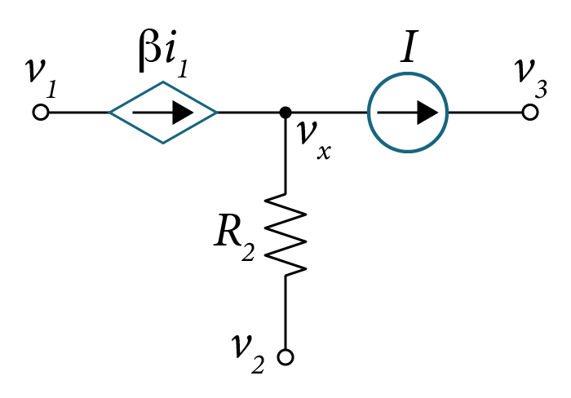
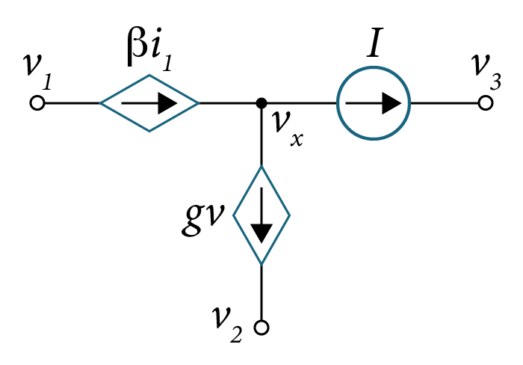
Examples of expressing currents in terms of the
node voltage variables
$$βi_{1}+\frac{v_{2}−v_{x}}{R_{2}}−I=0$$
$$βi_{1}−gv−I=0$$
$$−βi_{1}+\frac{v_{x}−v_{2}}{R_{2}}+I=0$$

Slide 20
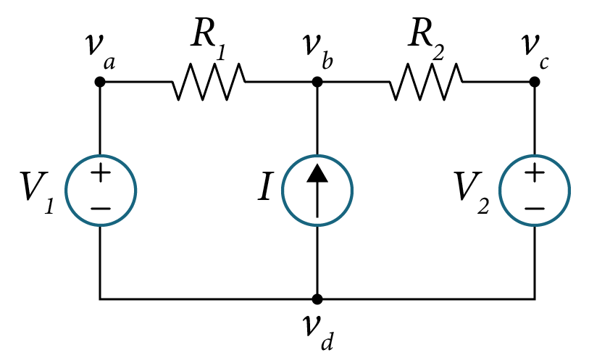
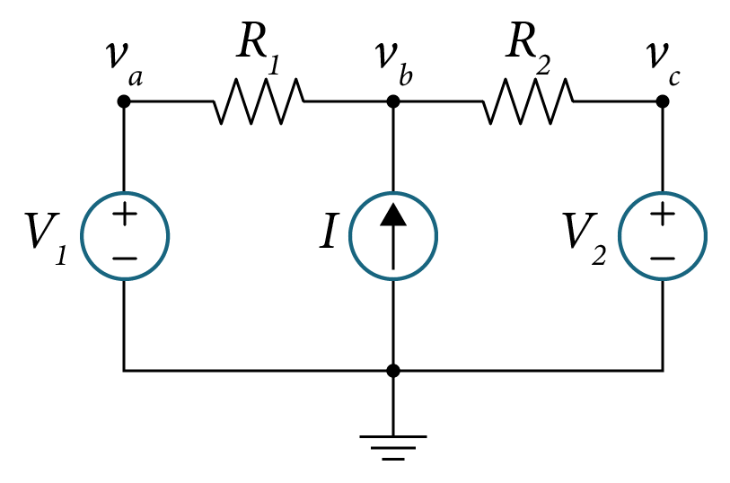
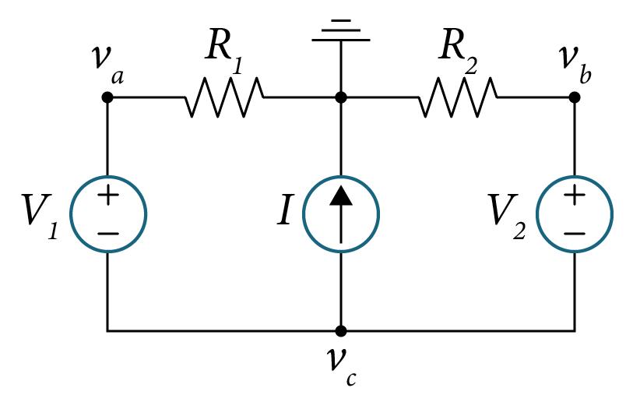
Examples of Expressing Voltage Sources in terms of the
node voltage variables
$$v_{a}−v_{d} =V_{1}$$
$$v_{c}−v_{d} =V_{2}$$
$$I+\frac{v_{a}−v_{b}}{R_{1}}+\frac{v_{c}−v_{b}}{R_{2}}=0$$
$$v_{a} =V_{1}$$
$$v_{c}=V_{2}$$
$$I+\frac{v_{a}−v_{b}}{R_{1}}+\frac{v_{c}−v_{b}}{R_{2}}=0$$
$$v_{a}−v_{c} =V_{1}$$
$$v_{b}−v_{c} =V_{2}$$
$$I+\frac{v_{a}}{R_{1}}+\frac{v_{b}}{R_{2}}=0$$

Slide 21
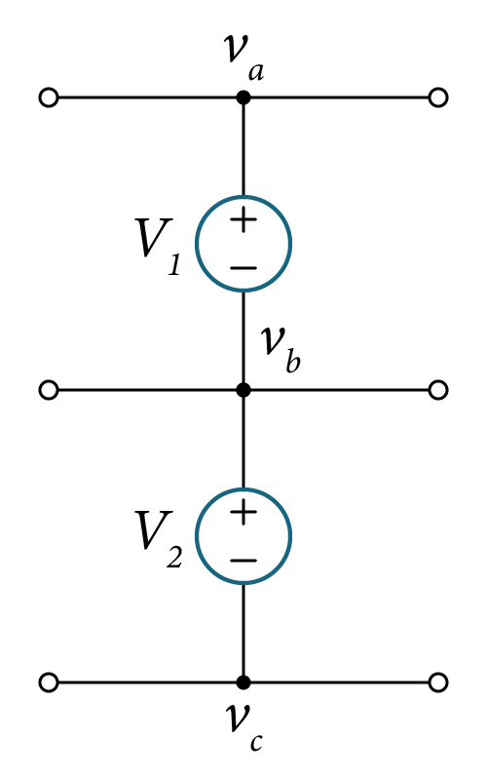
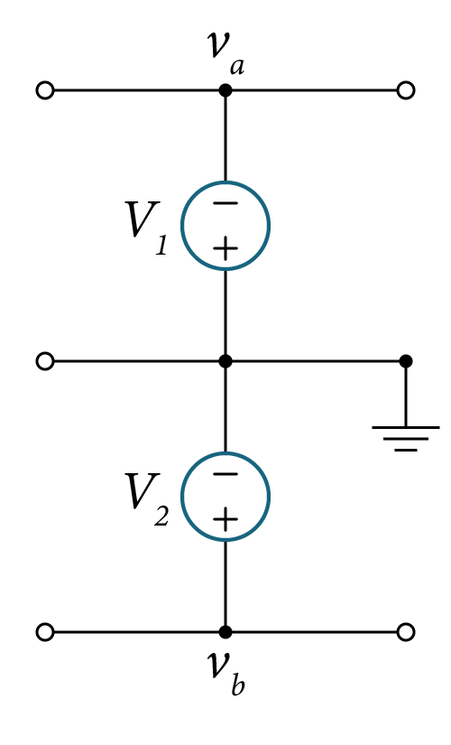
Examples of Expressing Voltage Sources in terms of the
node voltage variables
$$v_{a}−v_{b} =V_{1}$$
$$v_{b}−v_{c} =V_{2}$$
$$V_{1}=0−v_{a}=−v_{a}$$
$$V_{2}=v_{b}−0=v_{b}$$

Slide 22
Nodal Analysis with Current Sources
Given a circuit with n-nodes and no voltage sources, we follow the following steps:
1. Select a reference node and label it as ground.
2. Assign node voltages v_{a}, v_{b}, v_{c} ,…to the remaining (n-1) nodes.
3. Write (n-1) KCL equations at the (n-1) nodes by using Ohm’s law to express branch currents in terms of the node voltages.
4. Solve the (n-1) equations simultaneously for the nodal voltages v_{a}, v_{b}, v_{c}…
The circuit can be described completely by the required number of independent KCL equations.

Slide 23
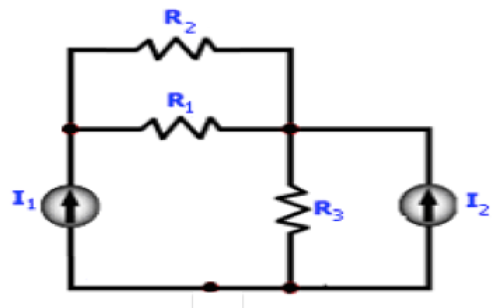
Example
Use the nodal analysis method to find:
The voltage and current in each resistance, and
The power dissipated in all resistors.
Variable | Values | Unit
I₁ | 6 | A
I₂ | 2 | A
R₁ | 2 | Ω
R₂ | 4 | Ω
R₃ | 3 | Ω

Slide 24
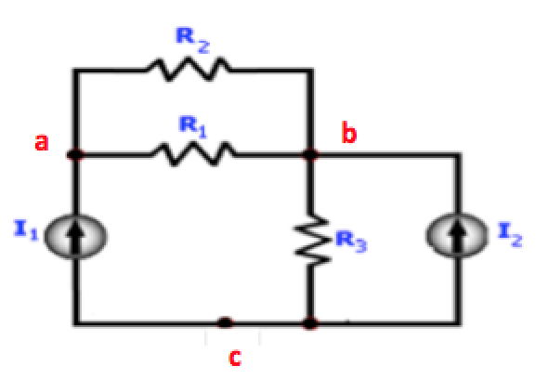
Solution
Note that there are three nodes: a, b, c
Any of these nodes can be ground or reference node (set to zero)
Let us consider three possible solutions:
Solution A – Set the ground node at c
Solution B – Set the ground node at b
Solution C – Set the ground node at a
a

Slide 25
Nodal Analysis with Current Sources
Given a circuit with n-nodes and no voltage sources, we follow the following steps:

Slide 26
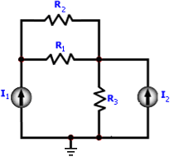
Nodal Analysis with Current Sources
Given a circuit with 3-nodes and no voltage sources, we follow the following steps:
1. Select a reference node and label it as ground – set node c to zero voltage.
c

Slide 27
Nodal Analysis with Current Sources
Given a circuit with 3-nodes and no voltage sources, we follow the following steps:
1. Select a reference node and label it as ground.
2. Assign node voltages v_{a}, and v_{b} since we have only two nodes (n=2).
Two nodes: v_{a} and v_{b}
c

Slide 28
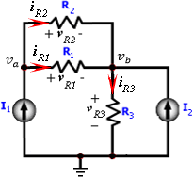
Nodal Analysis with Current Sources
Given a circuit with 3-nodes and no voltage sources, we follow the following steps:
1. Select a reference node and label it as ground.
2. Assign node voltages va, and vb since we have only two nodes (n=2).
3. Write 2 KCL equations at the 2 nodes (nodes v_{a} and v_{b} ) by using Ohm’s law to express branch currents in terms of the node voltages.
KCL at node ‘a’:
$$I_{1}{ − i}_{R1} {− i}_{R2}=0$$
(1)
KCL at node ‘b’:
$${−i}_{R1}{ − i}_{R2} {+ i}_{R3}−I_{2}=0$$
(2)
Resistor currents can be assigned

Slide 29
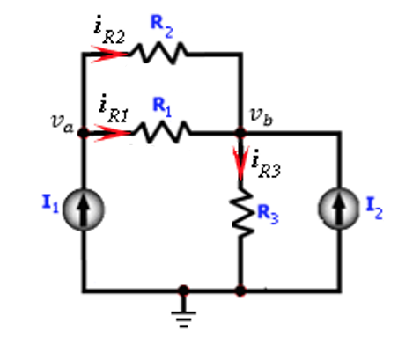
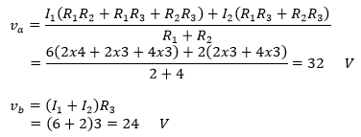
Nodal Analysis with Current Sources
Given a circuit with 3-nodes and no voltage sources, we follow the following steps:
1. Select a reference node and label it as ground.
2. Assign node voltages va, and vb since we have only two nodes (n=2).
3. Write 2 KCL equations at the 2 nodes by using Ohm’s law to express branch currents in terms of the node voltages.
4. Solve the 2 equations simultaneously for the nodal voltages va, vb.
Writing KCL at nodes v_{a} and v_{b}:
(1)
(2)
Solving for v_{a} and v_{b},

Slide 30
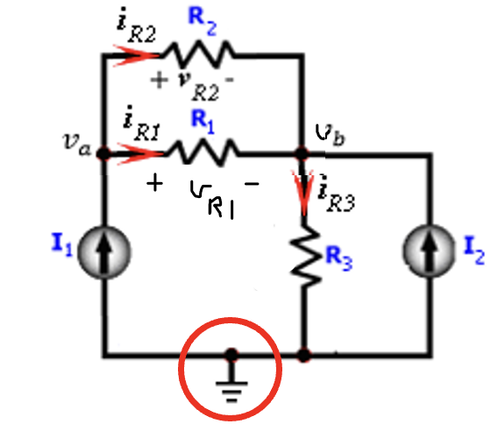
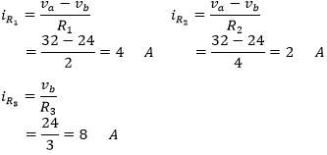
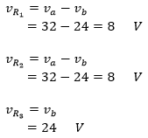
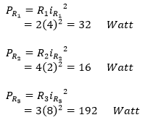
Solve for the resistor currents:
The current through the resistors,
Ground
The voltage across the resistors,
The power dissipated in the resistors,

Slide 31
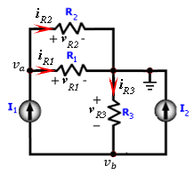
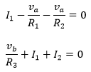
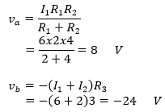
Solution B – Ground Moved as follows:
Ground
KCL at nodes ‘a’ and ‘b’:
(1)
(2)
Solving for v_{a} and v_{b},

Slide 32
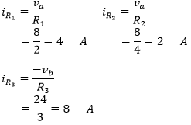
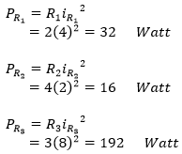
Solution B – Ground Moved as follows:
Ground
The current through the resistors,
The voltage across the resistors,
The power dissipated in the resistors,
Note: Same answers as Solution A

Slide 33
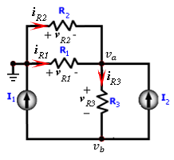
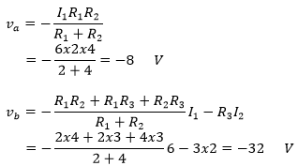
Solution C – Ground Moved as follows:
Ground
KCL at nodes ‘a’ and ‘b’:
Solving for v_{a} and v_{b},

Slide 34
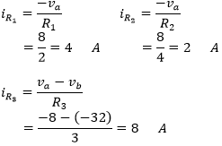
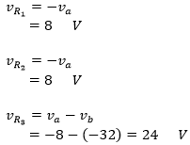
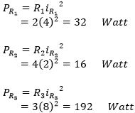
Solution C – Ground Moved as follows:
Ground
The current through the resistors,
The voltage across the resistors,
The power dissipated in the resistors,
Note: Same answers as Solution A

Slide 35
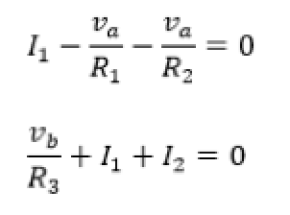
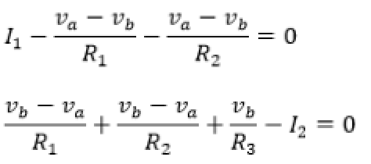
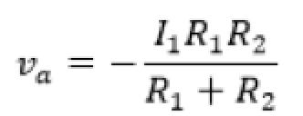
Solution A
Solution B
Solution C
Solving for v_{a} and v_{b}:

Slide 36
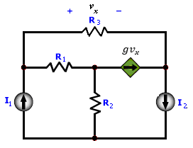
Example
Use the nodal analysis method to find:
The voltage and current in each resistance, and
The power dissipated in all resistors.
Variable | Values | Unit
I₁ | 6 | A
I₂ | 2 | A
R₁ | 2 | Ω
R₂ | 4 | Ω
R₃ | 3 | Ω
g | 0.5 | Ω⁻¹

Slide 37
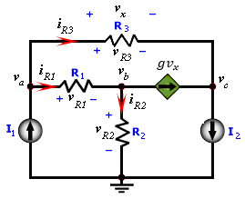
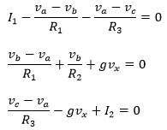
Solution:
KCL at nodes ‘a’, ‘b’, and ‘c’:
(1)
(2)
(3)
U$nknowns:$ $v_{a}$, $v_{b}$, $v_{c}$ and $v_{x}$ !!!
But we only have 3 equations (1)-(3)?

Slide 38
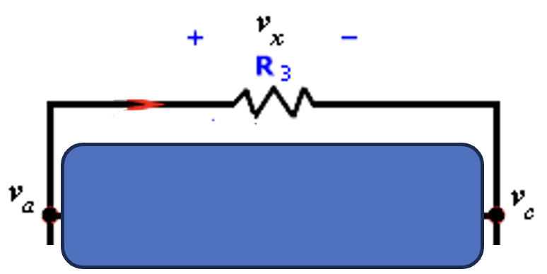
Solution:
KCL at nodes ‘a’, ‘b’, and ‘c’:
(1)
(2)
(3)
U$nknowns:$ $v_{a}$, $v_{b}$, $v_{c}$ and $v_{x}$ !!!
But we only have 3 equations (1)-(3)?
Answer: we can express $v_{x}$ in terms of $v_{a}$ and $v_{c}$
(4)
$v_{x}=v_{a}−v_{c}$

Slide 39
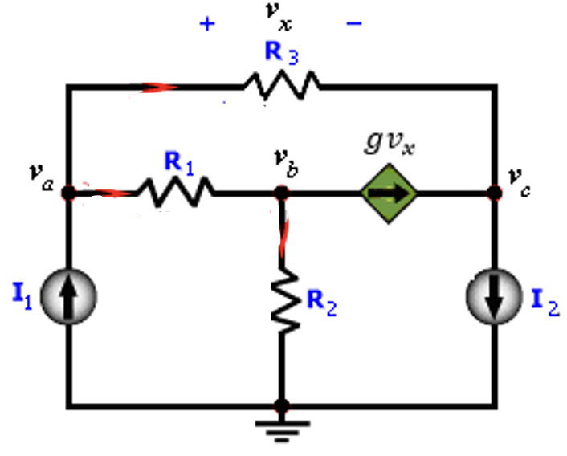
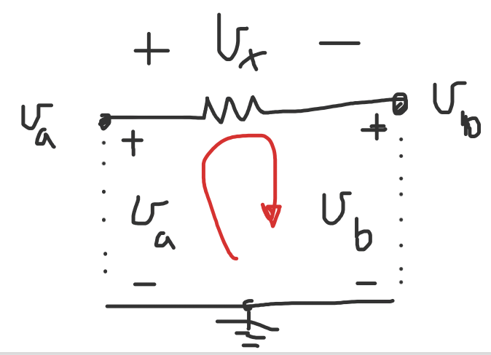
Solution:
A$nother way to view v_{x}$?
Apply KVL around $v_{x}$, $v_{a}$, and $v_{b}$as follows:
${−v}_{a}{+v}_{x}$ ${+v}_{c}=$
$v_{x}$= $v_{a}{−v}_{c}$
(4)
Now substitute for Eq. (4) into Eqs. (2) and (3) and then solve for $v_{a}$, $v_{b}$, $v_{c}$

Slide 40
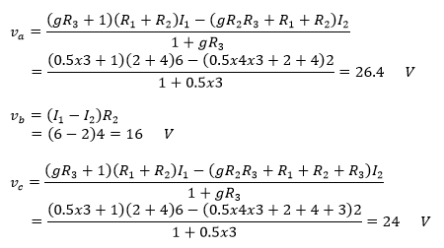
Solution
Solving for v_{a}, v_{b}, and v_{c},
If you are asked to find voltage $v_{x}:$
$$v_{x}\text{= }v_{a}{−v}_{c}$$
= $26.4−16$
$$=10.4 V$$

Slide 41
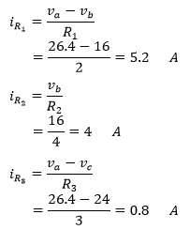
Solution:
The current through the resistors is,
The voltage across the resistors is,
The power dissipated in the resistors is,

Slide 42
Check your Solutions
Pick any node and write KCL
Let us pick the ground node:
$I_{1}−i_{R2}−I_{2}=0$?
6 – 4 – 2 =0. OK

Slide 43
Nodal Analysis Method
II. Circuits with voltage (including current sources)

Slide 44
Nodal Analysis with Voltage Sources
The number of required KCL equations is reduced.
Voltage at the node is directly assigned to the voltage source with respect to the reference node.
Notice:
$$V=v_{a}−v_{b}$$
The current in this branch is not known to write KCL

Slide 45
Nodal Analysis with Voltage Sources
The number of required KCL equations is reduced.
Voltage at the node is directly assigned to the voltage source with respect to the reference node.
KCL at the supernode:

Slide 46
Nodal Analysis with Voltage Sources in Series with a resistor
If the voltage source has a resistor in series, then by using source transformation we may replace it by an equivalent current source

Slide 47
Nodal Analysis with Voltage Sources
If the voltage source has a resistor in series, then by using source transformation we may replace it by an equivalent current source
Hence, the supernode is eliminated.

Slide 48
Example
Write the correct KCL equations at each node for the given circuit

Slide 49
Solution:
Assigning three node voltages and reference node.
Because we have a voltage source, the number of nodes can be reduced.
Assign three variable nodes: va, vb, and vc ; and the ground node.
KCL at nodes ‘a’, ‘b’ and ‘c’:
Only two equations need to be solved for $v_{b}{ and v}_{c}$ !

Slide 50
Example
Find the voltages, currents and power for each of the resistors.
Variable | Values | Unit
V₁ | 20 | V
V₂ | 10 | V
R₁ | 18 | Ω
R₂ | 14 | Ω
R₃ | 6 | Ω
α | 0.2 | -

Slide 51
Example
Find the voltages, currents and power for each of the resistors.
Variable | Values | Unit
V₁ | 20 | V
V₂ | 10 | V
R₁ | 18 | Ω
R₂ | 14 | Ω
R₃ | 6 | Ω
α | 0.2 | -
Supernode

Slide 52
KCL at the supernode ‘bc’:
By inspection the voltage v_{a} is given by:
The voltage across V₂ is given by:
The current i_{x} is given by:

Slide 53
Solving for v_{b}, and v_{c},
The resistors current,

Slide 54
The voltage across the resistors,
The power dissipated in the resistors,

Slide 55
Example
Find the voltages and currents for all the resistors.
Variable | Values | Unit
V | 5 | V
I₁ | 12 | A
I₂ | 8 | A
R₁ | 10 | Ω
R₂ | 6 | Ω
Solutions:
Solution A - Use the Supernode Method
Solution B - Use the external resistance method

Slide 56
Solution A) Use the Supernode Method
Solution
Assign nodes v_{a} and v_{b}
Use this super node
Notice we cannot write KCL at nodes v_{a} and v_{b} since they are connected to a volage source.
Notice that,
$V=v_{a}$- $v_{b}$ (1)
Apply KCL around the shaded node,
$$−I_{1}+\frac{v_{a}−0}{R_{1}}+I_{2}+\frac{v_{b}−0}{R_{2}}=0 (2)$$
Solving Eqs. (1) and (2) for the voltages v_{a}, and v_{b},
$$v_{a}=R_{1}\frac{V+R_{2}(I_{1}−I_{2}) }{{R_{1}+R}_{2}}$$
$$v_{a}=R_{2}\frac{−V+R_{1}(I_{1}−I_{2}) }{{R_{1}+R}_{2}}$$

Slide 57
Solution B) Use the external resistance method
Insert an external resistor r_{o} in series with the Voltage source V.
The approach:
Add small r_{o} then set it to zero at the end!

Slide 58
Solution
Applying a Voltage-to-Current source transformation:
Assign nodes v_{a} and v_{b}
Solve for nodes v_{a} and v_{b} then set r_{o}=0!

Slide 59
Solution
Applying KCL at nodes v_{a}, and v_{b},
Solving for the voltages v_{a}, and v_{b},
Solving for the voltages v_{a}, and v_{b},
Set r_{o}=0

Slide 60
Solution
The voltage across the resistors is,
The current passing through the resistors is,
18.2
1.8

Slide 61
Design Examples- Voltage Node Analysis.
Use the node voltage analysis to design the circuit shown so that V_{R1}=2 and V_{R2}=6 V.
Consider R₂= 50 Ω and I=6 A.
V_{R1}
V_{R3}

Slide 62
Design Examples- Voltage Node Analysis.
Use the node voltage analysis to design the circuit shown so that V_{R1}=2V_{R2}=6 V.
Consider R₂= 50 Ω and I=6 A,.
Solution:
Assign nodes 1 and 2 as shown
V_{R1}
V_{R3}

Slide 63
Solution:
Given R₂= 50 Ω,
We design for:
R₃= 50 Ω
R₁= 1 Ω,

Slide 64
Examples: Applying Nodal Analysis

Slide 69
2025+
What is next?
You?

