Slide 1
EEL 3004 Electrical Networks Lecture #6 Simple Circuit Analysis Voltage and Current Division Formulas & Delta and Wye Connection

Slide 2
Lecture Objectives
The lecture today will focus on Sections 3.3 and 3.4:
* Present two simple, but important, formulas:
Voltage Division
Current Division
* Two simple practical analysis methods:
Intuitive Method: Circuit Reduction
Delta and Wye Connection

Slide 3
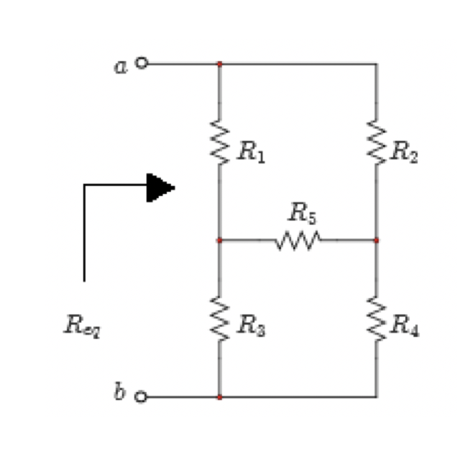
Example - Combining Resistors
What is the equivalent resistance seen between terminals “a” and “b?
Req ?

Slide 4
Example - Combining Resistors
What is the equivalent resistance seen between terminals “a” and “b?
Req ?
None of the resistors are in series or in parallel !!!

Slide 5
Example - Combining Resistors
One way to find the resistance between “a” and “b” is to set-up an experiment in the lab and apply a battery across terminals “a” and “b”:
Step 1: Measure I
Step 2: Since you know V, then carry out Ohm’s Law
$$R_{eq}=\frac{V}{i}$$
None of the resistors are in series or in parallel !!!

Slide 6
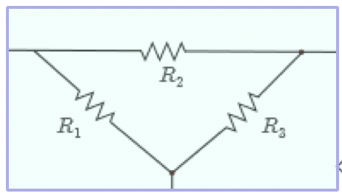
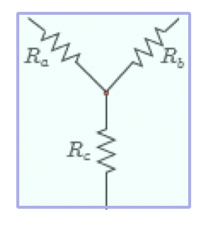
Delta and Wye Connections
In some resistor circuits, none of the resistors can be combined either in series or in parallel.
Wye and delta circuit interconnections are the most common configurations where resistors cannot be simplified by simple series or parallel.
Delta (△)
Wye (Y)

Slide 7
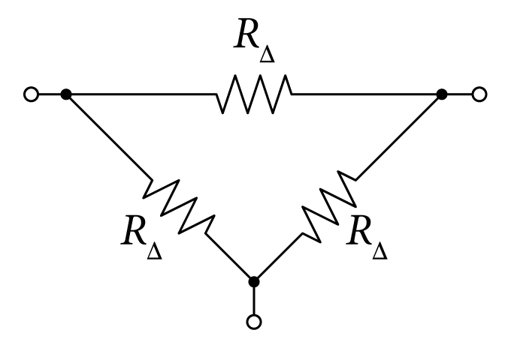
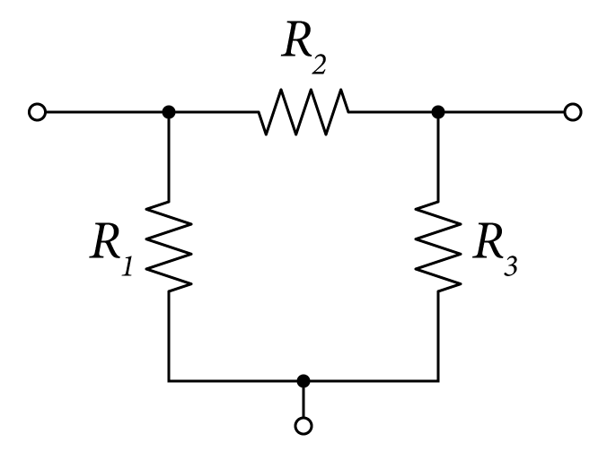
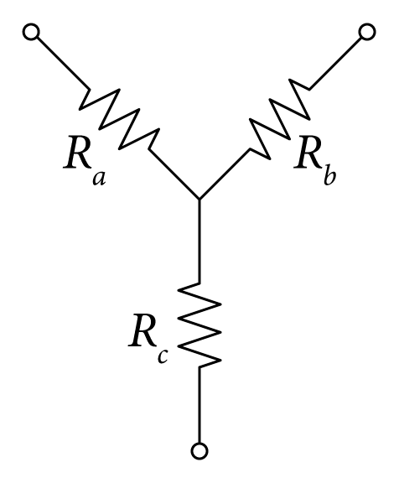
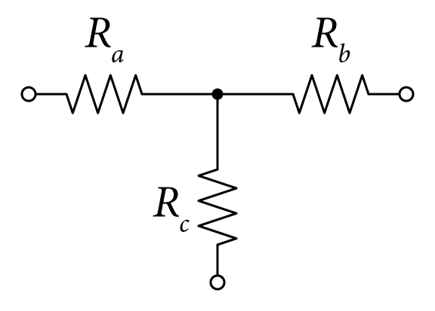
Delta and Wye Connections
Other configuration of Wye and delta circuit interconnections:
Delta (△)
Wye (Y)

Slide 8
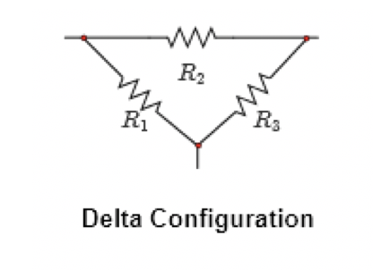
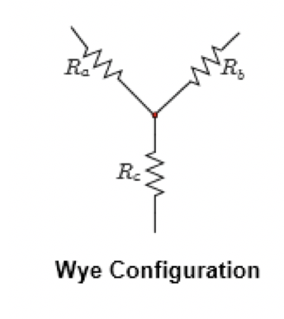
Delta and Wye Connection
In these two cases, we use a method known as the delta-to-wye (∆ Y) and wye-to-delta (Y ∆) transformations.
Circuit Transformation

Slide 9
Delta and Wye Transformation
Wye and delta circuit interconnections can be transformed from one configuration to the other by properly adjusting their resistor values.
To transform the ∆ configuration to Y configuration, you use the following relations:
∆→Y and Y→∆ transformation

Slide 10
Delta and Wye Connection
If all resistors in a given structure are equal as shown, then the transformation equations are simplified as follows:
∆→Y and Y→∆ transformation

Slide 11
The most Common Connection – The Bridge Circuit
For example, for the circuit shown, we are interested in finding the total equivalent resistance R_{eq} between terminals a and b.
No possible combination of resistors is allowed

Slide 12
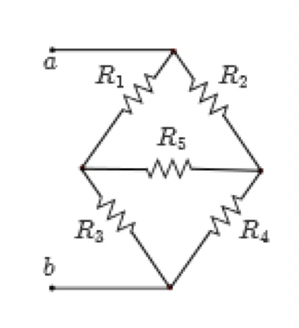
Delta Connection
Notice that there are two possible ways to from Delta connections as shown.
1) Delta 1: Resistors R1, R2, and R5
2) Delta 2: Resistors R3, R4, and R5

Slide 13
Delta Connection
Notice that there are two possible ways to from Wye connections as shown.
1) Wye 1: Resistors R2, R4, and R5
2) Wye 2: Resistors R1, R3, and R5

Slide 14
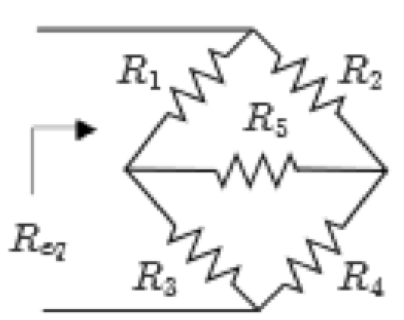
Example
Consider the problem of finding R_{eq} for the circuit shown:

Slide 15
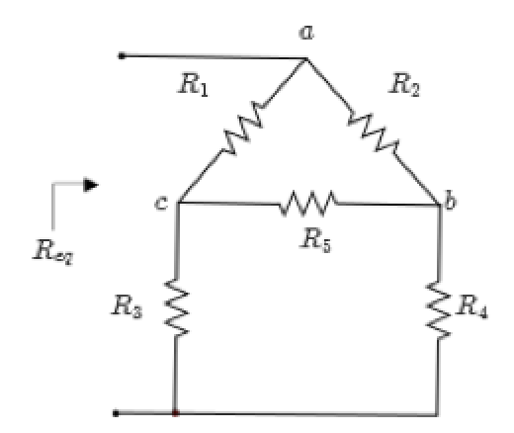
Example (solution)
Solution (A) – Use the upper ∆ to Y transformation):
Consider transforming the ∆ configuration formed by resistors R₁, R₂, and R₅ as shown:
Resistive circuit

Slide 16
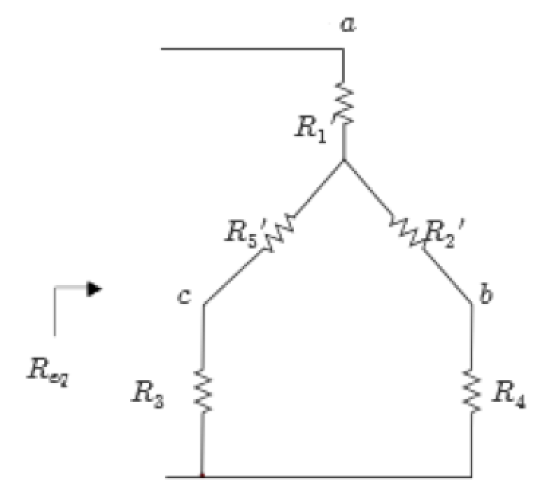
Example (solution-cont’d)
From the ∆-to-Y transformation equations come the following equations:

Slide 17
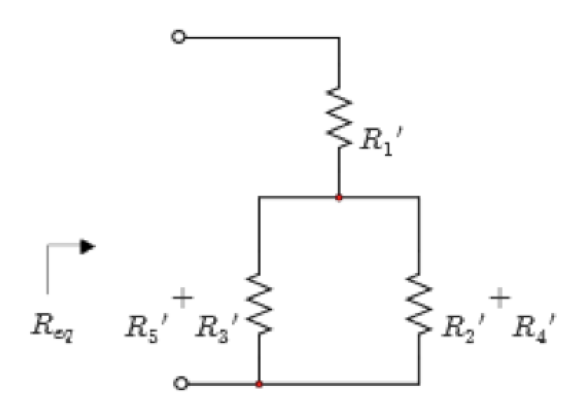
Example (solution-cont’d)
From the ∆-to-Y transformation equations come the following equations:

Slide 18
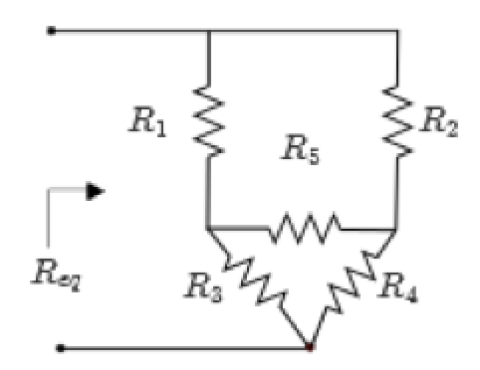
Example (solution-cont’d)
Solution (B) Use the lower ∆ to Y transformation):
Consider transforming the ∆ configuration formed by resistors R₃, R₄, and R₅ as shown;
Resistive circuit

Slide 19
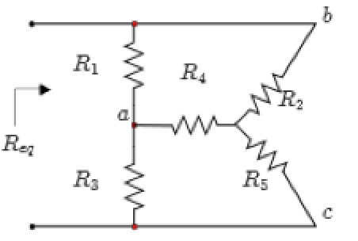
Example 3 (solution-cont’d)
Solution (C) - Use the right Y to ∆ transformation):
Consider transforming the Y configuration formed by resistors R₂, R₄, and R₅ as shown:
Resistive circuit

Slide 20
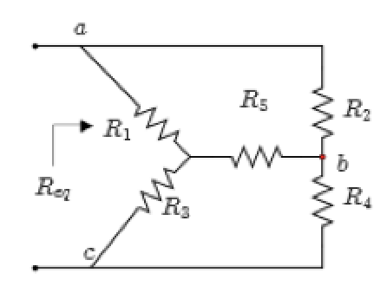
Example (solution-cont’d)
Solution (D) – Use the left Y to ∆ transformation):
Consider transforming the Y configuration formed by resistors R₁, R₃, and R₅ as shown:
Resistive circuit

Slide 22
$$i$$
In another words find i first then find $P_{s}$
$$P_{s}=\frac{V_{s}}{i}$$

Slide 23
$$i$$
In another words find i first then find $P_{s}$
$$P_{s}=\frac{V_{s}}{i}$$
Dr. Batarseh’s Pearson eText – Copy Rights Protected

Slide 24
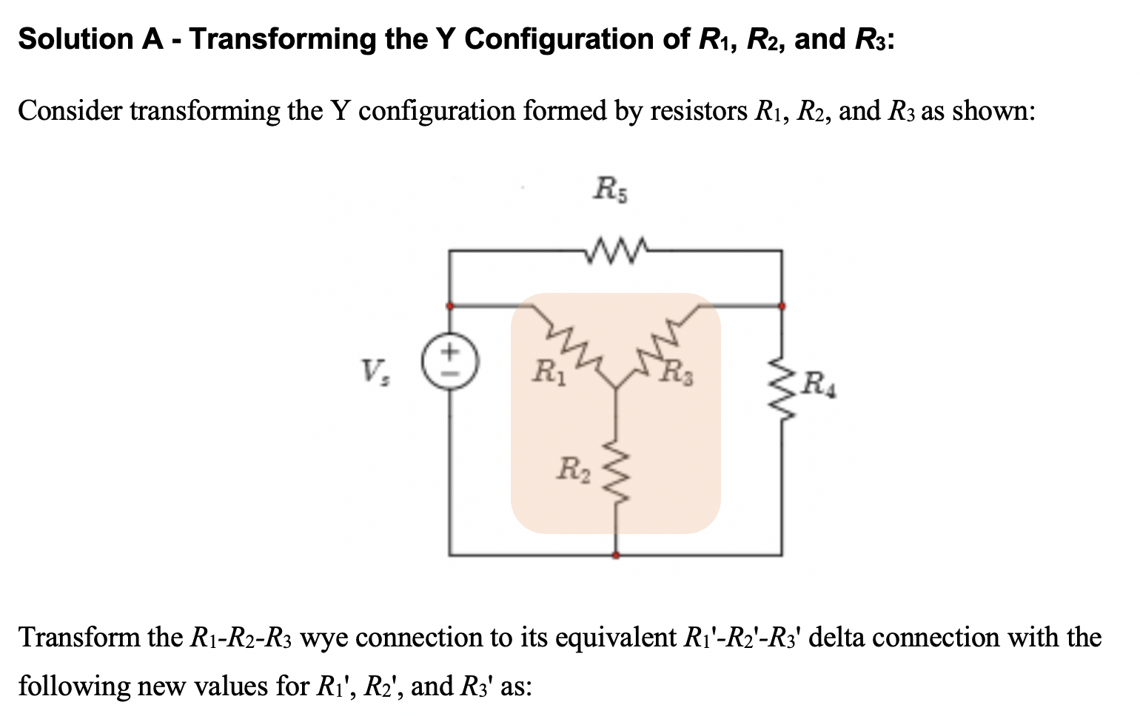
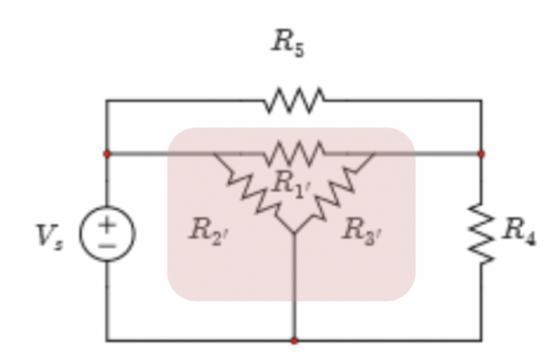

Slide 25
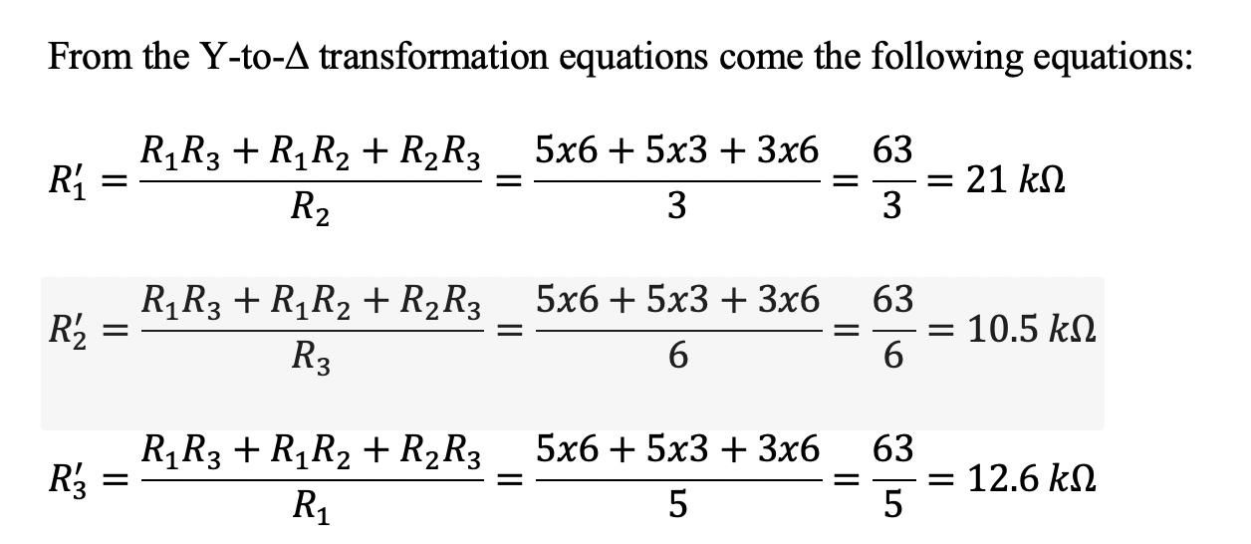
Redrawn as follows:

Slide 26
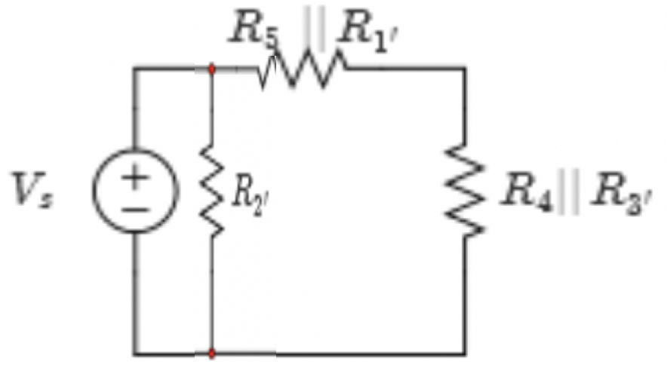
Next, combine R₁' and R₅ in parallel and R₃' and R₄ also in parallel as shown:
Finally, $R_{eq}$ is obtained by combining the two resistors of Figure 3.58(d) in series to yield
$$R_{eq}={(R}_{1}^{′}//R_{5}+R_{3}^{′}//R_{4})//R_{2}^{′}=(21//10+12.6//4)//10.5.$$
$$=(6.774+3.036)//10.5=9.81//10.5=5.1 kΩ$$

Slide 27
The total power defined by the voltage source v_{s} is given by,
$$P_{total}=\frac{V_{s}^{2}}{R_{eq}}= \frac{{10}^{2}}{5.1}=19.61 mW$$

Slide 28
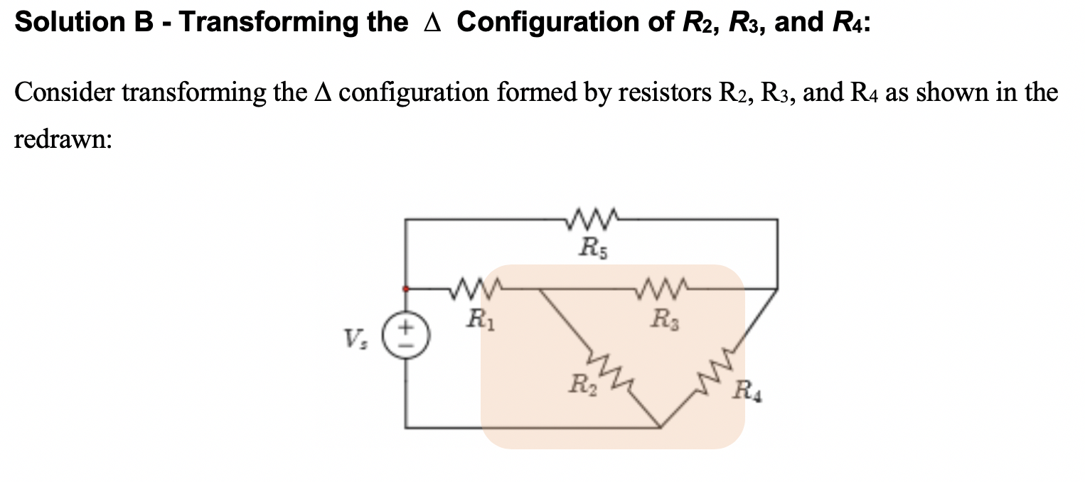

Slide 29
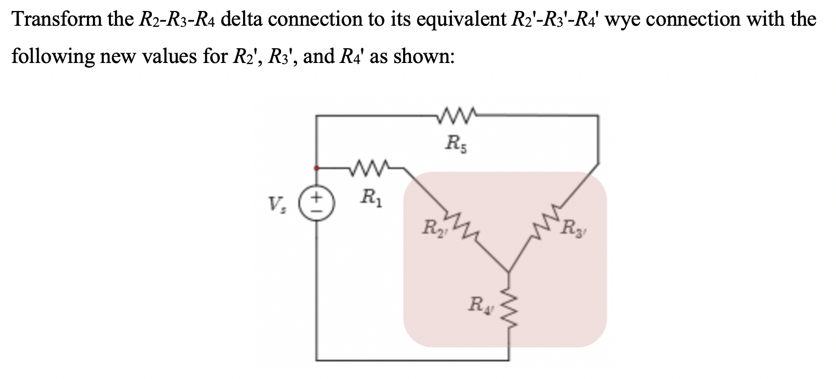
From the ∆-to-Y transformation equations come the following equations:
$$R_{2}^{′}=\frac{R_{2}R_{3}}{R_{2}+R_{3}+R_{4}}=\frac{3x6}{3+6+4}=\frac{18}{13}=1.385 kΩ$$
$$R_{3}^{′}=\frac{R_{3}R_{4}}{R_{2}+R_{3}+R_{4}}=\frac{6x4}{3+6+4}=\frac{24}{13}=1.846 kΩ$$
$$R_{4}^{′}=\frac{R_{2}R_{4}}{R_{2}+R_{3}+R_{4}}=\frac{3x4}{3+6+4}=\frac{12}{13}=0.923 kΩ$$

Slide 30
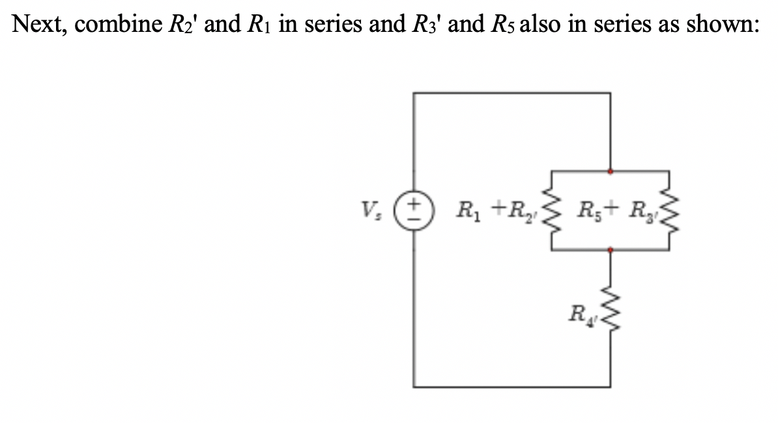
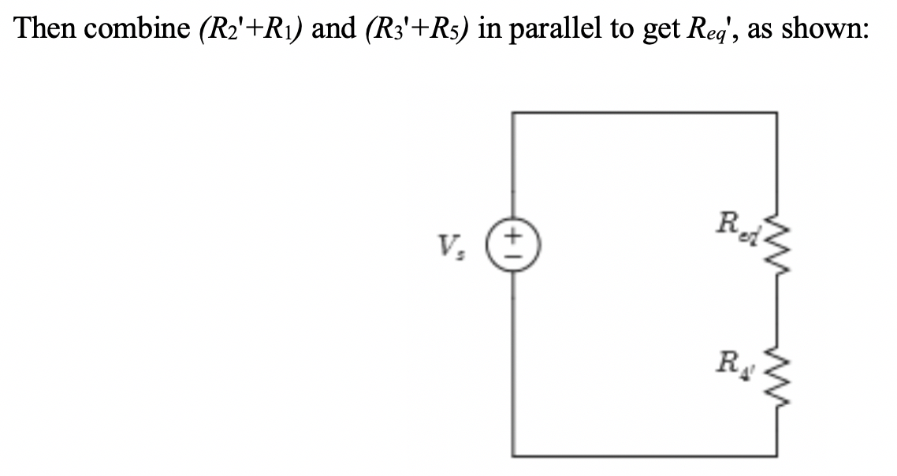

Slide 31
Finally, R_{eq} is obtained by combining the two resistors in series to yield,
$$R_{eq}=R_{4}^{′}+[(R_{1}{+R}_{2}^{′})//(R_{5}{+R}_{3}^{′})=0.923+(5+1.38)//(10+1.846)=9.23+6.38//11.846=0.923+\frac{75.577}{18.226}=0.923+4.147=5.1 kΩ$$
The total power defined by the voltage source v_{s} is given by,
$$P_{total}=\frac{V_{s}^{2}}{R_{eq}}= \frac{{10}^{2}}{5.1}=19.61 mW$$

Slide 32
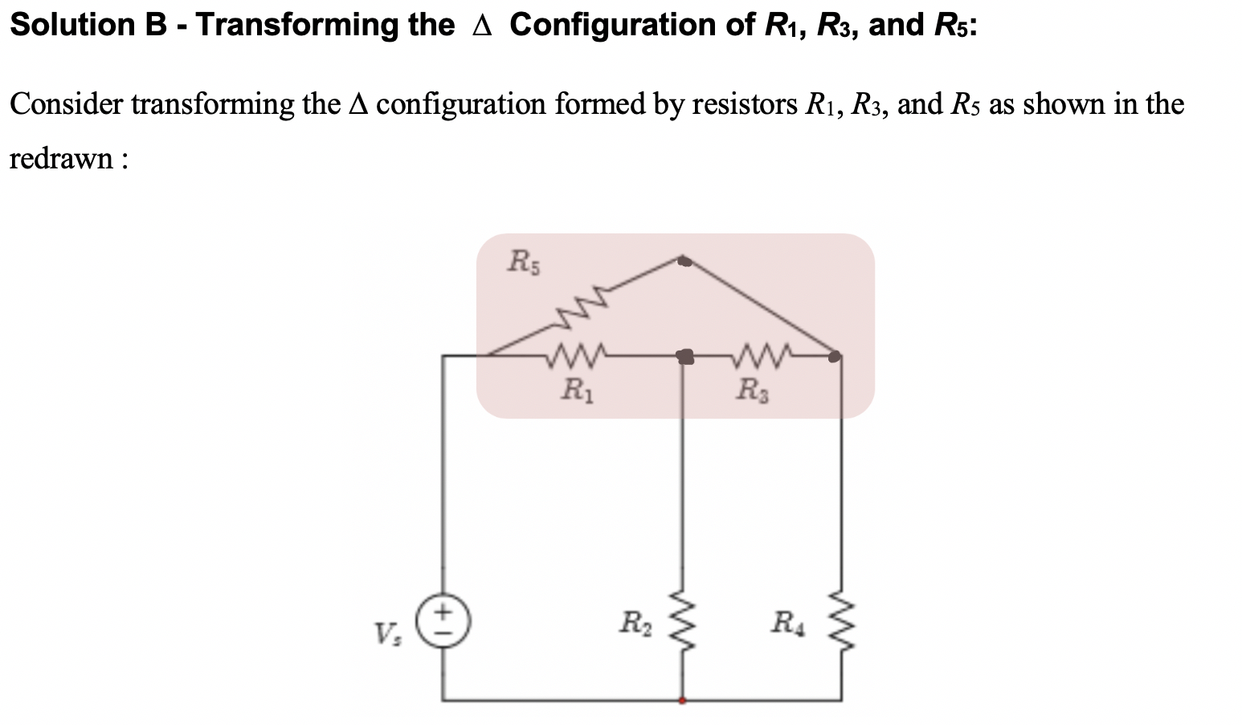

Slide 33
