Slide 1
EEL 3004 Linear Circuits I Lecture #6B Practical Relefence Gain of the Voltage MOSFET Amplifier

Slide 2
Lecture Objectives
The lecture today will focus on:
Learn about the voltage amplifier and why it is important in today’s electronic products
Understand the function of the transistor as an amplifier
Understand the model of the transistor
Learn the how to analyze simple voltage amplifier model

Slide 3
Smart Phones with its Printed Circuit Board (PCB)
iPhonse
Printed Circuit Board (PCB)
Four possible power amplifiers are identified

Slide 4
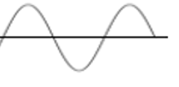
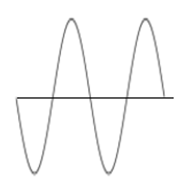
Voltage Amplifier
Block diagram of a voltage amplifier
$$A_{v}=\frac{v_{o}}{v_{s}}$$

Slide 5
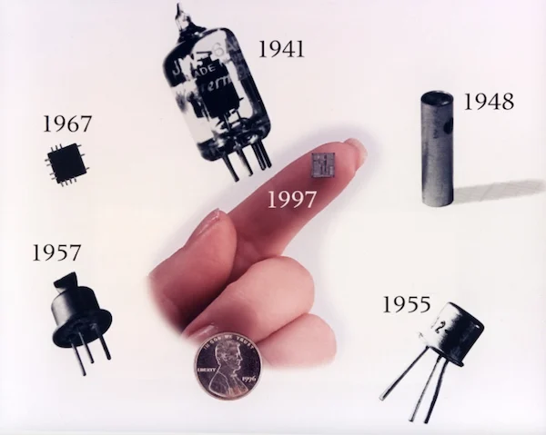
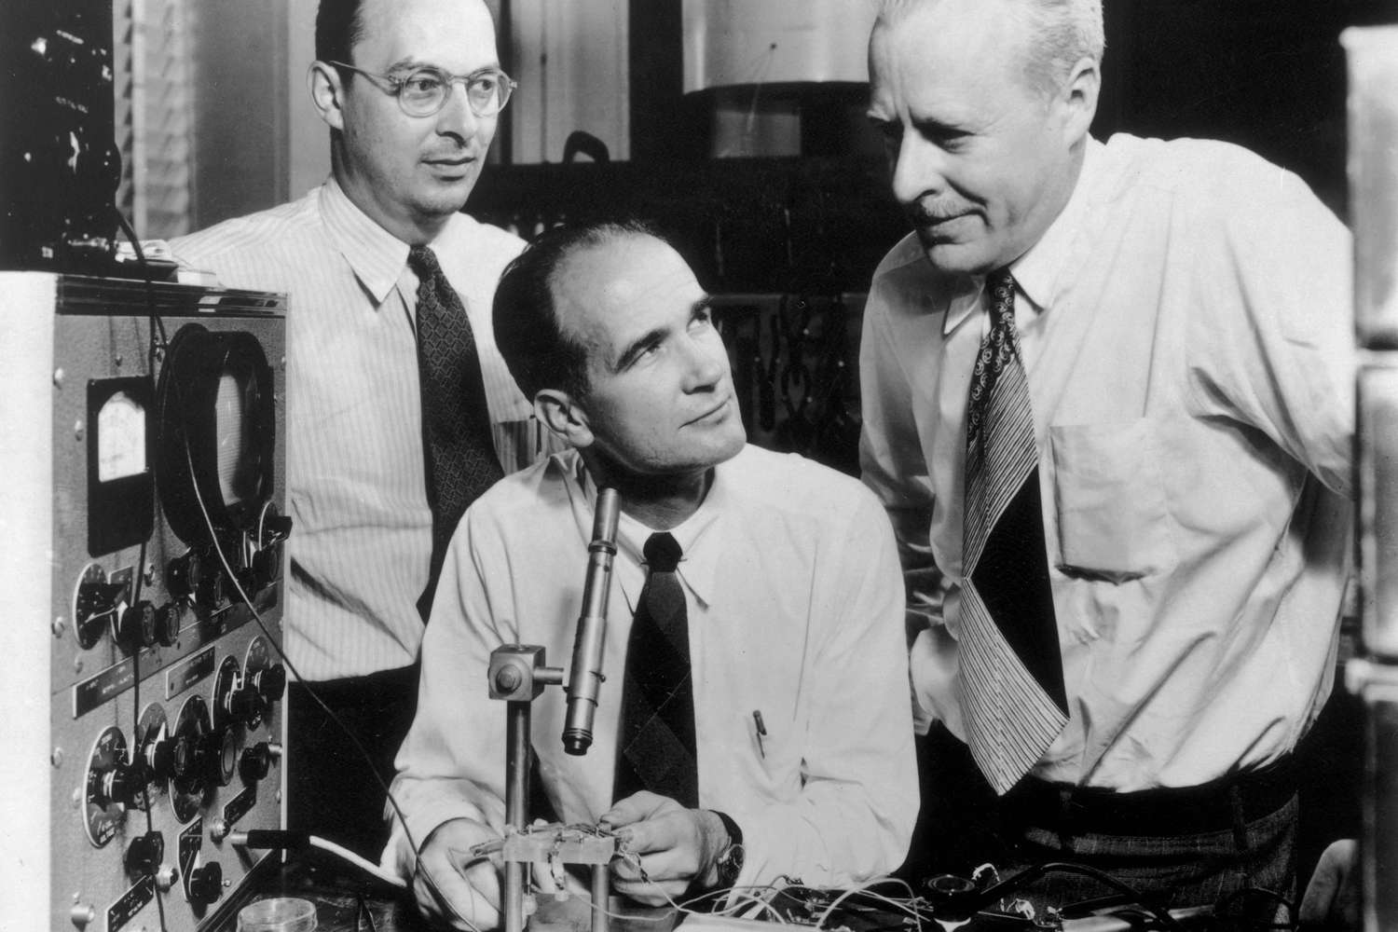
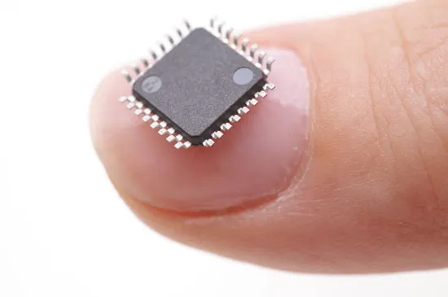
The MOSFET Transistor Amplifier
The invention of the transistor is a rare revolutionary event in the history of civilization when a single invention is so powerful that it alters the course of human history
Before the invention of the transistor, the early electronic switching (not mechanical switching) and signal amplification were done by using what was vacuum tubes
The breakthrough came in December 1947 when three scientists at Bell Labs in the United States, invented the world’s first working solid-state transistor known as a point-contact transistor.
Vacuum tube.
John Bardeen (1908-1991)
William Shockley (1910-1989)
Walter Brattain (1902-1987)
They shared the Nobel Prize in Physics in 1956.
One popular type known as the Metal Oxide Semiconductor Field Effect Transistor (MOSFET).
Today’s IC has billions of transistors.
Bardeen won 2nd Nobel Prize in Physics in 1972 on developing the theory of superconductivity.

Slide 6
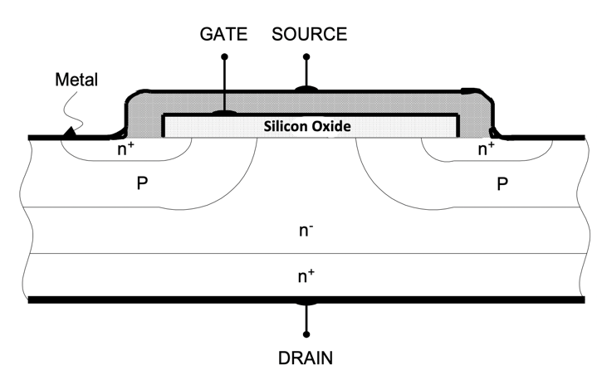
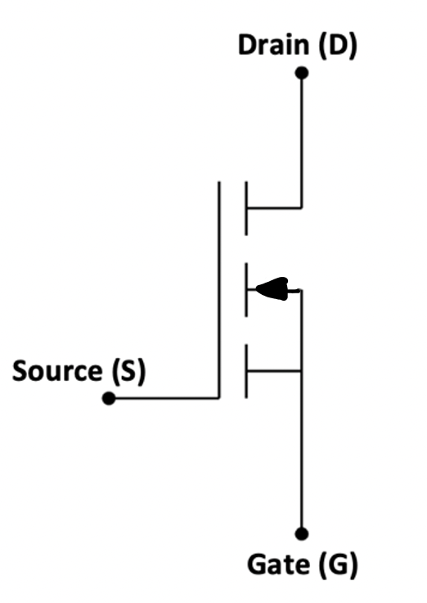
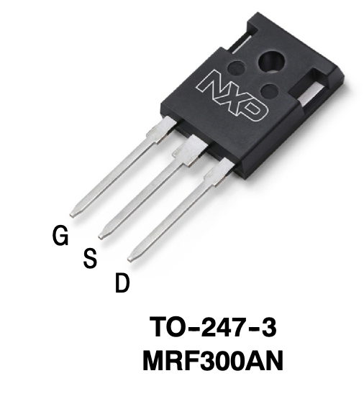
Transistor Technology - MOSEFT
MOSFET structure
Positively doped (p) atoms
Highly negatively (n+) atoms
Lightly negatively (n-) atoms
MOSEFT Symbol
Commercial MOSEFT by NXP Semiconductors

Slide 7
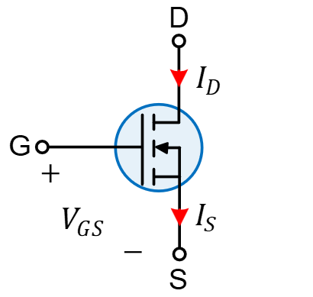
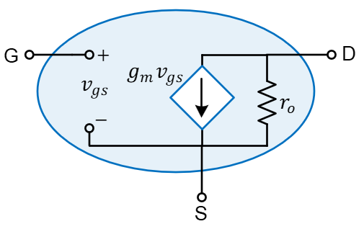
MOSFET Model as an Amplifier Technology
MOSEFT Symbol
MOSEFT Simple equivalent small-signal model

Slide 8
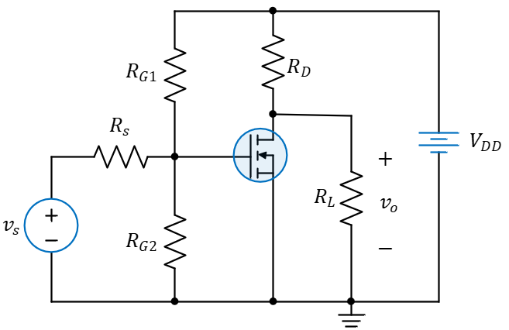
The MOSFET Voltage Amplifier
Common-source voltage amplifier using the Metal Oxide Semiconductor
Field Effect Transistor (MOSFET)

Slide 9
The MOSFET Voltage Amplifier
Small signal model of MOSFET voltage amplifier

Slide 10
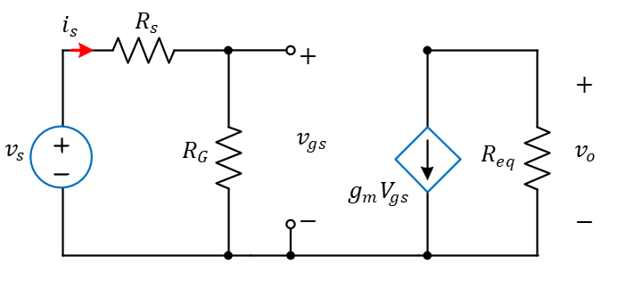
The MOSFET Voltage Amplifier
Small signal model of MOSFET voltage amplifier
$$R_{G}=\frac{R_{G1}R_{G2}}{R_{G1}+R_{G2}}$$
$$R_{eq}=r_{O}//R_{D}//R_{L}=\frac{1}{\frac{1}{r_{o}}+\frac{1}{R_{D}}+\frac{1}{R_{L}}}$$
Simplified equivalent circuit

Slide 11
Deriving the Voltage Gain ($A_{v}$)
$$R_{G}=\frac{R_{G1}R_{G2}}{R_{G1}+R_{G2}}$$
$$R_{eq}=r_{O}//R_{D}//R_{L}=\frac{1}{\frac{1}{r_{o}}+\frac{1}{R_{D}}+\frac{1}{R_{L}}}$$
Apply KVL to the left loop to yield,
By applying Ohm’s law, the output voltage and current are given by,
$$−v_{s}+R_{s}i_{s}+R_{G}i_{s}=0$$
Solving for $i_{s}$ to yield,
$$v_{o}=−R_{eq}g_{m}v_{gs}$$
$$i_{s}=\frac{v_{s}}{R_{s}+R_{G}}$$
$i_{o}=\frac{v_{o}}{R_{L}}=\frac{−R_{eq}}{R_{L}}g_{m}v_{gs}$
Apply voltage division,
$v_{gs}=\frac{R_{G}}{R_{s}+R_{G}}v_{s}$
Hence, the voltage gain from the input $v_{s}$ to the output $v_{o}$ is given by,
$$A_{v}=\frac{v_{o}}{v_{s}}=−\frac{R_{G}}{R_{s}+R_{G}}g_{m}R_{eq}$$

Slide 12
Deriving the Power Gain ($A_{P}$)
$$R_{G}=\frac{R_{G1}R_{G2}}{R_{G1}+R_{G2}}$$
$$R_{eq}=r_{O}//R_{D}//R_{L}=\frac{1}{\frac{1}{r_{o}}+\frac{1}{R_{D}}+\frac{1}{R_{L}}}$$
Next, we derive the power gain,
$$A_{P}=\frac{p_{o}}{p_{in}}$$
$p_{o}$ is the output power delivered to $R_{L}$
$p_{in}$ is the input power delivered by $v_{s}$
Hence, the power expressions are given as follows,
$$p_{o}=i_{o}v_{o}$$
$$p_{in}=i_{s}v_{s}$$
$$i_{s}=\frac{v_{s}}{R_{s}+R_{G}}$$
$i_{o}=\frac{−R_{eq}}{R_{L}}g_{m}v_{gs}$
$$v_{o}=−R_{eq}g_{m}v_{gs}$$
So, the power gain becomes
$$A_{P}=\frac{p_{o}}{p_{in}}=\frac{i_{o}v_{o}}{i_{s}v_{s}}=\frac{R_{eq}^{2}R_{G}^{2}}{\left(R_{s}+R_{G}\right)R_{L}}g_{m}^{2}$$

Slide 13
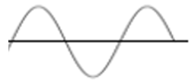
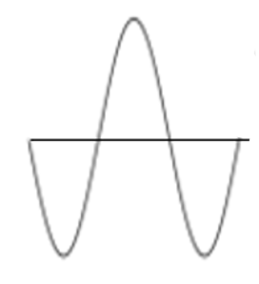
Example:
Consider specific voltage amplifier values that are realistic for a particular type of application, with the following specifications:
$$v_{s}=1.1 V$$
$$R_{s}=1 kΩ$$
$$R_{G1}=100 kΩ$$
$$R_{G2}=100 kΩ$$
$$g_{m}=2.5×{10}^{−3}S$$
$$r_{o}=100 kΩ$$
$$R_{L}=20 kΩ$$
$R_{D}=5 kΩ$
This gives the following combined values,
$$R_{G}=\frac{R_{G1}R_{G2}}{R_{G1}+R_{G2}}=\frac{100x100}{100+100}=50 kΩ$$
$$R_{eq}={r_{O}}//{R_{D}}//R_{L}=\frac{1}{\frac{1}{r_{o}}+\frac{1}{R_{D}}+\frac{1}{R_{L}}}=\frac{1}{\frac{1}{100}+\frac{1}{5}+\frac{1}{20}}=3.85 kΩ$$
$$A_{v}=−\frac{R_{G}}{R_{s}+R_{G}}g_{m}R_{eq}=−\frac{50}{1+50}x{10}^{3}\left(2.5x{10}^{−3}\right)\left(3.85\right)=− 9.44$$

Slide 14
Example:
This gives the following combined values,
$$R_{G}=50 kΩ$$
$$R_{eq}=3.85 kΩ$$
$$1.1 V$$
$$10.4 V$$
Hence, the voltage and power gains are given by,
$$A_{v}=−\frac{R_{G}}{R_{s}+R_{G}}g_{m}R_{eq}=−\frac{50}{1+50}x{10}^{3}\left(2.5x{10}^{−3}\right)\left(3.85\right)=− 9.44$$
$$A_{P}=\frac{R_{eq}^{2}R_{G}^{2}}{\left(R_{s}+R_{G}\right)R_{L}}g_{m}^{2}=\frac{{\left(3.85\right)}^{2}{\left(50\right)}^{2}}{\left(1+50\right)20}{\left(2.5x{10}^{−3}\right)}^{2}=227$$
So, a signal that has $v_{s}=1.1 V$ will deliver input power of,
$P_{in}=i_{s}v_{s}=23.73 μW$
$$v_{o}=v_{s}A_{v}=−10.4 V$$
$p_{o}=p_{in}A_{P}=5.39 mW$

