Slide 1
EEL 3004 Electrical Networks Lecture #6 Simple Circuit Analysis Voltage and Current Division Formulas & Current-voltage source transformation

Slide 2
Simple Circuit Analysis Techniques
Chapter 3
Chapter Outline
Introduction
3.1 Analysis of Single-Loop Circuits
3.2 Analysis of Single-Node-Pair Circuits
3.3 Voltage and Current Division
3.4 Intuitive Analysis Method
3.5 Voltage and Current Source Transformation

Slide 3
Lecture Objectives
The lecture today will focus on Sections 3.3 and 3.4:
* Present two simple, but important, formulas:
Voltage Division
Current Division
Two simple practical analysis methods:
Voltage source to current source transformation to obtain single-­‐node-­‐pair or single node circuits

Slide 4
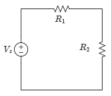
Voltage Division
Two conditions must be met to apply what is known as Voltage Division:
1) All the resistors being used in the formula share the same current.
AND
2) The voltage being divided is applied across all the resistors used in the division formula.
Simple circuit with two resistors in series

Slide 5
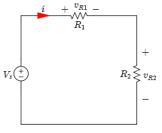
Voltage Division
In this case, we apply Voltage Division formula:
$$v_{R1}=\frac{R_{1}}{R_{1}+R_{2}}V_{s}$$
$$v_{R2}=\frac{R_{2}}{R_{1}+R_{2}}V_{s}$$
Simple circuit with two resistors in series
The voltage across a given resistor is equal to that resistor divided by the total of series-connected resistors multiplied by the applied voltage.

Slide 6
Voltage Division
In this case, we apply Voltage Division formula:
$$v_{R1}=\frac{R_{1}}{R_{1}+R_{2}}V_{s}$$
$$v_{R2}=\frac{R_{2}}{R_{1}+R_{2}}V_{s}$$
Apply KVL,
$$−V_{s}+v_{R1}+v_{R1}=0$$
$$v_{R1}+v_{R1}=V_{s}$$
$$v_{R1}+v_{R1}=\frac{R_{1}}{R_{1}+R_{2}}V_{s}+\frac{R_{2}}{R_{1}+R_{2}}V_{s}=V_{s}$$
Check:

Slide 7
Voltage Division
Assuming the following current direction and voltage polarities,
Applying KVL to the circuit below,
Solving for $i$ yields,
Therefore, vR1 and vR2 are given by,
Apply Ohm’s law:
Simple circuit with two resistors in series

Slide 8
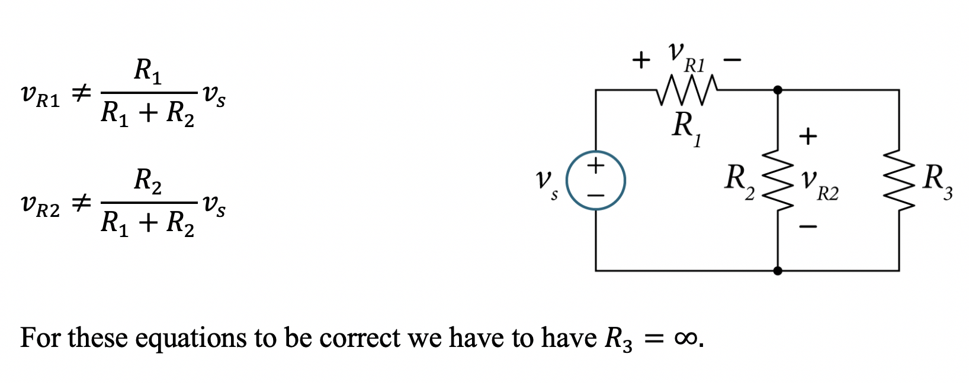
Invalid Examples of Voltage Division

Slide 9
Invalid Examples of Voltage Division
$$v_{R1}=\frac{R_{1}}{R_{1}+R_{2}+R_{3}}v_{s}$$
$$v_{R2}=\frac{R_{2}}{R_{1}+R_{2}+R_{3}}v_{s}$$
Or
$$v_{R1}=\frac{R_{1}}{R_{1}+{R_{2}}//R_{3}}v_{s}$$
$$v_{R2}=\frac{{R_{2}}//R_{3}}{R_{1}+{R_{2}}//R_{3}}v_{s}$$

Slide 10
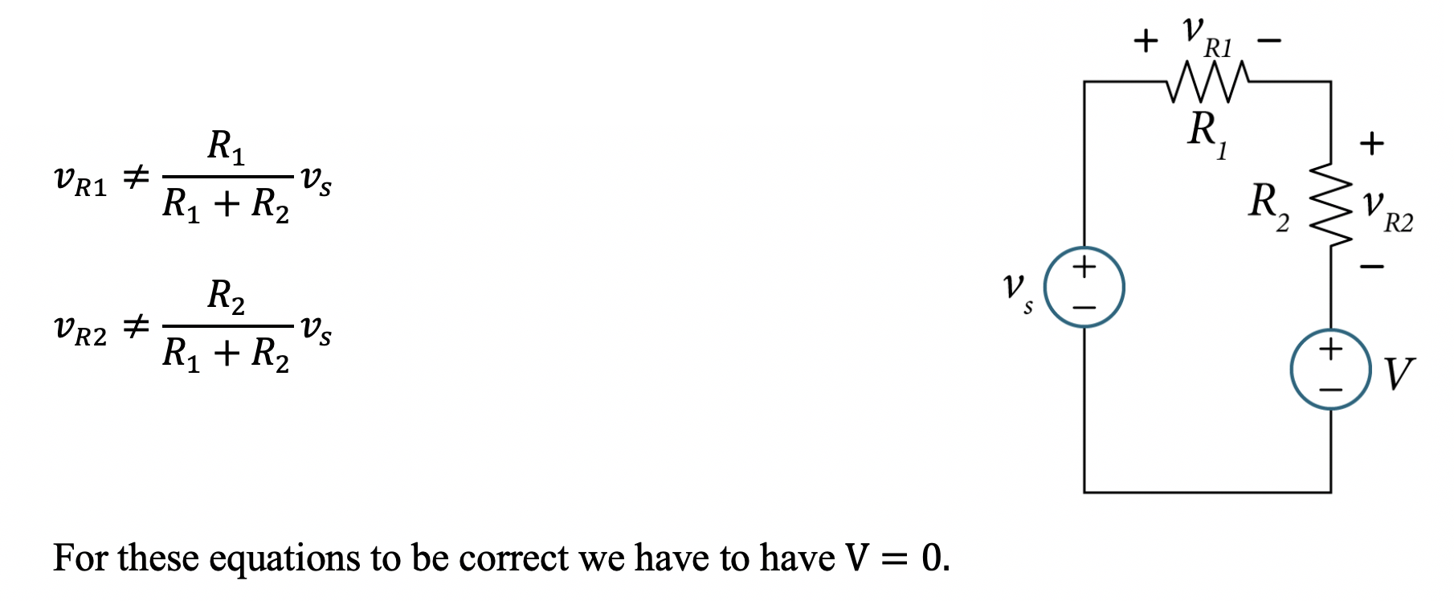
Invalid Examples of Voltage Division

Slide 11
Invalid Examples of Voltage Division

Slide 12
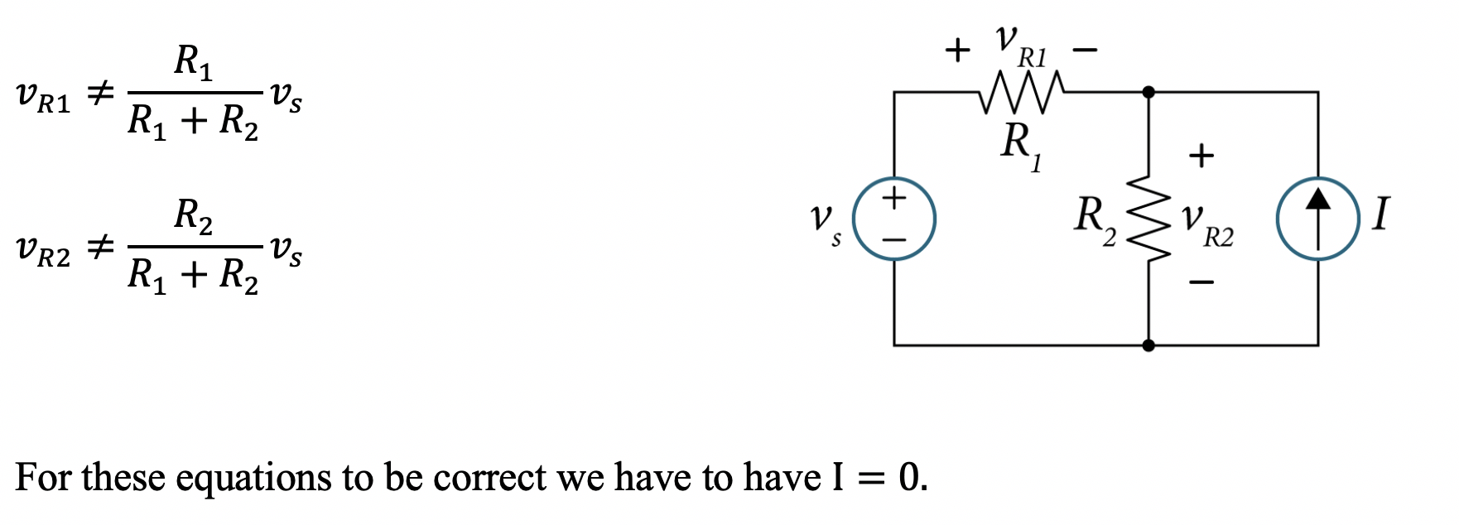
Invalid Examples of Voltage Division

Slide 13
Invalid Examples of Voltage Division

Slide 14
Voltage Division Formula
In series-connected resistors, the voltage across a given resistor is equal to that resistor divided by the total of series-connected resistors multiplied by the total voltage across the total of series-connected resistors.
Simple circuit with two resistors in series

Slide 15
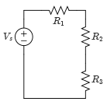
Example
For the circuit given, find the voltages across the resistors by using the voltage division formula.
Values:
Circuit with three resistors in series
Variable | Default | Unit
V_{s} | 18 | V
R₁ | 5 | Ω
R₂ | 10 | Ω
R₃ | 15 | Ω

Slide 16
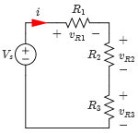
Example
Short Cut Solution – Direct application of voltage division formula:
Check:

Slide 17
Example
Standard Solution – Using KVL in a Single-Loop
Assume the direction of the current and voltage polarities shown, because the current in each resistor is the same then,
Applying KVL to the loop yields,
Solving for i yields,
Assigning current direction and voltage polarities

Slide 18
Example
Therefore, the voltages across the resistors are given by,
Assigning current direction and voltage polarities

Slide 19
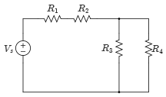
Example
Use voltage division to find the voltage across each resistor in the circuit.
Values:
Single-Loop circuit
Variable | Default | Unit
V_{s} | 18 | V
R₁ | 25 | kΩ
R₂ | 5 | kΩ
R₃ | 10 | kΩ
R₄ | 10 | kΩ

Slide 20
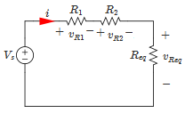
Example
Solution:
The circuit can be redrawn as an equivalent circuit with three series resistors,
Applying the voltage division formula,
Equivalent circuit with assigned current and voltages

Slide 21
Example
Because R₃ and R₄ are in parallel,
Equivalent circuit with assigned current and voltages

Slide 22
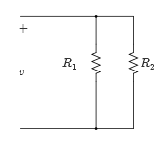
Current Division
To apply current division make sure that the resistors being used all have the same voltage across.
Current division gives you a simple method to find the current in single node-pair circuits.
Two resistors in parallel

Slide 23
Current Division
Current division is not as simple as voltage division, to make the equations for current division simpler, resistance is expressed in terms of its conductance values.
Consider the circuit below,
i_{s}
i_{R1}
i_{R2}
Two resistors in parallel
What fraction of i_{s} flows in each resistor?

Slide 24
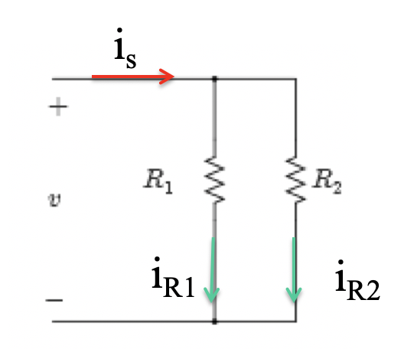
Current Division
Consider the circuit below,
What fraction of $i_{S}$ flows in $R_{1}$ and $R_{2}$
Two resistors in parallel
It can be shown the the applied current $i_{S}$ flows in $R_{1}$ and $R_{2}$ according to current division formulas:
Check: i_{s}=i_{R1}+i_{R2}

Slide 25
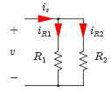
Current Division
We assign current directions as shown, because the voltage across each resistor in the parallel-connected resistors is v,
Applying KCL at the upper node connects all the resistors to yield
Current directions assigned
Substitute for v, and solve for iR1 and iR2, respectively,

Slide 26
Current Division
The equations of i_{R1} and i_{R2} consist of dividing the reciprocals of resistors.
Therefore, some books use the conductance, G, to express the current division formulas as shown,
Where,
Current directions assigned

Slide 27
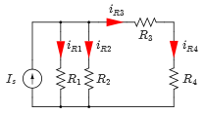
Example
Use the current division method to find the current in each resistor in the circuit given.
Circuit with load resistance

Slide 28
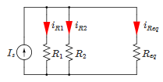
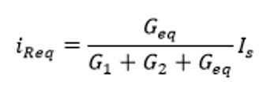
Example
Solution:
First, combine R₃ and R₄ in series,
Applying the current division formula,
Equivalent circuit
Where,

Slide 29
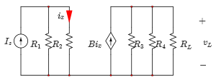
Example
Find the voltage across the load resistor v_{L} for the circuit using current division.
Circuit with load resistance

Slide 30
Example
Find the voltage across the load resistor v_{L} in terms of the circuit parameters for the circuit using current division.
i=?

Slide 31
Example
Find the voltage across the load resistor v_{L} for the circuit using current division.
i=?
Circuit with load resistance

Slide 32
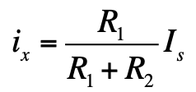
Example
Solution:
The current passing through resistor R₂,
Using the current division formula,
the voltage across the load resistor, v_{L},
Circuit with load resistance

Slide 33
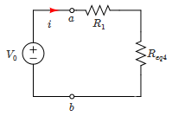
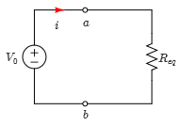
Example 6 (Solution)
Moreover, the circuit can be simplified to the one shown,
$$R_{eq4} =R_{eq1}//R_{4}//R_{eq2}{//R}_{eq3}$$
$$=\frac{I}{\frac{1}{R_{eq1}}+\frac{1}{R_{4}}+\frac{1}{R_{eq2}}+\frac{1}{R_{eq3}}}=\frac{10}{\frac{1}{4}+\frac{1}{4}+\frac{1}{12}+\frac{1}{12}}=\frac{10}{0.25+0.25+0.0833+0.0833}=\frac{1}{0.667}$$
$$=1.\text{5 }\text{k}\text{Ω}$$
$$R_{eq}=R_{eq4}+R_{1}=1.5+4=5.5\text{k}\text{Ω}$$
The total resistance seen by the voltage source Vo is 5.5 kΩ
Using Ohm’s law, we obtain,
Equivalent circuit
$$i=\frac{V_{o}}{R_{eq}}=\frac{10 V}{5.5\text{k}\text{Ω}}=1.8 mA$$

Slide 34
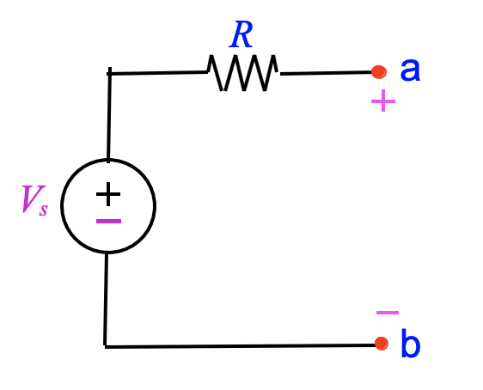
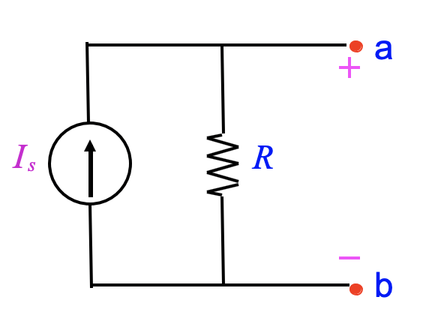
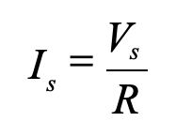
Source Transformation
Between node (a) and (b):
Voltage source V_{s} in series with resistor R can be replaced by a current source I_{s} in parallel with R and vice versa.
R
a
a
I_{s}
R
V_{s}
b
b
Condition:

Slide 35
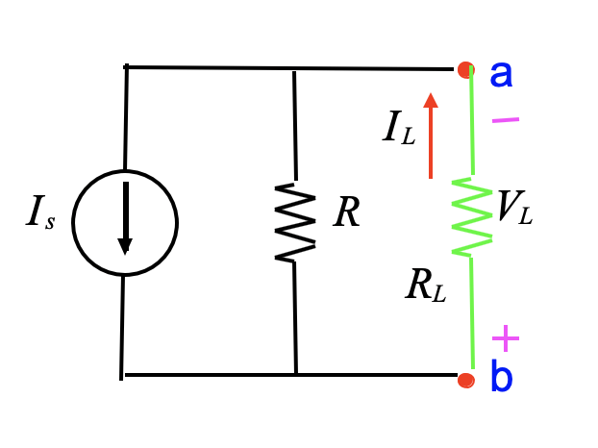
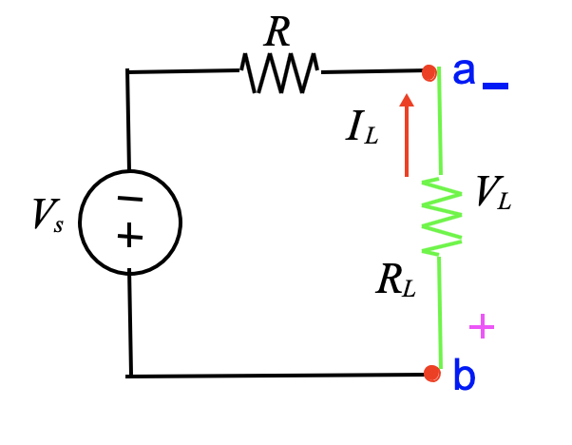
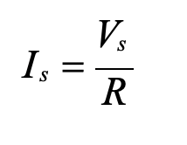
If the voltage is reversed, the we have
R
a
a
I_{L}
I_{L}
V_{s}
V_{L}
I_{s}
R
V_{L}
R_{L}
R_{L}
b
b

Slide 36
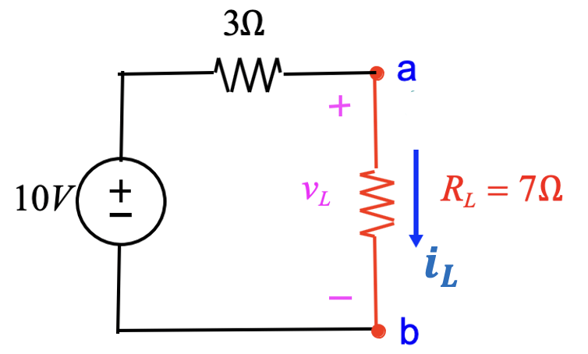
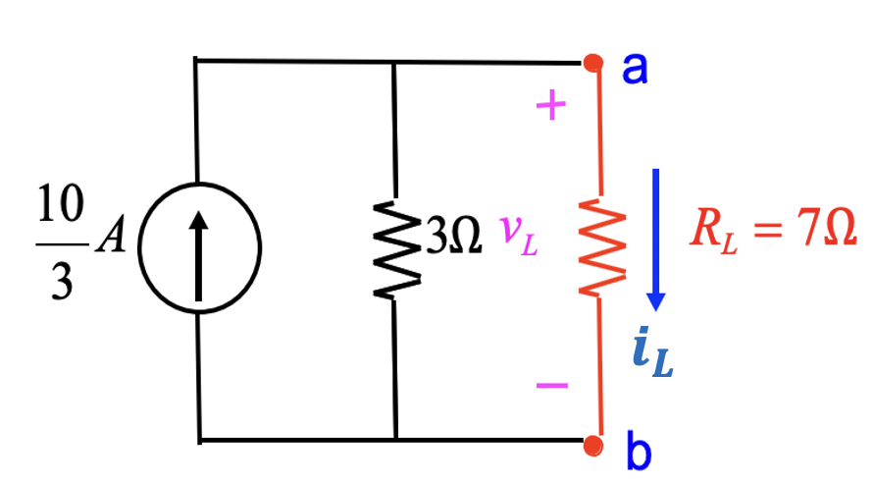
Example
The two circuits below are equivalent (the same) Show that the two circuits have the same current $i_{L}$ value.
10
Apply the voltage division formula:
Apply the current division formula:
$$v_{L}=\frac{7}{3+7}10=7 V$$
$$i_{L}=\left(\frac{3}{3+7}\right)\frac{10}{3}=1 A$$
Apply Ohm’s Law
Apply Ohm’s Law
$$i_{L}=\frac{v_{L}}{R_{L}}=\frac{7}{7}=1 A$$
$$v_{L}=i_{L}R_{L}=1x7=7 V$$

Slide 37
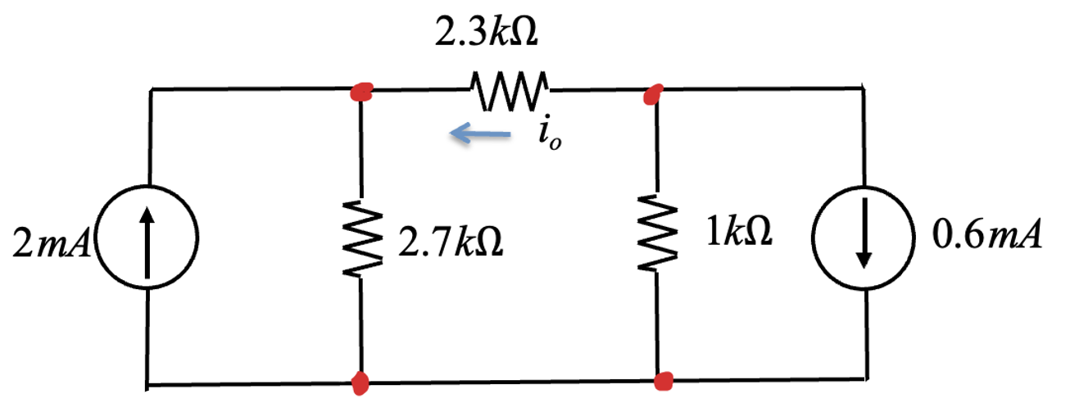
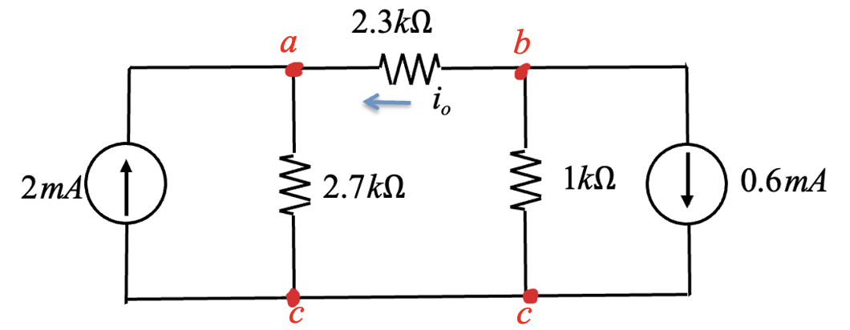
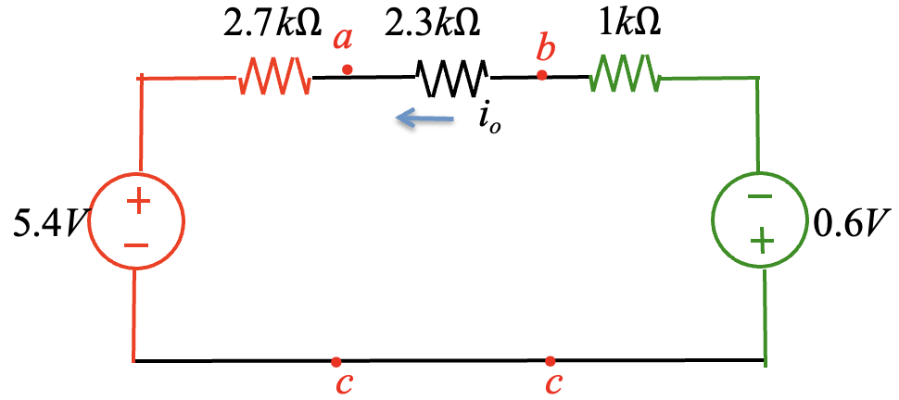
Example – Use source transformation to find i_{o}
Apply KVL:
$$−5.4−2.7i_{o}−2.3i_{o}−1i_{o}−0.6=0$$
Solve for $i_{o}$
$$i_{o}=−\frac{6V}{6 kΩ}=−1 mA$$

Slide 38
Example
Use the source transformation method to solve for all currents in the circuit.
Variable | Values | Unit
I | 8 | A
R₁ | 5 | Ω
R₂ | 15 | Ω
R₃ | 10 | Ω

Slide 39
Solution
Let us transform the current source I to voltage source:
IR₃
$$i_{o}$$
Apply KVL:
$$i_{o}R_{1}+i_{o}R_{2}+i_{o}R_{3}−IR_{3}=0$$
Solve for $i_{o}$
$$i_{o}=\frac{IR_{3}}{R_{1}+R_{2}+R_{3}}=\frac{8x10}{5+15+10}=2.7A$$

Slide 40
Solution
The current in R₁ and R₂ is equal to i_{a}
KCL at node v_{a}:
i_{R} = I + i_{a}
3
= 8 + (−2.7)= 5.3 A
Note: After using the source transformation, we can go back to the original circuit to find other values of current and voltage.

Slide 41
Example
Use the current-­‐to-­‐voltage transformation method to solve for all currents in the circuit.
Variable | Values | Unit
V | 10 | V
I | 8 | A
R₁ | 5 | Ω
R₂ | 15 | Ω
R₃ | 25 | Ω

Slide 42
Solution
^{R}eq
= R₂ // R₃
= 9.4 Ω
KVL:
− V + R₁i_{a} + R_{eq} i_{a} − IR_{eq} = 0
IR_{eq} + V
i_{a} =
R₁ + R_{eq}
= 5.9 A

Slide 43
Solution
The current in R₁ is equal to i_{a}
KCL at node v_{a}:
i_{a} = I + i_{R}
eq
i_{R} = i_{a} − I
eq
= −2.1 A
Next, obtain the individual currents in R₂ and R₃ by using Ohm’s
v_{R} = v_{R} = v_{R}
2 3 eq
v v
i =
R₂
i =
R₃
= i_{R}
^{R}eq
R₂
R₂
R₃
R₃
eq
= −1.3 A
= −19.6 V
= −0.78 A

Slide 44
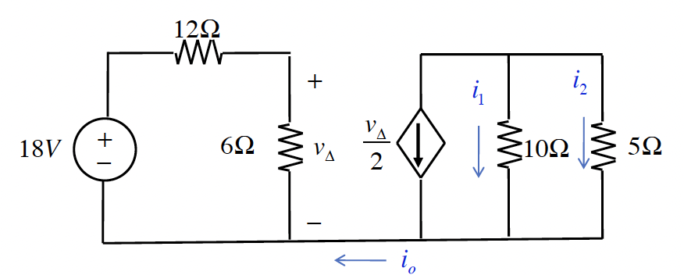
Example-Application of voltage and current division
For the circuit below find the currents $i_{1}$, $i_{2}$ and $i_{o}$as shown.

Slide 45
Solution-Application of voltage and current division
Apply voltage division:
$$v_{Δ}=\frac{6}{6+12}18=6 V$$
Apply current division:
$$i_{1}=−\frac{5}{5+10}\left(\frac{v_{Δ}}{2}\right)=−\frac{5}{5+10}\left(\frac{6}{2}\right)=−1 A$$
$$i_{2}=−\frac{10}{5+10}\left(\frac{v_{Δ}}{2}\right)=−\frac{10}{5+10}\left(\frac{6}{2}\right)=−2 A$$
$$i_{o}=0$$

Slide 46
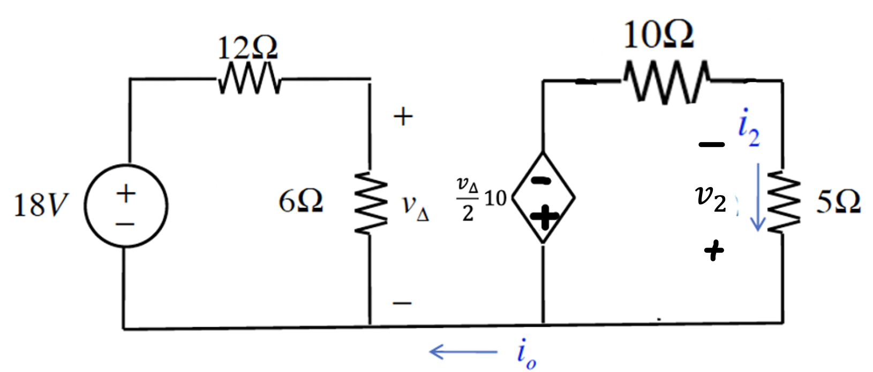
Solution-Application of current source transformation
Apply voltage division:
$$v_{Δ}=\frac{6}{6+12}18=6 V$$
Apply Current-source transformation:
Apply voltage division:
$$v_{2}=\frac{5}{5+10}\left(\frac{v_{Δ}}{2}10\right)=\frac{5}{5+10}\left(\frac{6}{2}10\right)=10 V$$
$$i_{o}=0$$
$$i_{2}=−\frac{v_{2}}{5}=−\frac{10}{5}=−2 A$$
Since the voltage $v_{2}$is also across the $10Ω$:
$$i_{1}=−\frac{v_{2}}{10}=−\frac{10}{10}=−1 A$$

Slide 47
600 BC
Static Electricity perceived by Thales of Miletus
Thales of Miletus - Greek philosopher ( 624 BC – 546 BC)
It is said that the Greek philosopher Thales of Miletus was the first known experimentalist on the static of electricity when he rubbed a rod of amber with cat's fur to attract light objects like feathers.

