Slide 1
EEL 3004 Linear Circuits I Lecture #5 Analysis of Single-loop and Single-Node Circuits

Slide 2
Lecture Objectives
The main objective of this lecture is to discuss two special cases of circuit analysis:
Analysis of Single-Loop Circuits
Analysis of Single Node-Pair Circuits
Students will learn through Examples with independent and
dependent sources.
Students will learn the Intuitive Method: Circuit Reduction

Slide 3
Simple Circuit Analysis Techniques
Chapter 3
Chapter Outline
Introduction
3.1 Analysis of Single-Loop Circuits
3.2 Analysis of Single-Node-Pair Circuits
3.3 Voltage and Current Division
3.4 Intuitive Analysis Method: Circuit Reduction
3.5 Voltage and Current Source Transformation

Slide 4
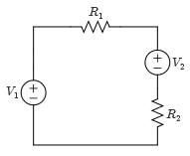
Single-Loop Circuits
All elements of the circuits are connected in series.
Usually, one KVL equation needed around the loop unless dependent sources are used.
Single-Loop circuit with four elements

Slide 5
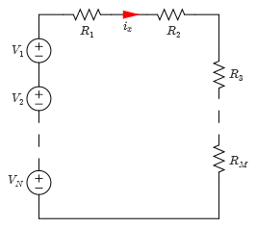
Single-Loop Circuits
Assign a current in the single-loop with an arbitrary reference direction.
Label the voltage polarities for each resistive element with respect to the positive sign convention.
Write the KVL equation around the only loop.
Solve for the loop current.
Single-Loop circuit

Slide 6
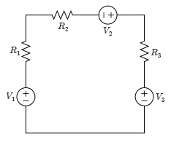
Example
Consider the single-loop circuit shown. Solve for the resistor currents in the circuit.
Variable | values | Unit
V₁ | 10 | V
V₂ | 15 | V
V₃ | 5 | V
R₁ | 5 | Ω
R₂ | 12 | Ω
R₃ | 18 | Ω
Single-Loop circuit

Slide 7
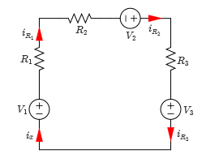
Example
Because the circuit consists of a single loop, only one current variable, i_{x}, is needed to be assigned.
Let us use the counter clock-wise direction for all elements:
The direction of the current for each individual resistor is chosen arbitrarily.
Single-Loop circuit

Slide 8
Example
Solution:
The i_{x} is the main loop current.
Select individual component currents i_{R1}, i_{R2} and i_{R3.}
Since this is a single loop it is clear that i_{x} =i_{R1} =i_{R2} = i_{R3.}
Because they have the same direction.

Slide 9
Example
Applying KVL around the loop gives the following equation in terms of i_{x} ,
Solve for i_{x} to yield,
Solve for the resistor currents,
Note that all branch voltages and power in the circuit can be obtained once we solve for the loop current i_{x}.
Single-Loop circuit

Slide 10
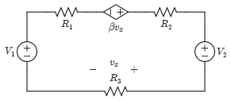
Example
After assigning a current direction for each element, solve for the resistor currents in the circuit shown
Values:
Single-Loop circuit
Variable | Default | Unit
V₁ | 18 | V
V₂ | 10 | V
R₁ | 5 | Ω
R₂ | 25 | Ω
R₃ | 15 | Ω
β | 5 | -

Slide 11
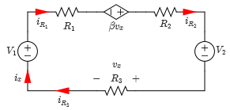
Example
Solution:
Because the circuit consists of a single loop, only one current variable, i_{x}, is needed to be assigned.
The direction of the current for each individual resistor is chosen arbitrarily.
Applying KVL around the loop gives the following equation,
Notice that,
Single-Loop circuit

Slide 12
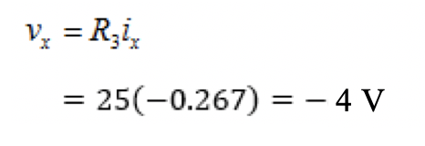
Example
Substitute v_{x} in the above KVL equation to yield one equation in terms of i_{x}, given by,
Solve for i_{x} to yield,
Thus, solving for v_{x} gives the following equation:

Slide 13
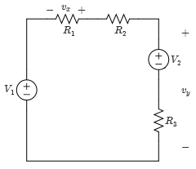
Example
Given the single-loop circuit, determine the following:
The voltages v_{x} and v_{y}.
The power supplied by the voltage sources.
Variable | Default | Unit
V₁ | 100 | V
V₂ | 150 | V
R₁ | 5 | Ω
R₂ | 12 | Ω
R₃ | 18 | Ω
Single-Loop circuit

Slide 14
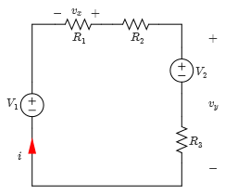
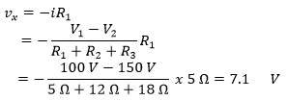
Example
Solution:
After assigning current i, we write the KVL equation,
Solving for i,
The voltages can be easily expressed as,
Single-Loop circuit
Assign a loop current, i, in the clockwise direction.

Slide 15
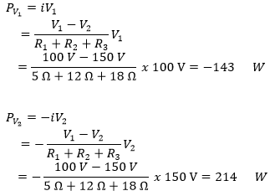
Example
And,
The power supplied or absorbed by the voltage sources is given by,
(Absorbed)
(Supplied)

Slide 16
Example
The net total power supplied by the circuit is given by,

Slide 17
Example
The net total power supplied by the circuit is given by,
The 71 W are dissipated in the three resistors.
Let us Check:
P_{R}=(R₁+R₂+R₃) i²=( 5+12+18)(-1.43)²=+71 W

Slide 18
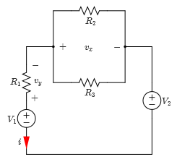
Example
Given the single-loop circuit, determine the following:
The voltages v_{x} and v_{y}.
The power supplied by the voltage sources.
Variable | Default | Unit
V₁ | 10 | V
V₂ | 8 | V
R₁ | 8 | Ω
R₂ | 12 | Ω
R₃ | 12 | Ω
Single-Loop circuit

Slide 19
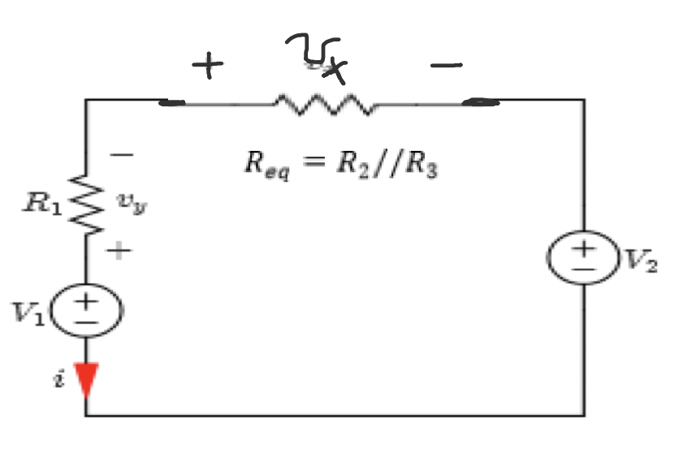
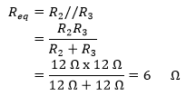
Example
Solution:
Assign a loop current, i, in the counter clockwise direction as shown.
We can simplify by finding the equivalent resistance for resistors R2 and R3.
Single-Loop circuit

Slide 20
Example
Now writing the KVL equation,
Solving for i,

Slide 21
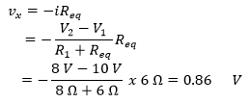
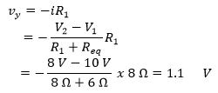
Example
The voltages can be easily expressed as,
And,

Slide 22
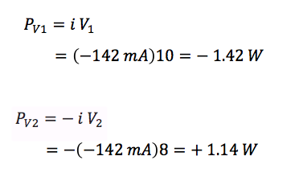
Example
The power supplied by the voltage sources is given by,
The total power supplied by the circuit is given by,
(Supplied)
(Absorbed)
(Supplied)

Slide 23
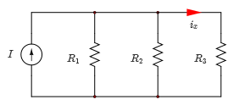
Single-Node-Pair Circuits
All the circuit elements are connected across the same pair of nodes.
Usually one KCL equation needed to be written at one of the nodes.
Upper node
Lower node
Single-Node-Pair circuit

Slide 24
Single-Node-Pair Circuits
Define a voltage v and arbitrarily assign its reference polarities across the node-pair.
Label the current direction in each resistive element according to the positive sign convention.
Write the KCL equation at one of the nodes.
Solve for the voltage v.
+
v
-
Single-Node-Pair circuit

Slide 25
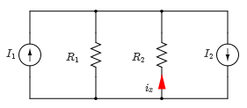
Example
For the circuit shown, solve for i_{x} and all resistor currents,
Single-Node-Pair circuit
Variable | Values | Unit
I₁ | 10 | A
I₂ | 8 | A
R₁ | 20 | Ω
R₂ | 10 | Ω

Slide 26
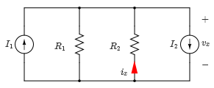
Example
Solution:
Assign voltage for v_{x} across the parallel branches as seen,
Applying KCL to the upper node,
Single-Node-Pair circuit

Slide 27
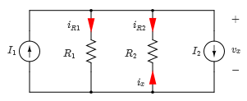
Example
Solving for v_{x} yields,
The resistor currents i_{R1}, i_{R2} and branch current i_{x} shown below are given by,
Single-Node-Pair circuit

Slide 28
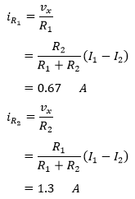
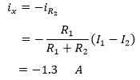
Example
The current i_{x} is given by,
Single-Node-Pair circuit

Slide 29
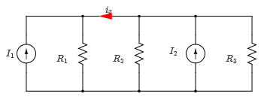
Example
For the circuit shown, solve for i_{x} and all resistor currents,
Single-Node-Pair circuit
Variable | Values | Unit
I₁ | 10 | mA
I₂ | 6 | mA
R₁ | 30 | kΩ
R₂ | 15 | kΩ
R₃ | 15 | kΩ

Slide 30
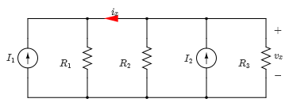
Example
Solution:
Assign voltage for v_{x} across the parallel branches as seen,
Applying KCL to the upper node,
Single-Node-Pair circuit

Slide 31
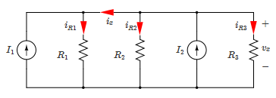
Example
Solving for v_{x} yields,
$$v_{x}=\frac{R_{1}R_{2}R_{3}}{R_{1}R_{2}+R_{1}R_{3}+R_{2}R_{3}}\left(I_{1}+I_{2}\right)$$
$$=\frac{30x15x15}{30X15+30x15+15x15}\left(10+6\right)=96 V$$
The resistor currents i_{R1}, i_{R2}, i_{R3} and branch current i_{x} shown below are given by,
Single-Node-Pair circuit

Slide 32
Example
$$i_{R_{1}}=\frac{v_{x}}{R_{1}}=\frac{96}{30}$$
$$=3.2 mA$$
$i_{R_{2}}=\frac{v_{x}}{R_{2}} =\frac{96}{15}$
$=6.4 mA$
$$i_{R_{3}}=\frac{v_{x}}{R_{3}}=\frac{96}{15}$$
$$=6.4 mA$$
What about the current i_{x}?
$$i_{x}=i_{R_{1}}−I_{1}$$
$$=3.2−10$$
$$=−6.8 mA$$
Single-Node-Pair circuit

Slide 33
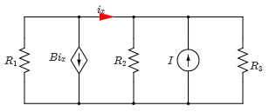
Example
For the circuit shown, solve for i_{x} and all resistor currents,
Single-Node-Pair circuit
Variable | Values | Unit
I | 8 | mA
R₁ | 12 | kΩ
R₂ | 12 | kΩ
R₃ | 6 | kΩ
β | 2 | -

Slide 34
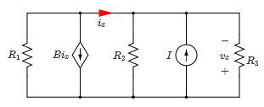
Example
Solution:
Assign voltage for v_{x} across the parallel branches as seen,
Applying KCL to the upper node,
Single-Node-Pair circuit
But we know that:
$$−\frac{v_{x}}{R_{1}}+βi_{x}−\frac{v_{x}}{R_{2}}−I−\frac{v_{x}}{R_{3}}=0$$
$$i_{x}=−\frac{v_{x}}{R_{2}}−I−\frac{v_{x}}{R_{3}}$$

Slide 35
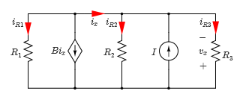
Example
Solving for v_{x} yields,
$v_{x}=$ $\frac{R_{1}R_{2}R_{3}\left(β+1\right)}{\left.R_{3}R_{2}+{\left(1+β)(R\right.}_{1}R_{3}+R_{1}R_{2}\right)}I$
= $\frac{12x12x6x3}{12x6+3x\left(12x6+12x12\right)}8=28.8$ V
The resistor currents i_{R1}, i_{R2}, i_{R3} and branch current i_{x} shown below are given by,
$i_{R1}=−\frac{v_{x}}{R_{1}}=−\frac{28.8}{12}=2.4 mA$
$$i_{R2}=−\frac{v_{x}}{R_{2}}=−\frac{28.8}{12}=2.4 mA$$
$$i_{R3}=−\frac{v_{x}}{R_{3}}=−\frac{28.8}{6}=4.8 mA$$
$$i_{x}=−\frac{v_{x}}{R_{2}}−I−\frac{v_{x}}{R_{3}}=\frac{28.8}{12}−8+\frac{28.8}{6}$$
Single-Node-Pair circuit
$$=−0.8 mA$$

Slide 36
Example
Check any node:
$$i_{R1}=i_{x}+βi_{x}$$
$$2.4=−0.8−2x0.8$$
$$−2.4=−2.4$$
$$?$$
$$?$$
$$✅$$
$$?$$
Check any node:
$$i_{R2}−I+i_{R3}−i_{x}=0$$
$$2.4−8+4.8+0.8=$$
$$0=0$$
Single-Node-Pair circuit
$$✅$$

Slide 37
Intuitive Method: Circuit Reduction
Reduce the number of components to an equivalent simplified circuit.
The final number of nodes and loops are significantly reduced.
Elements with currents and voltages of interest are left alone as given in the original circuit.
Does not follow a specific procedure, but rather depends on experience.

Slide 38
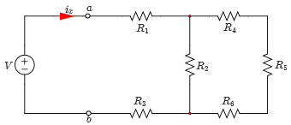
Example
Use the circuit reduction method to find the current i_{x} shown in the circuit.
Values:
Resistive circuit
Variable | Default | Unit
V | 18 | V
R₁ | 5 | kΩ
R₂ | 3 | kΩ
R₃ | 8 | kΩ
R₄ | 4 | kΩ
R₅ | 7 | kΩ
R₆ | 11 | kΩ

Slide 39
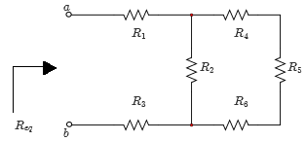
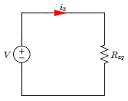
Example
Solution:
To find the current i_{x}, find the equivalent resistance as seen from terminals “a” and “b” as shown,
Original circuit
Equivalent circuit

Slide 40
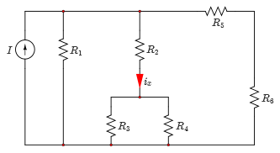
Example
Use the circuit reduction method to find the current i_{x} shown in the circuit.
Values:
Resistive circuit
Variable | Default | Unit
I | 8 | A
R₁ | 10 | Ω
R₂ | 10 | Ω
R₃ | 20 | Ω
R₄ | 20 | Ω
R₅ | 15 | Ω
R₆ | 25 | Ω

Slide 41
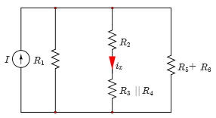
Example
Solution:
Because the current of interest is in the middle of the circuit, you combine the resistors in such a way that the R₂ branch always remains by itself in the reduced circuit.
By combining R₃ and R₄ in parallel and R₅ and R₆ in series,
Reducing the circuit

Slide 42
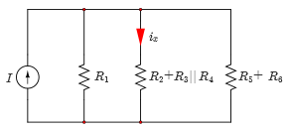
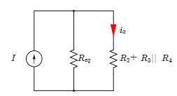
Example (Solution-cont’d)
Then you combine R₂ in series with (R₃//R₄).
Then, R₁ is combined in parallel with (R₅+R₆) as shown
Reducing the circuit
Reducing the circuit

Slide 43
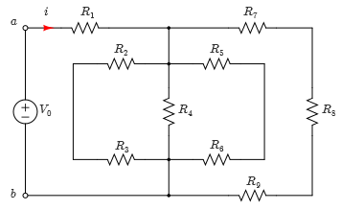
Example
For the circuit, given the values of V_{o} and all resistors, find:
The equivalent resistance, R_{eq}, seen between terminals “a” and “b”.
The current leaving the voltage source, i.
Variable | Values | Unit
V_{o} | 10 | V
R₁ | 4 | kΩ
R₂ | 1 | kΩ
R₃ | 3 | kΩ
R₄ | 4 | kΩ
R₅ | 6 | kΩ
R₆ | 6 | kΩ
R₇ | 3 | kΩ
R₈ | 5 | kΩ
R₉ | 4 | kΩ
Resistive circuit

Slide 44
Example
For the circuit, given the values of V_{o} and all resistors, find:
The equivalent resistance R_{eq} seen between terminals “a” and “b”.
The current leaving the voltage source, i.
Variable | Values | Unit
V_{o} | 10 | V
R₁ | 4 | kΩ
R₂ | 1 | kΩ
R₃ | 3 | kΩ
R₄ | 4 | kΩ
R₅ | 6 | kΩ
R₆ | 6 | kΩ
R₇ | 3 | kΩ
R₈ | 5 | kΩ
R₉ | 4 | kΩ
R_{eq}
Resistive circuit

Slide 45
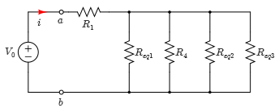
Example (Solution)
Solution:
a) By inspection, R₇, R₈ and R₉ are in series, R₅ and R₆ are in series and R₂ and R₃ as well.
$$R_{eq1} =R_{2}+R_{3}=1+3=4\text{k}\text{Ω}$$
$$R_{eq2} =R_{5}+R_{6}=6+6=\text{12}\text{k}\text{Ω}$$
$$R_{eq3} =R_{7}+R_{8}+R_{8}=3+5+4=\text{12}\text{k}\text{Ω}$$
The circuit is simplified as shown,
Simplified circuit

Slide 46
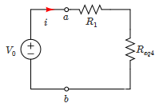
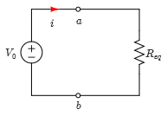
Example 6 (Solution)
Moreover, the circuit can be simplified to the one shown,
$$R_{eq4} =R_{eq1}//R_{4}//R_{eq2}{//R}_{eq3}$$
$$=\frac{I}{\frac{1}{R_{eq1}}+\frac{1}{R_{4}}+\frac{1}{R_{eq2}}+\frac{1}{R_{eq3}}}=\frac{10}{\frac{1}{4}+\frac{1}{4}+\frac{1}{12}+\frac{1}{12}}=\frac{10}{0.25+0.25+0.0833+0.0833}=\frac{1}{0.667}$$
$$=1.\text{5 }\text{k}\text{Ω}$$
$$R_{eq}=R_{eq4}+R_{1}=1.5+4=5.5\text{k}\text{Ω}$$
The total resistance seen by the voltage source Vo is 5.5 kΩ
Using Ohm’s law, we obtain,
Equivalent circuit
$$i=\frac{V_{o}}{R_{eq}}=\frac{10 V}{5.5\text{k}\text{Ω}}=1.8 mA$$

Slide 47
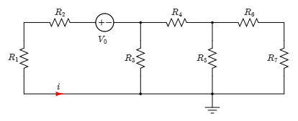
Example
Consider the circuit with all the parameters are given. Find the current i.
Variable | Values | Unit
V_{o} | 10 | V
R₁ | 8 | Ω
R₂ | 4 | Ω
R₃ | 9 | Ω
R₄ | 4 | Ω
R₅ | 10 | Ω
R₆ | 3 | Ω
R₇ | 7 | Ω
Resistive circuit

Slide 48
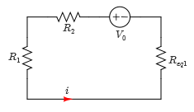
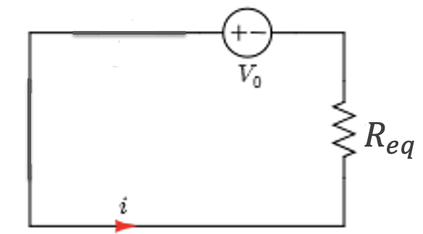
Example (Solution)
Solution:
We start by reducing the circuit as seen,
Apply Ohm’s law,
$$R_{eq}=R_{eq1}+R_{2}+R_{1}$$
$$R_{eq}=4.5+4+8=16.5 \text{Ω}$$
$$i=\frac{V_{o}}{R_{eq}}=\frac{10}{16.5}=0.61 A$$
Equivalent circuit – Single Loop

Slide 49
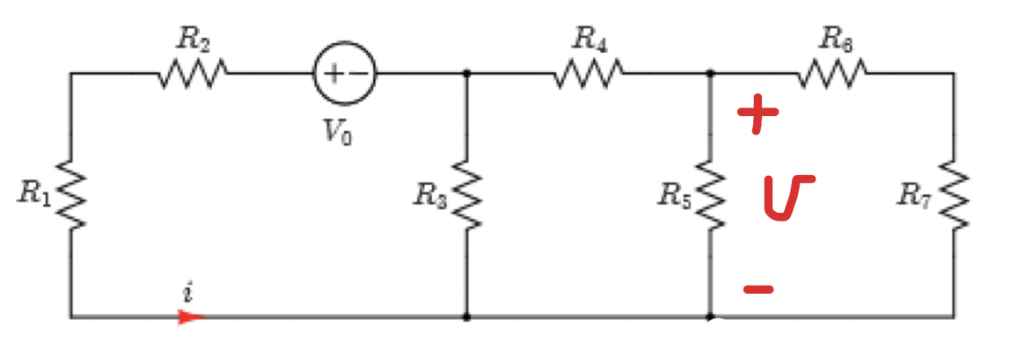
Example (Solution)
What if we ask for voltages $v^{′} and v$?
$$v$$
$$v^{′}$$
$$v^{′}=−i{ R}_{eq1 }=−0.61x4.5=−2.745 V$$
$$v^{′}$$

Slide 50
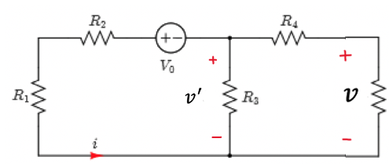
Example (Solution)
What if we ask for voltage $v$?
$${ R}_{eqx}={ R}_{5}//({ R}_{6}+{ R}_{7})=10//(3+7)=5 \text{Ω}$$
$${ R}_{eqx}$$
$${ i}_{eqx}$$
Apply KCL:
$${ i+\frac{v^{′}}{R_{3}}=i}_{eqx}$$
$${ i}_{eqx}=i+\frac{v^{′}}{R_{3}}=0.61+\frac{−2.745}{9}=0.305 A$$
$v=−R_{eqx}x{ i}_{eqx}=−5x(0.305)=−1.525 V$

Slide 51
Check your answer – pick any loop
$$i^{′′}$$
$$v^{′′}$$
Let us assign $v^{′′}$as shown above. Then we must have ${−v^{′}+v}^{′′}+v=0 !$
Notce, the current $i^{′′}$is given by,
$$i^{′′}=\frac{v}{R_{5}//(R_{6}+R_{7})}=\frac{−1.525}{10//(3+7)}=\frac{−1.525}{5}=−0. 305 A$$
So, we have $v^{′′}=R_{4}i^{′′}=4x\left(−0.305\right)=−1.22 V$
Now let us check your answer
$${−v^{′}+v}^{′′}+v=0 ?$$
$$−\left(−2.745\right)+\left(−1.22\right)+\left(−1.525\right)=0$$

Slide 52
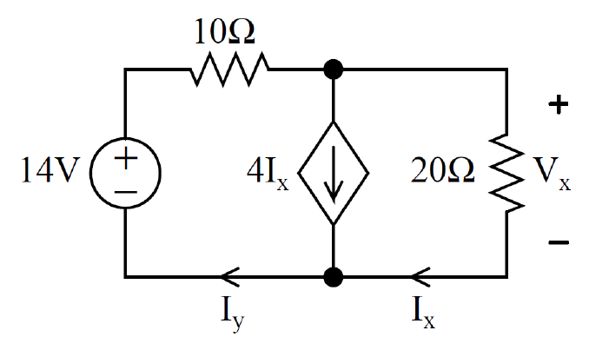
Example - Practice Quiz
(a) Determine the value for I_{x}. Show your work.
(b) Show that the total power developed equals the total power absorbed.

Slide 53
Example - Practice Quiz
(a) Determine the value for I_{x}. Show your work.
(b) Show that the total power developed equals the total power absorbed.

Slide 54
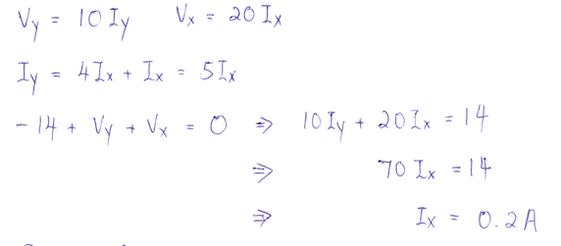
Example - Practice Quiz
Solution:
(a) Determine the value for I_{x}.

Slide 55
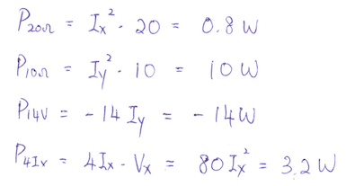
Example - Practice Quiz
Solution:
(b) Calculate power in each element:
As expected, the total power is zero.

Slide 56
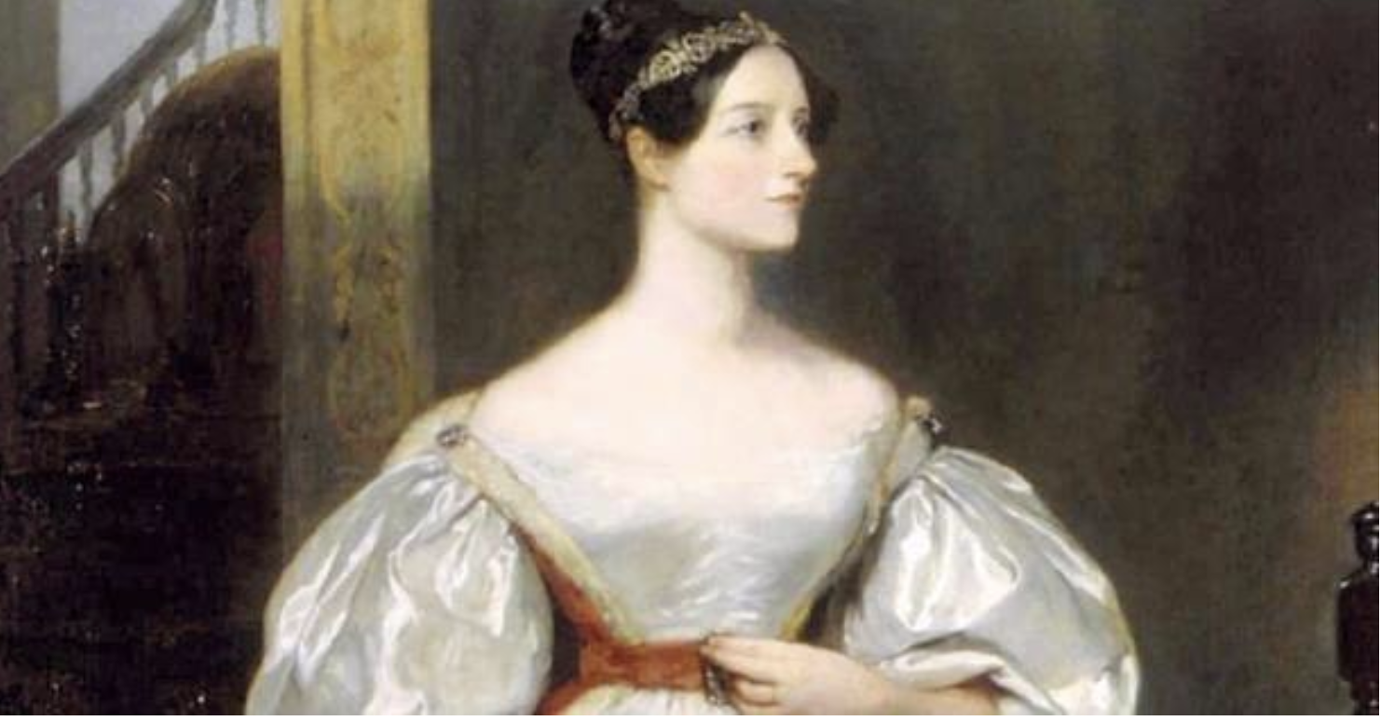
1841
The World’s First Programmer
British Mathematician and Computer Programmer Augusta Ada Byron (1815–1852) (later became Lady Lovelace)
Reference my article on LinkedIn:
The World’s First Programmer was a Woman: Lady Lovelace
https://www.linkedin.com/pulse/worlds-first-programmer-woman-lady-lovelace-issa-batarseh/

