Slide 1

EEL 3004 Linear Circuits I
Lecture #4
Equivalent Resistors

Slide 2
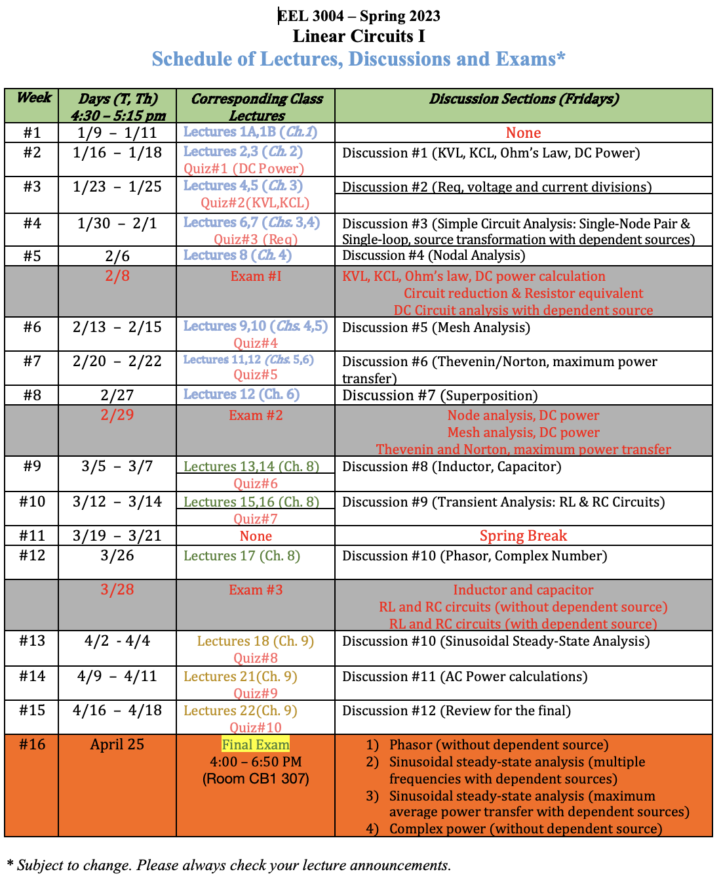

Slide 3
Lecture Objectives
To understand when resistors are connected in series and parallel
Be able to combine resistors that are in:
  Resistors in Series
  Resistors in Parallel
Learn to solve simple circuits by combining resistors.

Slide 4


Resistors in Series
Each of the two elements are connected to the same node without any additional elements connected to that node.
The current entering the first element is the same current entering the second element.
R1 and R2 share a single node between them
Two Resistors in Series

Slide 5
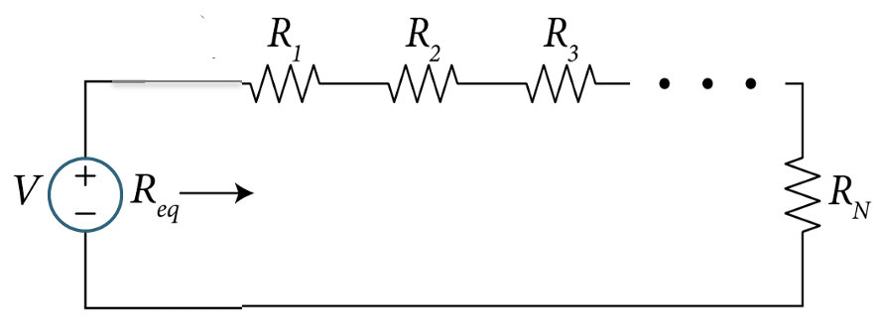
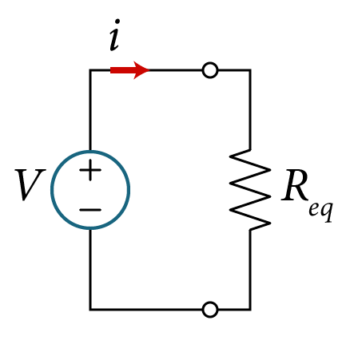
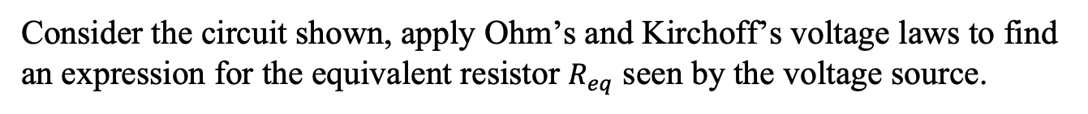

Resistors in Series
Consider the circuit shown, apply Ohm’s and Kirchoff’s voltage laws to find an expression for the equivalent resistor $R_{eq}$ seen by the voltage source.

Slide 6
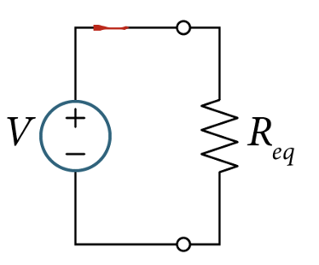

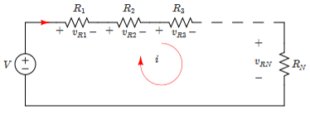

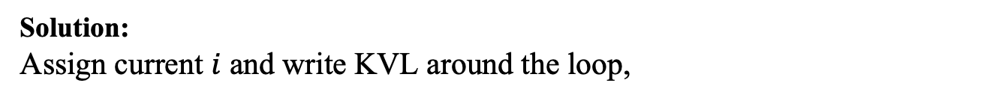


Resistors in Series
Consider the circuit shown, apply Ohm’s and Kirchoff’s voltage laws to find an expression for the equivalent resistor $R_{eq}$ seen by the voltage source.
Solution:
Assign current $i$ and write KVL around the loop,
$$−V+v_{R1}+v_{R2}+v_{R3}+…+v_{RN}=0$$
Apply Ohm's Law
$$V=R_{1}i+R_{2}i+R_{3}i{ + … +R}_{N}i$$
$$V=\left(R_{1}+R_{2}+R_{3}{+ … +R}_{N}\right)i$$
$$V=R_{eq}i$$
$$R_{eq}=R_{1}+R_{2}+R_{3}{+ …+ R}_{N}$$

Slide 7

Resistors in Series
Consider the circuit shown, apply Ohm’s and Kirchoff’s voltage laws to find an expression for the equivalent resistor $R_{eq}$ seen by the voltage source.
The total resistance seen by the voltage source V
$$R_{eq}=R_{1}+R_{2}+R_{3}{+ …+ R}_{N}$$
$$\frac{V}{i}=R_{eq}$$

Slide 8
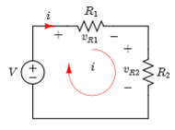

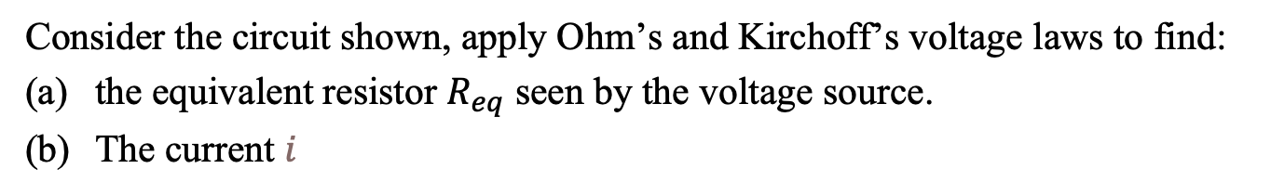


Example
Example
Consider the circuit shown, apply Ohm’s and Kirchoff’s voltage laws to find:
the equivalent resistor $R_{eq}$ seen by the voltage source.
The current $i$
1 kΩ
15 V
Two Resistors in Series
2 kΩ
Solution:
(a) Since R1 and R2 are in series, then the total resistance seen by the voltage source,
$$R_{eq}=R_{1}+R_{2}=1+2=3 \text{k}\text{Ω}$$
(b) Apply Ohm’s Law,
$$i=\frac{V}{R_{eq}}=\frac{15\text{V}}{3\text{k}\text{Ω}}=5 mA$$
15 V

Slide 9
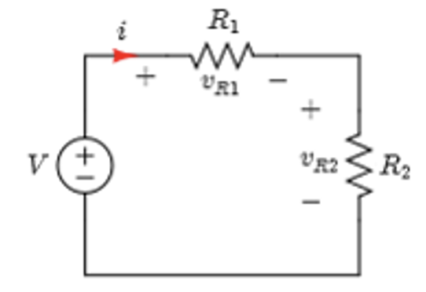
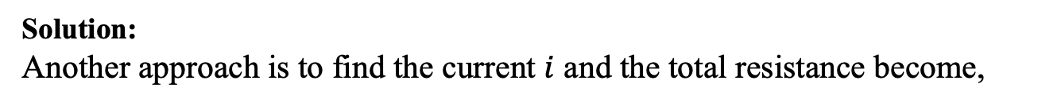
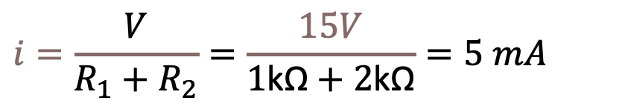


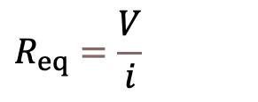
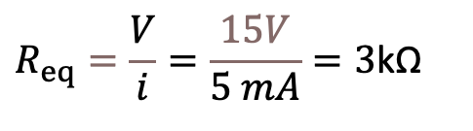
Example
Solution:
Another approach is to find the current $i$ and the total resistance become,
$$R_{eq}=\frac{V}{i}$$
Apply KVL,
$$−V+v_{R1}+v_{R2}=0$$
Apply Ohm's Law
$$V=R_{1}i+R_{2}i=\left(R_{1}+R_{2}\right)i$$
Resistors in Series
(b) Solve for $i$,
$$i=\frac{V}{R_{1}+R_{2}}=\frac{15V}{1\text{k}\text{Ω}+2\text{k}\text{Ω}}=5 mA$$
(a)hence,
$$R_{eq}=\frac{V}{i}=\frac{15V}{5 mA}=3\text{k}\text{Ω}$$

Slide 10
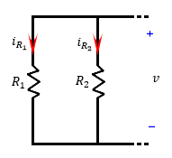

Resistors in Parallel
Resistors in Parallel:
  Both ends of one element are connected to both ends of the other element.
  The voltage across the first element equals the voltage across the second element.
R1 and R2 share the same node in BOTH sides
$${i=i}_{R1}+i_{R2}$$
Resistors in Parallel

Slide 11
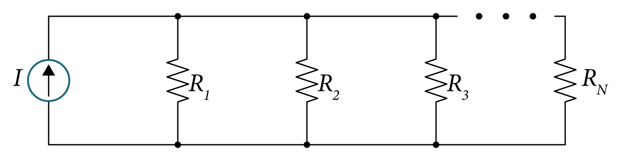
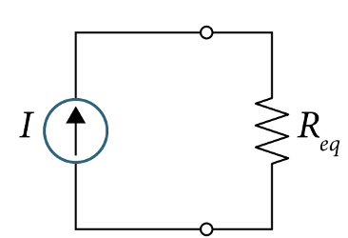

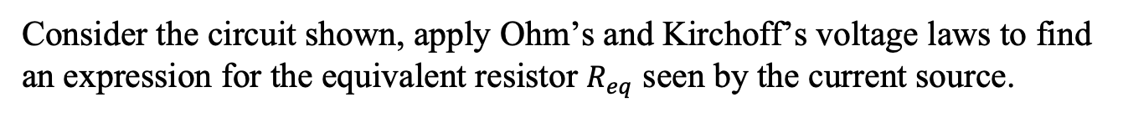
Resistors in Parallel
Consider the circuit shown, apply Ohm’s and Kirchoff’s voltage laws to find an expression for the equivalent resistor $R_{eq}$ seen by the current source.

Slide 12
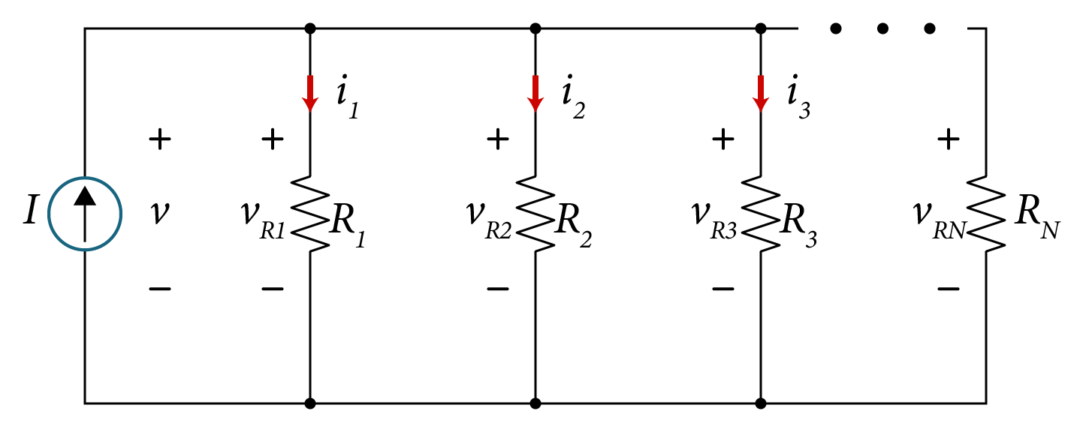
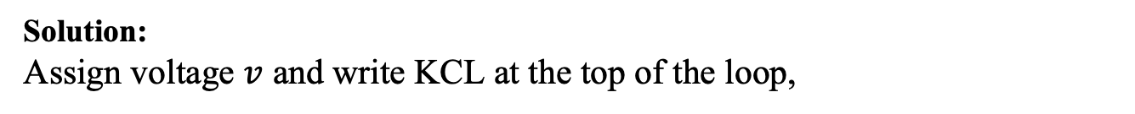
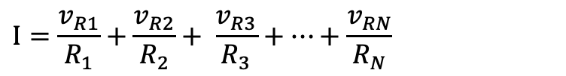
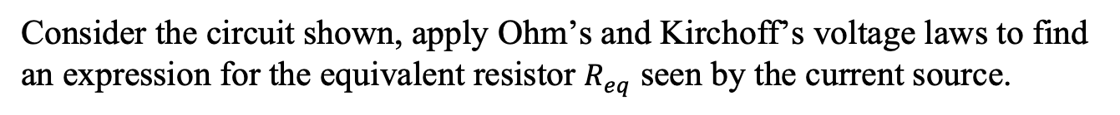
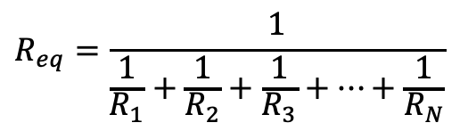
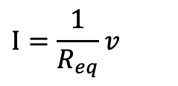
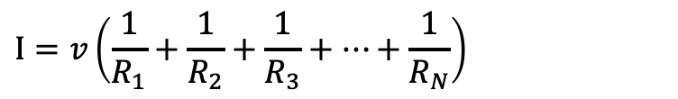
Resistors in Parallel
Consider the circuit shown, apply Ohm’s and Kirchoff’s voltage laws to find an expression for the equivalent resistor $R_{eq}$ seen by the current source.
Solution:
Assign voltage $v$ and write KCL at the top of the loop,
$$I−i_{R1}−i_{R2}−i_{R3}−…−i_{RN}=0$$
Apply Ohm's Law
$$I=\frac{v_{R1}}{R_{1}}+\frac{v_{R2}}{R_{2}}+ \frac{v_{R3}}{R_{3}}+…+\frac{v_{RN}}{R_{N}}$$
$$I=v\left(\frac{1}{R_{1}}+\frac{1}{R_{2}}+\frac{1}{R_{3}}+…+\frac{1}{R_{N}}\right)$$
$${v=v}_{R1}=v_{R2}=v_{R3}=…=v_{RN}$$
$$I=\frac{1}{R_{eq}}v$$
$$R_{eq}=\frac{1}{\frac{1}{R_{1}}+\frac{1}{R_{2}}+\frac{1}{R_{3}}+…+\frac{1}{R_{N}}}$$

Slide 13

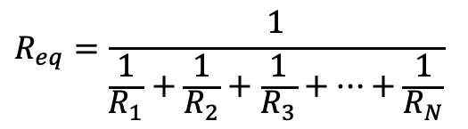

Resistors in Parallel
Consider the circuit shown, apply Ohm’s and Kirchoff’s voltage laws to find an expression for the equivalent resistor $R_{eq}$ seen by the current source.
The total resistance seen by the current source I
$$R_{eq}=\frac{1}{\frac{1}{R_{1}}+\frac{1}{R_{2}}+\frac{1}{R_{3}}+…+\frac{1}{R_{N}}}$$
$$\frac{v}{i}=R_{eq}$$

Slide 14
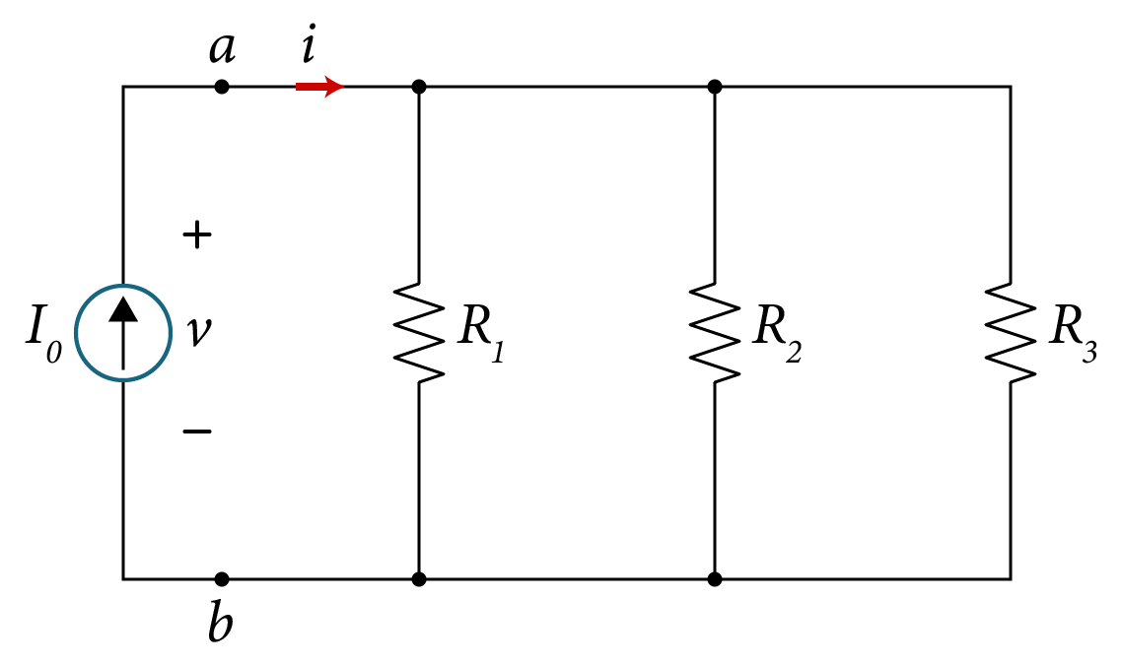
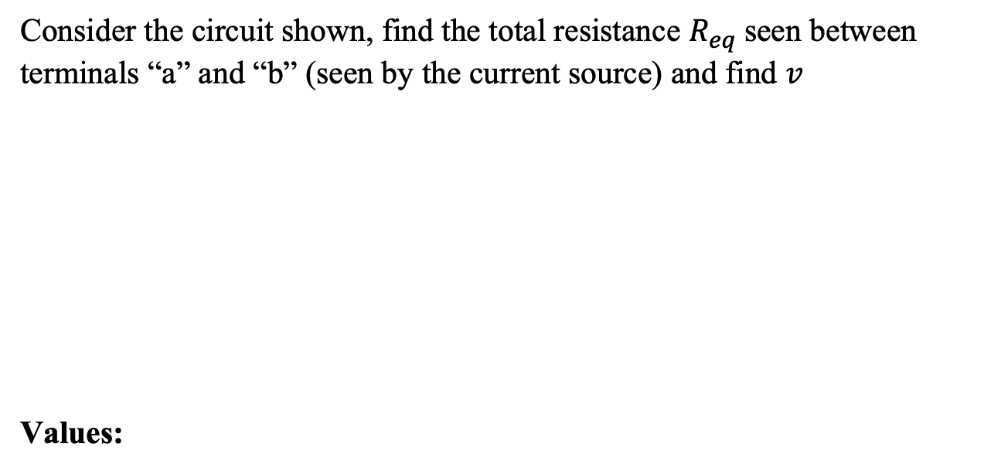
Example
Consider the circuit shown, find the total resistance $R_{eq}$seen between terminals “a” and “b” (seen by the current source) and find $v$
Values:
Resistors in Parallel
Variable | Default | Unit
I | 10 | mA
R₁ | 2.5 | kΩ
R₂ | 2.5 | kΩ
R₃ | 1.25 | kΩ

Slide 15
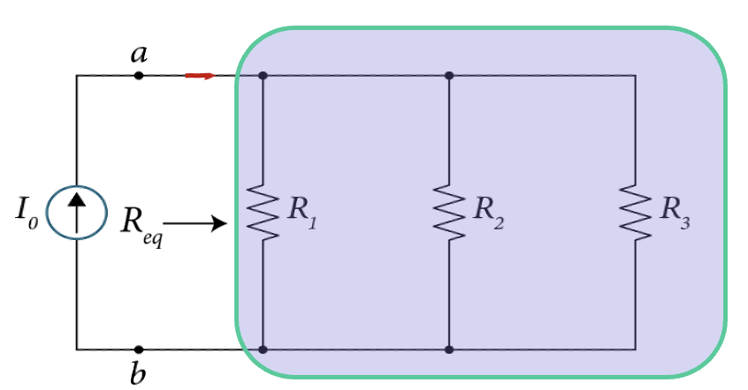

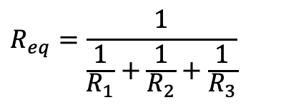

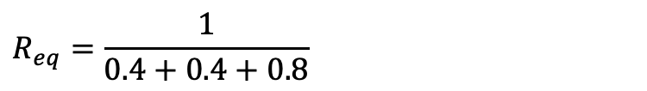
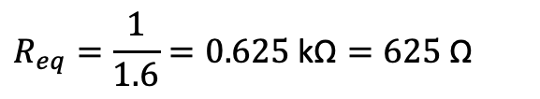


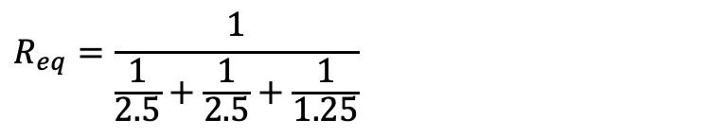
Example
Solution:
Since R1, R2 and R3 are all in parallel, then the total resistance seen by the voltage source,
$$R_{eq}=\frac{1}{\frac{1}{R_{1}}+\frac{1}{R_{2}}+\frac{1}{R_{3}}}$$
1.25kΩ
$$R_{eq}=\frac{1}{\frac{1}{2.5}+\frac{1}{2.5}+\frac{1}{1.25}}$$
10mA
2.5kΩ
2.5kΩ
$$R_{eq}=\frac{1}{0.4+0.4+0.8}$$
$$a$$
Apply Ohm’s Law
$$v=R_{eq}I$$
$$R_{eq}=\frac{1}{1.6}=0.625 \text{k}\text{Ω}=625 \text{Ω}$$
$$=0.625x10=6.25 V$$
$$b$$

Slide 16
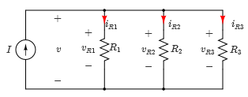

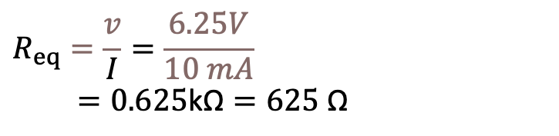
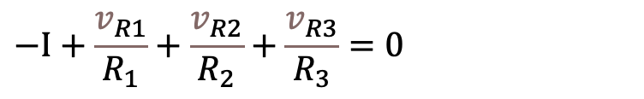


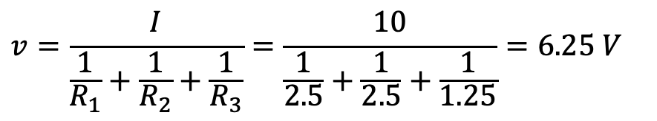

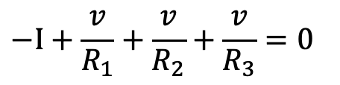
Example
Solution:
Another approach is to find the voltage $v$ first then $R_{eq}$ ,
Apply KCL,
$$−I+i_{R1}+i_{R2}+i_{R3}=0$$
Apply Ohm's Law
$$−I+\frac{v_{R1}}{R_{1}}+\frac{v_{R2}}{R_{2}}+\frac{v_{R3}}{R_{3}}=0$$
$${v=v}_{R1}+v_{R2}+v_{R3}$$
$$−I+\frac{v}{R_{1}}+\frac{v}{R_{2}}+\frac{v}{R_{3}}=0$$
Hence,
Solve for $v$,
$$v=\frac{I}{\frac{1}{R_{1}}+\frac{1}{R_{2}}+\frac{1}{R_{3}}}=\frac{10}{\frac{1}{2.5}+\frac{1}{2.5}+\frac{1}{1.25}}=6.25 V$$
$$R_{eq}=\frac{v}{I}=\frac{6.25V}{10 mA}$$
$=0.625\text{k}\text{Ω}=625 \text{Ω}$

Slide 17
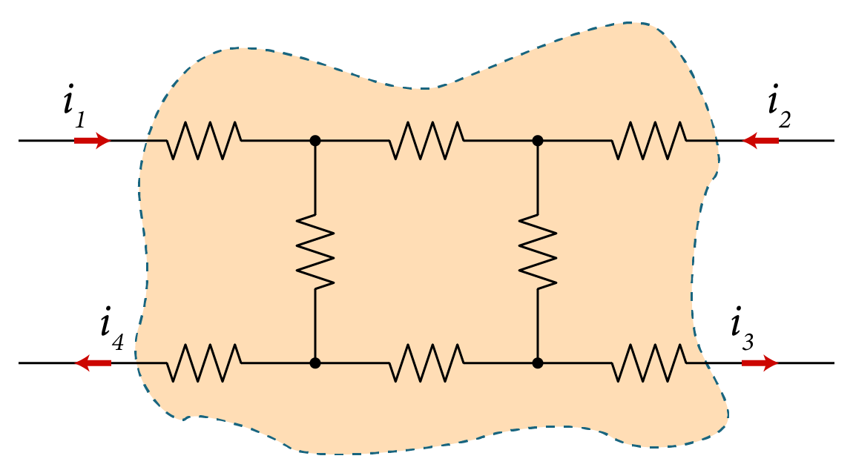
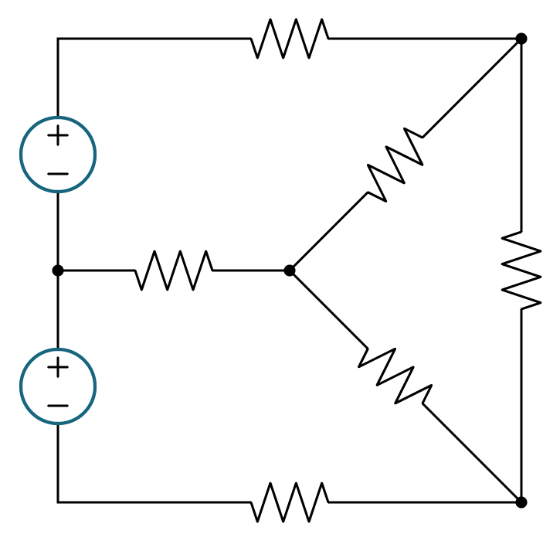
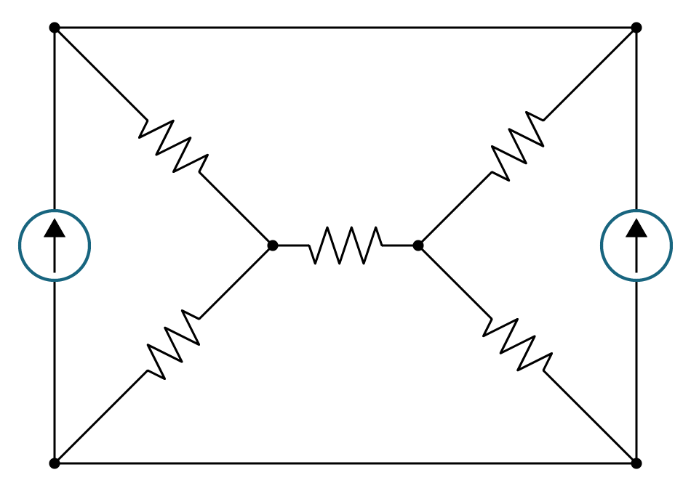
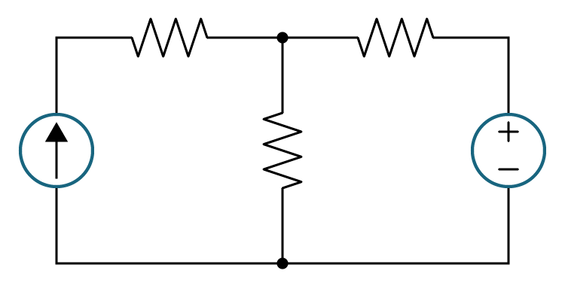
Resistors in Series and Parallel
Resistor connections that cannot be combined
Not all resistors in a circuit can be connected in series or parallel

Slide 18
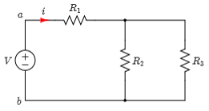
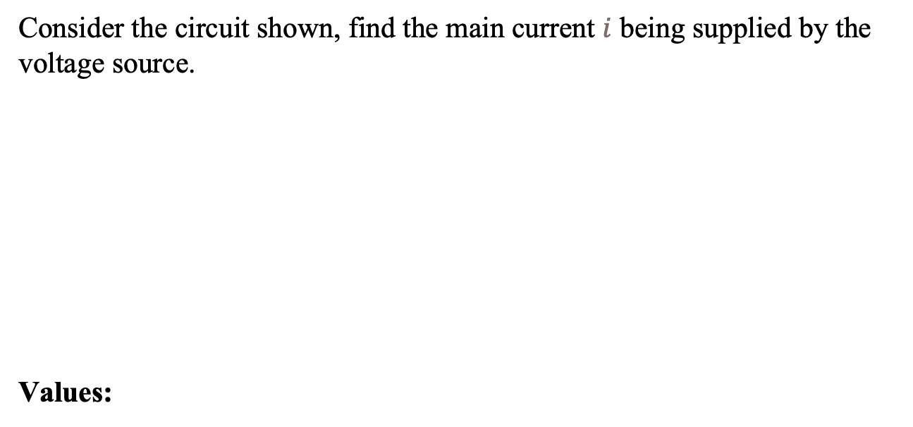
Example
Consider the circuit shown, find the main current $i$ being supplied by the voltage source.
Values:
Simple resistive circuit
Variable | Default | Unit
V | 15 | v
R₁ | 1 | Ω
R₂ | 4 | Ω
R₃ | 4 | Ω

Slide 19

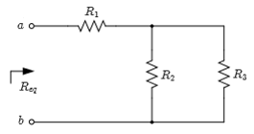
Example
Solution:
The equivalent resistance as seen from terminals “ab” is shown,
Equivalent resistance

Slide 20
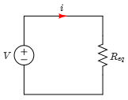
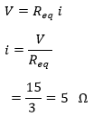
Example
The circuit shows the equivalent circuit after replacing the three resistors R1, R2 and R3 with one resistor Req,
Apply Ohm’s law and solving for the current gives,
Equivalent Resistance

Slide 21
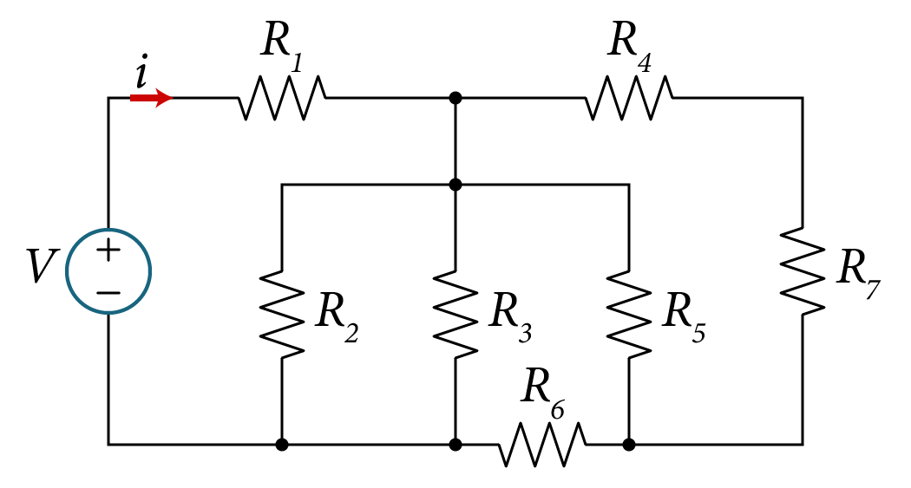








Example
Equivalent Resistance
Consider the circuit shown, find the main current $i$ being supplied by the voltage source.
$$R_{1}=10 Ω$$
$$R_{2}=7.5 Ω$$
$$R_{3}=15 Ω$$
$$R_{4}=7 Ω$$
$$53 V$$
$$R_{5}=25 Ω$$
$$R_{6}=6 Ω$$
$$R_{7}=18 Ω$$

Slide 22

Example
Equivalent Resistance
Simple approach: find $R_{eq}$ seen by the voltage source
Then solve for the current to give,
$$i=\frac{V}{R_{eq}}$$

Slide 23
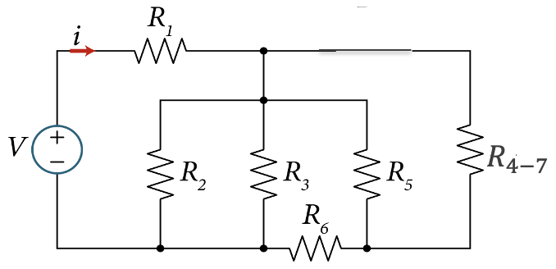
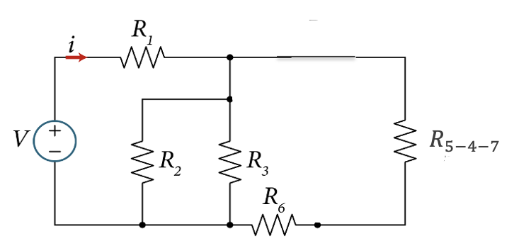





Example
Equivalent Resistance
Step-by-step to finding $R_{eq}$
1. Start at the end because it is clear that R4 and R7 are in series
$$R_{4−7}= R_{4}+R_{7}=25$$
3. Now R6 and R5-4-7 are in series
2. Now R5 and R4-7 are in parallel
$$R_{5−4−7}={R_{5}//R}_{4−7}=\frac{R_{5}{xR}_{4−7}}{R_{5}{+R}_{4−7}}=\frac{25x25}{25+25}=12.5$$
$$R_{eq1}={R_{6}+R}_{5−4−7}=6+12.5=18.5$$

Slide 24






Example
Equivalent Resistance
4. Now it is clear that R2 and R3 and Req1
are all in parallel
5. Now it is clear that R2-3 and Req1 are
all in parallel
$$R_{2−3}=\frac{R_{2}{xR}_{3}}{R_{2}{+R}_{3}}=\frac{7.5x15}{7.5+15}=\frac{112.5}{22.5}=5$$
$$R_{eq2}=\frac{R_{2−3}{xR}_{eq1}}{R_{2−3}{+R}_{eq1}}=\frac{5x18.5}{5+18.5}=\frac{92.5}{23.5}=3.94$$
6. Finally, R1 and Req2 are in series
$$R_{eq}=R_{1}+R_{eq2}+10+3.94=13.94 Ω$$
Solving for the current to give,
$i=\frac{V}{R_{eq}}=\frac{53}{13.94}=3.8 A$

Slide 25






Example
Equivalent Resistance
Consider the circuit shown, find the main current i being supplied by the voltage source.
$$R_{eq1}$$
$$R_{eq1}= R_{6}+R_{5}//(R_{4}+R_{7})=R_{6}+\frac{R_{5}{(R}_{4}+R_{7})}{R_{4}+R_{5}+R_{7}}$$
$$=6+\frac{25(7+18)}{25+7+18}=18.5 Ω$$
$R_{eq}= R_{1}+[R_{2}//R_{3}//R_{eq1}$]
$R_{eq}= R_{1}+\frac{R_{2}R_{3}R_{eq1}}{{R_{2}R_{3}+R_{3}R}_{eq1}+R_{2}R_{eq1}}$ =$10+\frac{7.5x15x18.5}{7.5x15+15x18.5+7.5x18.5}= 13.94 Ω$

Slide 26



Example
Equivalent Resistance
Find the input resistance $R_{eq}$ in ohms (Ω ) seen between terminals “a” and “b”.
$$R_{eq}$$
b

Slide 27




Example
Equivalent Resistance
Find the input resistance $R_{eq}$ in ohms (Ω ) seen between terminals “a” and “b”.
a
$$R_{eq}$$
b
Answer:
$$R_{eq}={R_{1}}//R_{2}+R_{5}+R_{6}=\frac{6x12}{6+12}+40+60=4+40+60=104 Ω$$
$$R_{in}=104 Ω$$

Slide 28


Example
Equivalent Resistance
Find the input resistance $R_{eq}$ in ohms (Ω ) seen between terminals “a” and “b”.
$$R_{eq}$$

Slide 29


Example
Equivalent Resistance
Find the input resistance $R_{eq}$ seen between terminals “a” and “b”.
$$R_{eq}$$
Answer:
$$R_{eq}={\left(R+R\right)}//R+R=\frac{2RxR}{R+2R}+R=\frac{2}{3} R+R=\frac{5}{3} R$$
$$R_{eq}=\frac{5}{3} R$$

Slide 30

Example
Example
Equivalent Resistance
Find the input resistance $R_{eq}$ seen between terminals “a” and “b”.
Variable | Values | Unit
R₁ | 7.5 | kΩ
R₂ | 4 | kΩ
R₃ | 2 | kΩ
R₄ | 6 | kΩ
R₅ | 2 | kΩ
R₆ | 1 | kΩ
R₇ | 3 | kΩ

Slide 31






Example
Equivalent Resistance
Solution:

Slide 32



Example
In the circuit shown, the independent source delivers input power $P_{in}=15 W$ to the circuit. Assume $V_{0}=5 V$, $β=0.9$ , and $R_{2}=10 Ω$ .
Determine:
The combined power dissipated in the three resistors
Determine $R_{1}$
The power supplied or dissipated in the dependent source
Verify the conservation of power concept

Slide 33




Example
Solution:
The input power supplied by the independent voltage source $V_{o}$ is given by
$$P_{in}=−V_{o}i=−V_{o}i_{x}$$
Solving for $i_{x}$
The Network
$$i_{x}=−\frac{P_{in}}{V_{o}}=−\frac{−15W}{5V}=3A$$

Slide 34




Solution
The current in $R_{2}$ as labeled is obtained by applying KCL at the node connecting the three resistors as follows,
$i_{R2}=i_{x}−βi_{x}=\left(1−β\right)i_{x}$
$=\left(1−0.9\right)\left(3A\right)=0.3A$
The voltage across $R_{2}$ is given by,
$$v_{R2}=i_{R2}R_{2}=\left(0.3\right)\left(10\right)=3V$$
The power absorbed in $R_{2}$ is given by,
$$P_{R2}=v_{R2}i_{R2}=\left(3\right)\left(0.3\right)=0.9 W$$

Slide 35







Solution
The voltage across $R_{1}$ is obtained from KVL when applied to the left loop,
$v_{R1}=V_{0}−v_{R2}=5−3=2 V$
The power absorbed in $R_{1}$ of the left loop is given,
$$P_{R1}=v_{R1}i_{R1}=v_{R1}i_{x}$$
$$P_{R1}=v_{R1}i_{R1}=v_{R1}i_{x}$$
$$KVL$$
$$=2x3=6 W$$
(b) Therefor, the resistor value of $R_{1 }$in the left loop is given by,
$$R_{1}=\frac{P_{R1}}{{i_{R1}}^{2}}=\frac{6}{3^{2}}=0.67 Ω$$

Slide 36


Solution
The power absorbed in $R_{1}$ of the right loop is given by,
$$P_{R1}=v_{R1}^{′}\left(βi_{x}\right)$$
Where $v_{R1}^{′}$ is given by,
$$v_{R1}^{′}=R_{1}(βi_{x})$$
So, the power absorbed in $R_{1}$ of the right loop is given by,
$$P_{R1}=R_{1}(βi_{x})(βi_{x})=0.67x\left(0.9\right)\left(3\right)\left(0.9x3\right)=4.88 W$$
The total power dissipated in the three resistors is,
$P_{R}=P_{R1}+P_{R1′}+P_{R2}=6+4.88+0.9=11.78 W$

Slide 37





Solution
(b) The power delivered to the dependent limit source is given by,
$$P_{depen}=vxβi_{x}$$
Where,
$${v=v}_{R2}−v_{R1}^{′}=v_{R2}−R_{1}\left(βi_{x}\right) =3−0.67x\left(0.9\right)\left(3\right)=3−1.81=+1.19 V$$
Therefore, power delivered to the dependent limit source is given by,
$$\left.P_{depen}=v(βi_{x}\right)=+1.19x\left(0.9\right)\left(3\right)=3.21 W$$
(d) The conservation of power is given by,
$$P_{in}+P_{R}+P_{dep}=0$$
$−15+11.78+3.21=0$ !
As expected!

Slide 38



Example :
Find $i_{x}$ and the power absorbed or delivered by each element. Then check that the conservation of power law is satisfied.
Variable | Default | Unit
I | 6 | A
V | 12 | V
$$i_{y}$$ | 2 | A

Slide 39

Solution:
The current source I=6A supply the amount of power given by,
$$P_{I}=−VI$$
$$=−\left(12V\right)\left(6A\right)=−72 W$$
The current $i_{x}$ is obtained by applying KCL at the upper node as follows,
$$I=i_{x}+i_{y}$$
Solving for $i_{x}$,
$$i_{x}=I−i_{y}$$
$$=6−2=4 A$$
So, the power absorbed by element 1 is given by,
$$P_{1}=Vi_{x}$$
$$=\left(12V\right)\left(4A\right)=48 W$$
And the power absorbed in element 2,
$$P_{2}=Vi_{y}$$
$$=\left(12V\right)\left(2A\right)=24 W$$
The total power generated or supplied is 72W and the total power absorbed is 48W+24W=72W, making the conservation of power applied.

Slide 40



Example:
Find $i_{x}$ and the power absorbed or delivered by each element. Then check that the conservation of power is satisfied.
Variable | Value | Unit
I | 6 | A
V1 | 12 | V
V2 | 12 | V
V3 | 3 | V
Vi | 9 | V
$$i_{y}$$ | 2 | A

Slide 41

Solution:
The current source I=6A supplies the amount of power given by,
$$P_{I}=−V_{i}I$$
$$=−\left(9V\right)\left(6A\right)=−54 W$$
The element 3 supplies the amount of power given by,
$$P_{3}=−V_{3}I$$
$$=−\left(3V\right)\left(6A\right)=−18 W$$
The current $i_{x}$ is obtained by applying KCL at the upper node as follows,
$$I=i_{x}+i_{y}$$
Solving for $i_{x}$,
$$i_{x}=I−i_{y}$$
$$=6−2=4 A$$
So, the power absorbed by element 1 is given by,
$$P_{1}=V_{1}i_{x}$$
$$=\left(12V\right)\left(4A\right)=48 W$$
And the power absorbed in element 2,
$$P_{2}=V_{2}i_{y}$$
$$=\left(12V\right)\left(2A\right)=24 W$$
The total power generated or supplied is 54W+18W=72W and the total power absorbed is 48W+24W=72W, satisfying the conservation of power requirement.

Slide 42


Example:
Find $i_{x}$ and the power absorbed or delivered by each element. Then check that the conservation of power is satisfied.
Variable | Default | Unit
I | 6 | A
V1 | 9 | V
Vi | 12 | V
V3 | 3 | V
V2 | 12 | V
i_{y} | 2 | A

Slide 43

Solution:
The current source I=6A supplies the amount of power given by,
$$P_{I}=−Vi I$$
$$=−\left(12V\right)\left(6A\right)=−72 W$$
The current $i_{x}$ is obtained by applying KCL at the upper node as follows,
$$I=i_{x}+i_{y}$$
Solving for $i_{x}$,
$$i_{x}=I−i_{y}$$
$$=6−2=4 A$$
So, the power absorbed by element 1 is given by,
$$P_{1}=V_{1}i_{x}$$
$$=\left(9V\right)\left(4A\right)=36 W$$
And the power absorbed in element 2,
$$P_{2}=V_{2}i_{y}$$
$$=\left(12V\right)\left(2A\right)=24 W$$
The element 3 absorbs the amount of power given by,
$$P_{3}=V_{3}i_{x}$$
$$=\left(3V\right)\left(4A\right)=12 W$$
The total power generated or supplied is 72W and the total power absorbed is 36W+24W+12W=72W, satisfying the conservation of power requirement.

Slide 44


Example:
Find $i_{x}$ and the power absorbed or delivered by each element. Then check that the conservation of power is satisfied.
Variable | Default | Unit
I | 6 | A
V1 | 9 | V
V2 | 9 | V
V3 | 3 | V
V4 | 3 | V
Vi | 12 | V
iy | 2 | A

Slide 45

Solution:
The current source I=6A supplies the amount of power given by,
$$P_{I}=−Vi I$$
$$=−\left(12V\right)\left(6A\right)=−72 W$$
The current $i_{x}$ is obtained by applying KCL at the upper node as follows,
$$I=i_{x}+i_{y}$$
Solving for $i_{x}$,
$$i_{x}=I−i_{y}$$
$$=6−2=4 A$$
So, the power absorbed by element 1 is given by,
$$P_{1}={V_{1}i}_{x}$$
$$=\left(9V\right)\left(4A\right)=36 W$$
And the power absorbed in element 2,
$$P_{2}=V_{2}i_{y}$$
$$=\left(9V\right)\left(2A\right)=18 W$$
The element 3 absorbs the amount of power given by,
$$P_{3}=V_{3}i_{x}$$
$$=\left(3V\right)\left(4A\right)=12 W$$
The element 4 absorbs the amount of power given by,
$$P_{4}=V_{4}i_{y}$$
$$=\left(3V\right)\left(2A\right)=6 W$$
The total power generated or supplied is 72W and the total power absorbed is 36W+18W+12W+6W=72W, satisfying the conservation of power requirement.

Slide 46

1752
Benjamin Franklin conducts famous ‘kite experiment’ to study electricity
Benjamin Franklin – American Scientist and Inventor
(1706 - 1790)
Benjamin Franklin, one of the founding fathers, won great fame for his study of electricity. He developed the theory of ‘positive’ and ‘negative’ electricity, showed the effect of pointed bodies in drawing off electricity, studied the identity of lightning and electricity, and recognized the potential of using iron rods to protect buildings. His famous kite and key experiment drew down electricity from the clouds and charged a Leyden jar.

