Slide 1

EEL 3004 Linear Circuits I
Lecture #3
Circuit Laws: Ohm’s, KVL and KCL Laws

Slide 2
Lecture Objectives
Ohm’s Law
Kirchhoff's Voltage Law (KVL)
Kirchhoff's Current Law (KCL)
Power Conservation Law

Slide 3
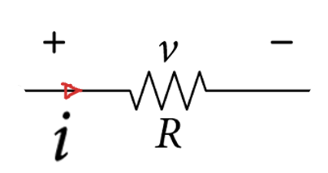
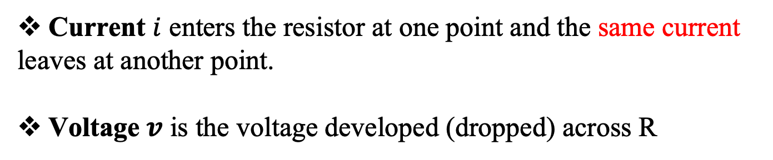
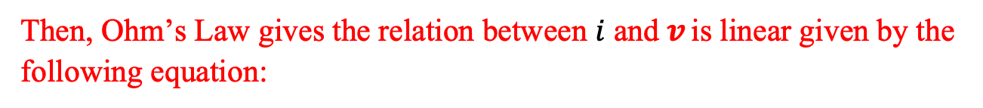

Ohm's Law
Ohm’s law provides the relationship between the terminal voltage, v, and the terminal current, i of a resistive element as follows:
Current $i$ enters the resistor at one point and the same current
leaves at another point.
Voltage $v$ is the voltage developed (dropped) across R
Then, Ohm’s Law gives the relation between $i$ and $v$ is linear given by the following equation:
$$v=iR$$

Slide 4
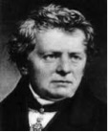
1827
Ohm’s law appears in the famous work:
“The Galvanic circuit investigated mathematically”
Georg Simon Ohm
German physicist and mathematician
(1789-1854)
Ohm is best known for the law named after him, Ohm’s law, the most simple and widely used law in electricity. He published his law in his famous work, “The Galvanic Circuit investigated mathematically” after his extensive and extraordinary research into the mathematical relationship between voltage (potential), current, and resistance in an electrical circuit. A unit of measuring resistance, the ‘ohm’ is named after him to honor his scientific contributions to electricity.

Slide 5
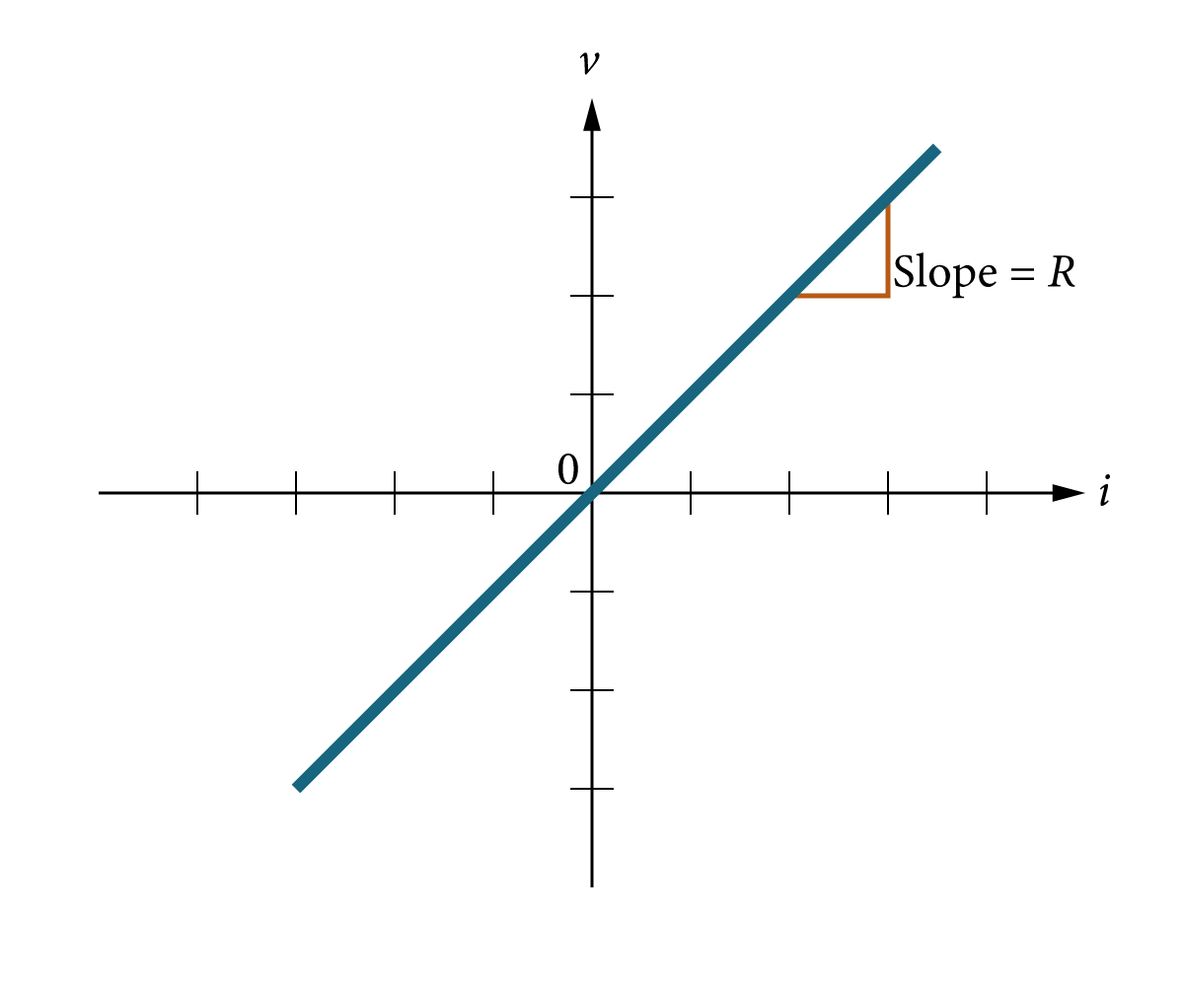
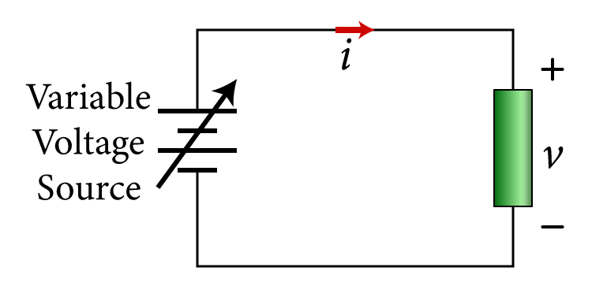
Ohm's Law
Ohm’s Law is also known as the i-v characteristic of the circuit.
A simple circuit with a variable voltage source
Linear i-v relationship

Slide 6
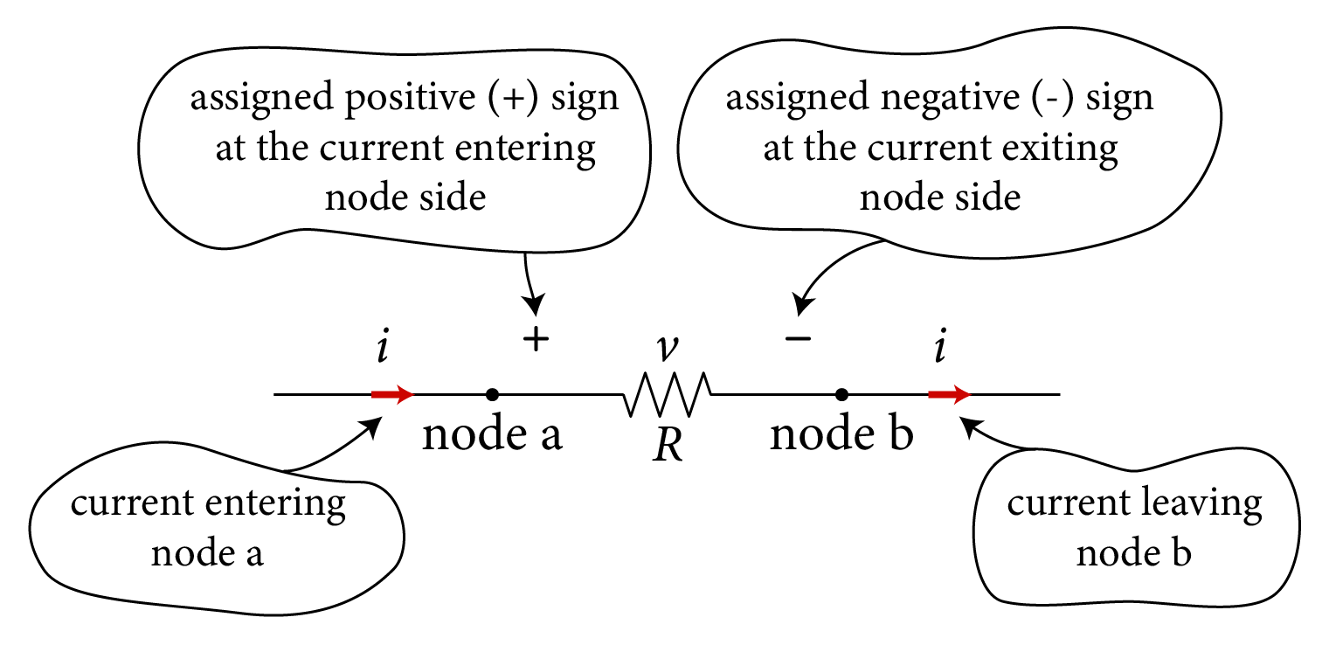
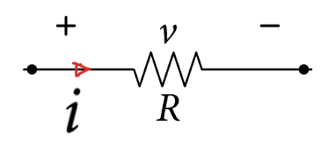

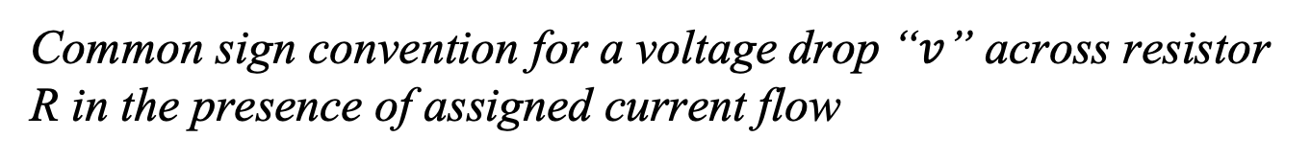
Common sign convention for a voltage drop “$v$” across resistor R in the presence of assigned current flow
$$v=R i$$
Ohm's Law

Slide 7
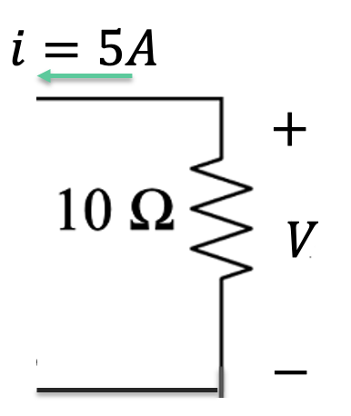
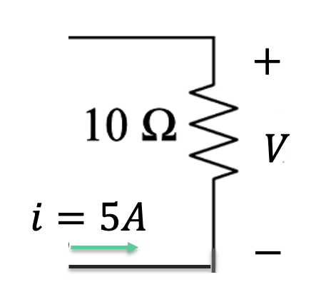
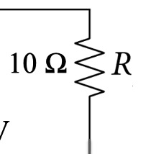







Example:
Determine the voltage V across the resistor.
$$−$$
$$V$$
$$V$$
$$+$$
$$+$$
$$i=5A$$
$$i=−5A$$

Slide 8

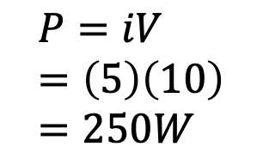
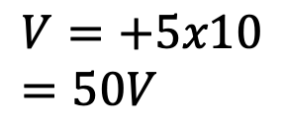

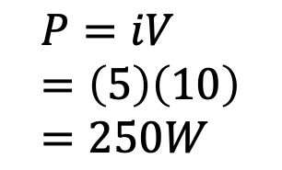
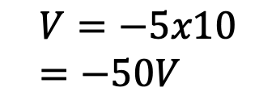

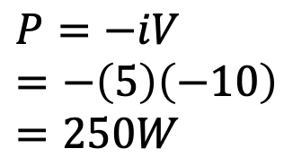
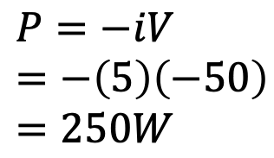
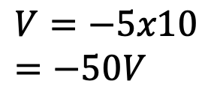
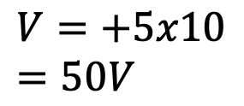
Example:
Determine the voltage V across the resistor.
$$i=5A$$
$$−$$
$$−$$
$$V$$
$$V$$
$$+$$
$$+$$
$$i=5A$$
$$V=−5x10=−50V$$
$$V=−5x10=−50V$$
$$V=+5x10=50V$$
$$V=+5x10=50V$$
$$P=−iV=−\left(5\right)\left(−50\right)=250W$$
$$P=−iV=−\left(5\right)\left(−10\right)=250W$$
$$P=iV=\left(5\right)\left(10\right)=250W$$
$$P=iV=\left(5\right)\left(10\right)=250W$$
dissipated
dissipated
dissipated
dissipated

Slide 9
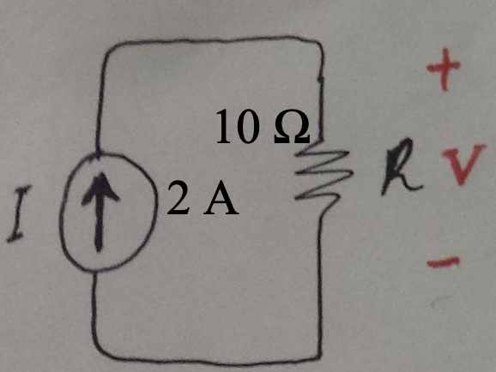
Example:
Determine the voltage V across the resistor.

Slide 10
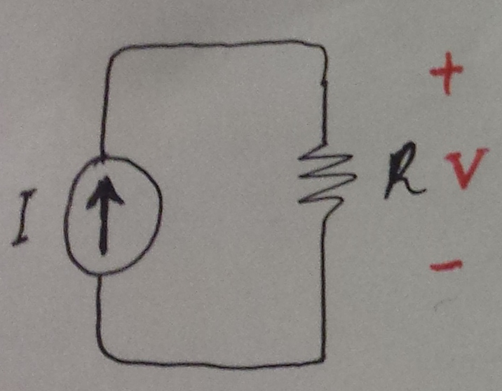
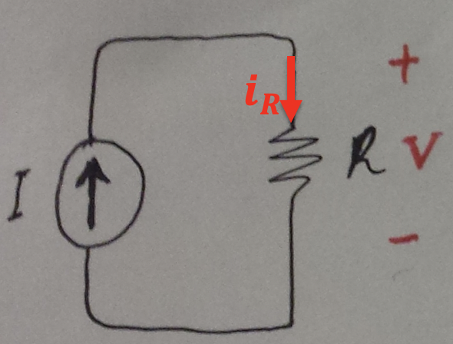


Solution:
Assign a current with arbitrary direction to R:
10 Ω
2 A
Note that $iR=I=2 A$
Apply Ohm’s Law,
$$V=iRR=\left(2\right)10=+20 V$$

Slide 11
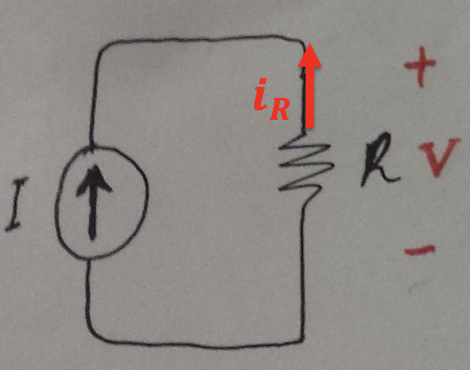

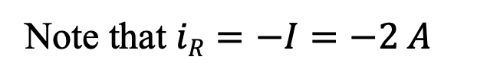
Solution:
Assign a current with arbitrary direction to R:
10 Ω
2 A
Note that $iR=−I=−2 A$
Apply Ohm’s Law,
$$V=−iRR=−\left(−2\right)10=+20 V$$

Slide 12
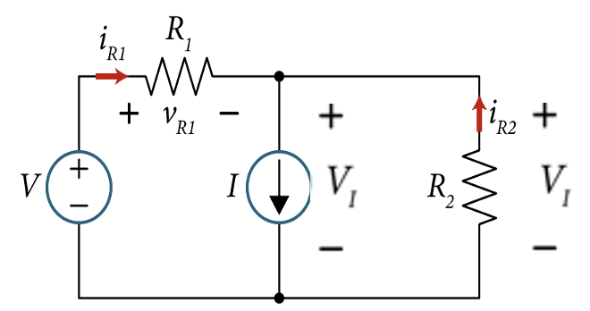
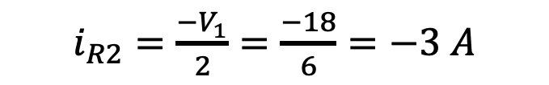
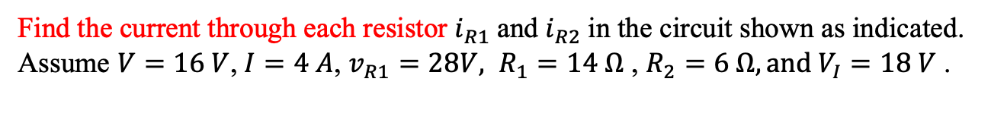
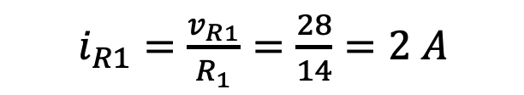
Example
Find the current through each resistor $i_{R1}$and $i_{R2}$in the circuit shown as indicated. Assume $V=16 V$, $I=4 A$, $v_{R1}=28V, R_{1}=14 Ω$ , $R_{2}=6 Ω, and V_{I}=18 V$ .
Solution:
Applying Ohm’s law across $R_{1}$ to find $i_{R1}$,
$i_{R1}=\frac{v_{R1}}{R_{1}}=\frac{28}{14}=2 A$
Applying Ohm’s law across $R_{2}$ to find $i_{R2}$,
$i_{R2}=\frac{−V_{1}}{2}=\frac{−18}{6}=−3 A$

Slide 13
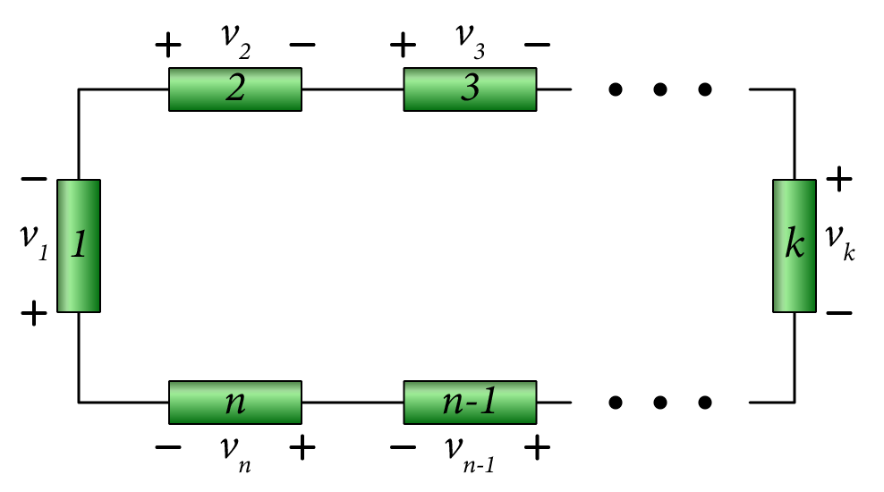

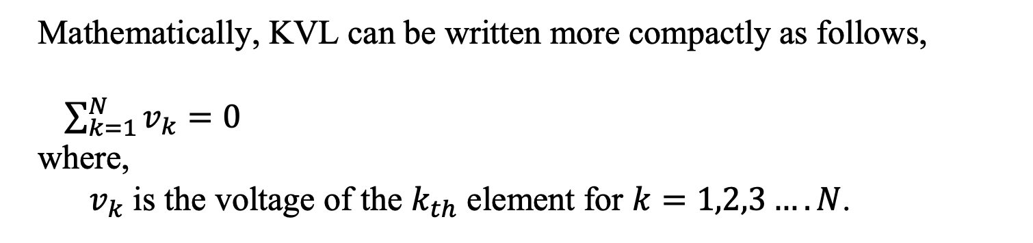
Kirchoff’s Voltage Law
The algebraic sum of all voltages in a closed circuit is equal to zero.
(KVL is a law of conservation of energy (zero net change in energy).
Where: Vn is the voltage across branch n.
Closed circuit - Loop
Apply KVL around the loop:
$$v_{1}+v_{2}+v_{3}+ …+v_{n}=0$$
Mathematically, KVL can be written more compactly as follows,
$\sum_{k=1}^{N}{v_{k}=0}$
where,
$v_{k}$ is the voltage of the $k_{th}$ element for $k=1,2,3….N$.

Slide 14
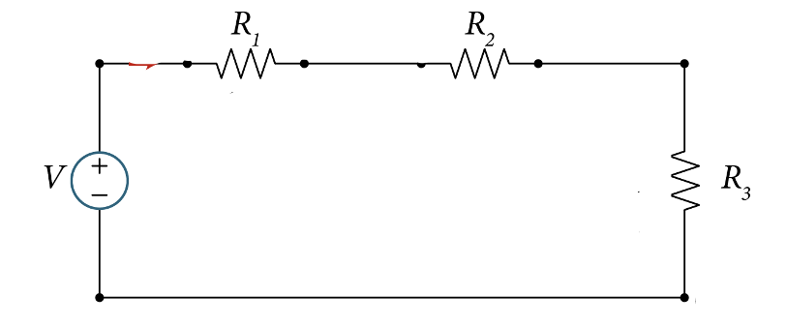
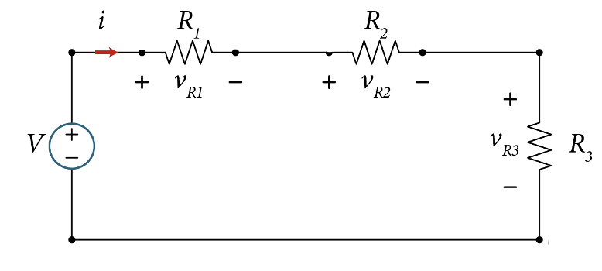
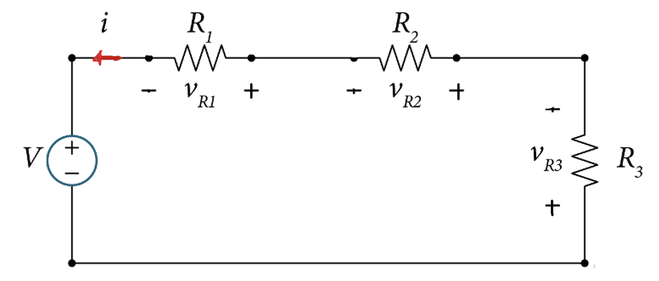
KVL - Example of four elements
Write KVL around this 4-element loop?

Slide 15


KVL - Example of four elements
Write KVL around this 4-elemnt loop?
Starting at one node and return back to the same node:
$−V+v_{R1}+v_{R2}+v_{R3}=0$
$V+v_{R1}+v_{R2}+v_{R3}=0$

Slide 16
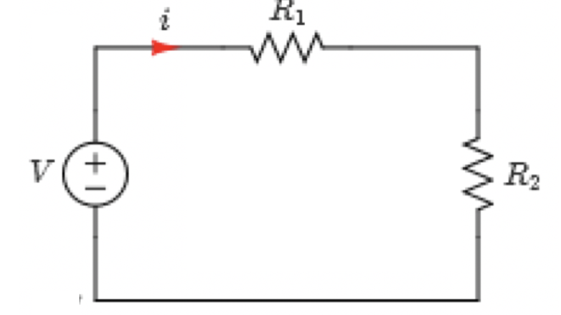
Example
Given the circuit, apply KVL to find the current i .
Variable | Values | Unit
V | 14 | V
R₁ | 15 | Ω
R₂ | 20 | Ω
Simple loop electric circuit

Slide 17
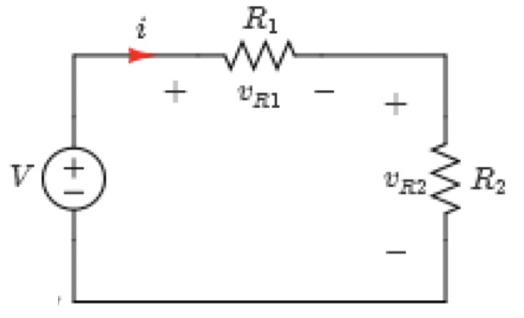



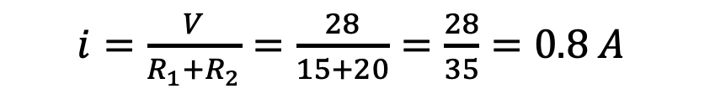
Example - Simple electric circuit
Solution:
First assign voltage polarities:
From KVL,
$$−V+v_{R1}+v_{R2}=0$$
Using Ohm’s Law,
$$−V+R_{1}i+R_{2}i=0$$
Solve for $i$,
$i=\frac{V}{R_{1}+R_{2}}=\frac{28}{15+20}=\frac{28}{35}=0.8 A$

Slide 18
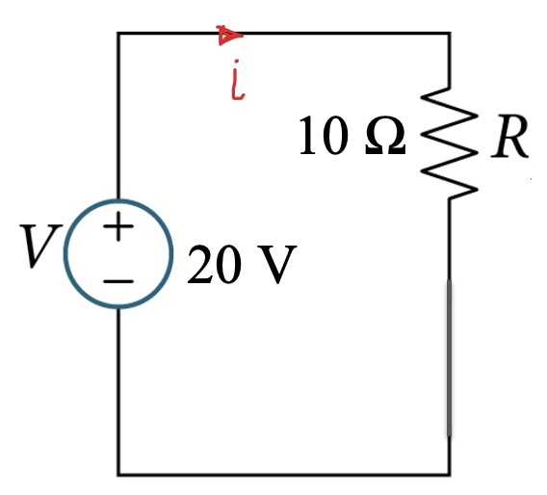
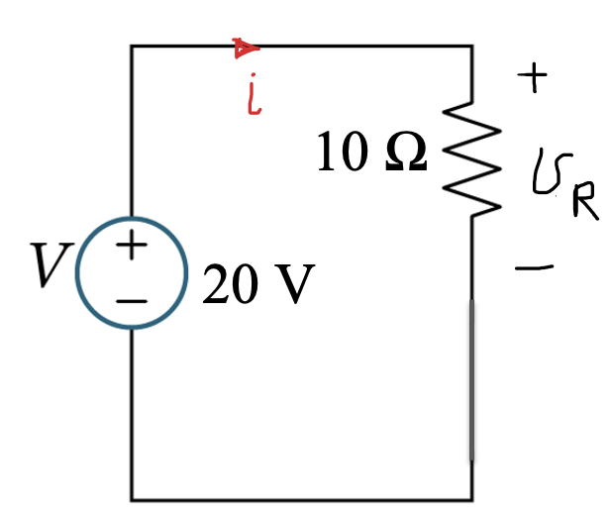

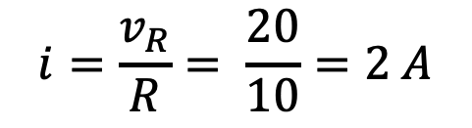

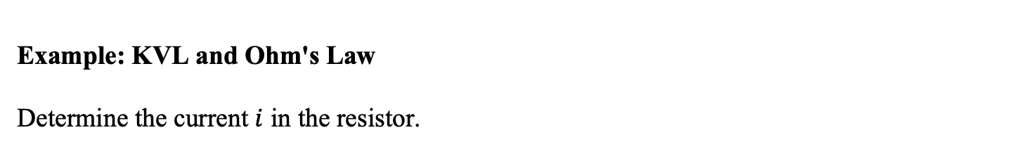



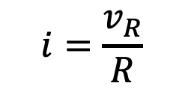
Example: KVL and Ohm's Law
Determine the current $i$ in the resistor.
Solution:
Assign voltage $v_{R}$across R as shown.
Apply Ohm’s Law,
$$v_{R}=Ri$$
$$i=\frac{v_{R}}{R}$$
To find $v_{R}, we apply KVL$
$$−V+v_{R}=0$$
$$v_{R}=V=20 V$$
$$i=\frac{v_{R}}{R}= \frac{20}{10}=2 A$$

Slide 19
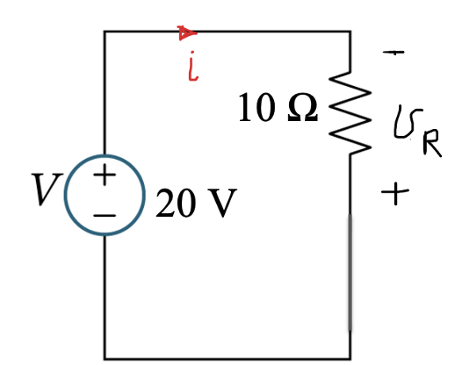

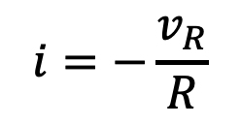
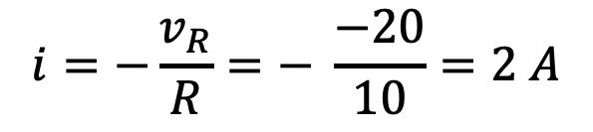




Solution:
What is you assigned voltage $v_{R}$as shown.
Apply Ohm’s Law,
$$v_{R}=−Ri$$
$$i=−\frac{v_{R}}{R}$$
To find $v_{R}, we apply KVL$
$$v_{R}=−V=−20 V$$
$$−V−v_{R}=0$$
$$i=−\frac{v_{R}}{R}=− \frac{−20}{10}=2 A$$

Slide 20
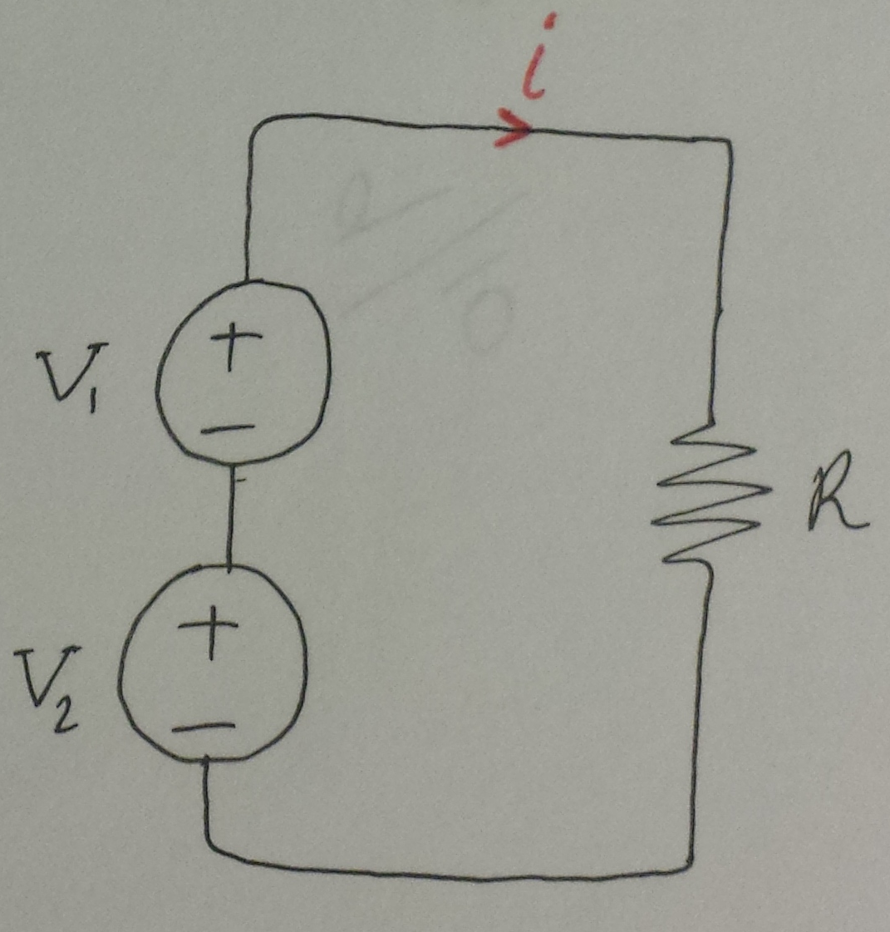


Example: Determine the current $i$ in the resistor.
20 V
10 Ω
10 V
Solution:
Since the two voltage sources are in series, we can combine them into one voltage source.
${V=(V}_{1}+V_{2})=20+10=30 V$
Apply Ohm’s Law:
$$i=\frac{V}{R}= \frac{30}{10}=3 A$$

Slide 21
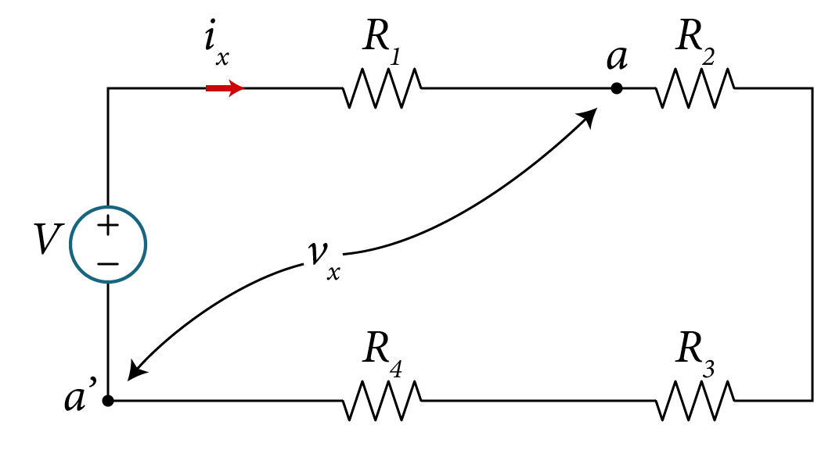

Example
Given the circuit shown, apply KVL to find:
The current $i_{x}$
The voltage $v_{x}$.
 | Default
Variables | Values | Unit
R₁ | 15 | Ω
R₂ | 5 | Ω
R₃ | 8 | Ω
R₄ | 4 | Ω
V | 25 | V

Slide 22
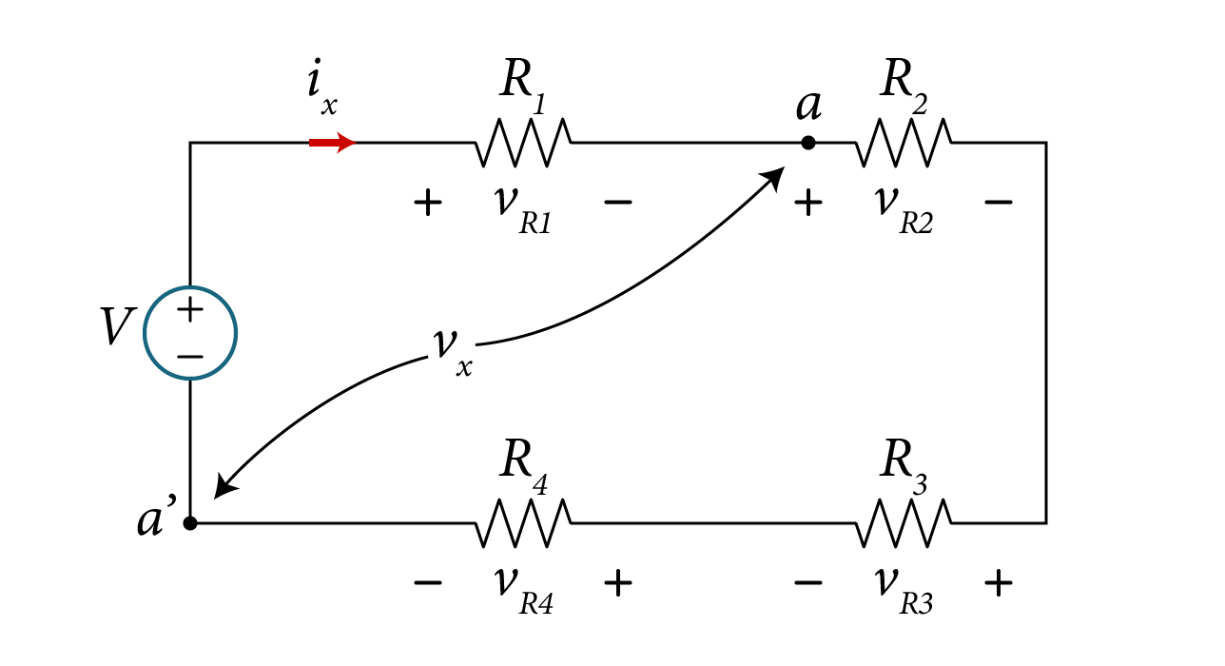
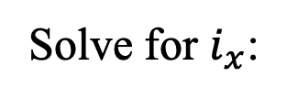

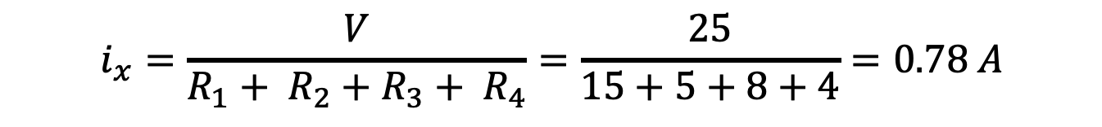


Solution A: clockwise direction:
First we need to find $i_{x} .$
Assign voltage $v_{R1}, v_{R2}, v_{R3}, and v_{R4}$ as shown
Apply KVL equation moving in the clockwise direction:
$$−V+v_{R1}+v_{R2}+v_{R3}+v_{R4}=0$$
From Ohm’s law
$$−V+i_{x} R_{1}+i_{x} R_{2}+i_{x} R_{3}+i_{x} R_{4}=0$$
Solve for $i_{x}$:
$$i_{x}=\frac{V}{R_{1}+ R_{2}+R_{3}+ R_{4}}=\frac{25}{15+5+8+4}=0.78 A$$

Slide 23


Solution B: counter-clockwise direction:
First we assign voltage $v_{R1}, v_{R2}, v_{R3}, and v_{R4}$ as shown
Apply KVL equation moving in the counter clockwise direction:
$$−v_{R4}−v_{R3}−v_{R2}−v_{R1}+V+=0$$
From Ohm’s law
$$−i_{x} R_{4}−i_{x} R_{3}−i_{x} R_{2}−i_{x} R_{1}+V=0$$
Solve for $i_{x}$:
$$i_{x}=\frac{V}{R_{1}+ R_{2}+R_{3}+ R_{4}}=\frac{25}{15+5+8+4}=0.78 A$$

Slide 24











Solution (con’d)
To find $v_{x}$, KVL can be applied around the path $v_{R2},$ $v_{R3}$, $v_{R4}$as shown
Apply KVL equation:
$$+V−v_{x}{−v}_{R1}=0$$
$$v_{x}=V−v_{R1}=V−i_{x} R_{1}$$
$$−v_{x}+v_{R2}+v_{R3}+v_{R4}=0$$
$$=25−0.78x15$$
$$v_{x}=v_{R2}+v_{R3}+v_{R4}$$
$$=i_{x} \left(R_{2}+R_{3}+R_{4}\right)$$
$$=0.78x(5+8+4)=13.3 V$$
$$=13.3 V$$

Slide 25



Kirchhoff's Current Law
The sum of all currents i₁, i₂, …i_{n} at any node is equal to 0.
Mathematically, KCL is given by,
n
$\sum{i_{k}=0}$ k=1
$i_{k}$ is the current of the $k_{th}$ element for $k=1,2,3….n$.

Slide 26


Kirchhoff’s Current Law
OR
OR
The total currents flowing in = total currents flowing out.
I₁+I₄+I₅=I₂+I₃
I+5=3+4+2
_{I= 4 A}

Slide 27

Kirchoff’s Current Law
Upper node
Example:
Lower node
The three branches:
Current source (Exciting Force) between nodes a and a’
Resistance R1 between nodes b and b’
Resistance R2 between nodes c and c'
KCL @ upper node: I=i_{R1} + i_{R2} or I- i_{R1} - i_{R2} =0
KCL @ lower node: I=i_{R1} + i_{R2} or -I+ i_{R1} + i_{R2} =0

Slide 28

Example: Application of Ohm's Law
Determine the voltage V across the resistor as shown.
10Ω
2A
1A

Slide 29



Example: Application of Ohm's Law
Determine the voltage V across the resistor as shown.
Solution:
Since the two current sources are in parallel, we can combine them into one current source.
${I=(I}_{1}+I)=2+1=3 A$
Apply Ohm’s Law,
$$V=RI=10×3=30 V$$

Slide 30


Example
Given the circuit, apply KCL to find the current i_{R2}.
Simple electric circuit
Variable | Values | Unit
I | 1 | mA
R₁ | 5 | kΩ
R₂ | 3 | kΩ
R₃ | 4 | kΩ

Slide 31





Example
Solution:
Assign currents and voltages.
Applying KCL at node “A”,
Voltage across all resistors is equal,
Simple electric circuit
Solving for voltage v,
Solving for current i_{R2} using Ohm’s Law,

Slide 32




Kirchoff’s Current Law
KCL also extends to surfaces of planar circuits.
KCL is a statement of conversation of charge, i.e., no charge is being generated or destroyed as a result of current flow.

Slide 33




Power Conservation in Circuits
The Law of Conservation of Power:
The total power supplied or delivered should always equal to the total power dissipated or absorbed in any stand-alone circuit.
General Electrical Network
$$p_{supplied}(−)$$
$$+$$
$$p_{absorbed}(+)$$
$$=0$$
Supplied (delivered) Power = absorbed (dissipated) Power

Slide 34







Example - Conservation of Power
For the circuit below, use the power balance to find the value of the current 𝑖 as shown.
$$P_{indep} =−16i$$
$$P_{4Ω} =4i^{2}$$
$P_{total}=−16i+4i^{2}$+12-6+10=0
$$4i^{2}−16i+16=0$$
$$i=2 A$$
$$i^{2}−4i+4=0$$

Slide 35

Example - Conservation of Power
For given V=10 V, i = 2 A, v₂ = 3 V and α = 0.5 in the figure below, find the power delivered or absorbed by each source.
How much power is dissipated in the two resistors?

Slide 36

Example
Solution:
The power in the independent voltage source is given by,
$P_{indep} =−Vi=−10x2=−20 W$ supplied (delivered)
Power in the dependent voltage source:
$P_{dep}=+(αv_{2}) i=+0.5x3x2=+3 W$ absorbed (dissipated)
Since the conservation of power requires that the total power supplied or delivered should equal the total power dissipated or absorbed, then we mush have the remaining dissipated power in the two resistors be 20W-3W=17 W.

Slide 37


Example – KVL & KCL
Determine the value of $V_{X}$ in the circuit shown below. Assume the values are given as follows: $R_{1}=2 Ω$ , $R_{2}=4 Ω$ , $γ=0.8$ and $I_{0}=12 A$

Slide 38




Example – KVL & KCL
Solution:
$I_{2}$
$I_{1}$
Plan of attack:
Assign currents $I_{1}$ and $I_{2}$ since we have two loops.
The Unknows: $I_{1}$, $I_{2} and V_{x}$
If you can solve for $I_{1}$ then you can find $V_{x}$ from Ohm’s Law
$V_{x}=−I_{1}$ $R_{1}$
You need three equations to solve for the three unknows.
Then use KCL, KVL and Ohm’s Laws to get one equation from each.

Slide 39







Example – KVL & KCL
Solution:
$I_{2}$
$I_{1}$
Apply KCL at node X
Solve for $I_{1}$, $I_{2} and V_{x}$
$$I_{2} =−\frac{\left(1+γ\right)R_{1}}{\left(1+γ\right)R_{1}+R_{2}}I_{o}=−5.68 A$$
$$I_{o}+I_{1}+I_{2}=0$$
Apply KVL around the second loop
$$V_{x}+γV_{x}+R_{2}I_{2}=0$$
$$I_{1}=−I_{o}−I_{2}=−6.32 A$$
$$V_{x}=−R_{1}I_{1}=12.6 V$$
Apply Ohm’s Law
$$I_{1}=\frac{−V_{x}}{R_{1}}$$

Slide 40



Practice – KVL & KCL
For the circuit below, use KVL, KCL and Ohm’s law to determine $i_{x}.$

Slide 41


Practical Relevance Example - Christmas Lights
Christmas lights are strands of electric lights used to decorate homes, buildings and Christmas trees during the Christmas season.
The types of lamps used in Christmas lighting sets may be based on a variety of technologies. Common lamp types are incandescent light bulbs and light-emitting diodes (LEDs).
Figure 3.1: (a) Commercial (Residential) Applications of Christmas lights, (b) one strand or string of lights

Slide 42
Practical Relevance Example - Christmas Lights
Christmas lights are connected in series to one voltage source, and the same current flows through each element of the circuit. Christmas lights are strands of electric lights used to decorate homes, buildings and Christmas trees during the Christmas season.
The types of lamps used in Christmas lighting sets may be based on a variety of technologies. Common lamp types are incandescent light bulbs and light-emitting diodes (LEDs).
Figure 3.1: (a) Commercial (Residential) Applications of Christmas lights, (b) one strand or string of lights

Slide 43



Series Connected Strands - model
The Christmas lights are connected in series; the elements are connected one after the other. Only the lead to the 1st element and the return lead from the last element are connected to the voltage source $V_{s}$
Schematic Representation of Christmas light chain, (b) Simplified circuit model of Christmas lights connected in series

Slide 44






Parallel Connected Strands - model
When Christmas lights are connected in parallel configuration, then each light has its own closed-loop circuit as shown in the fifty lights example of Fig. 2.92(a).
Schematic Representation of parallel strand Christmas light chain, Simplified circuit model of Christmas lights connected in series

Slide 45

Example of 50 Lights
As a numerical example, consider a Christmas lights circuit in which a total of 50 bulbs are connected in series to a voltage source $V_{s}=120 V.$
Christmas lights schematic with 50 light bulbs
What is the current I?

Slide 46

Example of 50 Lights
Solution:
Since the equivalent circuit represents a single loop circuit, we write one the KVL eq.
$${−V}_{s}+RI+RI+…+RI=0$$
Solving for $I$,
$$I=\frac{V_{s}}{R+R+…+R}=\frac{V_{s}}{50R}=\frac{120}{50x228}=10.5 mA$$
The voltage drop across each bulb is the same and is given by
$$V_{bulb}=RI=228x10.5=2.4 V$$

